Slide 1

QSAR

Slide 2
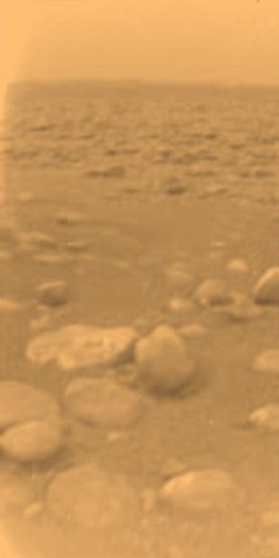

Lecture Outline
What is QSAR?
3D-QSAR
Identifying active elements
Ligand-receptor interactions
Ligand databases

Slide 3


QSAR
Quantitative Structure Activity Relationship
  A body of techniques
  Aim is activity prediction of small compounds
    Active role
    Dynamic transport
    Side effects
    Etc...
  An alternative to S. James Black method
    Modify substrates in search of analogues
    Test experimentally
  Not a substitute:
    Experimental testing still needed
    But for a smaller set
  ADME-TOX
  3D-QSAR

Slide 4
ADME-TOX
ADME
  Absoprtion, distribution, metabolism and excretion
    Administration method
    Transport and barrier-crossing
    Metabolism (liver redox by CytP450
    Elimination (kidney, lungs, seat, stools..)
TOX
  Potential for toxicity
    Of the compound
    Of its metabolites
Methods
  QSPR, QSAR
Side effects?
  Usually by experiment

Slide 5
QSAR
Similar molecules have similar functions and similar structures
  Similar structures should have similar functions
  Wouldn't it be nice if we could say...
    why one analogue works and other doesn't?
    if an analogue will work or block function?
    which analogue will work in advance?
    what will be the effects of a substance?
    What is the specific binding activity of different substrates?
    what is the actual activity / reactivity of different species?
    etc...
Look at structural similarities and try to predict.
  Any similarity in any property is worth using for our guess

Slide 6
3D-QSAR
Traditional QSAR models used any structural property
  Mainly bulk properties
    Volume
    Dimensions
    Charges, etc...
  Generally simplifications to speed up computation
With bigger computers we can now consider the 3D structure
  We may start from simplifications
    Extreme coordinates/dimensions
    Distribution of charges in space
    Etc...
  And go all the way to full models
    Rigid
    Flexible...

Slide 7
We want to
Tell how structures interact
  Identify possible interaction sites
  Identify other molecules that might interact
  Identify the 3D structure of the interaction
  Analyze the 3D interactions
Make inferences
  Where is the active site?
    What are the relevant residues for activity?
    How can I interpret a polymorphism/mutation?
  What are potential analogues
  Will they bind more weakly or strongly?
  Will the interaction be stable?
  How will the reaction proceed?
    Better or worst
    Not at all (blocker)

Slide 8
Identifying analogues
Protein structure:
  Experiment: X-ray, NMR, ME...
  Modelling: homology, threading
  Else...?
Active analogue
  Analyze fine structure of an active substrate
    Groups most probably involved in the interaction
  Refine fine structure
    Most stable structure
  Use several alternatives and look for possibly common features
  Use several substrates and look for common features
  If nothing is preserved use other properties (VdW, charge, etc...)

Slide 9
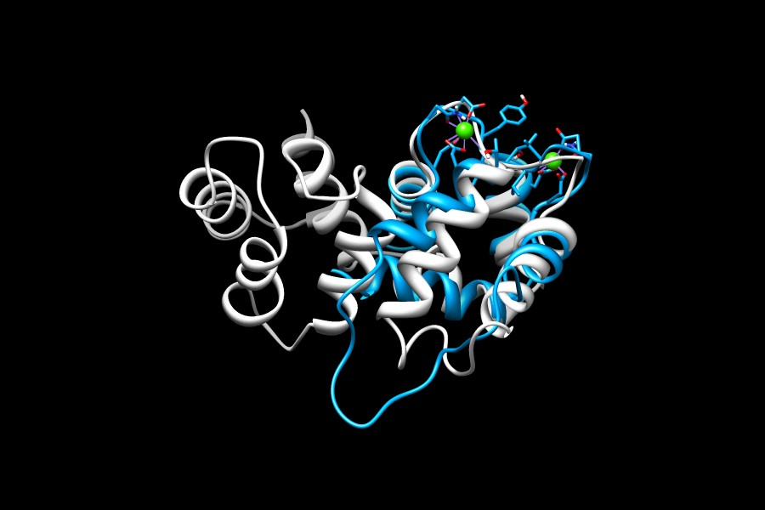
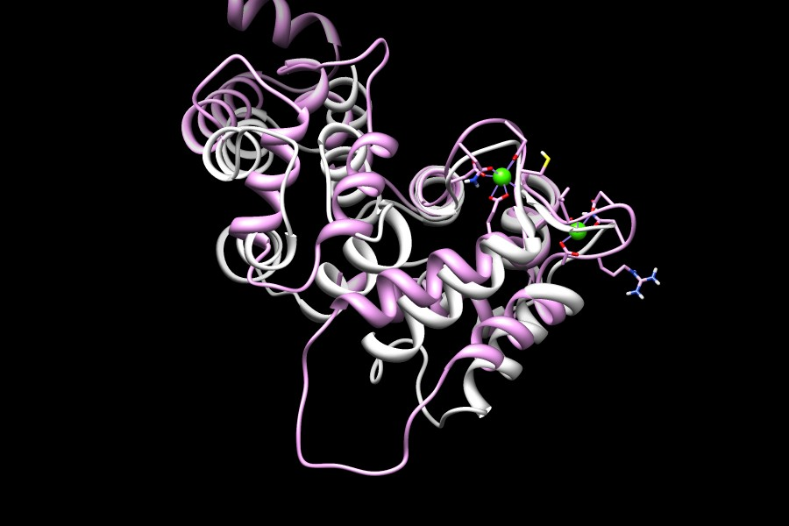
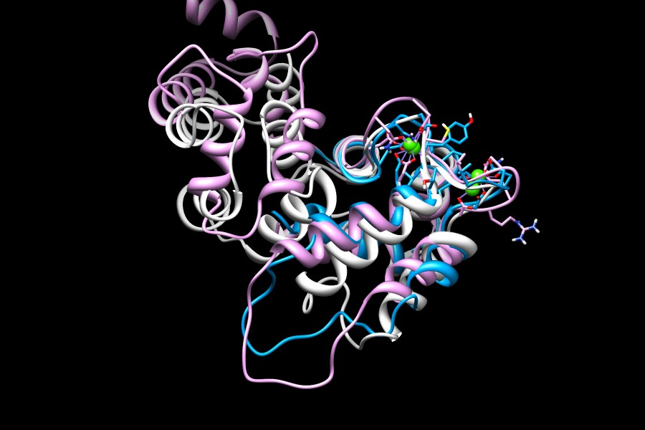
Ab initio prediction
Comparison of ab initio
predicted and known
structures (human and
mouse)

Slide 10
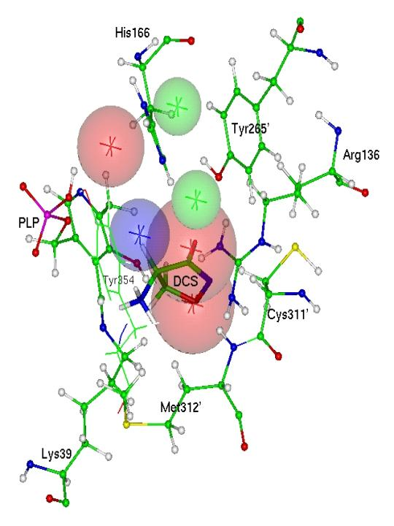
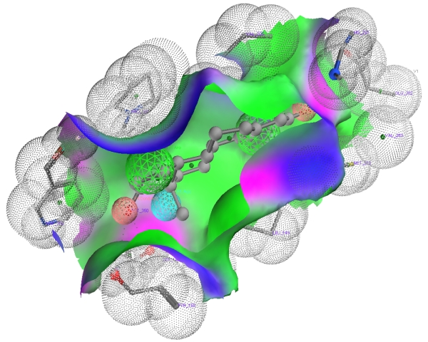
Analyzing analogues
Pharmacophore (Paul Ehrlich 1909)
  Molecular framework that carries the essential features for a drug's biological activity
  The set of features recognized by the receptor and reponsible for the biological activity.
Receptor volumes
  From the superposition we may deduce the complementary cavity

Slide 11
Ligand-receptor binding
Once the properties of ligands and binding site are known we can explore the binding process
  Experiment (e. g. X-ray)
  Elements
    Receptor (experiment, model or receptor volume)
    Ligand (one, pharmacophore or superposed group)
  Grid maps
    Define a grid around the protein
    use functional sites as probes (e. g. H₂O for -OH)
    Place probes on grid and look for putative interaction sites
  Multiple copy minimization
    Build a cloud of copies of the probe around the receptor
    Minimize each of them independently
    Model approximation of probe to receptor
    Refine

Slide 12
Docking
Grid maps and minimization identify putative interaction sites, but not the mechanism
Docking
  Simulate the interaction process
    Start from many configurations and bind
    MC
    MM/MD
  Compute interaction energies
  Computationally costy
    Rigid models
    Flexible model
    Electrostatic interactions
    Full MM/MD
  Once the active site is known we can repeat/compare with other target drugs.

Slide 13
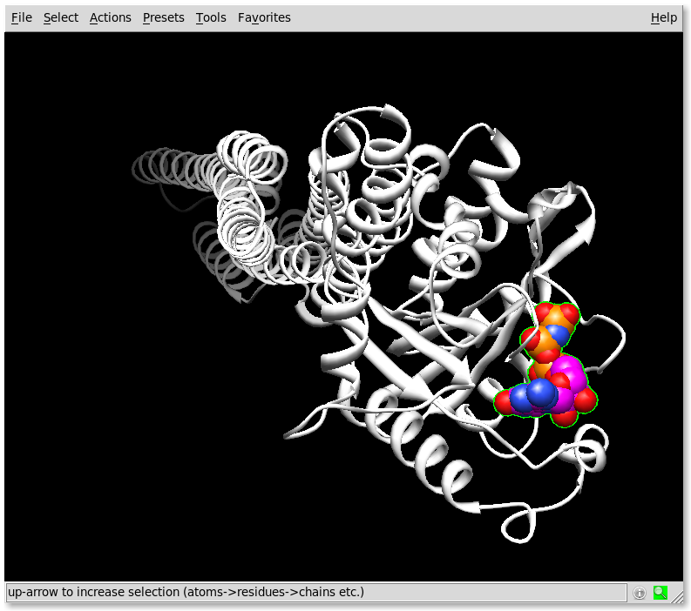
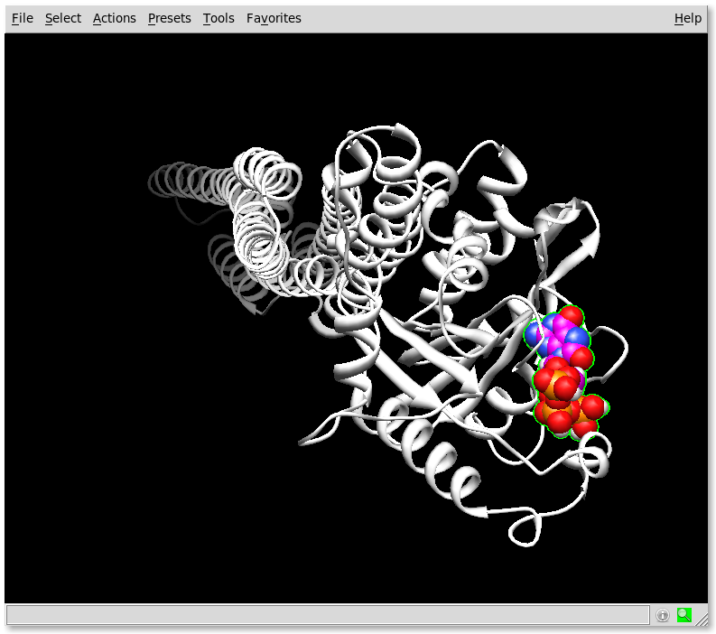
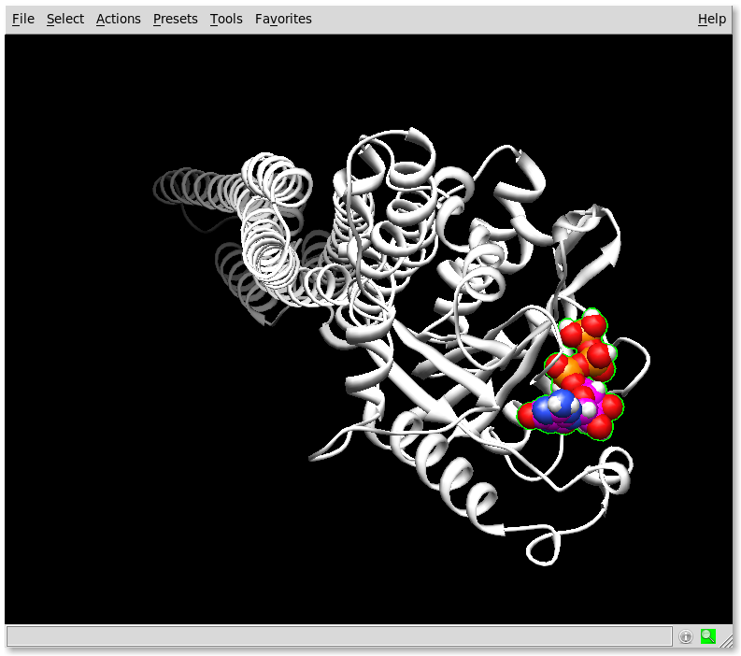
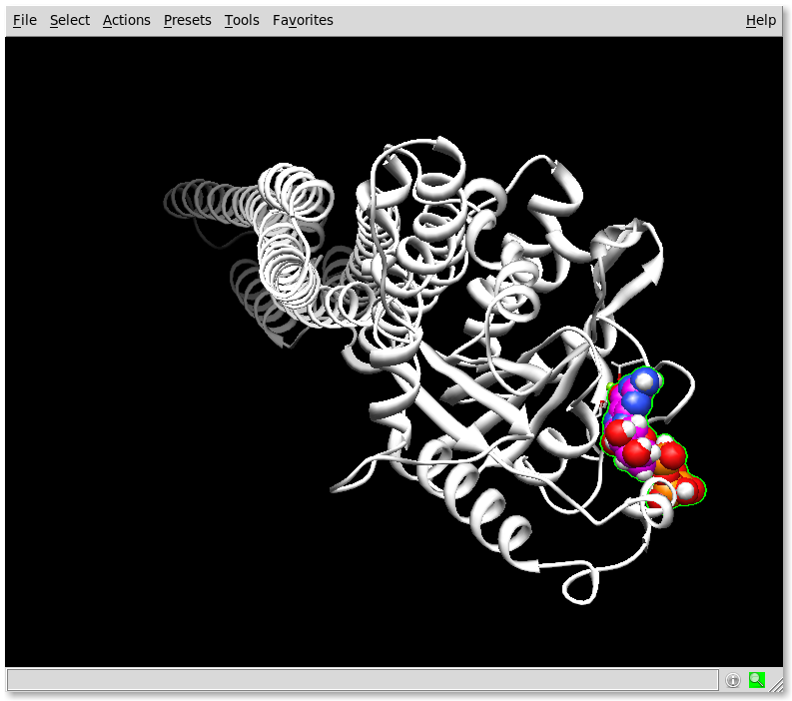
Docking 8oxoGTP
Over 200 docking experiments, 100 models each. Which are the correct ones?
Autodock
Dock6
3D-Dock
Gramm
Etc..
1f5n + GTP
1f5n + 8oxoGTP (max E)
1f5n + 8oxoGTP (max H)
1f5n + 8oxoGTP (max Grid)

Slide 14
Searching
Once the active site is known we can look for other target drugs
  Match them in the active site
  Match them in a receptor map
  Match them with the pharmacophore
Convert chemical formulas to structures
Search databases
  Commercial
  CORINA (gives isolated structures and synthesis info)
  HIC-UP (PDB ligands)
  NCI (antitumour drugss)
  ZINC (the database: millions of compounds)
  Lead compounds: representatives of drug families
  Dimensions → pKa, charge → aspect → structure

Slide 15
De novo design
Good molecules may be known
But better molecules might be designed
Start from an interaction map
  Match interaction points with interaction groups
  Join groups with bridges that stabilize their position without damaging the interaction
Very difficult process
  Requires expert chemist
Not limited to known existing molecules
May potentially yield a much better drug

