Slide 1


e-Learning in Bioinformatics
José R. Valverde
EMBnet, Executive Board
CNB/CSIC, Head of Scientific Computing jrvalverde@es.embnet.org
European Molecular Biology Network
Red Iberoamericana de Bioinformática
Red Temática Nacional de Bioinformática
Asia-Pacific Bioinformatics Network

Slide 2
Medicine
All science is either physics or stamp collecting
  Rutherford, Ernest (1871-1937)‏
We can only understand disease at the molecular level
  Alberto Sols (1917-1989)‏

Slide 3
Molecular Medicine
Biochemistry
Biphysics
Genetic medicine
Molecular basis of disease
Cellular basis of disease
Biological aspects of disease
Pharmacogenomics

Slide 4
Molecular Biology
A young science that flourished in the last two decades
  Genetics
  Proteins
  Molecular interactions
  Cellular integration
  Population dynamics
  Evolution

Slide 5
Bioinformatics
For the Biologist
  Analysis of experimental data from Molecular Biology
  Understanding Biological processes
For the physician
  Interpretation of test results
  Diagnose and prognosis
For the pharmaceutical
  Drug selection and study

Slide 6
Bridging the gap
Molecular Biology is increasingly being applied in Medicine
  Just follow MB experimental methods
  What about data interpretation?
    Bioinformatics has grown for the Biologist
    BI methods could be applied directly by the Physician
  But literature is Biologist-oriented

Slide 7
An example

Slide 8
Evolution
For the Biologist
  How did these species/genes originate?
    How did these species/genes evolve from a common ancestor to reach their current status?
    I want to know what is this!
For the Physician
  How does this disease/pathogen change?
    How does it spread?
    How does it develop new pathologies?
    How does it develop resistances?...
    I know what it is, Iwant to know what makes it special!

Slide 9

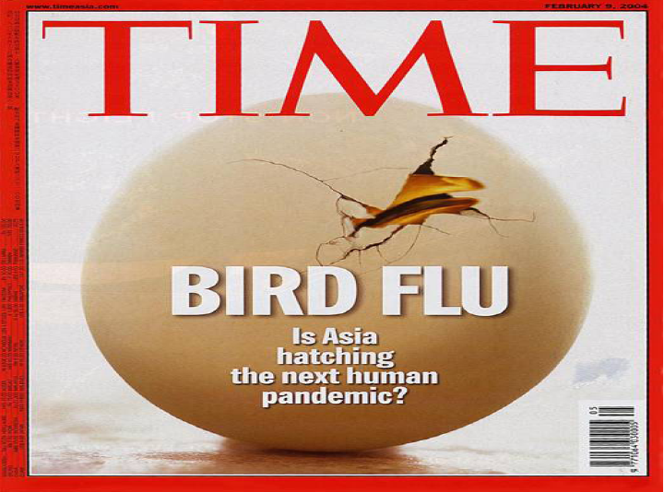

Avian Flu
From: Identification of human-to-human transmissibility factors in PB2 proteins of influenza A by large-scale mutual information analysis. InCoB2007 Hong Kong, 28th August 2007. Olivo Motto.
Can H5N1 viruses spread amongst humans?

Slide 10
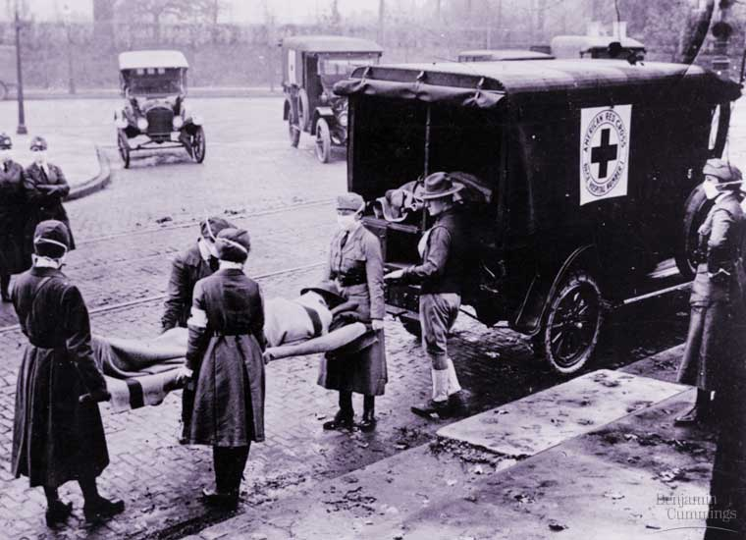
Human Sequences (H2H)‏
H2H variants show remarkable historical stability
Location of characteristic sites in binding domains suggests complex interactions are involved in adaptation to H2H transmission
  Both current lineages (H1N1, HxN2) have evolved from the same source (1918 Spanish Flu)‏
  The Spanish Flu (La Gripe) H1N1
  20-40 million dead in one year
  50-100 million dead in total
  20% world population infected
  8 million deaths in May in Spain
  death within hours

Slide 11
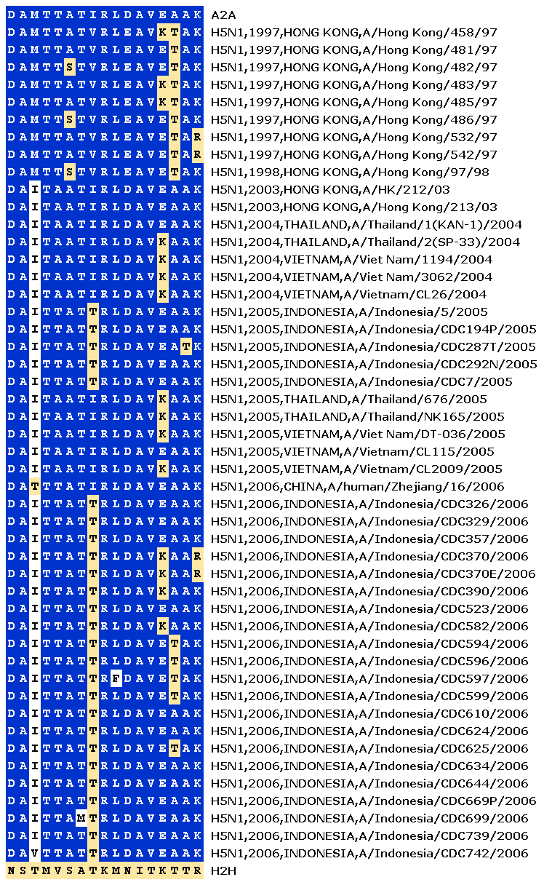
Avian sequences (H5N1)‏
Avian strains rarely show any H2H mutation
Spanish Flu had 5 H2H mutations
H5N1 repeatedly exhibits H2H mutations, but they do not “stick”
  H5N1 not becoming H2H
Reassortment is unlikely - and how pathogenic?

Slide 12
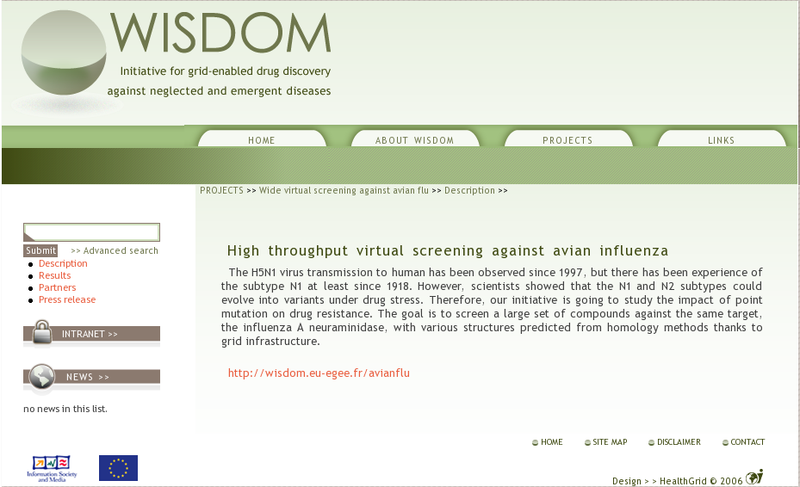
Fighting Avian Flu
  New Grid technologies are finding its way into Bioinformatics and Health informatics
  Drug screening initiatives are speeding up the path to discovery of new therapies.

Slide 13
Other applications
Identification of mutant genes
Diagnosis of genetic diseases
Prognosis of propensity to disease
  Genetic/molecular counsel
Personalized drug therapy
etc...
Note that all of them have a wider economic and social impact (travel, insurance, politics, commerce, discrimination...)‏

Slide 14
So, where is the problem?

Slide 15
Getting closer
Bioinformatics has grown hand-by-hand with Molecular Biology
  Most tools and documentation are oriented to the Biological problem
  Indeed, most of them are oriented to the Bioinformatician (Theoretical Life Scientist?)‏
Medical Doctors need to get acquainted with a well-stablished methodology
  Using a foreign language

Slide 16
Solving the problem

Slide 17
Adapt to MD needs
Translate tools and docs to medicalese
MDs need meaningful data to guide decisions
  Develop/adapt tools to MD needs
  Subject of a submitted COST proposal
Train MDs in the interpretation of analytical results

Slide 18
Training in Bioinformatics
Still inmature:
  Lack of professionals
  Wide range of subdisciplines
Bioinformatics is still a young discipline
  Comprehensive training is difficult to deliver
Either
  Experts at different institutions cooperate
  Or only specialized training is delivered

Slide 19
e-Learning
e-Learning allows pooling of training resources at different locations
EMBnet has started a public portal for
  Sharing (CC) training materials
  Cooperative training
  Delivering remote education
http://edu.embnet.org/

Slide 20
EMBnet is a group of ~40 collaborating nodes providing support to Life Scientists
  National nodes provide bioinformatics support to local scientists
  Specialist nodes provide expertise in highly specialized areas
  Other nodes collaborate on special areas
There are european as well as non-european nodes (Africa, America, Asia, Australasia)‏

Slide 21
Growing collaboration
Despite its size, EMBnet alone can not cover all the needs for e-Learning in Bioinformatics
To be truly useful such a resource must cover the needs of
  Most training institutions
    At different countries, cultures, etc...
  Most Bioinformatics fields
    Sequence Analysis, Evolution, Structural Biology, *omics...
  Most users
    Biologists, Medical Doctors, Pharmacologists, etc...

Slide 22

An international network of cooperating nodes oriented to Iberian (Spain and Portugal) and related American (Central and South American) countries.
Goal is to promote development of Bioinformatics in the region.
Many common members with EMBnet
Joined the initiative in June-2007

Slide 23

More than 20 organizational and 300 individual members from over 12 countries in the region
A non-profit, non-governmental, international organization.
It focuses on the promotion of bioinformatics in the Asia Pacific Region
Joined the initiative in August 2007

Slide 24

The national network for bioinformatics is the communication and community-building tool for our bioinformaticians and computational biologists. It has an open scope, as
  it represents the different trends in bioinformatics and computational biology,
  it includes people from different professional and academic origin, and
  it participates in the organization of scientific activities, dissemination and training
Joined initiative in February 2008

Slide 25
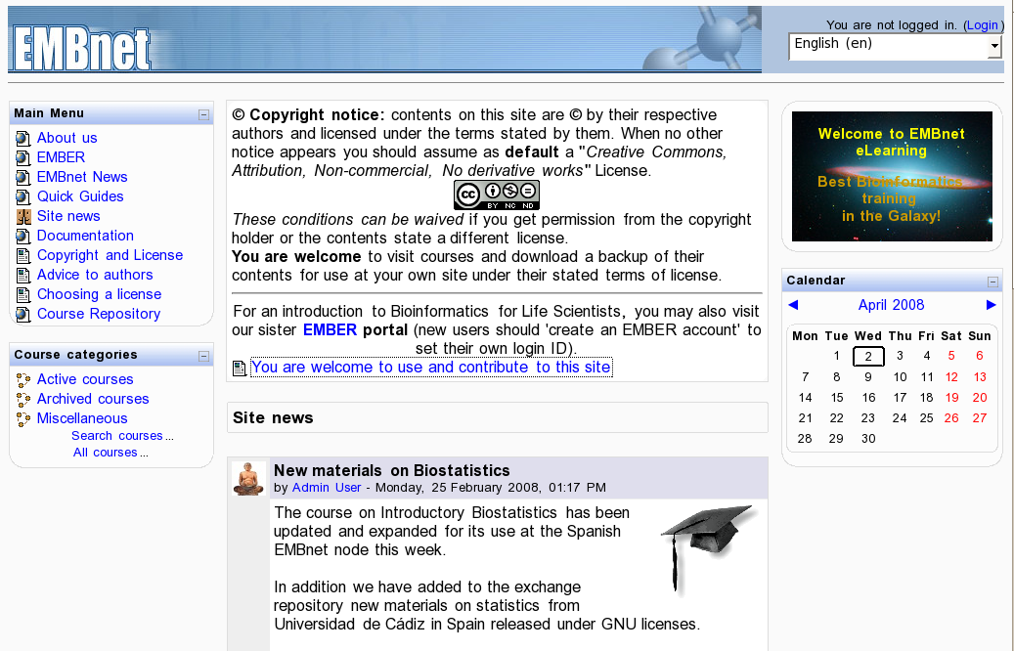
http://edu.embnet.org

Slide 26
http://elearning.embnet.org
A sharing point for training materials
  With advice to authors
An e-learning place to support courses
  Open to guest and registered users
  Multilingual (EN, ES, CN...)‏
  Wide range of courses available
  Used in real-world training
  All materials available for download/replication/use
Creative Commons licensing

Slide 27
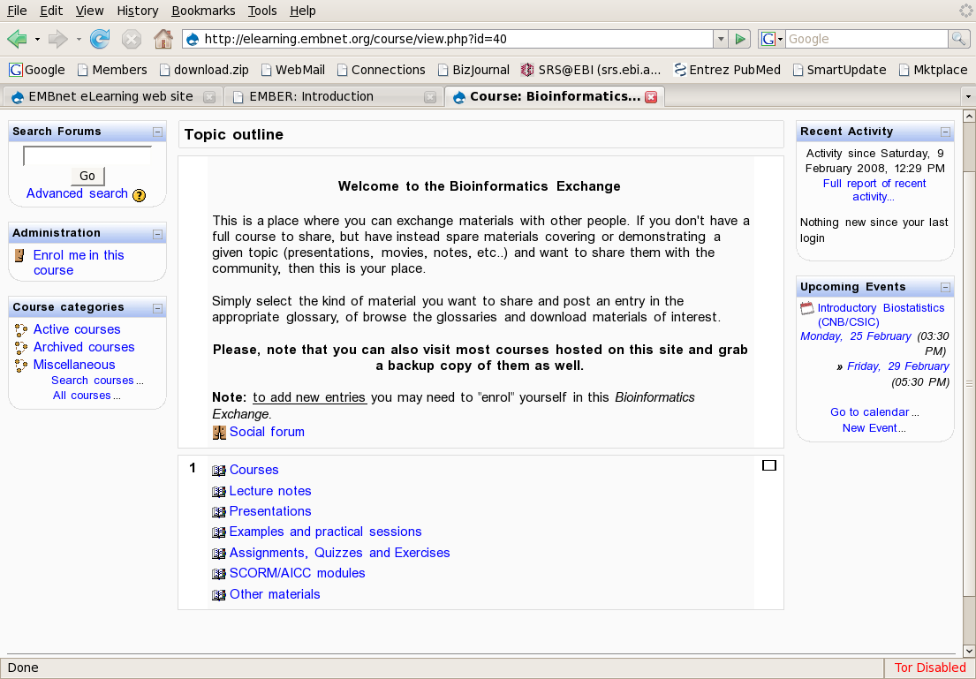

Slide 28
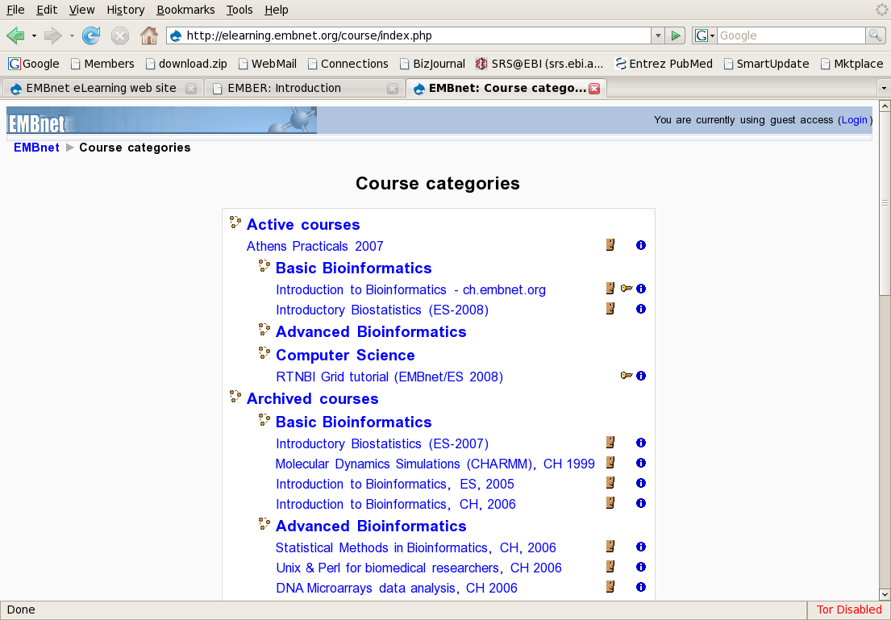

Slide 29
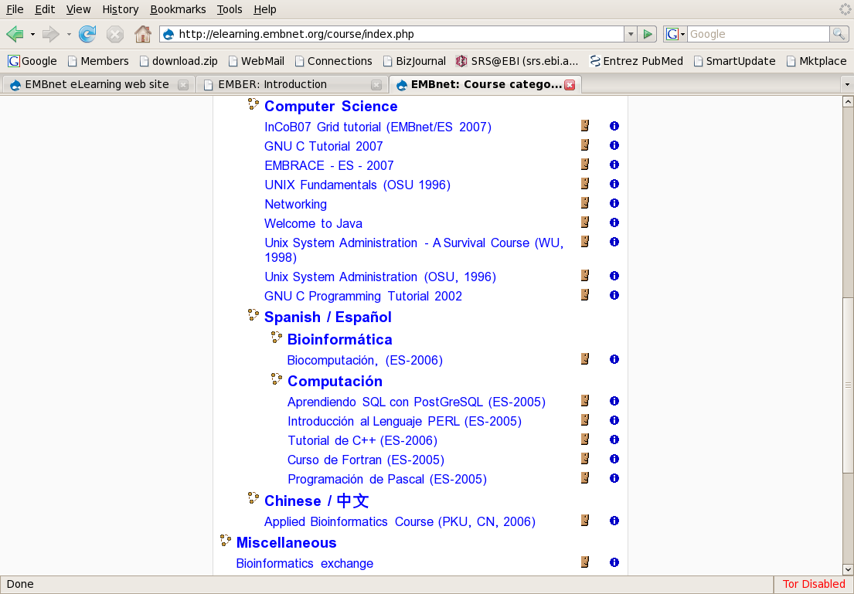

Slide 30
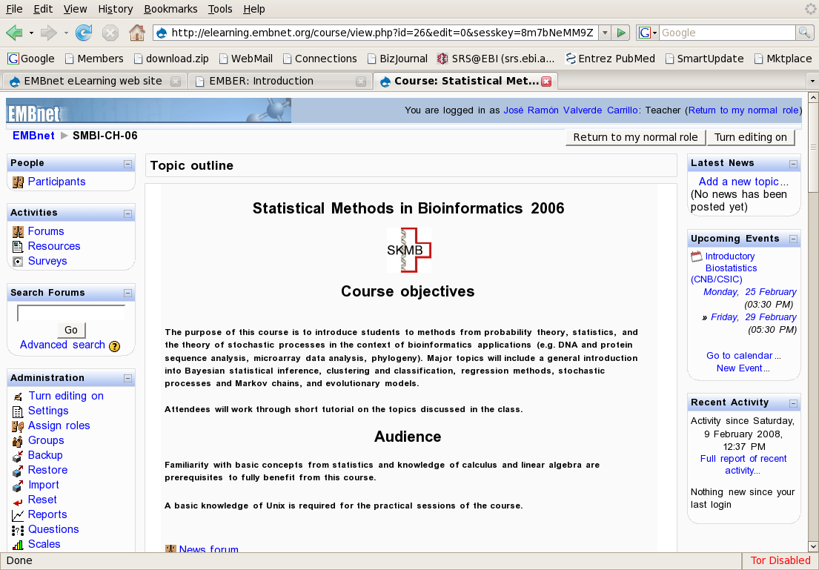

Slide 31
A long way to go...
A new initiative in its early phases
Need to increase coverage for
  More topics
  More languages
  More disciplines
  More communities
    Physicans (MD)‏
    Chemists (Pharma)‏
    Biology (other than MB)‏
  etc...

Slide 32
In one word
  It’s all about people

Slide 33
We need your help
To develop new materials
  Oriented to medical doctors
To develop new tools
  Oriented to medical practice
To benefit from our work
  Use
  Contribute
  Spread
  Support

Slide 34
José R. Valverde

