Slide 1
Analysis of Macromolecular Structures
CYTED FreeBIT, EMBnet, CNB, INB
FOSS

Slide 2
Contents
Getting started
What is FOSS
The FOSS model
  Share knowledge
  Build on existing knowledge
The FOSS Business Model
FOSS and you

Slide 3
Getting started
Insert the USB key and boot from it
Choose Try Without Installing
Wait for the computer to uncompress key contents.

Slide 4
What is FOSS
Free and Open Source Software
  Free as in beer
  Free as in Freedom
  FOSS licenses
    GNU
    BSD
    Artistic...
  Academic licenses

Slide 5
The FOSS model
Share knowledge
Get work done, do not wait
Break free
Build on top of existing knowledge
Share knowledge

Slide 6
The FOSS Business model
If you give it for free, how will you earn your living?
  Altruistic contributions
  Union builds strength
  Provide free and Pro version
    Free: no warranty
    Pro: warranty, demand driven
  Deliver services on top of complex systems

Slide 7
FOSS and you
You can use FOSS on top of your preferred system (Linux, Mac, Windows, UNIX, VMS...)
You can use a full FOSS environment (Linux, BSD)
  It's all about choice
  CHI is an active research field. Guess where are experiments run (hint: not on private production systems)
  The bleeding edge of research requires toys to tinker with (hint: not on private production systems)

Slide 8
The key to FOSS
Select keyboard (ES)
Choose Synaptic package manager
Search what you want
Point, click and install
You are done!

Slide 9
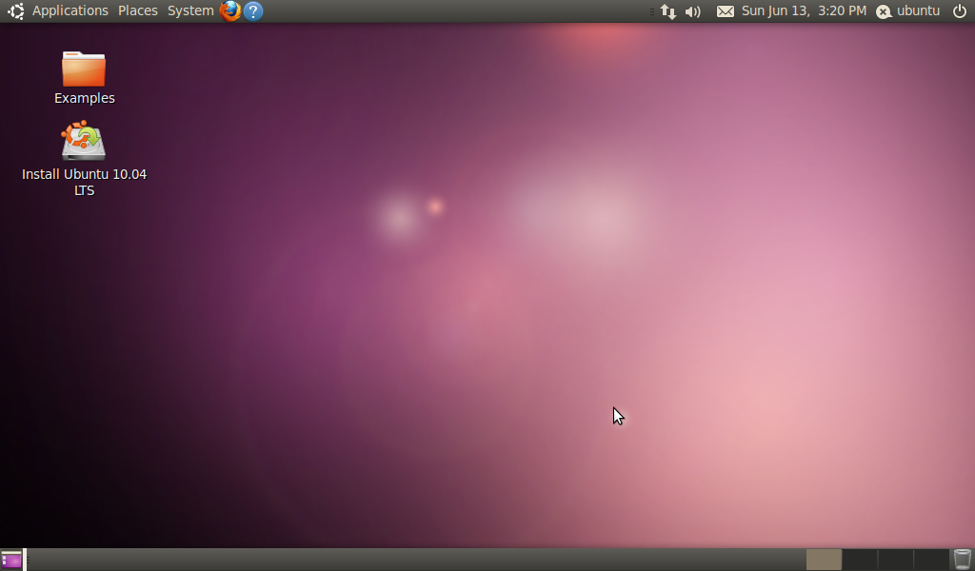

Slide 10
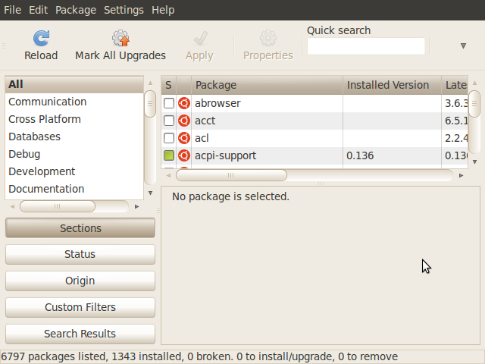

Slide 11
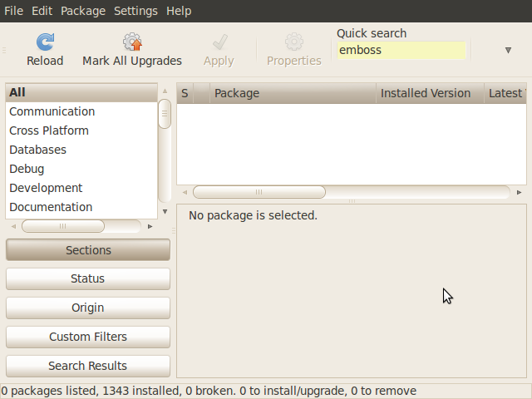

Slide 12
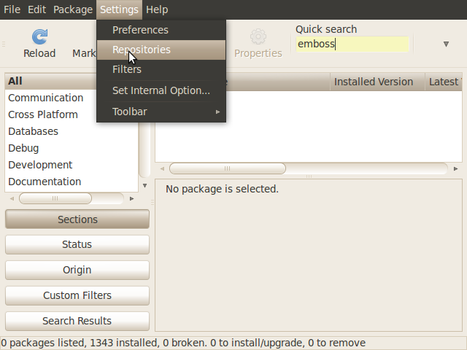

Slide 13
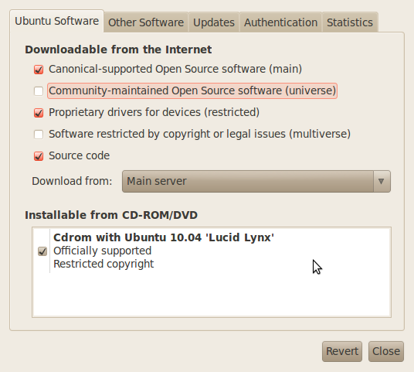

Slide 14
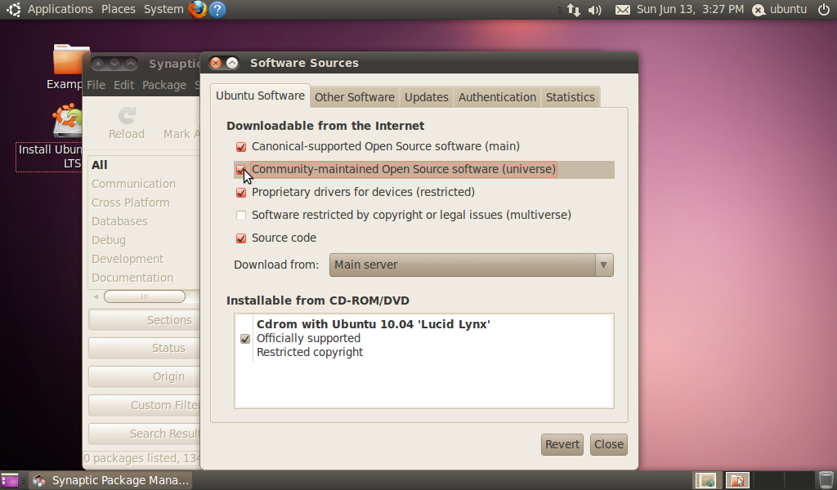

Slide 15
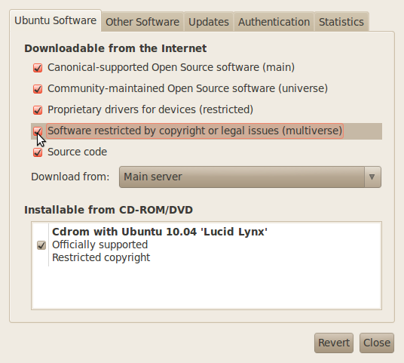

Slide 16
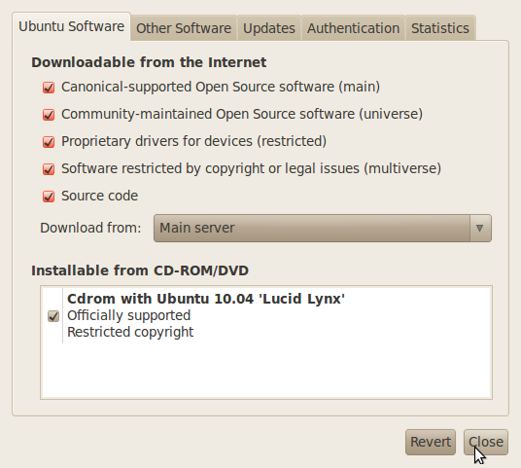

Slide 17
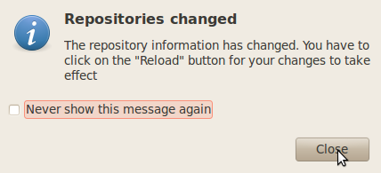

Slide 18
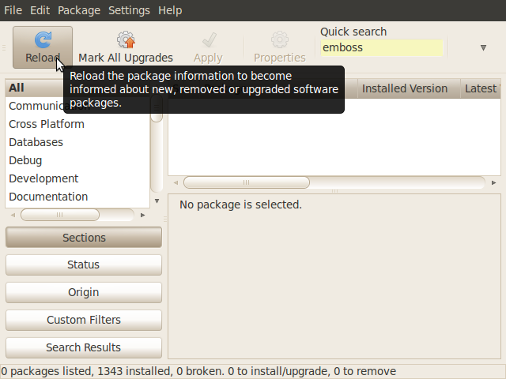

Slide 19
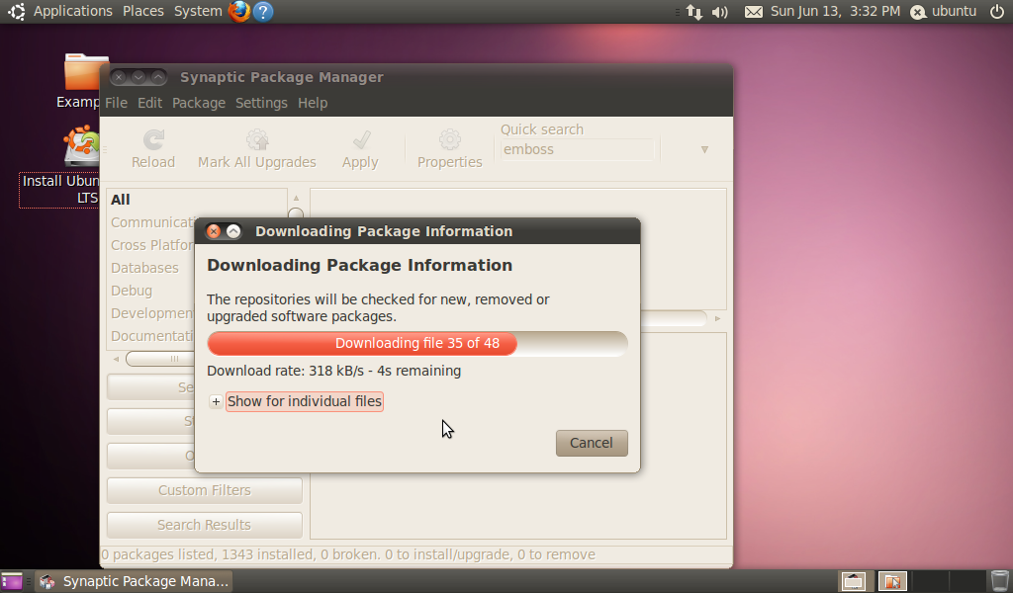

Slide 20
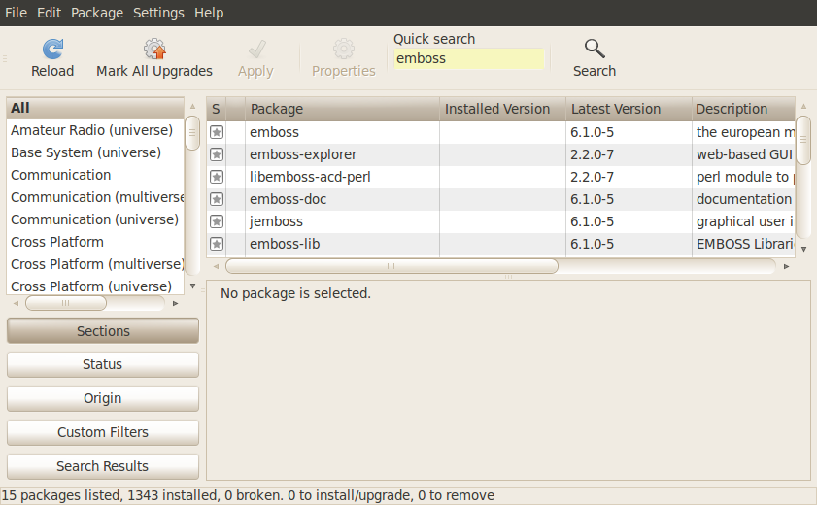

Slide 21
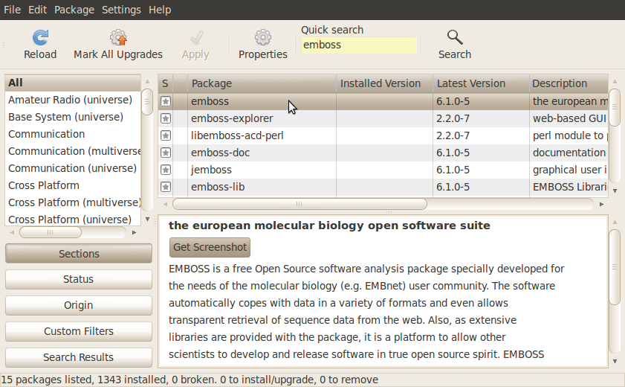

Slide 22
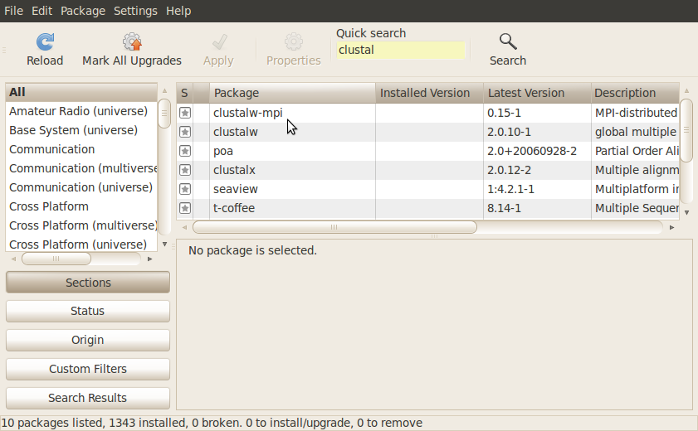

Slide 23
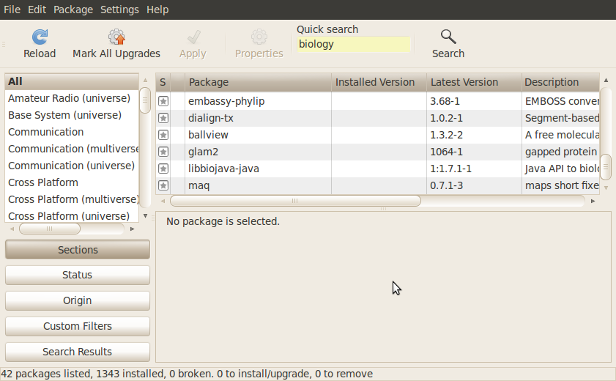

Slide 24
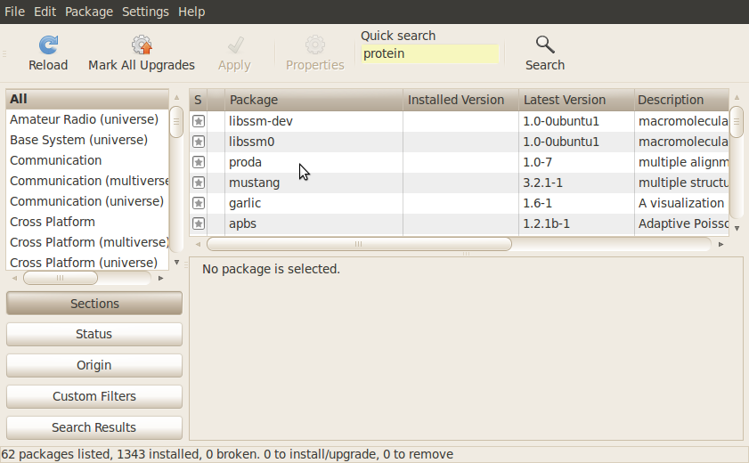

Slide 25
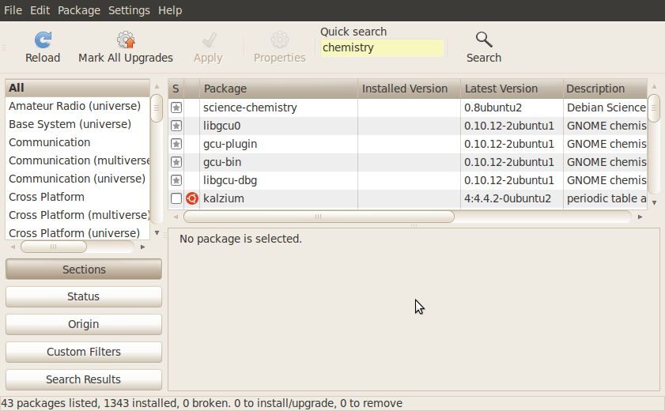

Slide 26
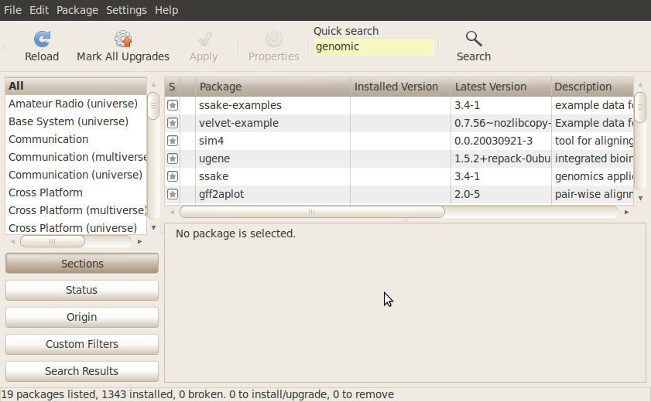

Slide 27
Thank you!

