Slide 1
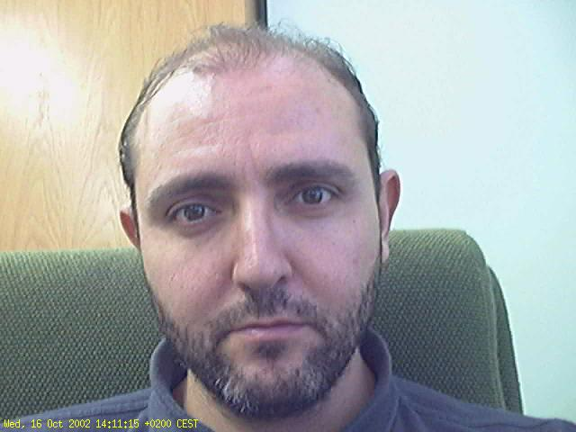
Drug resistance
Analysing drug
resistance

Slide 2


Overview
Drug resistance mechanisms
Understanding drug resistance
Sequence analysis
  Sequence comparison
  Functional analysis
  Evolution
  Metagenomics
Molecular modeling
  Structural modeling
  Drug-target interaction
Understanding drug resistance

Slide 3
Drug resistance mechanisms

Slide 4
Introduction
In the early times...
  Sickness was a godsend trial
  Yet, everybody tried to avoid it
Alexander Fleming
  Penicillin
  Millions saved
50 years later
  Many drug resistant variants
  An arms race against microbes and disease

Slide 5
Infectious diseases
Infected subject
Microorganism is transferred to susceptible subject
  Direct contact (e. g. HIV)
  Airborne (e. g. Influenza)
  Fomites (e. g. Diarrhoea)
  Vector (e. g. Malaria)
Susceptible subject becomes sick

Slide 6

Therapy and prevention
Treat sick subject
Avoid infection
  Patient isolation
    Cuarantine
    ... or worst
  Transmission control
    Cleaning/sterilization
    Vector control/extermination
    Vector therapy/vaccination (e.g. hydatidosis)
    Physical barriers
  Eradication (smallpox)
  Vaccination
  Preventive therapy

Slide 7
Disease resistance
A failure to respond to therapy and prevention
Due to changes in
  Target susceptibility
  Microorganism virulence
  Environmental interactions
    Pathogen
    Patient
  Drug sensitivity
Arising from a normal process
  Survival of the fittest
  Coevolution
Nature is a system
  As long as we are here we are part of the system

Slide 8
Understanding drug resistance

Slide 9
So, what does it mean?
Pathogens prey on their victims
  Imposing a selection pressure on them (e. g. sickle cell anemia)
Victims defend themselves
  Imposing a selection pressure on pathogens (e. g. drug resistance)
The world keeps turning (e.g. coevolution)
Parasites have evolved not to kill their hosts too fast
Symbionts have evolved to cooperate with host
Organelles have become one with the host.
All in all is a matter of evolution.
  See e. g. wikipedia on plasmodium (evolution)

Slide 10
For every action there is a reaction
Organisms change at random
Some changes make them fitter for survival
The fittest go ahead and supplant the rest
For any action we take to stop an infectious disease we can expect a resistance mechanism to develop
  Eventually
The trick is to develop defenses faster than Nature can adapt to them.
  For this we need to understand how Nature circumvents our defenses

Slide 11
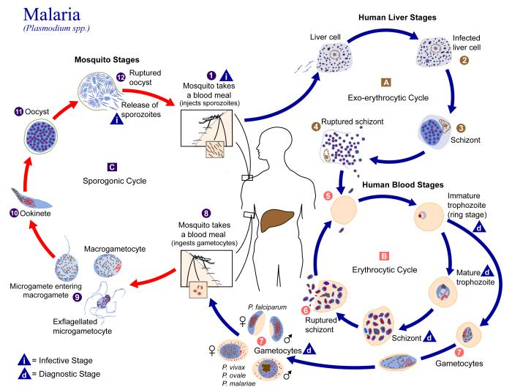
Example: malaria

Slide 12
Sequence analysis

Slide 13
Sequence comparison
Compare with database to identify sequence:
  Origin
  Contents
Compare many sequences to identify similarities
  Relevant functional sites
Compare many sequences to identify differences
  Spot non-relevant changes (polymorphism)
    e.g. KatG Arg 463 Leu (CGG-CTG)
  Spot relevant changes (function)
    e.g. KatG Ser 315 Thr yields INH resistance
Multiple sequence alignments
  Always review results for consistence before accepting them

Slide 14
Sequence comparison
Database search
  FastA
  Blast family of programs/algorithms
Multiple sequence comparison
  ClustalW (and ClustalX)
  T-Coffee
  NAST
  FSA
  Muscle
Alignment visualization/editing
  Jalview
Beware! Only mutations/indels considered!

Slide 15
Understanding sequence comparison
ATGCATGCATGCATGCATATATATATATATATATGCATGCATGCATGCATGC
|||||||||| ||||||
CGATCGATCGATCGATATATATATATGCATATATATGCATGCATGCATGCAT
Take care!
Indels
Slide
ATGCATGCATGCATGCATATATATATATATATATGCATGCATGCATGCATGC
|| || || |||||||||||| |||| ||||||||||||||||
CGATCGATCGATCGATATATATATATGCATATATATGCATGCATGCATGCAT
ATGCATGCATGCATGCATATATATATAT--ATATATGCATGCATGCATGCATGC
|| || || |||||||||||| |||||| ||||||||||||||||
CGATCGATCGATCGATATATATATATGCATATAT--ATGCATGCATGCATGCAT
--AT-GCAT-GCATGC-ATGCATATATATATAT--ATATAT--GCATGCATGCATGCATGC
|| | || | || | |||||||||||| |||||| ||||||||||||||||
CGATCG-ATCG-AT-CG----ATATATATATATGCATATATATGCATGCATGCATGCAT

Slide 16
But wait! There is more!
Repeats
ATGCATGCATGCATGCATATATATATATATATATGCATGCATGCATGCATGC
CGATCGATCGATCGATATATATATATGCATATATATGCATGCATGCATGCAT
ATGCGACATTATATGGACGCCGACAATATGCATGACTAGCATAGCATGCGAT
||| | | | | | |||
TAGCGTACGAGACGTTCAGTAGGTATAACAGTCGCAGGTATCTTACAGCGTA
Invert
ATGCGACATTATATGGACGCCGACAATATGCATGACTAGCATAGCATGCGAT
|||||||||| ||||||||| ||||||||| |||||| ||| ||||||||||
ATGCGACATTCTATGGACGCTGACAATATGGATGACTTGCAGAGCATGCGAT

Slide 17
Dot plots
C| X
G| X A T G C
T| X | | | |
A|X A T G C
+-------
A T G C
A| X .
C| . X A T G C A
G|X . X | | | |
T| . X G A T G C
A|. X
+---------
G A T G C
A|X X X
T| X X
G| X .
T| X . A T C A C T G T A
C| X . | | | | | | |
A|X X A T C A - - G T A
C| X
T| X X
A|X X
+-------------
A T C A G T A
A|X
T| X C G T A
G| X
C| X A T G C
+-------
A T G C
C| X X X
G| X X X
T| X X X X
A|X X X
+-------------------------
A T G C T A T G C A T G C
C| X X
G| X X
T| X X
A|X X X
+-----------------
A T G C A C G T A

Slide 18
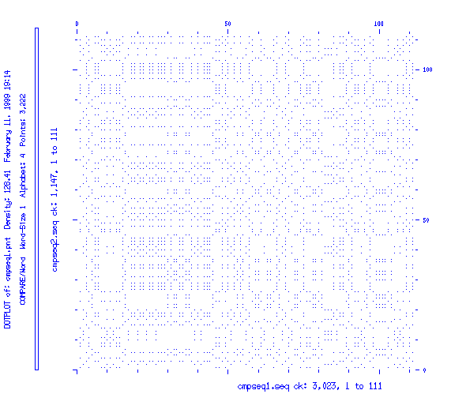
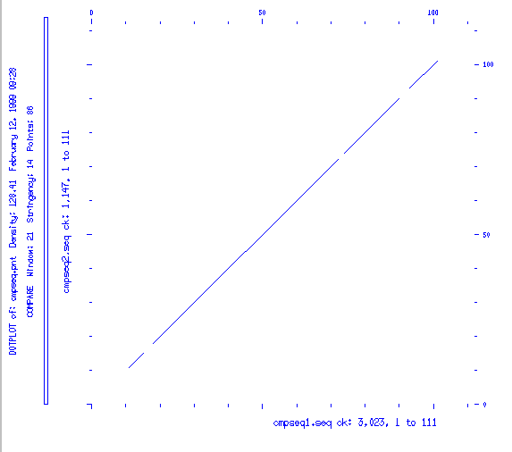
Filtering

Slide 19
Sequence comparison wrap up
We can compare sequences linearly
  Accommodating for different offsets, mutations and indels
We can perform multiple sequence comparisons
  To spot similarities and differences
We can carry out dot-plots
  To highlight rearrangements
But always
  The biologist must exercise scientific discretion

Slide 20
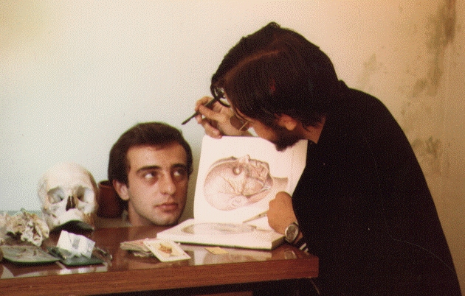
Functional analysis
How to dissect a protein
(and survive it)

Slide 21
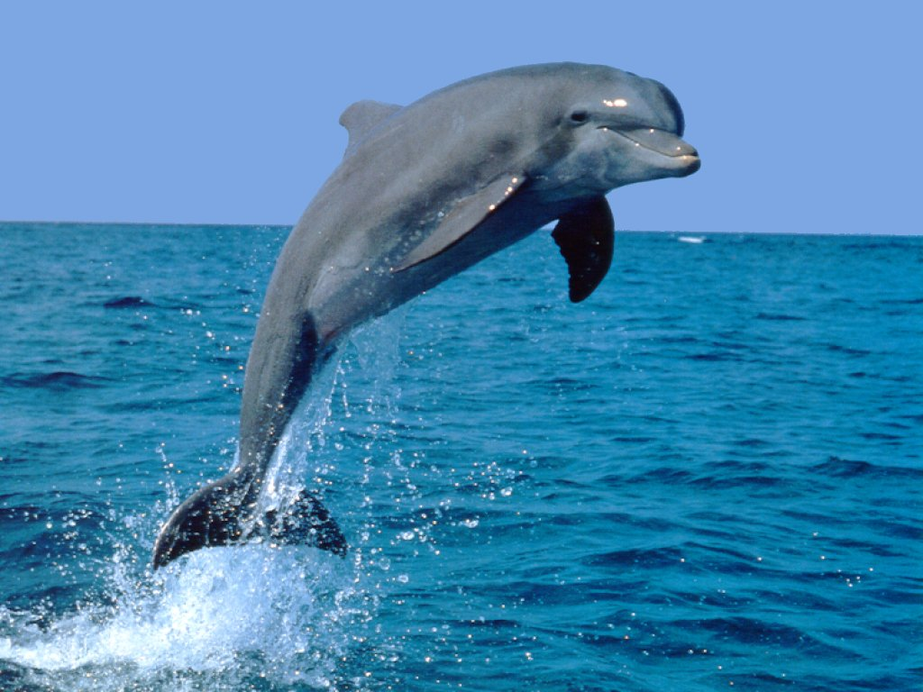
Introduction
Using theoretical predictions can save a lot of experimental work
Basis
  Similar sequences have similar structures
  Similar structures have similar functions
    Similar sequences have similar functions
  And vice-versa
  But... is this a fish?

Slide 22
The method
Multiple sequence comparisons allow us to “decypher the language of life”:
  Words (e.g. TATA box)
  Motifs (e. g. Leucine zipper)
  Context (e. g. intron-exon junction)
Trouble:
  Too large or too small a similarity makes it difficult
  Synonyms
  Polysemy
  Homonimy
Your biologist/scientific good sense is crucial!

Slide 23
Some magic words
Motif
  A well defined sequence with limited variability (something you can see)
Matrix
  A table stating relative frequencies of residues at each position
HMM
  A table of tables considering relative frequencies of residues with respect to each other and combinations
ANN
  A black box that works (like a brain) much like an HMM

Slide 24
Databases
Dictionaries of motifs, matrices, HMMs, ANNs...
  PROSITE (motifs and patterns, more recently rules and matrices)
  BLOCKS (full sequences of domains)
  PRINTS (protein family fingerprints -motifs and context)
  PFAM (common domains and protein families: alignments, HMMs, context)
  PRODOM (automatically generated exhaustive domain catalog)
  SUPERFAMILY, PIRSF, SMART, TIGRFAMs, Gene3D...
InterProt
  A database to bind them all...

Slide 25
Functional wrap-up
We can build “dictionary” databases to help us translate the “language of Life”
A database search will
  Highlight relevant sections present in our sequence
  Spot relevant sections absent from our sequence
There are many databases collecting different bits of information
  Formally (motifs, matrices, HMMs, ANNs...)
  Semantically (function, structure, fammiliarity...)
InterPro brings together many such databases into a single resource

Slide 26
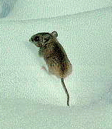
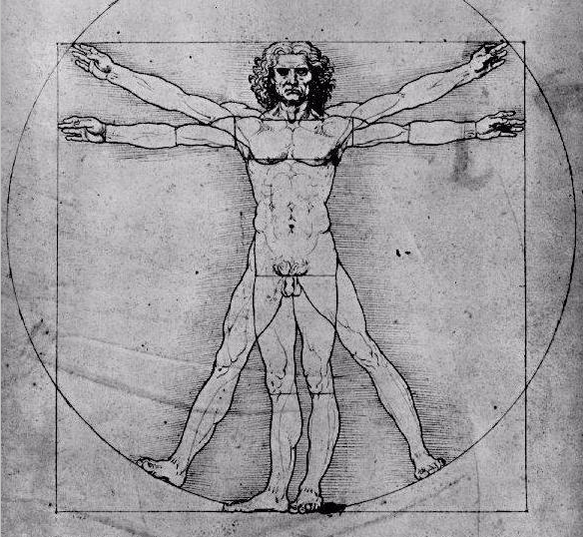
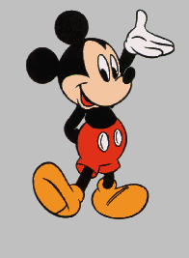
Evolution
chimp
~60 M
years
dinosaur

Slide 27

Evolutionary analysis
By comparing features we can derive how properties evolved
  By comparing sequences we can derive the origin of a gene
    Where did a disease outbreak occur?
    Where did resistance occur?
    How did it spread?
    How did the change take place?
  We must compare similar features
    Characters must be correctly aligned first.
    All significant characters considered must be considered in all species
      Characters not measured on one specie must be discarded

Slide 28
Evolution mechanisms
Selection
Drift

Slide 29
Speciation
Is it a hierarchical process?
Cladogenesis
Reticulated evolution
We normally expect cladogenesis, but when talking genes we may observe reticulated evolution (through duplication, recombination and rearrangement events).

Slide 30
Homology and similarity
Homologous structures in two or more organisms are those that are also present in the closest common ancestor.
Analogous structures are those that have the same function but do not share a common ancestor.
Molecular Biologists often talk about 'partial homology' to refer to sequence similarity.
REMEMBER: characters can be either homologous or not. Sequences may display 'partial similarity', not partial homology.

Slide 31
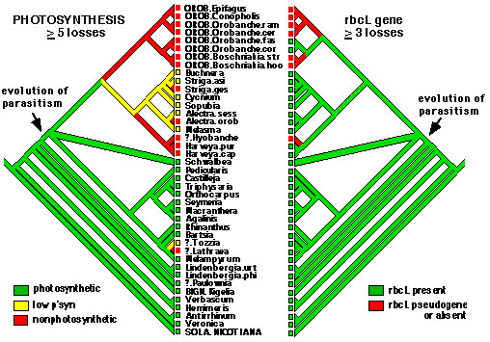
Coevolution
May occur when genes or their products interact with each other

Slide 32
Character classification
To arrange characters in a (hopefully) evolutive order we commonly use guide rules. As an example, Henning proposed in 1950
  What is common has an ancestral origin
  Complex characters are evolved from simpler characters
  Fossil characters are more ancient than current ones
  Progression rule:as organisms are more distant from a common ancestor their characters are more evolved
We will normally use a multiple alignment program
  But look out for mistakes (e.g. frame shifts in coding sequences, broken active sites...)
  Your biological good sense is crucial!

Slide 33
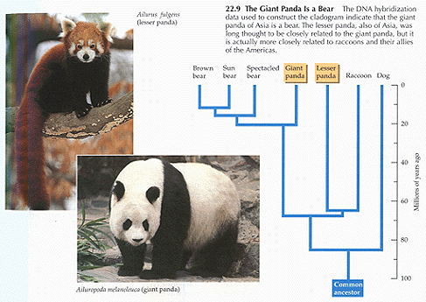
Trees
Once characters have been properly aligned for comparison we can build a tree.
  Watch out! Your biologist good sense is crucial!
Monophyletic
Paraphyletic

Slide 34
Trees: problems
Politomy
Negative branch lengths
Tritomy
Time
More than one branch from a single node: low resolution in these speciation events, lack of data or low quality..
A tree branch seems to grow backwards in evolution time: reversion of characters, saturation of changes, regression...
In any case, trees are always unrooted!

Slide 35
Rooting a tree: outgroup
Internal group
External group
We set the tree root to the internal branch between our problem species and those of the outgroup (which we know to lie outside).
outgroup
A
B
C
D
E

Slide 36
Building a tree: methods
Distances
Maximum Parsimony
Maximum Likelihood
Bayesian methods
In all cases you should always do a bootstrap

Slide 37
Evolution summary
Start with a set of homologous sequences
Select all common characters
Align them using a multiple alignment program
Build unrooted tree
  Look out for defects (trichotomy, negative branches)
    Add more information
  Add outgroup to root tree
Bootstrap tree!
  Look ut for defects
    Add more information

Slide 38
Metagenomics

Slide 39
What it is
Metagenomics is the study of genetic material taken directly from environmental samples
  No cloning, PCR instead
  Collect many sequences
  Identify origin by sequence comparison
Allows for a large variety of studies
  Biodiversity
  Evolution
  Environmental genomes
  Community metabolism
  etc...

Slide 40
Predicting protein structure

Slide 41
Protein structure
Primary structure (sequence)
Secondary structure (alpha, beta...)
Tertiary structure (domains)
Quaternary structure (protein complexes)
... and beyond
  Proteins not always act alone
    Sustrates
    Allosteric regulation
    Posttraductional modifications
    Integration in other structures (Ribosome, membrane...)
  Chemistry and interactions

Slide 42
Secondary structure prediction
Not much fiability, but may be only resource
  Fiability increases with available knowledge
  ~50% for three states
  ~75% for combinations of two states
  Bigger for complex structural motifs
PredictProtein
  Automated prediction of a protein properties by running a battery of tests.
  http://www.predictprotein.org
Many methods available in the Net

Slide 43
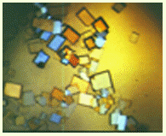
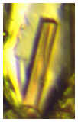
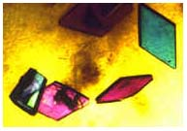
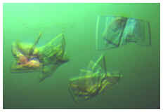
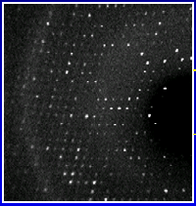
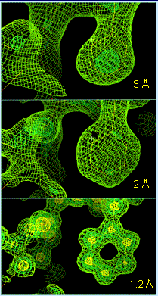
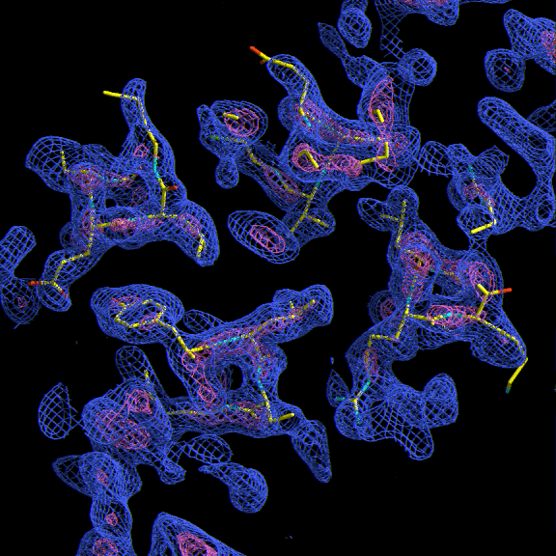
X-ray diffraction
X-ray crystallography provides structural detail of macromolecules and their assemblies at or near atomic resolution.
Purified proteins are examined under a wide range of solution conditions to generate crystals, which are then exposed to X-rays for the collection of X-ray diffraction data.
This is the most crytical part!
Obtain protein crystals
Diffraction pattern
These data are processed to yield 3D electron density maps into which the amino acid sequence of the molecule(s) of interest is fitted. This initial model is then refined so as to optimize the agreement between the model and the experimental diffraction data.
Electron density map

Slide 44

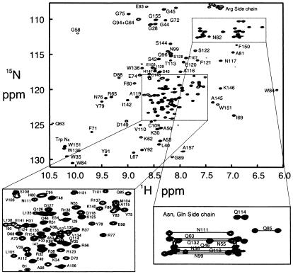
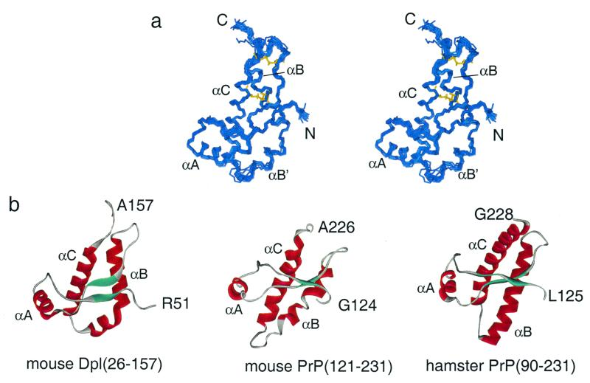
NMR
The principle behind NMR is that many nuclei have spin and all nuclei are electrically charged. If an external magnetic field is applied, an energy transfer is possible between the base energy to a higher energy level.
The signal that matches this transfer is measured in many ways and processed in order to yield an NMR spectrum for the nucleus concerned.
Sample in solution
NMR Spectra
Representative set of possible structures
Nuclear Magnetic Resonance (NMR) spectroscopy is a technique used for determining the content and purity of a sample as well as its molecular structure.
NMR can quantitatively analyze mixtures containing known compounds.
Once the basic structure is known, NMR can be used to determine molecular conformation in solution as well as studying physical properties at the molecular level such as conformational exchange, phase changes, solubility, and diffusion.

Slide 45
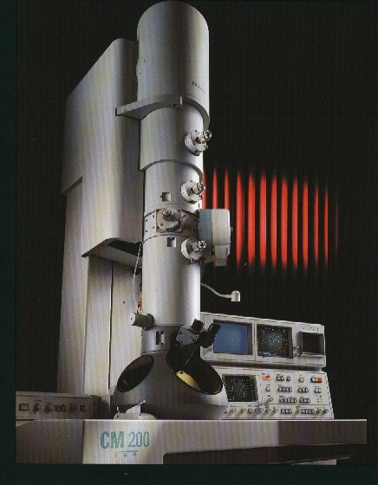
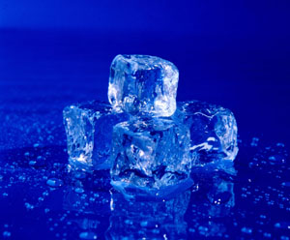
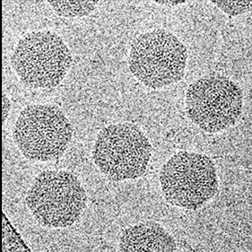
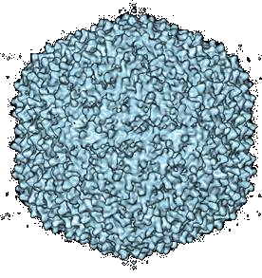
3DEM
Although the resolution of the 3D structure is key in determining the necessary number of 2D images, the inherent symmetry of the assembly also affects the number of images required for a 3D reconstruction.
Furthermore, the final 3D maps could have different resolution depending on the homogeneity of the specimen, the quality of the data and the methods used to perform the reconstruction.
Cryo-EM has been used to study cellular assemblies in different forms, symmetries, sizes and shapes. A purified assembly is rapidly frozen and transferred to a standard transmission electron microscope equipped with a cryo-specimen holder to keep the specimen at a temperatute near liquid nitrogen (-196ºC) during microscopic observation.
Images are recorded under low close without damaging the specimens. Generally, the images are noisy and require extensive image processing to combine images of specimens at different angles and to eliminate all the imaging artifacts. To this end, several specialized packages are available to handle different imaging techniches and particle symmetries.

Slide 46
Fear not!
We cannot predict protein 3D structure from scratch yet.
But we can refine a structure if it is close enough
Remember:
  Similar sequences usually have similar structures
We have a large compilation of known protein structures
  And more coming (High throughput structural analysis)
So
  Why not look in the database for a structure whose sequence is close enough to ours?
  And use it as a starter for refinement?

Slide 47
Homology modelling
Templates with similarity > 40%
Assign problem the template's structure
Optimize structure (resolve conflicts)
  http://swissmodel.expasy.org//
  http://www.bmm.icnet.uk/servers/3djigsaw/
  http://www.cbs.dtu.dk/services/CPHmodels/
What if no protein in the same family is known?
  Not everything is lost: you may identify fragments (domains)...

Slide 48
Threading
Partial templates, similarities < 30%
  http://www.sbg.bio.ic.ac.uk/~3dpssm/
  http://www-cryst.bioc.cam.ac.uk/~fugue/
  http://cbsuapps.tc.cornell.edu/loopp.aspx
    http://supfam.mrc-lmb.cam.ac.uk/SUPERFAMILY/index.html
Identify similar fragments and assign each fragment its own structure
  Then thread fragments like beads in a string
  Turn/hinge modeling is very important

Slide 49
Functional prediction from structure
Again, easiest, fastest approach is lookup in a database:
Protein Function Prediction Server
  Uses functional data extracted from structure files
  http://wolf.bms.umist.ac.uk/~mjfikpd2/predict/enon.html
Catalytic Site Atlas
  Structural models of active sites
  http://www.ebi.ac.uk/thornton-srv/databases/CSA/

Slide 50
Molecular interactions
Molecular “docking”
  Fit a structure against a “pocket” or complementary surface (much like you would dock a ship)
  Protein-protein
    Mainly hydrophobic interactions
  Protein-substrate
    Mainly electrostatic interactions
  Fixed docking
    Structures are considered rigid
  Flexible docking
    Structures are allowed to change conformation
    Following Molecular Dynamics rules.

Slide 51
Drug selection
in silico prediction of potential drugs
  Computationally expensive
    Use “abstrations” instead (pharmacophores,...)
    coevolution
  Many interesting possibilities
    protein-protein: 1K-100K
    protein-substrate: 10K – zillions
    We must balance efficiency vs. realiability
  And still it is very useful to guide experimental work

Slide 52
High throughput analysis
Phylogenetic profiles
QSAR screens
Interaction networks
An area under development.

Slide 53
Advice
Start with the sequence:
  ProSite, Blocks, PRINTS, Pfam, InterPro
  2D: PredictProtein, transmembrane, PTMs...
Go for the structure
  Predict if unavailable (Homology, Threading)
  Characterize (X-ray, NMR, 3D-EM)
  3D analysis: whatif, PFPS, CSA...
Analyze context and interactions
  MD - MM
  Docking (autdock, flex, 3D-dock, gramm...)
  QSAR, 3D-QSAR
  QM/MM - QM/MD

Slide 54
Molecular mechanics
Use laws of classical mechanics to
  simulate the behaviour of atoms and bonds
    Do atoms in molecules exist?
  Minimize energy
    Search for the most stable structure
    Is like cooling to 0 Kelvin
  The force field
Etot = Ebond + Eangle + Edihedral + Enon-bond
Enon-bond = Evdw + Eelectrostatic
AMBER, CHARMM, MM, OPLSA, ...

Slide 55
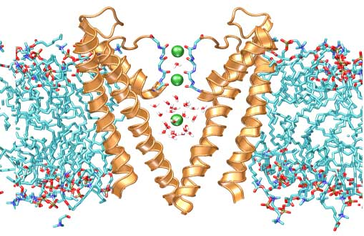
Molecular dynamics
Simulate dynamical behaviour
  Over time
  Under a “set” (ensemble) of conditions
    Pressure, temperature, concentration...
  Let it run for some time
    take and analyze statistics
    Observe the trajectory
    Analyze final structure
  Uses a force field
Atoms in molecules?

Slide 56
Simulated annealing
By analogy to steel making process:
  Heat to induce disorder, cool quickly to fix
For us it is normally a molecular dynamics simulation that
  Starts at 0 Kelvin
  Heats to room temperature (300K, 17C)
  Cools again to 0K
Is used to optimize structures
  attempts to jump over local minima

Slide 57
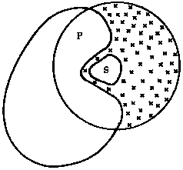
The solvent
Most important in biological systems
Involves a potentially large amount of additional molecules (and interactions)
Approaches
  Implicit solvent models
    Substitute solvent by an approximation
      Effective dielectric constant (e. g. 80 for water)
      Distance-dependent dielectric coefficient
      Continuum electrostatic theory
  Explicit solvent models
    Include the solvent as an explicit element of the calculation
      Requires boundary conditions to avoid leakages
      Can be limited to the active site

Slide 58
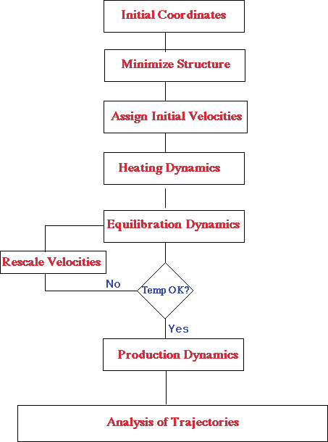
A molecular dynamics simulation

Slide 59
Molecular Dynamics/Mechanics limits
Limits from the model system
  Force field
  Atomic simplification (atomo ǂ molecule)
Límites from the computer
  Precision
  Computational time -> simulation time
1 second = 1000 miliseconds
1 milisecond = 1000 microseconds
1 microsecnd = 1000 nanoseconds
1 nanosecond = 1000 picoseconds
1 picosecond = 1000 femtoseconds

Slide 60
Computational chemistry
Use quantum mechanics for molecular modelling
  Much more precise
    Can simulate bond creation and breaking
  Much more slow
    Not feasible for large molecules
      Much less macromolecules
    Requires approximations
      Semiempirical methods (MOPAC, etc..)
      Poor results for heavy atoms (e.g. cromophores)
      Combined methods QM/MM and QM/MD

Slide 61
Why go quantum?
A molecule is not a string/network of atoms
  It is a cloud of electrons in a field of nuclei
  Molecular orbitals
QM deals with electrons and nuclei
  May account for bond-breaking / formation
  Explore the fine structure of species
  Explores electronic behaviour (excited states)
Quantum Dynamics may explore system evolution in time
Plus.. It's fun and generates wonderful graphics!

Slide 62
Electronic structure
We consider molecules as a cloud of electrons moving in a field of nuclei
Within the Born-Oppenheimer approximation
  Electrons move much faster than nuclei
  Hence electron and nuclear movement may be uncoupled
We usually ignore Dirac (relativistic) effects
  Valid for most atoms in organic chemistry
  As the nucleus grows, electrons close to it move faster
  Not valid for heavy atoms (Cr, Fe, Zn...)
We usually use time-independent calculations
  Not valid for electronic excitations (e. g. bioluminiscence)

Slide 63

A mathematical summary
Approach atomic orbitals by a sum of functions (Gauss, Wannier, Plane waves...)
Compute molecular orbitals as a linear combination of all atomic orbitals
Φi = ∑k cikΧk
Compute molecular wave function as a combination of molecular orbitals
Ψ = Φ1Φ2...Φn
Compute high order correlation effects as a combination of molecular wave functions
Ψenhanced = aΨ0 + bΨ1 + ...
Solve system of equations using self consistent field methods

Slide 64
Basic methods
Fully ab initio
  Compute the wave function entirely from first principles
  Very expensive (N⁴ to N⁷)
Semiempirical methods
  Substitute as much information as possible by precomputed values (N³ )
  Linear scaling method developed in the last decade
    MOZYME, MOPAC2009
DFT
  Forget the wave function: compute electron density
  Scales much better (N³ )
  Linear scaling methods developed recently
    SIESTA, etc...

Slide 65
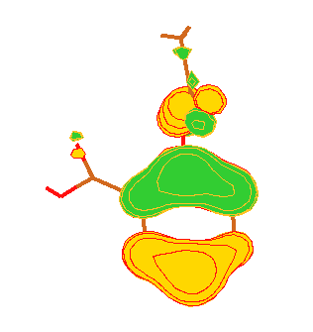
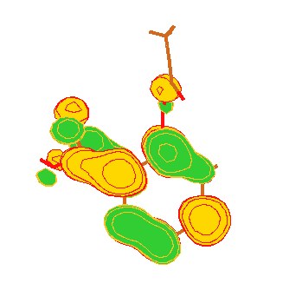
Applications
Frontier Orbital Theory
Electronic structure (HOMO, LUMO)

Slide 66
Applications
Charge distribution in space
  Assignment to nuclei (Atoms in Molecules)
Charge distribution
  Dipoles, multipoles, QSAR
Electrostatic field
Structure
  Molecular size, dimensions, derived properties
Energy and tensions
  Phonons (vibration states)
Electroaffinities
Additive properties

Slide 67
Applications
Reactions
Saddle point calculations
Transition state calculations
IRC (Internal reaction coordinates)
Reaction coordinate path
QM/MD
  Mixed approach: model one part as QM and another as MD
QMD
  Fully quantum molecular dynamics (Carr-Parrinello)

Slide 68
In practice
Usually use a semiempirical method
  MNDO, AM1, PM3, PM6
It is now feasible to use ab initio
  With STO-3G (minimal) or 6-311G or better
  RHF for singlet
  UHF/ROHF for unpaired electrons
  If correlation is relevant, use MP or CI
  If size is too big, use QM/MD
Consider DFT and Carr-Parrinello MD.
  More modern
  Less experience

