Slide 1

Abstract:
Title: GIT Based Website creation
Presented by: James Walsh Magdalene College Engineer
This presentation outlines the development of “The Exposition Archive” a static web repository for digital assets such as PowerPoints. I will cover the initial implementation of decentralised file storage, the technical architecture used to create it (specifically Git and HTML5), and demonstrate the final deployed application. The goal is to show how accessible modern web design can be.

Slide 2
GIT Based Website creation
By
James Walsh
Magdalene college cambridge

Slide 3
Order of Topics
Topic 1: Technical Architecture (The tools used)
Topic 2: Biggest Challenge & Solution(The "Embedded" issue)
Topic 3: Live Demonstration
Topic 4: Review & Future Scope (Conclusion)

Slide 4
Technical Architecture (The tools used)
The Architecture is comprised of 3 Main parts
VS Code: For writing semantic HTML5 structure.
Git: For version control.
GitHub Pages: For static hosting
Notes:
Semantic HTML5 structure means you use clear labelling throughout the website so its clear where everything is. It is also important for people using screen readers as it helps them understand layout better.
My initial file design was built up locally on my computer as was my code. I then pushed all my work to github where it is saved and recorded different versions throughout my time coding it which meant I could backtrack if needed.
I then utilised Github pages which hosted my website once it was built (for free) Static website means there is no processing and no data base everyone sees the same thing. The archive system I built is not a database but a static repository/file system

Slide 5
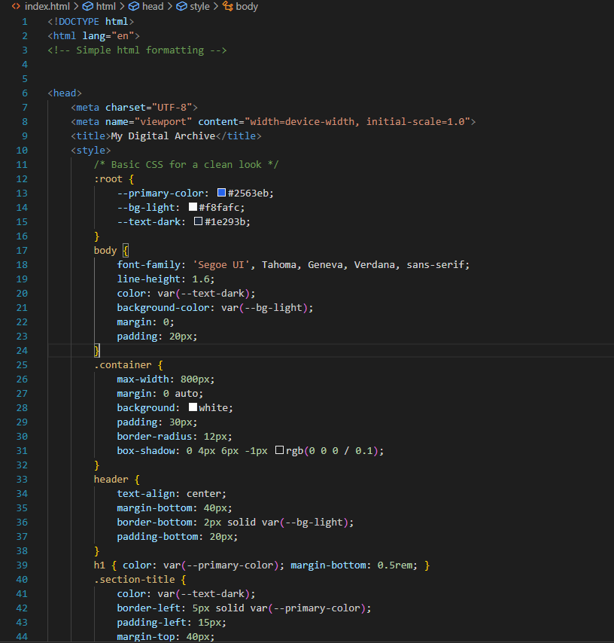
Technical Architecture (The tools used)
The document starts of defining some basic things such at the fact its in HTML and the language.
But also, the style of the website such as colour palette the shape of boxes font type and alignment.
I also used they styling to ensure the website scales to different screens.

Slide 6
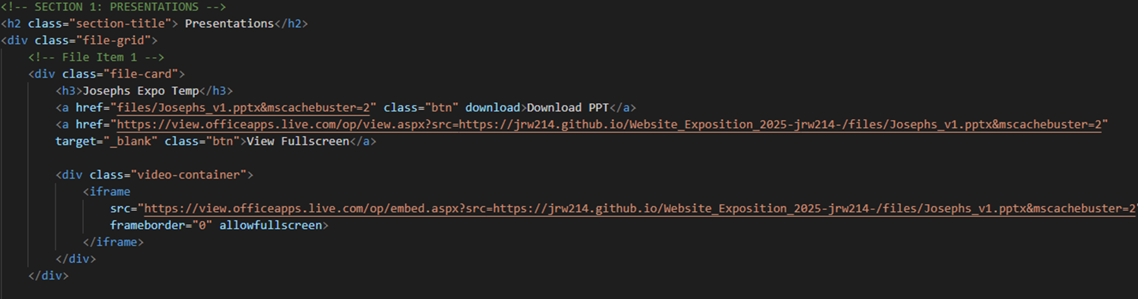
Technical Architecture (The tools used)
Section name and structure
Defines the “box” which the data will be inside & names the “box”.
Iframe utilises Microsoft's online PowerPoint visualisation for a live View
Links to both file download and full screen view
Notes:
The most important part of the code

Slide 7
Biggest Challenge & Solution (The "Embedded" issue)
The most difficult challenge I encountered was Microsoft's aggressive caching when attempting live viewing.
This meant when I updated a PowerPoint file the live view just wouldn’t update.
To save time Microsoft doesn’t redownload the file from GitHub if it recognises the URL it just regurgitates what it remembers.
To get around I forced it to update by adding a cache_buster(&mscachebuster=[VersionNum]) this is a dummy parameter that makes them redownload the file.

Slide 8
Live Demonstration (Showing it works)
https://jrw214.github.io/Website_Exposition_2025-jrw214-/

Slide 9
Review & Future Scope (Conclusion)
In the future id like to add more pages to categorise things better
Id like to automate the file indexing so when new PowerPoints are added html cards are created on the fly
Some form of access control to the website or certain documents

Slide 10
Review & Future Scope (Conclusion)
Technical Architecture (HTML, GIT, GIT Pages)
Biggest Challenge & Solution
Future Scope

Slide 11

Thankyou
https://jrw214.github.io/Website_Exposition_2025-jrw214-/#

