Slide 1
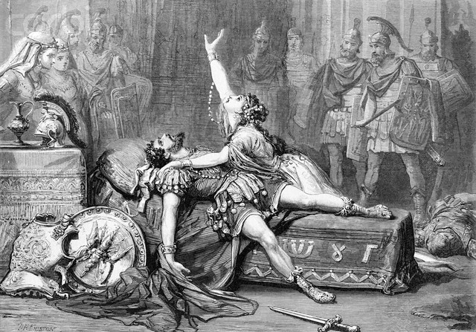
A Model and Platform for Designing and Implementing Reactive Systems
Justin Wilson
1 October 2012
Ph.D. Proposal Defense
Notes:
Introductions
Thanks

Slide 2
What is a reactive system?
A system that has “ongoing interactions with its environment”*
Input
Process
Output
e.g., web server
* Manna, Z. and Pnueli, A., “The temporal logic of reactive and concurrent systems: Specification,” 1992.

Slide 3
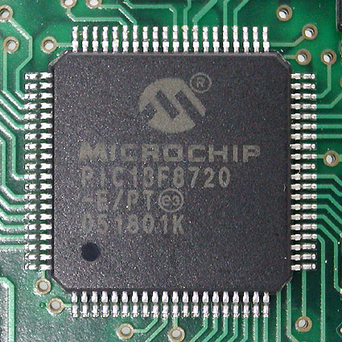
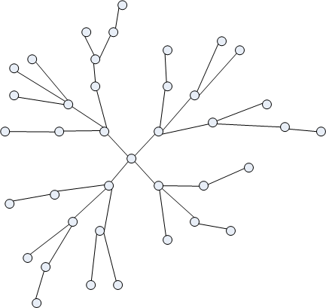
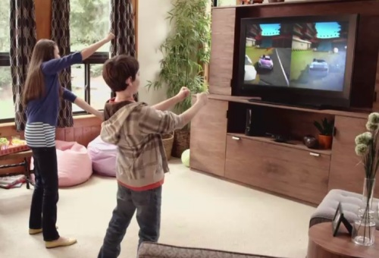
Reactive systems can interact with…
The Physical Environment
Embedded Systems
Each Other
Networked Systems
Us
Interactive Systems
Notes:
Inclusion of environment in model of computation.
Proliferating due to advances in hardware and software platforms e.g., iPhone.

Slide 4
Reactive systems are predicted to increase in number, scale, diversity, and complexity!
“Mobile Phone Access Reaches Three Quarters of Planet's Population.” The World Bank July 17, 2012.
“2012 Internet Trends.” Kleiner, Perkins, Caufield, & Byers May 2012.
“Apple sells 5 million iPhone 5 phones in first weekend.” CNN September 24, 2012.
“Oracle targets raised on cloud push, new products.” Reuters September 21, 2012.

Slide 5
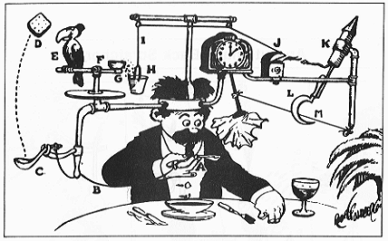
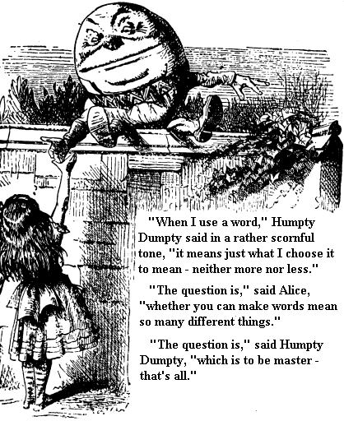
Challenges
Developing reactive systems is currently tedious and error prone!
Goals:
Reduce accidental complexity
Ensure reactive systems can be (de)composed in a principled way
Notes:
Practical software engineering problems.

Slide 6

Existing Approaches
ENVIRONMENT (outside)
REACTIVE SYSTEM
…
May run
FOREVER
STATE
CLOCK/
SCHEDULER
DETERMINISTIC
SEQUENCING
TRANSITION
Notes:
Intermediate states are important
Maps well to von Neumann architecture

Slide 7
Existing Approaches
…
NO COMMON CLOCK
CONCURRENT
…
Notes:
Synchronous models require a global clock which is difficult to implement.

Slide 8
Existing Approaches
…
SHARED RESOURCE
Updates must
be ATOMIC
SYNCHRONIZATION
…
Notes:
Shared resources are for communication

Slide 9
Limitations of the State of the Art
Developer’s Burden: Craft correct (infinite) sequences of arbitrarily interleaved events
Manually partition concurrent activities
Manually identify shared state
Manually designate atomic sections
Locks
Atomic transactions
TEDIOUS AND ERROR PRONE!

Slide 10
Composition and Decomposition
Motivation: reduce complexity, reuse, reliability
Complex System
Simple System
Simple System
Simple System
Increases number of interactions!
Requires interfaces that encapsulate reactive behavior
Notes:
We looked at accidental complexity.
Lets now look at composition.
Simple system means simple interface.
Diminishing returns.

Slide 11
Principles for (De)composition
Interface encapsulates behavior f(x) = x² f: Real -> Real
Recursive encapsulation g(x) = f(x) + 3
Substitutional equivalence g(x) = x² + 3
No qualitative difference after composition

Slide 12
…
IDEAL
ACTUAL
Not subject to principled composition and decomposition!
…
…
…
…
…
…
…
…
…
Notes:
Let each system be a thread for example.

Slide 13
Proposed Approach
…
NON-DETERMINISTIC
SEQUENCING
ATOMIC
TRANSITION
Notes:
Intermediate states are important
Choice when selecting next transition

Slide 14
Non-Deterministic Sequencing
Transition consists of a precondition and effect
Select any transition
Evaluate precondition
If transition is enabled, apply effect
Goto 1
FAIRNESS – Every transition selected infinite number of times in infinite execution
Notes:
Highlight difference with say Linux scheduler.
Brute-force scheduler.

Slide 15
…
1a
1b
1c
…
1a
1b
1c
…
2a
2b
2c
…
2a
2b
2c

Slide 16
Proposed Contributions
MODEL – REACTIVE COMPONENTS
IMPLEMENTATION
EVALUATION

Slide 17
Anatomy of a Reactive Component
Interface
State
State
Composition
Communication
Correlation
Transition1
TransitionA
out
in
Transition2
TransitionB
…
…
PORT
BINDING

Slide 18
Three Kinds of Transitions
PRECONDITION
α
PORT
β
PORT
γ
No state change

Slide 19
Recursive Encapsulation
State
MEMBER COMPONENT
β
α
Y
X
Z

Slide 20
Example: Channel
X
Channel
Y
queue
front
1
1,2
2
1
2
disabled
1
enabled
send
β-push
α-front & pop
recv

Slide 21
Proposed Implementation
Programming Language
Compiler & Virtual Machine
Assume fixed configuration of components

Slide 22
Composition Problem #1: Deterministic Transitions
α-tree
Same component
α1
β2
β3
Transition may be non-deterministic
All components must be different (conservative) or state must be disjoint (undecidable in general)
β1
Notes:
Composed transitions are atomic.
Must be deterministic.

Slide 23
Composition Problem #2: Concurrent Execution
…
Can these execute concurrently?
Yes, execute speculatively with atomic transactions.
Does not apply to I/O.
Maybe, prove state is disjoint.
Analysis is undecidable in general but useful.

Slide 24
A Model for Transition Analysis
A state variable names a set of memory locations, and variables (sets) are disjoint
Intersecting
x := f(v,x,y)
y := g(z)
Disjoint
x := f(v,x,y)
z := h(v,z)
Ephemeral data structures are efficient but require complex shape analysis. Persistent data structures require complex run-time support.

Slide 25
Qualitative Evaluation: Embedded Web Server
Web Server
Opportunities to explore composition and concurrency
Areas of reactive systems
Hardware
Protocol development
Application development
HTTP
TCP
IP
Ethernet Driver
I/O

Slide 26
Expectations: Ethernet Driver
Web Server
No synchronization code
HTTP
Ethernet Client (IP)
Send
Recv
TCP
IP
Ethernet Driver
Send
Recv
Ethernet Driver
I/O
Change from procedural interface to dataflow interface

Slide 27

Expectations: Network Protocols
Web Server
Is this straight-forward?
HTTP
TCP
IP
TCP
Is this pluggable?
Ethernet Driver
Congestion
Control
I/O

Slide 28
Expectations: Applications
Web Server
Comparison to existing web servers
What design patterns emerge/disappear?
e.g., Reactor
HTTP
TCP
IP
Ethernet Driver
I/O

Slide 29
Quantitative Evaluation: Scheduler
…
Efficiency
Overhead
Concurrency
Can the performance of the scheduler be improved with static/dynamic analysis?

Slide 30
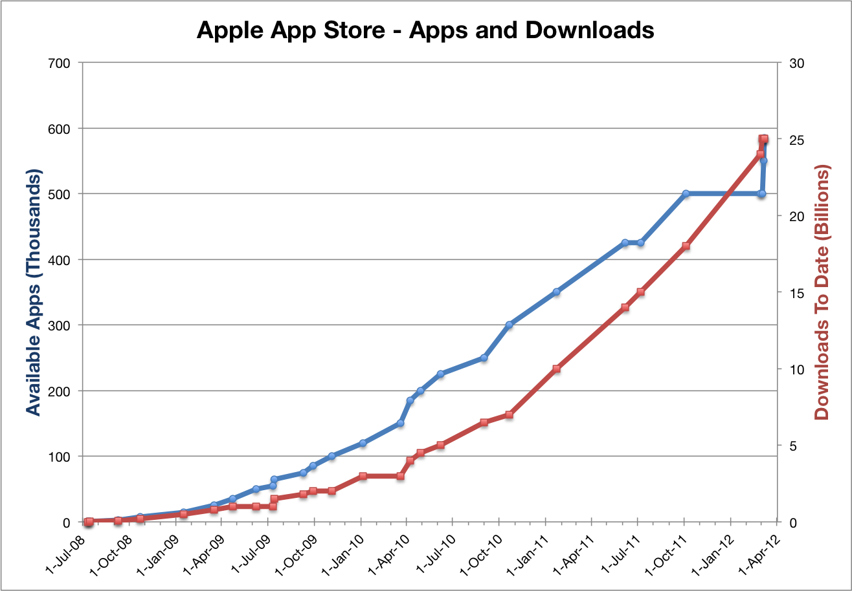
Conclusion
Reactive systems poised to increase in complexity
Reduce accidental complexity
Principled (de)composition
MODEL
Atomic transitions
Non-deterministic sequencing
Ports
IMPLEMENTATION
Programming language
Transition analysis
EVALUATION
Embedded web server
Scheduler performance
…

Slide 31
Bonus Slides

Slide 32
Transformational Program*
Transforms a finite input into a finite output
e.g., compiler
* Manna, Z. and Pnueli, A., “The temporal logic of reactive and concurrent systems: Specification,” 1992.
Notes:
Designed to halt so we can interpret the output

Slide 33
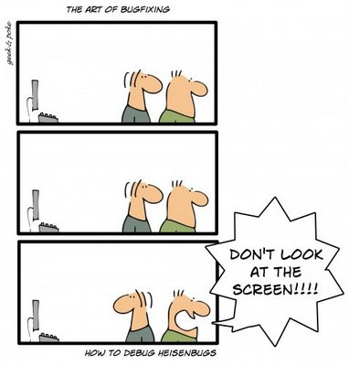
Complexity in Reactive Systems
Developers must reason about (infinite) sequences of arbitrarily interleaved events
Timing bug – correct execution depends on scheduling

Slide 34
Non-Determinism
Model: Behavior of reactive system is linear sequence of atomic events
A reactive system is non-deterministic if there is a choice for the next event at some point in the sequence

Slide 35
Ephemeral Functions
A function with an implementation (schedule) that only operates on ephemeral data structures
Relies on a check for “ephemerality”
Explicit copying

Slide 36
Pointers/References
A variable names a set of memory locations
Variables must remain disjoint
Pointer analysis
Or shared locations must be immutable
e.g., port values
x
y
x
y
A
B
C
α-statement
A
B
C
x
y
A
B
C

Slide 37
Scheduler Efficiency
Precondition -> overhead
Effect -> useful work
Efficiency
Enabled / Total
Count or time
Is overhead accept?
Efficient scheduling and execution
E.g., cache awareness

