Slide 1

Capstone 2
Presented by: Jeremy Walker
6/9/2022

Slide 2
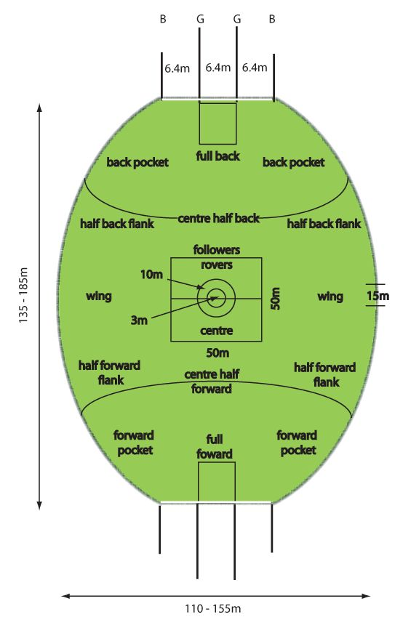
Australian Rules Football
Game Details:
Twenty minute quarters
18 players per team​ on field, 4 subs
Goal = 6 points, Behind = 1​

Slide 3
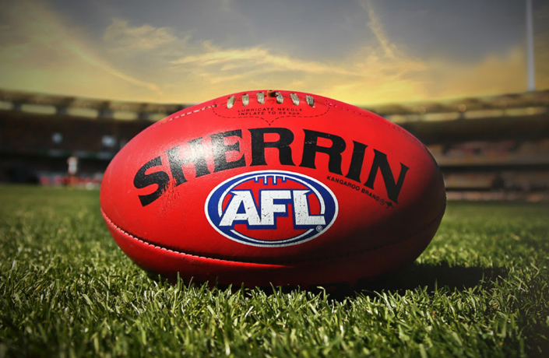
Dataset
https://www.kaggle.com/datasets/stoney71/aflstats
Game data from seasons 2012-2021.
Player statistics from each game over the period.
Basic player information like positions, height and weight.

Slide 4
Additional Power BI features
Imported animated GIF on drilldown menu
Created table with image URLs to dynamically attach logos to player information
Created custom toggle switch/button to alternate map views

Slide 5
Demo

Slide 6
Source Links
Ratings Links
https://www.mediaweek.com.au/demons-collect-the-trophy-afl-grand-final-2021-biggest-tv-show-on-the-year/
https://www.nfl.com/news/super-bowl-lvi-total-viewing-audience-estimated-at-over-208-million
https://www.usnews.com/news/sports/articles/2021-11-02/world-series-seeing-its-highest-tv-viewership-since-2019
Salary Links
https://www.thehoopsgeek.com/average-nba-salary/
https://www.afl.com.au/news/704938/show-them-the-money-who-are-the-the-afls-million-dollar-men
https://www.statista.com/statistics/236213/mean-salaray-of-players-in-majpr-league-baseball/
https://www.statista.com/statistics/236213/mean-salaray-of-players-in-majpr-league-baseball/
Teams Link
https://www.austadiums.com/sport/comp/afl/teams
Ro moluptaqui dolupturio te prae dolorem dolorehenis ab invelli ciisimu sanitia quatiisi siti con consequi tem. Optae peribus re, aspici tem velestis velitas ditem rem

Slide 7
Source Links
Attendance Links
https://www.pro-football-reference.com/years/2019/attendance.htm
https://www.footywire.com/afl/footy/attendances?year=2019&t=A&h=A&s=T
https://www.thescore.com/mlb/news/2341260
https://www.nba.com/news/nba-attendance-even-last-seasons-mark-official-release
Stadium Link
https://en.wikipedia.org/wiki/List_of_Australian_Football_League_grounds
Population Link
https://worldpopulationreview.com/countries/cities/australia

Slide 8
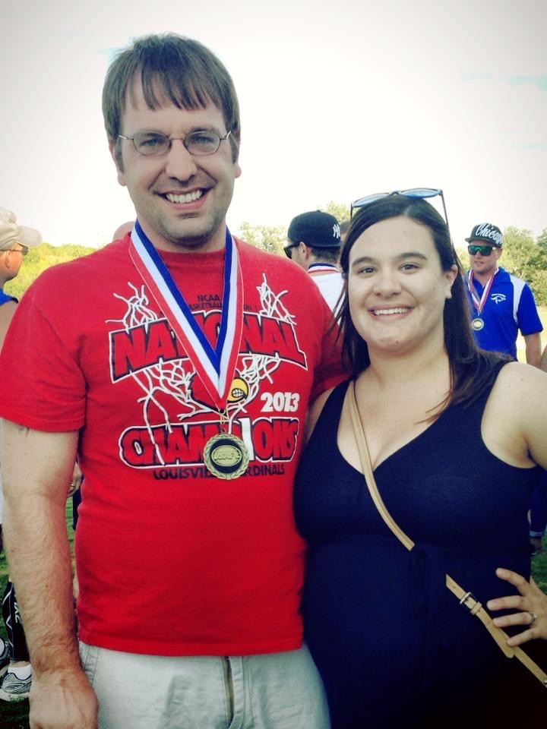
How did I learn about footy?
-Played for Louisville kings
-Won two Division IV national champtionships
This is
a chart

Slide 9
Questions?

Slide 11
TEKsystems Slide Templates

Slide 12
This Headline is Arial Regular in Dark Blue
This Subtitle is Arial in Light Orange
This Bolded portion is Arial in Medium Blue This is a two column content heavy slides.
To blautemped est es enita vit ea sunt pliquidem velitat emporum des apedi dolorrovidus quat accus voluptae eiciam reri doluptaest odis assi dolesse rciminctas dolesec eperumq uuntio que vitaquia sam, nonseque pro qui offictibus aperestrum quos et harcimilia nonsequaero eaquas assiminverum? Optae peribus re, aspici tem velestis velitas ditem rem nonseque pro qui
Tem quiae ni descimus, necte reptiunt at quiam repratur modissimet mil moluptam quos nos magnis sitat.
Ro moluptaqui dolupturio te prae dolorem dolorehenis ab invelli ciisimu sanitia quatiisi siti con consequi tem. Optae peribus re, aspici tem velestis velitas ditem rem

Slide 13

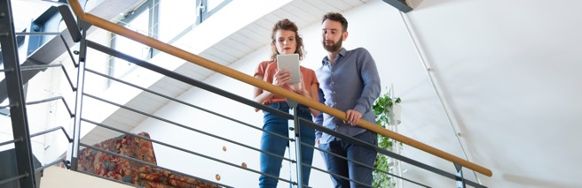
This Headline is Arial Regular in Dark Blue
This Subtitle is Arial in Light Orange
This slide is a two content option with imagery. To create the blue effect, click on the image, select the picture properties and drop the transparency to the desired opacity.
Et alique prorenim ipsa sum etur? Qui consed most aut quia is voloria voluptatio beror sam, sites vollant, teceaque volorep erchil maximolupta sit, quo tem quunt rem quaeres ciiscia tenimo mo verecus, quis ut aliaess

Slide 14

This Headline is Arial Regular in Dark Blue
This Subtitle is Arial in Light Orange
Et alique prorenim ipsa sum etur? Qui consed most aut quia is voloria voluptatio beror sam, sites vollant, teceaque volorep erchil maximolupta sit, quo tem quunt rem quaeres ciiscia tenimo mo verecus, quis ut aliaess
Et alique prorenim ipsa sum etur? Qui consed most aut quia is voloria voluptatio beror sam, sites vollant, teceaque volorep erchil maximolupta sit, quo tem quunt rem quaeres ciiscia tenimo mo verecus, quis ut aliaess
Et alique prorenim ipsa sum etur? Qui consed most aut quia is voloria voluptatio beror sam, sites vollant, teceaque volorep erchil maximolupta sit, quo tem quunt rem quaeres ciiscia tenimo mo verecus, quis ut aliaess
vollant, teceaque volorep erchil maximolupta sit, quo tem quunt rem quaeres ciiscia tenimo mo verecus, quis ut aliaess

Slide 15
This Headline is Arial Regular in Dark Blue
This Subtitle is Arial in Light Orange
TABLE TITLE HERE
Subhead | Subhead | Subhead
Body copy | Body copy | Body copy
Body copy | Body copy | Body copy
Body copy | Body copy | Body copy
Body copy | Body copy | Body copy
Body copy | Body copy | Body copy
Body copy | Body copy | Body copy

