Slide 1

Capstone 2
Presented by: Jeremy Walker
6/9/2022

Slide 2
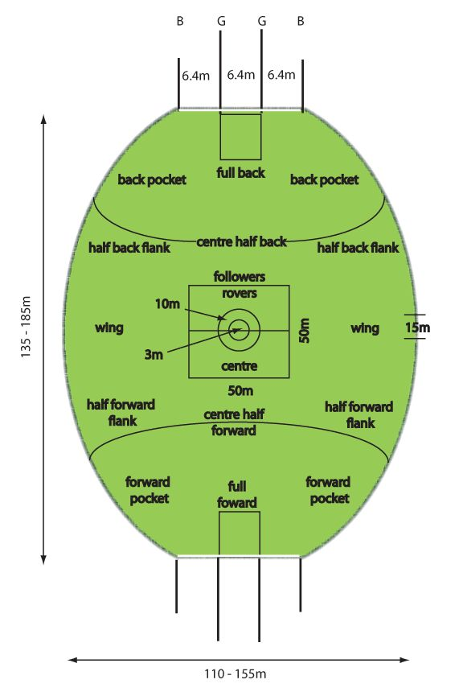
Australian Rules Football
Game Details:
Twenty minute quarters
18 players per team​ on field, 4 subs
Goal = 6 points, Behind = 1​

Slide 3
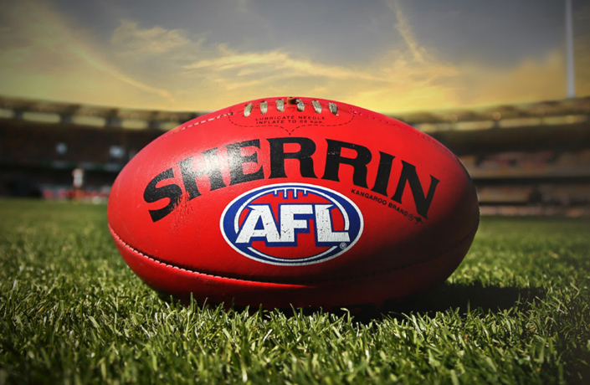
Dataset
https://www.kaggle.com/datasets/stoney71/aflstats
Game data from seasons 2012-2021.
Player statistics from each game over the period.
Basic player information like positions, height and weight.

Slide 4
Additional Power BI features
Imported animated GIF on drilldown menu
Created table with image URLs to dynamically attach logos to player information
Created custom toggle switch/button to alternate map views

Slide 5
Demo

Slide 6
Source Links
Ratings Links
https://www.mediaweek.com.au/demons-collect-the-trophy-afl-grand-final-2021-biggest-tv-show-on-the-year/
https://www.nfl.com/news/super-bowl-lvi-total-viewing-audience-estimated-at-over-208-million
https://www.usnews.com/news/sports/articles/2021-11-02/world-series-seeing-its-highest-tv-viewership-since-2019
Salary Links
https://www.thehoopsgeek.com/average-nba-salary/
https://www.afl.com.au/news/704938/show-them-the-money-who-are-the-the-afls-million-dollar-men
https://www.statista.com/statistics/236213/mean-salaray-of-players-in-majpr-league-baseball/
https://www.statista.com/statistics/236213/mean-salaray-of-players-in-majpr-league-baseball/
Teams Link
https://www.austadiums.com/sport/comp/afl/teams
Ro moluptaqui dolupturio te prae dolorem dolorehenis ab invelli ciisimu sanitia quatiisi siti con consequi tem. Optae peribus re, aspici tem velestis velitas ditem rem

Slide 7
Source Links
Attendance Links
https://www.pro-football-reference.com/years/2019/attendance.htm
https://www.footywire.com/afl/footy/attendances?year=2019&t=A&h=A&s=T
https://www.thescore.com/mlb/news/2341260
https://www.nba.com/news/nba-attendance-even-last-seasons-mark-official-release
Stadium Link
https://en.wikipedia.org/wiki/List_of_Australian_Football_League_grounds
Population Link
https://worldpopulationreview.com/countries/cities/australia

Slide 8

How did I learn about footy?
-Played for Louisville Mings
-Won two Division IV national championships
This is
a chart

Slide 9
Questions?

