Slide 1

Capstone 2
Presented by: Jeremy Walker
6/9/2022

Slide 2
Capstone 1 Instructions
Student guide for planning your presentation
Suggested order of components to demo:
Web App UI – Data Entry Functionality​
Sales Dashboard, and Analysis Findings​
Back end – Database Design​
Focal points should be: ​
Design choices & justifications​
Value to the customer
Slides & flow
Title Slide
One slide with the name of your solution, a few screenshots, and your picture
Use this slide to very briefly introduce your app, providing a summary of how it works.
[Live Demo]
Appendix
Any supporting materials such as diagrams, that you may refer to during Q&A

Slide 3
Instructions
How to use this template
There are many layout options you can use for each of your slides
Slides 5-13 are layout templates. They state the font colors and styles to use.
Suggest copying and pasting the slide you want and then modifying
Slide 14 is a divider if you wanted to have sections to your presentation
After you are done creating your presentation, delete any unused slides

Slide 4
TEKsystems Slide Templates

Slide 5
Demo

Slide 6
This Headline is Arial Regular in Dark Blue
This Subtitle is Arial in Light Orange
This Bolded portion is Arial in Medium Blue This is a single column content heavy slides.
To blautemped est es enita vit ea sunt pliquidem velitat emporum des apedi dolorrovidus quat accus voluptae eiciam reri doluptaest odis assi dolesse rciminctas dolesec eperumq uuntio que vitaquia sam, nonseque pro qui offictibus aperestrum quos et harcimilia nonsequaero eaquas assiminverum? Optae peribus re, aspici tem velestis velitas ditem rem nonseque pro qui
Tem quiae ni descimus, necte reptiunt at quiam repratur modissimet mil moluptam quos nos magnis sitat.
Ro moluptaqui dolupturio te prae dolorem dolorehenis ab invelli ciisimu sanitia quatiisi siti con consequi tem. Optae peribus re, aspici tem velestis velitas ditem rem

Slide 7
This Headline is Arial Regular in Dark Blue
This Subtitle is Arial in Light Orange
Et alique prorenim ipsa sum etur? Qui consed most aut quia is voloria voluptatio beror sam, sites vollant, teceaque volorep erchil maximolupta sit, quo tem quunt rem quaeres ciiscia tenimo mo verecus, quis ut aliaess
Et alique prorenim ipsa sum etur? Qui consed most aut quia is voloria voluptatio beror sam, sites vollant, teceaque volorep erchil maximolupta sit, quo tem quunt rem quaeres ciiscia tenimo mo verecus, quis ut aliaess
Et alique prorenim ipsa sum etur? Qui consed most aut quia is voloria voluptatio beror sam, sites vollant, teceaque volorep erchil maximolupta sit, quo tem quunt rem quaeres ciiscia tenimo mo verecus, quis ut aliaess
Et alique prorenim ipsa sum etur? Qui consed most aut quia is voloria voluptatio beror sam, sites vollant, teceaque volorep erchil maximolupta sit, quo tem quunt rem quaeres ciiscia tenimo mo verecus, quis ut aliaess
Et alique prorenim ipsa sum etur? Qui consed most aut quia is voloria voluptatio beror sam, sites vollant, teceaque volorep erchil maximolupta sit, quo tem quunt rem quaeres ciiscia tenimo mo verecus, quis ut aliaess
Et alique prorenim ipsa sum etur? Qui consed most aut quia is voloria voluptatio beror sam, sites vollant, teceaque volorep erchil maximolupta sit, quo tem quunt rem quaeres ciiscia tenimo mo verecus, quis ut aliaess

Slide 8
This Headline is Arial Regular in Dark Blue
This Subtitle is Arial in Light Orange
This Bolded portion is Arial in Medium Blue This is a two column content heavy slides.
To blautemped est es enita vit ea sunt pliquidem velitat emporum des apedi dolorrovidus quat accus voluptae eiciam reri doluptaest odis assi dolesse rciminctas dolesec eperumq uuntio que vitaquia sam, nonseque pro qui offictibus aperestrum quos et harcimilia nonsequaero eaquas assiminverum? Optae peribus re, aspici tem velestis velitas ditem rem nonseque pro qui
Tem quiae ni descimus, necte reptiunt at quiam repratur modissimet mil moluptam quos nos magnis sitat.
Ro moluptaqui dolupturio te prae dolorem dolorehenis ab invelli ciisimu sanitia quatiisi siti con consequi tem. Optae peribus re, aspici tem velestis velitas ditem rem

Slide 9
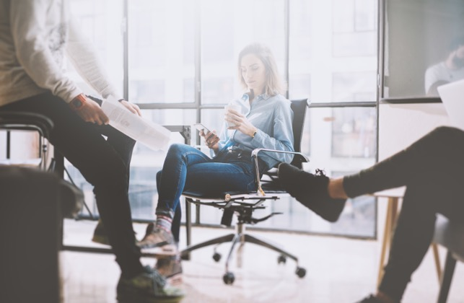
This Headline is Arial Regular in Dark Blue
This Subtitle is Arial in Light Orange

Slide 10

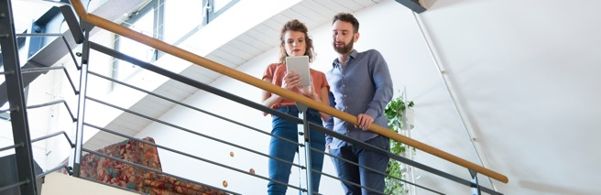
This Headline is Arial Regular in Dark Blue
This Subtitle is Arial in Light Orange
This slide is a two content option with imagery. To create the blue effect, click on the image, select the picture properties and drop the transparency to the desired opacity.
Et alique prorenim ipsa sum etur? Qui consed most aut quia is voloria voluptatio beror sam, sites vollant, teceaque volorep erchil maximolupta sit, quo tem quunt rem quaeres ciiscia tenimo mo verecus, quis ut aliaess

Slide 11

This Headline is Arial Regular in Dark Blue
This Subtitle is Arial in Light Orange
Et alique prorenim ipsa sum etur? Qui consed most aut quia is voloria voluptatio beror sam, sites vollant, teceaque volorep erchil maximolupta sit, quo tem quunt rem quaeres ciiscia tenimo mo verecus, quis ut aliaess
Et alique prorenim ipsa sum etur? Qui consed most aut quia is voloria voluptatio beror sam, sites vollant, teceaque volorep erchil maximolupta sit, quo tem quunt rem quaeres ciiscia tenimo mo verecus, quis ut aliaess
Et alique prorenim ipsa sum etur? Qui consed most aut quia is voloria voluptatio beror sam, sites vollant, teceaque volorep erchil maximolupta sit, quo tem quunt rem quaeres ciiscia tenimo mo verecus, quis ut aliaess
vollant, teceaque volorep erchil maximolupta sit, quo tem quunt rem quaeres ciiscia tenimo mo verecus, quis ut aliaess

Slide 12
This Headline is Arial Regular in Dark Blue
This Subtitle is Arial in Light Orange
TABLE TITLE HERE
Subhead | Subhead | Subhead
Body copy | Body copy | Body copy
Body copy | Body copy | Body copy
Body copy | Body copy | Body copy
Body copy | Body copy | Body copy
Body copy | Body copy | Body copy
Body copy | Body copy | Body copy

Slide 13
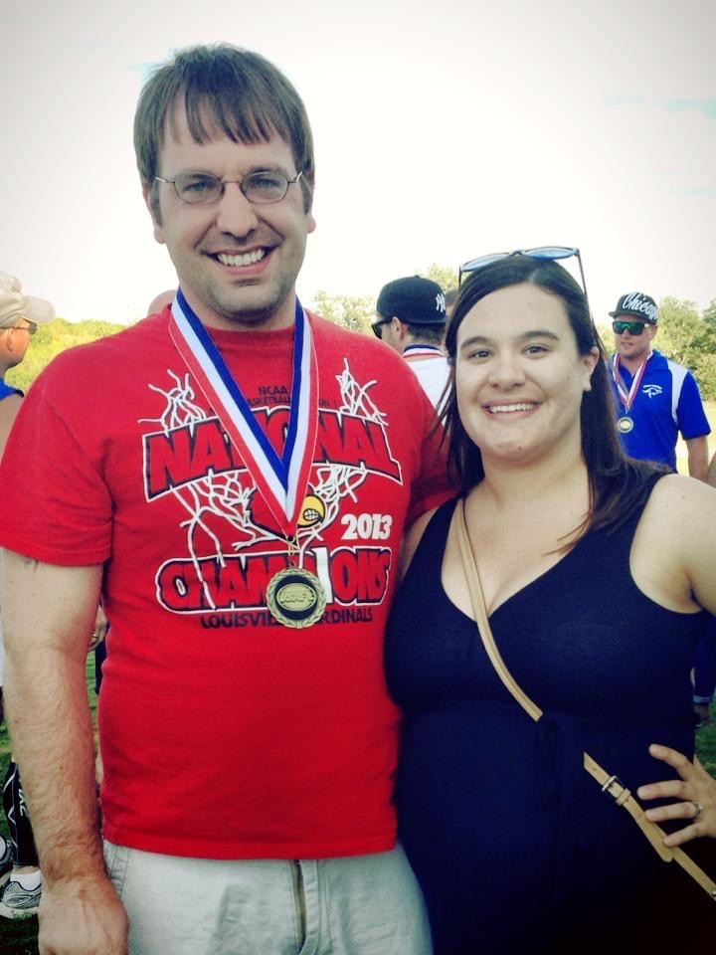
How did I learn about footy?
-Played for Louisville kings
-Won two Division IV national champtionships
This is
a chart

