Slide 1
Engineering Application
Legends
Input
Exam
Packet
Output
Feature/
Functionality
Activity/
Operation
Info
FPGA
Calibration
Software Update
Application Logging
TCD Logging
TCD Power Status
TCD Probes Status
High Level Design Diagram of Engineering Application

Slide 2
Exam Info
Display TCD Probes Status
TCD
TCD Power
Turn On
Turn Off
Spectrogram
M-Mode
Parameters
Power
Depth
Filter
S-Volume
Start Depth
PRF
Read Parameters
Read Parameters
Set Spectrum Bin
128/
256/
512
Legends
Limits
Input
Write
Parameters
On
Off
Output
Parameters
Min, Mean
Max, PI, TIC
Feature/
Functionality
Limits
On
Off
Activity/
Operation

Slide 3
Information Screen
Legends
Input
Board Info
Channel Assignment
TCD
Output
Read
Read
Feature/
Functionality
Write
Write
Activity/
Operation
Probe Info
Operating Info
Read
Read
Write

Slide 4
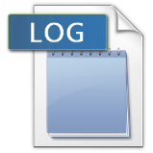
Legends
Application Logging
Input
Output
Application Activities
Write to
file
Feature/
Functionality
Activity/
Operation
Write to UI
Application Log
Application Log
Display
TCD
TCD Logging
TCD Activities
Write to
file
TCD Log
Write to UI
TCD Log
Display

Slide 5

Legends
Input
Output
Software Update
Feature/
Functionality
Activity/
Operation
Software Version
Boot Version
Hardware Version
Read Current Version Info
TCD
Write
Software Update
Read
Update File

Slide 6

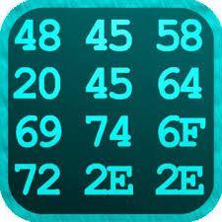
Legends
Display Packet Information
Input
Output
Refresh Interval
OnRefresh
TCD
Feature/
Functionality
Read Request
Activity/
Operation
Update Refresh Interval
Envelop Tree
Update Envelope Tree
Envelope Data
Select Tree
Node
Update Hex View
Hex View

