Slide 1
Capstone Project From Data to Decisions
Author: John Willcox
Date: October 2021

Slide 2
Table OF CONTENTS
Background and Assumptions
Estimated Demand
Design and Prototyping Costs
Specification and Regulatory Approval
Technical Solution
Findings
Considerations
Recommendations
References

Slide 3
Background and Assumptions
On 16 March 2020 the UK government launched “the ventilator challenge”, asking manufacturers and medical device specialists in the UK to be part of the effort to procure up to an additional 22,000 ventilators for use in the NHS within weeks
This project represents a fictional car manufacturer’s response to the ventilator challenge
The simulated date for creation of this proposal is 18 March 2020

Slide 4
Estimated Demand
The following two slides give some indication of demand
Figure 1 indicates the number of cases and deaths due to Covid-19 in the UK has spiked rapidly and is expected to grow exponentially in the short-term
Figure 2 shows the worst-case estimate of Covid-19 mechanical ventilation bed demand (for England only) produced by NHS England and NHS Improvement
The data indicates demand for mechanical ventilators in the England may surpass existing supply in 2-3 weeks’ time, perhaps by as much as 7,000 ventilators

Slide 5
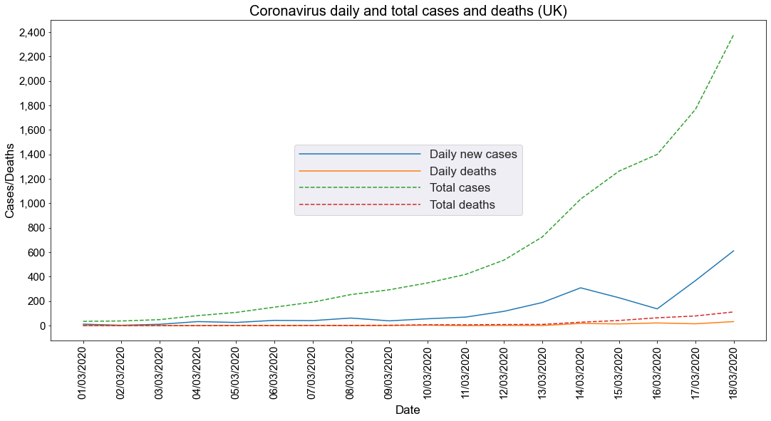
Data as of 18 March 2020 [5]

Slide 6
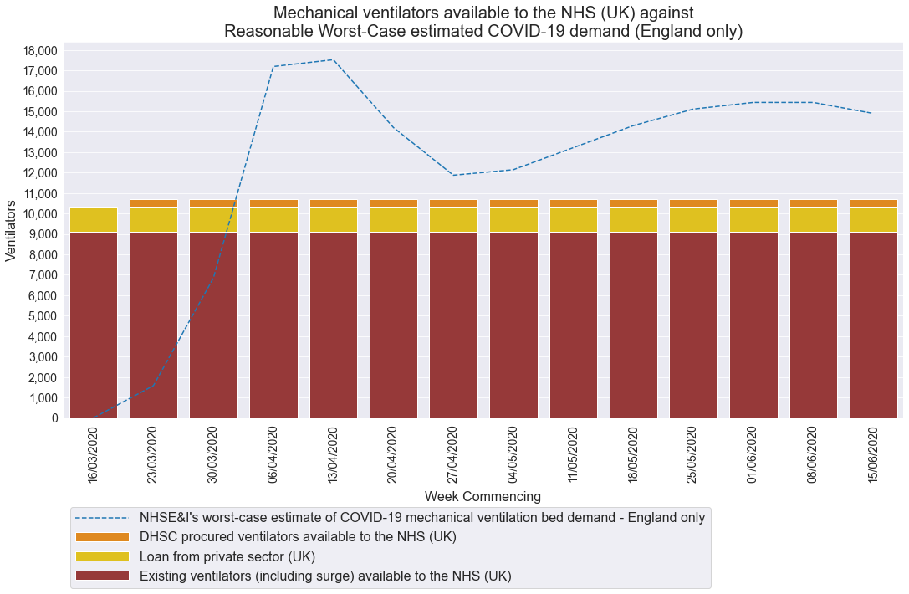
Data as of 18 March 2020 (data after this date is estimated) [3]

Slide 7
Design and Prototyping Costs
The UK government will provide financial assistance to companies competing in the UK ventilator challenge [3]
Design and prototyping costs will be met and assistance for the cost of components and factory capacity will also be provided subject to conditions

Slide 8
Specification and Regulatory Approval
The UK government has provided comprehensive specifications for rapidly manufactured ventilator systems – see [1]
It is anticipated that regulatory approval by the Medicines & Healthcare products Regulatory Agency (MHRA) will be expedited via Exceptional use of non-UKCA marked medical devices [2]

Slide 9
Technical Solution
We opted to use a Linear programming model* to solve the problem, implemented in Python with the following parameters:
Decision variables:
Type X – number of type X ventilators to produce per week
Type Y – number of type Y ventilators to produce per week
Objective function:
Maximise profit ($): 25 * type X + 30 * type Y
Constraints:
Type X and Type Y are non-negative integers
People: type X <= 6,000
People: type Y <= 4,000
Machinery: 1/200 * type X + 1/140 * type Y <= 40

Slide 10
Findings
Figure 3 provides a visual indication of the optimal solution
It is feasible to produce ventilators of both types and sell them
Given the defined constraints, the optimal solution is to produce 6,000 ventilators of type X and 1,400 ventilators of type Y each week
This would give a profit of $192,000 per week
This solution uses all machine resources, 100% capacity of type X specialists but uses only 35% capacity of type Y specialists

Slide 11
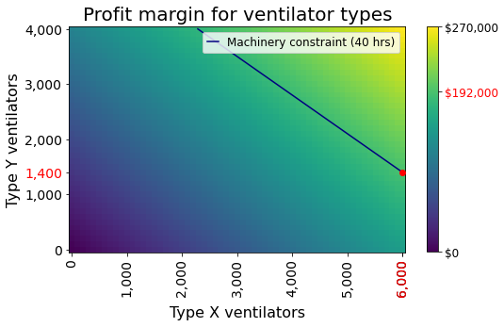

Slide 12
Findings (continued)
The optimal solution uses all machine resources and all available capacity for type X specialists but leaves us with considerable spare capacity for type Y specialists
We should investigate the potential for allocating more machine resource; each additional hour of machine resource we can utilise, up to 58.6 hours, will allow us to manufacture 140 more type Y ventilators, up to a maximum of 6,000 type X ventilators and 4,000 type Y ventilators, filling the constraints on specialists’ capacity and giving a maximum profit of $270,000
Hiring additional type X specialists (and additional type Y specialists if machine resources can be increased as above) would also increase maximum profit

Slide 13
Considerations
The two selected designs are simple and initial prototypes have been made using existing factory resources; however there are risks associated with scaling up manufacture of entirely new product lines:
defects may be introduced
although the process of regulatory approval will be expedited, it is still a significant obstacle to overcome before units can be sold
future demand for mechanical ventilators in the UK is uncertain; our research suggests there is likely to be a deficit in supply in England within the next few weeks; but it is difficult to predict demand several months from now and there is a risk of overproduction
other companies with similar manufacturing capability may compete to fill the supply deficit
supply chains may be disrupted by the spread of Covid-19
Adding additional machinery resource may be difficult due to disruption of supply chains
Hiring additional specialist personnel will be difficult because of the current, high, global demand for people with these skills
The country is in crisis; there is a moral duty for the company to help; secondary to this, there is an opportunity for the company to enhance our public standing with a “good news story”

Slide 14
Recommendations
We recommend:
the company moves to begin manufacture of BOTH types of ventilator immediately in the proportions described on the Findings slide
the company commences discussion with MHRA regarding expediting regulatory approval for the existing designs of type X and type Y ventilators
the company investigates the feasibility of increasing available machinery resource; however due to the unknown factors such as supply chain disruption and the future spread of Covid-19 and consequent demand for mechanical ventilators, we recommend the company wait for more data before committing to such an increase
the company contacts other companies with similar manufacturing capability to see whether there is scope for a consortium to spread risk and increase the probability of a better outcome for patients
the company contacts the Medical Device Coordination Group (MDCG) regarding ventilator demand and regulatory approval processes in the EU with the aim of expanding the available market (see [8])

Slide 15
References
[1] Medicines & Healthcare products Regulatory Agency (2020). Specification for Rapidly Manufactured Ventilator System (RMVS). Retrieved 15 October 2021 from https://www.gov.uk/government/publications/specification-for-ventilators-to-be-used-in-uk-hospitals-during-the-coronavirus-covid-19-outbreak/rapidly-manufactured-ventilator-system-rmvs
[2] Medicines & Healthcare products Regulatory Agency (2020). Exceptional use of non-UKCA marked medical devices. Retrieved 15 October 2021 from https://www.gov.uk/guidance/exceptional-use-of-non-ukca-marked-medical-devices
[3] Cabinet Office and Department of Health & Social Care (2020). Investigation into how government increased the number of ventilators available to the NHS in response to COVID-19. Retrieved 15 October 2021 from https://www.nao.org.uk/wp-content/uploads/2020/09/Investigation-into-how-the-Government-increased-the-number-of-ventilators.pdf
[4] Medicines & Healthcare products Regulatory Agency (2020). Regulating medical devices in the UK. Retrieved 15 October 2021 from https://www.gov.uk/guidance/regulating-medical-devices-in-the-uk
[5] Our World in Data (2021). Coronavirus (COVID-19) Hospitalizations. Retrieved 15 October 2021 from https://ourworldindata.org/covid-hospitalizations
[6] Worldometer (2021). Coronavirus. Retrieved 15 October 2021 from https://www.worldometers.info/coronavirus/country/uk/
[7] VentilatorChallengeUK Consortium (2020). Ventilator Challenge UK. Retrieved 15 October 2021 from https://www.ventilatorchallengeuk.com/
[8] Medical Device Coordination Group (2020). Regulatory Requirements for Ventilators and Related Accessories. Retrieved 15 October 2021 from https://ec.europa.eu/health/sites/default/files/md_sector/docs/md_mdcg_2020-9_regulatory_requirements_ventilators_en.pdf

