Slide 1
Village Water Pump Reliability: A Predictive Maintenance Case Study
John Woodward, Kaggle Dataset Predictive Analytics

Slide 2
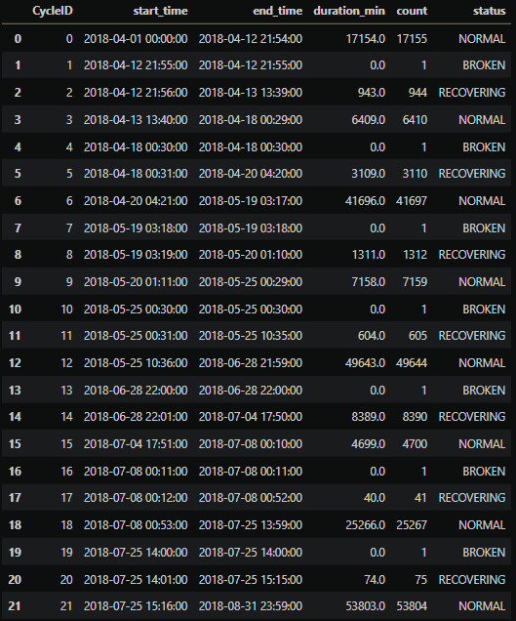
Water Pump Stats (Aggregated)
Records 7 cycles each:
Normal to Broken – “working”
Broken to Recovering – “1-minute status”
Recovering to Normal – “inoperable”

Slide 3
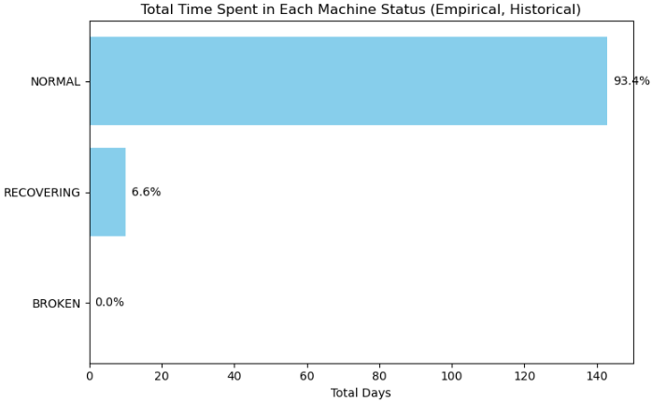
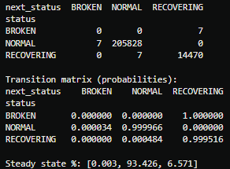
Water Pump Stats (Continued)
Machine Status Cycles
Normal
Broken
Recovering
Reliability
In Minutes
In Probability

Slide 4
Observations as former Industrial Engineer
Long-term, the water pump is expected to operate in NORMAL machine status ~93% of the time, and 7% of the time it is in RECOVERING status.
93% availability is not bad for high-volume manufacturing equipment, but for a small village relying on a single pump, it can have serious consequences.
Traditionally, adding a 2nd village water pump mitigates downtime risk when the primary fails; in a critical supply setting, where significant downtime can cost lives, relying on just one machine is not only risky, it’s a fundamental system design flaw.
Assuming adding a backup is infeasible, then predictively maintaining this becomes all-the-more critical to ensure a reliable water supply.

Slide 5


What is the Problem: Anomaly Detection?
Let’s imagine a sensor value jumping ±100% of its usual.
On the surface, that looks like an anomaly.
Anomaly detection, in isolation, might flag it:
“Please observe this anomalous value.”
Sounds useful, right?
But in reality, most anomalies like this don’t correlate with actual pump status changes.
They could just be sensor hiccups or other benign problems (e.g., unusually hot or cold day).
Triggering alerts for these “false positives”:
Wastes time
Erodes trust
Leads to alert fatigue
Eventually, users stop paying attention and mock it as the “boy (monitoring system) who cried wolf (anomaly).”
The real problem:
We don’t just want to detect anomalies
We want to know: “will the pump status change imminently?”
The solution methodology:
Classifying pump status changes:
1 = Change Expected within next week
0 = No Change Expected
Normal
Recovering

Slide 6
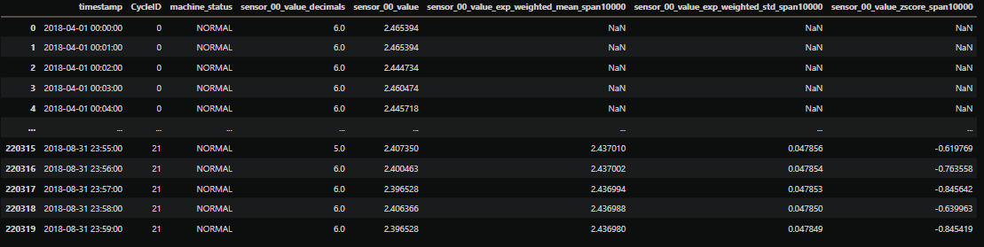
Classifying `machine_status` Changes: Sample of Features
“sensor_00” is 1 out of 52 (one sensor was missing data)
Unlabeled sensors, therefore unknown
Values provided per sensor
+ Per sensor: added decimal places, mean, standard deviation, z-score
By
Minute,
4-Months in 2018

Slide 7
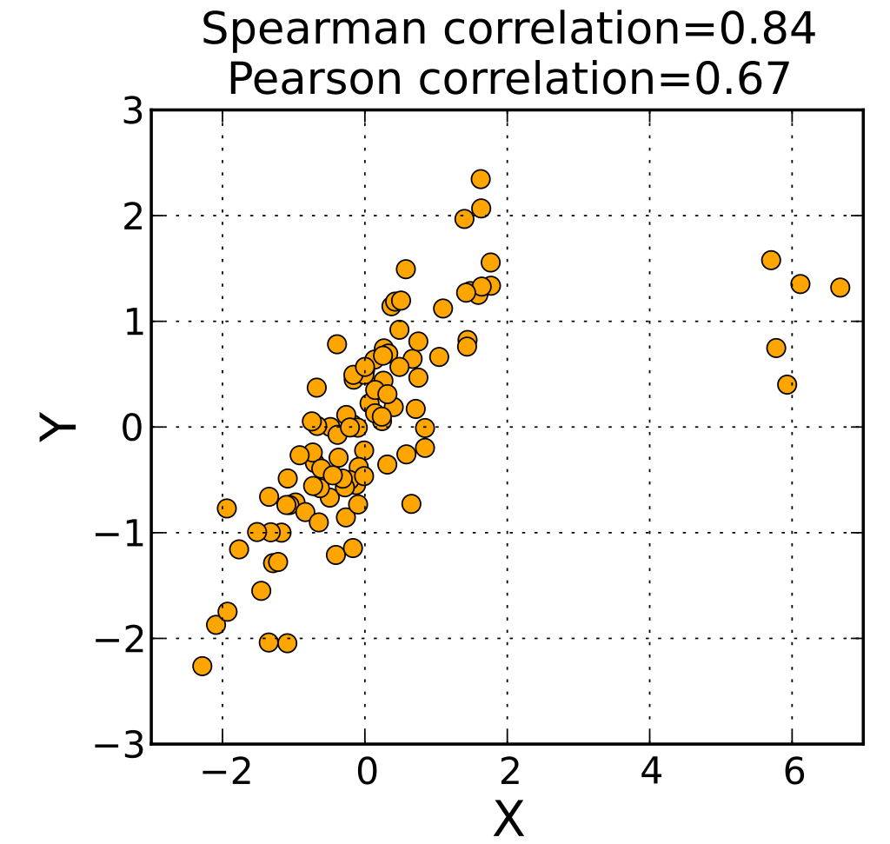
Classifying Pump Status Changes: Capturing Sensor Relationships
Domain-knowledge: “Machines have correlated sensors” let’s exploit this:
Apply graph-learning on status predictions
Pivoted. TREE-G, a novel, graph-learning gradient-boosting decision tree struggling with scaling up (unable to fit 200K rows even after days or runtime).
Apply graph-informed features
Clustering based on Spearman Correlation (>= 60%) on sensor values specifically.
Spearman correlation is great with non-linear, non-normal, and spurious outliers

Slide 8
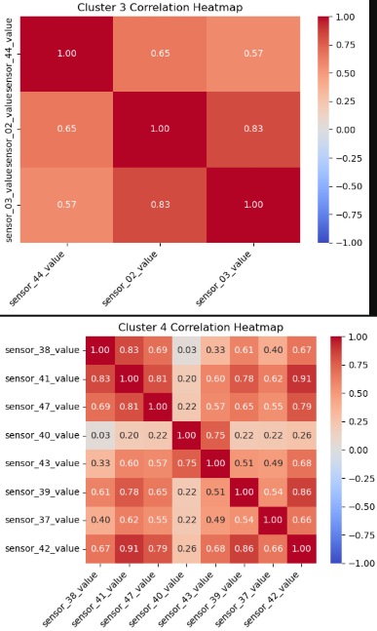
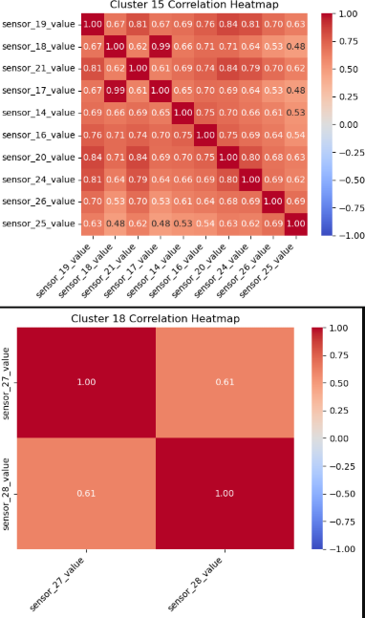
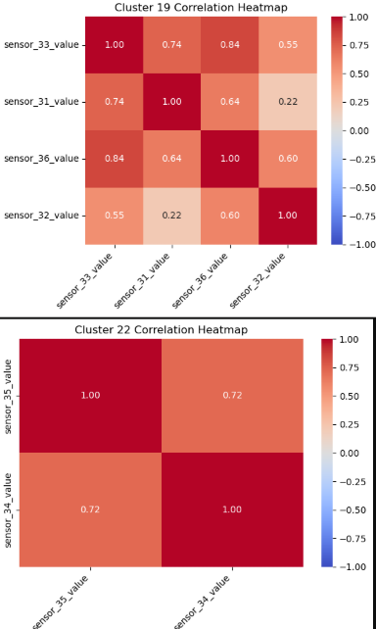
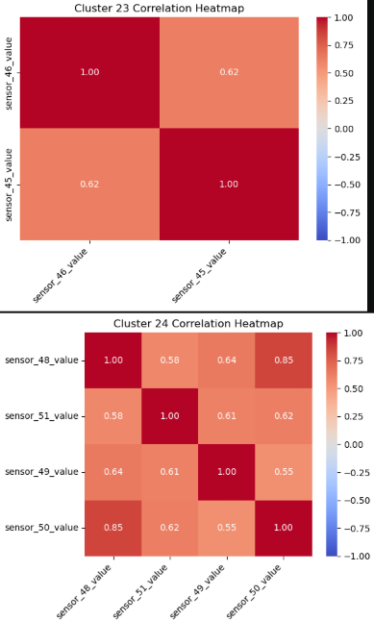
Correlations Among Sensor Values

Slide 9
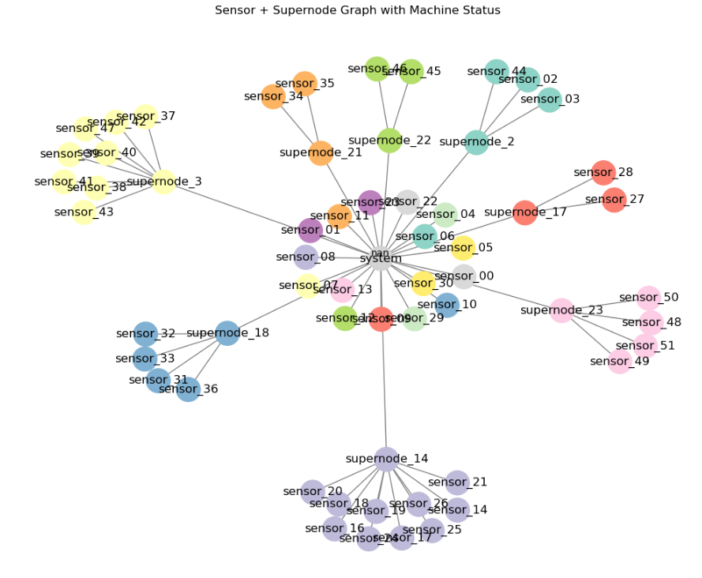
Graph of Machine Sensors + 8 Supernodes (Clusters of 2+ Correlated Sensors)
Supernodes aggregate 2+ nodes by:
mean
standard deviation

Slide 10
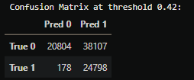
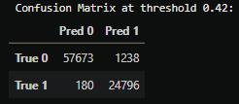
Classifying “State Change Soon” (Matthews Correlation Coefficient, MCC – 100% = Perfect, 0% = Random)
Data split: Train / Test / Holdout
No k-fold cross-validation (time-series data)
Feature selection: Recursive Feature Elimination (336 → 40)
High-depth CatBoost decision trees (16) + feature importance
Random “noise” variable (random integer of 0 or 1) added to differentiate signal vs. noise, removing features below
Repeated until only high-signal features remained
Tuned + Evaluated ML models on Train/Test (MCC average of three different seeds if stochastic*)
Logistic Regression
Support Vector Machines (SVM)
CatBoost*
Random Forest*
Ensemble of best ML models (VotingClassifier)
Selected + Applied best model to Test/Holdout (Holdout set was all one class, so combined with Test)
Despite predictive model (out-of-sample MCC of 37%), still experienced high false positive rate:
To avoid the “boy who cried wolf” issue; applied a moving average on predicted probabilities (window of last 11 days) and a classifying threshold (42%) based on tuning, and the model predictive value skyrocketed (out-of-sample MCC of 96%).
Rationale: Events are autoregressive → stacking predictions over time avoids false positives and boosts signal

Slide 11
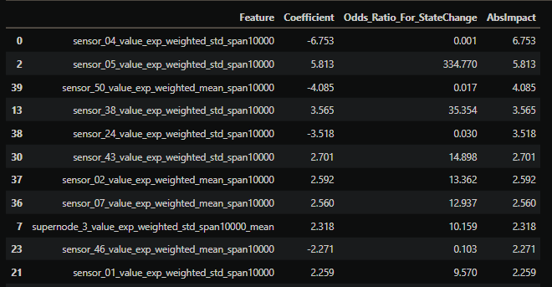
Interpretation of Final Model (Logistic Regression)
Observing these sensors is of most importance (absolute, descending):
`sensor_04_value_exp_weighted_std_span10000`:
For every standardized increase in the value, the risk for a state change soon is multiplied by 0.001.
Increases reduce change risk, stabilizing.
`sensor_05_value_exp_weighted_std_span10000`:
For every standardized increase in the value, the risk for a state change soon is multiplied by 335.
Increases multiply change risk, destabilizing.
And so on for the remaining features (40 total).
Note:
This applies to the original prediction probability, which is then absorbed in a time-window aggregation classifier
forming an autoregressive, temporal smoothing that improves the MCC significantly (up to 96% on test+holdout MCC).

Slide 12
Key Insights & Proof-of-Concept
Graph-based feature engineering:
Built a graph of sensors using Spearman correlations
Created supernode features capturing multi-sensor interactions
These features survived recursive feature elimination, highlighting persistent high-signal predictors
Models explored (repeating some thrice for reducing variance*):
Logistic Regression, SVM, CatBoost*, Random Forest*; Ensemble (VotingClassifier) tested, but not main driver
Feature-level understanding:
Some sensors stabilize risk (sensor_04…), others amplify risk (sensor_05…)
Most important features were created using exponentially weighted moving averages (EWMA)
Varying spans (e.g., 1,000 & 10,000 minutes) may produce different predictive patterns
Surprising insight: imputed median values on EWMA (early NaNs) worked well; Logistic Regression outperformed tree-based methods
False positives & temporal smoothing:
Surprising improvement: 11-day moving average of predicted probabilities transformed MCC from 34% → 96%
Dramatically reduced significant false positives → avoided the “boy who cried wolf” problem
Proof-of-concept outcome:
Demonstrates a promising predictive maintenance methodology
Can inform engineering a real-time alert system

