Slide 1

_example:
push rbp
mov rbp, rsp
test edi, edi
je LBB0_1
mov eax, edi
add eax, -1
lea ecx, [rdi + 2*rdi]
add ecx, 4
imul ecx, eax
lea eax, [rdi + 2*rdi]
add eax, ecx
add eax, 4
pop rbp
ret
LBB0_1:
xor eax, eax
pop rbp
ret
1 int example(int n) {
2 int x = n * 2;
3 int y = 0;
4 for (unsigned int i = 0; i < n; i++) {
5 y += x + 4 + n;
6 }
7 return y;
8 }
Clang 13 (O1)
Notes:
Emphasise that debug info is not shown here

Slide 2
_example:
push rbp
mov rbp, rsp
test edi, edi
je LBB0_1
mov eax, edi
add eax, -1
lea ecx, [rdi + 2*rdi]
add ecx, 4
imul ecx, eax
lea eax, [rdi + 2*rdi]
add eax, ecx
add eax, 4
pop rbp
ret
LBB0_1:
xor eax, eax
pop rbp
ret
1 int example(int n) {
2 int x = n * 2;
3 int y = 0;
4 for (unsigned int i = 0; i < n; i++) {
5 y += x + 4 + n;
6 }
7 return y;
8 }
Clang 13 (O1)
6 / 17 instructions mapped to wrong source lines
Notes:
most of the function happens on line 5, but it turns out almost none of the instructions gets mapped to line 5; we'll see later this is because of a bug

Slide 3
_example:
push rbp
mov rbp, rsp
test edi, edi
je LBB0_1
mov eax, edi
add eax, -1
lea ecx, [rdi + 2*rdi]
add ecx, 4
imul ecx, eax
lea eax, [rdi + 2*rdi]
add eax, ecx
add eax, 4
pop rbp
ret
LBB0_1:
xor eax, eax
pop rbp
ret
1 int example(int n) {
2 int x = n * 2;
3 int y = 0;
4 for (unsigned int i = 0; i < n; i++) {
5 y += x + 4 + n;
6 }
7 return y;
8 }
Clang 13 (O1)
6 / 17 instructions mapped to wrong source lines
Variable y not available for 4 / 17 instructions

Slide 4
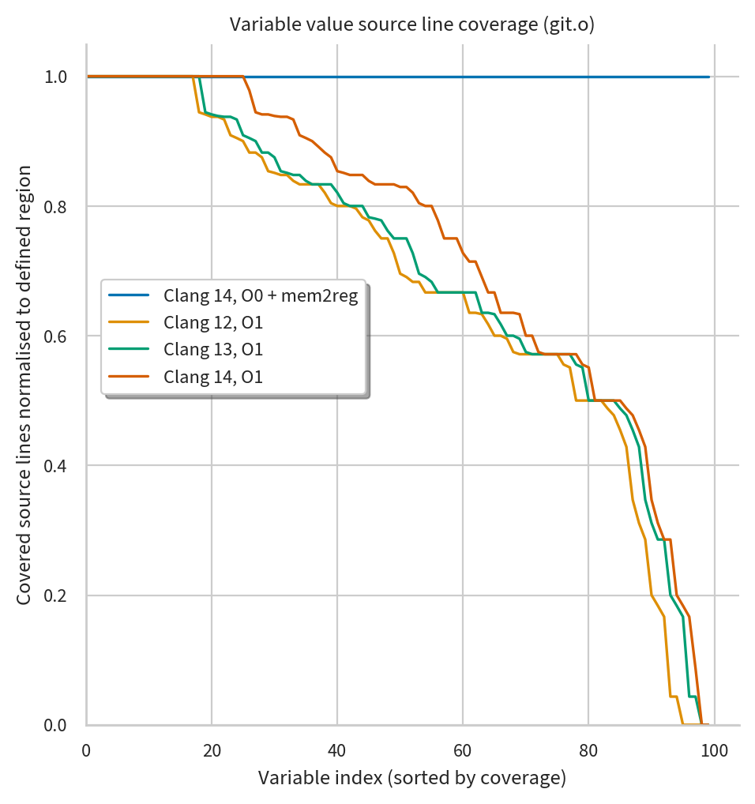
Debug info value coverage
Will talk about coverage metrics in more detail later in the talk…
In programs optimised by common compilers, most variables are missing values for at least 1 line where they are defined
Some variables are entirely inaccessible

Slide 5

Debug info consistency check
.bc
l3: y = 0
l5: y = x + 4 + n
Enables strong consistency check
For each variable separately, we ensure it goes the same source-level assignment events at the same source locations in both program versions
Sym. source values (O0)
Extract features (O0)
e.g. source assignments
Clang (O0)
LLVM IR (O0)
.c
Best avail. oracle is unoptimised program
Checking consistency between O0 and O1
🔎
Compare
🔎
Compare
Source code
.bc
l3: y = 0
l5: y = x + 4 + n
Clang (O1)
LLVM IR (O1)
Sym. source values (O1)
Extract features (O1)
e.g. source assignments
Consistency check
each function independently
Notes:
Be sure to talk through using features invariant under optimisation, no slide after this that covers it

Slide 6
Disabling optimisation is not always an option
Real scenarios for optimised debugging
  Core dumps collected in production
  Resource heavy programs (e.g. video games) which are too slow without optimisation
  Programs whose behavior depends on optimisation (e.g. Linux kernel)
  Tracing unwanted behaviours (e.g. race conditions, memory errors) which may only occur with optimisation
  Any program … if you want to debug what actually ran!
Poor developer experience has trained many programmers to assume optimised debugging is somehow insurmountable
  Some may avoid using debuggers entirely
  In some cases, you can rebuild without optimisation and try debugging again…

Slide 7
Lost in the pipes
Optimisations today often corrupt or drop debug info
Testing debug info is often manual, has poor coverage
  SN Systems, LLVM contributors. Dexter. 2019.
Recent work brings some automation, but checks values with heuristics
  Li et al. Debug information validation for optimized code. PLDI 2020.
  Di Luna et al. Who’s debugging the debuggers? Exposing debug information bugs in optimized binaries. ASPLOS 2021.
  Assaiante et al. Where did my variable go? Poking holes in incomplete debug information. ASPLOS 2023.
Stronger testing would help spot more debug info handling bugs
  Should lead to more reliable debugger experience overall
Notes:
With Dexter, don’t say “covering paths”, but instead “covering much of the compiler”

Slide 8
Approach

Slide 9
Debug info consistency check
.c
Source code

Slide 10
the binary we want to check
the moral
authority
.bc
Clang
(-g -O1)
LLVM IR
(-g -O1)
.c
Source code
.bc
a convenient proxy
Clang
(-g -O0)
LLVM IR
(-g -O0)

Slide 11
1 int f(int *data, void *arg)
2 {
3 int i = 0, tmp, out1 = 0, out2 = 0;
4
5 i = tmp = get_start(arg);
6 for (; i < MAX; ++i)
7 {
8 out1 ^= data[i];
9 }
10
11 for (i = tmp; i < MAX; ++i)
12 {
13 out2 &= data[i];
14 }
15 g(out1, out2);
16 return tmp;
17}

Slide 12
1 int f(int *data, void *arg)
2 {
3 int i = 0, tmp, out1 = 0, out2 = 0;
4
5 i = tmp = get_start(arg);
6 for (; i < MAX; ++i)
7 {
8 out1 ^= data[i];
9 }
10
11 for (i = tmp; i < MAX; ++i)
12 {
13 out2 &= data[i];
14 }
15 g(out1, out2);
16 return tmp;
17}

Slide 13
1 int f(int *data, void *arg)
2 {
3 int i = 0, tmp, out1 = 0, out2 = 0;
4
5 i = tmp = get_start(arg); int *p = &data[tmp];
6 for (; i < MAXp < &data[MAX]; ++ip)
7 {
8 out1 ^= data[i]*p;
9 }
10
11 for (i = tmpp = &data[tmp]; i < MAX
12 p<&data[MAX]; ++ip) {
13 out2 &= data[i]*p;
14 }
15 g(out1, out2);
16 return tmp;
17}

Slide 14
1 int f(int *data, void *arg)
2 {
3 int i = 0, tmp, out1 = 0, out2 = 0;
4
5 i = tmp = get_start(arg); int *p = &data[tmp];
6 for (; i < MAXp < &data[MAX]; ++ip)
7 {
8 out1 ^= data[i]*p;
13 out2 &= data[i]*p;
9 }
11 for (i = tmp; i < MAX; ++i)
12 {
13 out2 &= data[i];
14 }
15 g(out1, out2);
16 return tmp;
17}

Slide 15
data: in r1 at all points
arg: in r2 at all points
i: in r3 from 3
tmp: in r4 from 5
out1: in r5 from 3
out2: in r6 from 3
1 int f(int *data, void *arg)
2 {
3 int i = 0, tmp, out1 = 0, out2 = 0;
4
5 i = tmp = get_start(arg);
6 for (; i < MAX; ++i)
7 {
8 out1 ^= data[i];
9 }
10
11 for (i = tmp; i < MAX; ++i)
12 {
13 out2 &= data[i];
14 }
15 g(out1, out2);
16 return tmp;
17}

Slide 16
data: in r1 at all points
arg: in r2 at all points
i: value 0 from 3 to 5
in r3 from 5
tmp: in r4 from 5
out1: in r5 from 3
out2: in r6 from 3
1 int f(int *data, void *arg)
2 {
3 int i = 0, tmp, out1 = 0, out2 = 0;
4
5 i = tmp = get_start(arg);
6 for (; i < MAX; ++i)
7 {
8 out1 ^= data[i];
9 }
10
11 for (i = tmp; i < MAX; ++i)
12 {
13 out2 &= data[i];
14 }
15 g(out1, out2);
16 return tmp;
17}

Slide 17
data: in r1 at all points
arg: in r2 at all points
i: value 0 from 3 to 5
value (r7-r1)/4
from 5
tmp: in r4 from 5
out1: in r5 from 3
out2: in r6 from 3
1 int f(int *data, void *arg)
2 {
3 int i = 0, tmp, out1 = 0, out2 = 0;
4
5 i = tmp = get_start(arg); int *p = &data[tmp];
6 for (; i < MAXp < &data[MAX]; ++ip)
7 {
8 out1 ^= data[i]*p;
9 }
10
11 for (i = tmpp = &data[tmp]; i < MAX
12 p<&data[MAX]; ++ip) {
13 out2 &= data[i]*p;
14 }
15 g(out1, out2);
16 return tmp;
17}

Slide 18
data: in r1 at all points
arg: in r2 at all points
i: value 0 from 3 to 5
value (r7-r1)/4
from 5
tmp: in r4 from 5
out1: in r5 from 3
out2: in r6 from 3
1 int f(int *data, void *arg)
2 {
3 int i = 0, tmp, out1 = 0, out2 = 0;
4
5 i = tmp = get_start(arg); int *p = &data[tmp];
6 for (; i < MAXp < &data[MAX]; ++ip)
7 {
8 out1 ^= data[i]*p;
13 out2 &= data[i]*p;
9 }
11 for (i = tmp; i < MAX; ++i)
12 {
13 out2 &= data[i];
14 }
15 g(out1, out2);
16 return tmp;
17}

Slide 19
Some difficulties defining correctness:
the object program may maintain different state (not just more state)
- a mapping may exist only ‘up to’ how state is observed
the object program may maintain less state
- state can be dropped if ‘not subsequently observed’
the object program does not simulate the source program!
- operations with no ‘observable’ effect can be deleted
- operations can be reordered, if the change is not ‘observable’
What notion of ‘observability’?
- program input/output (sequential semantics)
- memory model (concurrent semantics)
- separate compilation contract incl. ABI
- NOT debugging! yet debugging ‘observes’ execution

Slide 20
Suppose MAX is 5 and get_start returns 2. Over such a program path, what does i do?
1 int f(int *data, void *arg)
2 {
3 int i = 0, tmp, out1 = 0, out2 = 0;
4
5 i = tmp = get_start(arg);
6 for (; i < MAX; ++i)
7 {
8 out1 ^= data[i];
9 }
10
11 for (i = tmp; i < MAX; ++i)
12 {
13 out2 &= data[i];
14 }
15 g(out1, out2);
16 return tmp;
17}
0
2
3
4
5
2
3
4
5

Slide 21
Suppose MAX is 5 and get_start returns 2. What does r3 (holding i from line 5) do?
1 int f(int *data, void *arg)
2 {
3 int i = 0, tmp, out1 = 0, out2 = 0;
4
5 i = tmp = get_start(arg);
6 for (; i < MAX; ++i)
7 {
8 out1 ^= data[i];
9 }
10
11 for (i = tmp; i < MAX; ++i)
12 {
13 out2 &= data[i];
14 }
15 g(out1, out2);
16 return tmp;
17}
2
3
4
5
2
3
4
5

Slide 22
Suppose MAX is 5 and get_start returns 2. What does i do?
1 int f(int *data, void *arg)
2 {
3 int i = 0, tmp, out1 = 0, out2 = 0;
4
5 i = tmp = get_start(arg);
6 for (; i < MAX; ++i)
7 {
8 out1 ^= data[i];
9 }
10
11 for (i = tmp; i < MAX; ++i)
12 {
13 out2 &= data[i];
14 }
15 g(out1, out2);
16 return tmp;
17}
value 0 from 3 to 5
in r1 from 5
0
2
3
4
5
2
3
4
5

Slide 23
Suppose MAX is 5 and get_start returns 2. What does i do?
1 int f(int *data, void *arg)
2 {
3 int i = 0, tmp, out1 = 0, out2 = 0;
4
5 i = tmp = get_start(arg); int *p = &data[tmp];
6 for (; i < MAXp < &data[MAX]; ++ip)
7 {
8 out1 ^= data[i]*p;
9 }
10
11 for (i = tmpp = &data[tmp]; i < MAX
12 p<&data[MAX]; ++ip) {
13 out2 &= data[i]*p;
14 }
15 g(out1, out2);
16 return tmp;
17}
value 0 from 3 to 5
value (r7-r1)/4
from 5
0
2
3
4
5
2
3
4
5

Slide 24
Suppose MAX is 5 and get_start returns 2. What does i do?
1 int f(int *data, void *arg)
2 {
3 int i = 0, tmp, out1 = 0, out2 = 0;
4
5 i = tmp = get_start(arg); int *p = &data[tmp];
6 for (; i < MAXp < &data[MAX]; ++ip)
7 {
8 out1 ^= data[i]*p;
13 out2 &= data[i]*p;
9 }
11 for (i = tmp; i < MAX; ++i)
12 {
13 out2 &= data[i];
14 }
15 g(out1, out2);
16 return tmp;
17}
value 0 from 3 to 5
value (r7-r1)/4
from 5
0
2
3
4
5

Slide 25
Fusing the loops broke our property over i!
Deletion of operations and state (avoid saying “code”) is usually OK
- ... i.e. OK if we can residualise what was deleted
- depends on our debug format!
- in DWARF:
- can augment program state with anything functionally redundant
- can augment control flow with any straight-line spliceable segments
-- move program counter and any local variable through arbitrary ‘virtual state’ sequence that can be computed from the preceding actual state
- can’t augment with state that the object program overwrites/destroys
- can’t augment with both-ways-live branches
Reordering is usually OK.
- our property explicitly accommodates it
- problem: reordering that affects a variable with respect to itself

Slide 26
Fusing the loops broke our property over i!
We’re going to need a relaxation for these cases.
- hypothesis: few enough passes need this that is can be an annotation in the pass itself, passing through to the debug info
Possible relaxations:
- lifetime splitting: “i epoch 1”, “i epoch 2”
... when we fuse the later updates to i in among earlier updates to i,
first rename i (effectively; not a user-visible rename, just checker-visible)
- “bag relaxation”: discard order, just treat line-annotated updates as a set (or bag, more properly)
... this is the extreme version of lifetime splitting; not clear it’s needed
... maybe needed for loop tiling: index variables progress in a different sequence (hmm, can factor in terms of chopping up a range?)
- “subsequence relaxation”: allow skipping ahead

Slide 27
LLVM IR (O0)
LLVM IR (O1)
Consistency check

Slide 28
Debug info consistency check
.bc
l3: y = 0
l5: y = x + 4 + n
Sym. source values (O0)
Extract features (O0)
e.g. source assignments
Clang (O0)
LLVM IR (O0)
.c
Best avail. orale is unoptimised program
Checking consistency between O0 and O1
Compare
Compare
Source code
.bc
l3: y = 0
l5: y = x + 4 + n
Clang (O1)
LLVM IR (O1)
Sym. source values (O1)
Extract features (O1)
e.g. source assignments
Consistency check
each function independently
Notes:
Be sure to talk through using features invariant under optimisation, no slide after this that covers it

Slide 29
.bc
l3: y = 0
l5: y = x + 4 + n
Sym. source values (O0)
Extract features (O0)
e.g. source assignments
Clang (O0)
LLVM IR (O0)
.c
Best avail. oracle is unoptimised program
Checking consistency between O0 and O1
Compare
Compare
Source code
.bc
l3: y = 0
l5: y = x + 4 + n
Clang (O1)
LLVM IR (O1)
Sym. source values (O1)
Extract features (O1)
e.g. source assignments
Consistency check
each function independently
Notes:
Be sure to talk through using features invariant under optimisation, no slide after this that covers it

Slide 30
Debug info consistency check
Approach allows for code motion
  Each variable is explored separately
  Optimisations remain free to reorder instructions affecting different source variables
Source variables values can be checked even if eliminated at run-time
  Value assignment may be actual (run-time) or residual (debug-time) in different program versions
  Can still check values as expected via formulae collected by KLEE at assignment points
Notes:
Be sure to talk through using features invariant under optimisation, no slide after this that covers it

Slide 31
Ways of thinking about debug info
If a variable is eliminated, it is not necessarily the case that it is absent from the debug illusion: some debug info formats can describe how to reconstruct it from state that remains
  DWARF supports expressions in an interpreted stack machine language that the debugger can use to compute functions of program state
The more thoroughly a variable is “eliminated” from the emitted program, the more it needs to be described in the debug info
Rather than viewing optimisations and debugging as mutually excluding, it is more accurate to see debug info as residualising the eliminations or simplifications made during optimisation
  Run-time program gets shorter during optimisation, debug info grows to maintain illusion
Notes:
Be sure to talk through using features invariant under optimisation, no slide after this that covers it

Slide 32
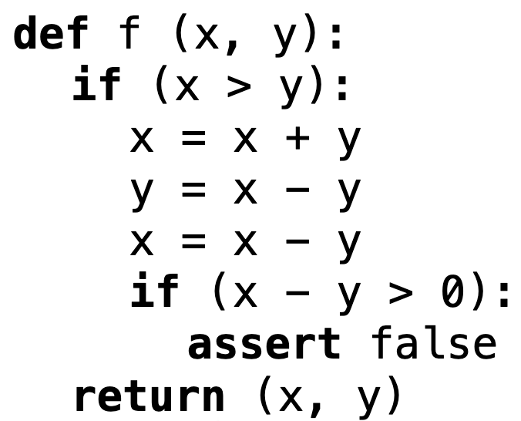
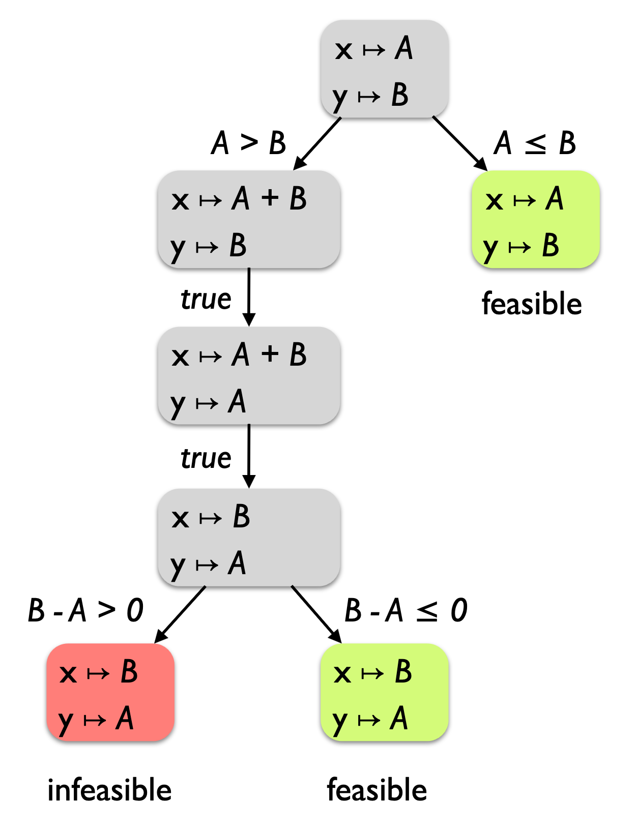
Symbolic execution
Symbolic execution tools (such as KLEE) run a program using abstract formulae in place of concrete input values
When branches are encountered, execution state is “forked” for each path
Path constraints track requirements of each side of the conditional
Can obtain symbolic formulae for program variables
Images from 2016 lecture by Emina Torlak
https://courses.cs.washington.edu/courses/cse403/16au/lectures/L16.pdf

Slide 33
KLEE aimed at debug info
KLEE can help us check debug info more systematically
KLEE explores paths through LLVM IR automatically
Symbolic IR values are evaluated during KLEE’s program execution
LLVM IR supports debug info mappings from IR to source values
define i32 @example(i32 %n)
%mul = shl i32 %n, 1, l2 c13
⓵ KLEE tracks %mul as the symbolic value (Shl n 1) (simplified KQuery syntax)
@dbg.value(i32 %mul, "x" l2)
⓶ Debug info mapping states that source var x = IR value %mul
⓷ From ⓵ and ⓶, it follows that x = symbolic value (Shl n 1)
Debug info example in abbreviated LLVM IR
Notes:
S: Can spend less time on syntax apology

Slide 34
Debug info consistency check
Separately for each local source variable, statically compute a pairwise matching of the IR-level assignment events that affect it in the two compilations of the program
  Assignments are paired if they are “the same event” as identified by their source coordinates in debug info
Dynamically explore paths (via our extended KLEE) through the function and collect formulae for the IR values “assigned” at each identified assignment operation
For each source variable, for each pair of matched assignments to that variable, we use the SMT solver to check that the assigned formulae are equivalent
Notes:
Be sure to talk through using features invariant under optimisation, no slide after this that covers it

Slide 35
Assignment events in IR
SSA value mapped directly to a source variable
%add = add 1, 2
@dbg.value(%add, "x")
Other direct representations of a source variable
@dbg.value(3, "x")
Notes:
Be sure to talk through using features invariant under optimisation, no slide after this that covers it

Slide 36
Assignment events in IR
Residualised source variables
%y = load %y*
@dbg.value(%y, "x", (add 1 %y))
Stores to local memory allocations
%x* = alloca
@dbg.declare(%x*, "x")
store 3, %x*
Notes:
Be sure to talk through using features invariant under optimisation, no slide after this that covers it

Slide 37
Examples

Slide 38
Consistency check examples
Example 1: inconsistency found
  Unoptimised LLVM IR (O0)
  Optimised LLVM IR (O1)

Slide 39
Example 1: inconsistency found
1 int example(int n) { 2 int x = n * 2; 3 int y = 0; 4 for (unsigned int i = 0; i < n; i++) { 5 y += x + 4 + n; 6 } 7 return y; 8 } | define i32 @example(i32 %n) { entry: %y = alloca i32 ⓵ allocates stack space, %y points to this storage @dbg.declare(i32* %y, "y" l3) ⓶ source var y is stored at %y store i32 0, i32* %y, l3 ⓷ stores constant (0) for source var y for.body: %3 = load i32, i32* %x, l5 %add = add i32 %3, 4, l5 %4 = load i32, i32* %n.addr, l5 %add1 = add i32 %add, %4, l5 %5 = load i32, i32* %y, l5 %add2 = add i32 %5, %add1, l5 store i32 %add2, i32* %y, l5 ⓸ stores %add2 for source var y
Source code | Unoptimised LLVM IR (O0)
Notes:
Emphasise that `dbg.declare` means "y" is stored at memory location %y (the different kinds of variables here)

Slide 40
Example 1: inconsistency found
1 int example(int n) { 2 int x = n * 2; 3 int y = 0; 4 for (unsigned int i = 0; i < n; i++) { 5 y += x + 4 + n; 6 } 7 return y; 8 } | define i32 @example(i32 %n) { entry: %y = alloca i32 ⓵ allocates stack space, %y points to this storage @dbg.declare(i32* %y, "y" l3) ⓶ source var y is stored at %y store i32 0, i32* %y, l3 ⓷ stores constant (0) for source var y for.body: %3 = load i32, i32* %x, l5 %add = add i32 %3, 4, l5 %4 = load i32, i32* %n.addr, l5 %add1 = add i32 %add, %4, l5 %5 = load i32, i32* %y, l5 %add2 = add i32 %5, %add1, l5 store i32 %add2, i32* %y, l5 ⓸ stores %add2 for source var y
Source code | Unoptimised LLVM IR (O0)
At source line 3:
y = 0
At source line 5:
y = (Add 4 (Add
(Mul 2 n) n))
Notes:
Emphasise that `dbg.declare` means "y" is stored at memory location %y

Slide 41
Example 1: inconsistency found
1 int example(int n) { 2 int x = n * 2; 3 int y = 0; 4 for (unsigned int i = 0; i < n; i++) { 5 y += x + 4 + n; 6 } 7 return y; 8 } | define i32 @example(i32 %n) { entry: @dbg.value(i32 0, "y" l3) ⓵ source var y = constant (0) for.cond.cleanup.loopexit: %0 = add i32 %n, -1, l4 %add = add i32 %n, 4 %mul = shl i32 %n, 1, l2 %add1 = add i32 %add, %mul %1 = mul i32 %0, %add1, l4 %2 = mul i32 %n, 3, l4 %3 = add i32 %1, %2, l4 %4 = add i32 %3, 4, l4 ⓶ should be mapped to y, but debug mapping lost! @dbg.value(i32 undef, "y" l3) ⓷ dead debug mapping without an input value
Source code | Optimised LLVM IR (O1)
Notes:
While `dbg.value` needs some explanation, can go through it quickly

Slide 42
Example 1: inconsistency found
1 int example(int n) { 2 int x = n * 2; 3 int y = 0; 4 for (unsigned int i = 0; i < n; i++) { 5 y += x + 4 + n; 6 } 7 return y; 8 } | define i32 @example(i32 %n) { entry: @dbg.value(i32 0, "y" l3) ⓵ source var y = constant (0) for.cond.cleanup.loopexit: %0 = add i32 %n, -1, l4 %add = add i32 %n, 4 %mul = shl i32 %n, 1, l2 %add1 = add i32 %add, %mul %1 = mul i32 %0, %add1, l4 %2 = mul i32 %n, 3, l4 %3 = add i32 %1, %2, l4 %4 = add i32 %3, 4, l4 ⓶ should be mapped to y, but debug mapping lost! @dbg.value(i32 undef, "y" l3) ⓷ dead debug mapping without an input value
Source code | Optimised LLVM IR (O1)
At source line 3:
y = 0
Value mapping lost, should be:
y = %4 = (Add 4
(Add
(Mul (Add -1 n)
(Add 4
(Add n (Shl n 1))))
(Mul 3 n)))

Slide 43
Example 1: inconsistency found
define i32 @example(i32 %n) { entry: %y = alloca i32 ⓵ allocates stack space, %y points to this storage @dbg.declare(i32* %y, "y" l3) ⓶ source var y is stored at %y store i32 0, i32* %y, l3 ⓷ stores constant (0) for source var y for.body: %3 = load i32, i32* %x, l5 %add = add i32 %3, 4, l5 %4 = load i32, i32* %n.addr, l5 %add1 = add i32 %add, %4, l5 %5 = load i32, i32* %y, l5 %add2 = add i32 %5, %add1, l5 store i32 %add2, i32* %y, l5 ⓸ stores %add2 for source var y | define i32 @example(i32 %n) { entry: @dbg.value(i32 0, "y" l3) ⓵ source var y = constant (0) for.cond.cleanup.loopexit: %0 = add i32 %n, -1, l4 %add = add i32 %n, 4 %mul = shl i32 %n, 1, l2 %add1 = add i32 %add, %mul %1 = mul i32 %0, %add1, l4 %2 = mul i32 %n, 3, l4 %3 = add i32 %1, %2, l4 %4 = add i32 %3, 4, l4 ⓶ should be mapped to y, but debug mapping lost! @dbg.value(i32 undef, "y" l3) ⓷ dead debug mapping without an input value
Unoptimised LLVM IR (O0) | Optimised LLVM IR (O1)
At source line 3:
y = 0
At source line 3:
y = 0
Value mapping lost, should be:
y = %4 = (Add 4
(Add
(Mul (Add -1 n)
(Add 4
(Add n (Shl n 1))))
(Mul 3 n)))
At source line 5:
y = (Add 4 (Add
(Mul 2 n) n))

Slide 44
Example 1: inconsistency found
define i32 @example(i32 %n) { entry: %y = alloca i32 ⓵ allocates stack space, %y points to this storage @dbg.declare(i32* %y, "y" l3) ⓶ source var y is stored at %y store i32 0, i32* %y, l3 ⓷ stores constant (0) for source var y for.body: %3 = load i32, i32* %x, l5 %add = add i32 %3, 4, l5 %4 = load i32, i32* %n.addr, l5 %add1 = add i32 %add, %4, l5 %5 = load i32, i32* %y, l5 %add2 = add i32 %5, %add1, l5 store i32 %add2, i32* %y, l5 ⓸ stores %add2 for source var y | define i32 @example(i32 %n) { entry: @dbg.value(i32 0, "y" l3) ⓵ source var y = constant (0) for.cond.cleanup.loopexit: %0 = add i32 %n, -1, l4 %add = add i32 %n, 4 %mul = shl i32 %n, 1, l2 %add1 = add i32 %add, %mul %1 = mul i32 %0, %add1, l4 %2 = mul i32 %n, 3, l4 %3 = add i32 %1, %2, l4 %4 = add i32 %3, 4, l4 ⓶ should be mapped to y, but debug mapping lost! @dbg.value(i32 undef, "y" l3) ⓷ dead debug mapping without an input value
Unoptimised LLVM IR (O0) | Optimised LLVM IR (O1)
At source line 3:
y = 0
At source line 3:
y = 0
Value mapping lost, should be:
y = %4 = (Add 4
(Add
(Mul (Add -1 n)
(Add 4
(Add n (Shl n 1))))
(Mul 3 n)))
At source line 5:
y = (Add 4 (Add
(Mul 2 n) n))
Assignments: wrong source line
Values: mapping lost
Inconsistency found!
Notes:
Spend a bit more time focusing on the fact that we found something

Slide 45
Status

Slide 46
Current status
Approach implemented in new tool built on top of KLEE
Expects two LLVM modules (*.bc or *.ll), one before and one after optimisation
Produces consistency report for each function (via independent mode)
### Variables
❌ Value produced for `i` (decl src ln 4): missing line info
❌ Value produced for `y` (decl src ln 3): missing line info
~ Multiple assignments to `x` in range from ln 2, col 0 to ln 2, col 13
✅ 4 before variables found, 4 after variables found, 0 mismatched
### Assignments
✅ Before live range coverage
### Symbolic values
~ After `i` ln 4, col 0 coords don't match before ln 4, col 36
~ After `y` ln 3, col 0 coords don't match before ln 5, col 7
❌ After `y` ln 3, col 0 symbolic value doesn't match before ln 5, col 7
(Eq (Add w32 0x4
(Add w32 (Mul w32 0x2
N0:(ReadLSB w32 0x0 n))
N0))
0x0)
❌ Before symbolic values checked against after
$ check-debug-info example-O0.ll example-O1.ll

Slide 47
Results
Confirmed existing compiler debug issues to build confidence
  16 issues confirmed so far
Discovered and filed new issues via real and generated programs
  9 issues discovered so far via Csmith-generated programs (1), examining Git (7), and author-written (1) code
  Out of these 9 issues
    1 issue resolved in a later version
    7 issues confirmed as valid by LLVM community
    1 issue newly filed and awaiting confirmation

Slide 48
False positives
Static assignment matching may be confused by dead code removal
  Currently using a basic local analysis to detect obvious cases of this
  May add more robustness by e.g. running LLVM’s own dead code removal passes
  Could move toward fully dynamic approach
Control flow changes may cause assignment to occur on subset of paths
  Formulae presented to SMT solver unlikely to be equivalent in such cases

Slide 49
IR design obstacles
LLVM debug info IR doesn’t explicitly state assignment locations
  Location defined by next real instruction, but this may change during optimisation
  Try to allow for slight changes by modelling assignment “generations” rather than requiring exact line number matches
  May propose debug info IR changes to preserve more explicit locations

Slide 50
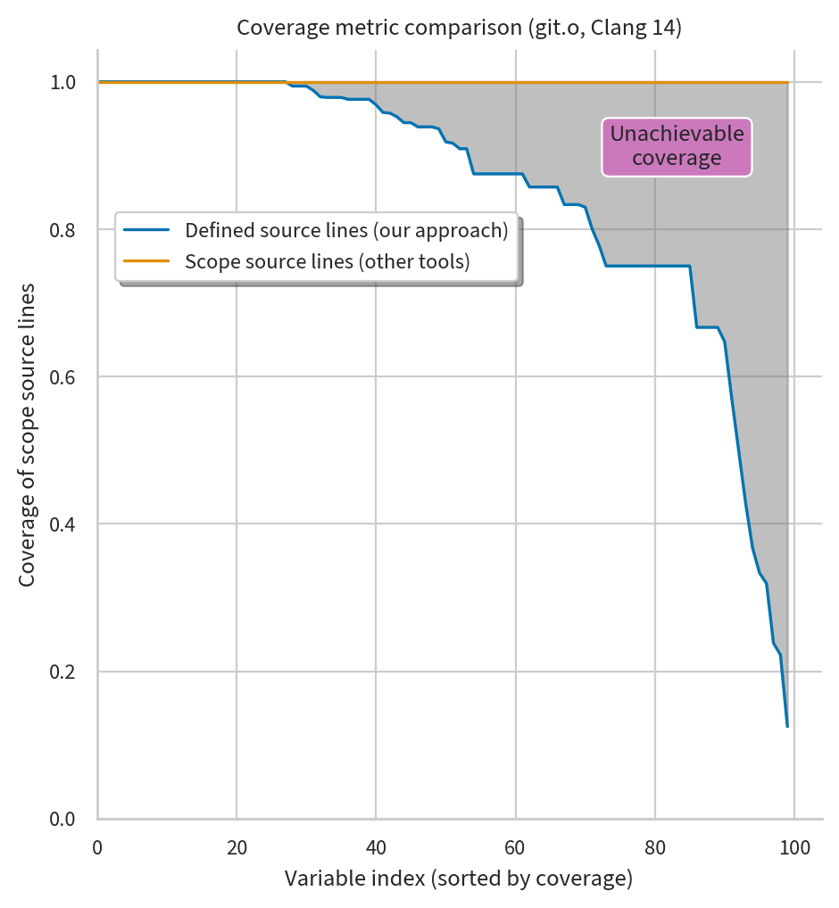
Metrics
Other tools (llvm-dwarfdump, debuginfo-quality) measure coverage using parent scope which includes potentially undefined program points
Our approach starts tracking coverage from point(s) of first definition
Coverage in terms of source lines instead of instruction bytes
Unlike past metrics, full coverage is actually attainable with our approach

Slide 51
Metrics
Variable value coverage slowly but surely increasing with each new Clang version
A large chasm remains uncovered
Lots of room for future debug info coverage improvements

Slide 52
Future work
Testing approaches
  Gather debuggability stats by optimisation pass
  Expand coverage to include machine code gen phase
Formal verification
  Ensure debug info is correct through approaches like translation validation, functional verification, etc.
  Design compilers for “correct by construction” debug info residualisation
Debug illusion
  Extend debuggers to allow retaining more program state
  Explore limits of debug info formats vs. “knowable” values from program state

Slide 53
Summary
Debug info often gets lost during optimisation
Prior testing approaches are often manual and checks values with heuristics
Our approach enables strong consistency checks of debug value correctness by lifting symbolic formulae up to source variable values
Testing tool implemented as research prototype, available soon
Metrics tool ready for general use, also available soon
Notes:
Thanks for your time, happy to take any questions!
We’d also like to hear your own perspective on debugging, learn about challenges you may have faced when trying offer reliable debugging, etc.

Slide 54
Unusual application of symbolic execution
Each function explored independently
Each basic block visited at least once (similar to a compiler)
Sufficient to gather generalised symbolic values for each source variable assignment from both target programs
Very different needs from
most applications of symbolic execution!

Slide 55
Priority of debug info for compiler authors
Passes do try to preserve debug info…
  e.g. LLVM’s How to update debug info guide for optimisation pass authors
Incentives not aligned for correct and complete debug info
  Extra work to produce debug info on top of fast, correct run-time code
No standard metrics for comparing debug info quality
  Our own metric tracking coverage over variable’s defined range (instead of scope) may help move the conversation forward here

Slide 56
Example of discovered issue
time_t example(struct tm *tm) { int b[] = {9, 4}; int c = tm->tm_year, d = tm->tm_mon; int day = tm->tm_mday; day--; return c + b[d] + day; } | define i64 @example(ptr readonly %tm) { entry: ... @dbg.value(i32 %2, "day") %dec = add i32 %2, -1 @dbg.value(i32 %dec, "day") %idxprom = sext i32 %1 to i64 %arrayidx = getelementptr [2 x i32], ptr @b, i64 0, i64 %idxprom %3 = load i32, ptr %arrayidx %add = add i32 %0, %3 %add1 = add i32 %add, %dec %conv = sext i32 %add1 to i64 ret i64 %conv }
Source code | Before Reassociate pass (O1)

Slide 57
Example of discovered issue
time_t example(struct tm *tm) { int b[] = {9, 4}; int c = tm->tm_year, d = tm->tm_mon; int day = tm->tm_mday; day--; return c + b[d] + day; } | define i64 @example(ptr readonly %tm) { entry: ... @dbg.value(i32 %2, "day") @dbg.value(i32 poison, "day") %idxprom = sext i32 %1 to i64 %arrayidx = getelementptr [2 x i32], ptr @b, i64 0, i64 %idxprom %3 = load i32, ptr %arrayidx %add = add i32 %0, -1 %dec = add i32 %add, %2 %add1 = add i32 %dec, %3 %conv = sext i32 %add1 to i64 ret i64 %conv }
Source code | After Reassociate pass (O1)

Slide 58
Variable locations in DWARF
DWARF debug info generated by compiler (which we want to test) describes source variables via Turing-powerful stack machine with registers and memory as inputs
Similar stack machine value expressions also appear in LLVM IR debug mappings
Locations are like a symbolic mapping of source variables to storage… Using KLEE’s symbolic values from execution, we can ask an SMT solver to check the values in these locations!
DW_TAG_variable
DW_AT_name ("y")
DW_AT_decl_line (3)
DW_AT_type (0x000000d5 "int")
DW_AT_location
[0x3f74, 0x3f7d):
DW_OP_fbreg -12
[0x3f7d, 0x3f90):
<no location emitted>
[0x3f90, 0x3f94):
DW_OP_breg5 RDI+0, DW_OP_constu 0xffffffff, DW_OP_and,
DW_OP_lit1, DW_OP_shl, DW_OP_stack_value
Simulated output illustrating expressivity of DWARF locations
Notes:
it's about mappings between object code and source code...
use it to mention complexity of mapping,
tantalising link between value exprs and KLEE formulae
e.g. we could go into a formula and ask an SMT solver whether this is
equivalent to what KLEE has for the same source var
Call out `fbreg` and other directly
Say way you might get a complex expression

Slide 59
Example 2: consistent
1 int example(int n) { 2 int x = n * 2; 3 int y = 0; 4 for (unsigned int i = 0; i < n; i++) { 5 y += x + 4 + n; 6 } 7 return y; 8 } | define i32 @example(i32 %n) { entry: @dbg.value(i32 0, "y" l3) ⓵ source var y = constant (0) %mul = shl i32 %n, 1, l2 %add = add i32 %n, 4 %add1 = add i32 %add, %mul for.body: %y.011 = phi i32 [%add2, %for.body], [0, %entry] @dbg.value(i32 %y.011, "y" l3) ⓶ source var y = %add2 or 0 %add2 = add i32 %add1, %y.011, l5 @dbg.value(i32 %add2, "y" l3) ⓷ source var y = %add2
Source code | Partially optimised LLVM IR (O1)

Slide 60
Example 2: consistent
1 int example(int n) { 2 int x = n * 2; 3 int y = 0; 4 for (unsigned int i = 0; i < n; i++) { 5 y += x + 4 + n; 6 } 7 return y; 8 } | define i32 @example(i32 %n) { entry: @dbg.value(i32 0, "y" l3) ⓵ source var y = constant (0) %mul = shl i32 %n, 1, l2 %add = add i32 %n, 4 %add1 = add i32 %add, %mul for.body: %y.011 = phi i32 [%add2, %for.body], [0, %entry] @dbg.value(i32 %y.011, "y" l3) ⓶ source var y = %add2 or 0 %add2 = add i32 %add1, %y.011, l5 @dbg.value(i32 %add2, "y" l3) ⓷ source var y = %add2
Source code | Partially optimised LLVM IR (O1)
At source line 3:
y = 0
At source line 5:
y = (Add 4 (Add n (Mul 2 n)))

Slide 61
Example 2: consistent
define i32 @example(i32 %n) { entry: %y = alloca i32 ⓵ allocates stack space, %y points to this storage @dbg.declare(i32* %y, "y" l3) ⓶ source var y is stored at %y store i32 0, i32* %y, l3 ⓷ stores constant (0) for source var y for.body: %3 = load i32, i32* %x, l5 %add = add i32 %3, 4, l5 %4 = load i32, i32* %n.addr, l5 %add1 = add i32 %add, %4, l5 %5 = load i32, i32* %y, l5 %add2 = add i32 %5, %add1, l5 store i32 %add2, i32* %y, l5 ⓸ stores %add2 for source var y | define i32 @example(i32 %n) { entry: @dbg.value(i32 0, "y" l3) ⓵ source var y = constant (0) %mul = shl i32 %n, 1, l2 %add = add i32 %n, 4 %add1 = add i32 %add, %mul for.body: %y.011 = phi i32 [%add2, %for.body], [0, %entry] @dbg.value(i32 %y.011, "y" l3) ⓶ source var y = %add2 or 0 %add2 = add i32 %add1, %y.011, l5 @dbg.value(i32 %add2, "y" l3) ⓷ source var y = %add2
Unoptimised LLVM IR (O0) | Partially optimised LLVM IR (O1)
At source line 3:
y = 0
At source line 3:
y = 0
At source line 5:
y = (Add 4 (Add
(Mul 2 n) n))
At source line 5:
y = (Add 4 (Add n (Mul 2 n)))

Slide 62
Example 2: consistent
define i32 @example(i32 %n) { entry: %y = alloca i32 ⓵ allocates stack space, %y points to this storage @dbg.declare(i32* %y, "y" l3) ⓶ source var y is stored at %y store i32 0, i32* %y, l3 ⓷ stores constant (0) for source var y for.body: %3 = load i32, i32* %x, l5 %add = add i32 %3, 4, l5 %4 = load i32, i32* %n.addr, l5 %add1 = add i32 %add, %4, l5 %5 = load i32, i32* %y, l5 %add2 = add i32 %5, %add1, l5 store i32 %add2, i32* %y, l5 ⓸ stores %add2 for source var y | define i32 @example(i32 %n) { entry: @dbg.value(i32 0, "y" l3) ⓵ source var y = constant (0) %mul = shl i32 %n, 1, l2 %add = add i32 %n, 4 %add1 = add i32 %add, %mul for.body: %y.011 = phi i32 [%add2, %for.body], [0, %entry] @dbg.value(i32 %y.011, "y" l3) ⓶ source var y = %add2 or 0 %add2 = add i32 %add1, %y.011, l5 @dbg.value(i32 %add2, "y" l3) ⓷ source var y = %add2
Unoptimised LLVM IR (O0) | Partially optimised LLVM IR (O1)
At source line 3:
y = 0
At source line 3:
y = 0
At source line 5:
y = (Add 4 (Add
(Mul 2 n) n))
At source line 5:
y = (Add 4 (Add n (Mul 2 n)))
Assignments: consistent
Values: consistent
Debug info check passed! 🎉

Slide 63
Consistency check examples
Example 1: inconsistency found
  Unoptimised LLVM IR (O0)
  Optimised LLVM IR (O1)
  Assignments: wrong source line
  Values: mapping lost
Example 2: consistent
  Unoptimised LLVM IR (O0)
  Partially optimised LLVM IR (O1, stopping early)
    Optimisation stopped just before induction variable simplification
  Assignments: consistent
  Values: consistent

Slide 64
Suppose MAX is 5 and get_start returns 2. What does i do?
1 int f(int *data, void *arg)
2 {
3 int i = 0, tmp, out1 = 0, out2 = 0;
4
5 i = tmp = get_start(arg); int *p = &data[tmp];
6 for (; i < MAXp < &data[MAX]; ++ip)
7 {
8 out1 ^= data[i]*p;
13 out2 &= data[i]*p;
9 }
11 for (i = tmp; i < MAX; ++i)
12 {
13 out2 &= data[i];
14 }
15 g(out1, out2);
16 return tmp;
17}
at 3
value 0 from 3 to 5
value (r7-r1)/4
from 5
0
at 5
2
at 6
3
4
5
at 6
at 6
Set is:
{3:undef→0, 5:0→2, 6:2→3, 6:3→4, 6:4→5}

Slide 65
Suppose MAX is 5 and get_start returns 2. What does i do?
1 int f(int *data, void *arg)
2 {
3 int i = 0, tmp, out1 = 0, out2 = 0;
4
5 i = tmp = get_start(arg);
6 for (; i < MAX; ++i)
7 {
8 out1 ^= data[i];
9 }
10
11 for (i = tmp; i < MAX; ++i)
12 {
13 out2 &= data[i];
14 }
15 g(out1, out2);
16 return tmp;
17}
at 3
value 0 from 3 to 5
value (r7-r1)/4
from 5
0
at 5
2
at 6
3
4
5
at 11
at 6
at 6
2
3
4
5
at 11
at 11
at 11
Set is:
{3:undef→0, 5:0→2, 6:2→3, 6:3→4, 6:4→5,
11:5→2, 12:2→3, 12:3→4, 12:3→5}

Slide 66
1 int f(int *data, void *arg)
2 {
3 int i = 0, tmp, out1 = 0, out2 = 0;
4
5 i = tmp = get_start(arg);
6 for (; i < MAX; ++i)
7 {
8 out1 ^= data[i];
9 }
10
11 for (int j = tmp; j < MAX; ++j)
12 {
13 out2 &= data[j];
14 }
15 g(out1, out2);
16 return tmp;
17}

Slide 67
1 int f(int *data, void *arg)
2 {
3 int i = 0, tmp, out1 = 0, out2 = 0;
4
5 i = tmp = get_start(arg);
6 for (; i < MAX; ++i)
7 {
8 out1 ^= data[i];
9 }
10
11 for (int j = tmp; j < MAX; ++j)
12 {
13 out2 &= data[j];
14 }
15 g(out1, out2);
16 return tmp;
17}
0
2
3
4
5
2
3
4
5
After fusion, i and j will be modelled by the same machine variable...

Slide 68
Suppose MAX is 5 and get_start returns 2. What does i do?
1 int f(int *data, void *arg)
2 {
3 int i = 0, tmp, out1 = 0, out2 = 0;
4
5 i = tmp = get_start(arg); int *p = &data[tmp];
6 for (; i < MAXp < &data[MAX]; ++ip)
7 {
8 out1 ^= data[i]*p;
13 out2 &= data[i]*p;
9 }
11 for (i = tmp; i < MAX; ++i)
12 {
13 out2 &= data[i];
14 }
15 g(out1, out2);
16 return tmp;
17}
value 0 from 3 to 5
value (r7-r1)/4
from 5
0
2
3
4
5
backwards jump relative to source program
3
4
5
Our cue to split i into two epochs
- for which our property is evaluated separately
- run concurrently (interleaved)...
- the same machine variable models both!

