Slide 1
Pester Stuff
Jason Ryberg
Senior Consultant
Microsoft Federal

Slide 2
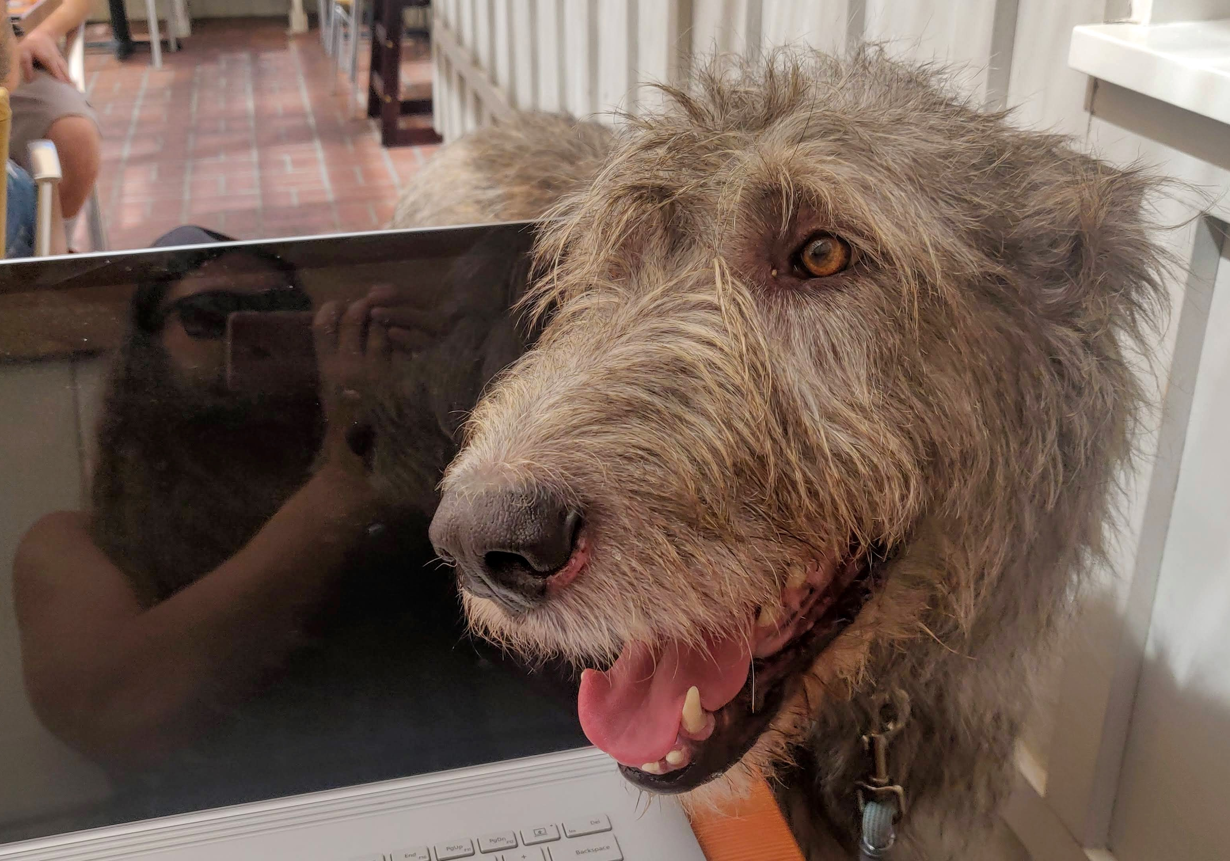
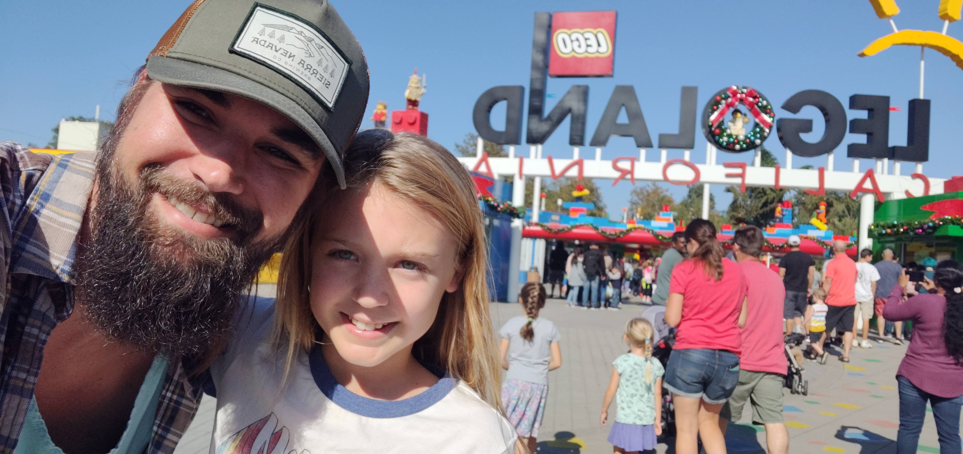
Who is this guy?
Microsoft since 2015
DoD Contracting since 2012
Notes:
Go over who you are and what you’ve been doing

Slide 3
Who is this for?
PowerShell enthusiasts
Cloud Engineers
IaC Developers

Slide 4
Agenda
Pester 5 – A New World
Testing Goals
Testing Approach

Slide 5
Pester 5 – A New World
Pester runs in two ‘phases’
Discovery then Run
‘Read then execute’
Allows for Pester to build the tests before executing them
This provides greater insight into scoping test failures (each block is saved in discovery phase then executed separately during the run phase)
More formal declarations lead to cleaner, faster tests
Requires closer attention to variable scoping
E.g. ‘BeforeAll’ doesn’t run until after discovery, which means tests populated by loops (foreach/TestCases) do not have variable values defined in BeforeAll); so use BeforeDiscovery to populate variables used by loops
All code must be in Pester block
It, BeforeAll, BeforeEach, AfterAll or AfterEach
Any code outside these blocks will run during Discovery phase and likely be lost
Migrating from v4: https://pester-docs.netlify.app/docs/migrations/v4-to-v5

Slide 6
Pester 5 – A New World cont…
Invoking Pester
Configuration objects are now preferred method to invoke tests
$config = New-PesterConfiguration
$config.Output.Verbosity = ‘Detailed’ # Provides output similar to v4
Invoke-Pester -Configuration $config
###### OR ######
Invoke-Pester –Output Detailed
Asserting Mocks now use –Invoke
V5: Should -Invoke -CommandName Build -Times 0
V4: Assert-MockCalled Build –Times 0

Slide 7
Testing Goals
Why (not) tests?
Code Coverage

Slide 8
Why Tests?
Increase code quality
Detect Defects
Earlier the better
Reliability
Stress or performance testing
Increased Confidence
Risk Management
Detect more use cases
Credibility / Customer optics
Reduced long-term costs
Test a backup/restore procedure?

Slide 9
Why Not Tests?
Value vs Resources
Is a corner case worth adding hours/days of testing?
Is a case going to be repeated or singular?
Did your program budget for a testing environment?
Trust your tools
Can you afford to trust your tools?
Do you need a test to test the test was tested?

Slide 10
Code Coverage
Not ‘every single line’ should be tested, but …
Every single case should be tested
Very much not likely all the time
Testing all logic/conditions is what is important
Drives simpler logic in smaller functions
Nested if’s are no fun to test – how can you write code better to make testing easier?
Test-driven Development!

Slide 11
Testing Pattern
Arrange
Act
Assert

Slide 12
Arrange
Initial setup
Define Mocks
Initialize mock data and outputs
Pester’s ‘Discovery’ phase
Scoping is important
BeforeDiscovery vs BeforeAll
Module scope for private functions
TestCases/ForEach

Slide 13
Act
Initiate the thing for each case/condition
Run the function and store the output in a variable
Did every line in the function run?
Was every parameter passed in?
What about ‘unhappy paths’?
Error handling?

Slide 14
Assert
Measure the output
Mocks invoked or not
Positive and negative assertion
Error messaging

Slide 15
Demo Time

Slide 16

https://github.com/jrybergDemo/
/DevopsJesus
Notes:
Any questions?

