Slide 1
RXMG Data Challenge
Josh Dimaculangan

Slide 2
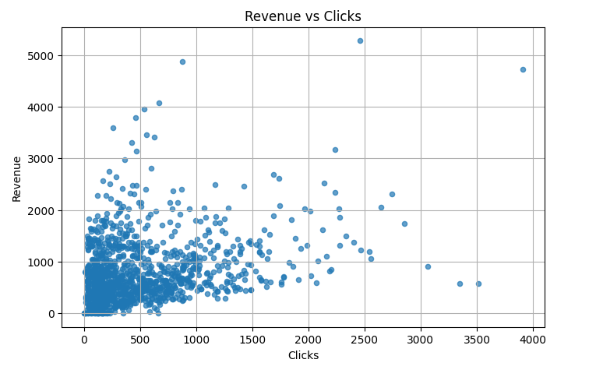
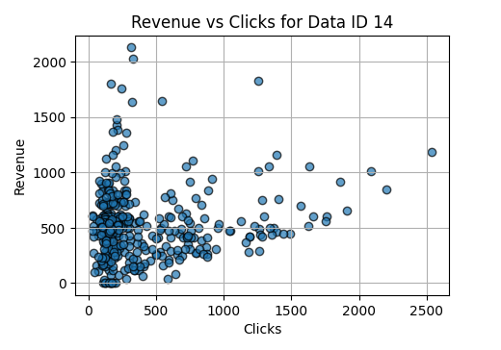
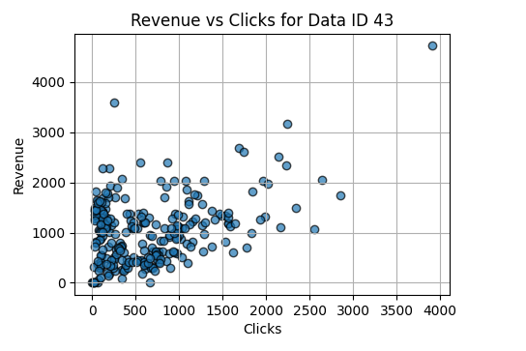
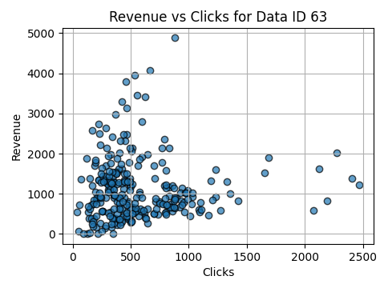
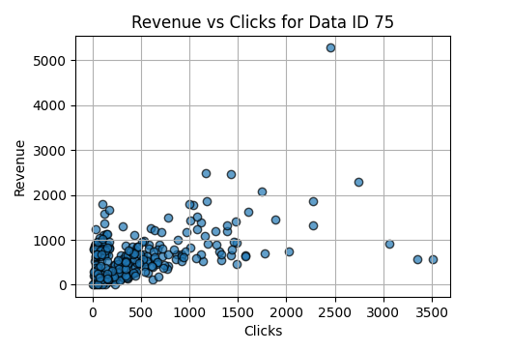
Prompt #3
Does it vary by Data ID?
When you look at each individual Data ID’s scatter plot and all of the records attached to the Data ID, the general consensus is that there’s little to no positive correlation between clicks and revenue. Half of the Audience Types show no correlation while the other half shows little positive correlation. The correlation coefficients per Data ID are as follows:
Data ID 14: 0.11
Data ID 43: 0.38
Data ID 63: 0.04
Data ID 75: 0.47
This further supports how our general revenue to clicks correlation has that particular coefficient of 0.30, which shows a weak positive correlation, and we can ultimately assume that it does not vary by Data ID. However, the opposite can be said when you consider and compare each individual Data ID to the others, in which they do vary.
What is the relationship between revenue and clicks?
The relationship between revenue and clicks reveals an intriguing result. There is a weak positive correlation between the two, with a correlation coefficient of approximately 0.30. This indicates that while offers with higher clicks tend to generate more revenue overall, there are numerous instances where high click volumes do not translate to significant revenue. The graph below illustrates the distribution of revenue and clicks across all offers, highlighting this variability.

Slide 3
How does this impact offer selection?
This impacts offer selection because when comparing the offers by Data ID and the correlations between clicks and revenues, the Data ID’s with stronger correlations show that the audience responds better to the current offers. For the Data ID’s with weaker correlations, it indicates the need to change offer approach to those demographics.
As an example, with Data ID 75 having a correlation coefficient of 0.47, the strongest correlation between clicks and revenue between the Data IDs, we can project an increase in revenue of about approximately $220 per 500 clicks based on the current trend. This informs the company that the approach taken towards the credit card audience generates more revenue per click than the other audience types.

Slide 4
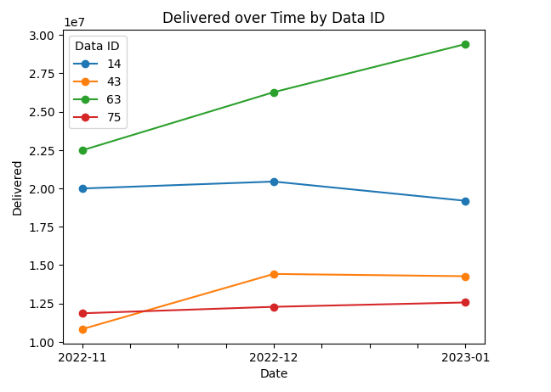
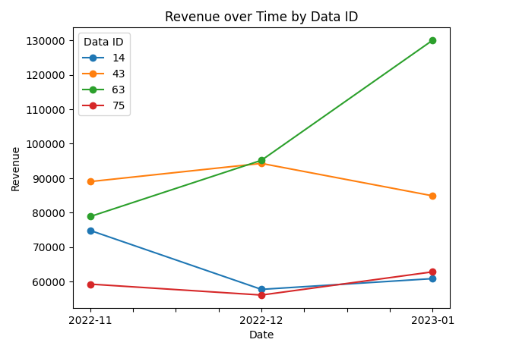
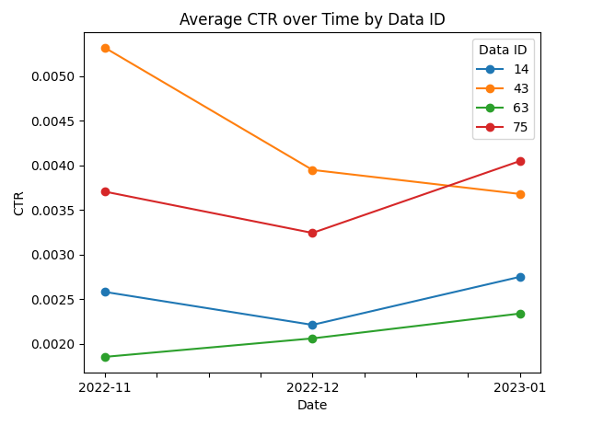
Prompt #2
How is that impacting revenue and CTR?
The amount delivered is impacting revenue in a generally positive correlation. However, there is one outlier, specifically Data ID 14, which increased in revenue even when less was delivered, which we could assume is leveraging quantity over the quality of the offers.
What is happening with the size of the Data IDs over time?
The change in size of each Data ID differs.
Data ID 63 is growing rapidly at a constant rate of approximately 3,462,834 delivered per month.
Data ID 14’s growth was stagnant throughout the month of November and December retaining 20,220,564 delivered, but started shrinking near the month of January with only 19,193,621 delivered.
Data ID 43 grew from November to December by 3,597,576 delivered, but January remained similar in size to December.
The size of Data ID 75 has been pretty consistent in size within the 3 months recorded at about 12,237,690 delivered.
As for CTR, at first glance, the data presents an interesting trend—CTR appears to decrease as the amount delivered rises. However, a deeper look reveals distinct behaviors among different Data IDs.
Offers to Data IDs 43 and 75 stand out as the most effective at engaging their target audience. Data ID 43, despite having the lowest delivery, achieved the highest CTR. However, as its delivery increased, CTR declined—first sharply, then at a slower rate once the delivery volume stabilized.
Meanwhile, offers to Data ID 75 maintained a steady delivery volume, yet its CTR fluctuated while remaining relatively high. This suggests that factors beyond delivery volume may be influencing engagement.
In contrast, offers to Data ID 63 showed a positive correlation between delivery and clicks, yet, similar to the offers to Data ID 14, it struggled to effectively capture audience interest. These patterns suggest that increasing delivery does not necessarily lead to a higher CTR, despite CTR being a function of impressions.
Ultimately, this analysis highlights that audience engagement is not solely dictated by delivery volume—other factors, such as targeting precision and content relevance, likely play a significant role in CTR performance.

Slide 5
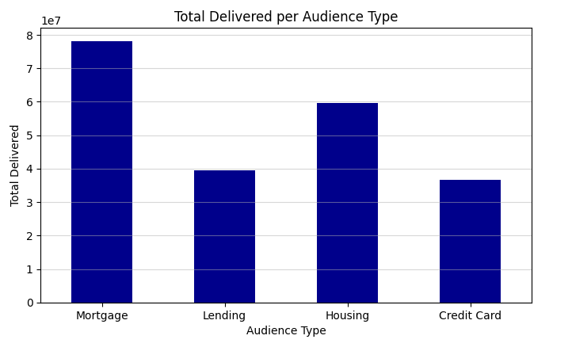
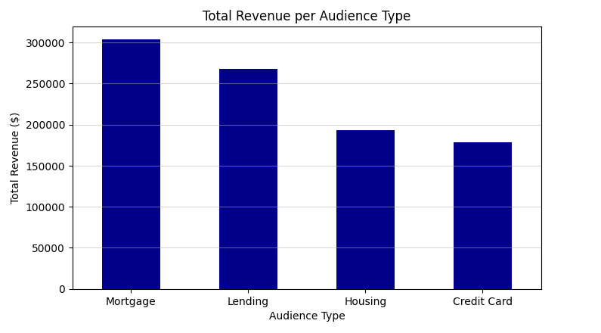
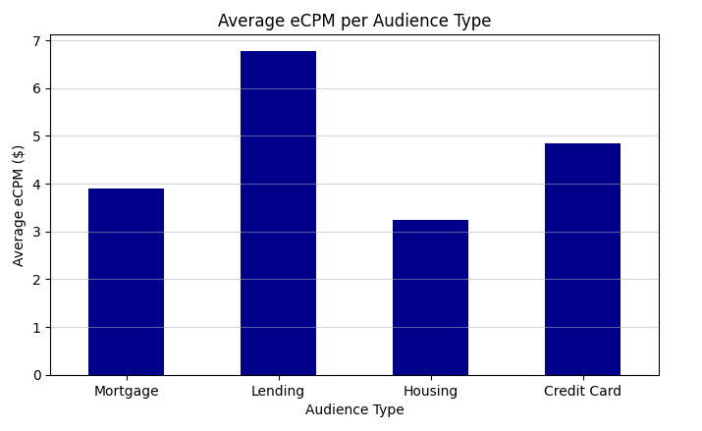
Self-Made Prompt #1
Which Data ID is Reaching Audiences Most Effectively? Least Effectively? Which metric could best represent this?
One of the most effective ways to measure the success of offers across different audiences is cumulative eCPM (revenue per 1,000 delivered). This metric provides insight into how efficiently an offer generates revenue relative to its delivery volume.
Top Performer: Lending Audience (Data ID 43)
Among all audience types, Data ID 43 (Lending Audience) stands out as the most successful. Despite having the second-lowest delivery volume, it achieves the second-highest total revenue. This indicates that Lending offers are highly efficient, converting well despite lower distribution. For marketers, this presents a key opportunity: investing more in Lending could yield high revenue with minimal waste.
Lowest Performer: Housing Audience (Data ID 14)
Conversely, Data ID 14 (Housing Audience) represents the least efficient segment. Despite having the second-highest delivery volume, it generates one of the lowest revenues, leading to the lowest eCPM. This suggests that Housing-focused offers struggle to convert effectively. Identifying the cause—whether due to targeting, messaging, or audience fit—could help optimize future marketing efforts.
Overinvestment vs. Underperformance
Data ID 75 (Mortgage Audience) underperforms relative to Data ID 63 (Credit Card Audience). Mortgage offers seem over-invested in delivery, attempting to maximize revenue through sheer volume, but with diminishing returns. Meanwhile, Credit Card offers generate lower revenue, but also receive less investment, making them less of a liability in inefficiency.
When evaluating offer success, cumulative eCPM is crucial because it directly ties audience reach to revenue efficiency. While CTR (Click-Through Rate) measures engagement, it does not guarantee conversions. At the end of the day, revenue generation is the ultimate goal, making eCPM one of the most relevant metrics for assessing marketing effectiveness.
Notes:
Which Data ID is reached the most successfully? Which data is reached the least successfully? Which metric could best represent this?
The metric that best represents the successfulness of offers to particular audiences would be the cumulative eCPM by Data ID/Audience Type.
The Data ID that offers the most success would be Data ID 43, which is of the Lending Audience Type. It has the second least in amount delivered, but has the second most in total revenue, which shows how efficient and effective the offers are towards this audience. This is an important piece of data because it allows companies to consider the Lending audience for further investment into the offers provided to them, as they would produce most revenue in the most efficient way.
Data ID 14, which is the Housing Audience Type, has the second most amount delivered, but has the second least amount of revenue, which resulted in the lowest eCPM, which shows how inefficient or ineffective the offers are towards housing audiences. This is important because it allows companies to find where the inefficiencies are for the offers catered towards the housing audience.
Data ID 75, the Mortgage Audience Type, does a bit worse than the Data ID 63, the Credit Card Audience Type, seemingly because of over investment into the amount delivered to try and milk out as much revenue as possible, whereas the offers towards the credit card audience is not earning as much, but isn’t being invested into the amount delivered as much as well.
The reason the cumulative eCPM would be one of the most important metrics when considering success in offers categorized by Data ID is because at the end of the day, the point of the offers is to reach audiences and have them convert resulting in revenue earned. Although the amount of offers delivered, the amount of clicks for each offer, and the revenue gained from those all have a relationship with one another, at the end of the day, revenue is one of the most important factor in a company. And CTR can show initial engagement, but will not show success in conversions.

Slide 6
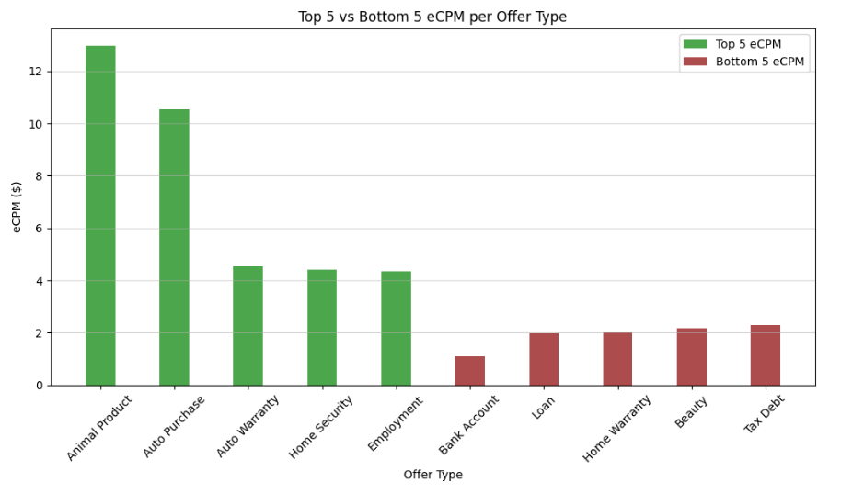
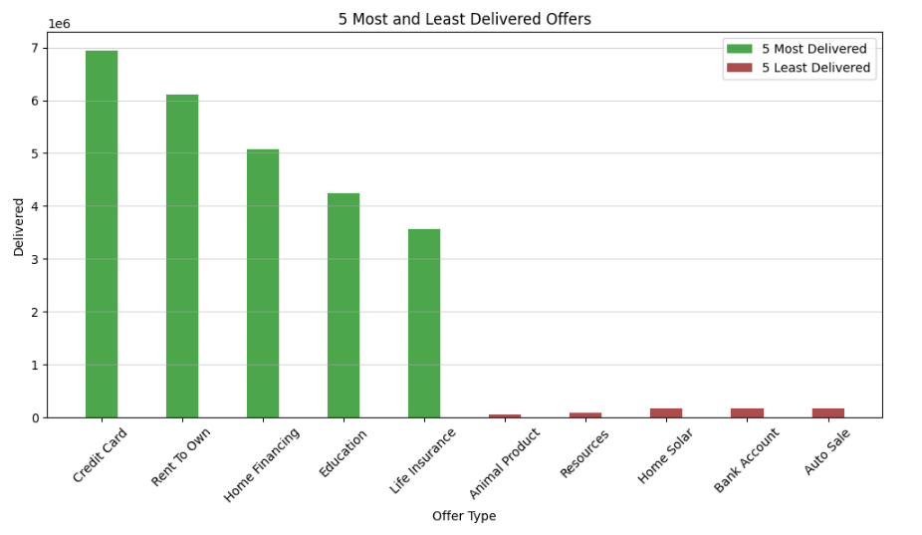
Self-Made Prompt #2
Top Performers
As we analyze the graph on the left, a clear trend emerges in the top-performing offer types for the Housing audience. Animal products and auto purchases stand out significantly, boasting eCPMs of $12.97 and $10.54, respectively, leaping ahead of the competition. The next-best performer, auto warranty offers, lags behind at $4.55 eCPM with 2,290,808 offers delivered, while employment offers, the lowest among the top-tier group with 3,202,979 offers delivered, comes in at $4.34 eCPM. To put this in perspective, both auto warranty and employment offers generate less than half the revenue per thousand impressions compared to auto purchases.
Lowest Performers
On the other end of the spectrum, the worst-performing offer types reveal a stark contrast. Bank account offers struggle the most, with an eCPM of just $1.10. The best among the lowest performers, tax debt offers, reach $2.28 eCPM—still falling well below the overall median eCPM of $3.25.
Why is this important?
The disparity in delivery volume tells an even more compelling story. Despite its stellar eCPM, only 47,248 animal product offers were delivered. Meanwhile, bank account offers, which rank among the worst performers, were delivered 167,252 times—354% of the animal product offers, yet their eCPM is a mere 8.5% of animal product offers.
This data reveals a fundamental inefficiency: high-performing offers are being underutilized, while low-performing offers receive disproportionate investment. The top five most-delivered offers all perform worse than the median eCPM, while four out of the five least-delivered offers actually outperform it.
What does this mean for strategy?
A shift in focus is necessary. Rather than continuing to heavily invest in high-volume, low-revenue offers, reallocating delivery efforts toward higher-performing, higher-converting offers could significantly improve overall efficiency and profitability. This is just a glimpse into the broader eCPM landscape for the Housing audience, but the implications are clear: better targeting and resource allocation could drive substantial revenue growth.
What do you think contributes to the weak eCPM performance of the Housing audience on the previous slide?
How may this be improved?

