Slide 1
Challenge #0 Get your machines ready!
Determine Your Team Language for the app and services. These can be the same or different depending on the skills of the team (i.e. ASP.NET Core Web app and Node.js API Service).
Determine Your Team Coding IDE – Visual Studio Code, Visual Studio Enterprise, others?
Install Git – allows for working with Git repos locally on your machine as well as in VSTS. https://gitscm.com/downloads
Review Your Teams Azure DevOps (formerly VSTS) project VSTS Project for Each AppDev Hack team.
Project Structure – each App Dev team has an Azure DevOps (formally VSTS) project pre-provisioned with all tasks required for each challenge, just not how they should be accomplished.
Under this project structure, you may organize your code repo as you see fit to complete the challenges and successfully work together.
Determine Azure Subscription you will use for deployment
Notes:
If you have a Mac… great! You’re already a step ahead.
If not, get your Windows box loaded up with all the tools that work well in the OSS world!

Slide 2
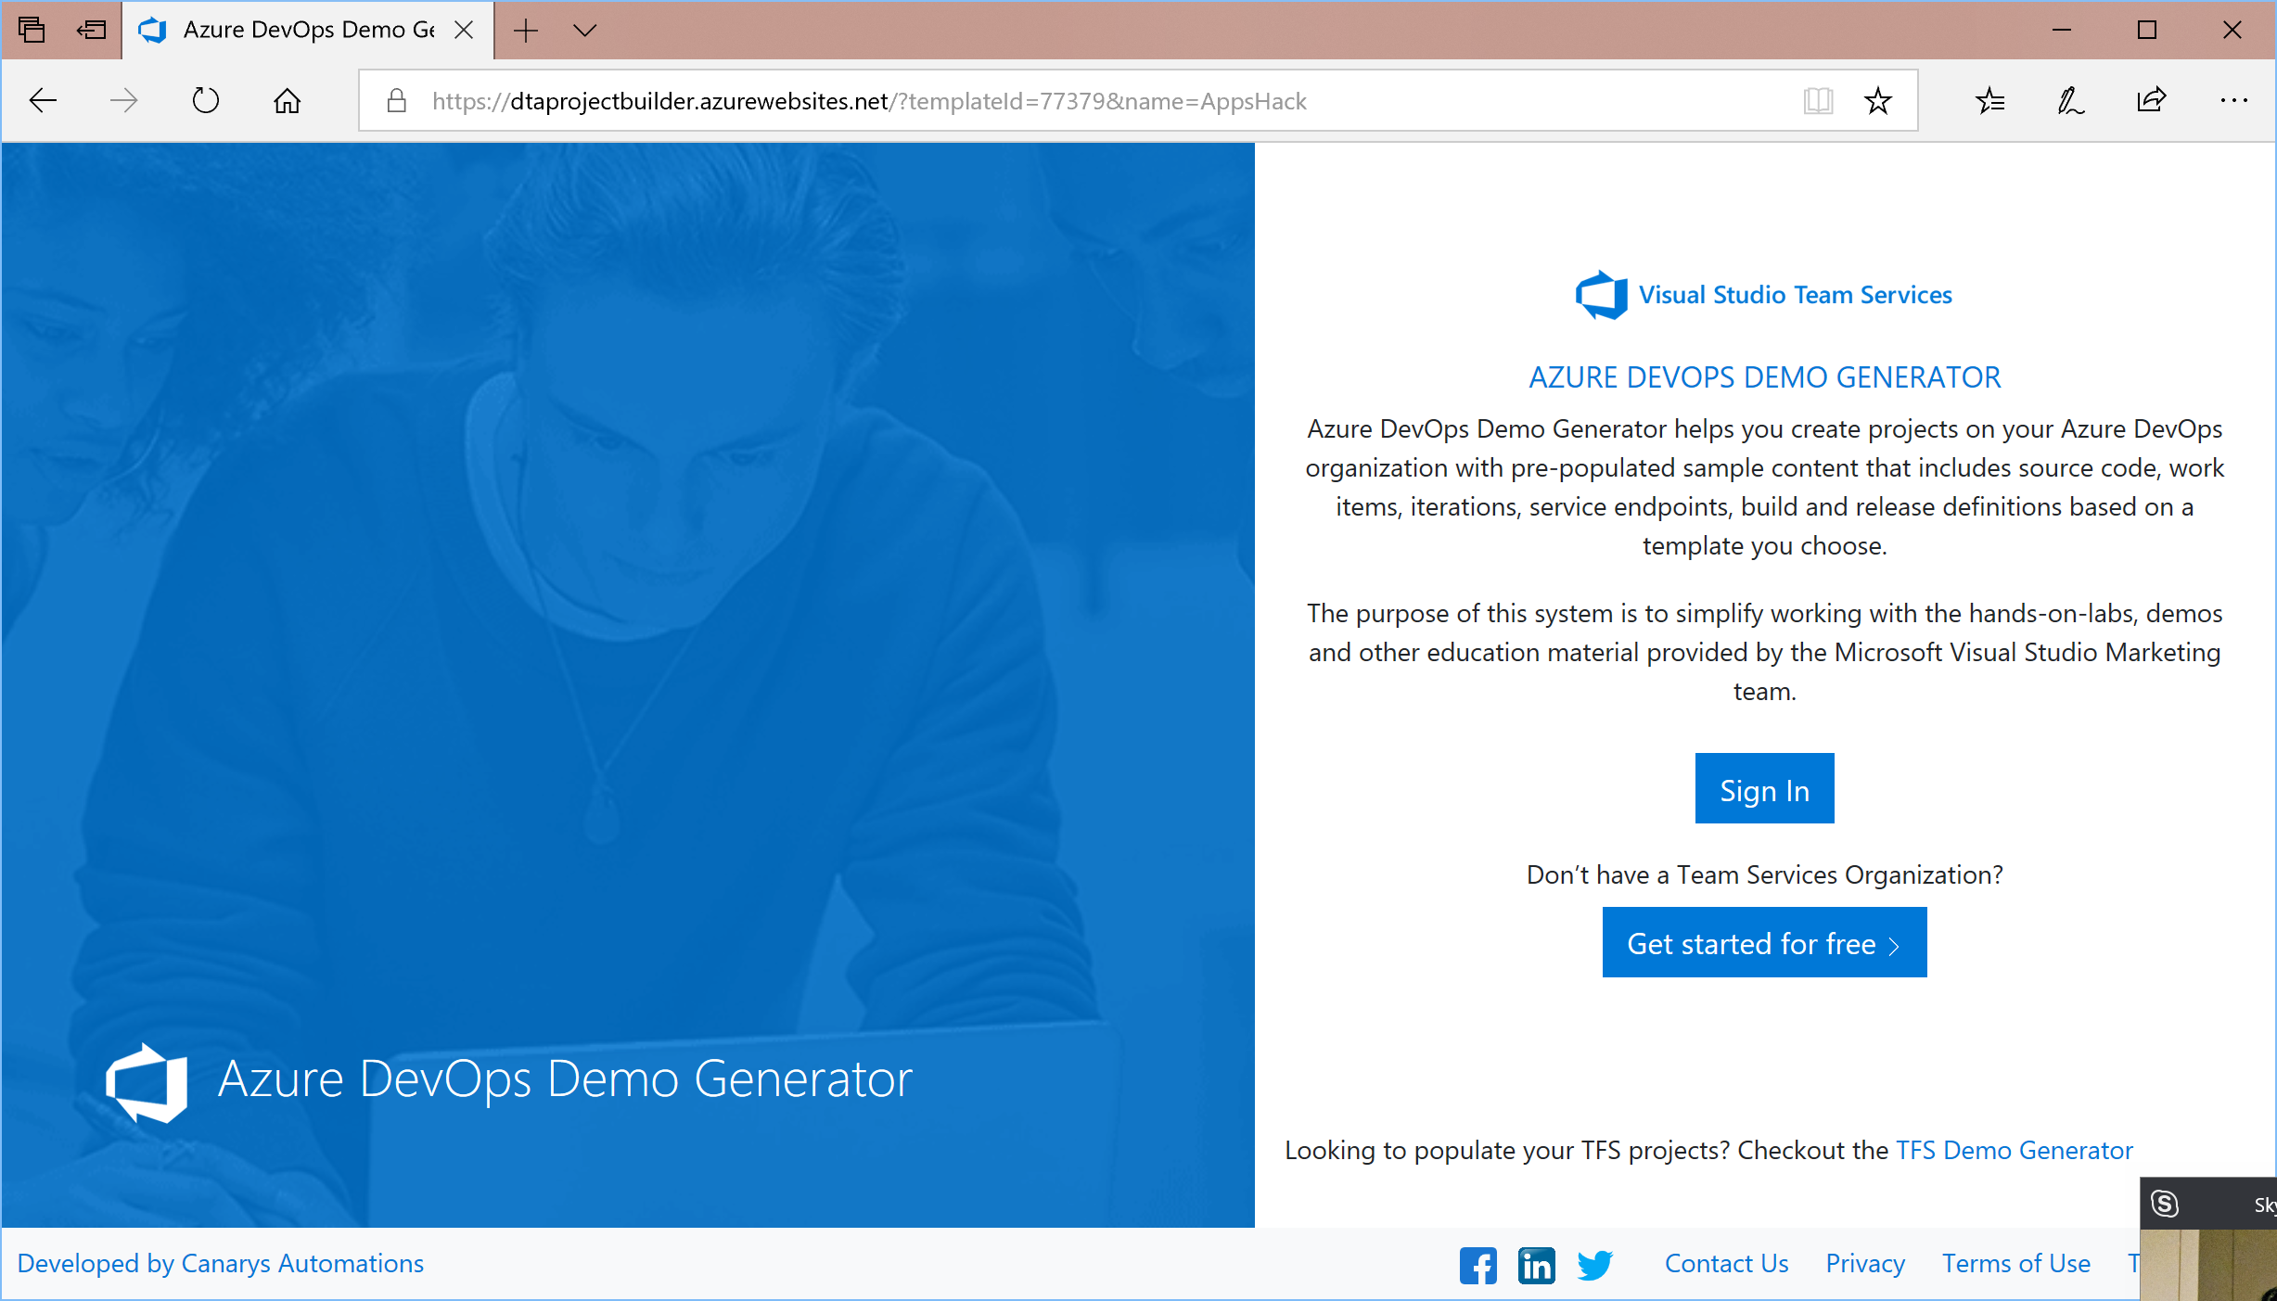
1
Only one person per team!
https://aka.ms/dtaHacks
Sign-in
3
If you don’t have one, sign up using your @Microsoft.com credentials
2

Slide 3
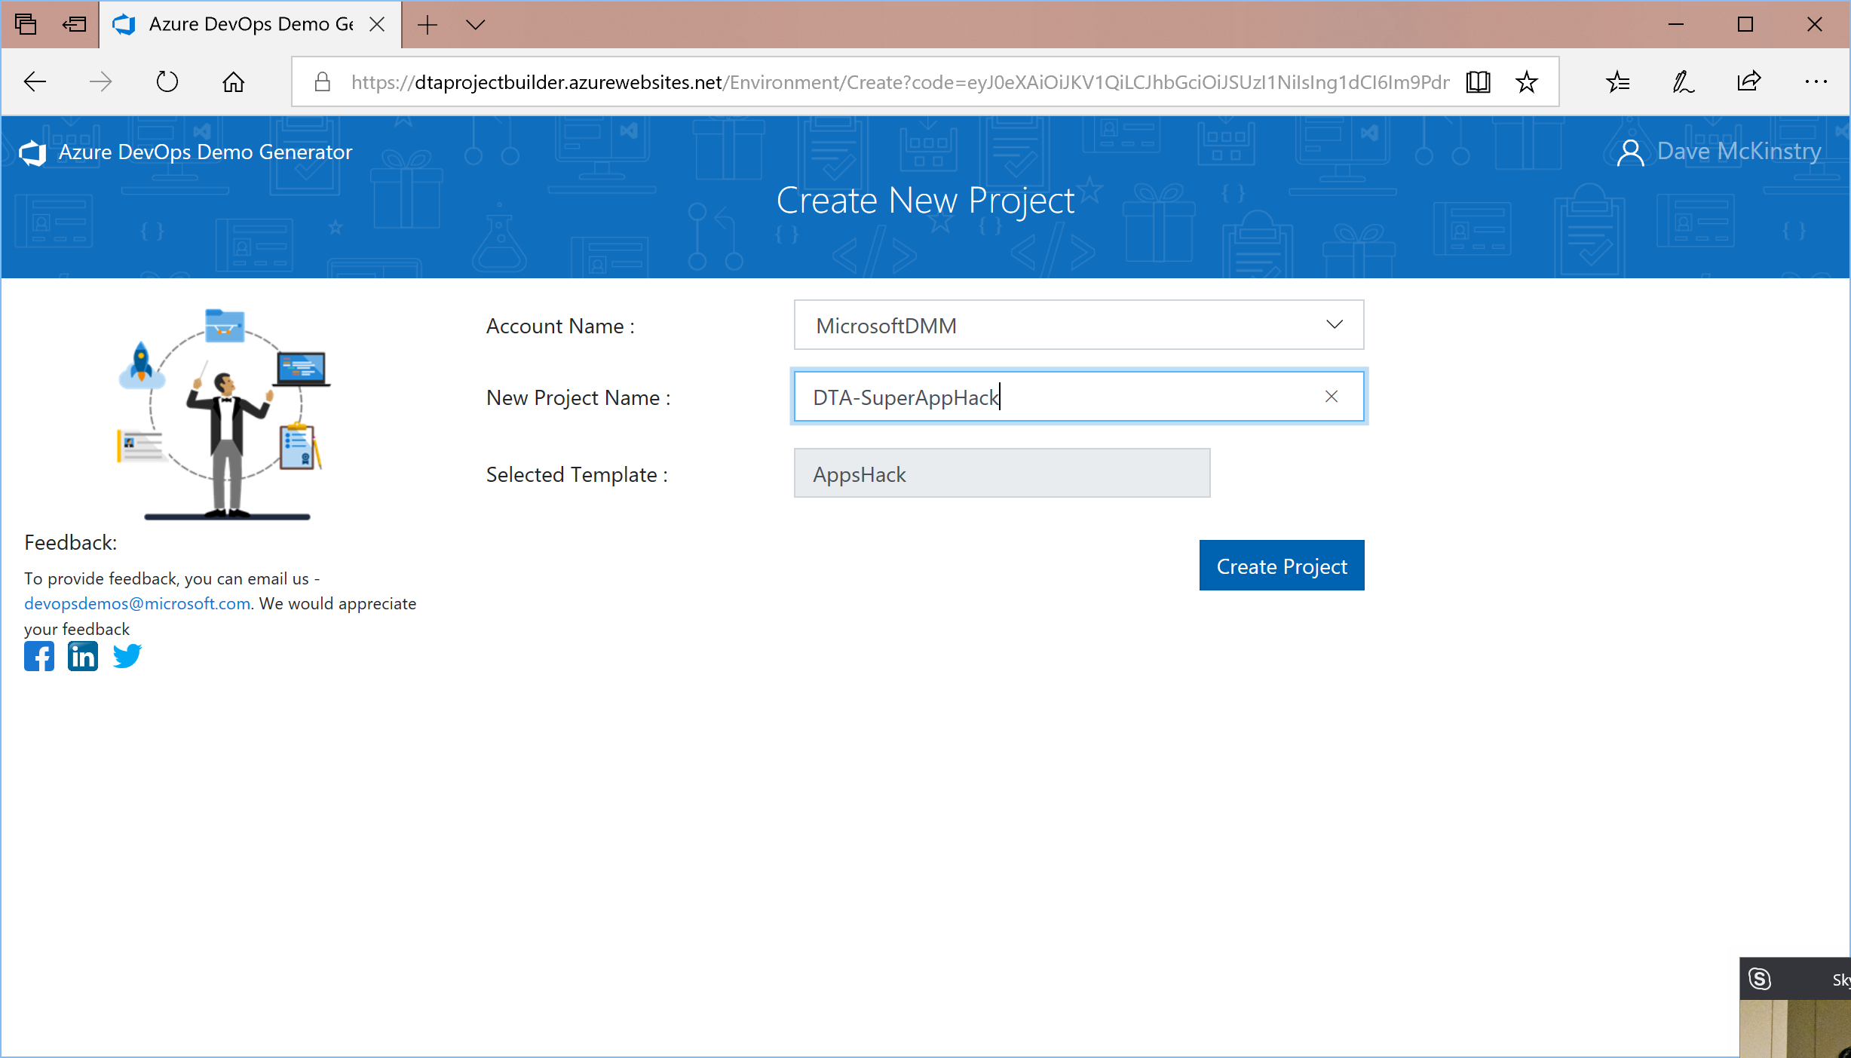
2
Enter a project name for your team
1
Select your account (org)
3
Click the button and wait a couple of minutes

Slide 4
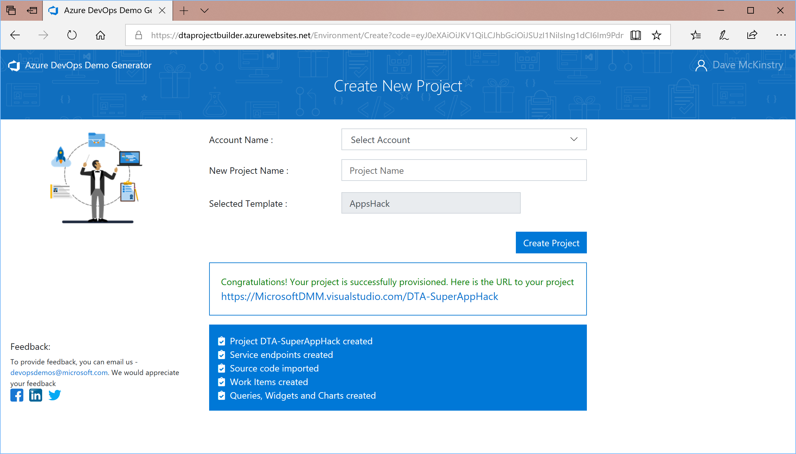
When it’s done, click on the link and share with your team. (They can’t sign-in yet)
1

Slide 5
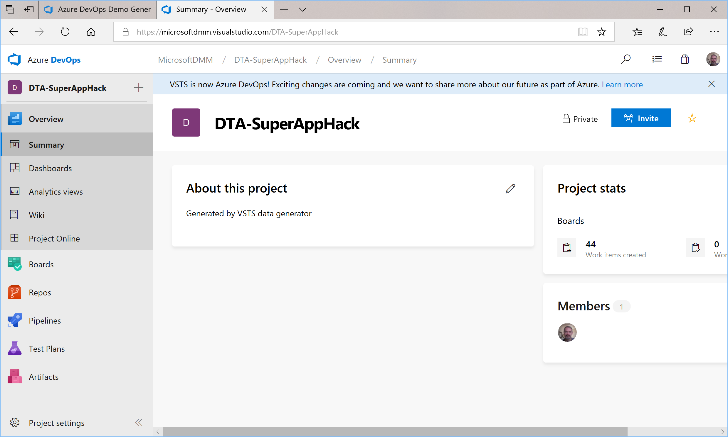
1
Now add your teammates to the project (using their @Microsoft.com credentials)

Slide 6
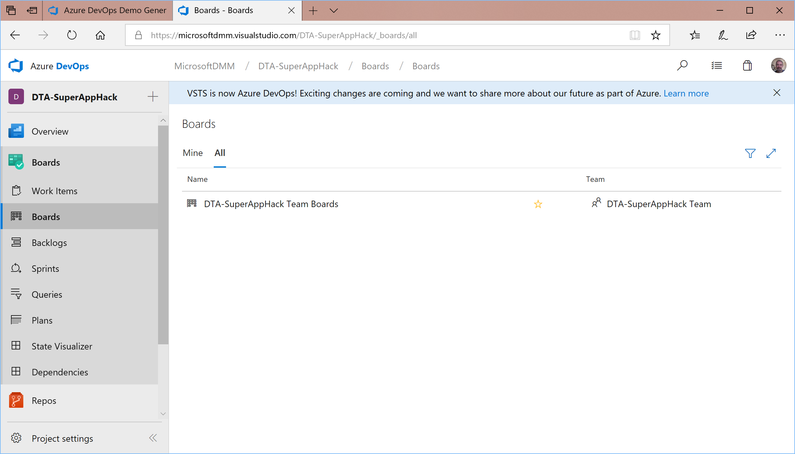
Access the Kanban board to review your hackathon goals…
1
3
2

Slide 7
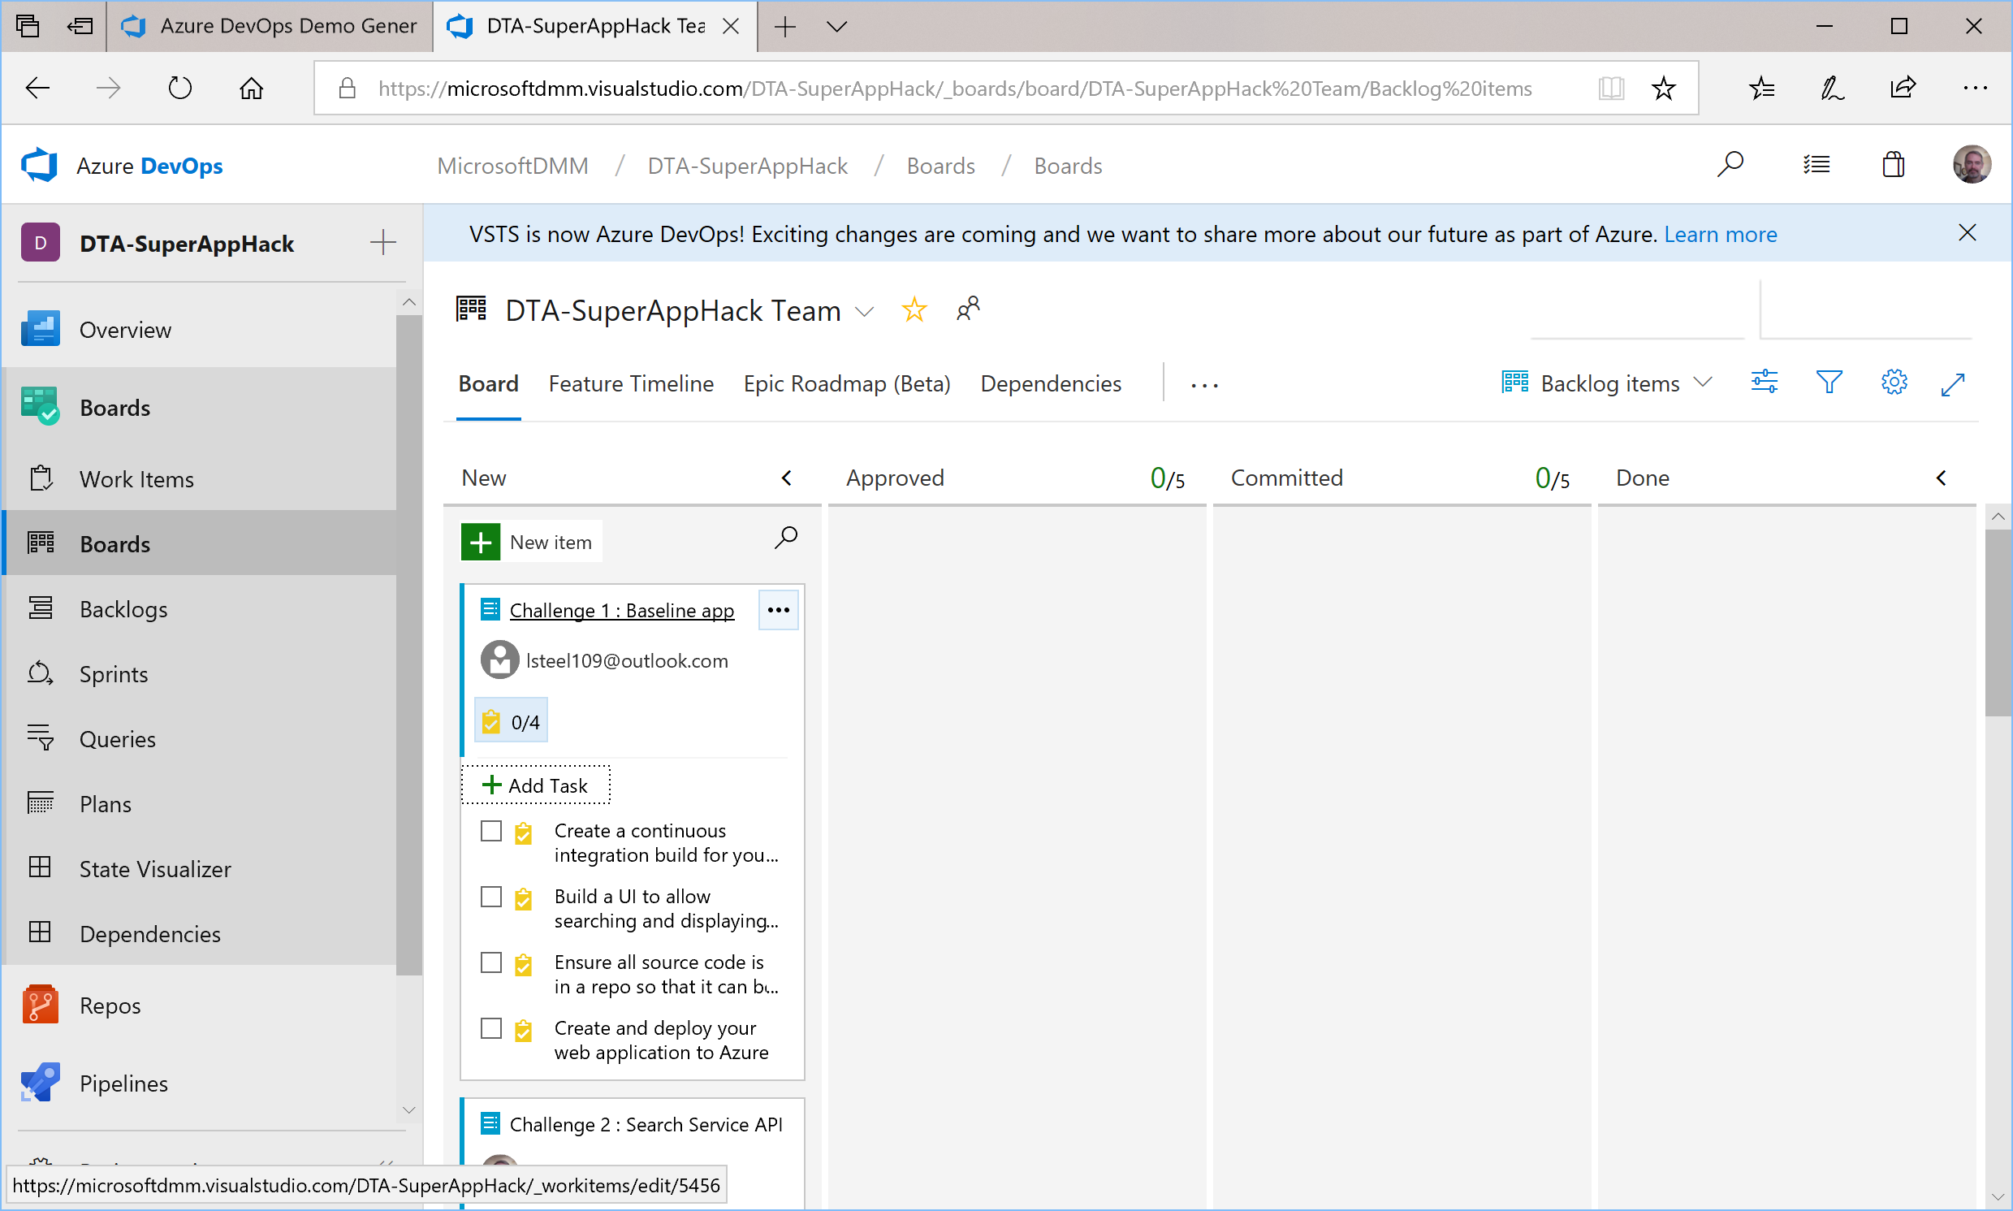
Review the cards and as a team. Click on the title to review the description. Expand the tasks to see individual prerequisites and expectations (reverse order). Assign work as appropriate and drag the card across the board as work proceeds.
Happy Hacking!

