Slide 1
phd_ui slide figures
presentation presets at true size on a 16:9 slide

Slide 2
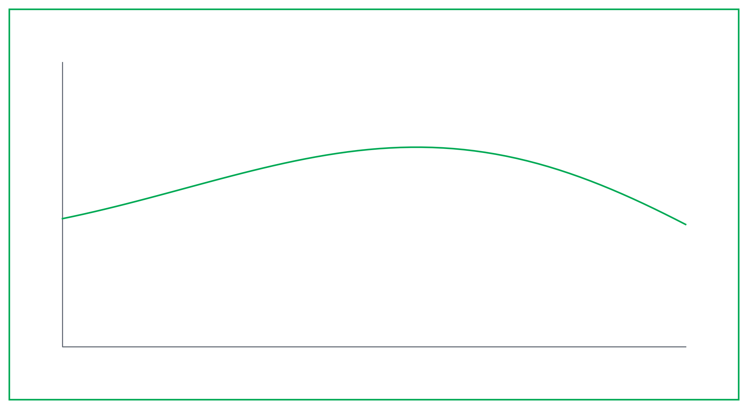
slide_16x9 - a slide-filling hero
slide_16x9 (26 x 14 cm)

Slide 3
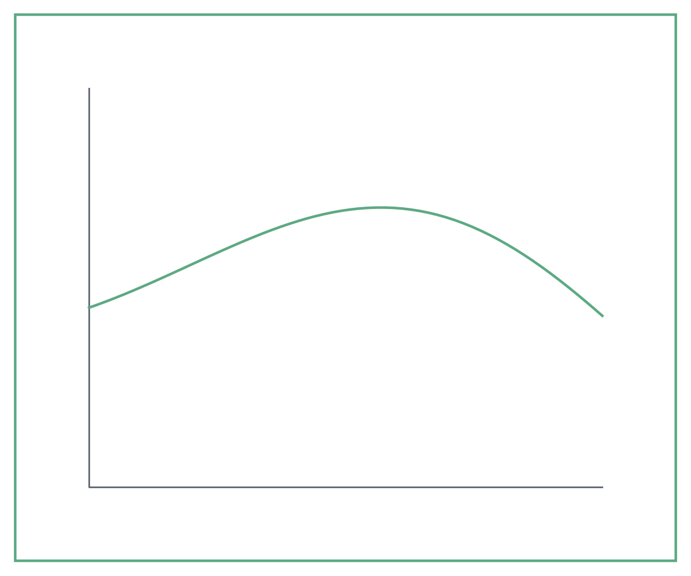
slide_half - two figures side by side
slide_half (14.5 x 12 cm)
slide_half (14.5 x 12 cm)

Slide 4
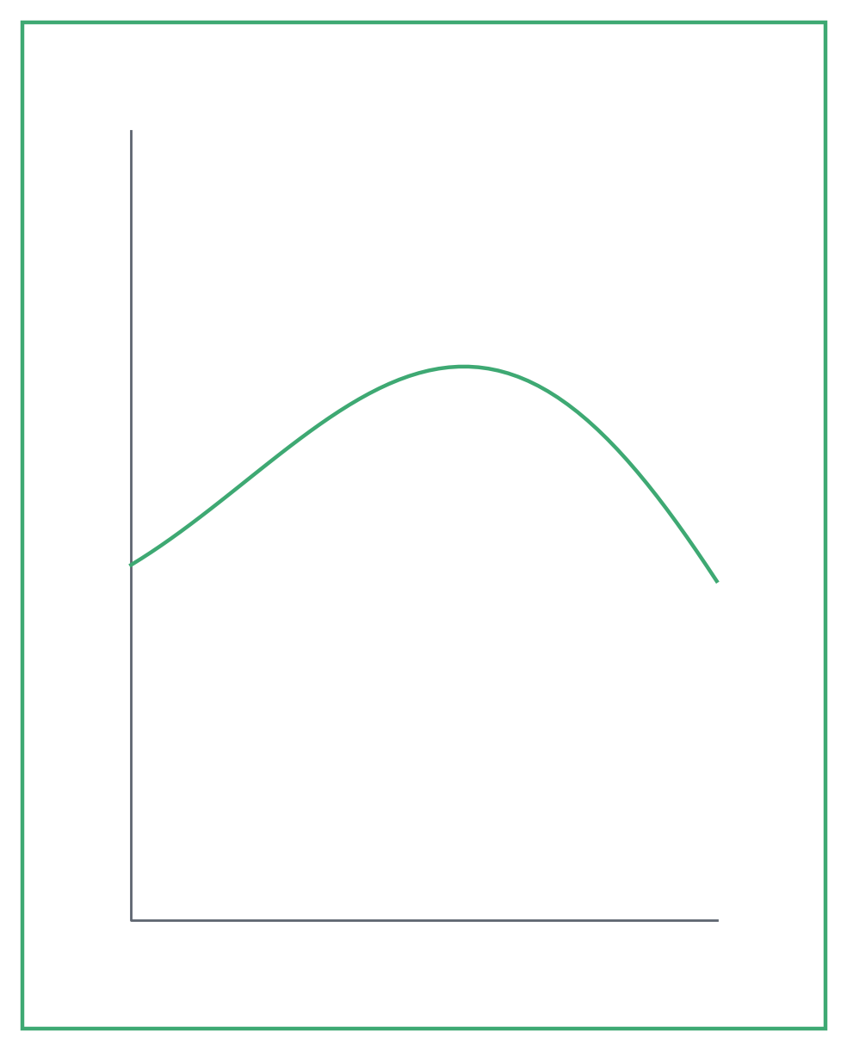
slide_tall - a portrait figure beside bullets
• Conversion rises with temperature
• Selectivity peaks near 250 C
• Model matches the measured trend

