Slide 1
phd_ui slide figures
presentation presets at true size on a 4:3 slide

Slide 2
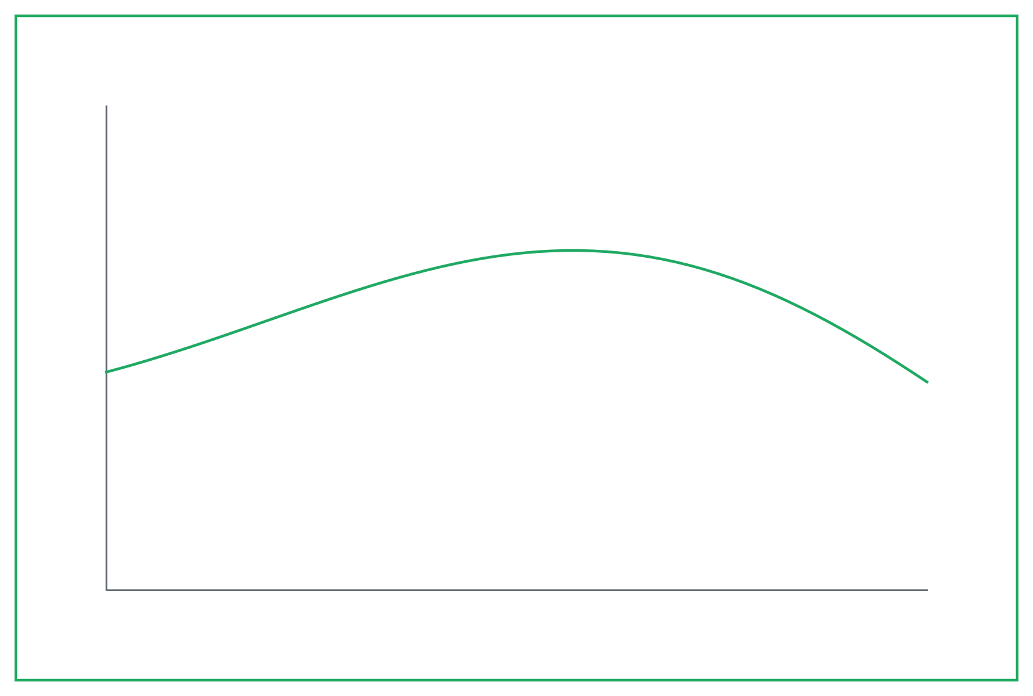
slide_4x3 - a slide-filling hero
slide_4x3 (21 x 14 cm)

Slide 3
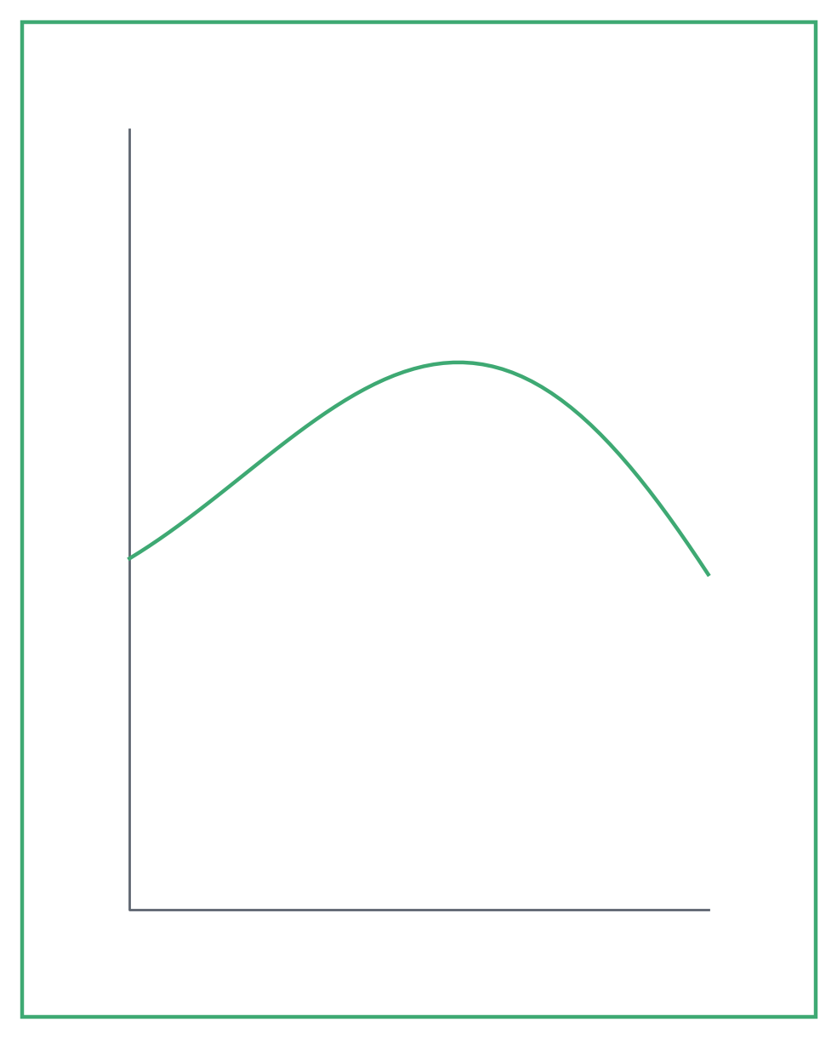
slide_tall - a portrait figure beside bullets
• Conversion rises with temperature
• Selectivity peaks near 250 C
• Model matches the measured trend

