Slide 1
phd_ui slide figures
presentation presets at true size on a 16:9 slide

Slide 2
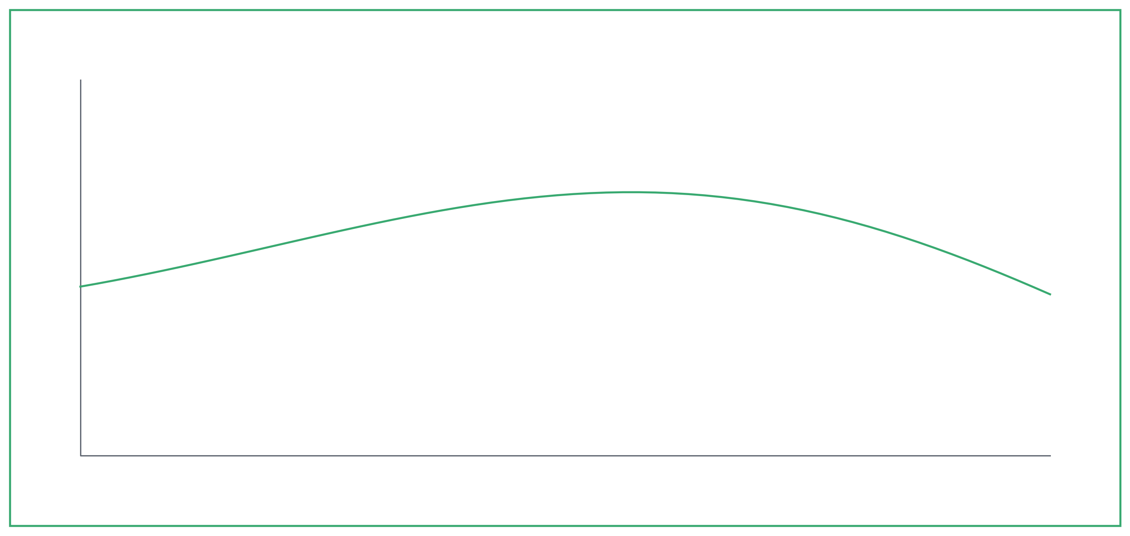
slide_full - fills the body box under the title

Slide 3
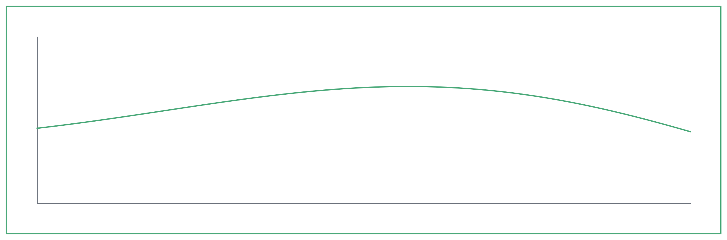
slide - full width, with room for a takeaway line
slide (31 x 10 cm)
• Conversion tracks the equilibrium limit above 240 C

Slide 4
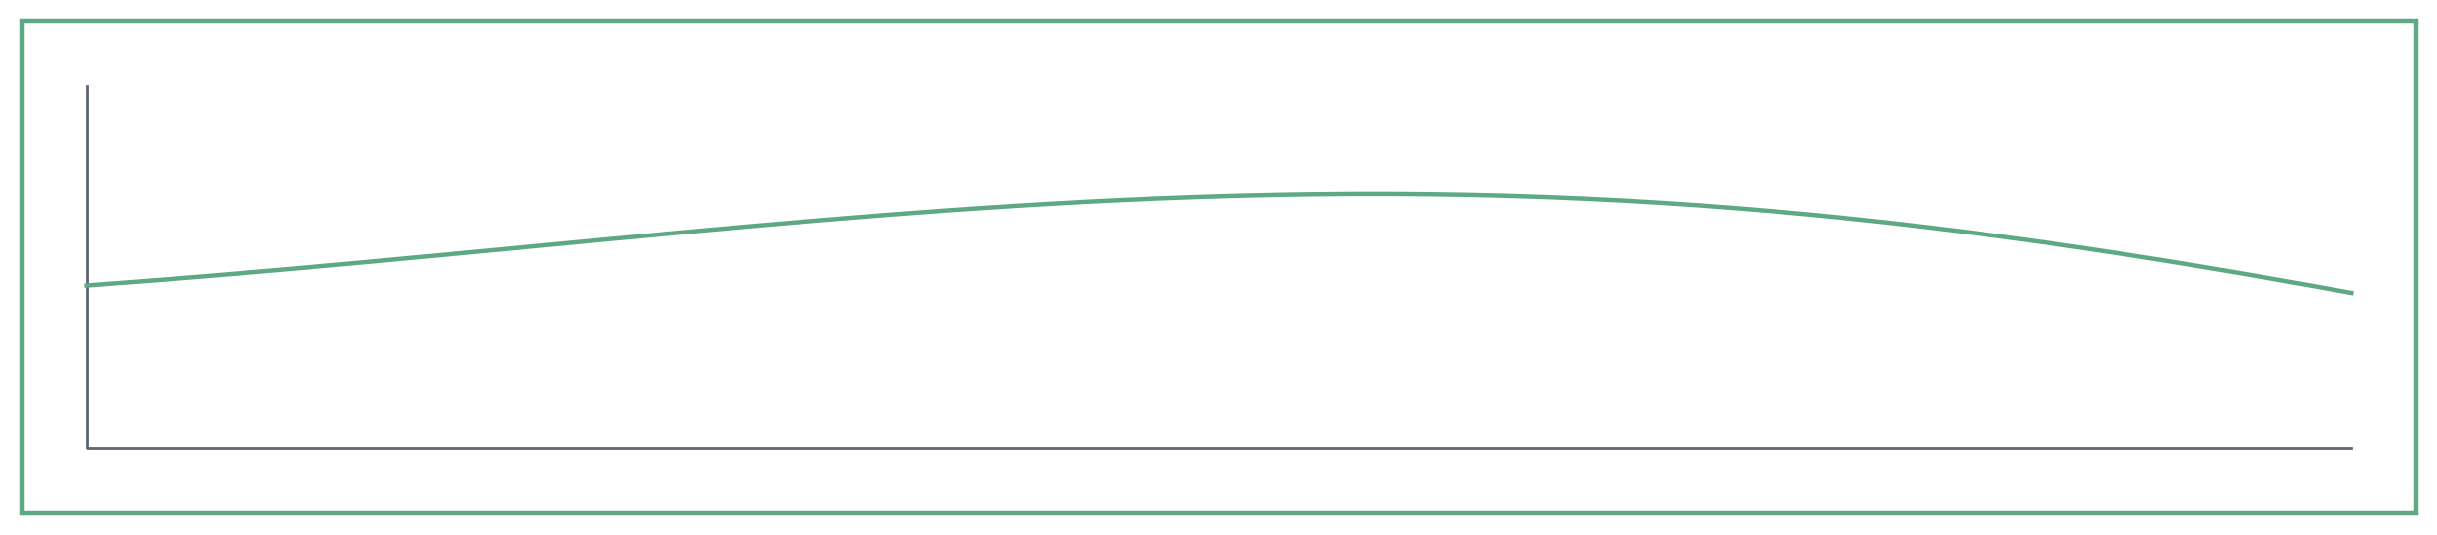
slide_short - a band across the body
slide_short (31 x 6.5 cm)
• Steady over 40 h on stream
• No deactivation at either feed ratio

Slide 5
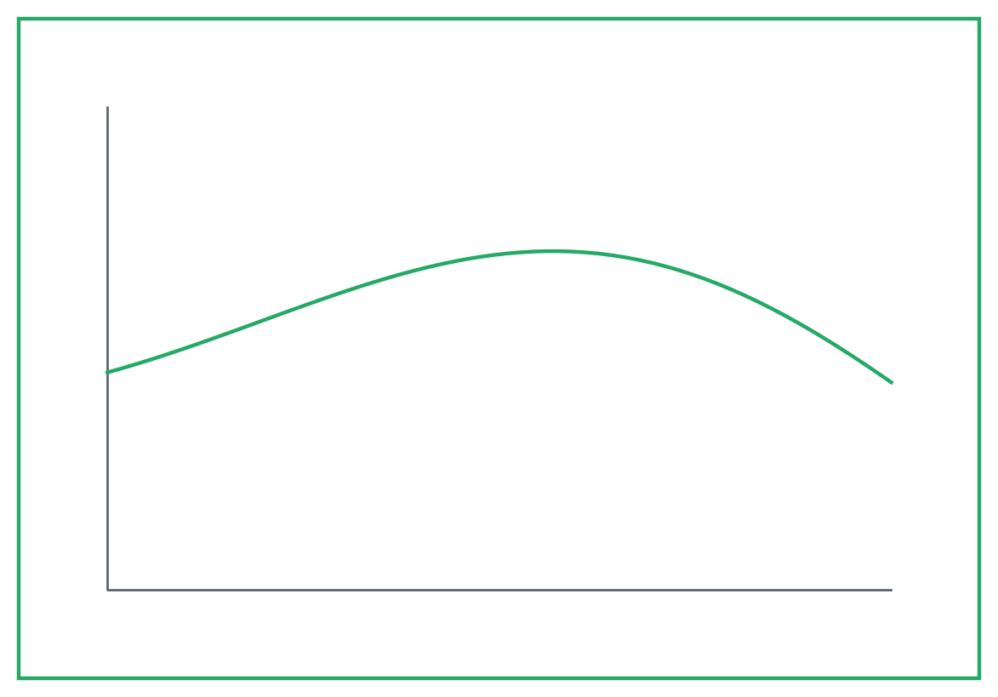
slide_half - two figures side by side
slide_half (14.5 x 10 cm)
slide_half (14.5 x 10 cm)

Slide 6
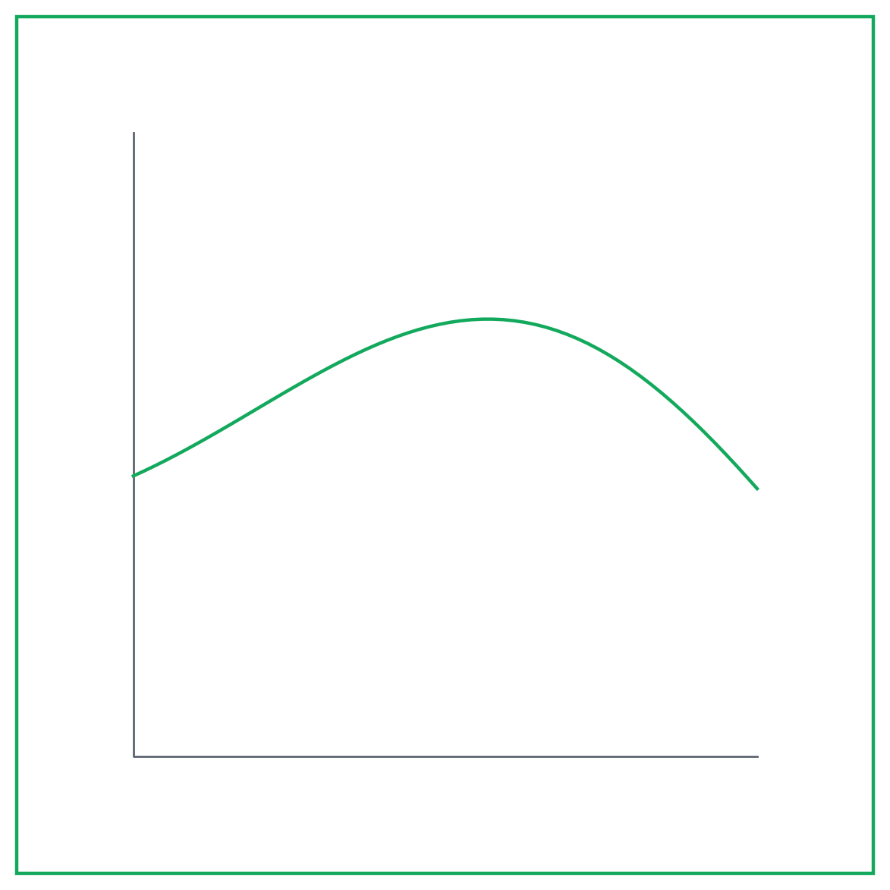
slide_square - a square figure beside bullets
• Conversion rises with temperature
• Selectivity peaks near 250 C
• Model matches the measured trend

Slide 7
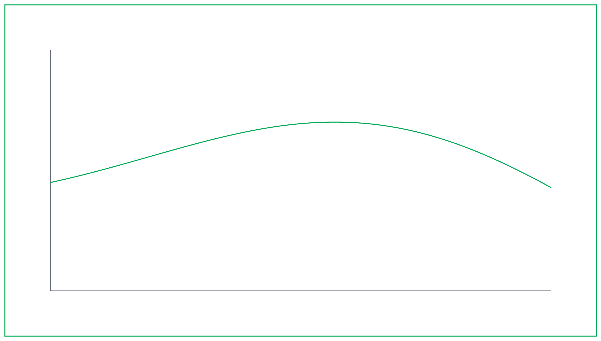

Slide 8
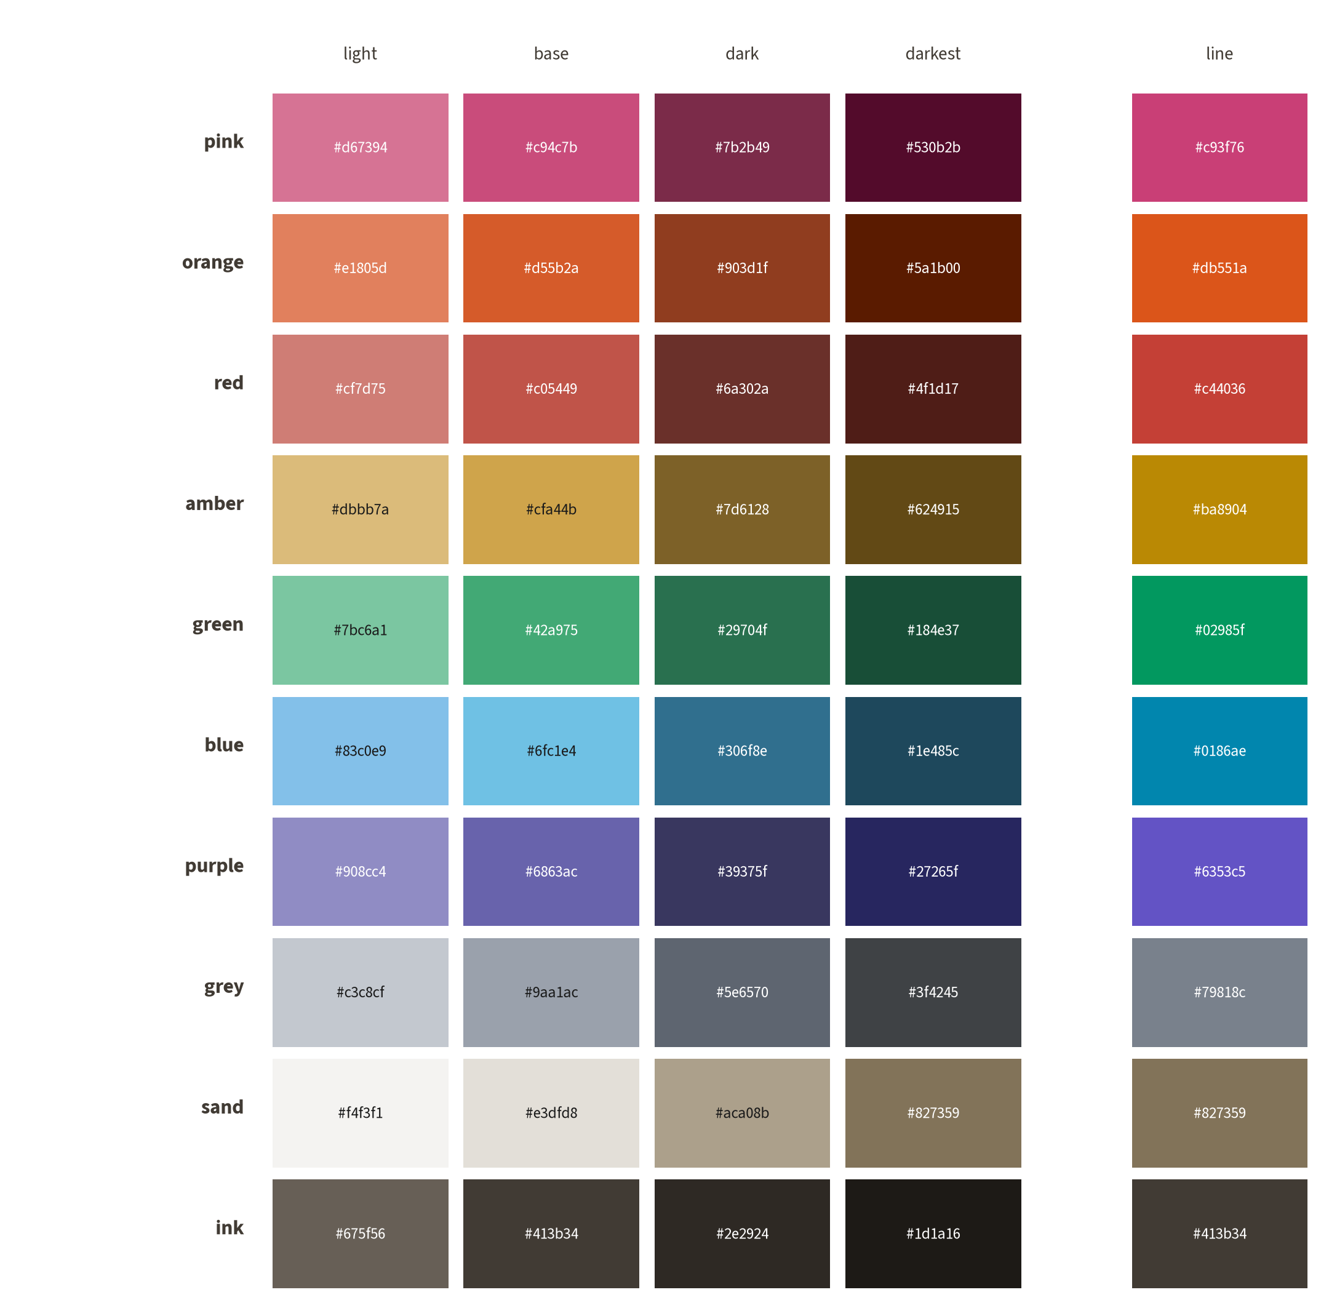
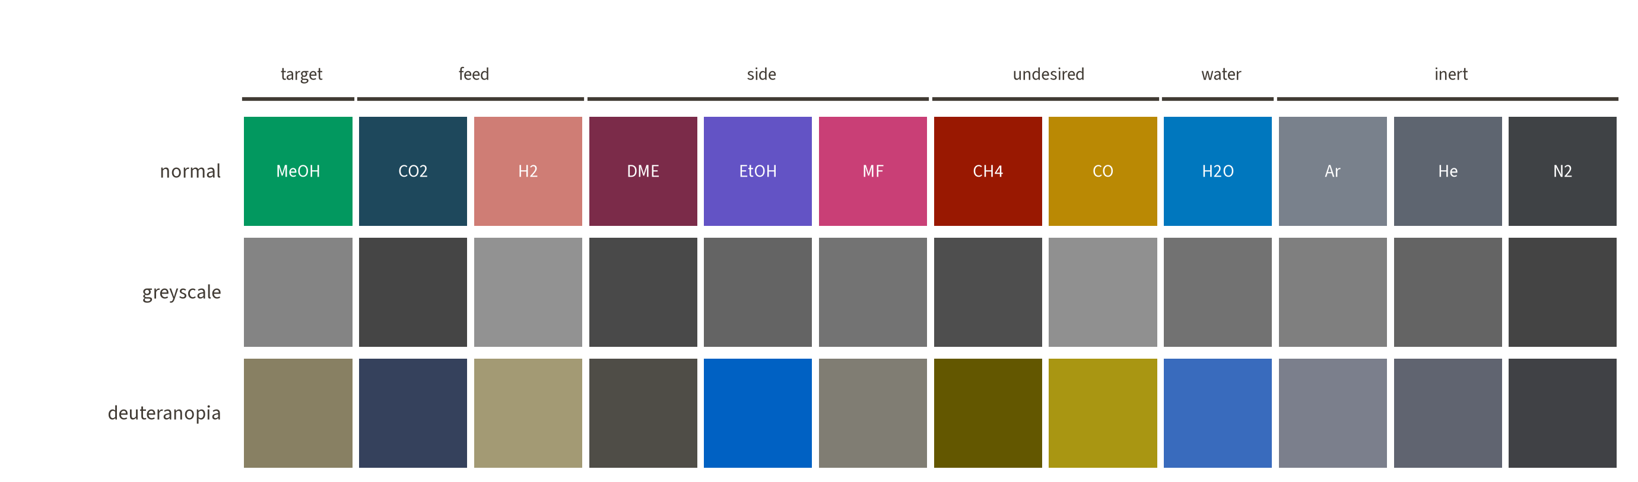
colour scheme: fill tones, line tones, species
• lines and markers take the line tone
• bands, patches and drawings the base tone
• a species keeps its hue in every figure type

Slide 9
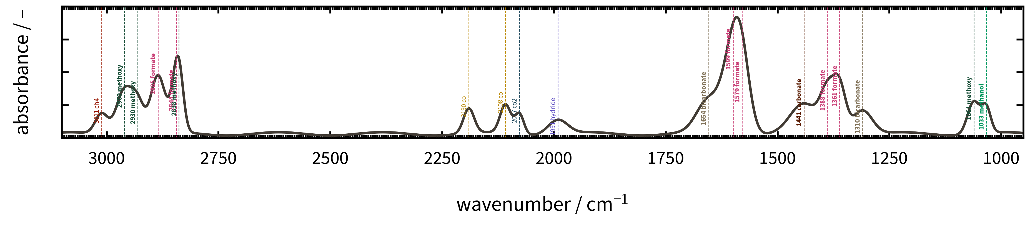
DRIFTS band colours follow the species
• hue = the species, the same in the atlas, the spectra and the MS traces
• lightness = how far along the pathway, methoxy darker than methanol
• formate pink as the methyl formate precursor, carbonates the two browns

Slide 10
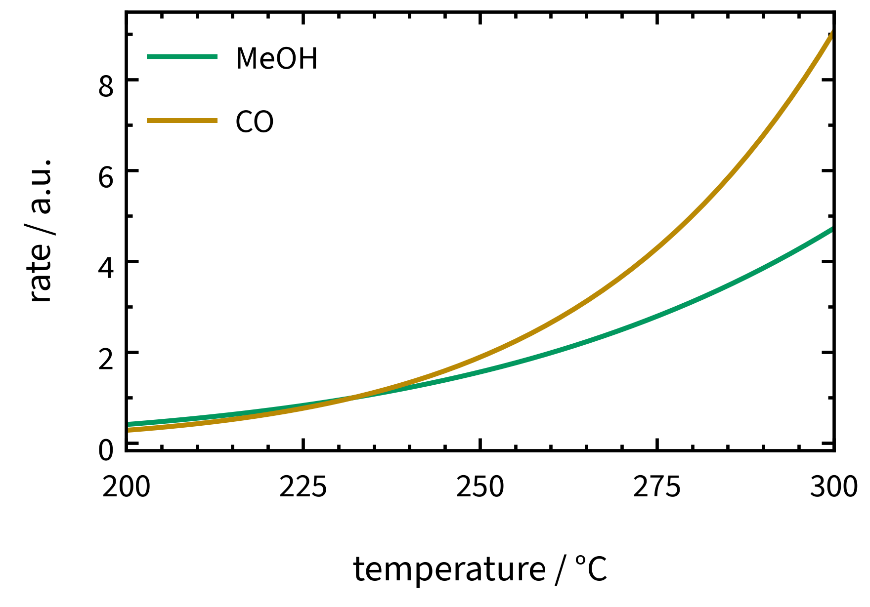
typography: 2x point size on a slide
Source Sans 3, 24 pt: the slide body
Source Sans 3, 18 pt: a bullet, the same size as the axis labels beside it
Segoe UI, 18 pt: the font used on the slides so far, for comparison
figure: 16 pt ticks and legend, 18 pt axis labels, Source Serif 4 for maths; on paper the same figure has 8 and 9 pt, beside 10 pt body text

Slide 11
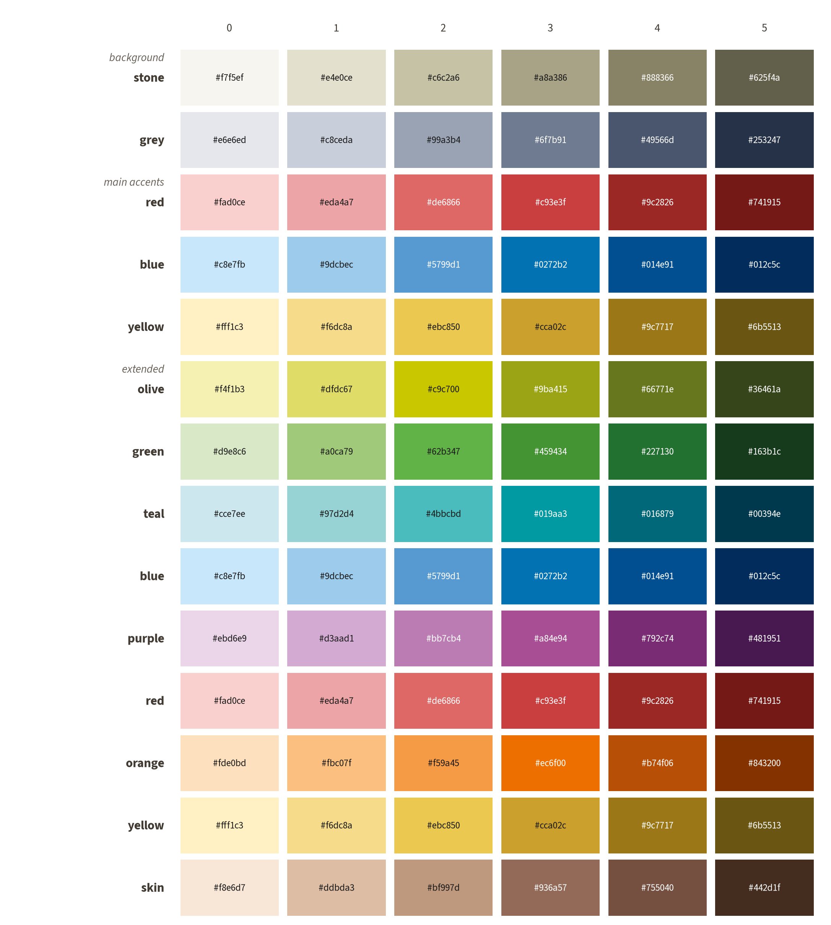
Nature's palette, for drawings in Nature's style
• background families for context
• main accents for the action
• the extended set to categorise and group
• for conceptual drawings, not for data figures

Slide 12
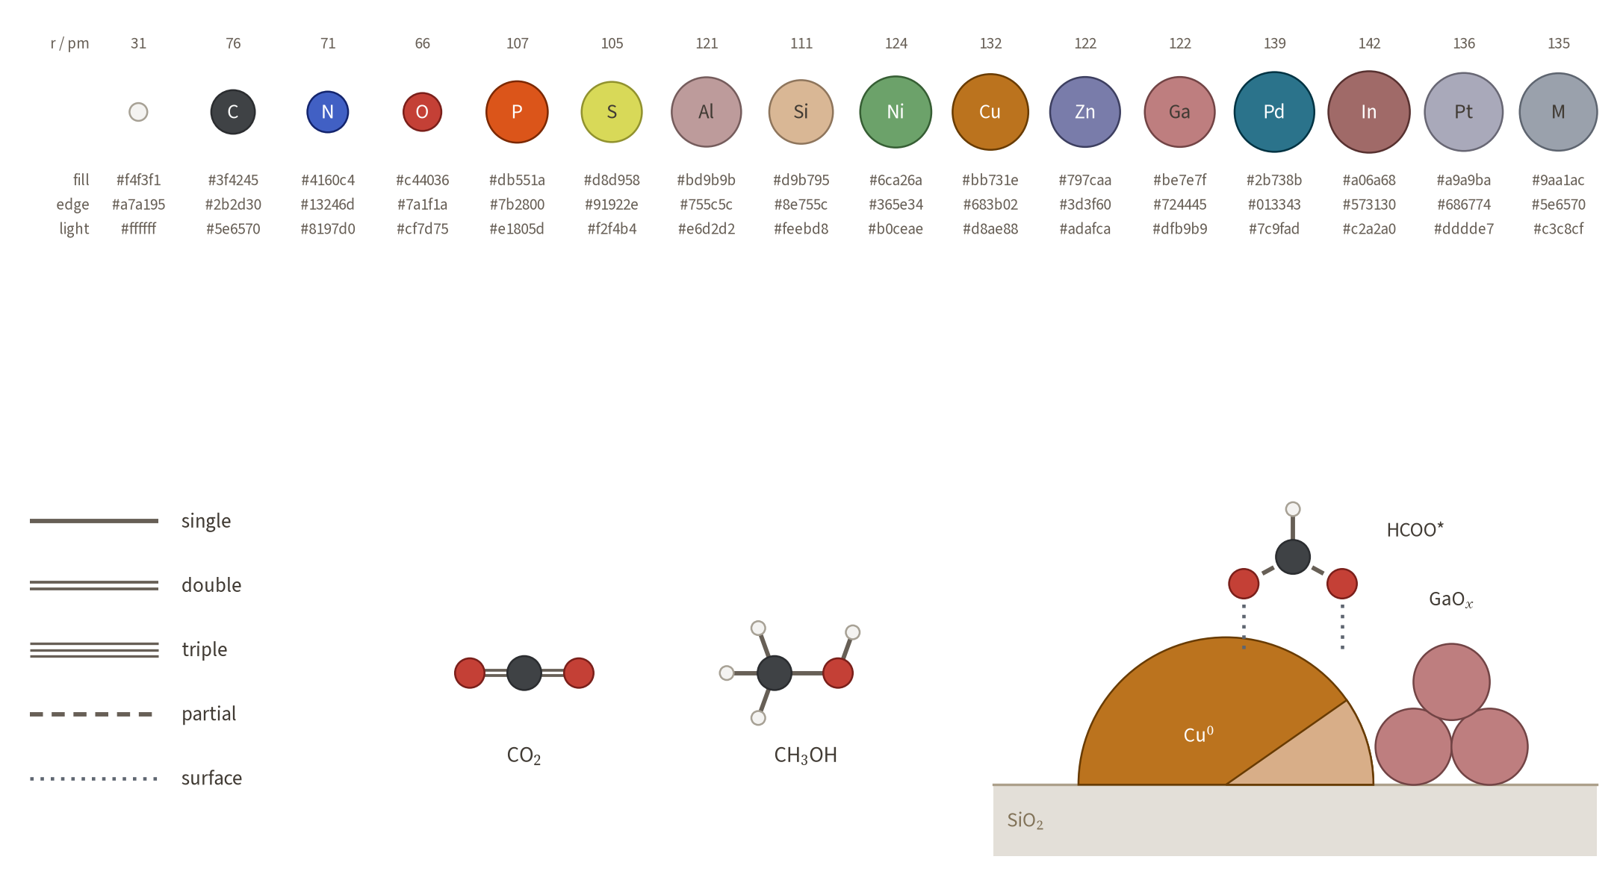
atoms and bonds: CPK, flat, true sizes

