Slide 1
Supervised Learning: Bias and Variance
Ayal Gussow

Slide 2
Today’s Outline
Evaluating our models
Balancing bias and variance
How to fit hyperparameters
Homework

Slide 3
Evaluating our Model
We need a way to assess how well we are doing
Tune our algorithm.
Report how well we are doing to a client, journal, etc.

Slide 4
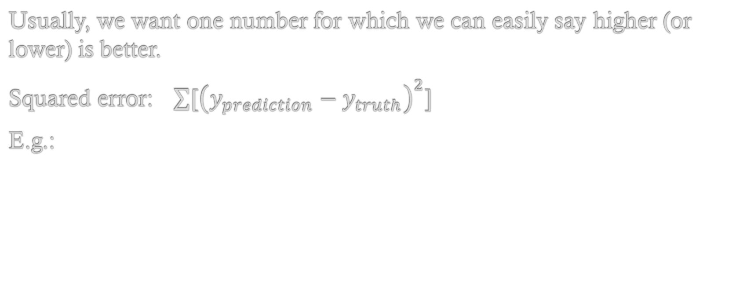
Common evaluations
Usually, we want one number for which we can easily say higher (or lower) is better.
Squared error: $\sum{{[\left(y_{prediction}−y_{truth}\right)}^{2}]}$
E.g.:
House ID | Predicted Price | True Price
1 | 100,000 | 50,000
2 | 150,000 | 150,000
3 | 600,500 | 700,000

Slide 5
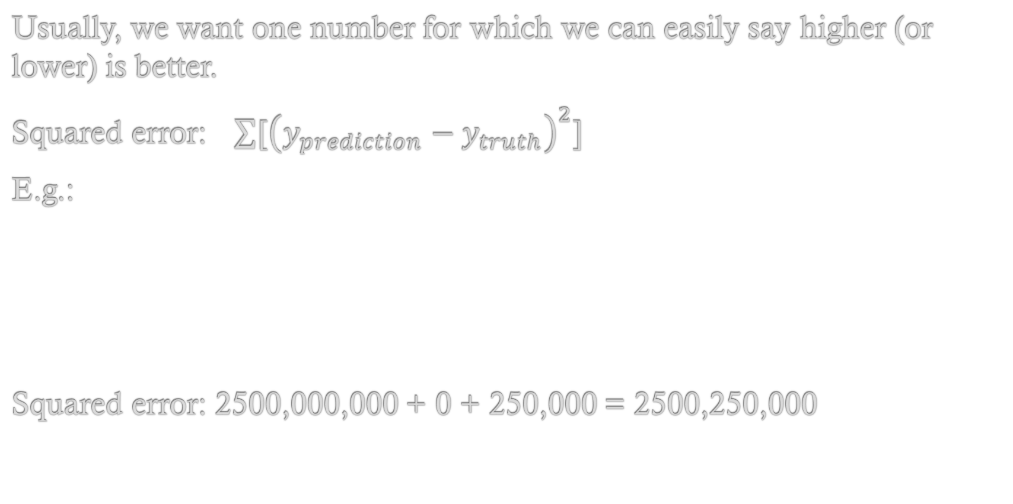
Common evaluations
Usually, we want one number for which we can easily say higher (or lower) is better.
Squared error: $\sum{{[\left(y_{prediction}−y_{truth}\right)}^{2}]}$
E.g.:
Squared error: 2500,000,000 + 0 + 250,000 = 2500,250,000
House ID | Predicted Price | True Price | Error
1 | 100,000 | 50,000 | 50,000
2 | 150,000 | 150,000 | 0
3 | 600,500 | 700,000 | -500

Slide 6
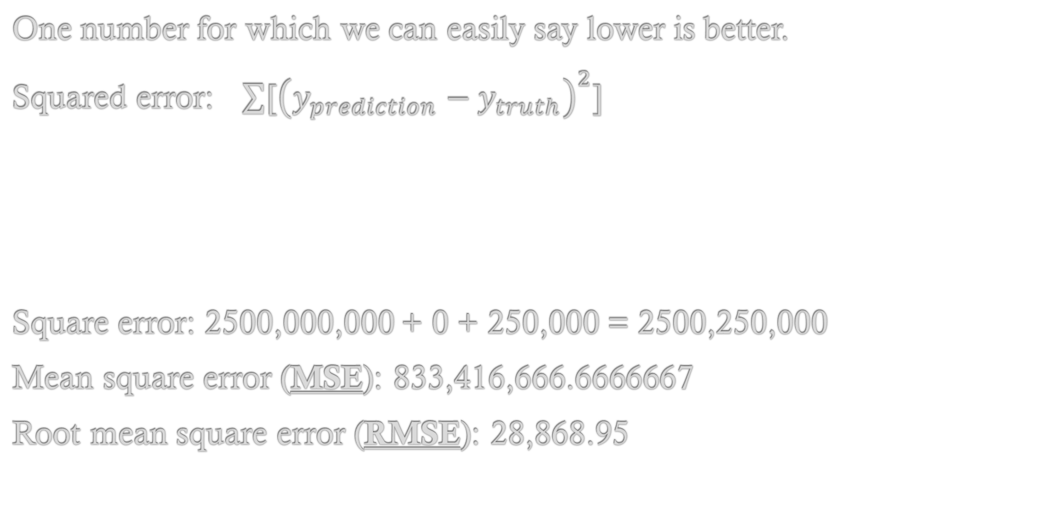
Common evaluations
One number for which we can easily say lower is better.
Squared error: $\sum{{[\left(y_{prediction}−y_{truth}\right)}^{2}]}$
Square error: 2500,000,000 + 0 + 250,000 = 2500,250,000
Mean square error (MSE): 833,416,666.6666667
Root mean square error (RMSE): 28,868.95
House ID | Predicted Price | True Price | Error
1 | 100,000 | 50,000 | 50,000
2 | 150,000 | 150,000 | 0
3 | 600,500 | 700,000 | -500

Slide 7
Common evaluations
We’ll talk about evaluations for classification in next class, but you’re probably familiar with some:
ROC AUC
PR-AUC

Slide 8
Common evaluations
How you evaluate is subjective.
Human level? (radiologist example)
Some semi-arbitrary cutoff (e.g. 50K deviation from house prices)
More complex needs, specific to your situation (perhaps you’d prefer to underestimate the chance of a false positive?)
This decision is subjective and will affect your model and outcomes.

Slide 9
Ames Dataset
Dataset of houses in Ames, Iowa with 79 features per house, including:
Square footage
Number of bathrooms
Number of fireplaces
etc
Price

Slide 10
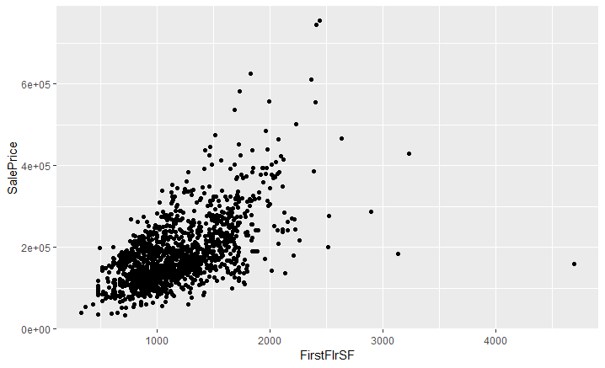
Ames Dataset

Slide 11
Ames Dataset
Dataset of houses in Ames, Iowa.
Subset to 10 houses.
Features:
Square footage of first floor
Predict: Price

Slide 12
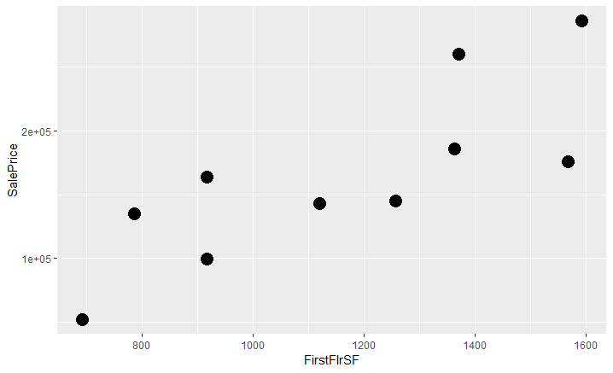
Ames Dataset

Slide 13

Linear Regression
$$y=Xβ$$
y = $β_{0}$ * 1 + $β_{1}$ * square_feet

Slide 14
Predict by first floor square footage
Square Footage | Predicted Price | Real Price | Difference
1120 | 157914 | 142953 | 14960.99
1372 | 201394 | 260000 | -58606
693 | 84239.48 | 52500 | 31739.48
1364 | 200013.7 | 185850 | 14163.71
1258 | 181724.5 | 145000 | 36724.49
1593 | 239525.3 | 286000 | -46474.7
786 | 100285.7 | 134900 | -34614.3
1569 | 235384.4 | 175900 | 59484.38
918 | 123060.9 | 99500 | 23560.94
RMSE: 39,169.82

Slide 15
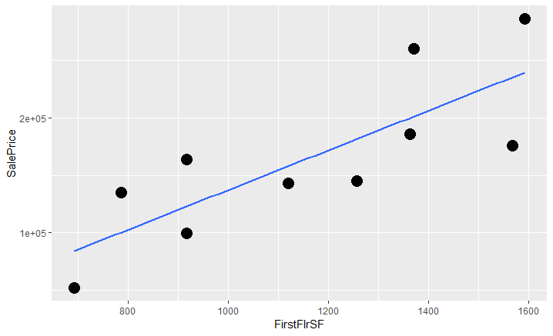

Our Goal
Minimize the RMSE.
$$y=Xβ$$
y = $β_{0}$ * 1 + $β_{1}$ * square_feet

Slide 16
Our Goal
Minimize the RMSE.
What if we do it too well?

Slide 17
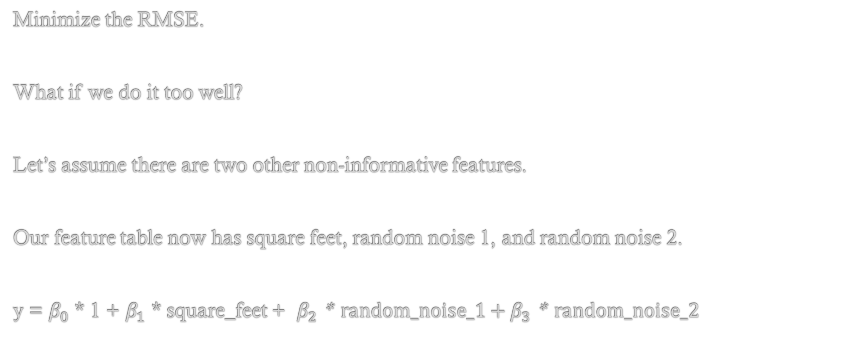
Our Goal
Minimize the RMSE.
What if we do it too well?
Let’s assume there are two other non-informative features.
Our feature table now has square feet, random noise 1, and random noise 2.
y = $β_{0}$ * 1 + $β_{1}$ * square_feet + $β_{2}$ * random_noise_1 + $β_{3}$ * random_noise_2

Slide 18
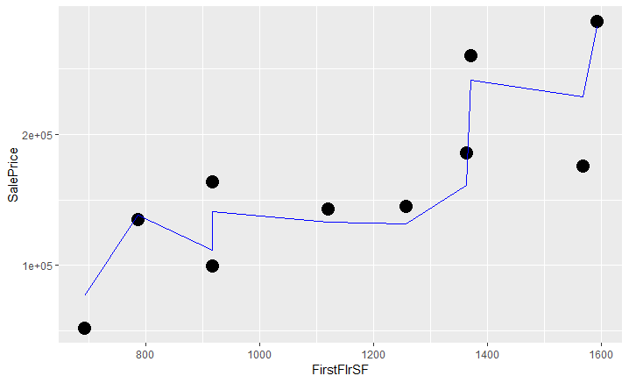
Our Goal
Let’s assume there are two other non-informative features.

Slide 19
Our Goal
Let’s assume there are two other non-informative features.

Slide 20
Our Goal
Let’s assume there are two other non-informative features.
RMSE: 39,169.82

Slide 21
Our Goal
Let’s assume there are two other non-informative features.
RMSE: 39,169.82
RMSE: 23,102.99

Slide 22
Model Variance
High-variance (model varies greatly with different data), overfitting
Overly complex model
Noise in model
Small subset of unrepresentative data

Slide 23
Model Variance

Slide 24
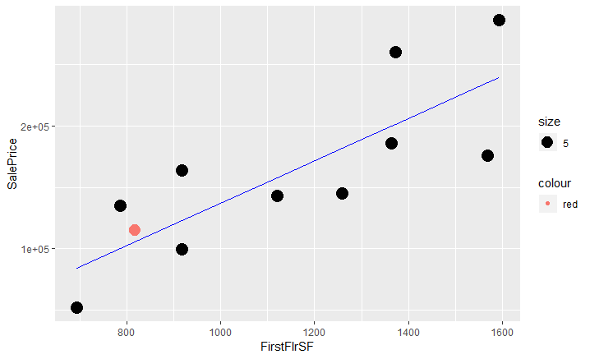
Model Variance
Off by $9,193

Slide 25
Model Variance
High-variance (model varies greatly with different data), overfitting
Overly complex model
Noise in model
Small subset of unrepresentative data

Slide 26
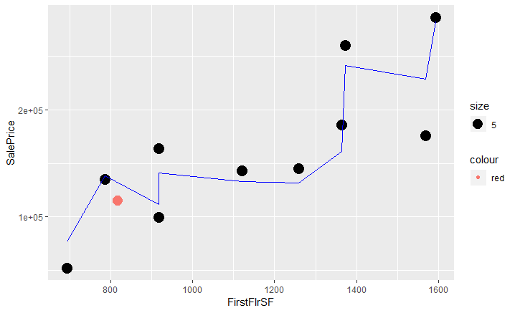
Model Variance
High-variance (model varies greatly with different data), overfitting
Off by $31,608

Slide 27
Model Variance
High-variance models don’t generalize well.
How to combat it?
More data.
Simpler models.
E.g. Linear regression vs Decision Tree
Manually select features, more features leads to a more complex model.
Regularization. Penalize model for giving too much weight to a given feature.
Cross-validation. Assessment of how well the model generalizes.

Slide 28
Regularization
Basic goal: Lower model complexity and prevent overfitting.
This can be done by minimizing the our coefficients.

Slide 29


Regularization
Let’s take our overfit equation:
y = $β_{0}$ * 1 + $β_{1}$ * square_feet + $β_{2}$ * random_noise_1 + $β_{3}$ * random_noise_2
Normally, when calculating our betas we find the solution that minimizes the RMSE:
$$\sum{{[\left(y_{prediction}−y_{truth}\right)}^{2}]}$$

Slide 30

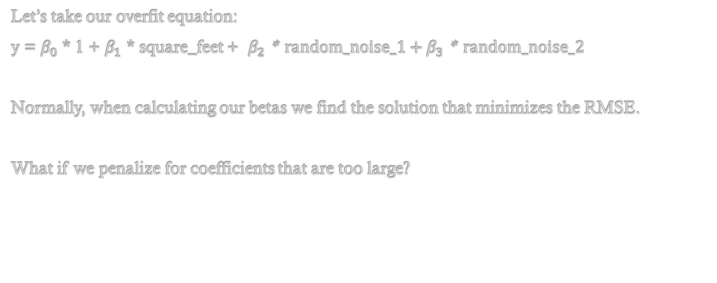
Regularization
Let’s take our overfit equation:
y = $β_{0}$ * 1 + $β_{1}$ * square_feet + $β_{2}$ * random_noise_1 + $β_{3}$ * random_noise_2
Normally, when calculating our betas we find the solution that minimizes the RMSE.
What if we penalize for coefficients that are too large?
$\sum{{[\left(y_{prediction}−y_{truth}\right)}^{2}]}$ $+ λ∑β^{2}$

Slide 31

Regularization
$\sum{{[\left(y_{prediction}−y_{truth}\right)}^{2}]}$ $+ λ∑β^{2}$
$λ∑β^{2}$ is our regularization term. Now when we are minimizing both the RMSE and the magnitude of our coefficients.

Slide 32
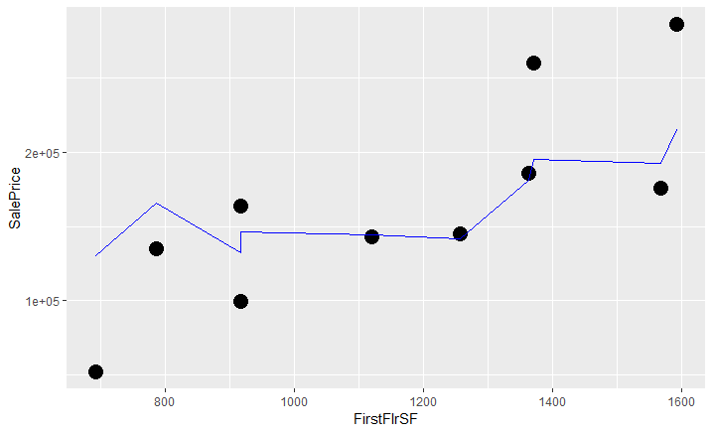
Regularization
$\sum{{[\left(y_{prediction}−y_{truth}\right)}^{2}]}$ $+ λ∑β^{2}$
$λ∑β^{2}$ is our regularization term. Now when we are minimizing both the RMSE and the magnitude of our coefficients.

Slide 33

Regularization
$\sum{{[\left(y_{prediction}−y_{truth}\right)}^{2}]}$ $+ λ∑β^{2}$
Names: Ridge regression, L2 regression
Need to set the lambda parameter.
In sklearn:
sklearn.linear_model.Ridge

Slide 34

Regularization
$\sum{{[\left(y_{prediction}−y_{truth}\right)}^{2}]}$ $+ λ∑β^{2}$
What if lambda is set incredibly high?

Slide 35
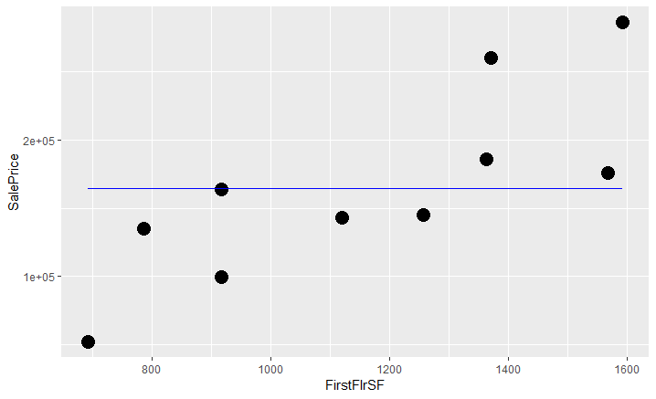
Regularization
$\sum{{[\left(y_{prediction}−y_{truth}\right)}^{2}]}$ $+ λ∑β^{2}$
What if lambda is set incredibly high?

Slide 36
High Bias
High bias, underfitting

Slide 37
High Bias vs High Variance
High Bias, underfitting
High Variance, overfitting

Slide 38
The Bias-Variance Tradeoff
Models with high bias won’t fit the data well, and won’t learn from the data.
Models with high variance will fit the data too well, and give vastly different results for different data subsets.

Slide 39
The Bias-Variance Tradeoff
Ideally, you will strike a
Balance between the two.
Sometimes, the balance
is subjective.

Slide 40
Evaluating Bias-Variance
How can you evaluate how well your model generalizes?
The simplest way: holdout a percentage of data (~20%) and test the model on that.
In our example of n=10, we could split the data into a training set of 8 and a testing set of 2.
We can then calculate the training error (RMSE of the training set) and the test error RMSE of test set.

Slide 41
Evaluating Bias-Variance
How can you evaluate how well your model generalizes?
The simplest way: holdout a percentage of data (~20%) and test the model on that.
In our example of n=10, we could split the data into a training set of 8 and a testing set of 2.
We can then calculate the training error (RMSE of the training set) and the test error RMSE of test set.

Slide 42
Evaluating Bias-Variance
The simplest way: holdout a percentage of data (~20%) and test the model on that.
Issues:
The two that we holdout may not be representative.
Can we afford to ignore two datapoints?

Slide 43
Evaluating Bias-Variance
Cross-validation.
LeavePOut.
KFold.
StratifiedKFold.

Slide 44
Evaluating Bias-Variance
Cross-validation.
Using cross-validation you can use the average metric as your assessment, and also see the distribution.

Slide 45
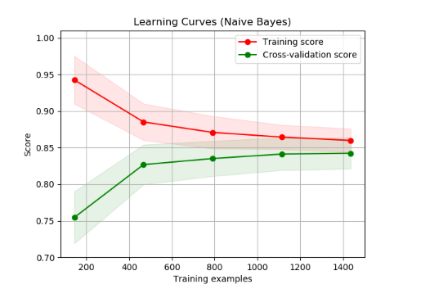
Is my algorithm too biased, or too variant?
Context matters, but basically:
If curves converge to low score, you are likely
dealing with high bias (underfitting).
If training curve is much higher, you are likely
dealing with high variance (overfitting).
http://scikit-learn.org/stable/modules/learning_curve.html

Slide 46
Is my algorithm too biased, or too variant?
To fix high variance:
Fewer features
More training examples
Fix high bias:
Add features
Examine model (linear?)
http://scikit-learn.org/stable/modules/learning_curve.html

Slide 47
Selecting Hyperparameters
What are hyperparameters?
Model parameters, such as:
Lambda (in regularized linear regression)
n_trees, max_depth (in Random Forest)
Some models have multiple parameters to set.

Slide 48
Selecting Hyperparameters
How do we decide what to set a hyperparameter to?
Say, n_trees and max_depth.
Option 1: We can choose hyperparameters ourselves (based on knowledge of domain).
E.g. “I think around 1,000 trees should work with a max_depth of 50.”

Slide 49
Selecting Hyperparameters
How do we decide what to set a hyperparameter to?
Say, n_trees and max_depth.
Option 1: We can choose hyperparameters ourselves (based on knowledge of domain).
Option 2: We can do a search across a preset parameter space. Sklearn: GridSearchCV.
E.g. “Somewhere between 100 to 10,000 trees should work, and a max_depth of 10 to 200. Let’s try all possible combinations / a random subset / evolutionary choice of options”.

Slide 50
Selecting Hyperparameters
Envision the following:
You have a set of data for housing prices predictions.
You decide to use a random forest model.
You choose an n_trees parameter and find that your CV RMSE is $30,000.
You manually play with the n_trees parameter (or you use a method like GridSearchCV).
You find that the optimal n_trees is 1057, with a CV RMSE of $300.
You report your model with an RMSE of $300.

Slide 51
Selecting Hyperparameters
Model is now overfit to hyperparameters and your assessment is overly optimistic.
Extra reading: http://jmlr.csail.mit.edu/papers/volume11/cawley10a/cawley10a.pdf

Slide 52
Selecting Hyperparameters
Solution: Nested CV.
For each split, we will calculate the score on the testing set and report the distribution.
All Data
Training (2/3)
Testing (1/3)
3x

Slide 53
Selecting Hyperparameters
Solution: Nested CV.
All Data
Training (2/3)
Testing (1/3)
3x
Training (2/3)
Testing (1/3)
A different set of hyperparameters is used for until
the optimal is found.
3x

Slide 54
Selecting Hyperparameters
Solution: Nested CV.
All Data
Training (2/3)
Testing (1/3)
3x
Training (2/3)
Testing (1/3)
A different set of hyperparameters is used for until
the optimal is found.
3x

