Slide 1

SCHEDULE CREATOR
SOFTWARE SYSTEMS DEVELOPMENT
Team-27

Slide 2
Team Overview
Jeet Shah - 2022201009
Mayank Gupta - 2022201012
Amitabh Paliwal - 2022201030
Gaurav Khapekar - 2022201055
Project Mentor :
Sai Anirudh Karre

Slide 3
Introduction - Idea
The schedule generator application generates a schedule based on user input.
The user only has to provide details about the event such as its name, description, number of days, number of events of a particular type and their duration, number of breaks, and their duration.
Upon providing such details the user receives a downloadable schedule.
The application has a variety of use cases as it can be used wherever a schedule is required.

Slide 4



Technology Stack

Slide 5
Application Structure

Slide 6
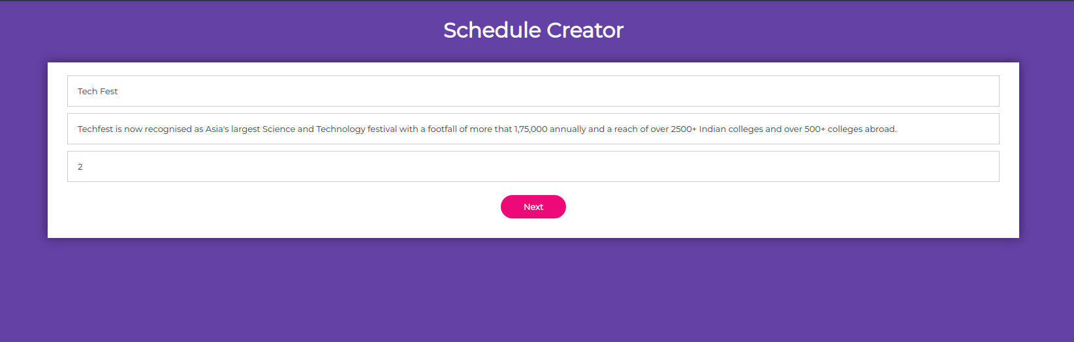
Screen 1 :
User has to provide Event Name, Event Description, No. of days for that Event.

Slide 7
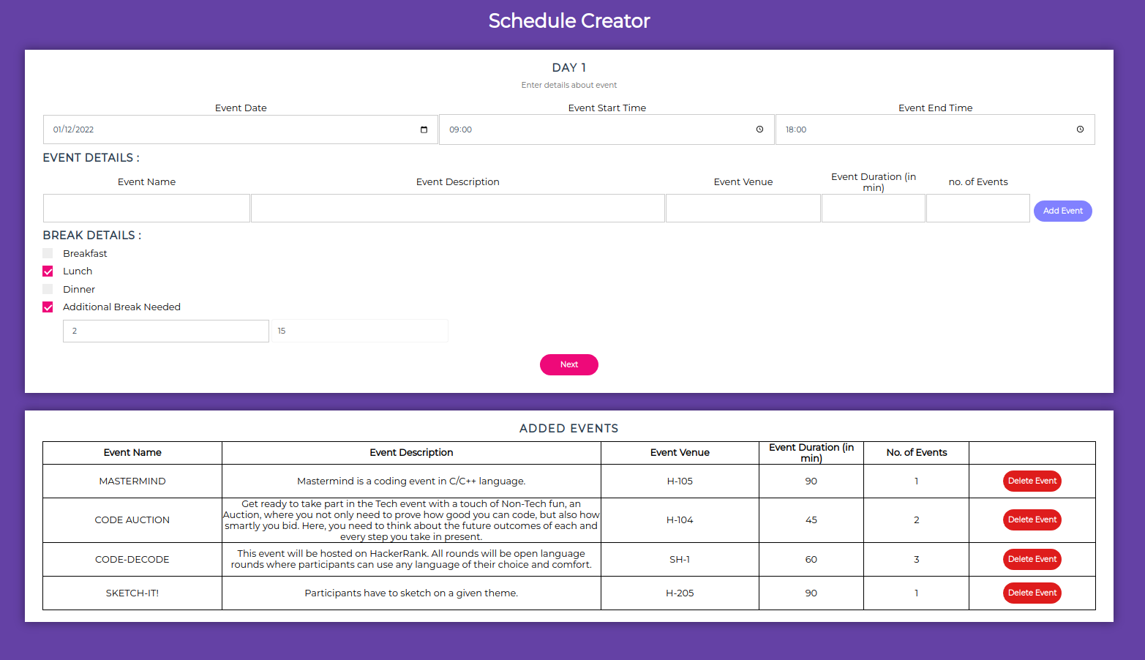
Screen 2 :
User has to provide Event, Break Details. (Based on the no. of days.)

Slide 8
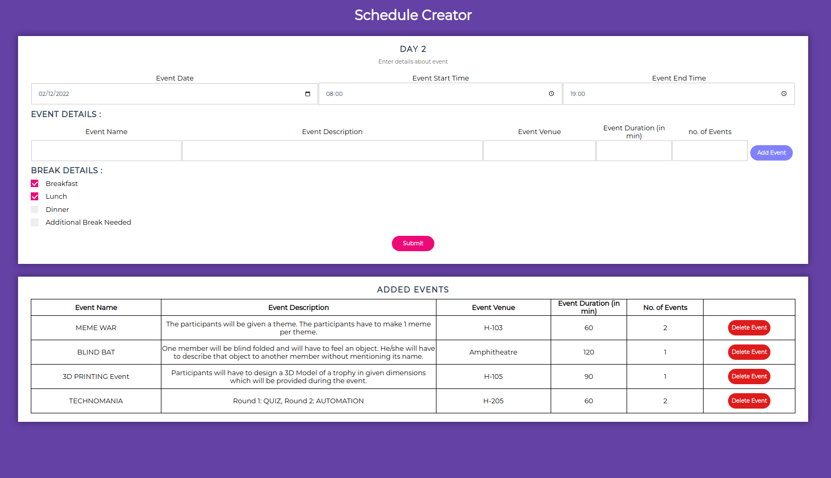

Slide 9
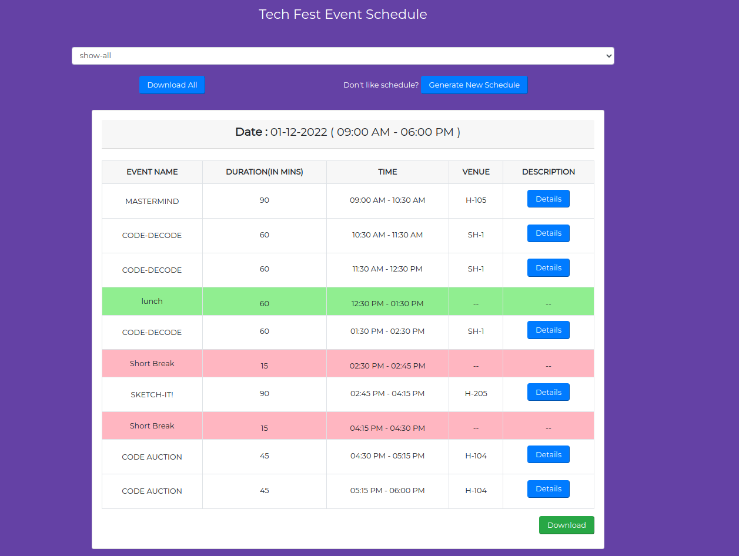
Screen 3 :
Created Schedule will be displayed. (User can filter schedule on basis of Dates, also if user don’t like the schedule, the new schedule can be created by clicking Generate New Schedule button.)

Slide 10
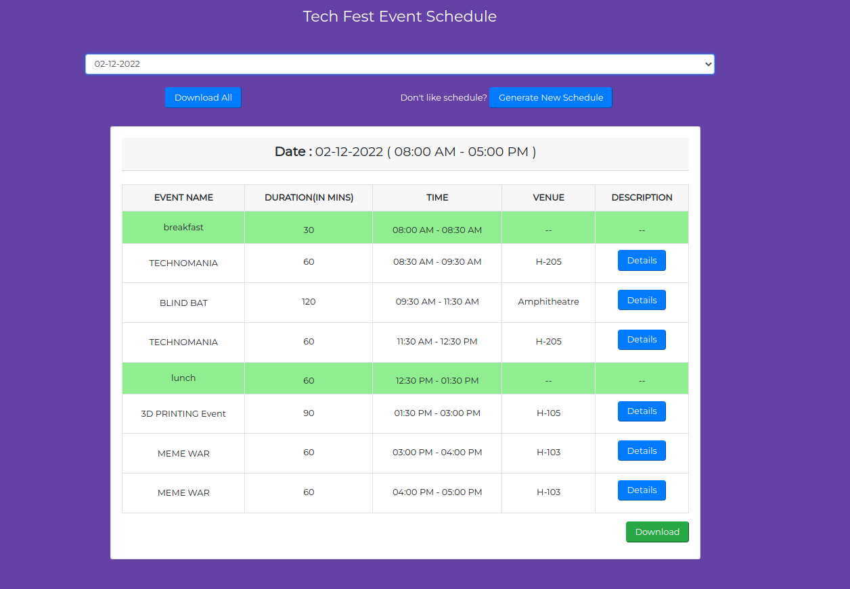

Slide 11
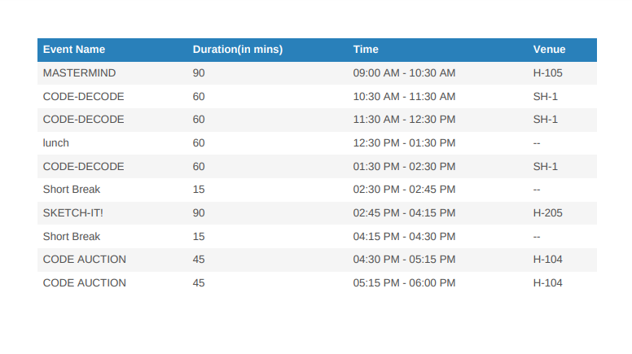
Screen 4 :
Created Schedule can be downloaded by clicking on download button.

Slide 12
Thank You

