Slide 1
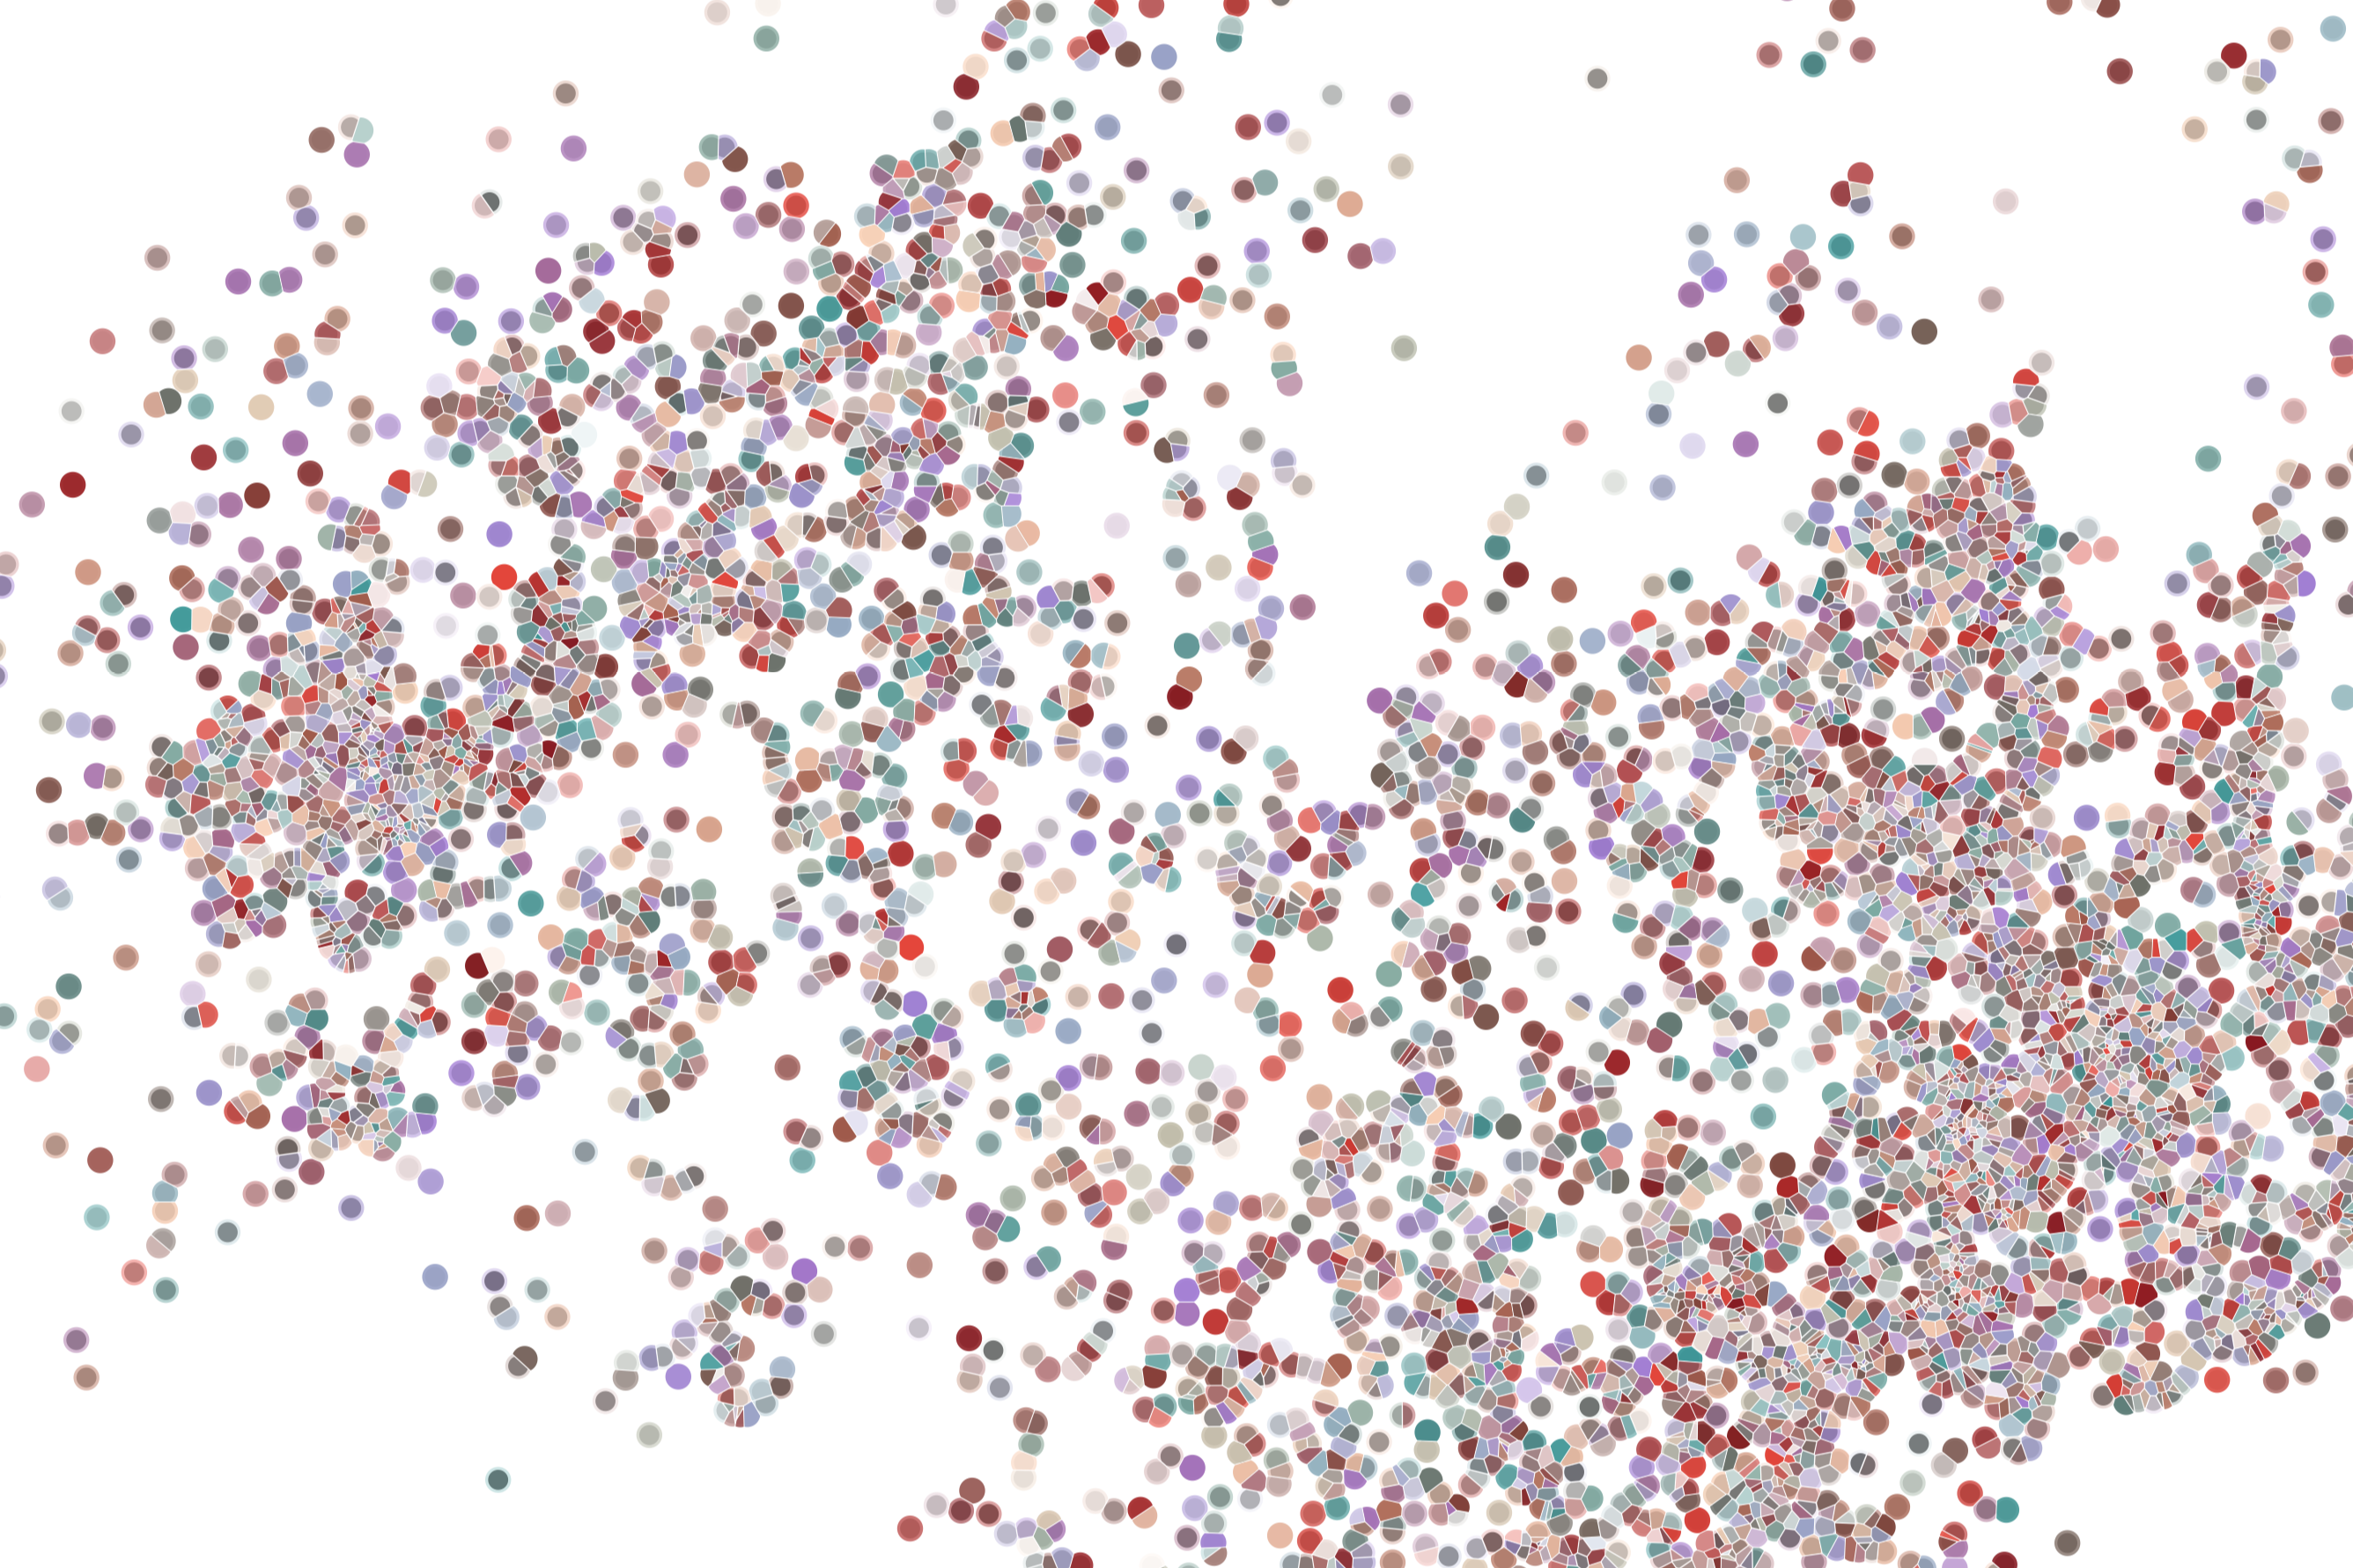
The developer toolkit
Physalia course 2022
Instructor: Jacques Serizay
Notes:
Hello everybody and thank you for attending my presentation. I am going to talk about the project I recently started working on in the Spassky and Koszul labs, both located in Paris. This project focuses on the unusual cooption of the mitotic machinery to drive, not cell division but cell differentiation.

Slide 2
Bioconductor version
To develop an R/Bioc package, developers must be careful of the weather…
https://contributions.bioconductor.org/use-devel.html#use-devel
BEWARE
BIOC VERSION
Package authors should develop against the version of R that will be available to users when the Bioconductor devel branch becomes the Bioconductor release branch.
R has a ‘.y’ release in x.y.z every year (typically mid-April), but Bioconductor has a .y release (where current devel becomes release) every 6 months (mid-April and mid-October).
This means that:
from mid-October through mid-April, Bioconductor developers should be developing against R-devel
from mid-April to mid-October, developers should use R-release for Bioconductor development.

Slide 3
The (Bioc.) developer toolkit
https://r-pkgs.org/
https://contributions.bioconductor.org/index.html
devtools
usethis
remotes
testthat
BiocCheck
Biocthis
RStudio
And many more…: https://indrajeetpatil.github.io/awesome-r-pkgtools/

Slide 4
Devtools and co
devtools makes package development easier by providing R functions that simplify and expedite common tasks.

Slide 5
Devtools and co
devtools makes package development easier by providing R functions that simplify and expedite common tasks.
For interactive use, useRs should attach devtools and think of it as the provider of your favorite functions for package development.
library(devtools)
#Loading required package: usethis
load_all()

Slide 6
Devtools and co
devtools makes package development easier by providing R functions that simplify and expedite common tasks.
For interactive use, useRs should attach devtools and think of it as the provider of your favorite functions for package development.
For programmatic use, such as inside another package, developeRs should NOT depend on devtools, but should instead access functions via the package that is their primary home.
library(devtools)
#Loading required package: usethis
load_all()
pkgload::load_all()

Slide 7
Devtools and co
devtools makes package development easier by providing R functions that simplify and expedite common tasks.
For interactive use, useRs should attach devtools and think of it as the provider of your favorite functions for package development.
For programmatic use, such as inside another package, developeRs should NOT depend on devtools, but should instead access functions via the package that is their primary home.
“One Ring to rule them all”
– The Free People
library(devtools)
#Loading required package: usethis
load_all()
pkgload::load_all()

Slide 8
Devtools and co
devtools makes package development easier by providing R functions that simplify and expedite common tasks.
devtools’ NAMESPACE:
importFrom(cli,cat_bullet)
importFrom(cli,cat_rule)
importFrom(ellipsis,check_dots_used)
importFrom(lifecycle,deprecated)
importFrom(memoise,memoise)
importFrom(miniUI,miniPage)
importFrom(pkgbuild,clean_dll)
importFrom(pkgbuild,find_rtools)
importFrom(pkgbuild,has_devel)
importFrom(pkgbuild,with_debug)
importFrom(pkgload,check_dep_version)
importFrom(pkgload,parse_deps)
importFrom(pkgload,unload)
importFrom(profvis,profvis)
importFrom(remotes,dev_package_deps)
importFrom(remotes,github_pull)
importFrom(remotes,github_release)
importFrom(remotes,install_bioc)
importFrom(remotes,install_bitbucket)
importFrom(remotes,install_cran)
importFrom(remotes,install_dev)
importFrom(remotes,install_git)
importFrom(remotes,install_github)
importFrom(remotes,install_gitlab)
importFrom(remotes,install_local)
importFrom(remotes,install_svn)
importFrom(remotes,install_url)
importFrom(remotes,install_version)
importFrom(remotes,update_packages)
importFrom(sessioninfo,package_info)
importFrom(sessioninfo,session_info)
importFrom(stats,update)
importFrom(urlchecker,url_check)
importFrom(usethis,ui_code)
importFrom(usethis,ui_done)
importFrom(usethis,ui_field)
importFrom(usethis,ui_path)
importFrom(usethis,ui_todo)
importFrom(usethis,ui_value)
importFrom(usethis,use_test)
importFrom(utils,available.packages)
importFrom(utils,contrib.url)
importFrom(utils,install.packages)
importFrom(utils,installed.packages)
importFrom(utils,modifyList)
importFrom(utils,packageDescription)
importFrom(utils,packageVersion)
importFrom(utils,remove.packages)

Slide 9
Devtools and co
devtools makes package development easier by providing R functions that simplify and expedite common tasks.
> sessionInfo()
R version 4.1.2 (2021-11-01)
Platform: x86_64-apple-darwin17.0 (64-bit)
Running under: macOS High Sierra 10.13.6
Matrix products: default
BLAS: /Library/Frameworks/R.framework/Versions/4.1/Resources/lib/libRblas.0.dylib
LAPACK: /Library/Frameworks/R.framework/Versions/4.1/Resources/lib/libRlapack.dylib
locale:
[1] en_GB.UTF-8/en_GB.UTF-8/en_GB.UTF-8/C/en_GB.UTF-8/en_GB.UTF-8
attached base packages:
[1] stats graphics grDevices utils datasets methods base
other attached packages:
[1] devtools_2.4.1 usethis_2.0.1
loaded via a namespace (and not attached):
[1] ps_1.6.0 prettyunits_1.1.1 rprojroot_2.0.2 crayon_1.4.1
[5] withr_2.4.2 R6_2.5.0 lifecycle_1.0.0 magrittr_2.0.1
[9] rlang_0.4.11 cachem_1.0.5 cli_2.5.0 rstudioapi_0.13
[13] remotes_2.4.2 fs_1.5.0 testthat_3.0.2 callr_3.7.0
[17] ellipsis_0.3.2 desc_1.3.0 tools_4.1.2 glue_1.4.2
[21] purrr_0.3.4 pkgload_1.2.1 fastmap_1.1.0 compiler_4.1.2
[25] processx_3.5.2 pkgbuild_1.2.0 sessioninfo_1.1.1 memoise_2.0.0

Slide 10
The Bioc. developer toolkit
https://r-pkgs.org/
https://contributions.bioconductor.org/index.html
devtools
usethis
remotes
testthat
BiocCheck
Biocthis
RStudio
And many more…: https://indrajeetpatil.github.io/awesome-r-pkgtools/
→ Fastening early package development

Slide 11
The Bioc. developer toolkit
https://r-pkgs.org/
https://contributions.bioconductor.org/index.html
devtools
usethis
remotes
testthat
BiocCheck
Biocthis
RStudio
And many more…: https://indrajeetpatil.github.io/awesome-r-pkgtools/
→ Installing packages from anywhere

Slide 12
Some useful functions
>remotes::install_*
remotes::install_gitlab
remotes::install_github
remotes::install_cran
remotes::install_deps
remotes::install_bitbucket
remotes::install_local
remotes::install_dev
remotes::install_url
remotes::install_svn
remotes::install_version
remotes::install_bioc
remotes::install_git
remotes::install_remote
>usethis::use_*
usethis::use_gpl_license
usethis::use_git_ignore
usethis::use_version
usethis::use_roxygen_md
usethis::use_github_action
usethis::use_github
usethis::use_data
usethis::use_tibble
usethis::use_vignette
usethis::use_readme_md
usethis::use_description
usethis::use_git_credentials
usethis::use_test
usethis::use_pipe
usethis::use_agpl_license
usethis::use_tidy_upkeep_issue
usethis::use_github_links
usethis::use_description_defaults
usethis::use_bioc_badge
usethis::use_pkgdown_github_pages
usethis::use_tidy_github_actions
usethis::use_coverage
usethis::use_package_doc
usethis::use_github_actions
usethis::use_git_config
usethis::use_usethis
usethis::use_pkgdown
usethis::use_testthat

Slide 13
The Bioc. developer toolkit
https://r-pkgs.org/
https://contributions.bioconductor.org/index.html
devtools
usethis
remotes
testthat
BiocCheck
Biocthis
RStudio
And many more…: https://indrajeetpatil.github.io/awesome-r-pkgtools/
→ Adding unit testing in later package development

Slide 14
The Bioc. developer toolkit
https://r-pkgs.org/
https://contributions.bioconductor.org/index.html
devtools
usethis
remotes
testthat
BiocCheck
Biocthis
RStudio
And many more…: https://indrajeetpatil.github.io/awesome-r-pkgtools/
→ Extra Bioconductor-specific features

Slide 15
Some useful functions
>testthat::expect_*
testthat::expect_match
testthat::expect_snapshot_warning
testthat::expect_snapshot_error
testthat::expect_equal
testthat::expect_lt
testthat::expect_cpp_tests_pass
testthat::expect_condition
testthat::expect_equivalent
testthat::expect_failure
testthat::expect_visible
testthat::expect_s3_class
testthat::expect_known_hash
testthat::expect_length
testthat::expect_less_than
testthat::expect_equal_to_reference
testthat::expect_warning
testthat::expect_snapshot
testthat::expect_snapshot_output
testthat::expect_true
testthat::expect_that
testthat::expect_error
testthat::expect_lte
testthat::expect_reference
testthat::expect_s4_class
testthat::expect_setequal
testthat::expect_invisible
testthat::expect_null
testthat::expect_message
testthat::expect_snapshot_value
testthat::expect_mapequal
testthat::expect_silent
testthat::expect_more_than
testthat::expect_known_value
testthat::expect_named
testthat::expect_false
testthat::expect_is
testthat::expect_type
testthat::expect_output_file
testthat::expect_snapshot_file
testthat::expect_success
testthat::expect_output
testthat::expect_gte
testthat::expect_gt
testthat::expect_known_output
testthat::expect_vector
testthat::expect_identical
testthat::expect_no_match
>biocthis::*
biocthis::use_bioc_description
biocthis::bioc_style
biocthis::use_bioc_vignette
biocthis::use_bioc_citation
biocthis::use_bioc_github_action
biocthis::use_bioc_pkg_templates
biocthis::biocthis_example_pkg
biocthis::use_bioc_support
biocthis::use_bioc_issue_template
biocthis::use_bioc_readme_rmd
biocthis::use_bioc_coc
biocthis::use_bioc_news_md

Slide 16
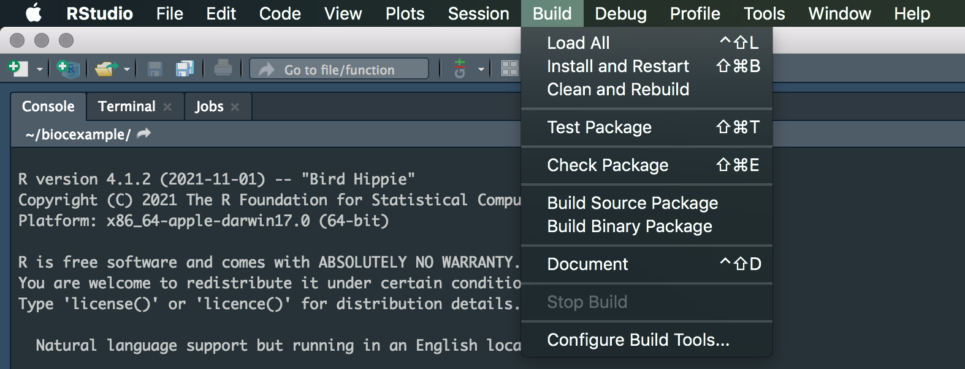
Rstudio and package development
“devtools works hand-in-hand with RStudio, which we [Hadley] believe is the best development environment for most R users. To be clear, you can use devtools without using RStudio and you can develop packages in RStudio without using devtools. But there is a special, two-way relationship that makes it very rewarding to use devtools and RStudio together.”

Slide 17
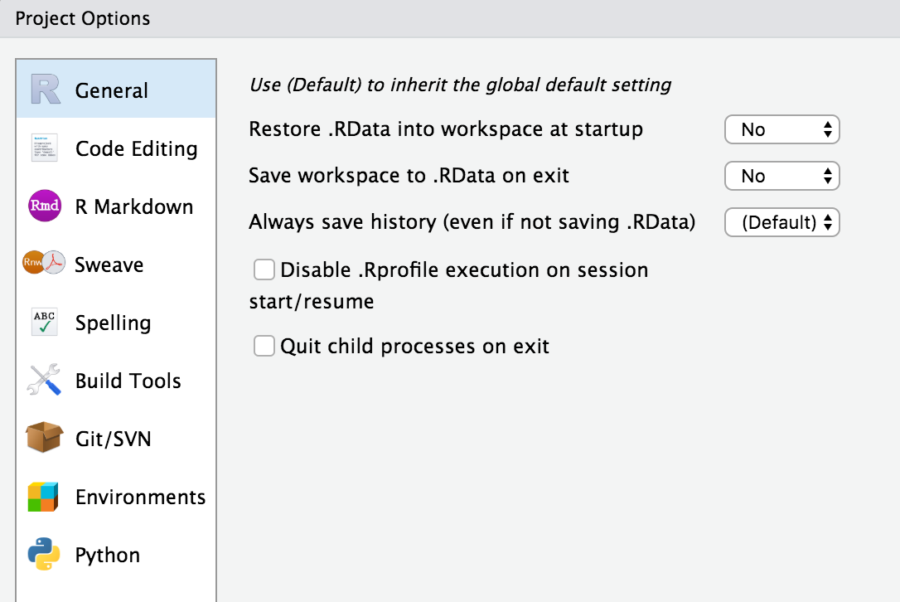
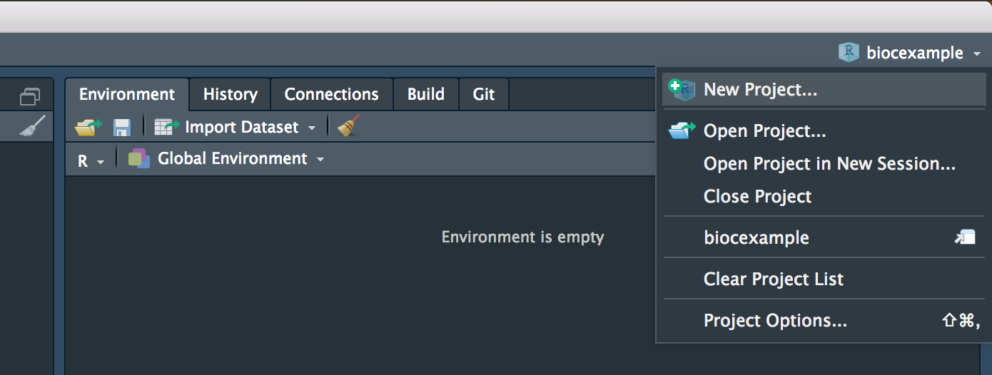
Rstudio and projects (.Rproj files)
Projects are very “launch-able”. It’s easy to fire up a fresh instance of RStudio in a Project, with the file browser and working directory set exactly the way you need, ready for work.
Each Project is isolated. You can have several RStudio Projects open at once and code executed in Project A does not have any effect on the R session and workspace of Project B.
You get handy code navigation tools like F2 to jump to a function definition and Ctrl + . to look up functions or files by name.
You get useful keyboard shortcuts and a clickable interface for common package development tasks, like generating documentation, running tests, or checking the entire package.

Slide 18
Rstudio and projects (.Rproj files)
Working with projects ensures:
That you are not accidently loading additional variables when opening Rstudio after rebooting
That your package root is always correct!
Many more convenient stuff you don’t actually want to realize it would need to be taken care of without projects (e.g. package dependencies, versions, …)
> library(devtools)
> usethis::create_package()
> usethis::use_rstudio()
> usethis::proj_sitrep()

