Slide 1
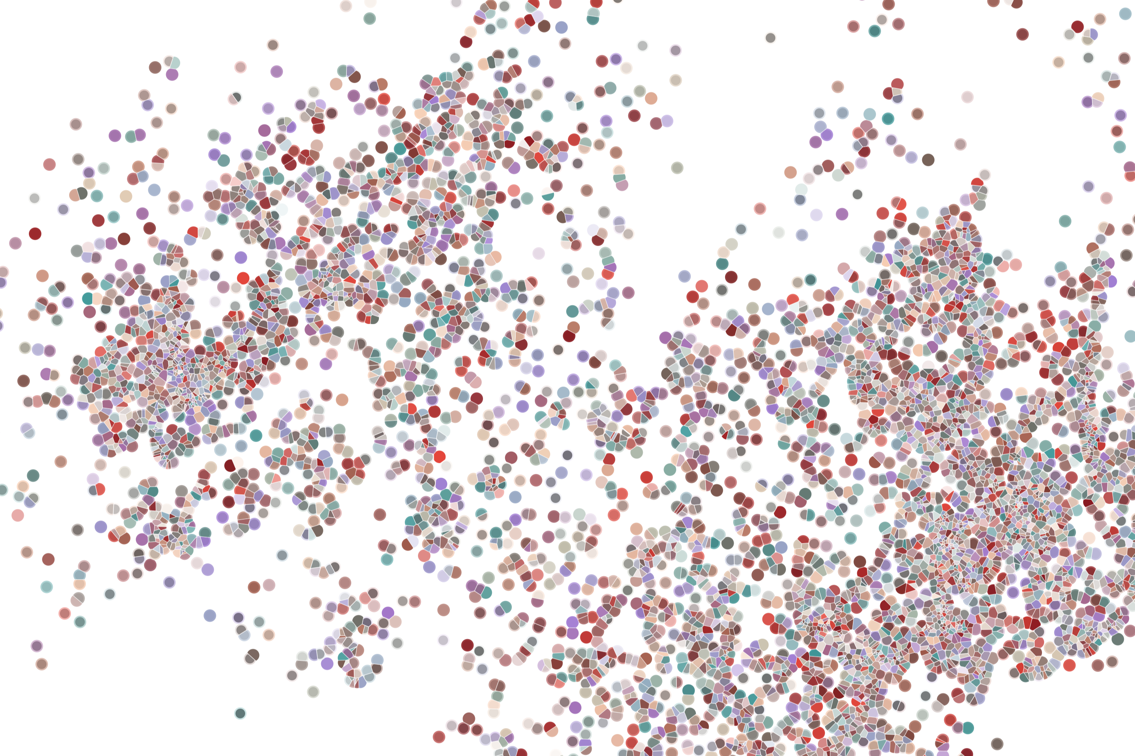
Developing R/Bioconductor packages for bioinformatics
Physalia course 2022
Instructor: Jacques Serizay
Notes:
Hello everybody and thank you for attending my presentation. I am going to talk about the project I recently started working on in the Spassky and Koszul labs, both located in Paris. This project focuses on the unusual cooption of the mitotic machinery to drive, not cell division but cell differentiation.

Slide 2
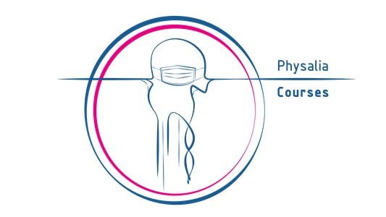
Overall goals
Leverage `Bioconductor` principles of interoperability (a.k.a "do-not-reinvent-the-wheel!")
Write sets of interconnected functions for genomic data
Document and test functions
Manage package dependencies
Manage package versions
Manage package continuous integration
Build a dedicated website for your package
Submitting/releasing/maintaining your package
Disseminating your package (publish it!)
HAVE FUN!
2
Notes:
I would like to expand these observations to in vivo data. I also want to check what happens in terms of transcriptional dynamics in cells where Cyclin O, a key non-canonical cyclin involved in MCC diff., is knocked-out.

Slide 3
Organizational notes
https://github.com/js2264/Bioc-workshop
Ask questions or use chat! Raise hand in Zoom (Participants).
Please use video, and mute microphone when not in use.
Write comments and questions in the dedicated Slack channel.
Please be patient with technical issues (network, Zoom, etc...).
3
Notes:
I would like to expand these observations to in vivo data. I also want to check what happens in terms of transcriptional dynamics in cells where Cyclin O, a key non-canonical cyclin involved in MCC diff., is knocked-out.

Slide 4
Schedule
Formal lectures:
Key concepts, theory (~1-2h).
Practical examples / demonstration:
Translate the theory into a real-life `R/Bioconductor` package (~1-2h)
Homeworks:
During the rest of the daily sessions, you will work by yourself, following guided exercises to practice your package development skills. Hints and solution are provided for each exercise. The exercises will mainly focus on specific concepts introduced earlier that day but also build up throughout the week to reach a comprehensive view of package development.
Office hours:
During the last hour of the day, I will be available for 1-to-1 or group meetings to answer questions/give advices.
This is the first edition of this course, and I do appreciate any feedback!!
4
Notes:
I would like to expand these observations to in vivo data. I also want to check what happens in terms of transcriptional dynamics in cells where Cyclin O, a key non-canonical cyclin involved in MCC diff., is knocked-out.

Slide 5
Baby steps
1. Developing R/Bioconductor packages for bioinformatics
2. Developing R/Bioconductor packages for bioinformatics
3. Developing R/Bioconductor packages for bioinformatics
5
Notes:
I would like to expand these observations to in vivo data. I also want to check what happens in terms of transcriptional dynamics in cells where Cyclin O, a key non-canonical cyclin involved in MCC diff., is knocked-out.

Slide 6
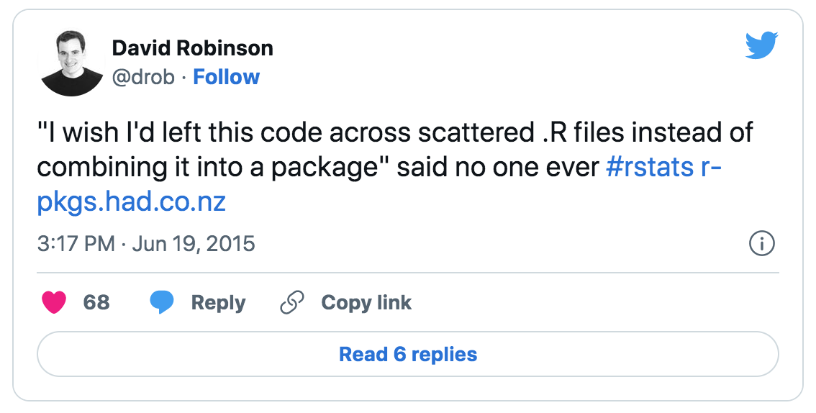
Why bother developing a package?
Re-usability: Tired of copying-pasting your functions?
6
Notes:
I would like to expand these observations to in vivo data. I also want to check what happens in terms of transcriptional dynamics in cells where Cyclin O, a key non-canonical cyclin involved in MCC diff., is knocked-out.

Slide 7
Why bother developing a package?
Re-usability: Tired of copying-pasting your functions?
Distribution: Everybody (or not) can access your package, you help yourself and everyone!
7
Notes:
I would like to expand these observations to in vivo data. I also want to check what happens in terms of transcriptional dynamics in cells where Cyclin O, a key non-canonical cyclin involved in MCC diff., is knocked-out.

Slide 8
Why bother developing a package?
Re-usability: Tired of copying-pasting your functions?
Distribution: Everybody (or not) can access your package, you help yourself and everyone!
Documentation: Do you remember what was this or that variable meant to be (class, length, …)?
8
Notes:
I would like to expand these observations to in vivo data. I also want to check what happens in terms of transcriptional dynamics in cells where Cyclin O, a key non-canonical cyclin involved in MCC diff., is knocked-out.

Slide 9
Why bother developing a package?
Re-usability: Tired of copying-pasting your functions?
Distribution: Everybody (or not) can access your package, you help yourself and everyone!
Documentation: Do you remember what was this or that variable meant to be (class, length, …)?
Functionalities: Implement new ways of wrangling the data / analyzing it
9
Notes:
I would like to expand these observations to in vivo data. I also want to check what happens in terms of transcriptional dynamics in cells where Cyclin O, a key non-canonical cyclin involved in MCC diff., is knocked-out.

Slide 10
Why bother developing a package?
Re-usability: Tired of copying-pasting your functions?
Distribution: Everybody (or not) can access your package, you help yourself and everyone!
Documentation: Do you remember what was this or that variable meant to be (class, length, …)?
Functionalities: Implement new ways of wrangling the data / analyzing it
BECAUSE IT’S FUN!
10
Notes:
I would like to expand these observations to in vivo data. I also want to check what happens in terms of transcriptional dynamics in cells where Cyclin O, a key non-canonical cyclin involved in MCC diff., is knocked-out.

Slide 11
Why Bioconductor?
Why bother developing a BIOCONDUCTOR package?
Why not a CRAN package?
Who are your friends? Do you like them? Do you want to help them?
Because you are already using Bioconductor ecosystem?
11
Notes:
I would like to expand these observations to in vivo data. I also want to check what happens in terms of transcriptional dynamics in cells where Cyclin O, a key non-canonical cyclin involved in MCC diff., is knocked-out.

Slide 12

Any question?

