Slide 1
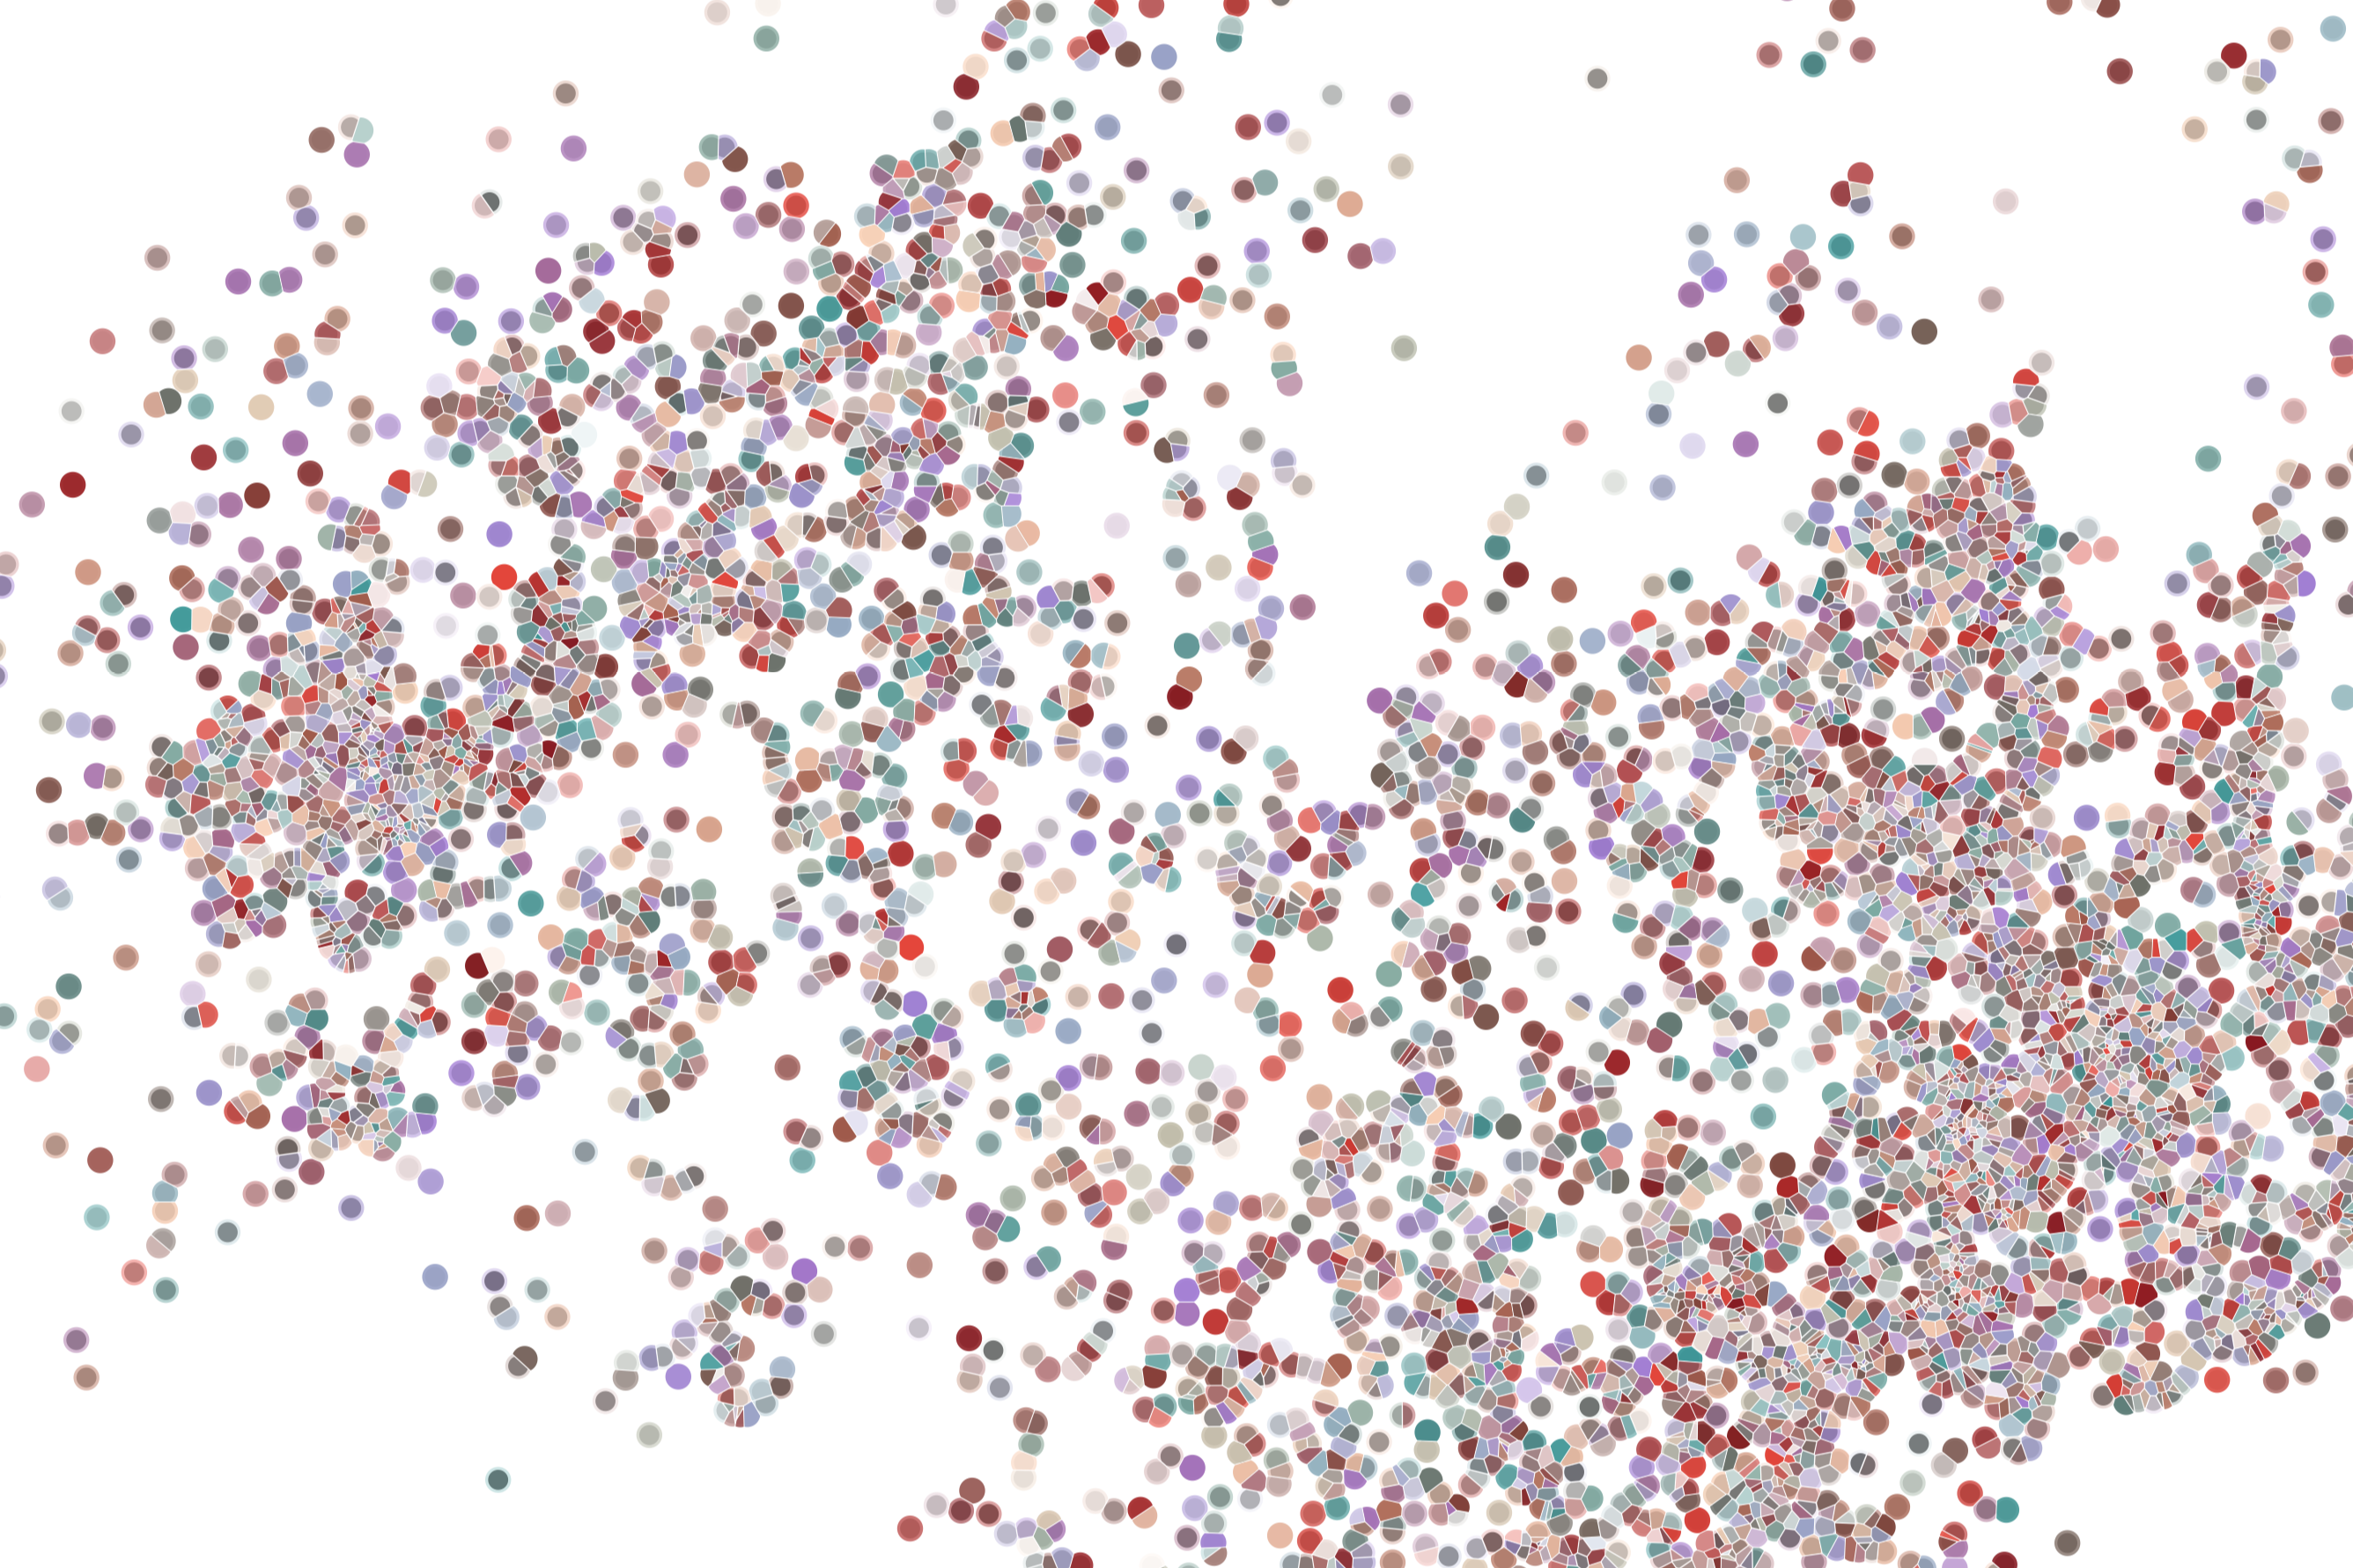
Continuous development: The virtuous circle of writing/documenting/testing
Physalia course 2022
Instructor: Jacques Serizay
Notes:
Hello everybody and thank you for attending my presentation. I am going to talk about the project I recently started working on in the Spassky and Koszul labs, both located in Paris. This project focuses on the unusual cooption of the mitotic machinery to drive, not cell division but cell differentiation.

Slide 2
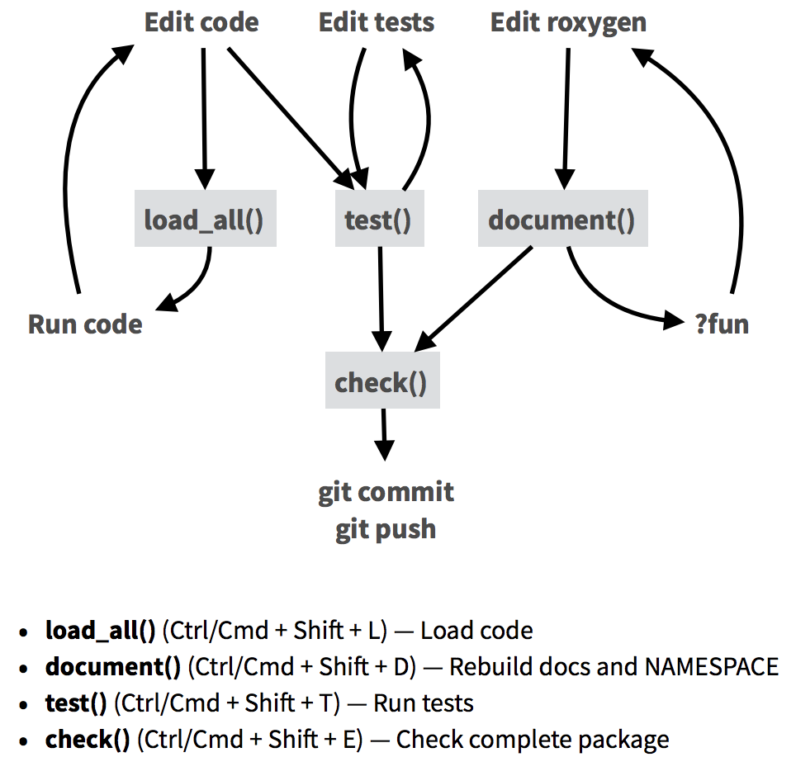
Package development workflow
https://raw.githubusercontent.com/rstudio/cheatsheets/main/package-development.pdf

Slide 3
Package development workflow
> devtools::create_package()
> usethis::use_readme_md()
> usethis::use_news_md()
> usethis::use_gpl3_license()
myPackage/
DESCRIPTION
README.md
NAMESPACE
NEWS
LICENSE

Slide 4
Package development workflow
Write functions
> devtools::load_all()
myPackage/
R/
functions.R
utils.R
DESCRIPTION
README.md
NAMESPACE
NEWS
LICENSE

Slide 5
Package development workflow
Write functions
myPackage/
R/
functions.R
utils.R
DESCRIPTION
README.md
NAMESPACE
NEWS
LICENSE
Document functions
Arguments
Imports
examples

Slide 6
Package development workflow
Write functions
myPackage/
R/
functions.R
utils.R
man/
myfunction.Rd DESCRIPTION
README.md
NAMESPACE
NEWS
LICENSE
> devtools::document()
> devtools::run_examples()
> devtools::load_all()
Document functions
Arguments
Imports
examples

Slide 7
Package development workflow
Write functions
myPackage/
R/
functions.R
utils.R
man/
myfunction.Rd tests/
testthat.R
testthat/
test-myfun.R
DESCRIPTION
README.md
NAMESPACE
NEWS
LICENSE
Document functions
Arguments
Imports
examples
> devtools::document()
> devtools::run_examples()
> devtools::test()
> devtools::load_all()
Test functions

Slide 8
Package development workflow
Write functions
myPackage/
R/
functions.R
utils.R
man/
myfunction.Rd tests/
testthat.R
testthat/
test-myfun.R
data/
toy-data.rda
inst/
ext/
raw.bed
DESCRIPTION
README.md
NAMESPACE
NEWS
LICENSE
Document functions
Arguments
Imports
examples
> devtools::check()
> devtools::document()
> devtools::run_examples()
> devtools::test()
> devtools::load_all()
Git commit
Github push
Test functions

Slide 9
Package development workflow
Write functions
myPackage/
R/
functions.R
utils.R
man/
myfunction.Rd tests/
testthat.R
testthat/
test-myfun.R
data/
toy-data.rda
inst/
ext/
raw.bed
DESCRIPTION
README.md
NAMESPACE
NEWS
LICENSE
Document functions
Arguments
Imports
examples
> devtools::document()
> devtools::run_examples()
> devtools::test()
> devtools::load_all()
Test functions
Add example data
Git commit
Github push

Slide 10
Package development workflow
Write functions
myPackage/
R/
functions.R
utils.R
man/
myfunction.Rd tests/
testthat.R
testthat/
test-myfun.R
data/
toy-data.rda
inst/
ext/
raw.bed
vignettes/
myPackage.Rmd
DESCRIPTION
README.md
NAMESPACE
NEWS
LICENSE
Document functions
Arguments
Imports
examples
> devtools::document()
> devtools::run_examples()
> devtools::test()
> devtools::load_all()
Test functions
Add example data
Add vignettes
Git commit
Github push

Slide 11
Package development workflow
Write functions
myPackage/
R/
functions.R
utils.R
man/
myfunction.Rd tests/
testthat.R
testthat/
test-myfun.R
data/
toy-data.rda
inst/
ext/
raw.bed
vignettes/
myPackage.Rmd
DESCRIPTION
README.md
NAMESPACE
NEWS
LICENSE
_pkgdown.yml
Document functions
Arguments
Imports
examples
> devtools::document()
> devtools::run_examples()
> devtools::test()
> devtools::load_all()
Test functions
Add example data
Add vignettes
Publish supporting website
Git commit
Github push

Slide 12

Package development workflow
Write functions
myPackage/
R/
functions.R
utils.R
man/
myfunction.Rd tests/
testthat.R
testthat/
test-myfun.R
data/
toy-data.rda
inst/
ext/
raw.bed
vignettes/
myPackage.Rmd
DESCRIPTION
README.md
NAMESPACE
NEWS
LICENSE
_pkgdown.yml
Document functions
Arguments
Imports
examples
> devtools::document()
> devtools::run_examples()
> devtools::test()
> devtools::load_all()
Test functions
Add example data
Add vignettes
Publish supporting website
Submit to Bioconductor
Git commit
Github push

Slide 13
Package development workflow
Write functions
myPackage/
R/
functions.R
utils.R
man/
myfunction.Rd tests/
testthat.R
testthat/
test-myfun.R
data/
toy-data.rda
inst/
ext/
raw.bed
vignettes/
myPackage.Rmd
DESCRIPTION
README.md
NAMESPACE
NEWS
LICENSE
_pkgdown.yml
Document functions
Arguments
Imports
examples
> devtools::document()
> devtools::run_examples()
> devtools::test()
> devtools::load_all()
Test functions
Add example data
Add vignettes
Publish supporting website
Submit to Bioconductor
Git commit
Github push

Slide 14
How to write functions
Write functions
myfun <- function(arg1, arg2, ...) {
## Internal checkups
if (...) {
stop("There has been an error. Aborting now.")
}
## Internal processing steps
step1 <- ...(arg1)
step2 <- ...(step1)
step3 <- ...(step2, arg2)
## Computing and returning result
res <- list(step3, ...(arg2), ...)
return(res)
}

Slide 15
How to write functions
Always put .R files containing functions in R/. The easiest to create these files is to run `use_r(”…”)`.
`source(“.”)` and `load_all(“.”)` do not behave the same way: while `source` dumps all .R files found in directory and recursively, `load_all(“.”)` specifically reads in .R files from R/ folder.
Write functions

Slide 16
How to write functions
Prefer many short functions over a single massive function. Bioconductor advises functions shorter than 100 lines.
Functions are immensely easier to test/debug this way.
Write functions

Slide 17
Documenting functions
Write functions
#' @title
#' Paste of vector elements
#'
#' @description
#’ `myPaste` returns a string and a numerical value
#’ pasted together.
#'
#' @details
#' This is a generic function: methods can be
#' defined for it directly or via the
#' [Summary()] group generic. For this to work
#' properly, the arguments `...` should be
#' unnamed, and dispatch is on the first
#' argument.
#'
#' @param arg1 character A character string.
#' @param arg2 numeric A numerical value to append
#' to the character string provided in \code{arg1}.
#'
#' @returns character A string with \code{arg1} and
#' \code{arg2} pasted together
#'
#' @importFrom glue glue
#'
#' @export
#'
#' @examples
#' myPaste("Jacques' cat is ", 3)
myPaste <- function(arg1, arg2) {
## Internal checkups
if (!is.character(arg1) | !is.numeric(arg2)) {
stop("There has been an error. Aborting now.")
}
## Internal processing steps
res <- glue::glue(arg1, arg2)
## Return result
return(res)
}
Document functions
Arguments
Imports
examples
“Roxygen” function documentation works by adding @tags before your function, such as:
@title
@description
@details
@params
@returns
@imports
@export
@examples
https://cran.r-project.org/web/packages/roxygen2/vignettes/rd.html

Slide 18
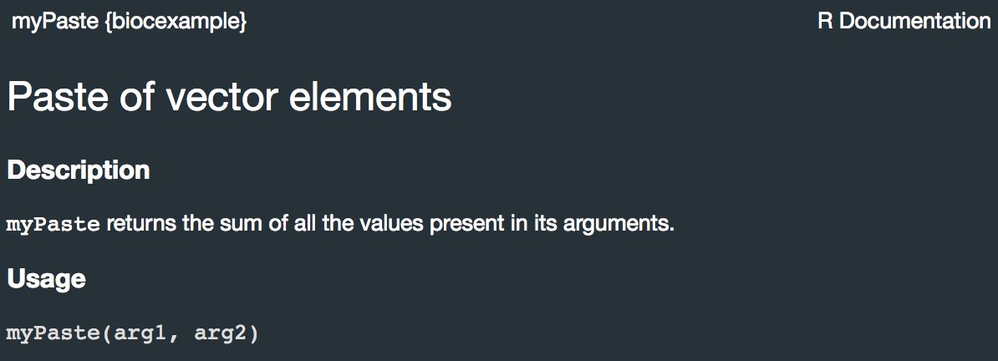
Documenting functions
Write functions
Document functions
Arguments
Imports
examples
devtools::document()
#’ @title
#’ Paste of vector elements
#'
#’ @description
#’ `myPaste` returns a string and a numerical #’ value pasted together.
myPaste <- function(arg1, arg2) {
...
}

Slide 19
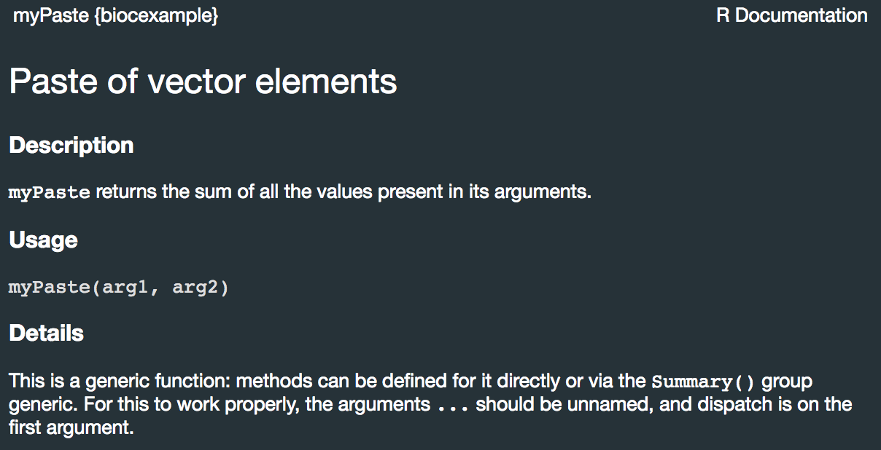
Documenting functions
Write functions
Document functions
Arguments
Imports
examples
devtools::document()
#’ @title
#’ Paste of vector elements
#'
#’ @description
#’ `myPaste` returns a string and a numerical #’ value pasted together.
#'
#' @details
#' This is a generic function: methods can be
#' defined for it directly or via the
#' [Summary()] group generic. For this to work
#' properly, the arguments `...` should be
#' unnamed, and dispatch is on the first
#' argument.
myPaste <- function(arg1, arg2) {
...
}

Slide 20
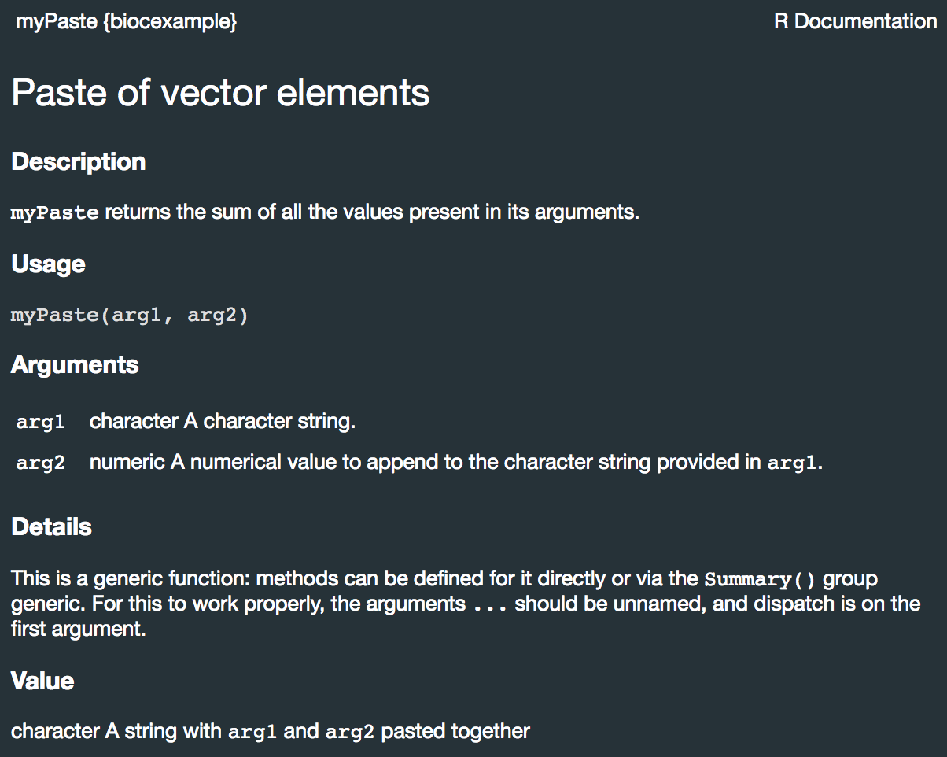
Documenting functions
Write functions
Document functions
Arguments
Imports
examples
#’ @title
#’ Paste of vector elements
#'
#’ @description
#’ `myPaste` returns a string and a numerical
#’ value pasted together.
#'
#' @details
#' This is a generic function: methods can be
#' defined for it directly or via the
#' [Summary()] group generic. For this to work
#' properly, the arguments `...` should be
#' unnamed, and dispatch is on the first
#' argument.
#'
#' @param arg1 character A character string.
#' @param arg2 numeric A numerical value to append
#' to the character string provided in \code{arg1}.
#'
#' @returns character A string with \code{arg1} and
#' \code{arg2} pasted together
#'
myPaste <- function(arg1, arg2) {
...
}

Slide 21
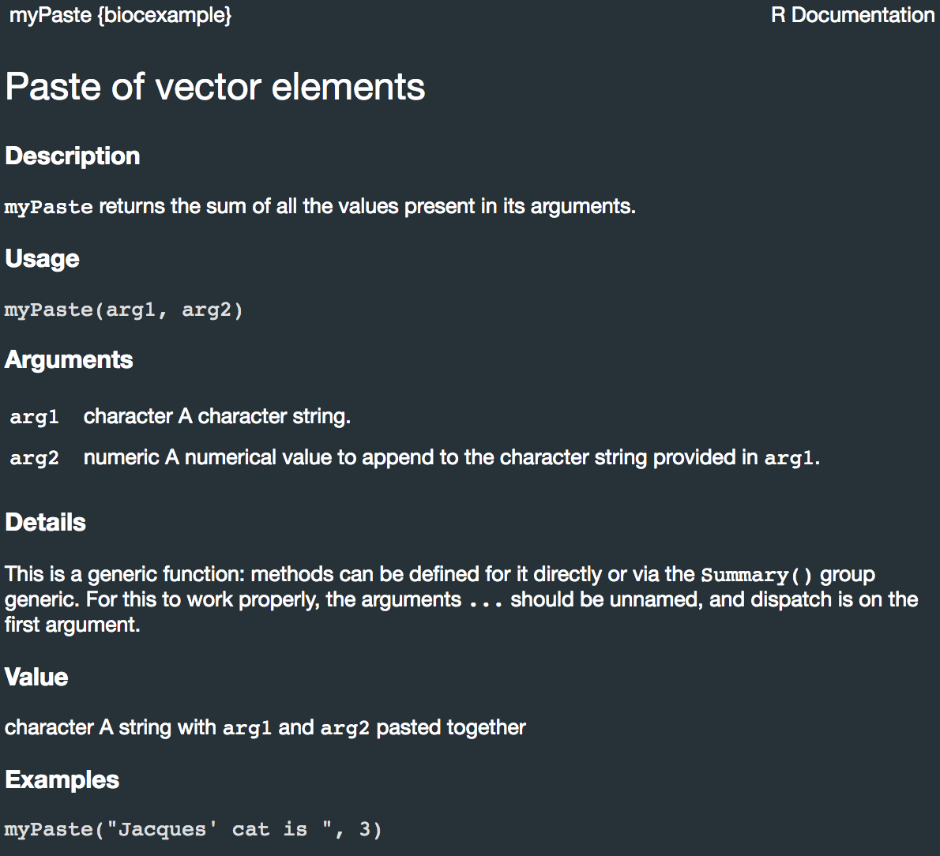
Documenting functions
Write functions
Document functions
Arguments
Imports
examples
#' @title
#' Paste of vector elements
#'
#' @description
#’ `myPaste` returns a string and a numerical value
#’ pasted together.
#'
#' @details
#' This is a generic function: methods can be
#' defined for it directly or via the
#' [Summary()] group generic. For this to work
#' properly, the arguments `...` should be
#' unnamed, and dispatch is on the first
#' argument.
#'
#' @param arg1 character A character string.
#' @param arg2 numeric A numerical value to append
#' to the character string provided in \code{arg1}.
#'
#' @returns character A string with \code{arg1} and
#' \code{arg2} pasted together
#'
#' @examples
#' myPaste("Jacques' cat is ", 3)
myPaste <- function(arg1, arg2) {
... }

Slide 22
Documenting functions
#' @title
#' Paste of vector elements
#'
#' @description
#’ `myPaste` returns a string and a numerical value
#’ pasted together.
#'
#' @details
#' This is a generic function: methods can be
#' defined for it directly or via the
#' [Summary()] group generic. For this to work
#' properly, the arguments `...` should be
#' unnamed, and dispatch is on the first
#' argument.
#'
#' @param arg1 character A character string.
#' @param arg2 numeric A numerical value to append
#' to the character string provided in \code{arg1}.
#'
#' @returns character A string with \code{arg1} and
#' \code{arg2} pasted together
#'
#' @examples
#' myPaste("Jacques' cat is ", 3)
#'
#' @importFrom glue glue
#' @export
myPaste <- function(arg1, arg2) {
## Internal checkups
if (!is.character(arg1) | !is.numeric(arg2)) {
stop("There has been an error. Aborting now.")
}
## Internal processing steps
res <- glue::glue(arg1, arg2)
## Return result
return(res)
}
Write functions
Document functions
Arguments
Imports
examples

Slide 23
Documenting functions
Do not forget to `@export` the user-level functions!
Internal functions (those that should not be used by regular users) should start with a dot (`.`).
Write functions
Document functions
Arguments
Imports
examples
#’ internal_check function
#’
#’ This function is not meant to be used
#’ interactively
#’
#’ @param arg
#’ @return logical
.check_fun <- function(arg) {
if (...) return(TRUE)
}
#’ import function
#’
#’ @param path
#’ @return Value
#’ @export
import <- function(path) {
.check_fun()
...
}

Slide 24
Testing functions
Tests are implemented to make sure each fundamental brick of your package works, but also that the whole package in itself works (especially if there are many complex, nested functions)
Test functions

Slide 25
Testing functions
Tests are implemented to make sure each fundamental brick of your package works, but also that the whole package in itself works (especially if there are many complex, nested functions)
“Rien ne sert de courir, mieux vaut partir à point.” (Slow and steady wins the race)
– The tortoise in that kid story
– But for real: Jean de la Fontaine
Test functions

Slide 26
Testing functions
Tests are implemented to make sure each fundamental brick of your package works, but also that the whole package in itself works (especially if there are many complex, nested functions)
Always put .R files containing tests in `tests/testthat`. The easiest to create these files is to run `use_test("...")`.
Test functions

Slide 27
Testing functions
Tests are implemented to make sure each fundamental brick of your package works, but also that the whole package in itself works (especially if there are many complex, nested functions)
Always put .R files containing tests in `tests/testthat`. The easiest to create these files is to run `use_test("...")`.
Test functions
> usethis::use_testthat()
✓ Setting active project to '/Users/jacquesserizay/biocexample'
✓ Adding 'testthat' to Suggests field in DESCRIPTION
✓ Setting Config/testthat/edition field in DESCRIPTION to '3'
✓ Creating 'tests/testthat/'
✓ Writing 'tests/testthat.R'
• Call `use_test()` to initialize a basic test file and open it for editing.

Slide 28
Testing functions
Tests are implemented to make sure each fundamental brick of your package works, but also that the whole package in itself works (especially if there are many complex, nested functions)
Always put .R files containing tests in `tests/testthat`. The easiest to create these files is to run `use_test("...")`.
Test functions
> usethis::use_testthat()
✓ Setting active project to '/Users/jacquesserizay/biocexample'
✓ Adding 'testthat' to Suggests field in DESCRIPTION
✓ Setting Config/testthat/edition field in DESCRIPTION to '3'
✓ Creating 'tests/testthat/'
✓ Writing 'tests/testthat.R'
• Call `use_test()` to initialize a basic test file and open it for editing.
> usethis::use_test(
name = ‘myPaste’
)

Slide 29
Testing functions
Tests are implemented to make sure each fundamental brick of your package works, but also that the whole package in itself works (especially if there are many complex, nested functions)
Always put .R files containing tests in `tests/testthat`. The easiest to create these files is to run `use_test("...")`.
Test functions
> usethis::use_testthat()
✓ Setting active project to '/Users/jacquesserizay/biocexample'
✓ Adding 'testthat' to Suggests field in DESCRIPTION
✓ Setting Config/testthat/edition field in DESCRIPTION to '3'
✓ Creating 'tests/testthat/'
✓ Writing 'tests/testthat.R'
• Call `use_test()` to initialize a basic test file and open it for editing.
> usethis::use_test(
name = ‘myPaste’
)
Tests/testthat/test-myPaste.R
test_that("myPaste works", {
expect_equal(
myPaste("Jacques is ", 30),
"Jacques is 30"
)
})

Slide 30
Testing functions
Tests are implemented to make sure each fundamental brick of your package works, but also that the whole package in itself works (especially if there are many complex, nested functions)
Always put .R files containing tests in `tests/testthat`. The easiest to create these files is to run `use_test("...")`.
Test functions
> usethis::use_testthat()
✓ Setting active project to '/Users/jacquesserizay/biocexample'
✓ Adding 'testthat' to Suggests field in DESCRIPTION
✓ Setting Config/testthat/edition field in DESCRIPTION to '3'
✓ Creating 'tests/testthat/'
✓ Writing 'tests/testthat.R'
• Call `use_test()` to initialize a basic test file and open it for editing.
> usethis::use_test(
name = ‘myPaste’
)
> devtools::test()
i Loading biocexample
i Testing biocexample
✓ | OK F W S | Context
✓ | 1 | myPaste [0.2 s]
══ Results ═══════════════════════
Duration: 0.2 s
[ FAIL 0 | WARN 0 | SKIP 0 | PASS 1 ]
Woot!
Tests/testthat/test-myPaste.R
test_that("myPaste works", {
expect_equal(
myPaste("Jacques is ", 30),
"Jacques is 30"
)
})

Slide 31
Rinse-and-repeat!!!
Write functions
myPackage/
R/
functions.R
utils.R
man/
myfunction.Rd tests/
testthat.R
testthat/
test-myfun.R
DESCRIPTION
README.md
NAMESPACE
NEWS
LICENSE
Document functions
Arguments
Imports
examples
> devtools::document()
> devtools::run_examples()
> devtools::test()
> devtools::load_all()
Test functions
Add example data
Add vignettes
Publish supporting website
Submit to Bioconductor

Slide 32
Thorough checks
Tools to run longer, integrated checks:
devtools::check()
BiocCheck::BiocCheck()
rcmdcheck:: rcmdcheck()

