Slide 1
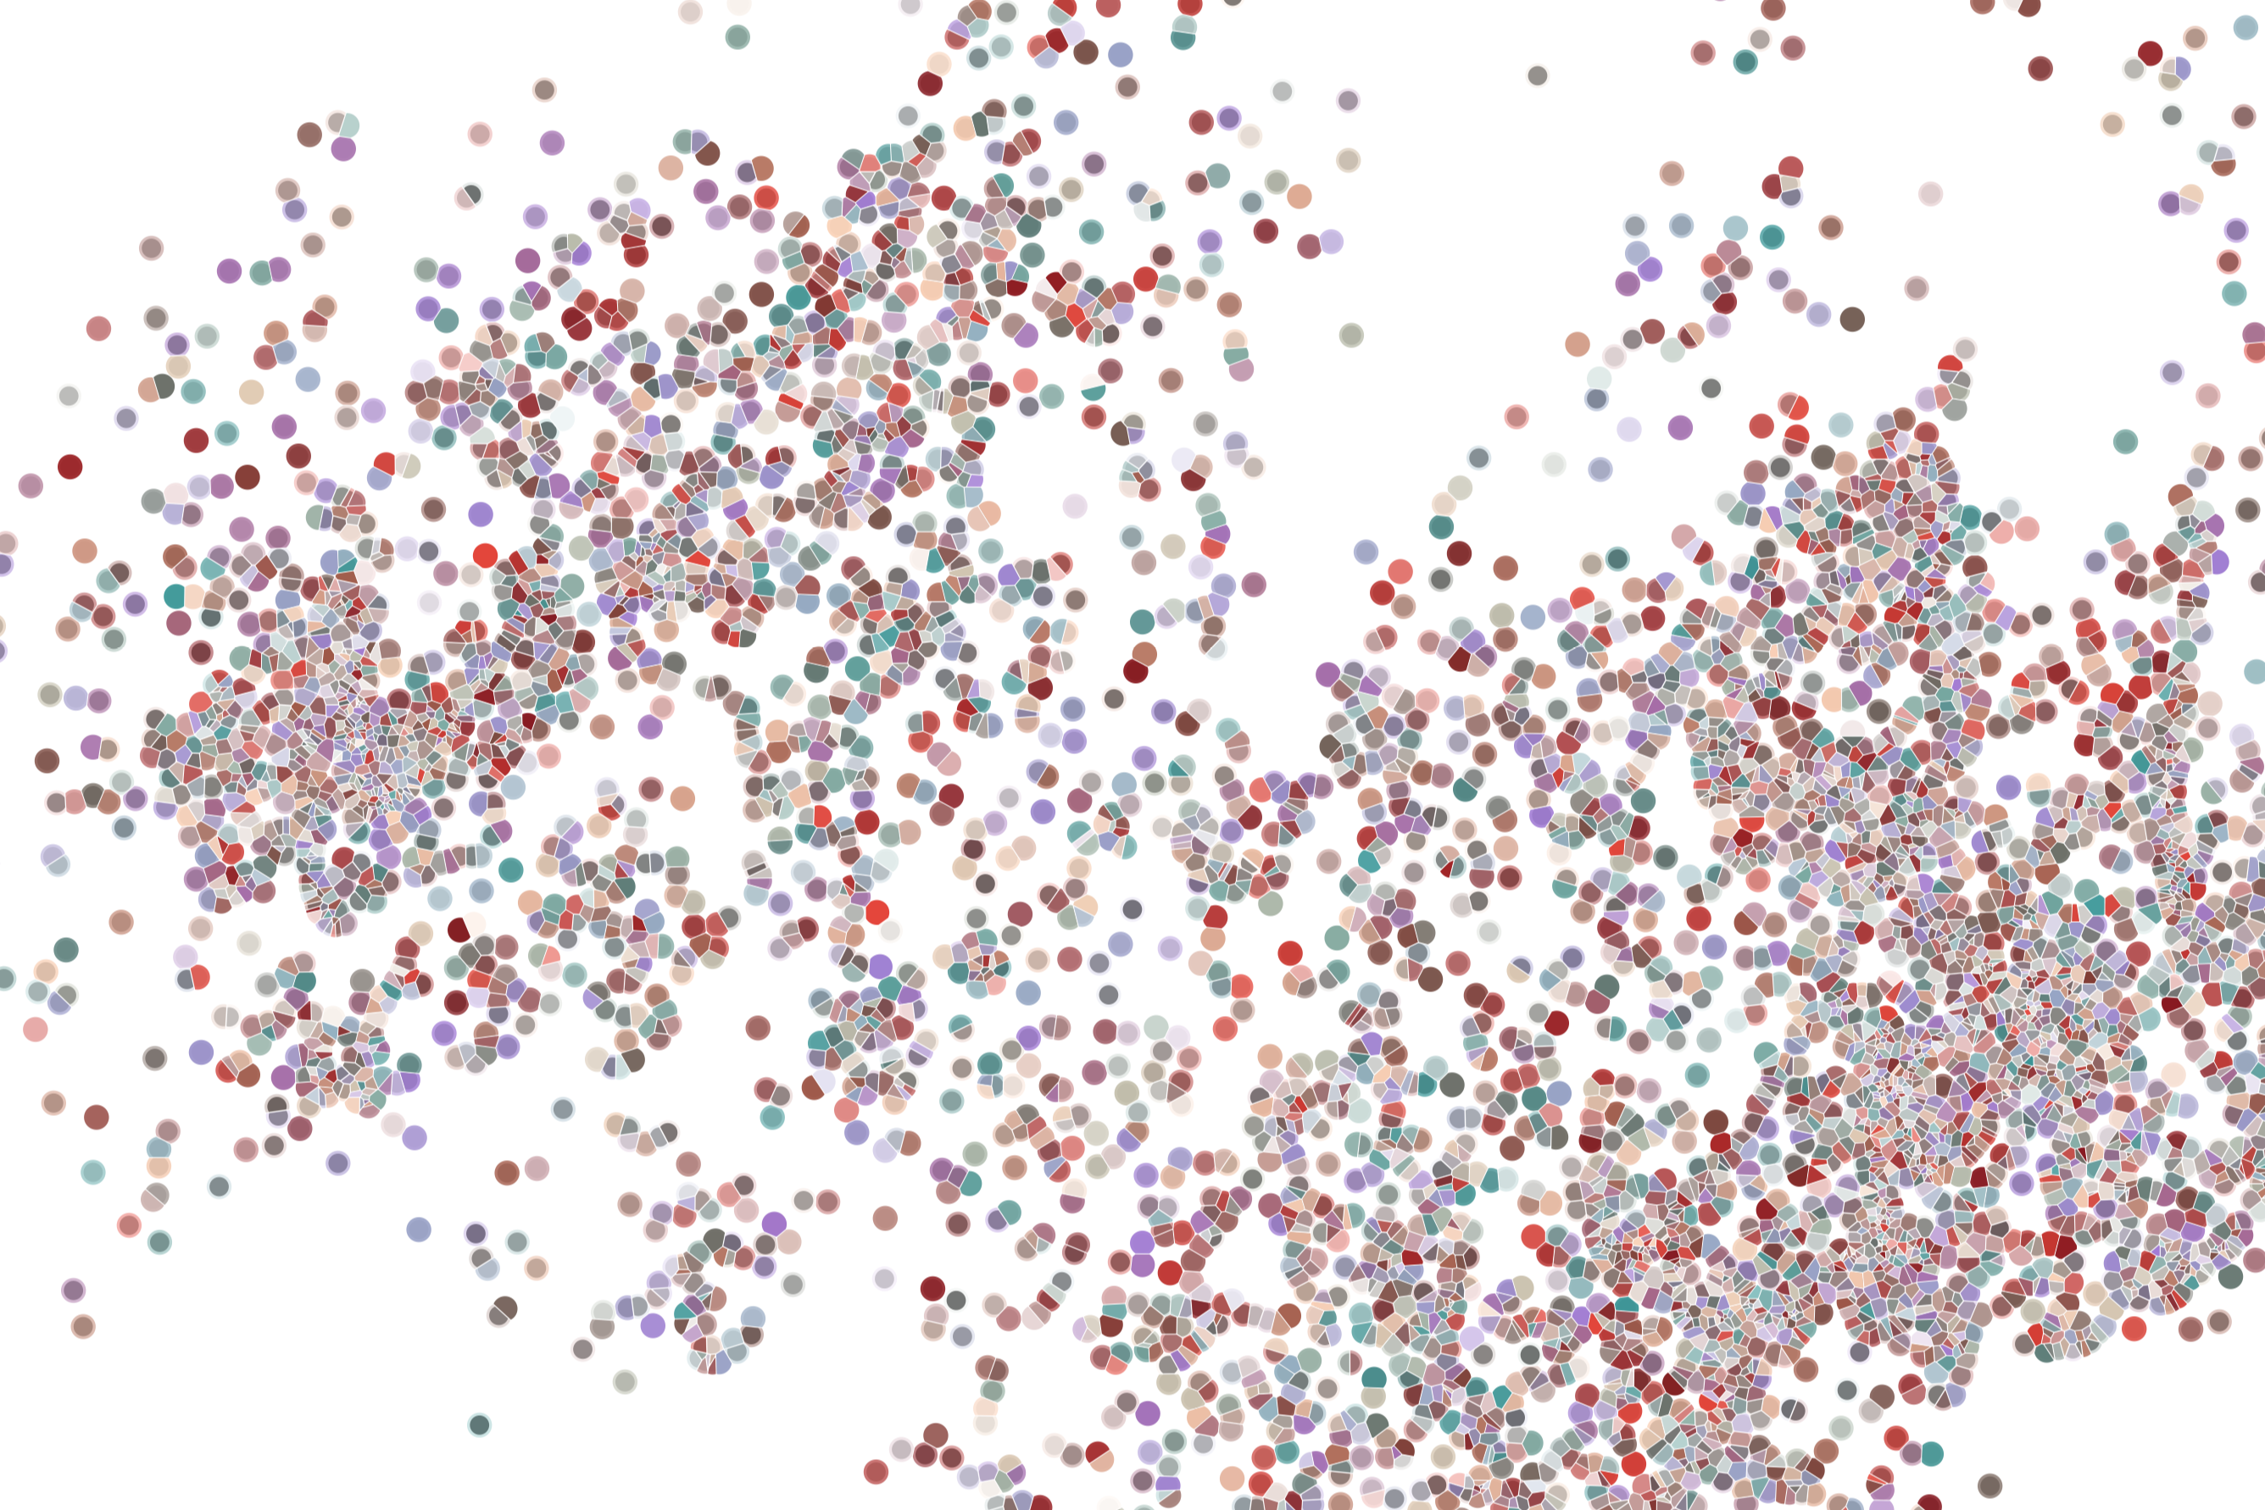
Package architecture
Physalia course 2022
Instructor: Jacques Serizay
Notes:
Hello everybody and thank you for attending my presentation. I am going to talk about the project I recently started working on in the Spassky and Koszul labs, both located in Paris. This project focuses on the unusual cooption of the mitotic machinery to drive, not cell division but cell differentiation.

Slide 2
Standard package content

