Slide 1
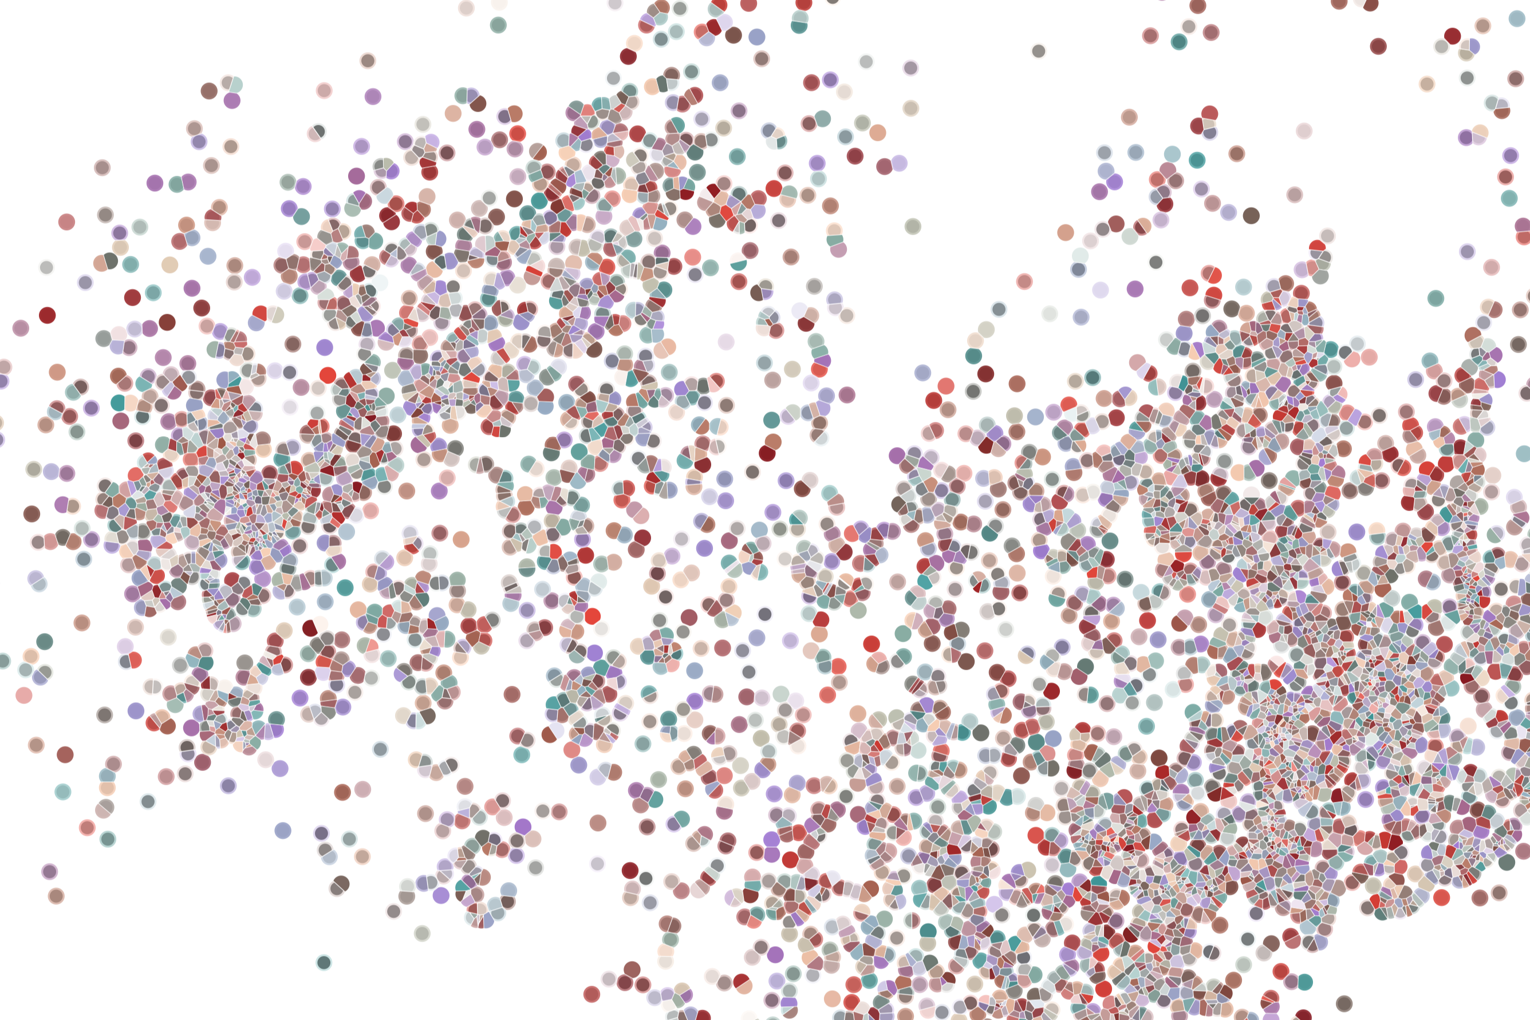
Package dissemination
Physalia course 2022
Instructor: Jacques Serizay
Notes:
Hello everybody and thank you for attending my presentation. I am going to talk about the project I recently started working on in the Spassky and Koszul labs, both located in Paris. This project focuses on the unusual cooption of the mitotic machinery to drive, not cell division but cell differentiation.

Slide 2
Incentivize other people to use your package
Your computer:
Many computers:
myPackage/
R/
functions.R
utils.R
man/
myfunction.Rd tests/
testthat.R
testthat/
test-myfun.R
inst/
extdata/
<raw-data-file>
data/
<data>.Rda
vignettes/
myPackage.Rmd
DESCRIPTION
NAMESPACE
README.md
NEWS
LICENSE
myPackage/
R/
functions.R
utils.R
man/
myfunction.Rd tests/
testthat.R
testthat/
test-myfun.R
inst/
extdata/
<raw-data-file>
data/
<data>.Rda
vignettes/
myPackage.Rmd
DESCRIPTION
NAMESPACE
README.md
NEWS
LICENSE

Slide 3
Incentivize other people to use your package
Well-made documentation package
Public resources

