Slide 1
Processing NGS data
Epigenomics Data Analysis
Jacques Serizay
Physalia 2026

Slide 2

NGS processing workflow
Get .bcl files
Create fastq files
QC: remove/trim low quality reads
Align fastq to BAM
Filter duplicates, artifacts, …
Generate tracks
Assay-specific downstream analysis

Slide 3
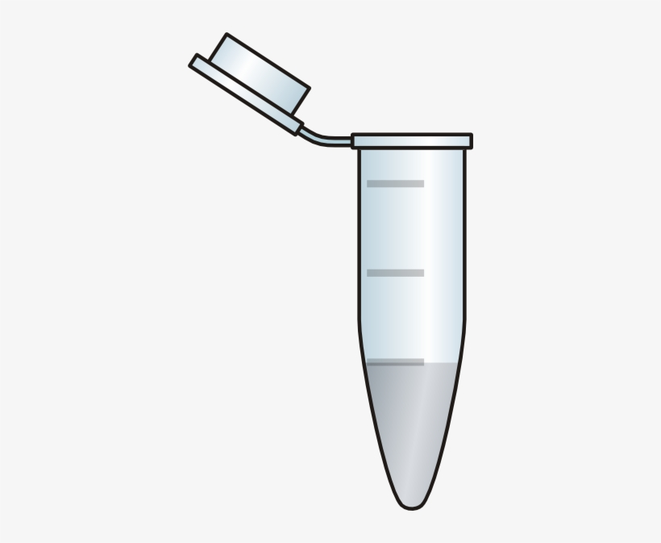
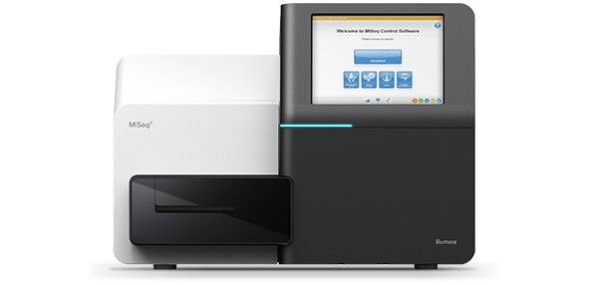
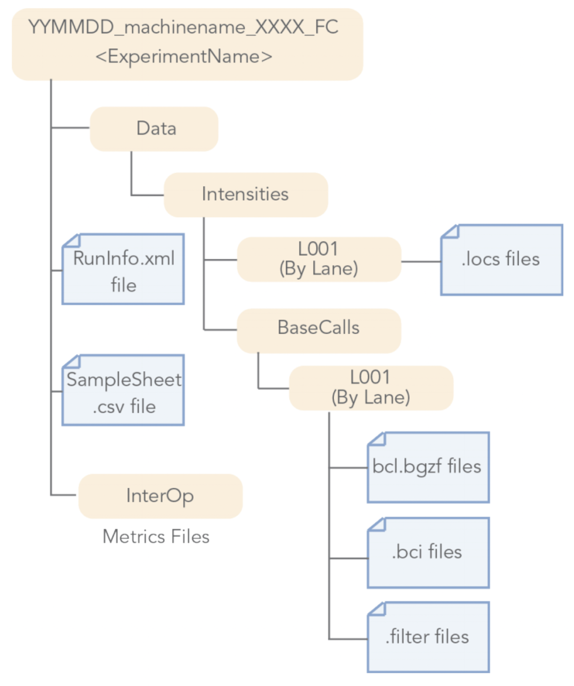
.bcl files
.bcl:
Raw data output of a sequencing run
Binary, non-human-readable file
Contains the base calling and quality score per cluster, per sequencing lane, per cycle
Huge files
No aggregated sequence per read
Notes:
I would like to expand these observations to in vivo data. I also want to check what happens in terms of transcriptional dynamics in cells where Cyclin O, a key non-canonical cyclin involved in MCC diff., is knocked-out.

Slide 4

NGS processing workflow
Get .bcl files
Create fastq files
QC: remove/trim low quality reads
Align fastq to BAM
Filter duplicates, artifacts, …
Generate tracks
Assay-specific downstream analysis

Slide 5
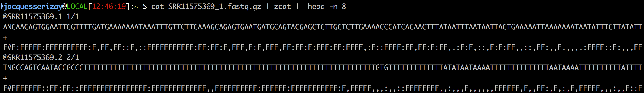
Fastq files
A fastq file contains reads, each read is composed of 4 lines:
A sequence identifier with information about the sequencing run
The sequence (the base calls; A, C, T, G and N).
A separator, which is simply a plus (+) sign.
The base call quality scores, using ASCII characters to represent the numerical quality scores.
Notes:
I would like to expand these observations to in vivo data. I also want to check what happens in terms of transcriptional dynamics in cells where Cyclin O, a key non-canonical cyclin involved in MCC diff., is knocked-out.

Slide 6
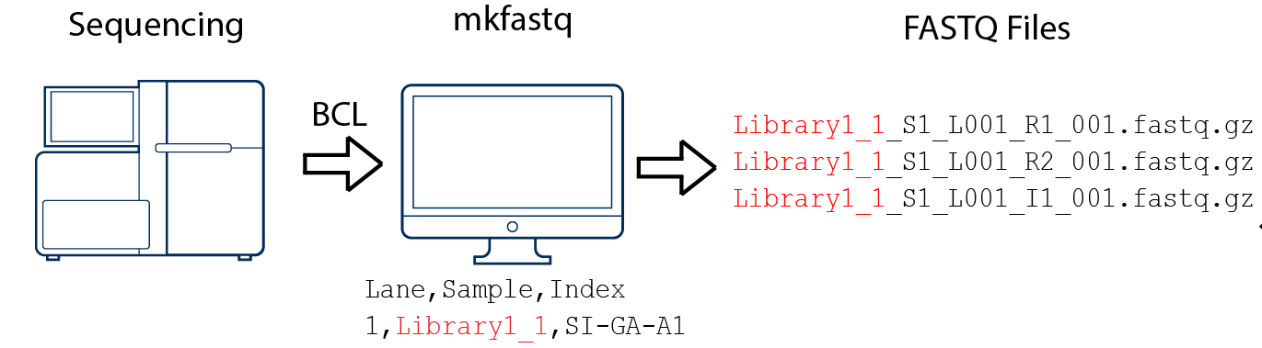
bcl2fastq
bcl2fastq --run-folder-dir <bcl_files_folder> --output-dir <fastq_files_folder>
bcl2fastq
User guide:
https://support.illumina.com/content/dam/illumina-support/documents/documentation/software_documentation/bcl2fastq/bcl2fastq_letterbooklet_15038058brpmi.pdf
Notes:
I would like to expand these observations to in vivo data. I also want to check what happens in terms of transcriptional dynamics in cells where Cyclin O, a key non-canonical cyclin involved in MCC diff., is knocked-out.

Slide 7
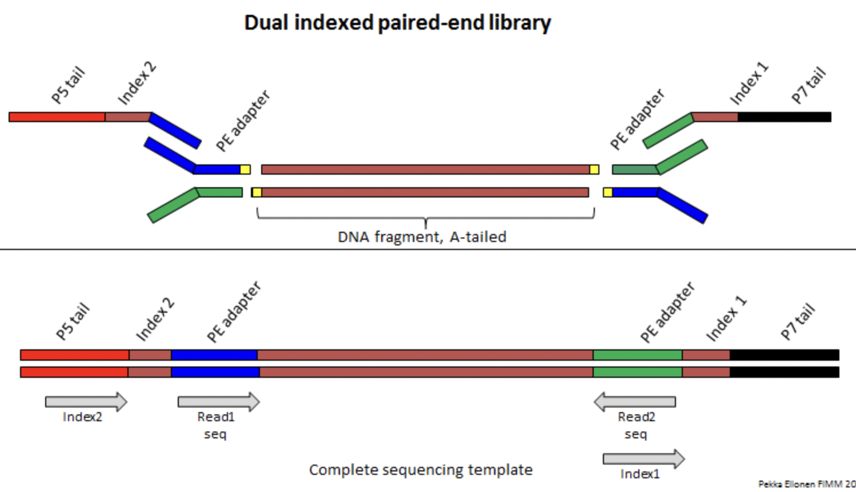
Why so many fastq files?
Library preparation
Sequencing
“R1” sequence
Notes:
I would like to expand these observations to in vivo data. I also want to check what happens in terms of transcriptional dynamics in cells where Cyclin O, a key non-canonical cyclin involved in MCC diff., is knocked-out.

Slide 8
Why so many fastq files?
Library preparation
Sequencing
“I1” sequence
Notes:
I would like to expand these observations to in vivo data. I also want to check what happens in terms of transcriptional dynamics in cells where Cyclin O, a key non-canonical cyclin involved in MCC diff., is knocked-out.

Slide 9
Why so many fastq files?
Library preparation
Sequencing
“R2” sequence
Notes:
I would like to expand these observations to in vivo data. I also want to check what happens in terms of transcriptional dynamics in cells where Cyclin O, a key non-canonical cyclin involved in MCC diff., is knocked-out.

Slide 10
Why so many fastq files?
Library preparation
Sequencing
“I2” sequence
“R2” sequence
Notes:
I would like to expand these observations to in vivo data. I also want to check what happens in terms of transcriptional dynamics in cells where Cyclin O, a key non-canonical cyclin involved in MCC diff., is knocked-out.

Slide 11
Why so many fastq files?
Library preparation
Sequencing
I2
R1
R2
I1
Notes:
I would like to expand these observations to in vivo data. I also want to check what happens in terms of transcriptional dynamics in cells where Cyclin O, a key non-canonical cyclin involved in MCC diff., is knocked-out.

Slide 12
Why so many fastq files?
Library preparation
Sequencing
I2
R1
R2
I1
Only used for demultiplexing
Notes:
I would like to expand these observations to in vivo data. I also want to check what happens in terms of transcriptional dynamics in cells where Cyclin O, a key non-canonical cyclin involved in MCC diff., is knocked-out.

Slide 13
NGS processing workflow
Get .bcl files
Create fastq files
Or bcl2fastq
QC: remove/trim low quality reads
Align fastq to BAM
Filter duplicates, artifacts, …
Generate tracks
Assay-specific downstream analysis

Slide 14
NGS processing workflow
Get .bcl files
Create fastq files
Or bcl2fastq
CHECK YOUR DATA
QC: remove/trim low quality reads
Align fastq to BAM
Filter duplicates, artifacts, …
Generate tracks
Assay-specific downstream analysis

Slide 15
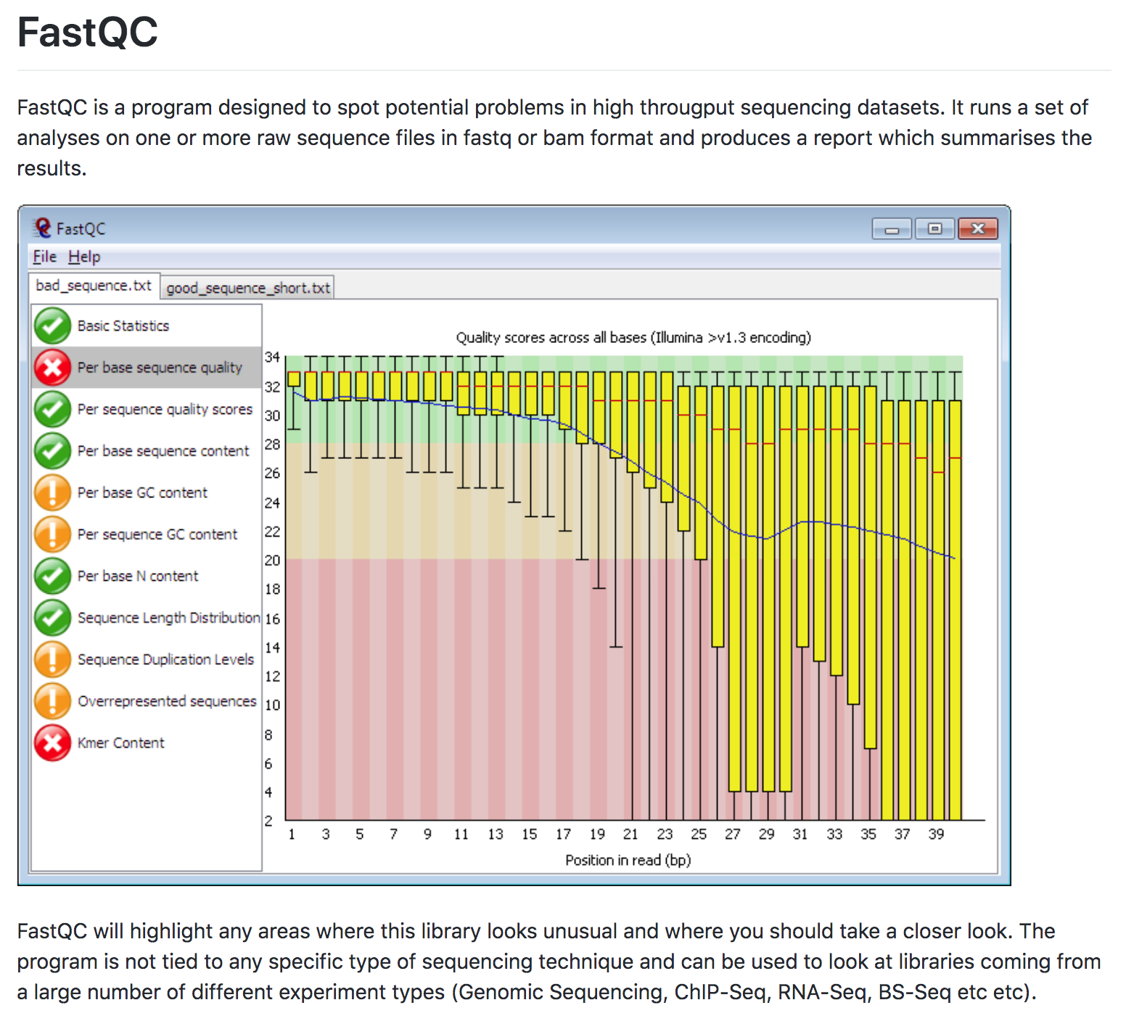
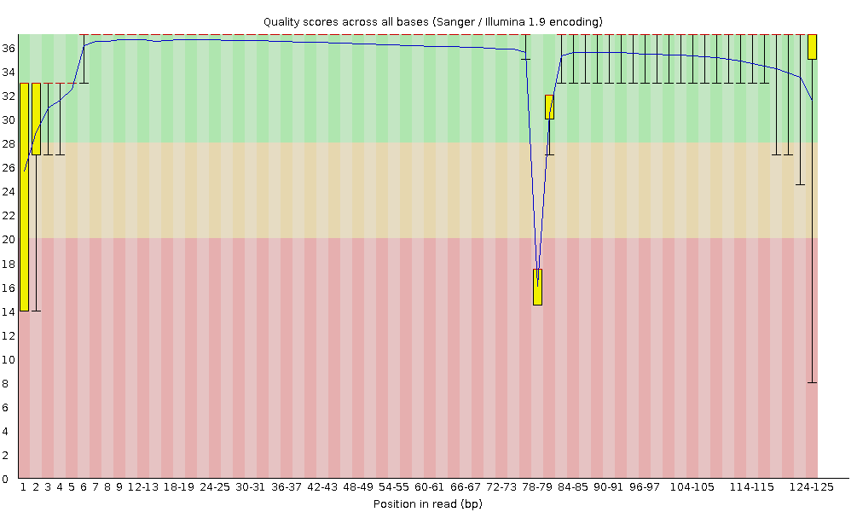
FastQC
Notes:
I would like to expand these observations to in vivo data. I also want to check what happens in terms of transcriptional dynamics in cells where Cyclin O, a key non-canonical cyclin involved in MCC diff., is knocked-out.

Slide 16
FastQC
Local artefact
Overall decrease in sequencing quality
Notes:
I would like to expand these observations to in vivo data. I also want to check what happens in terms of transcriptional dynamics in cells where Cyclin O, a key non-canonical cyclin involved in MCC diff., is knocked-out.

Slide 17
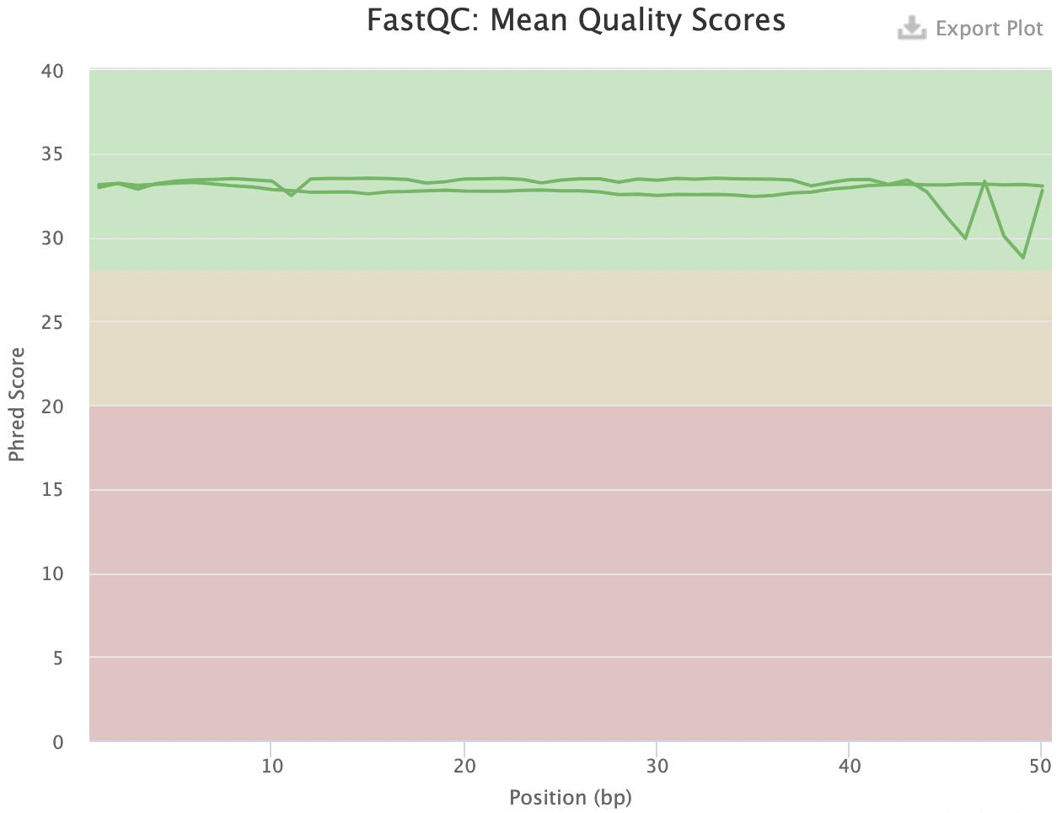
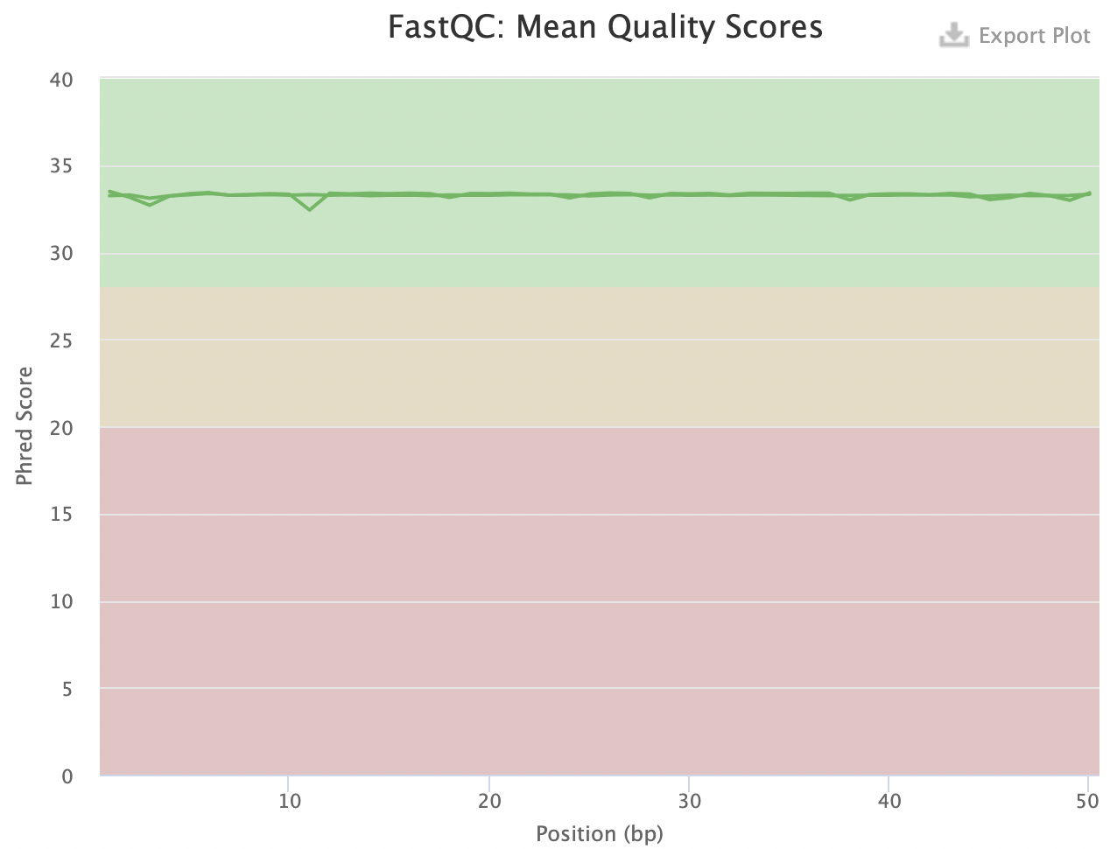
Cutadapt: trim away adapter sequences and low-quality ends
Notes:
I would like to expand these observations to in vivo data. I also want to check what happens in terms of transcriptional dynamics in cells where Cyclin O, a key non-canonical cyclin involved in MCC diff., is knocked-out.

Slide 18
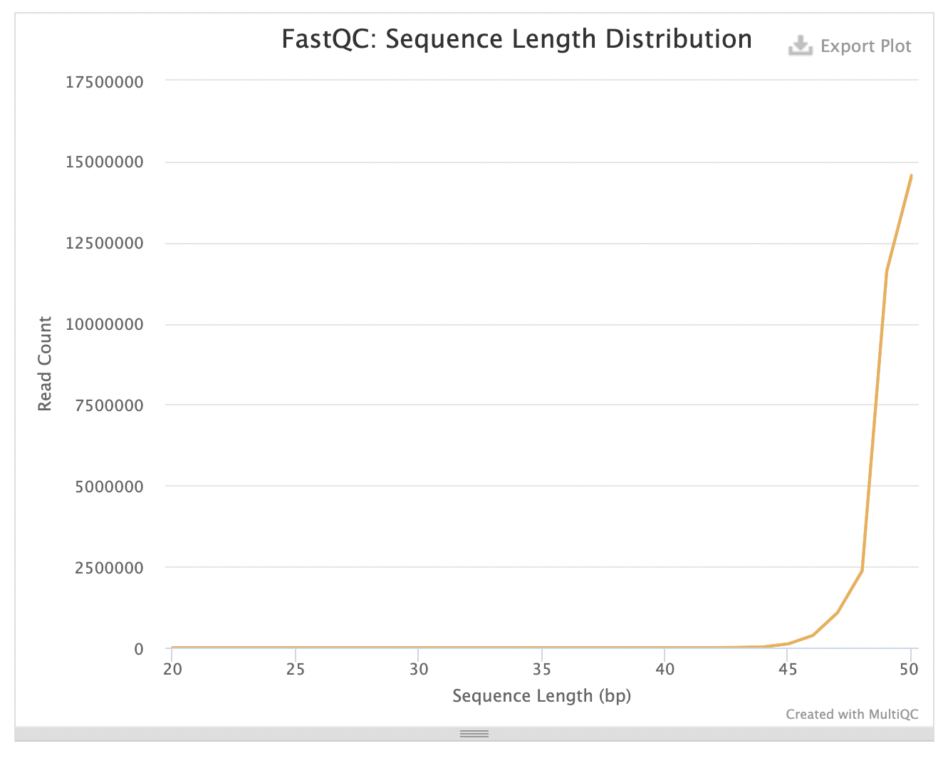
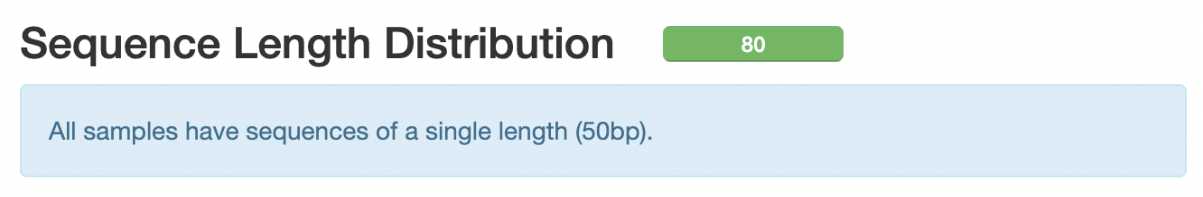
Cutadapt: trim away adapter sequences and low-quality ends
Notes:
I would like to expand these observations to in vivo data. I also want to check what happens in terms of transcriptional dynamics in cells where Cyclin O, a key non-canonical cyclin involved in MCC diff., is knocked-out.

Slide 19
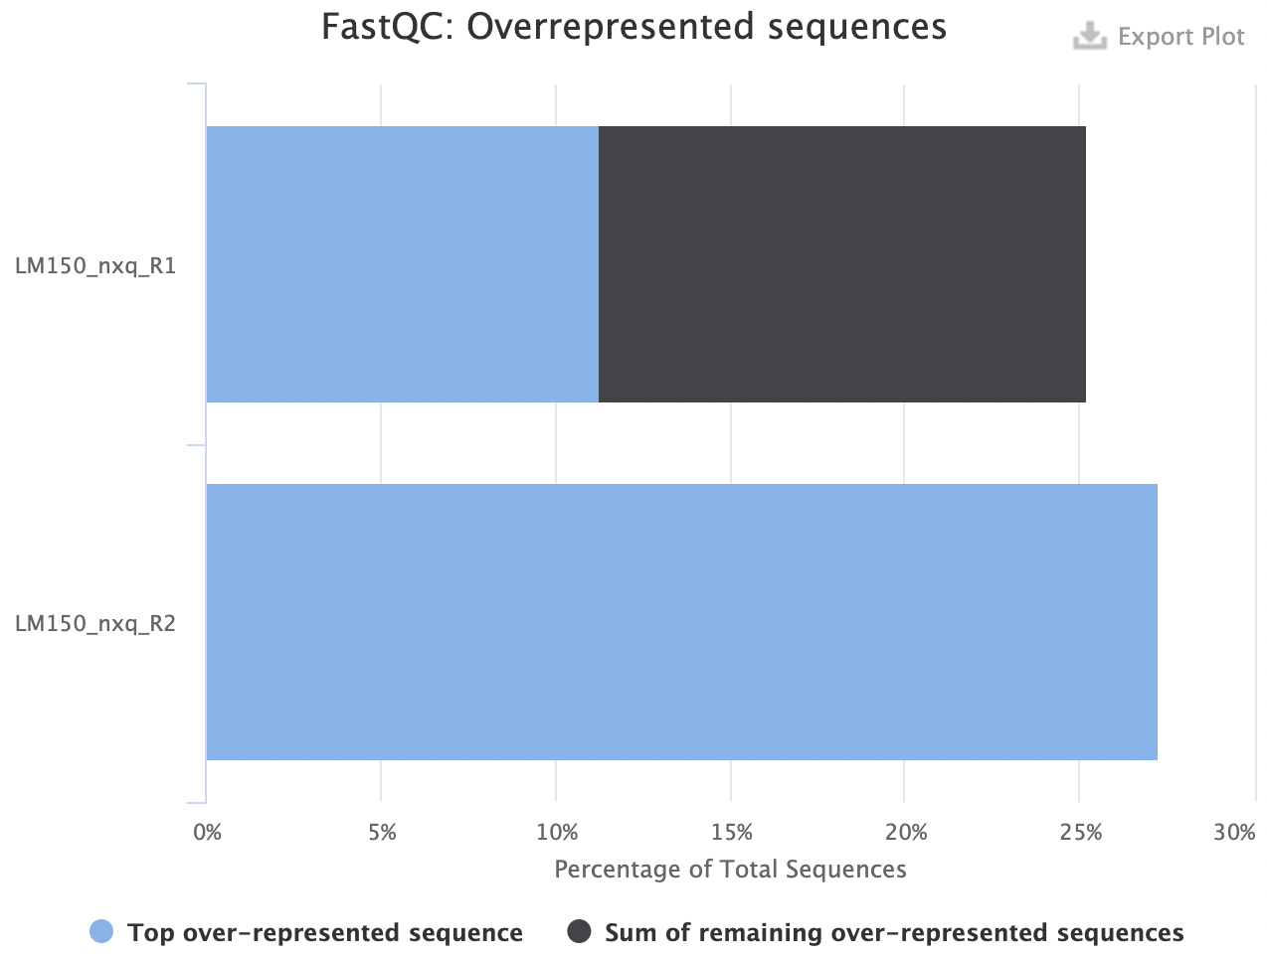
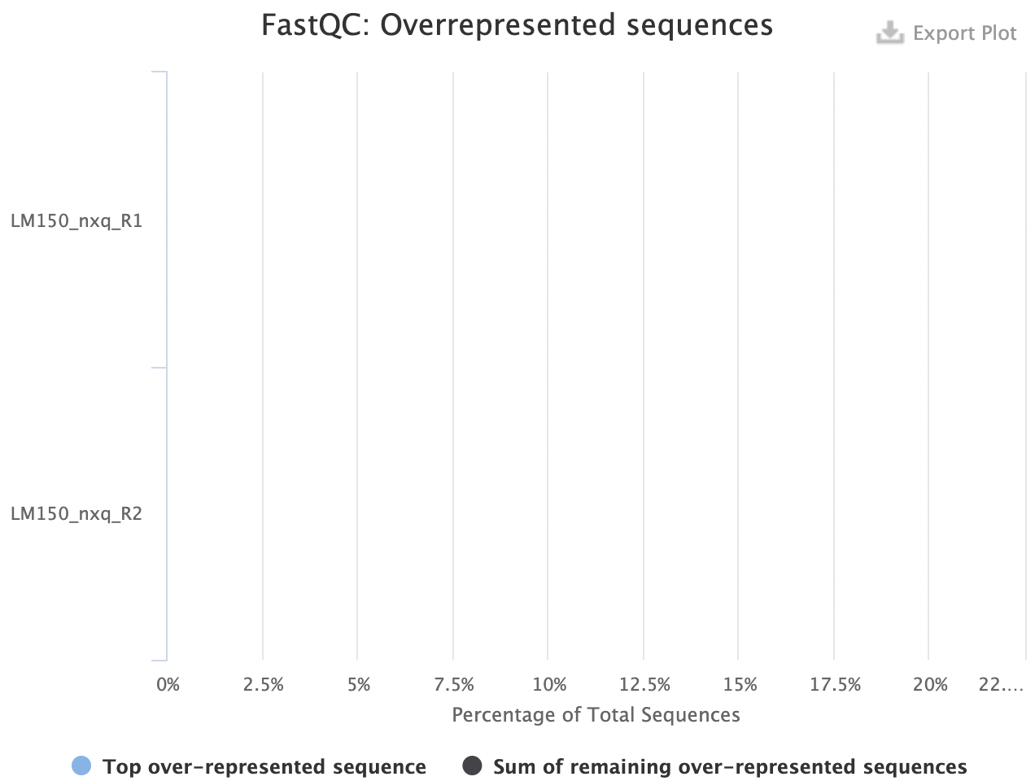
Cutadapt: trim away adapter sequences and low-quality ends
Notes:
I would like to expand these observations to in vivo data. I also want to check what happens in terms of transcriptional dynamics in cells where Cyclin O, a key non-canonical cyclin involved in MCC diff., is knocked-out.

Slide 20
NGS processing workflow
Get .bcl files
Create fastq files
Or bcl2fastq
CHECK YOUR DATA
E.g. FastQC
QC: remove/trim low quality reads
E.g. cutadapt
Align fastq to BAM
Filter duplicates, artifacts, …
Generate tracks
Assay-specific downstream analysis

Slide 21
Mapping sequencing reads to a reference

Slide 22
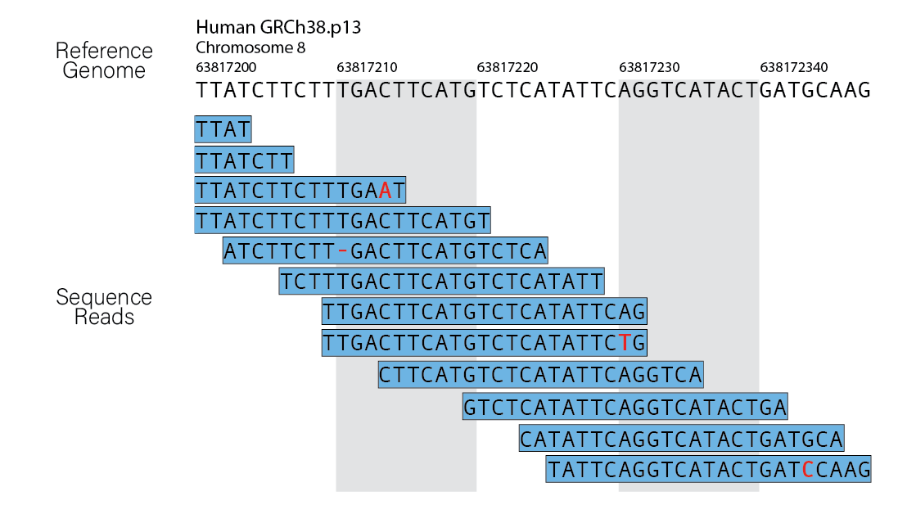
Mapping sequencing reads to a reference

Slide 23
Mapping sequencing reads to a reference

Slide 24
Mapping sequencing reads to a reference

Slide 25
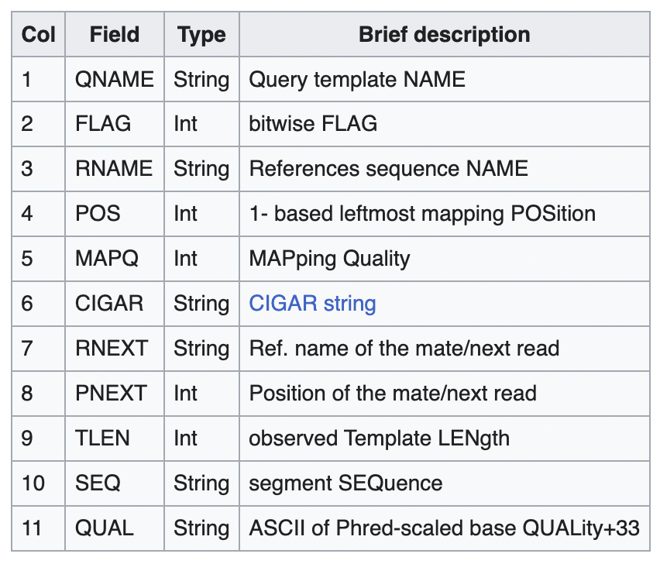
SAM file format
Sequence Alignment Map (SAM) is a human-readable, rectangular, text-based format for storing biological sequences aligned to a reference sequence.
Each entry (line) describes where a read is mapped on the reference and how it is mapped

Slide 26
SAM file format
Sequence Alignment Map (SAM) is a human-readable, rectangular, text-based format for storing biological sequences aligned to a reference sequence.
Each entry (line) describes where a read is mapped on the reference and how it is mapped
Per base
sequencing
quality
Read name
(mate)
Chr
(mate)
Position
(mate)
Read name
Flag
Chr
Position
Length
Sequence
HWI-ST330:304:H045HADXX:2093#1 2 chr8 63817200 50 14M1X 2093#2 chr8 6381932 TTATCTTCTTTGAAT ?????BBBBBBDD=?
CIGAR

Slide 27
BAM file format
BAM files are binarized SAM files, allowing great compression of the alignment results.
However, bam files are not directly human-readable.
samtools view --bam ….sam > ….bam

Slide 28
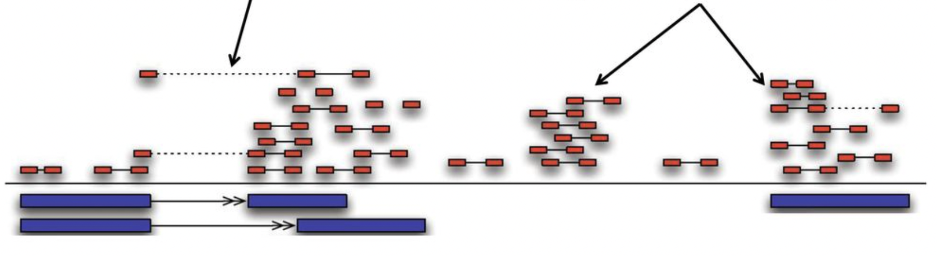
Mapping tools
There are a plethora of alignment tools.
Each one requires the genome reference to be indexed first.
Some mappers can be ”splice-aware”, allowing reads to be mapped over annotated introns.
Pair with 1 read mapping over an intron
Read pairs
Read singleton
Genome sequence reference
Gene annotations reference

Slide 29
NGS processing workflow
Get .bcl files
Create fastq files
Or bcl2fastq
QC: remove/trim low quality reads
E.g. cutadapt
Align fastq to BAM
E.g. bowtie2
Filter duplicates, artifacts, …
Generate tracks
Assay-specific downstream analysis

Slide 30
NGS processing workflow
Get .bcl files
Create fastq files
Or bcl2fastq
QC: remove/trim low quality reads
E.g. cutadapt
Align fastq to BAM
E.g. bowtie2
CHECK YOUR DATA
Filter duplicates, artifacts, …
Generate tracks
Assay-specific downstream analysis

Slide 31
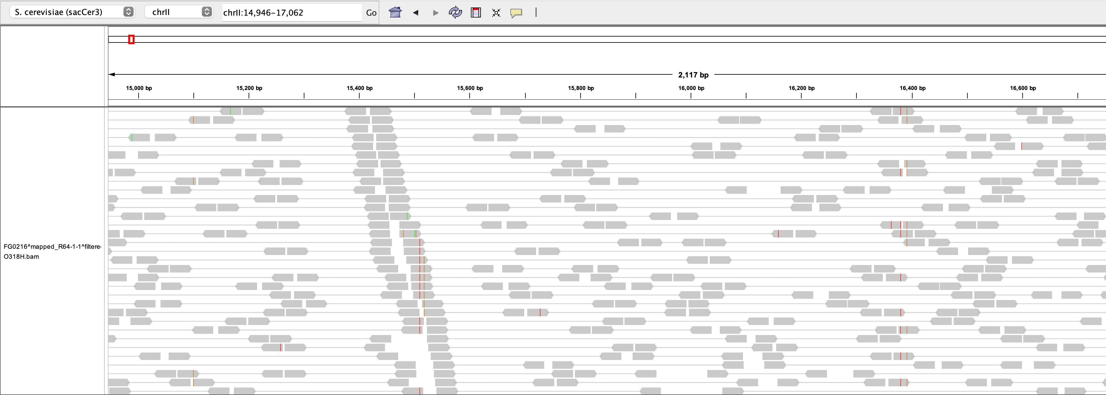
IGV: Integrative Genome Browser

Slide 32
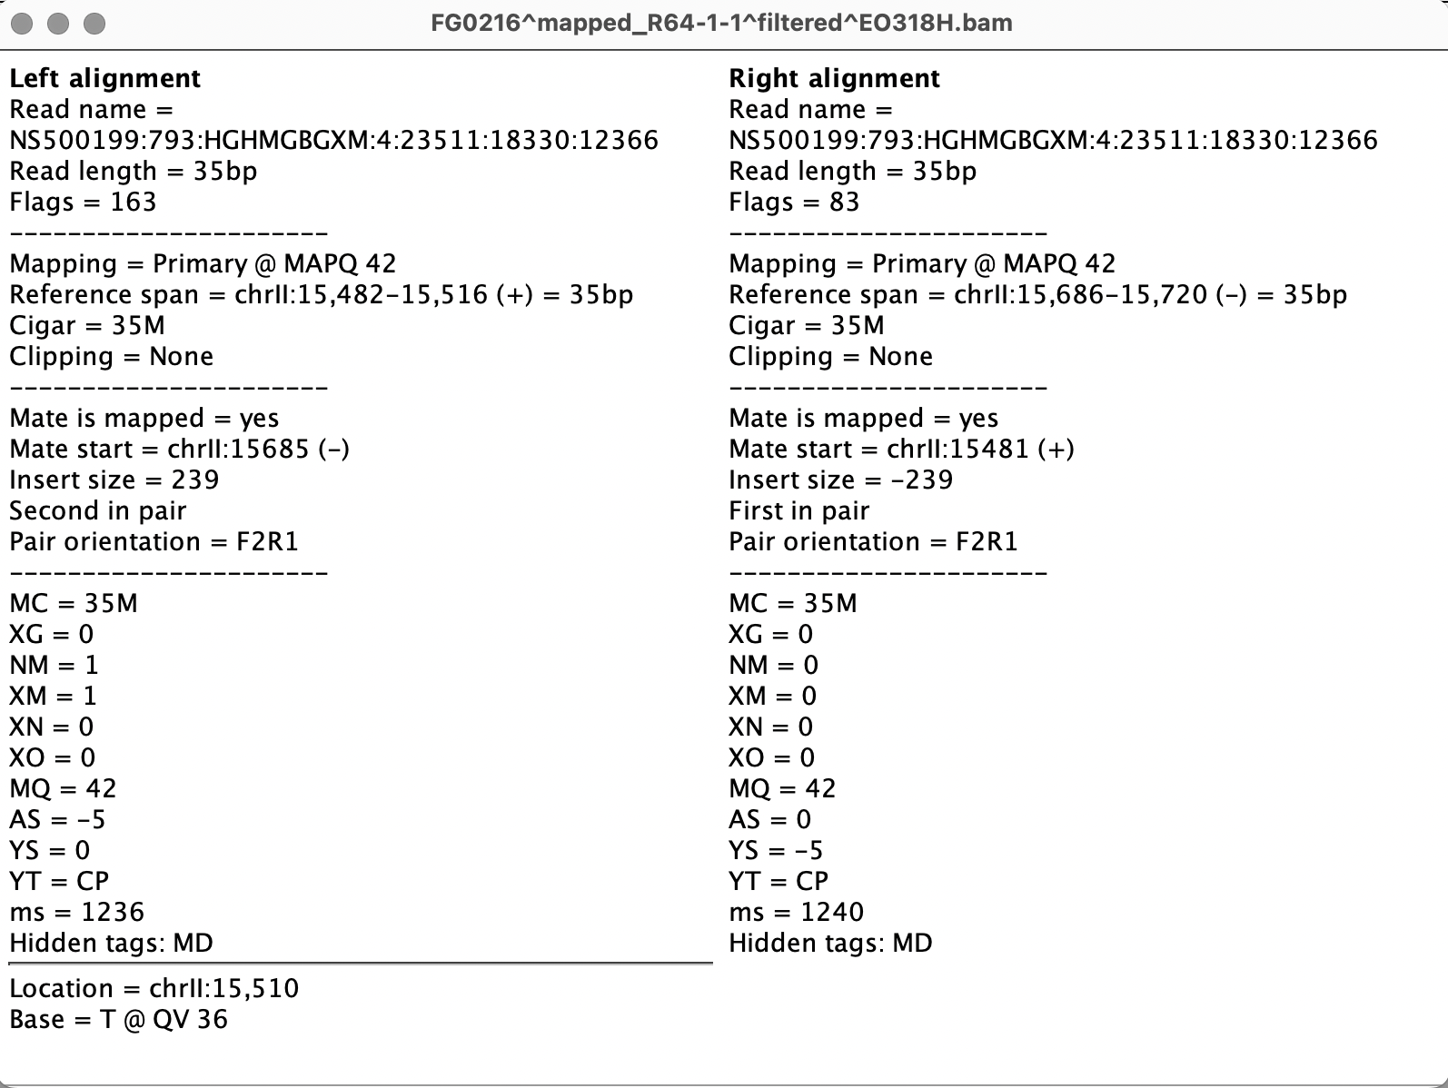
IGV: Integrative Genome Browser

Slide 33
Filtering duplicates
Multiple reads (fragments) with same mapping position (start & end) can be viewed as PCR duplicates.

Slide 34
Filtering duplicates
Multiple reads (fragments) with same mapping position (start & end) can be viewed as PCR duplicates.

Slide 35
Filtering out low-quality mapping reads
Mapping Quality Scores (MAPQ) quantify the probability that a read is misplaced.
$$MAPQ= −10∗\log_{10}\left(P\left(read is wrongly mapped\right)\right)$$
MAPQ ~ 18
MAPQ ~ 32
MAPQ ~ 12
MAPQ ~ 42
MAPQ ~ 42
MAPQ ~ 8
MAPQ ~ 42

Slide 36
Filtering out low-quality mapping reads
Mapping Quality Scores (MAPQ) quantify the probability that a read is misplaced.
For example, a MAPQ score of 20 indicates that the probability for the read to be map at the indicated position is 0.01.
$$MAPQ= −10∗\log_{10}\left(P\left(read is wrongly mapped\right)\right)$$
MAPQ ~ 18
MAPQ ~ 32
MAPQ ~ 12
MAPQ ~ 42
MAPQ ~ 42
MAPQ ~ 8
MAPQ ~ 42

Slide 37
NGS processing workflow
Get .bcl files
Create fastq files
Or bcl2fastq
QC: remove/trim low quality reads
E.g. cutadapt
Align fastq to BAM
E.g. bowtie2
Filter duplicates, artifacts, …
E.g. samtools
Generate tracks
Assay-specific downstream analysis

Slide 38
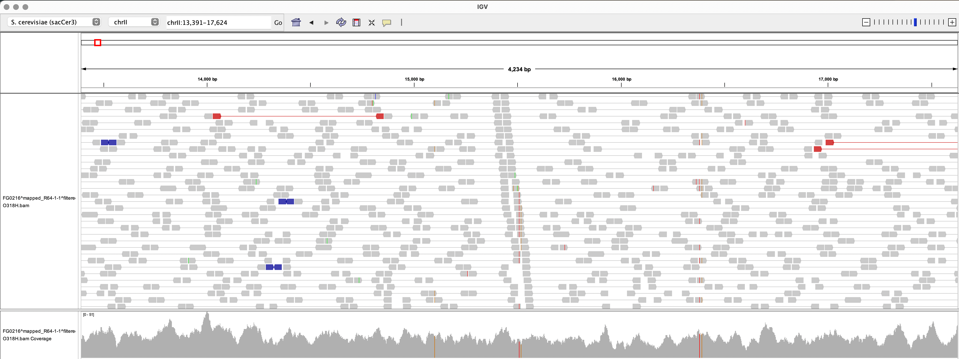
Generating tracks from mapped reads
Basic approach: ”pile-up” of all the fragments in `bam` files to generate a coverage track.

Slide 39
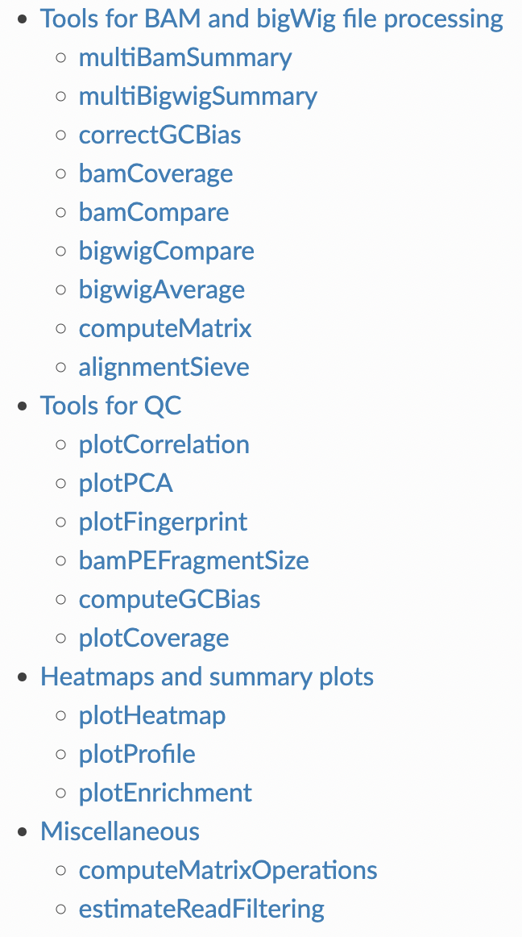
deepTools: a software suite to manage/produce genomic tracks
https://deeptools.readthedocs.io/en/latest/content/list_of_tools.html

Slide 40
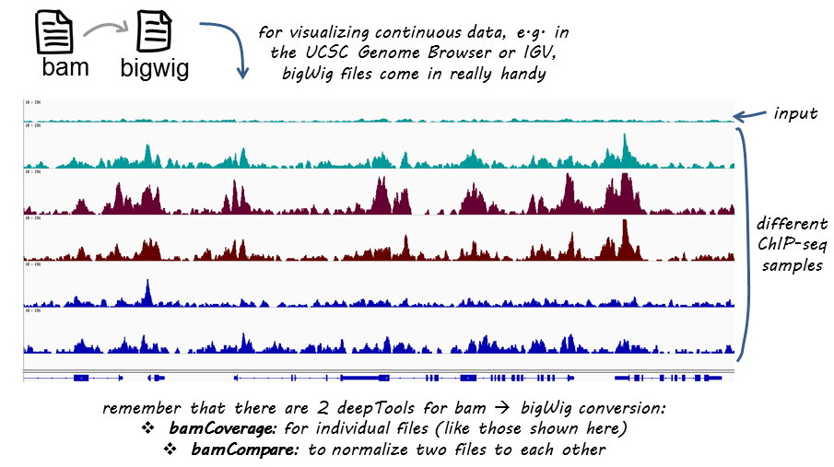
deepTools: a software suite to manage/produce genomic tracks

Slide 41
NGS processing workflow
Get .bcl files
Create fastq files
Or bcl2fastq
QC: remove/trim low quality reads
E.g. cutadapt
Align fastq to BAM
E.g. bowtie2
Filter duplicates, artifacts, …
E.g. samtools
Generate tracks
E.g. deepTools
Assay-specific downstream analysis

Slide 42
NGS processing workflow
Get .bcl files
Create fastq files
Or bcl2fastq
QC: remove/trim low quality reads
E.g. cutadapt
Align fastq to BAM
E.g. bowtie2
Filter duplicates, artifacts, …
E.g. samtools
Generate tracks
E.g. deepTools
CHECK YOUR DATA
Assay-specific downstream analysis

Slide 43
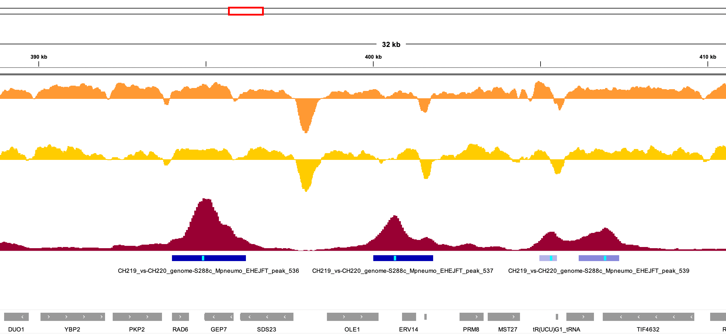
Epigenomics in a browser

Slide 44
Epigenomics in a browser

Slide 45
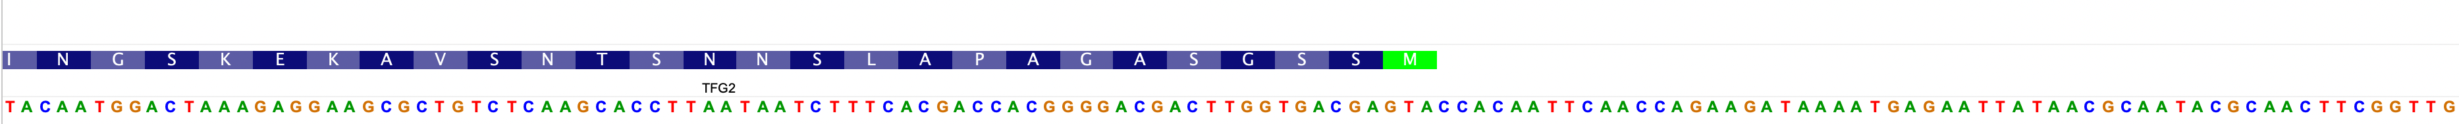
Epigenomics in a browser

Slide 46
Epigenomics in a browser

Slide 47
Epigenomics in a browser

Slide 48
Epigenomics in a browser
Genomic tracks are generally stored as bigwig files.
bigwig files store long numerical vectors in a binarized format
I 2 5 0.153096
I 5 7 0.459288
I 7 9 0.612384
I 9 11 0.76548
I 11 15 0.918576
I 15 16 1.07167
I 16 17 1.37786
I 17 30 1.68406

Slide 49
Epigenomics in a browser
Genomic tracks are generally stored as bigwig files.
bigwig files store long numerical vectors in a binarized format
I 2 5 0.153096
I 5 7 0.459288
I 7 9 0.612384
I 9 11 0.76548
I 11 15 0.918576
I 15 16 1.07167
I 16 17 1.37786
I 17 30 1.68406
&�XHA'\0�eJ]R�@6��09�0|]<pc<�d?�f?�,@@,-@~_@K�`���?�V�@53d�ej�A��i�B���IJ�II�h
III��IV`VjVIQVII|�VIIIIP�X a
XI
�,
XII
�sXIII
�� XIV
XVۦXVIbwMitoOx�=� �U������{��so�J�2KD��V2U�d(���2RQ
���BȔJ�
2)4�
]��'����i����JM���~X�w��9"��Y���Jp|ں4�����>YQ��4NL[e��X_���[ub�S8O'����i��S|$mÓ3|"�m�O�mM����N�i�ū�$�,k�!�:X�Y��NO�[&xn��\���i[Y94�8O�nH�F����[fܔ��i�bݰg2�]�'8;mm���s|��Hۈ�F&�f�,�Jp����N��s�$�n�n��{��9~����ޑࢴ�=��s�6�'�����4�ω .e�&%�������9�J��w1�]����۸-��zl똸w�f�:3���N����`gsḺKc�-��f���c�-Z4;�����I��|ȫ%�������`/s<���/���m���c?s<�}��=>x�9�i=��8x�9���|k���/x�9^l���-3{n�W��8�l_b�כ�P�78&��8�1����9m�ڼ����o%82mc�|;�[X���M�Vse���6��� ޖ�}������?$86m_�[����

Slide 50
Epigenomics in a browser
Genomic tracks are generally stored as bigwig files.
bigwig files store long numerical vectors in a binarized format
In R, bigwig files can be imported with `import()` from the `rtracklayer` package
> library(rtracklayer)
> import('….bw')
GRanges object with 6243328 ranges and 1 metadata column:
seqnames ranges strand | score
<Rle> <IRanges> <Rle> | <numeric>
[1] I 3-5 * | 0.153096
[2] I 6-7 * | 0.459288
[3] I 8-9 * | 0.612384
[4] I 10-11 * | 0.765480
[5] I 12-15 * | 0.918576
... ... ... ... . ...
[6243324] Mito 85775 * | 9.79815
[6243325] Mito 85776 * | 8.26719
[6243326] Mito 85777 * | 6.43003
[6243327] Mito 85778 * | 5.66455
[6243328] Mito 85779 * | 3.21502
-------
seqinfo: 17 sequences from an unspecified genome

Slide 51
Run-length encoding vectors
Genomic tracks are generally stored as bigwig files.
bigwig files store long numerical vectors in a binarized format.
In R, bigwig files can be imported with `import()` from the `rtracklayer` package.
bigwig files can be imported as numerical vectors, stored as Run-length encoding vectors.
b b b b k k e e f a a a a a a a a g g g

Slide 52
Run-length encoding vectors
Genomic tracks are generally stored as bigwig files.
bigwig files store long numerical vectors in a binarized format.
In R, bigwig files can be imported with `import()` from the `rtracklayer` package.
bigwig files can be imported as numerical vectors, stored as Run-length encoding vectors.
b b b b k k e e f a a a a a a a a g g g
4 b

Slide 53
Run-length encoding vectors
Genomic tracks are generally stored as bigwig files.
bigwig files store long numerical vectors in a binarized format.
In R, bigwig files can be imported with `import()` from the `rtracklayer` package.
bigwig files can be imported as numerical vectors, stored as Run-length encoding vectors.
b b b b k k e e f a a a a a a a a g g g
4 b
2 k

Slide 54
Run-length encoding vectors
Genomic tracks are generally stored as bigwig files.
bigwig files store long numerical vectors in a binarized format.
In R, bigwig files can be imported with `import()` from the `rtracklayer` package.
bigwig files can be imported as numerical vectors, stored as Run-length encoding vectors.
b b b b k k e e f a a a a a a a a g g g
4 b
2 k
2 e

Slide 55
Run-length encoding vectors
Genomic tracks are generally stored as bigwig files.
bigwig files store long numerical vectors in a binarized format.
In R, bigwig files can be imported with `import()` from the `rtracklayer` package.
bigwig files can be imported as numerical vectors, stored as Run-length encoding vectors.
b b b b k k e e f a a a a a a a a g g g
4 b
2 k
2 e
1 f

Slide 56
Run-length encoding vectors
Genomic tracks are generally stored as bigwig files.
bigwig files store long numerical vectors in a binarized format.
In R, bigwig files can be imported with `import()` from the `rtracklayer` package.
bigwig files can be imported as numerical vectors, stored as Run-length encoding vectors.
b b b b k k e e f a a a a a a a a g g g
4 b
2 k
2 e
1 f
8 a

Slide 57
Run-length encoding vectors
Genomic tracks are generally stored as bigwig files.
bigwig files store long numerical vectors in a binarized format.
In R, bigwig files can be imported with `import()` from the `rtracklayer` package.
bigwig files can be imported as numerical vectors, stored as Run-length encoding vectors.
b b b b k k e e f a a a a a a a a g g g
4 b
2 k
2 e
1 f
8 a
3 g

Slide 58
Run-length encoding vectors
Genomic tracks are generally stored as bigwig files.
bigwig files store long numerical vectors in a binarized format.
In R, bigwig files can be imported with `import()` from the `rtracklayer` package.
bigwig files can be imported as numerical vectors, stored as Run-length encoding vectors.
b b b b k k e e f a a a a a a a a g g g
Run-values: b k e f a g
Run-lengths: 4 2 2 1 8 3

Slide 59
Run-length encoding vectors
Genomic tracks are generally stored as bigwig files.
bigwig files store long numerical vectors in a binarized format.
In R, bigwig files can be imported with `import()` from the `rtracklayer` package.
bigwig files can be imported as numerical vectors, stored as Run-length encoding vectors.
b b b b k k e e f a a a a a a a a g g g
Run-values: b k e f a g
Run-lengths: 4 2 2 1 8 3
12 alpha-numeric values instead of 20 alphabetic values

Slide 60
Epigenomics in a browser
Genomic tracks are generally stored as bigwig files.
bigwig files store long numerical vectors in a binarized format.
In R, bigwig files can be imported with `import()` from the `rtracklayer` package.
bigwig files can be imported as numerical vectors, stored as Run-length encoding vectors.
> library(rtracklayer)
> import('….bw')
GRanges object with 6243328 ranges and 1 metadata column:
seqnames ranges strand | score
<Rle> <IRanges> <Rle> | <numeric>
[1] I 3-5 * | 0.153096
[2] I 6-7 * | 0.459288
[3] I 8-9 * | 0.612384
[4] I 10-11 * | 0.765480
[5] I 12-15 * | 0.918576
... ... ... ... . ...
[6243324] Mito 85775 * | 9.79815
[6243325] Mito 85776 * | 8.26719
[6243326] Mito 85777 * | 6.43003
[6243327] Mito 85778 * | 5.66455
[6243328] Mito 85779 * | 3.21502
-------
seqinfo: 17 sequences from an unspecified genome

Slide 61
Epigenomics in a browser
Genomic tracks are generally stored as bigwig files.
bigwig files store long numerical vectors in a binarized format.
In R, bigwig files can be imported with `import()` from the `rtracklayer` package.
bigwig files can be imported as numerical vectors, stored as Run-length encoding vectors.
> import('….bw', as = ‘Rle')
RleList of length 17
$I
numeric-Rle of length 230218 with 104639 runs
Lengths: 2 3 2 2 2 ... 2 30 1 1084
Values : 0.000000 0.153096 0.459288 0.612384 0.765480 ... 0.612384 0.459288 0.306192 0.000000
$II
numeric-Rle of length 813184 with 424729 runs
Lengths: 2 1 1 2 1 ... 6 1 5 2
Values : 0.153096 0.306192 0.612384 0.918576 1.071670 ... 0.459288 0.306192 0.153096 0.000000
...
<15 more elements>

