Slide 1
Introduction to epigenomics Or how genes are regulated…
Epigenomics Data Analysis
Jacques Serizay
Physalia 2026

Slide 2
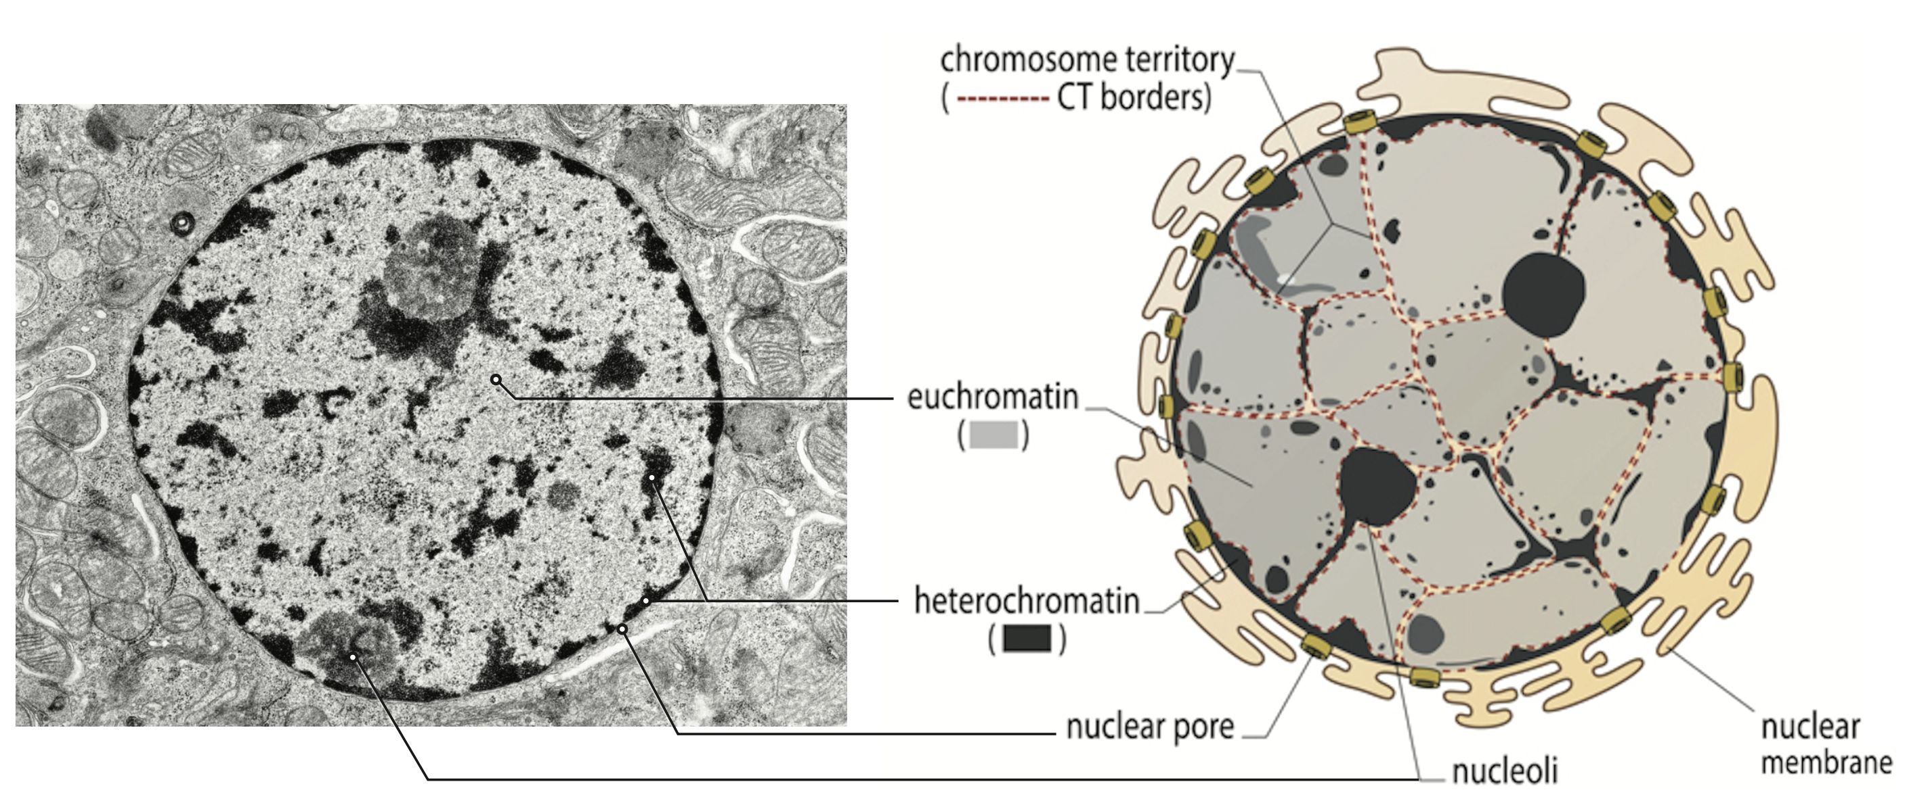
Chromatin is complex

Slide 3
Chromatin composition varies along the genome
DNA

Slide 4
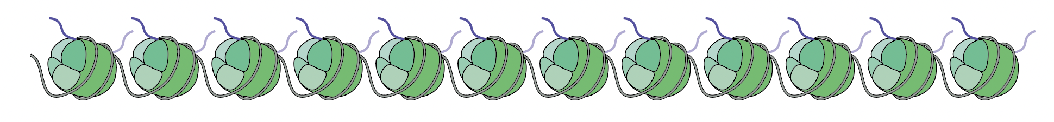
Chromatin composition varies along the genome
DNA
+ Histone cores
Nucleosomes: core chromatin structural unit

Slide 5
Chromatin composition varies along the genome
DNA
+ Histone cores
+ nucleosome positioning
Nucleosomes: core chromatin structural unit

Slide 6
Chromatin composition varies along the genome
DNA
+ Histone cores
+ nucleosome positioning
+ transcription factors
Nucleosomes: core chromatin structural unit

Slide 7
Chromatin composition varies along the genome
DNA
+ Histone cores
+ nucleosome positioning
+ transcription factors
+ Promoter accessibility
Nucleosomes: core chromatin structural unit

Slide 8

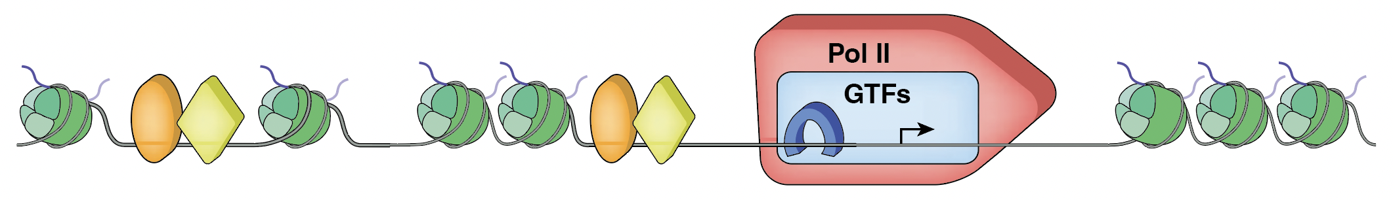
Chromatin composition varies along the genome
DNA
+ Histone cores
+ nucleosome positioning
+ transcription factors
+ Promoter accessibility
+ Polymerase
Nucleosomes: core chromatin structural unit

Slide 9
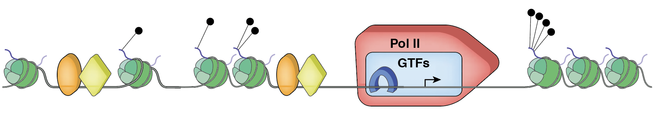
Chromatin composition varies along the genome
DNA
+ Histone cores
+ nucleosome positioning
+ transcription factors
+ Promoter accessibility
+ Polymerase
+ Histone PTMs
Nucleosomes: core chromatin structural unit

Slide 10
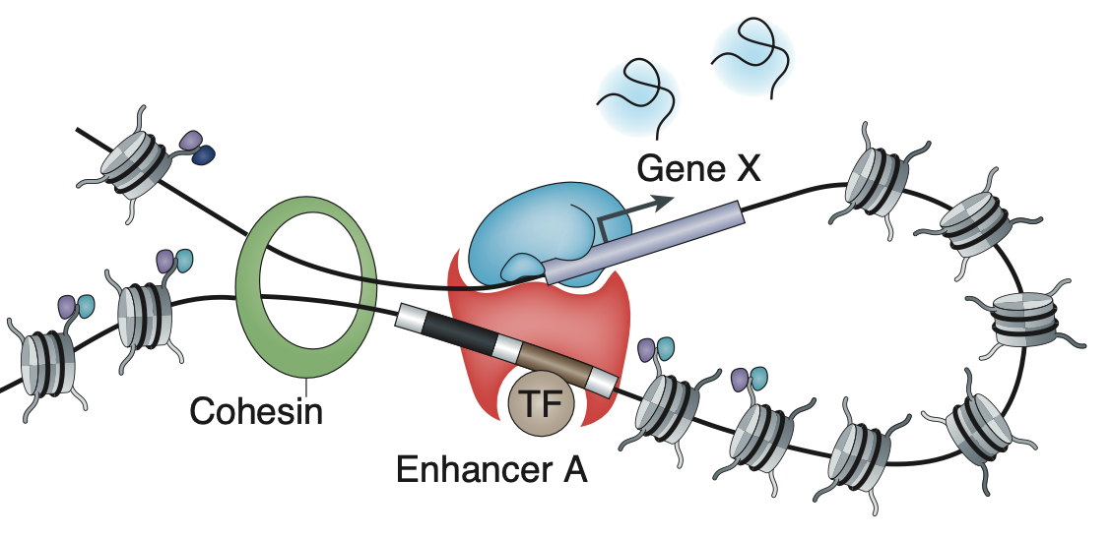
Chromatin composition varies along the genome
DNA
+ Histone cores
+ nucleosome positioning
+ transcription factors
+ Promoter accessibility
+ Polymerase
+ Histone PTMs
+ Chromatin folding
Nucleosomes: core chromatin structural unit

Slide 11
Chromatin composition varies along the genome
DNA
+ Histone cores
+ nucleosome positioning
+ transcription factors
+ Promoter accessibility
+ Polymerase
+ Histone PTMs
+ Chromatin folding
WGS
Nucleosomes: core chromatin structural unit
ChIP-seq
MNase-seq
ChIP-seq
ATAC-seq
RNA-seq
ChIP-seq
Hi-C

Slide 12
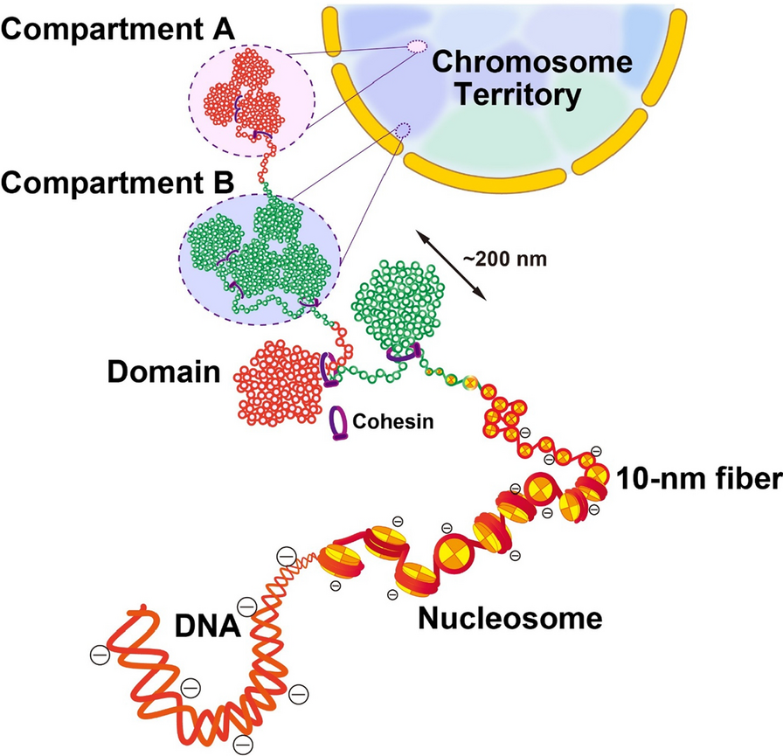
Chromatin is organized in hierarchical structure to enable transcriptional regulation
Euchromatin
Heterochromatin
Lafontain et al., Current Protocols 2021

Slide 13
Chromatin is organized in hierarchical structure to enable transcriptional regulation
Euchromatin
Hi-C
Heterochromatin
RNA-seq
ATAC-seq
ChIP-seq
WGS
MNase-seq
Lafontain et al., Current Protocols 2021

Slide 14
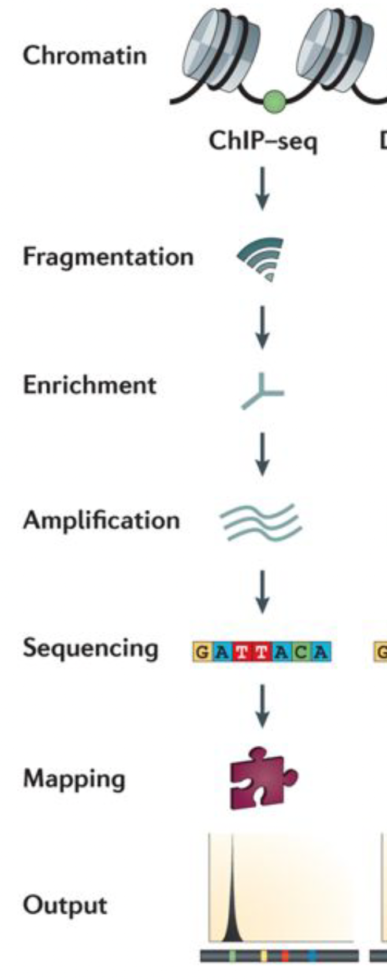
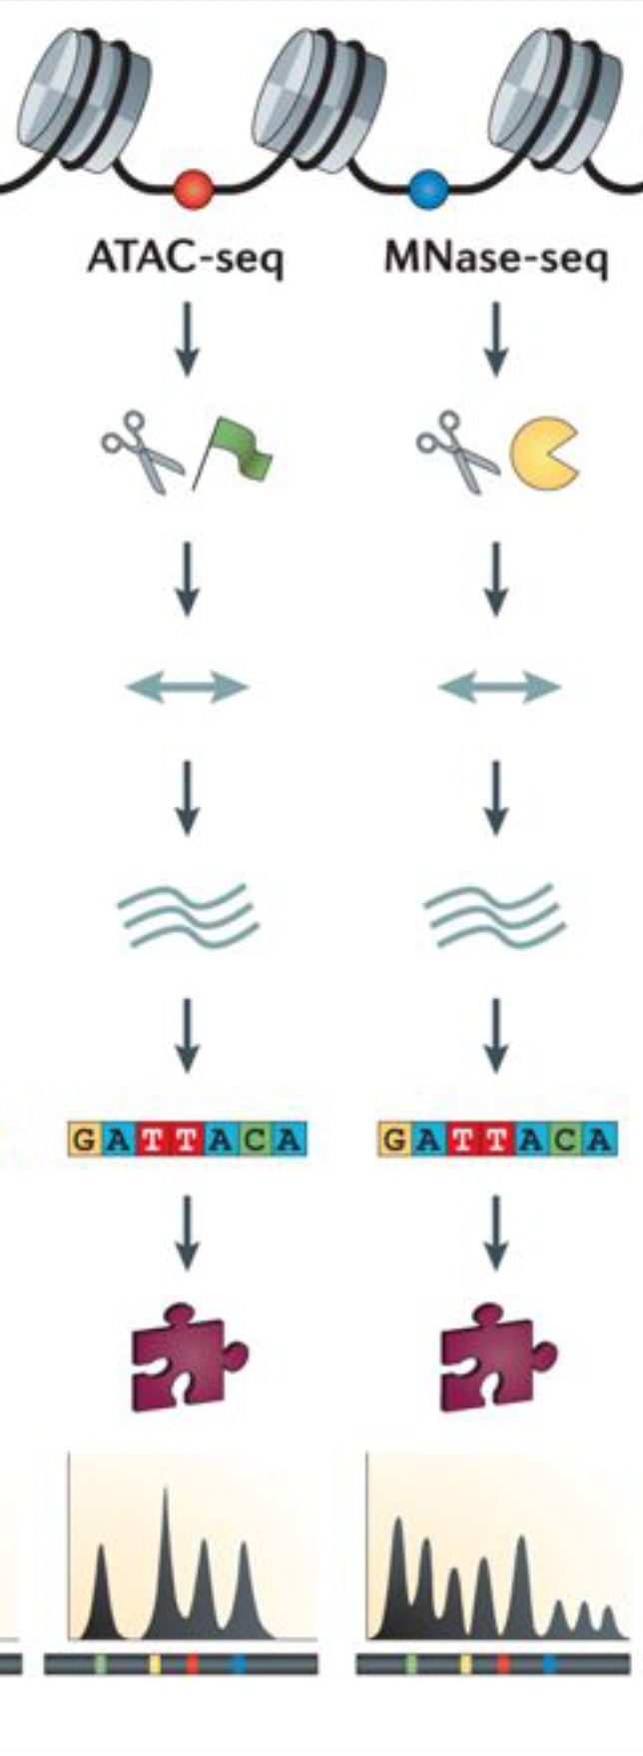
ChIP-seq vs. ATAC-seq vs MNase-seq

Slide 15
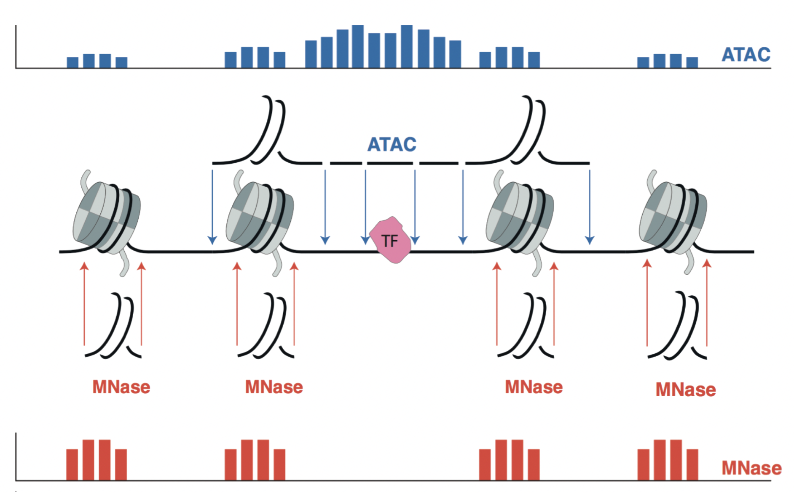
ATAC-seq vs MNase-seq

Slide 16
ATAC-seq vs MNase-seq

Slide 17
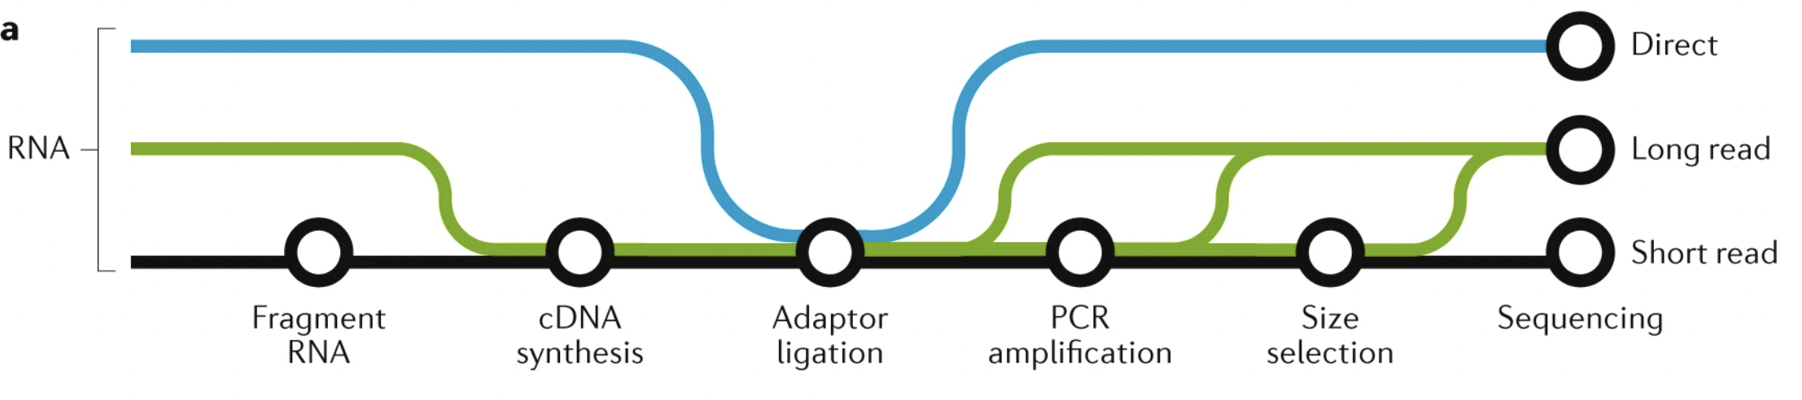
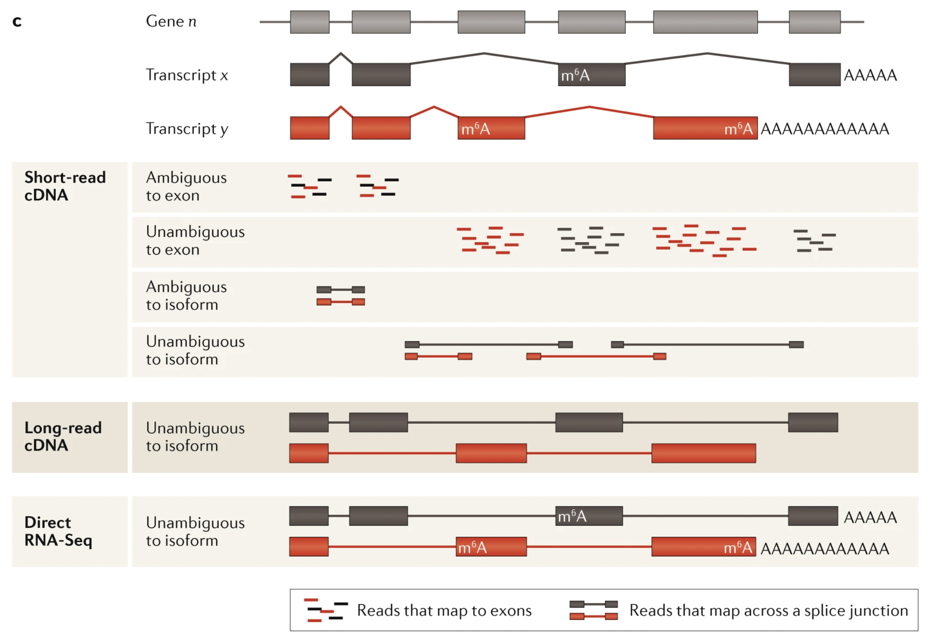
RNA-seq
Stark, Grzelak & Hadfield 2019

Slide 18
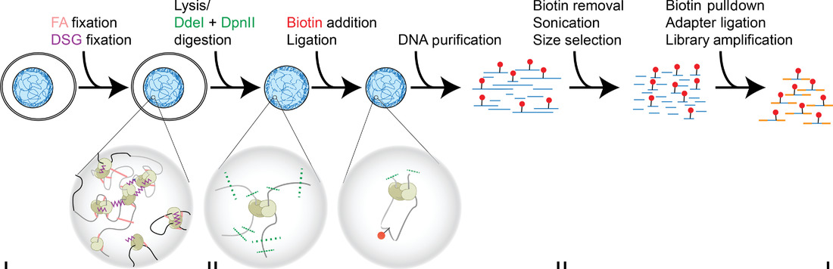
Hi-C
Restriction enzyme digestion
Biotin incorporation
End repair
Religation
Sonication
Biotin pull-down
Fixation
DNA purification
Lafontain et al., Current Protocols 2021

