Slide 1
ATAC-seq analysis
Epigenomics Data Analysis
Jacques Serizay
Physalia 2026

Slide 2
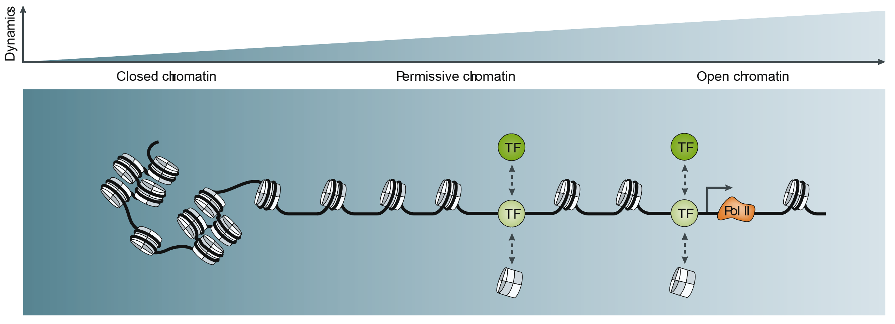
Beyond textbook statements: a spectrum of regulatory capacity
Chromatin accessibility continuum that ranges from closed chromatin to highly dynamic, accessible or permissive chromatin
This landscape of chromatin accessibility reflects the spectrum of regulatory capacity — rather than a bistate organization
Klemm et al., Nat .Rev. Genet 2019

Slide 3
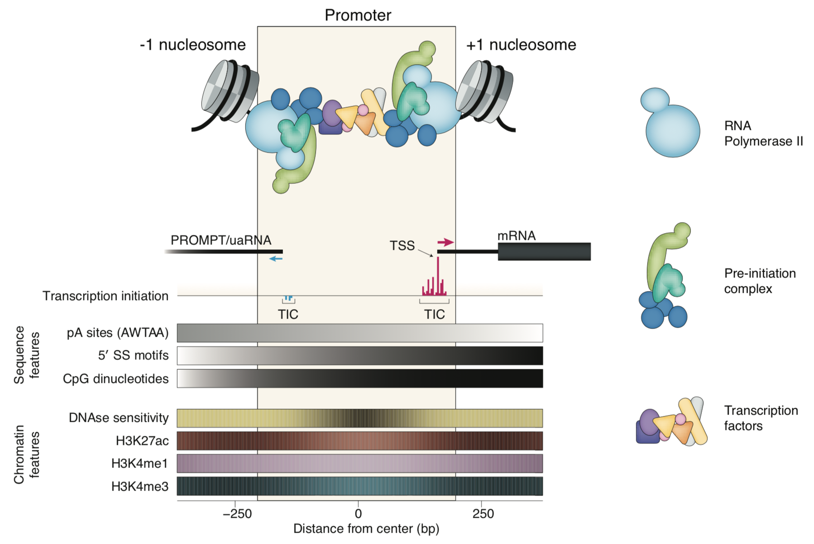
Promoter organization
Promoters are crowded environments!
Haberle and Lenhard, Semin. Cell Dev. Biol. 2016

Slide 4
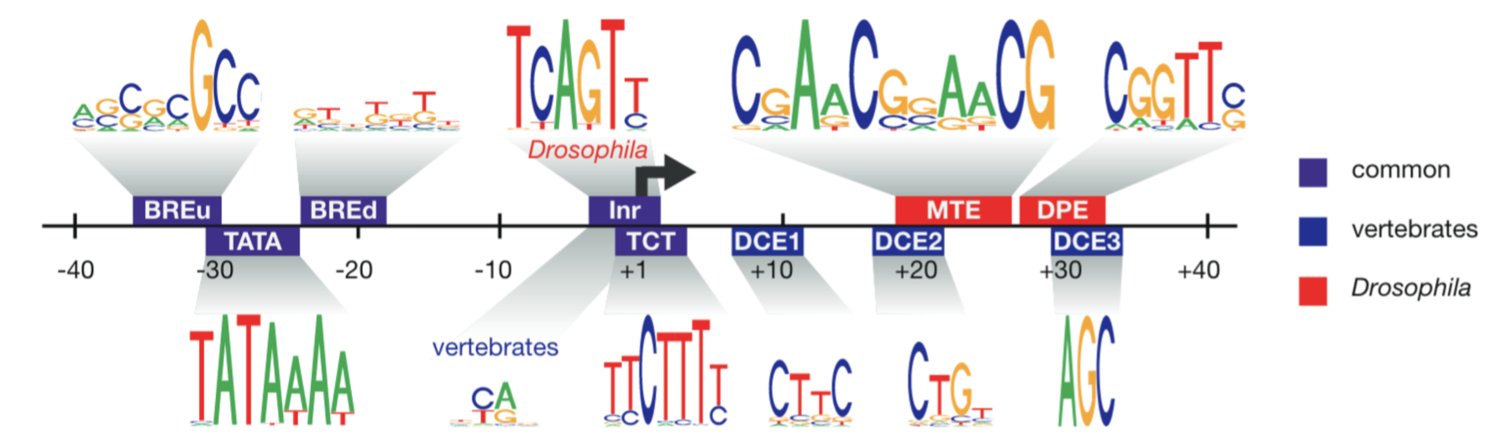
Promoter organization
Transcription machinery and general transcription factors need access to DNA to recognize their binding motif
Haberle and Lenhard, Semin. Cell Dev. Biol. 2016

Slide 5
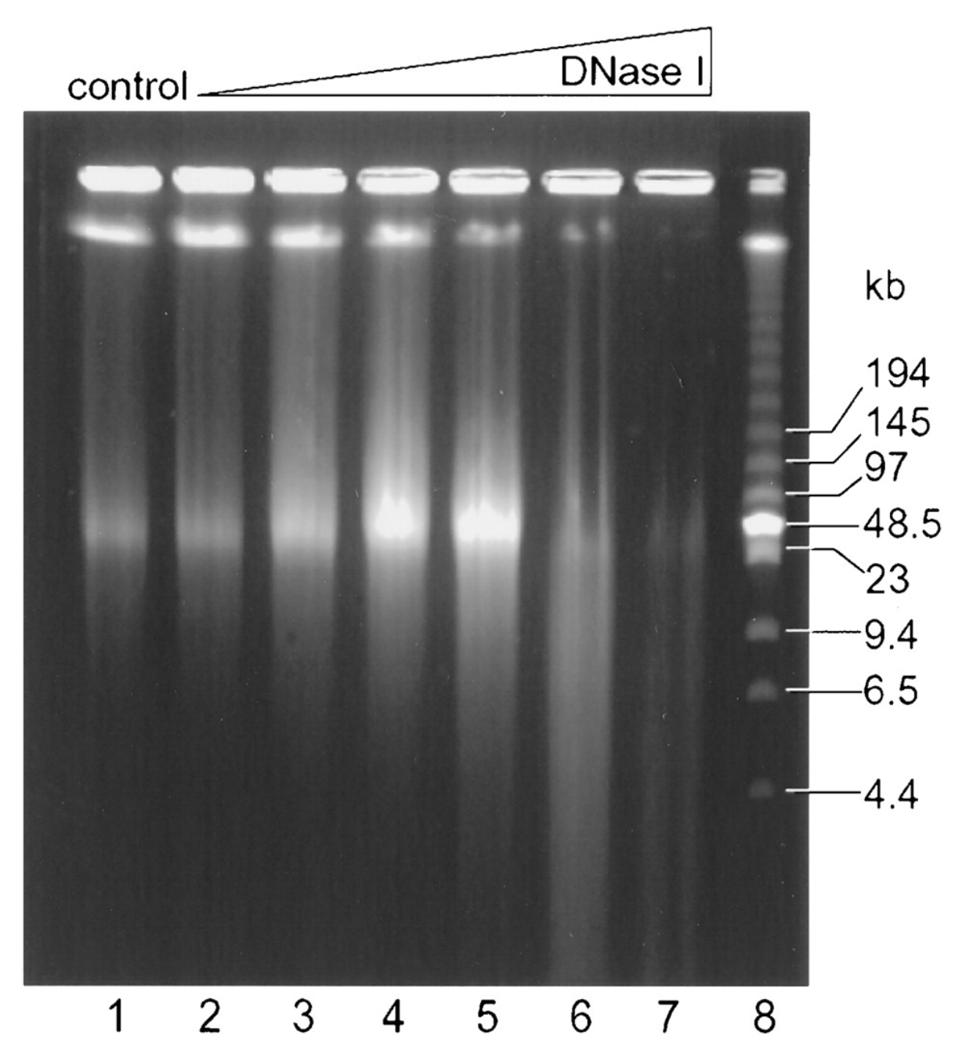
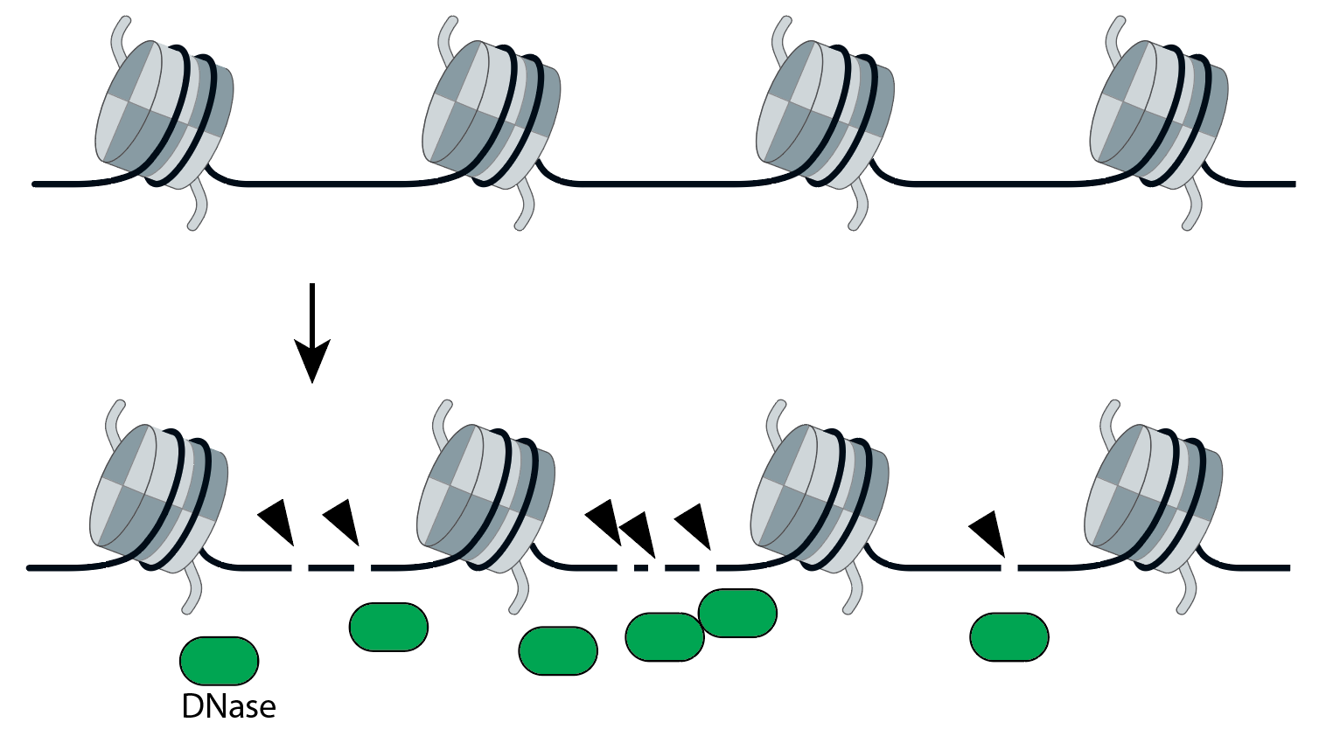
How to measure chromatin accessibility: originally with nucleases
Nuclease enzymes were historically used to profile chromatin accessibility
Dnase I (deoxyribonuclease I): a non-specific double-strand endonuclease
Paul & Ferl, Plant Cell 1998

Slide 6
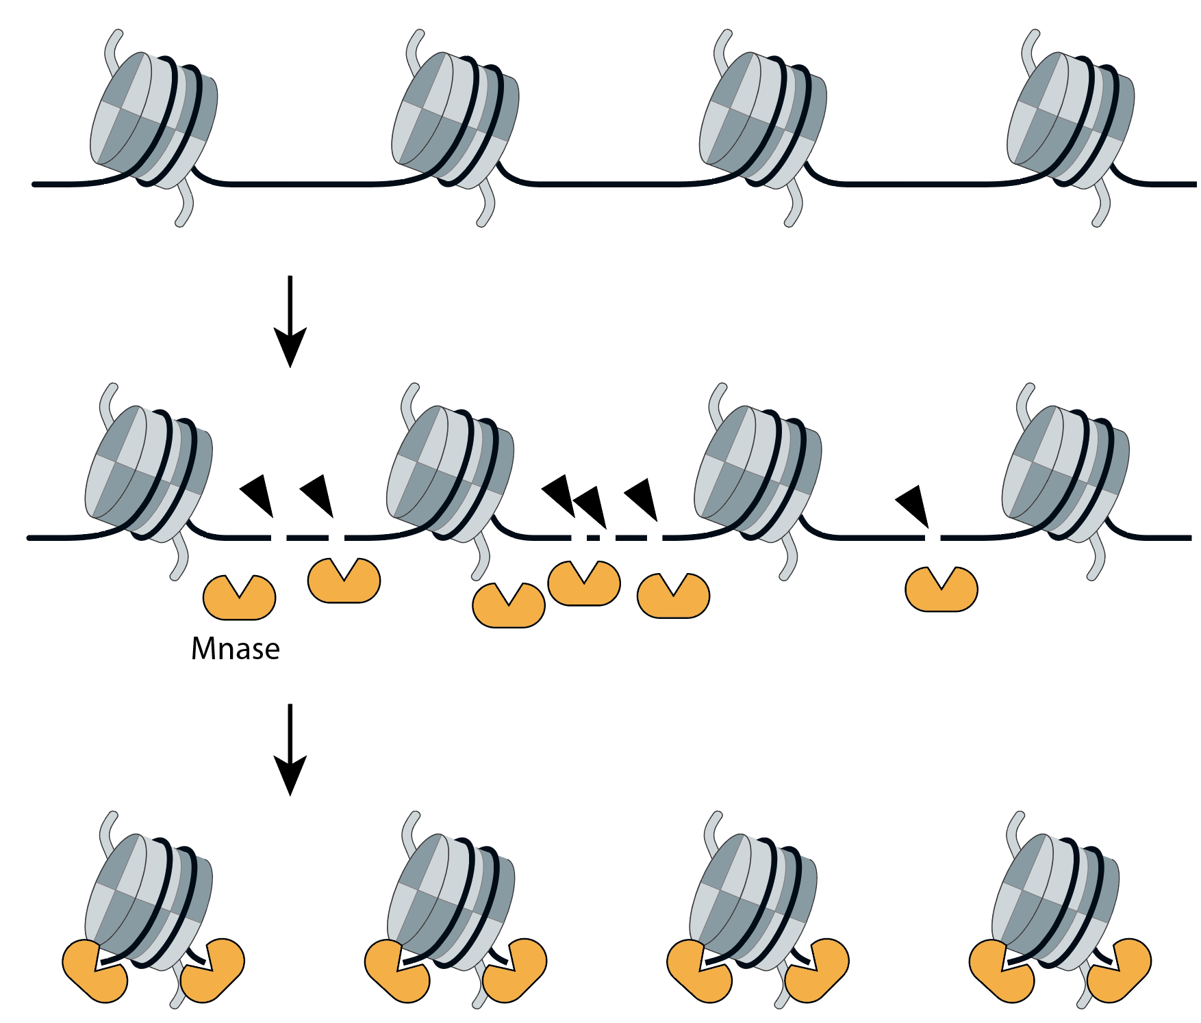
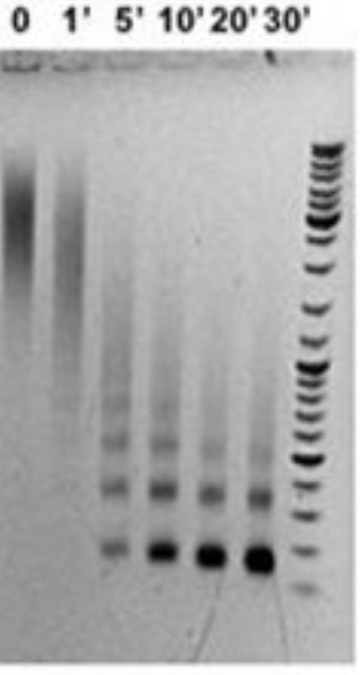
How to measure chromatin accessibility: originally with nucleases
Nuclease enzymes were historically used to profile chromatin accessibility
Dnase I (deoxyribonuclease I): a non-specific double-strand endonuclease
Mnase (Micrococcal nuclease): a endo-exonuclease with preference to single-strand DNA but with also double-strand nuclease activity
Rodríguez-Campos & Azorín, PLoS One 2007

Slide 7
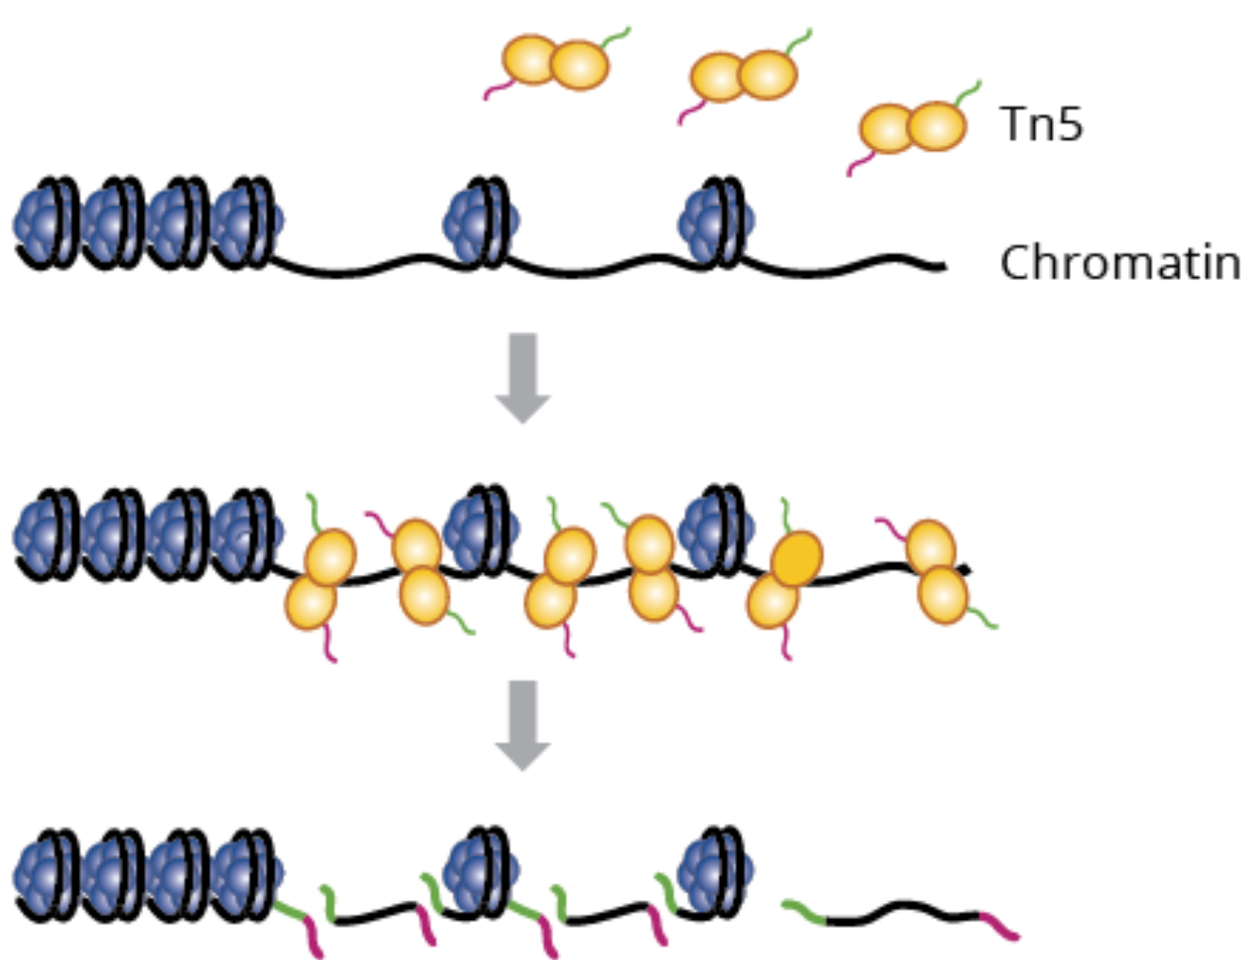
How to measure chromatin accessibility: originally with nucleases
Nuclease enzymes were historically used to profile chromatin accessibility
Dnase I (deoxyribonuclease I): a non-specific double-strand endonuclease
Mnase (Micrococcal nuclease): a endo-exonuclease with preference to single-strand DNA but with also double-strand nuclease activity
ATAC: a Tn5 transposase, integrating transposons wherever it is possible (i.e. accessible)
Buenrostro et al., 2013

Slide 8
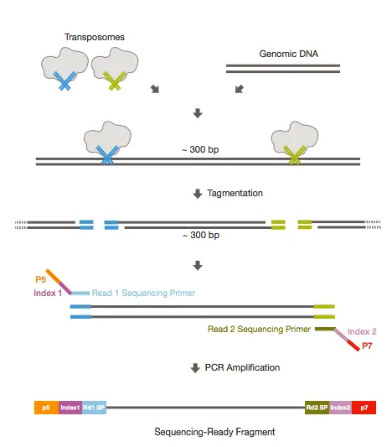
ATAC-seq: from chromatin to NGS library
Since the sequence of the transposons loaded on the Tn5 transposome is known, one can use them to in a PCR
“Tagmented” (i.e. DNA with inserted transposons) will be amplified.
Each end of a fragment corresponds to a transposition event.

Slide 9
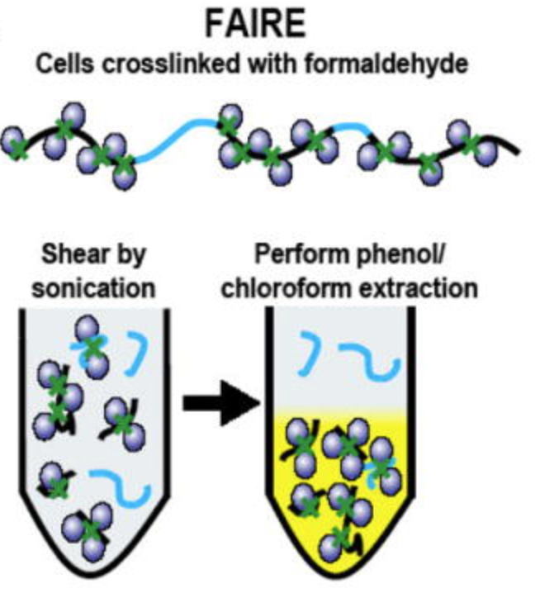
Emergence of other enzymatic or mechanical approaches
Mechanical approaches
FAIRE-seq: Formaldehyde-Assisted Isolation of Regulatory Elements
→ Uses a crosslinking + sonication + phenol extraction to isolate nucleosome-depleted chromatin
Giresi & Lieb, Methods 2009

Slide 10
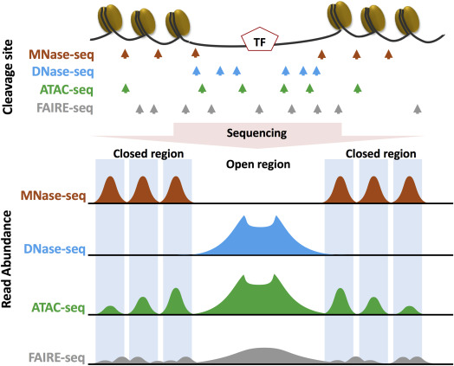
Comparison of the main experimental approaches
Each assay generates a specific type of profile.
Hsu et al., Epigenetics in Human Diseases 2018

Slide 11
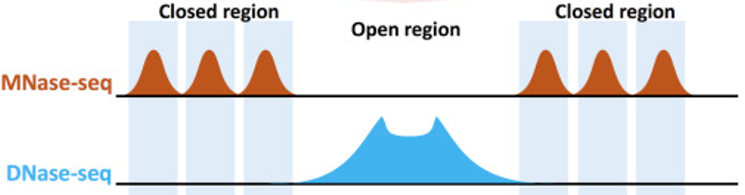
Positive vs. negative measurements
DNAse-seq relies on presence of signal (positive measurements) to map accessible regulatory elements
Mnase-seq relies on absence of signal (negative measurements) to map accessible regulatory elements

Slide 12


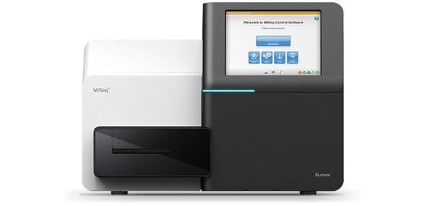
ATAC-seq downstream analysis
Get .bcl files
Create fastq files
Or bcl2fastq
QC: remove/trim low quality reads
E.g. cutadapt
Align fastq to BAM
E.g. bowtie2
Filter duplicates, artifacts, …
E.g. samtools
Generate tracks
E.g. deepTools
Assay-specific downstream analysis
Peak calling
Differential peak analysis
Fragment size distribution
Promoter footprint analysis

Slide 13
ATAC peak callers
Most peak callers were designed before the emergence of ATAC-seq
Few of them directly aim at identifying peaks in chromatin accessibility signals

Slide 14
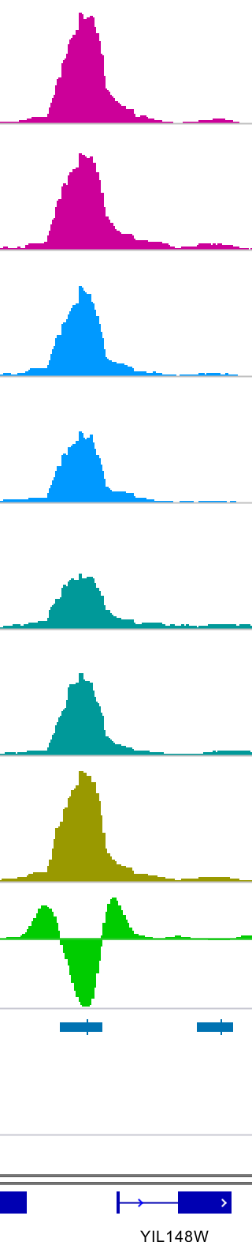
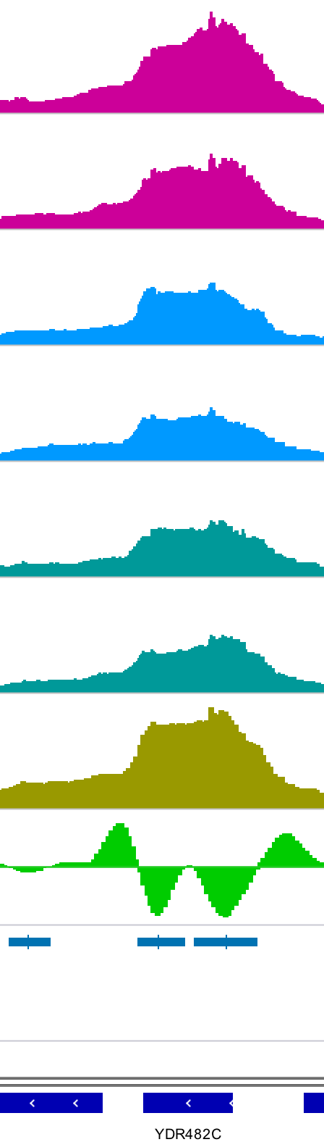
ATAC peak callers
Most peak callers were designed before the emergence of ATAC-seq
Few of them directly aim at identifying peaks in chromatin accessibility signals
Since the emergence of ATAC-seq, new peak callers were designed with the identification of peak “shape” in mind.
Sample 1
Sample 2
Sample 3
Gene annot.

Slide 15
ATAC peak callers
Most peak callers were designed before the emergence of ATAC-seq
Few of them directly aim at identifying peaks in chromatin accessibility signals
Since the emergence of ATAC-seq, new peak callers were designed with the identification of peak “shape” in mind.
Sample 1
Sample 2
Sample 3
Aggregated signal
Gene annot.

Slide 16
ATAC peak callers
Most peak callers were designed before the emergence of ATAC-seq
Few of them directly aim at identifying peaks in chromatin accessibility signals
Since the emergence of ATAC-seq, new peak callers were designed with the identification of peak “shape” in mind.
Sample 1
Sample 2
Sample 3
Aggregated signal
2nd derivative
Gene annot.

Slide 17
ATAC peak callers
Most peak callers were designed before the emergence of ATAC-seq
Few of them directly aim at identifying peaks in chromatin accessibility signals
Since the emergence of ATAC-seq, new peak callers were designed with the identification of peak “shape” in mind.
Sample 1
Sample 2
Sample 3
Aggregated signal
2nd derivative
Peaks
Gene annot.

Slide 18
ATAC peak callers
Most peak callers were designed before the emergence of ATAC-seq
Few of them directly aim at identifying peaks in chromatin accessibility signals
Since the emergence of ATAC-seq, new peak callers were designed with the identification of peak “shape” in mind.
yapc output_refix \
sample1 sample1_rep1.bw sample1_rep2.bw \
sample2 sample2_rep1.bw sample2_rep2.bw \
… \
sampleN sampleN_rep1.bw sampleN_rep2.bw

