Slide 1
Motif identification from ChIP-seq
Epigenomics Data Analysis
Jacques Serizay
Physalia 2026

Slide 2
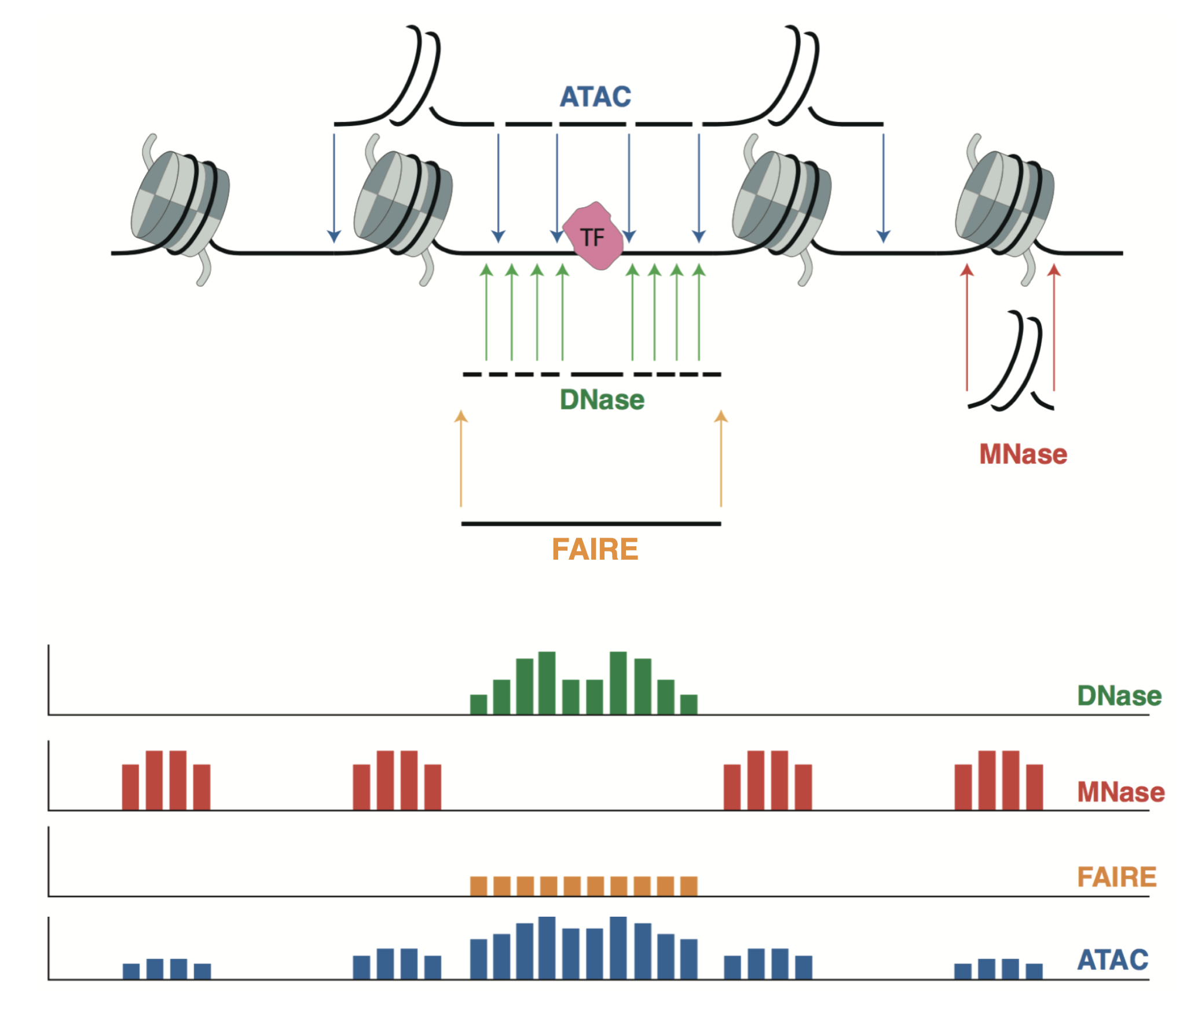
Accessible sites are often regulatory elements

Slide 3
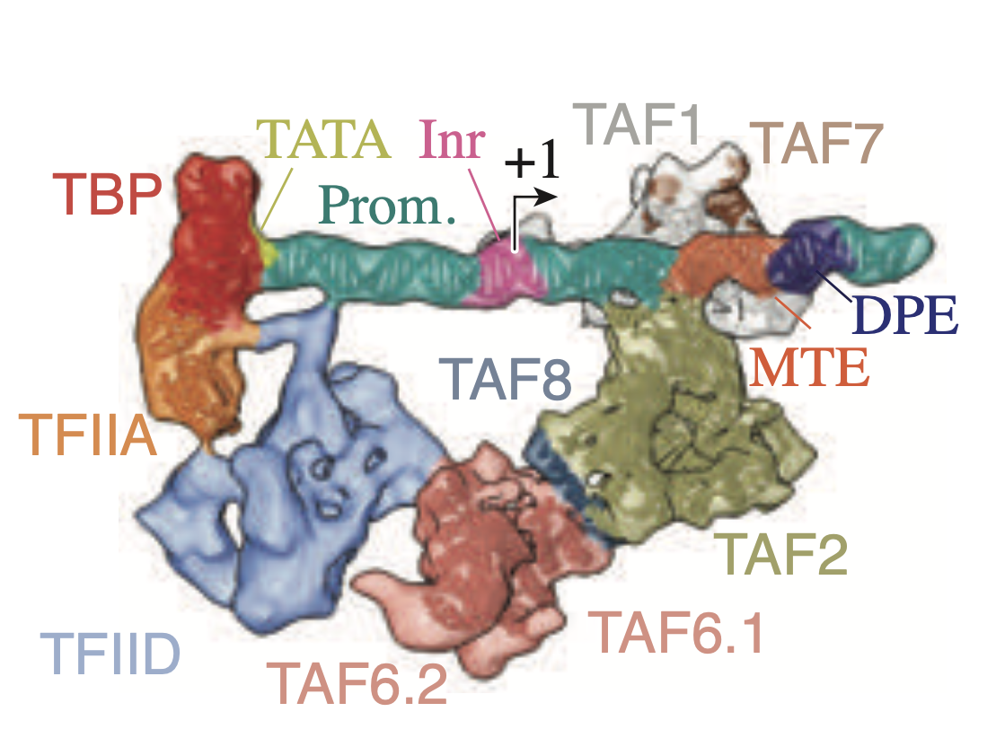
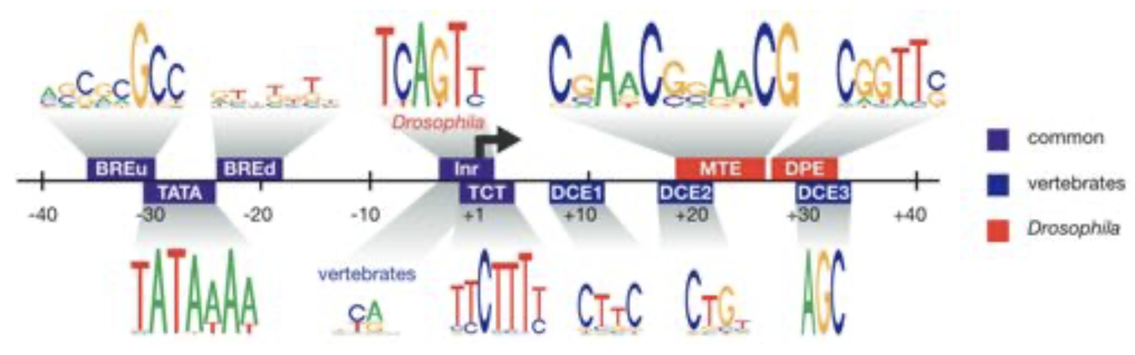
General transcription machinery is assembled around promoters using sequence affinity

Slide 4
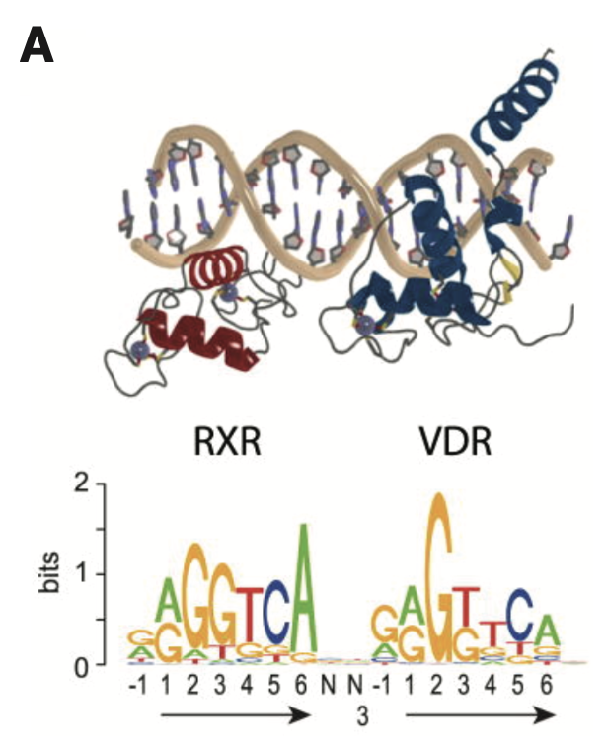
Transcription factors can be recruited directly to DNA motifs

Slide 5
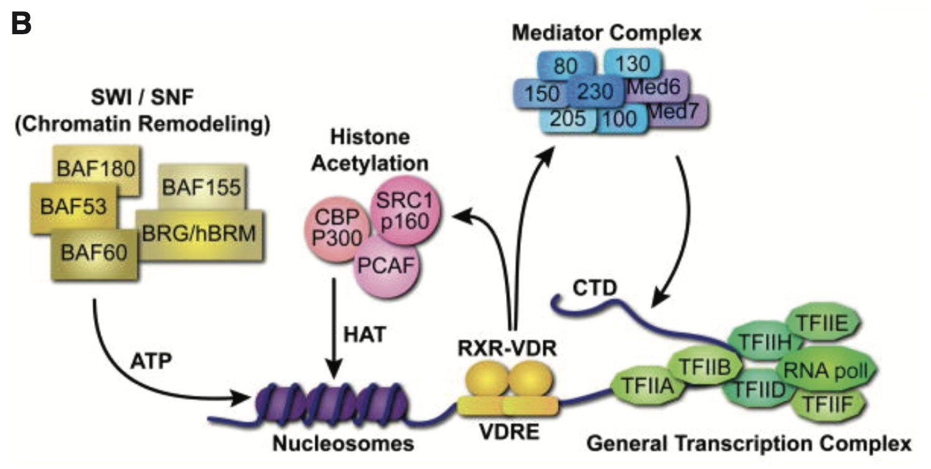
TFs can also mediate INDIRECT recruitment of factors to chromatin

Slide 6
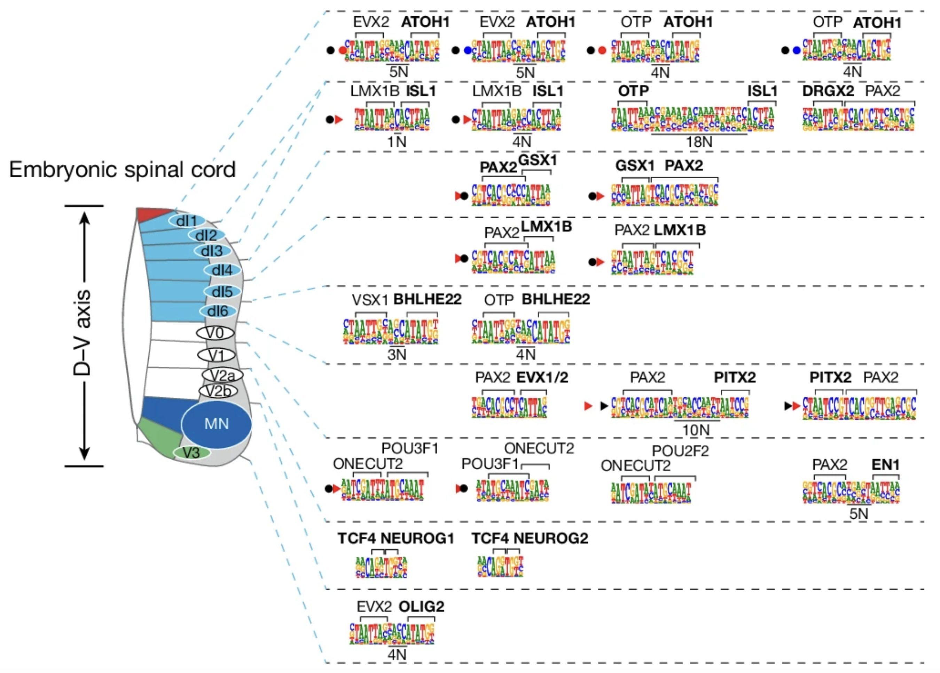
Motifs are important in shaping all biological processes
https://www.nature.com/articles/s41586-025-08844-z

Slide 7
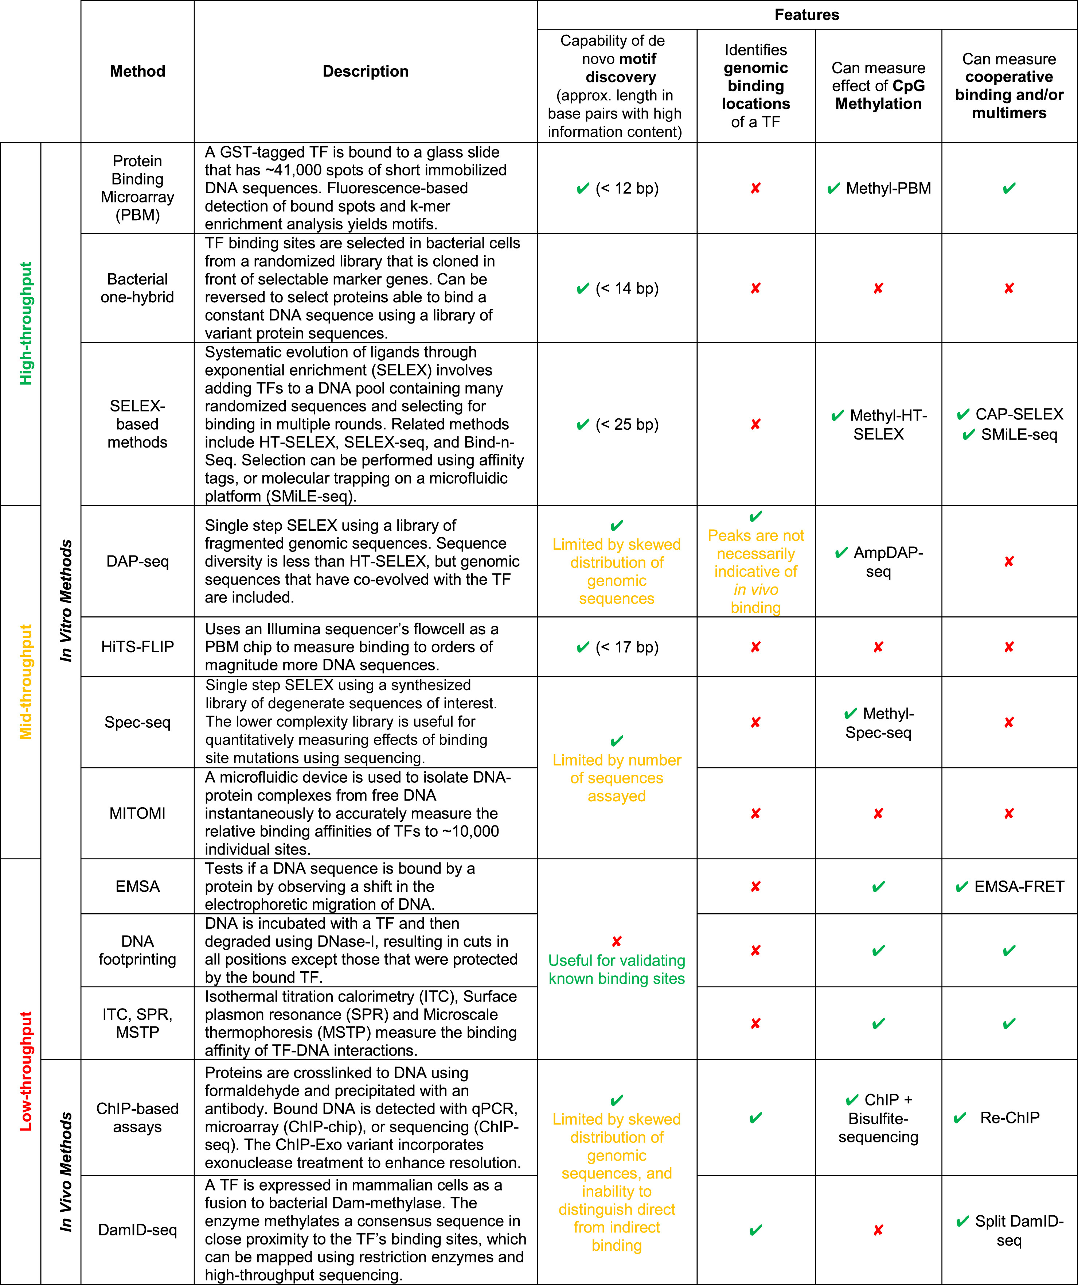
Motifs are important in shaping all biological processes
https://doi.org/10.1016/j.cell.2018.01.029

Slide 8
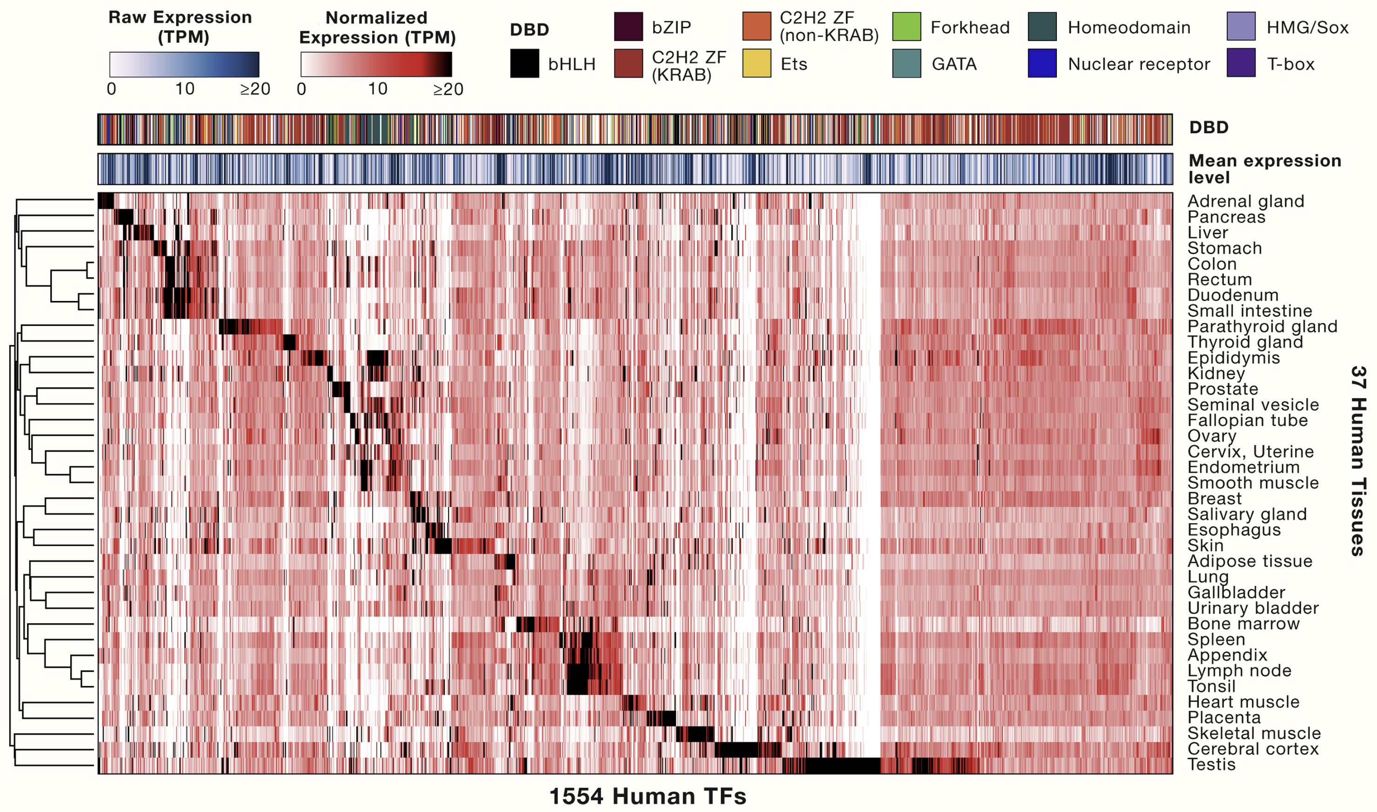
TF gene expression: an orthogonal approach to estimate TF’s activity
https://doi.org/10.1016/j.cell.2018.01.029

Slide 9
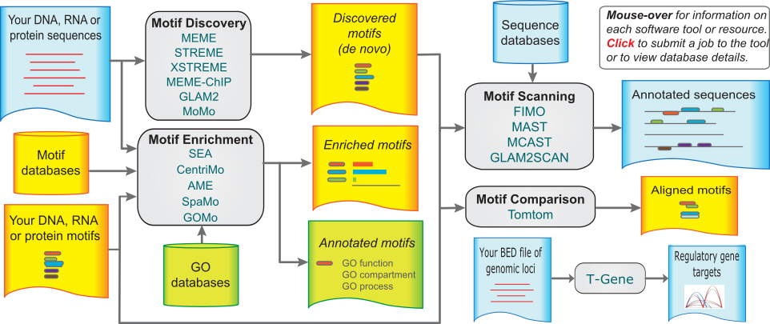

Finding motifs enriched in sequences extracted from ChIP-seq peaks
MEME is a versatile suite of softwares largely used to identify known or de novo motifs enriched in a given set of sequences of interest.
https://meme-suite.org/meme/

Slide 10
DE NOVO identification vs COMPARISON to known motifs
https://meme-suite.org/meme/

Slide 11
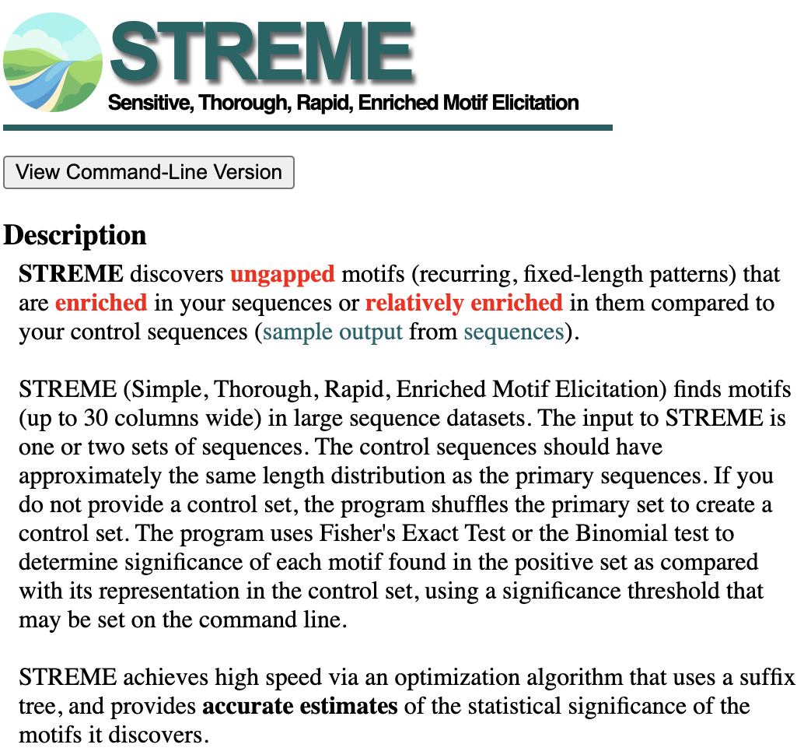
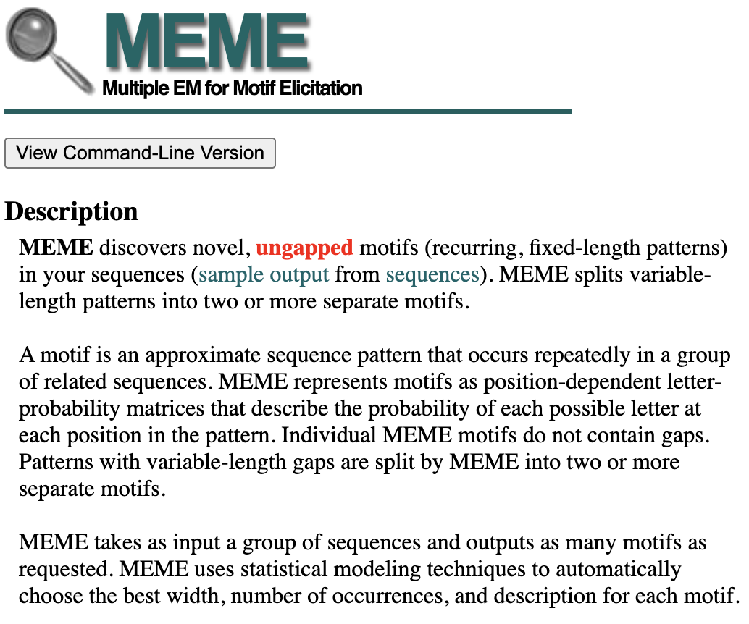
DE NOVO identification vs COMPARISON to known motifs
https://meme-suite.org/meme/

Slide 12
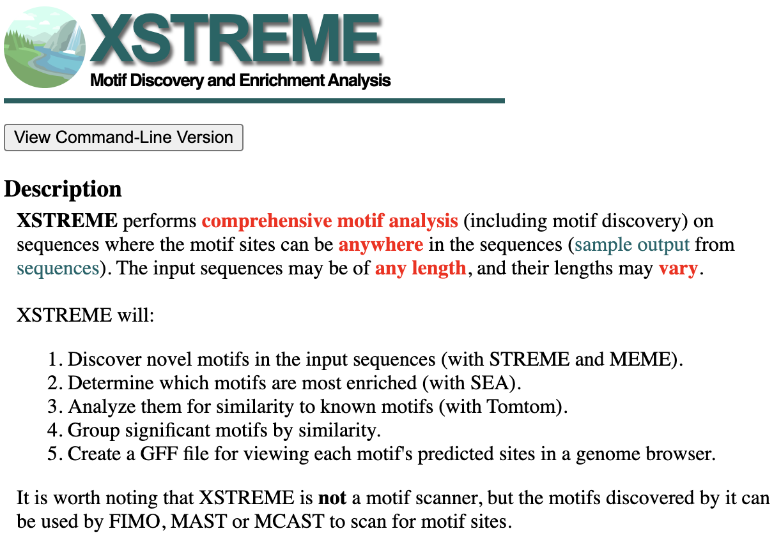
DE NOVO identification vs COMPARISON to known motifs
https://meme-suite.org/meme/

Slide 13
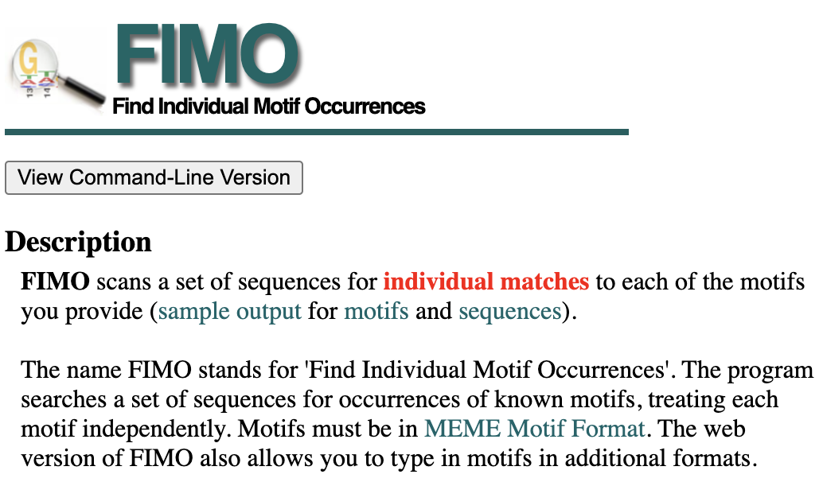
DE NOVO identification vs COMPARISON to known motifs
https://meme-suite.org/meme/

Slide 14
DE NOVO identification vs COMPARISON to known motifs
https://meme-suite.org/meme/

Slide 15
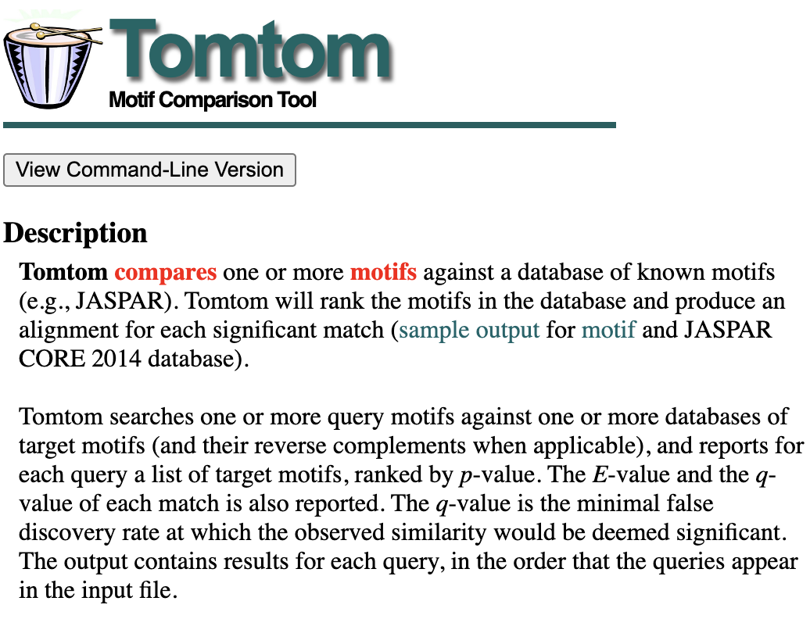
DE NOVO identification vs COMPARISON to known motifs
https://meme-suite.org/meme/

Slide 16
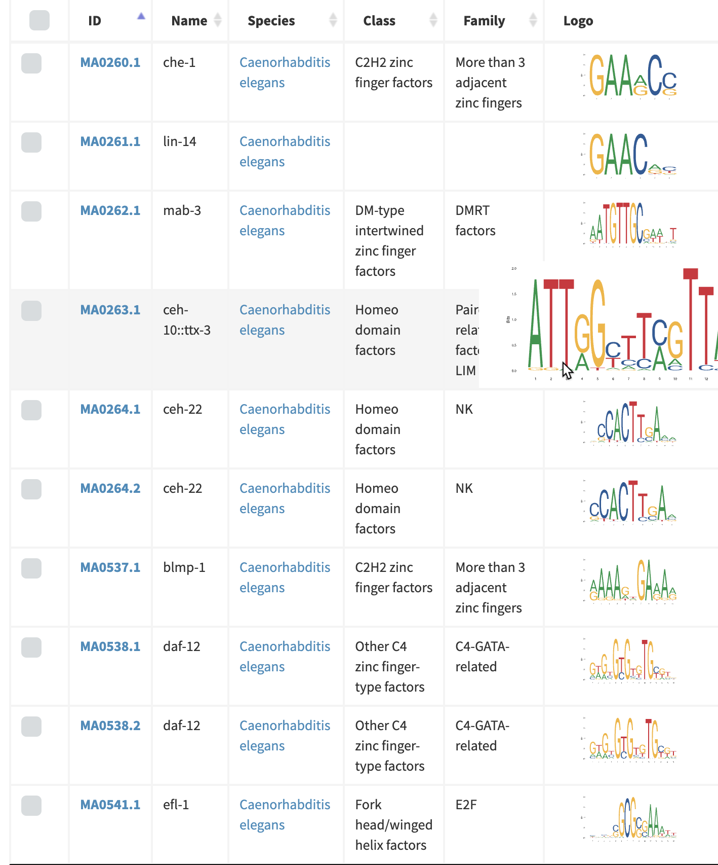
Public motif databases provide extensive knowledge of TFBS
https://jaspar.elixir.no/

