Slide 1
Hi-C processing
Epigenomics Data Analysis
Jacques Serizay
Physalia 2026

Slide 2
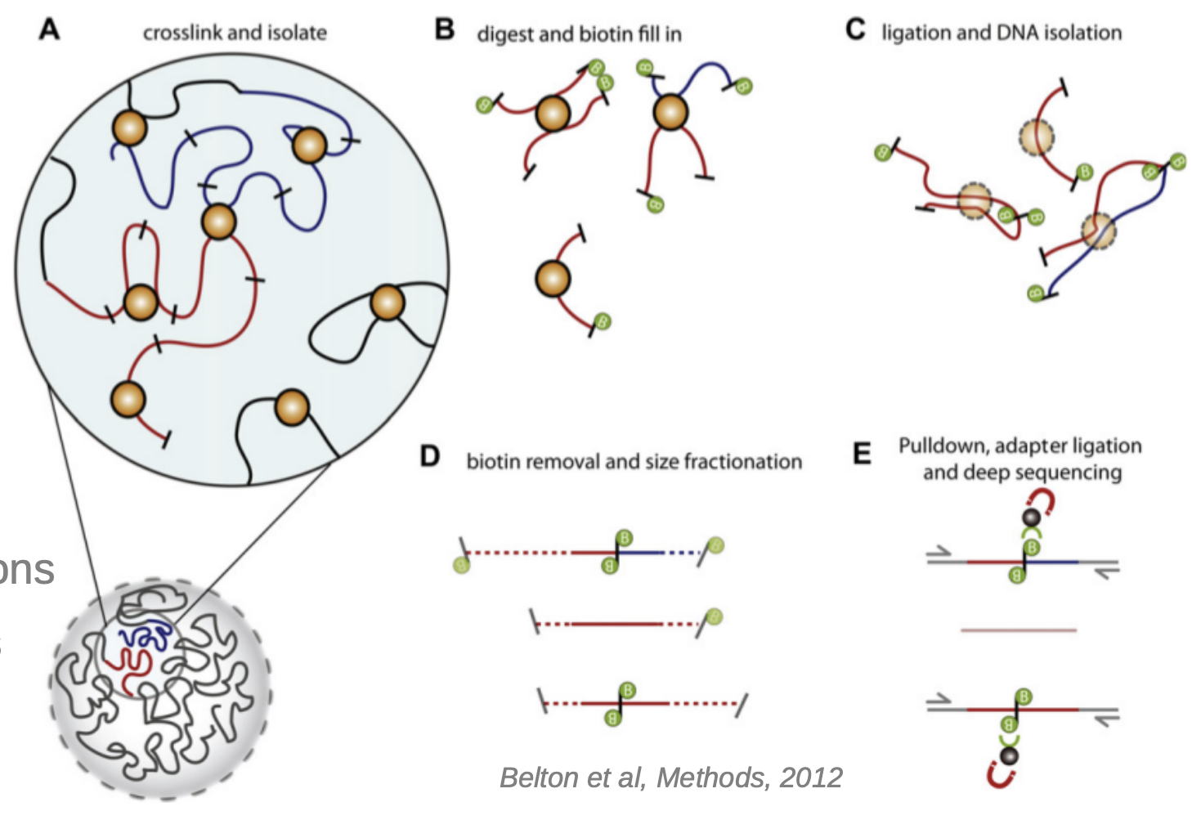
Hi-C experimental workflow
Belton et al., Methods 2012

Slide 3
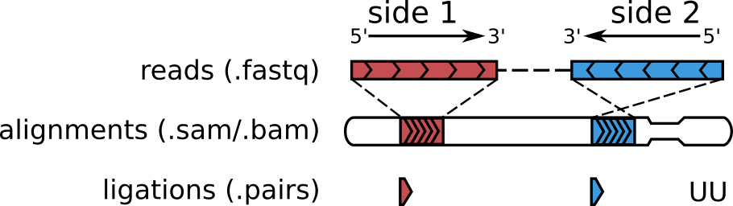
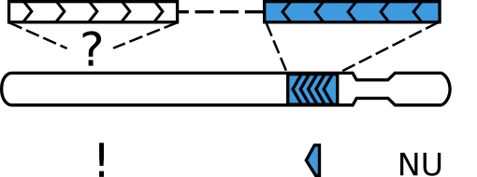
Hi-C computational workflow
R1
R2
Open2C et al., Biorxiv 2023

Slide 4
Hi-C computational workflow
R1 (50bp)
R1 (50bp)
R2 (50bp)
Open2C et al., Biorxiv 2023

Slide 5
Hi-C computational workflow
Open2C et al., Biorxiv 2023

Slide 6

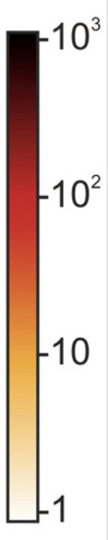
Hi-C computational workflow
Contact counts
Open2C et al., Biorxiv 2023

Slide 7
Hi-C computational workflow
Contact counts
Open2C et al., Biorxiv 2023

Slide 8
Hi-C computational workflow
Contact counts
Open2C et al., Biorxiv 2023

Slide 9
Hi-C computational workflow
Contact counts
Open2C et al., Biorxiv 2023

Slide 10


Hi-C pipeline
Get .bcl files
Create fastq files
QC: remove/trim low quality reads
Align fastq to BAM
Filter duplicates, artifacts, …
Generate tracks
Assay-specific downstream analysis

Slide 11
Hi-C pipeline
Get .bcl files
Create fastq files
QC: remove/trim low quality reads
Align fastq to BAM
Filter duplicates, artifacts, …
Generate tracks
Assay-specific downstream analysis

Slide 12
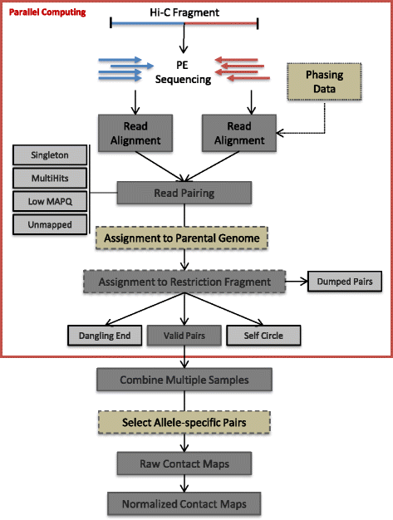
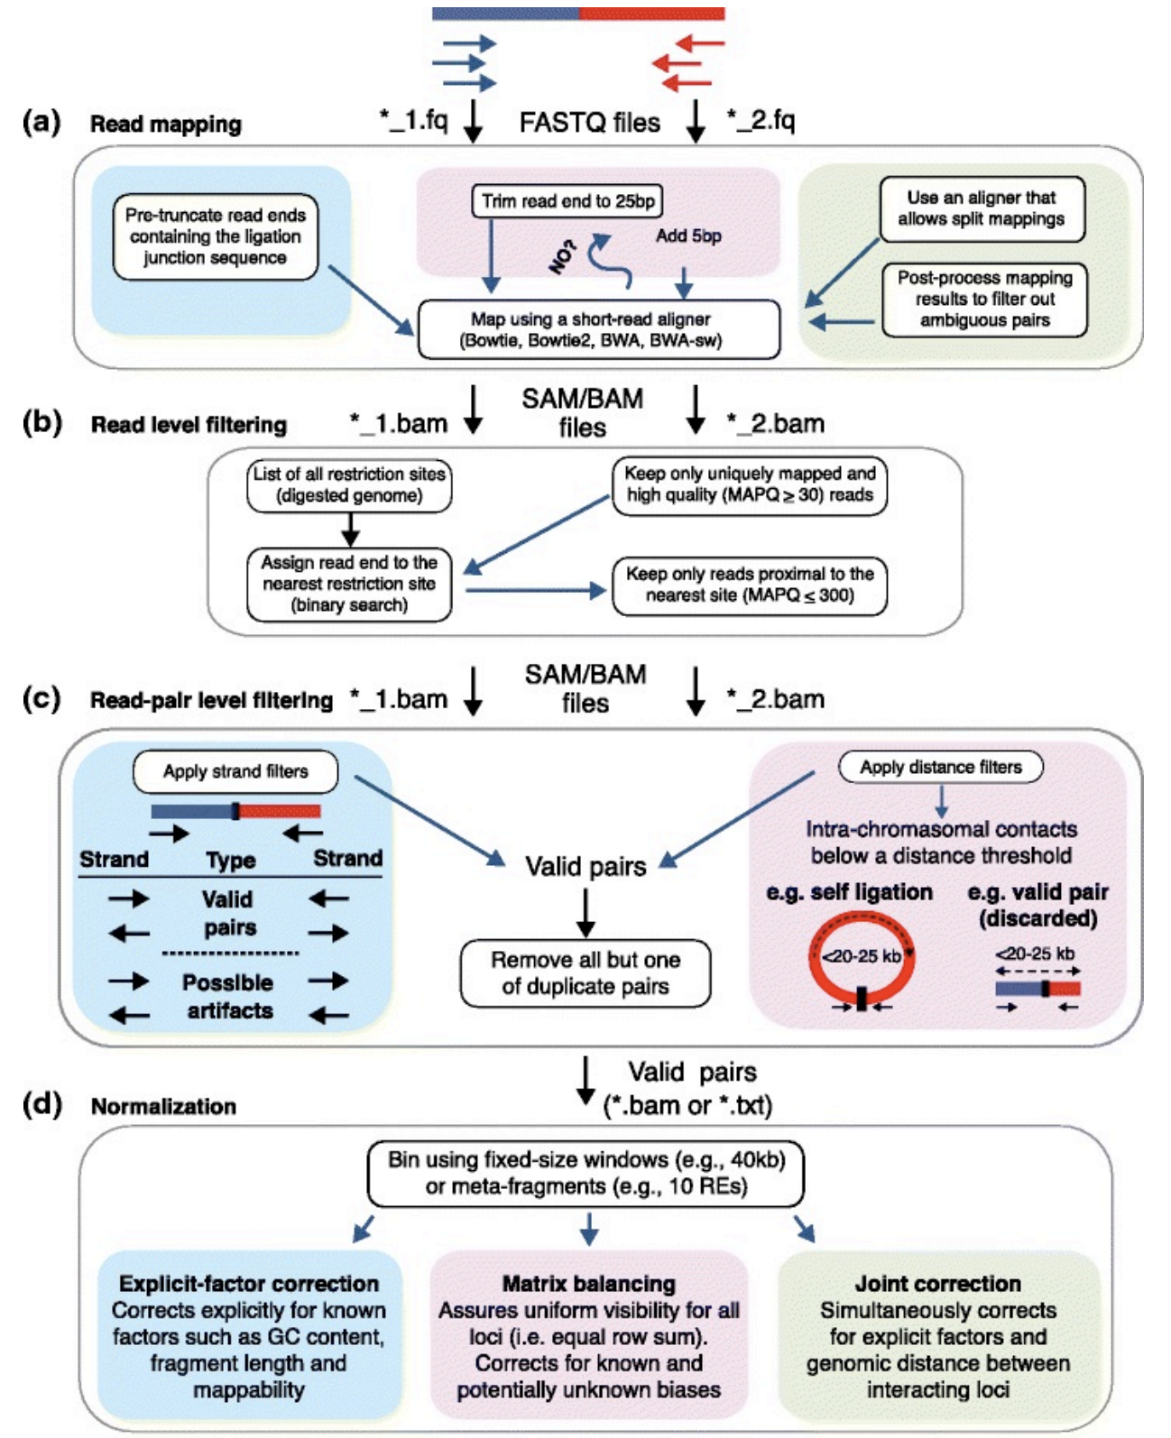
Hi-C pipeline(s)
Servant et al., Genome Biol. 2015
Ay & Noble Genome Biol 2015

Slide 13
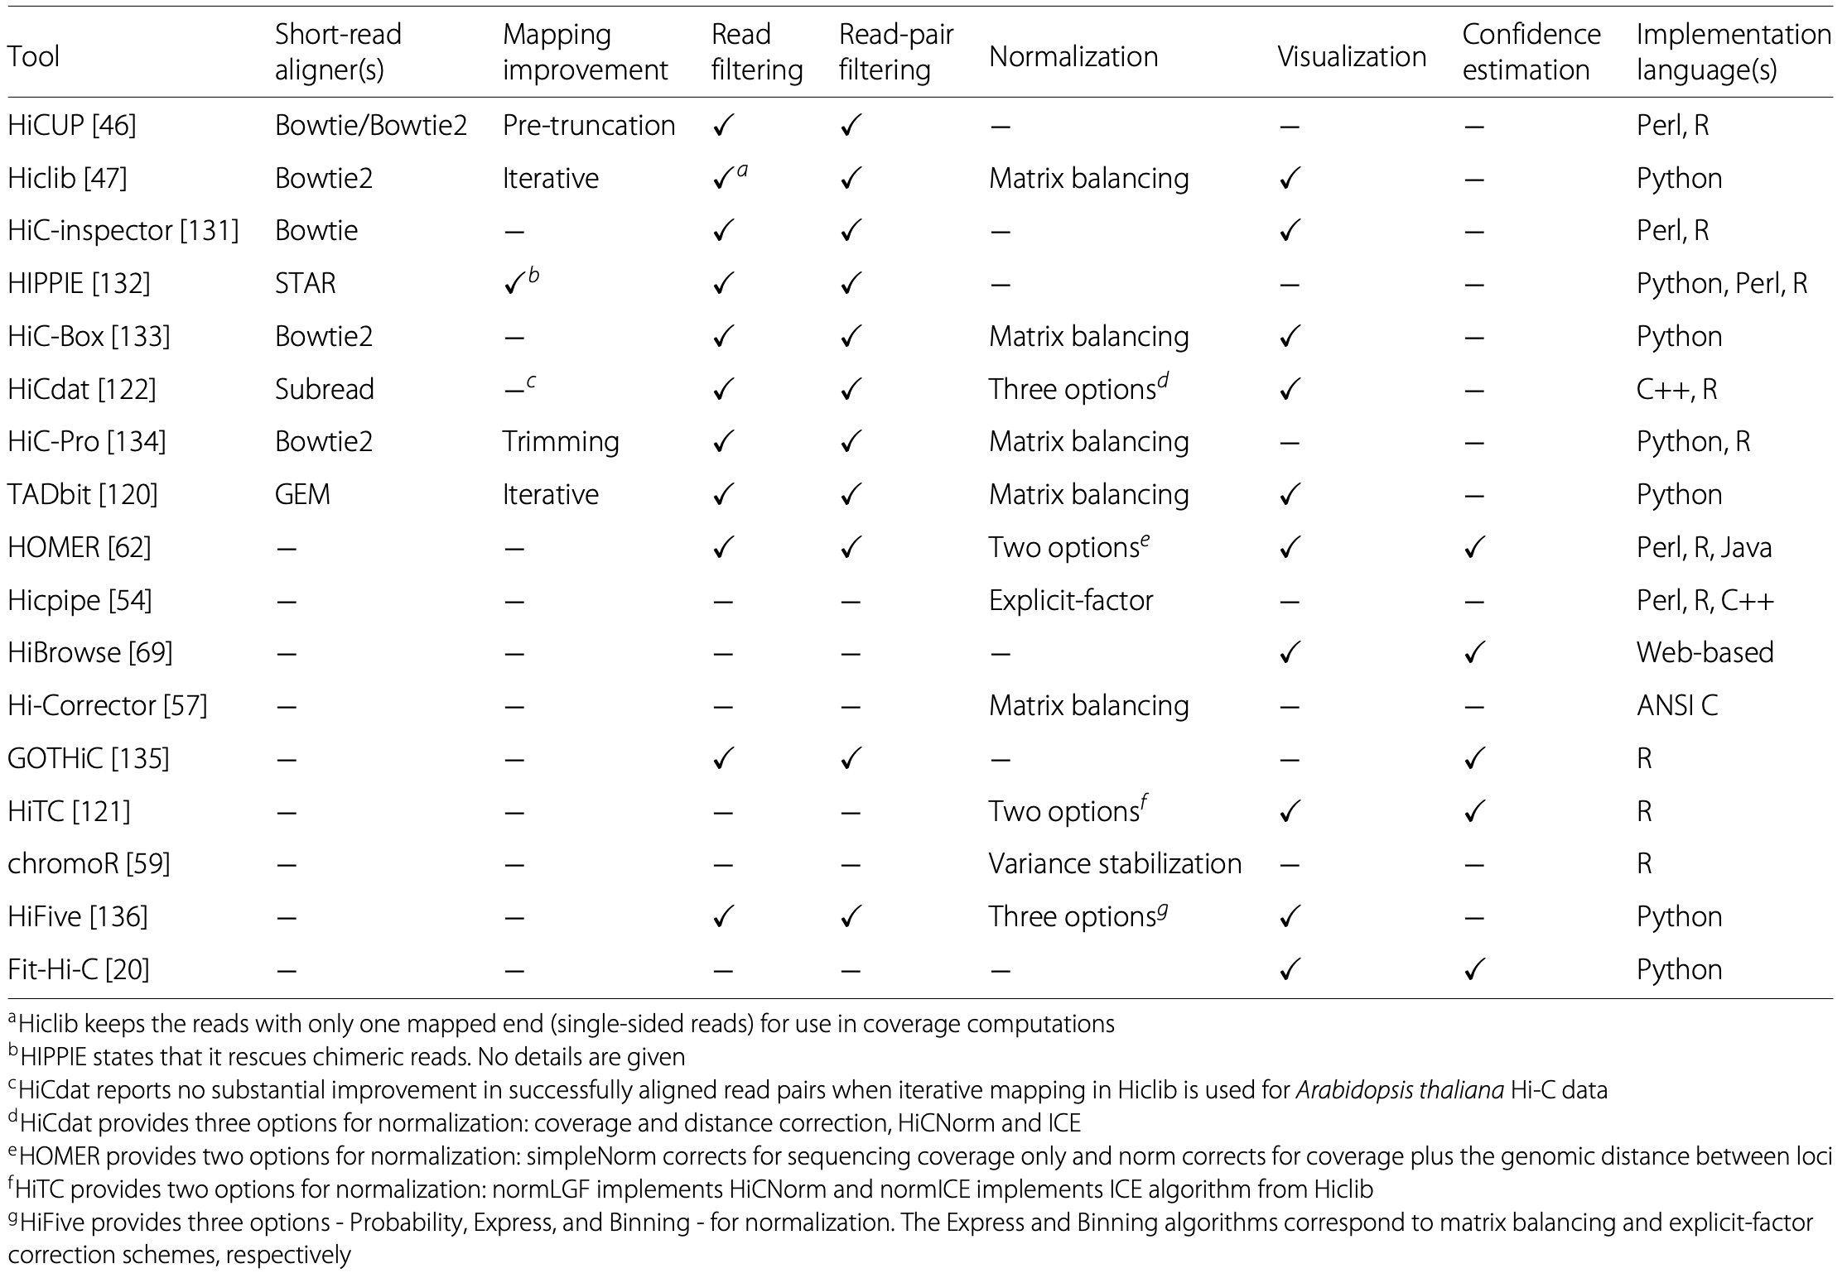
Hi-C pipeline(s) – 2015
Servant et al., Genome Biol. 2015
Ay & Noble Genome Biol 2015

Slide 14
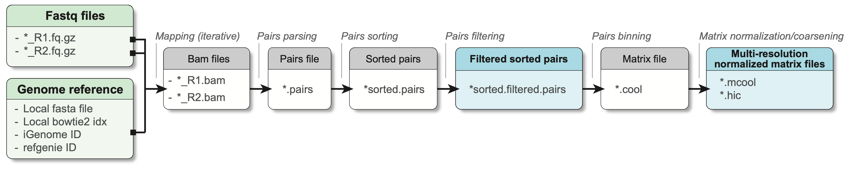
Common Hi-C processing steps

Slide 15
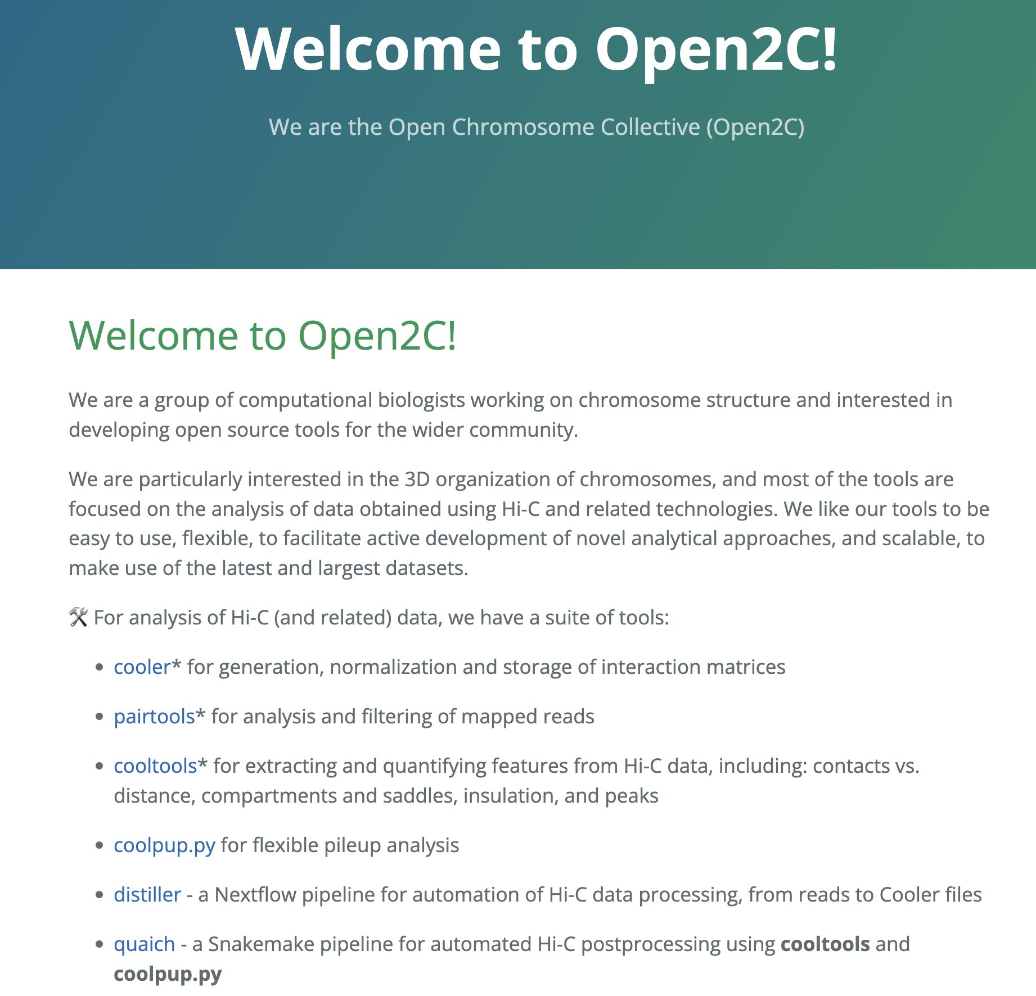
Open2C collective
https://github.com/open2c/

Slide 16
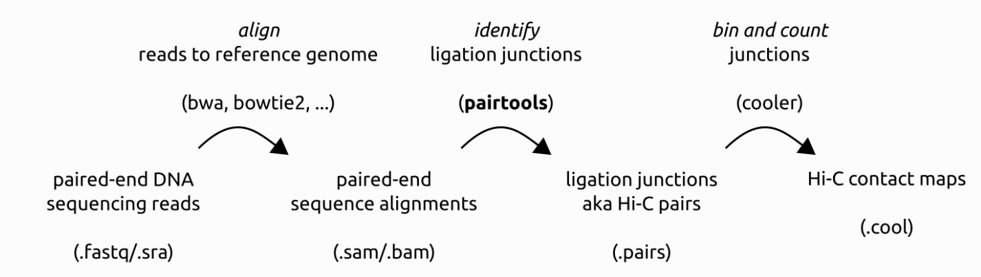
Pairtools
https://pairtools.readthedocs.io/en/latest/

Slide 17
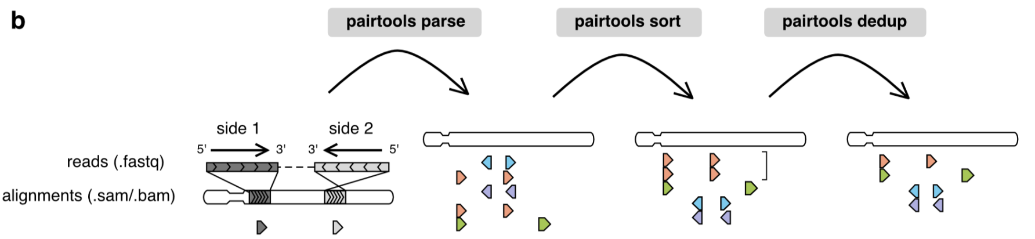
Pairtools
https://pairtools.readthedocs.io/en/latest/

Slide 18
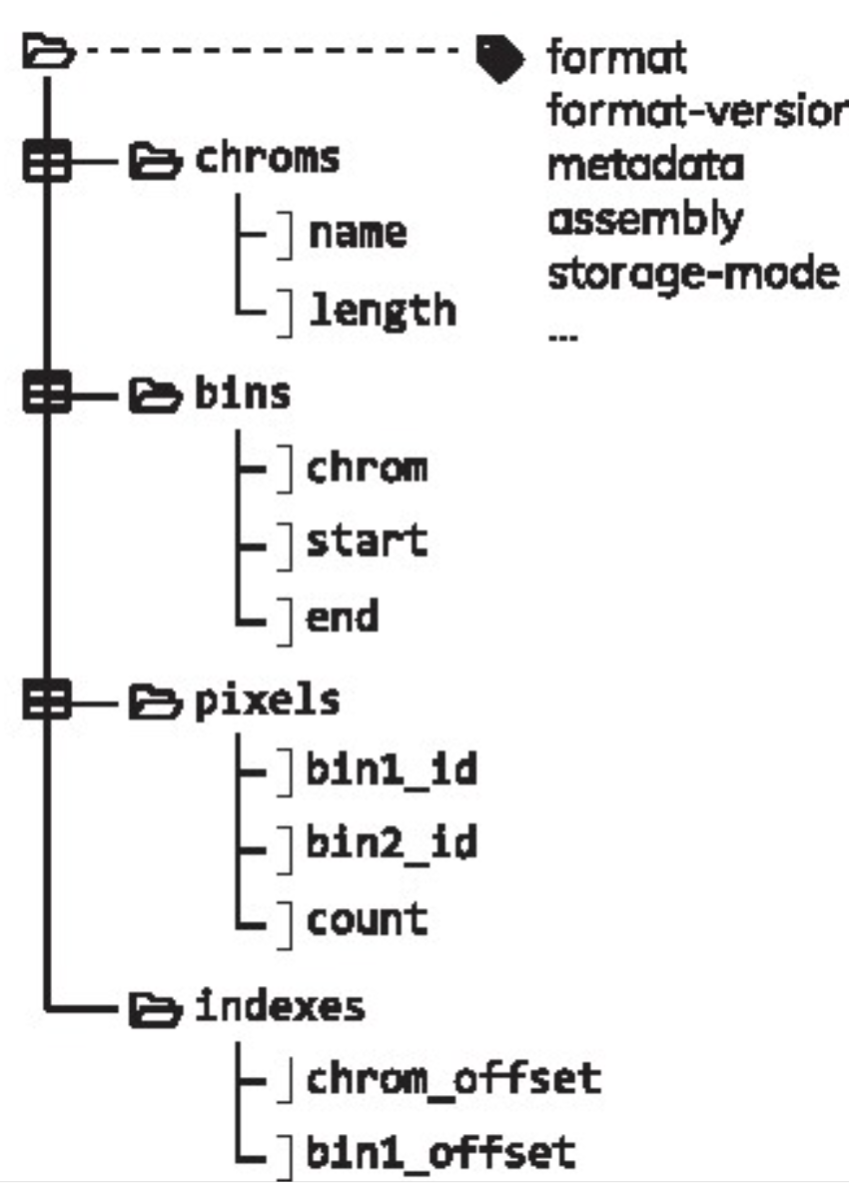
Cooler
https://cooler.readthedocs.io/en/latest/

Slide 19
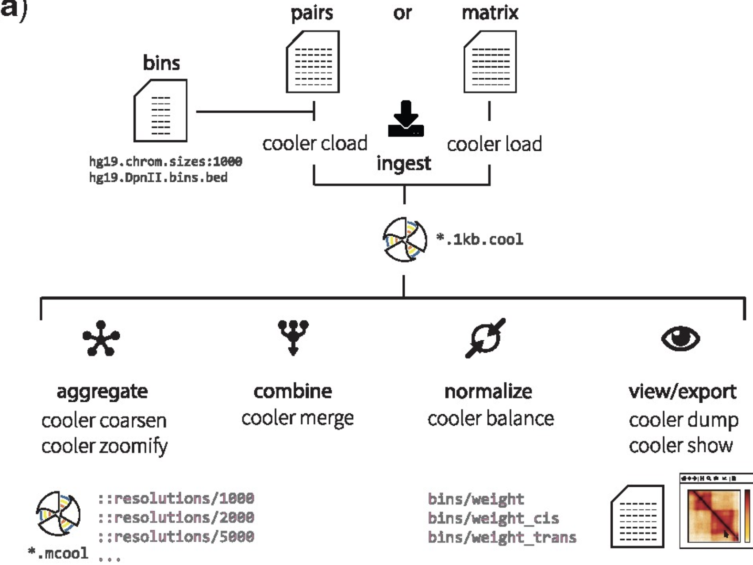
Cooler
https://cooler.readthedocs.io/en/latest/

Slide 20
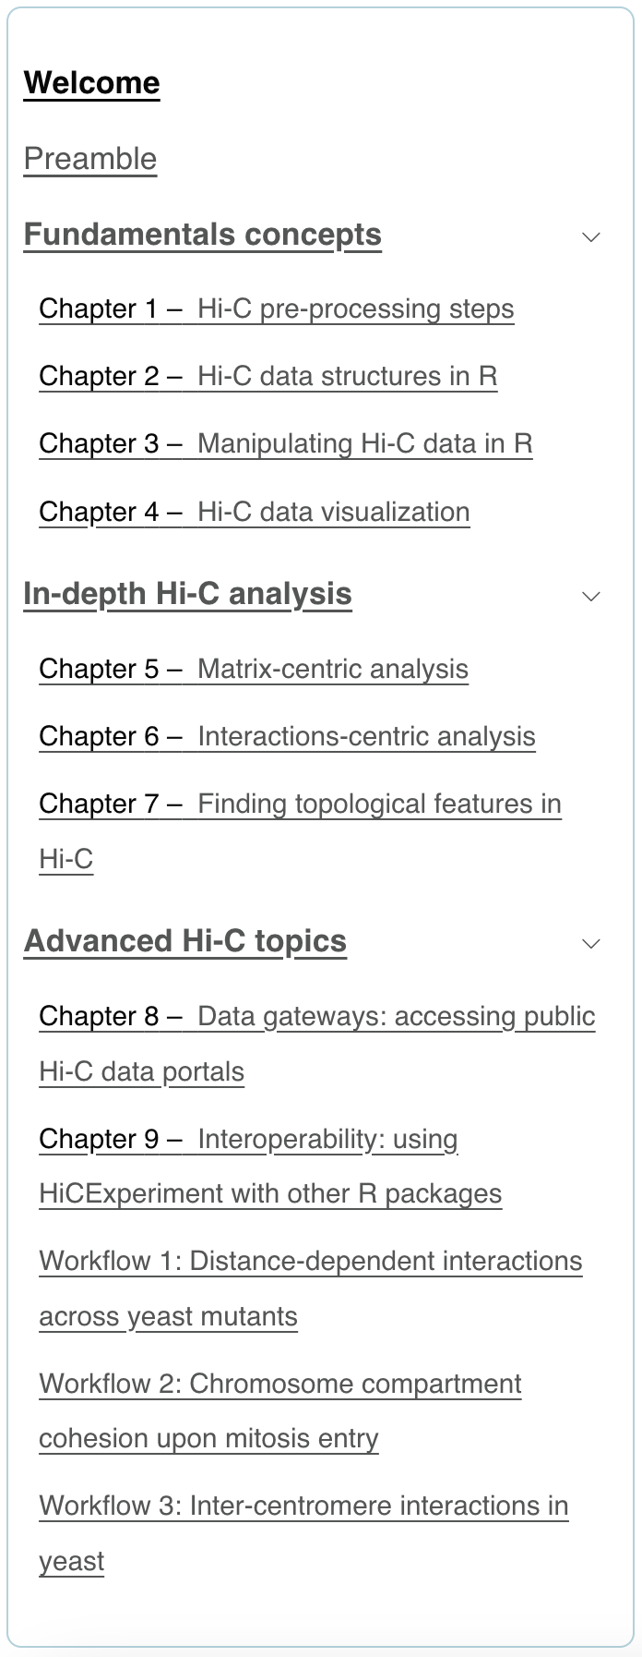
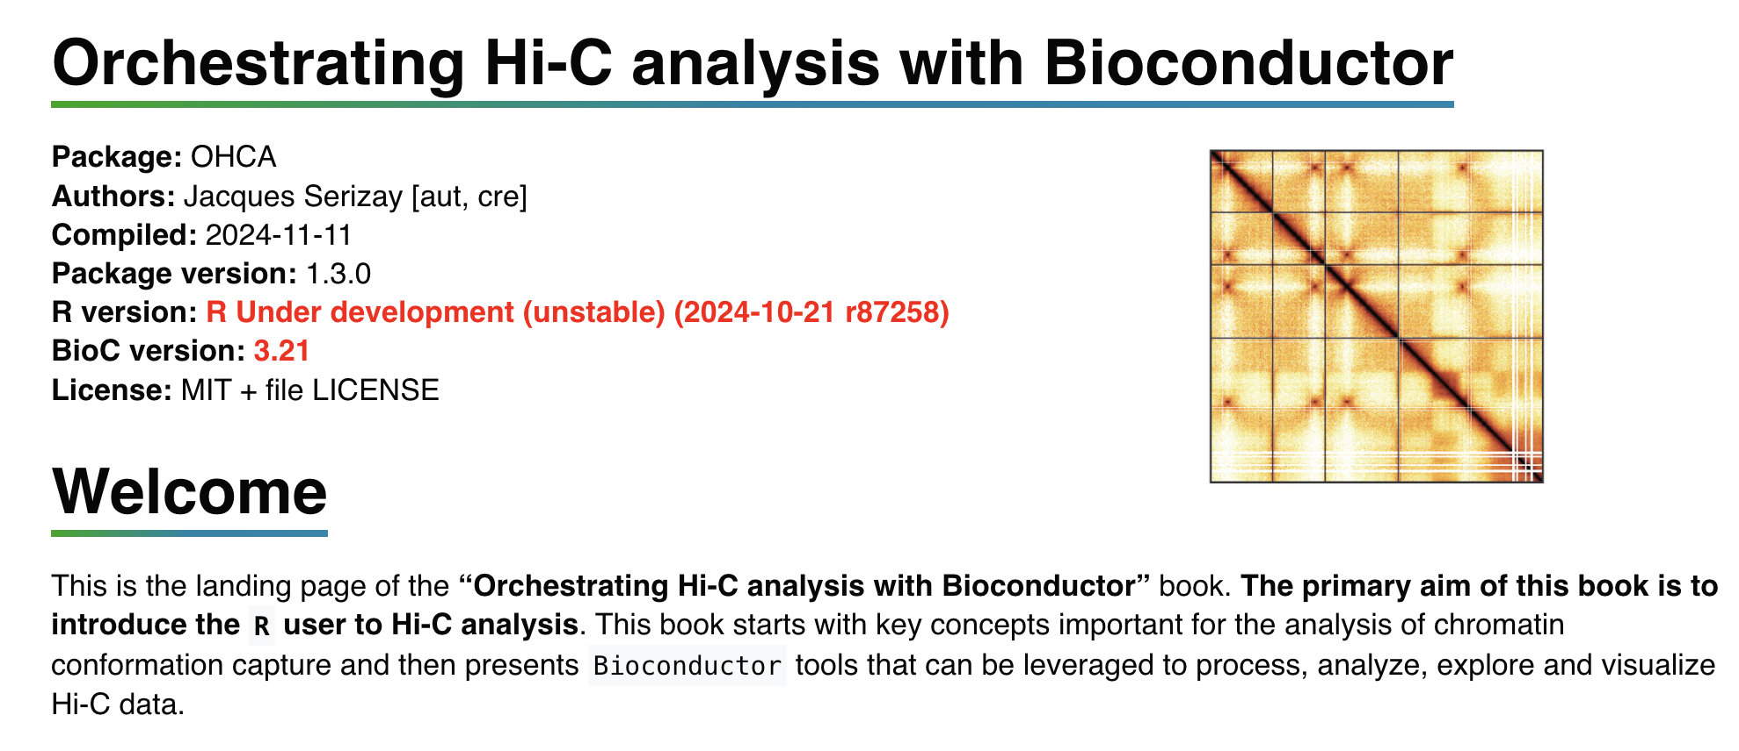
Handling Hi-C data in R
https://www.nature.com/articles/s41467-024-44761-x

Slide 21
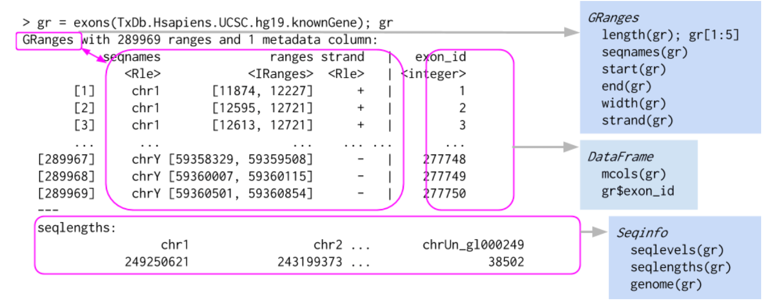
Granges vs GInteractions

Slide 22
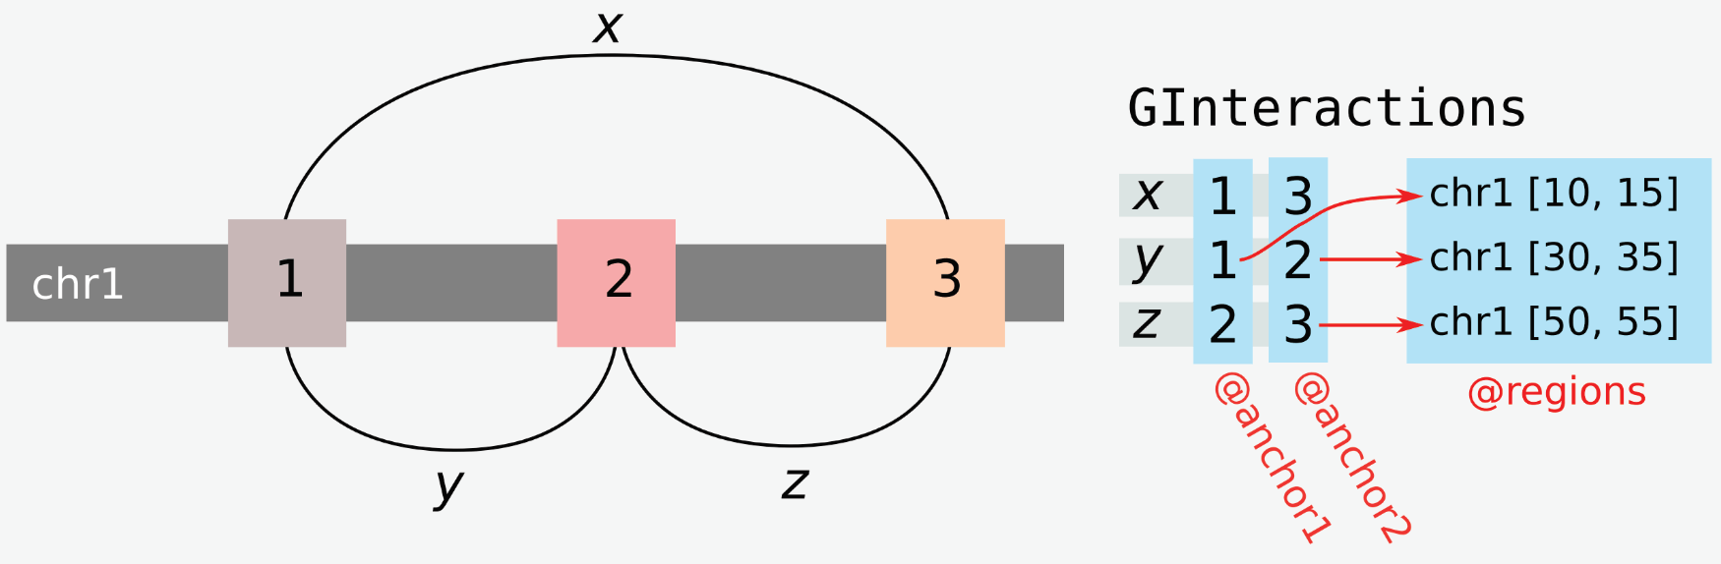
Granges vs GInteractions

Slide 23
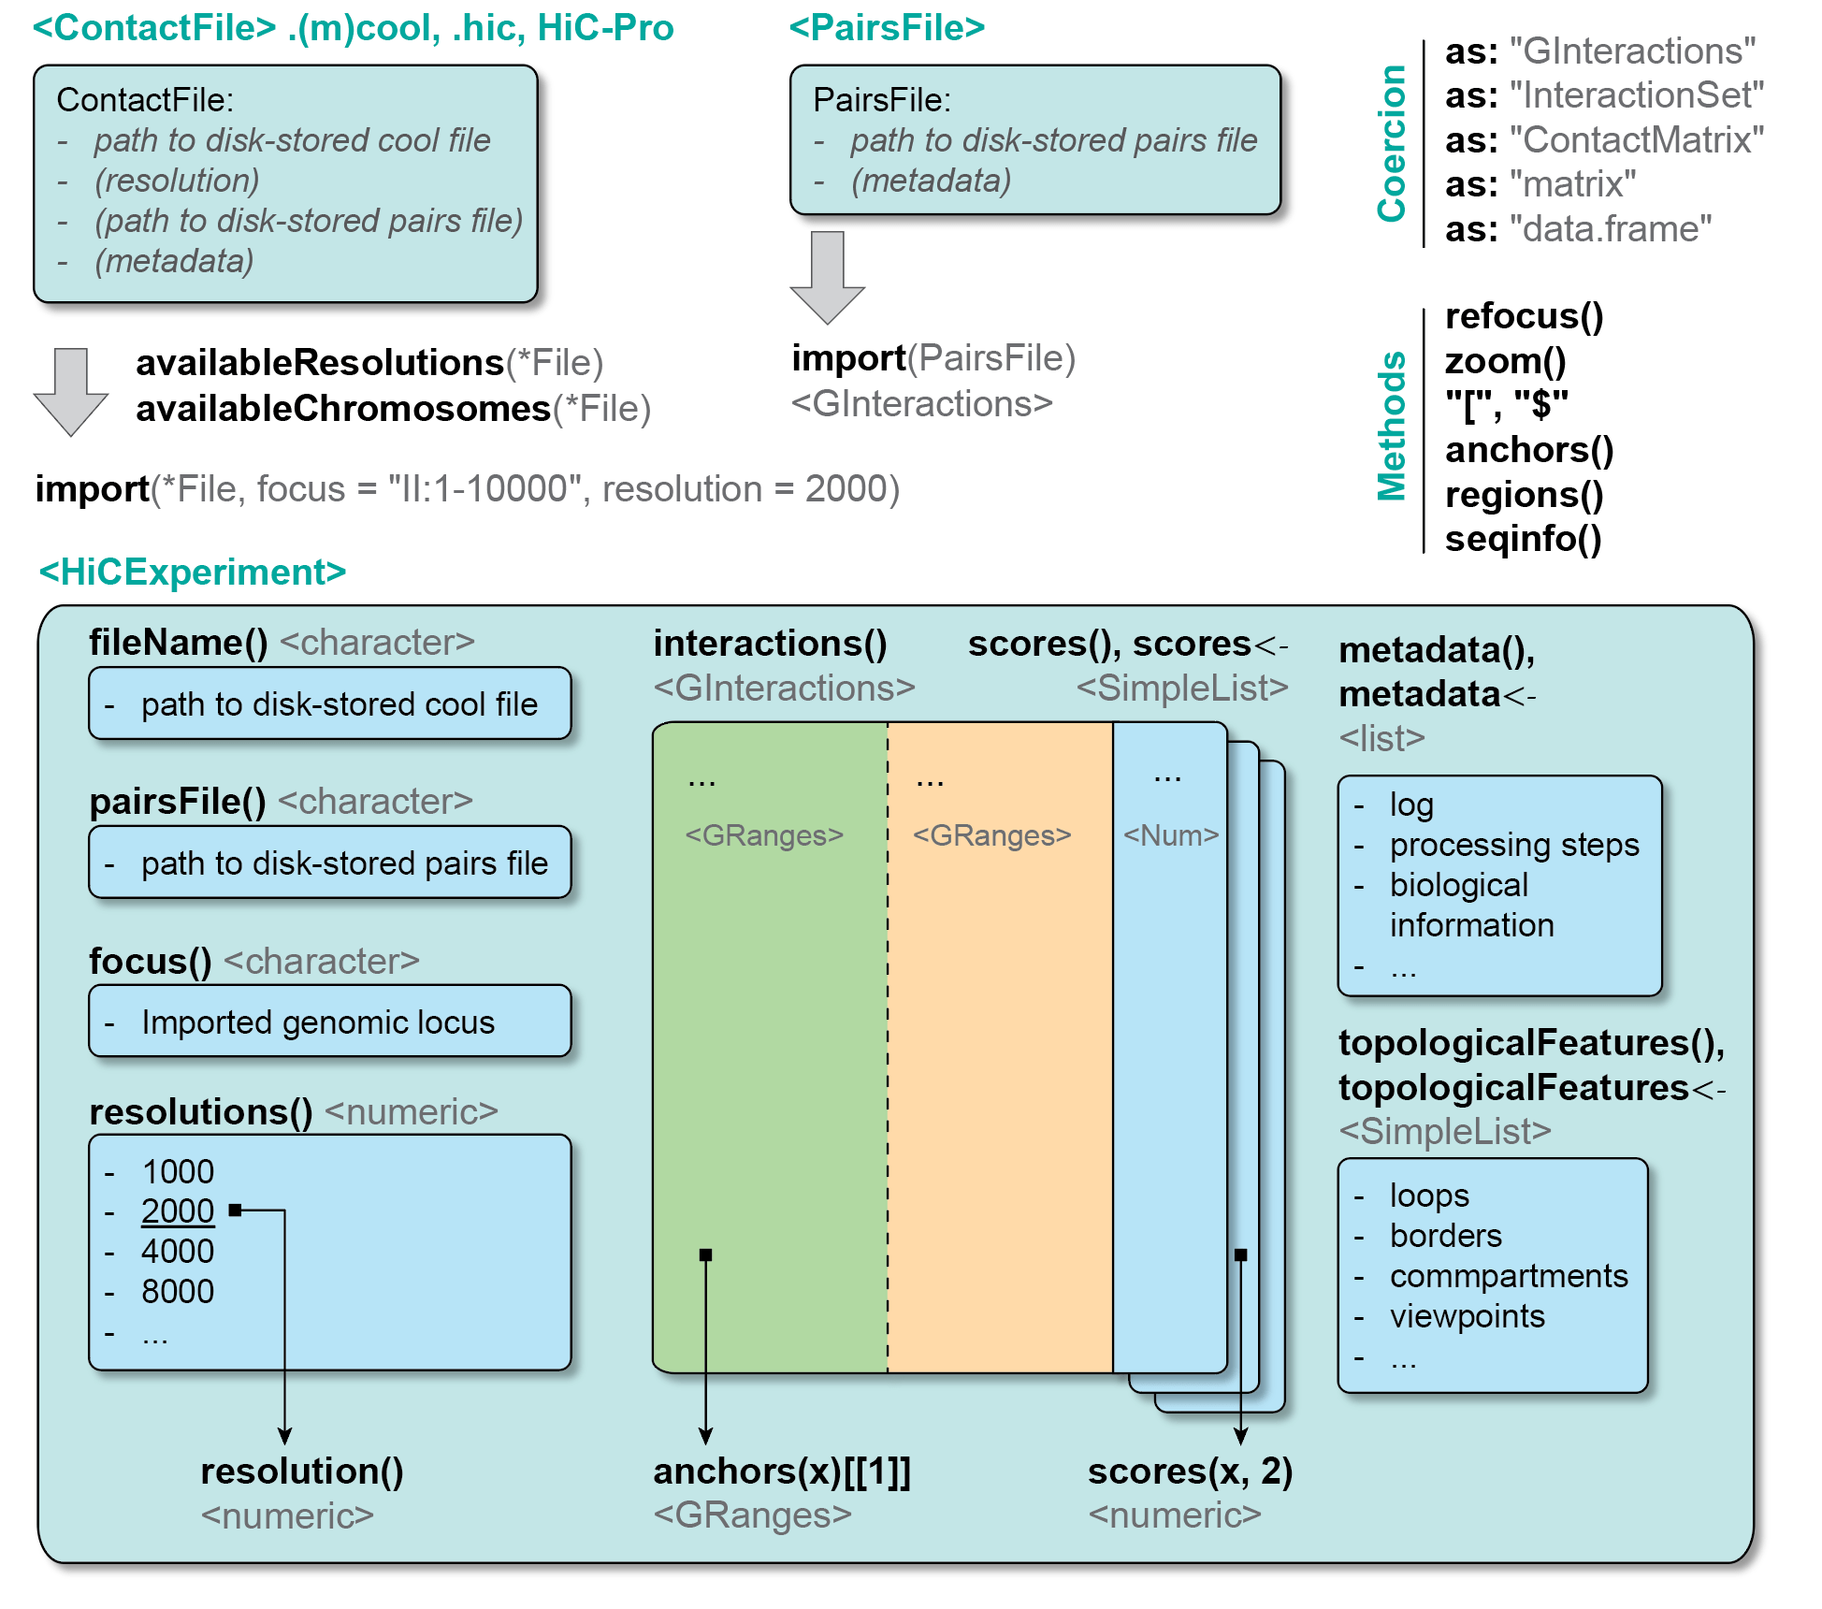
Handling Hi-C files in R

