Slide 1
Quantification of gene expression
Epigenomics Data Analysis
Jacques Serizay
Physalia 2026

Slide 2


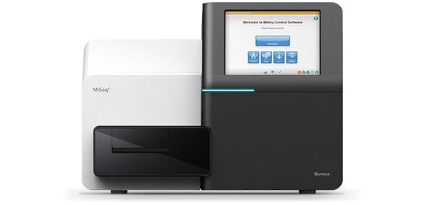
RNA-seq downstream analysis
Get .bcl files
Create fastq files
Or bcl2fastq
QC: remove/trim low quality reads
E.g. cutadapt
Align fastq to BAM
E.g. bowtie2, STAR
Filter duplicates, artifacts, …
E.g. samtools
Generate tracks
E.g. deepTools
Assay-specific downstream analysis
Transcript abundance quantification
Differential gene expression analysis
Gene ontology over-representation analysis

Slide 3
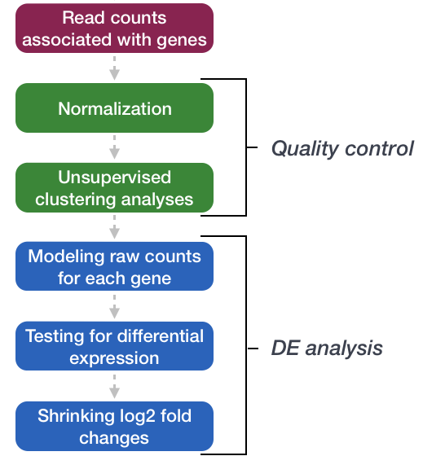
DESeq2 analysis workflow
https://hbctraining.github.io/DGE_workshop/

Slide 4
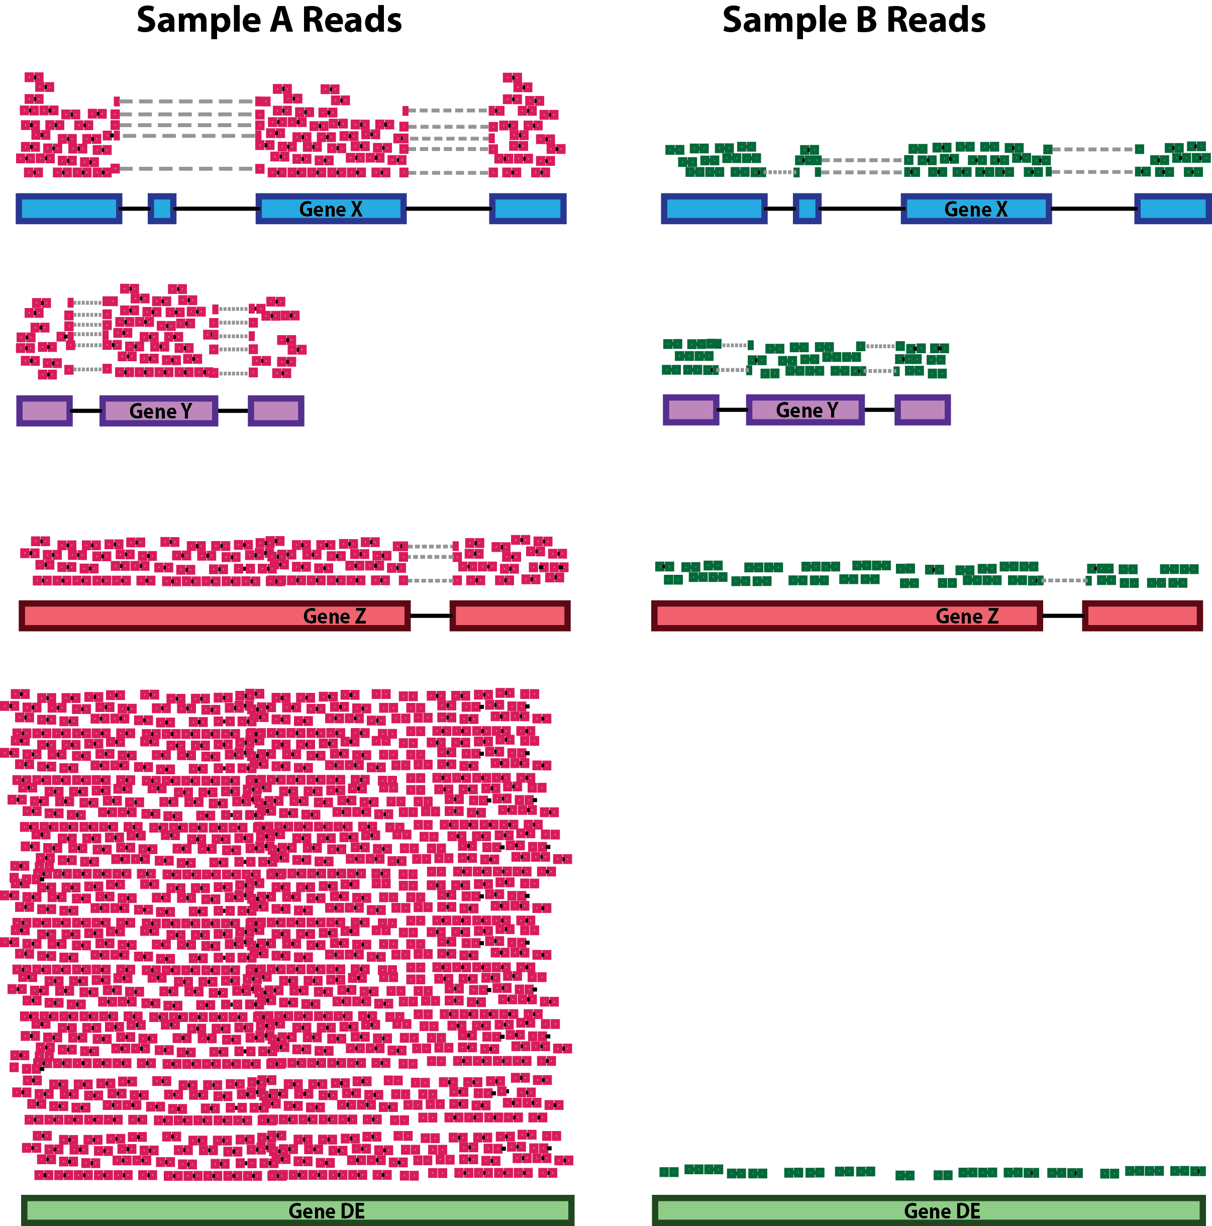
Estimating gene/transcript abundance in RNA-seq
Important points when comparing gene abundance for different datasets/genes are:
Sequencing depth
https://hbctraining.github.io/DGE_workshop/

Slide 5
Estimating gene/transcript abundance in RNA-seq
Important points when comparing gene abundance for different datasets/genes are:
Sequencing depth
Gene length
https://hbctraining.github.io/DGE_workshop/

Slide 6
Estimating gene/transcript abundance in RNA-seq
Important points when comparing gene abundance for different datasets/genes are:
Sequencing depth
Gene length
RNA composition
https://hbctraining.github.io/DGE_workshop/

Slide 7
Estimating gene/transcript abundance in RNA-seq
featureCounts can be used to count reads overlapping a set of gene annotations.
# in bash
featureCounts \
-g gene_name \
-s 2 \
-p -B \
-T 16 \
-o data/counts/RNAseq_counts.tsv \
-a data/counts/hg38_Gencodev41.gtf \
data/mapping/RNA_ctl_1^hg38^filtered.bam \
data/mapping/RNA_ctl_2^hg38^filtered.bam \
data/mapping/RNA_ctl_3^hg38^filtered.bam \
data/mapping/RNA_foxj1_1^hg38^filtered.bam \
data/mapping/RNA_foxj1_2^hg38^filtered.bam

Slide 8
Estimating gene/transcript abundance in RNA-seq
featureCounts can be used to count reads overlapping a set of gene annotations.
Rsubread is an R package which wraps featureCounts function in R.
# in bash
featureCounts \
-g gene_name \
-s 2 \
-p -B \
-T 16 \
-o data/counts/RNAseq_counts.tsv \
-a data/counts/hg38_Gencodev41.gtf \
data/mapping/RNA_ctl_1^hg38^filtered.bam \
data/mapping/RNA_ctl_2^hg38^filtered.bam \
data/mapping/RNA_ctl_3^hg38^filtered.bam \
data/mapping/RNA_foxj1_1^hg38^filtered.bam \
data/mapping/RNA_foxj1_2^hg38^filtered.bam
# in R
cnts <- Rsubread::featureCounts(
files = c('….bam’, '….bam'),
annot.ext = 'annots.gtf',
isGTFAnnotationFile = TRUE,
GTF.featureType = 'sequence_feature’,
GTF.attrType = 'id’,
isPairedEnd = TRUE,
nthreads = 16
)

Slide 9
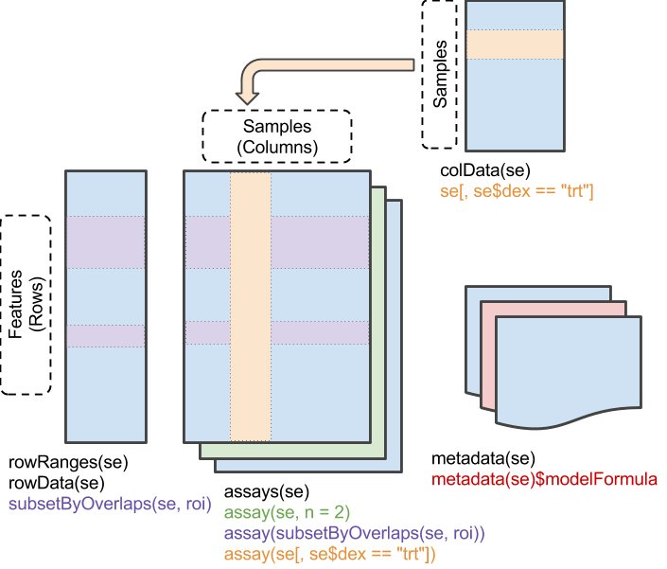
DESeq2 analysis workflow
DESeq2 is based on a SummarizedExperiment object.

Slide 10
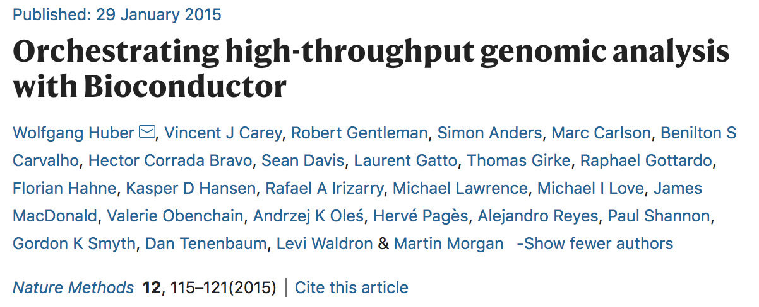
SummarizedExperiment
Huber et al., Nat. Meth. 2015

Slide 11
SummarizedExperiment
colData(): Annotations on each column, as a DataFrame.
E.g., description of each sample

Slide 12
SummarizedExperiment
colData(): Annotations on each column, as a DataFrame.
E.g., description of each sample
rowData/rowRanges(): Annotations on each row.
E.g., coordinates of gene / exons /peaks in transcripts / etc.

Slide 13
SummarizedExperiment
colData(): Annotations on each column, as a DataFrame.
E.g., description of each sample
rowData/rowRanges(): Annotations on each row.
E.g., coordinates of gene / exons /peaks in transcripts / etc.
assay(), assays(): A matrix-like or list of matrix-like objects of identical dimension
rows: refer to rowRanges: genes, genomic coordinates, etc.
columns: refer to colData: samples, cells, etc.
Implements dim(), dimnames() and 2-dimensional [ , ]
Can be several assays!!!

Slide 14
SummarizedExperiment
colData(): Annotations on each column, as a DataFrame.
E.g., description of each sample
rowData/rowRanges(): Annotations on each row.
E.g., coordinates of gene / exons /peaks in transcripts / etc.
assay(), assays(): A matrix-like or list of matrix-like objects of identical dimension
rows: refer to rowRanges: genes, genomic coordinates, etc.
columns: refer to colData: samples, cells, etc.
Implements dim(), dimnames() and 2-dimensional [ , ]
Can be several assays!!!
metadata(): List of unstructured metadata describing the overall content of the object.

Slide 15
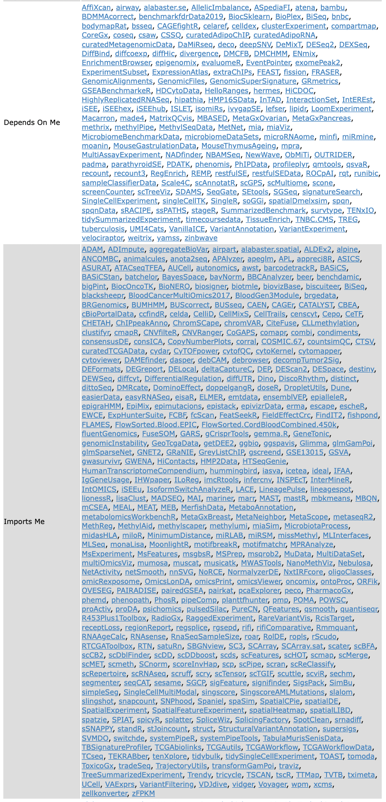
SummarizedExperiment
SummarizedExperiment is a key data structure in Bioconductor, reused by or modified in:
clusterExperiment
SingleCellExperiment
LoomExperiment
MsExperiment
TreeSummarizedExperiment
SpatialExperiment
And 100s more…

Slide 16
DESeq2 analysis workflow
DESeq2 is based on a SummarizedExperiment object.
A formula needs to be specified
> dds <- DESeqDataSet(counts, design = ~ timepoint)

Slide 17
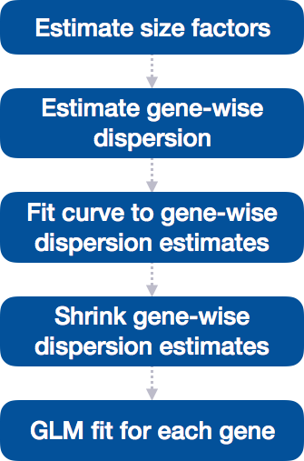
DESeq2 analysis workflow
Differential expression analysis is as simple as DESeq()

Slide 18
DESeq2 analysis workflow
DESeq2 is based on a SummarizedExperiment object.
A formula needs to be specified
Differential expression analysis is as simple as DESeq()
> dds <- DESeqDataSet(counts, design = ~ Condition + Treatment)
> dds <- DESeq(dds)
estimating size factors
estimating dispersions
gene-wise dispersion estimates
mean-dispersion relationship
final dispersion estimates
fitting model and testing
> dds
class: DESeqDataSet
dim: 6513 10
metadata(1): version
assays(4): counts mu H cooks
rownames: NULL
rowData names(37): summit peakID ... deviance maxCooks
colnames: NULL
colData names(5): sample timepoint replicate bam sizeFactor
 | Condition | Replicate # | Treatment
sample1 | WT | 1 | No drug
sample2 | WT | 2 | No drug
sample3 | KO | 1 | Drug
sample4 | KO | 2 | drug
sample5 | WT | 1 | drug
sample6 | WT | 2 | drug

Slide 19
DESeq2 analysis workflow
4) Extract results
We can use DESeq2::results()
DESeq2 extracts results for pairwise comparison between 2 conditions
> contrasts
15_v_00 30_v_00 45_v_00 60_v_00 30_v_15 45_v_15 60_v_15 45_v_30 60_v_30 60_v_45
[1,] "timepoint" "timepoint" "timepoint" "timepoint" "timepoint" "timepoint" "timepoint" "timepoint" "timepoint" "timepoint"
[2,] "15" "30" "45" "60" "30" "45" "60" "45" "60" "60"
[3,] "00" "00" "00" "00" "15" "15" "15" "30" "30" "45"

Slide 20
DESeq2 analysis workflow
4) Extract results
We can use DESeq2::results()
DESeq2 extracts results for pairwise comparison between 2 conditions
> contrasts
15_v_00 30_v_00 45_v_00 60_v_00 30_v_15 45_v_15 60_v_15 45_v_30 60_v_30 60_v_45
[1,] "timepoint" "timepoint" "timepoint" "timepoint" "timepoint" "timepoint" "timepoint" "timepoint" "timepoint" "timepoint"
[2,] "15" "30" "45" "60" "30" "45" "60" "45" "60" "60"
[3,] "00" "00" "00" "00" "15" "15" "15" "30" "30" "45”
> results(dds, contrast = contrasts[, 2])
log2 fold change (MLE): timepoint 30 vs 00
Wald test p-value: timepoint 30 vs 00
DataFrame with 6513 rows and 6 columns
baseMean log2FoldChange lfcSE stat pvalue padj
<numeric> <numeric> <numeric> <numeric> <numeric> <numeric>
1 1643.7457 -0.900131 0.225114 -3.99856 6.37297e-05 0.002809493
2 106.1707 -0.876365 0.313066 -2.79930 5.12139e-03 0.066589377
3 134.4141 -0.753498 0.311437 -2.41942 1.55451e-02 0.133487340
4 203.8053 -1.094019 0.227780 -4.80296 1.56338e-06 0.000140911
5 67.2922 -1.001061 0.336647 -2.97362 2.94309e-03 0.046569804
... ... ... ... ... ... ...
6509 36.1437 -0.0313828 0.417826 -0.0751098 0.9401274 0.979001
6510 603.5468 -0.4020281 0.181778 -2.2116386 0.0269916 0.185475
6511 42.8792 -0.3776449 0.378523 -0.9976807 0.3184342 0.633629
6512 15.2541 -0.5818438 0.642764 -0.9052221 0.3653477 NA
6513 37.8941 -0.8396196 0.427293 -1.9649731 0.0494173 0.258224

Slide 21
DESeq2 analysis workflow
4) Extract results
We can use DESeq2::results()
DESeq2 extracts results for pairwise comparison between 2 conditions
> contrasts
15_v_00 30_v_00 45_v_00 60_v_00 30_v_15 45_v_15 60_v_15 45_v_30 60_v_30 60_v_45
[1,] "timepoint" "timepoint" "timepoint" "timepoint" "timepoint" "timepoint" "timepoint" "timepoint" "timepoint" "timepoint"
[2,] "15" "30" "45" "60" "30" "45" "60" "45" "60" "60"
[3,] "00" "00" "00" "00" "15" "15" "15" "30" "30" "45”
> results(dds, contrast = contrasts[, 2])
log2 fold change (MLE): timepoint 30 vs 00
Wald test p-value: timepoint 30 vs 00
DataFrame with 6513 rows and 6 columns
baseMean log2FoldChange lfcSE stat pvalue padj
<numeric> <numeric> <numeric> <numeric> <numeric> <numeric>
1 1643.7457 -0.900131 0.225114 -3.99856 6.37297e-05 0.002809493
2 106.1707 -0.876365 0.313066 -2.79930 5.12139e-03 0.066589377
3 134.4141 -0.753498 0.311437 -2.41942 1.55451e-02 0.133487340
4 203.8053 -1.094019 0.227780 -4.80296 1.56338e-06 0.000140911
5 67.2922 -1.001061 0.336647 -2.97362 2.94309e-03 0.046569804
... ... ... ... ... ... ...
6509 36.1437 -0.0313828 0.417826 -0.0751098 0.9401274 0.979001
6510 603.5468 -0.4020281 0.181778 -2.2116386 0.0269916 0.185475
6511 42.8792 -0.3776449 0.378523 -0.9976807 0.3184342 0.633629
6512 15.2541 -0.5818438 0.642764 -0.9052221 0.3653477 NA
6513 37.8941 -0.8396196 0.427293 -1.9649731 0.0494173 0.258224

Slide 22
DESeq2 analysis workflow
4) Extract results
We can use DESeq2::results()
DESeq2 extracts results for pairwise comparison between 2 conditions
> contrasts
15_v_00 30_v_00 45_v_00 60_v_00 30_v_15 45_v_15 60_v_15 45_v_30 60_v_30 60_v_45
[1,] "timepoint" "timepoint" "timepoint" "timepoint" "timepoint" "timepoint" "timepoint" "timepoint" "timepoint" "timepoint"
[2,] "15" "30" "45" "60" "30" "45" "60" "45" "60" "60"
[3,] "00" "00" "00" "00" "15" "15" "15" "30" "30" "45”
> results(dds, contrast = contrasts[, 2])
log2 fold change (MLE): timepoint 30 vs 00
Wald test p-value: timepoint 30 vs 00
DataFrame with 6513 rows and 6 columns
baseMean log2FoldChange lfcSE stat pvalue padj
<numeric> <numeric> <numeric> <numeric> <numeric> <numeric>
1 1643.7457 -0.900131 0.225114 -3.99856 6.37297e-05 0.002809493
2 106.1707 -0.876365 0.313066 -2.79930 5.12139e-03 0.066589377
3 134.4141 -0.753498 0.311437 -2.41942 1.55451e-02 0.133487340
4 203.8053 -1.094019 0.227780 -4.80296 1.56338e-06 0.000140911
5 67.2922 -1.001061 0.336647 -2.97362 2.94309e-03 0.046569804
... ... ... ... ... ... ...
6509 36.1437 -0.0313828 0.417826 -0.0751098 0.9401274 0.979001
6510 603.5468 -0.4020281 0.181778 -2.2116386 0.0269916 0.185475
6511 42.8792 -0.3776449 0.378523 -0.9976807 0.3184342 0.633629
6512 15.2541 -0.5818438 0.642764 -0.9052221 0.3653477 NA
6513 37.8941 -0.8396196 0.427293 -1.9649731 0.0494173 0.258224

Slide 23
DESeq2 analysis workflow
4) Extract results
We can use DESeq2::results()
DESeq2 extracts results for pairwise comparison between 2 conditions
> contrasts
15_v_00 30_v_00 45_v_00 60_v_00 30_v_15 45_v_15 60_v_15 45_v_30 60_v_30 60_v_45
[1,] "timepoint" "timepoint" "timepoint" "timepoint" "timepoint" "timepoint" "timepoint" "timepoint" "timepoint" "timepoint"
[2,] "15" "30" "45" "60" "30" "45" "60" "45" "60" "60"
[3,] "00" "00" "00" "00" "15" "15" "15" "30" "30" "45”
> results(dds, contrast = contrasts[, 2])
log2 fold change (MLE): timepoint 30 vs 00
Wald test p-value: timepoint 30 vs 00
DataFrame with 6513 rows and 6 columns
baseMean log2FoldChange lfcSE stat pvalue padj
<numeric> <numeric> <numeric> <numeric> <numeric> <numeric>
1 1643.7457 -0.900131 0.225114 -3.99856 6.37297e-05 0.002809493
2 106.1707 -0.876365 0.313066 -2.79930 5.12139e-03 0.066589377
3 134.4141 -0.753498 0.311437 -2.41942 1.55451e-02 0.133487340
4 203.8053 -1.094019 0.227780 -4.80296 1.56338e-06 0.000140911
5 67.2922 -1.001061 0.336647 -2.97362 2.94309e-03 0.046569804
... ... ... ... ... ... ...
6509 36.1437 -0.0313828 0.417826 -0.0751098 0.9401274 0.979001
6510 603.5468 -0.4020281 0.181778 -2.2116386 0.0269916 0.185475
6511 42.8792 -0.3776449 0.378523 -0.9976807 0.3184342 0.633629
6512 15.2541 -0.5818438 0.642764 -0.9052221 0.3653477 NA
6513 37.8941 -0.8396196 0.427293 -1.9649731 0.0494173 0.258224

Slide 24
Regularized log counts
DESeq2 is primarily designed to estimate fold-change between conditions, NOT actual abundance!

Slide 25
Regularized log counts
DESeq2 is primarily designed to estimate fold-change between conditions, NOT actual abundance!
Rlog (regularized log) can be used to approximate gene expression levels.

Slide 26
Regularized log counts
DESeq2 is primarily designed to estimate fold-change between conditions, NOT actual abundance!
Rlog (regularized log) can be used to approximate gene expression levels.
Rlog transforms the count data to the log2 scale in a way which
1) minimizes differences between samples for rows with small counts
2) normalizes with respect to library size
DESeq2::rlog()

