Slide 1
ChIP-seq analysis
Epigenomics Data Analysis
Jacques Serizay
Physalia 2026

Slide 2

Chromatin immunoprecipitation: an old tool rejuvenated by high-throughput sequencing
Chromatin IP is not a new approach. It has been around for the past three decades
Summary
We have used formaldehyde-mediated proteinDNA crosslinking within intact cells to examine the in vivo chromatin structure of the D. melanogaster heat shock protein 70 ( hsp70) genes. In agreement with previous in vitro studies, we find that the heat shockmediated transcriptional induction of the hsp70 genes perturbs their chromatin structure, resulting in fewer proteinDNA contacts crosslinkable in vivo by formaldehyde. However, contrary to earlier in vitro evidence that histones may be absent from actively transcribed genes, we show directly, by immunoprecipitation of in vivocrosslinked chromatin fragments, that at least histone H4 remains bound to hsp70 DNA in vivo, irrespective of its rate of transcription. The formaldehyde-based in vivo mapping techniques described in this work are generally applicable, and can be used both to probe proteinDNA interactions within specific genes and to determine the genomic location of specific chromosomal proteins.

Slide 3
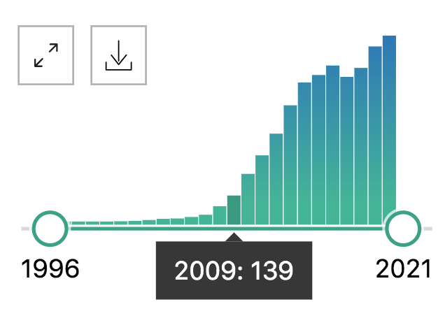
Chromatin immunoprecipitation: an old tool rejuvenated by high-throughput sequencing
It gained a lot of traction when high-throughput sequencing emerged

Slide 4
Current ChIP-seq approaches
ChIP-seq
Low input ChIP-seq
Native ChIP-seq
Indirect ChIP-seq with DamID
ChIP-seq with chemical-based fragmentation
Cut&Run, Cut&Tag
Single-cell ChIP-seq
…

Slide 5
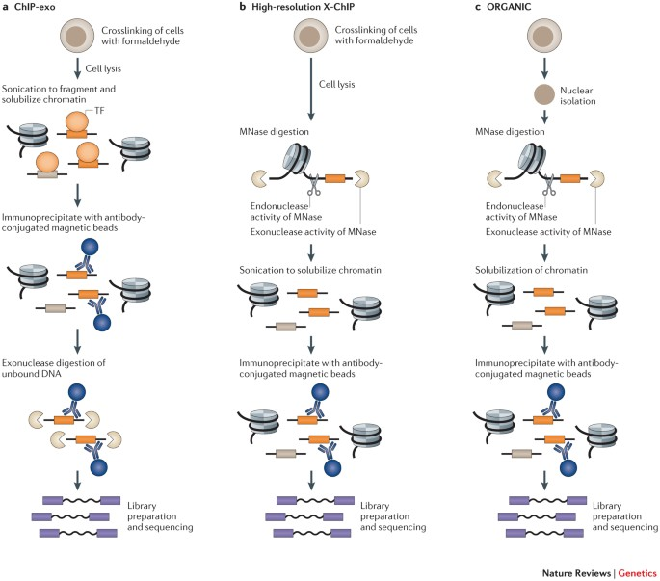
Current ChIP-seq approaches
Direct approaches
Zentner & Henikoff, Nat. Rev. Genet. 2014

Slide 6
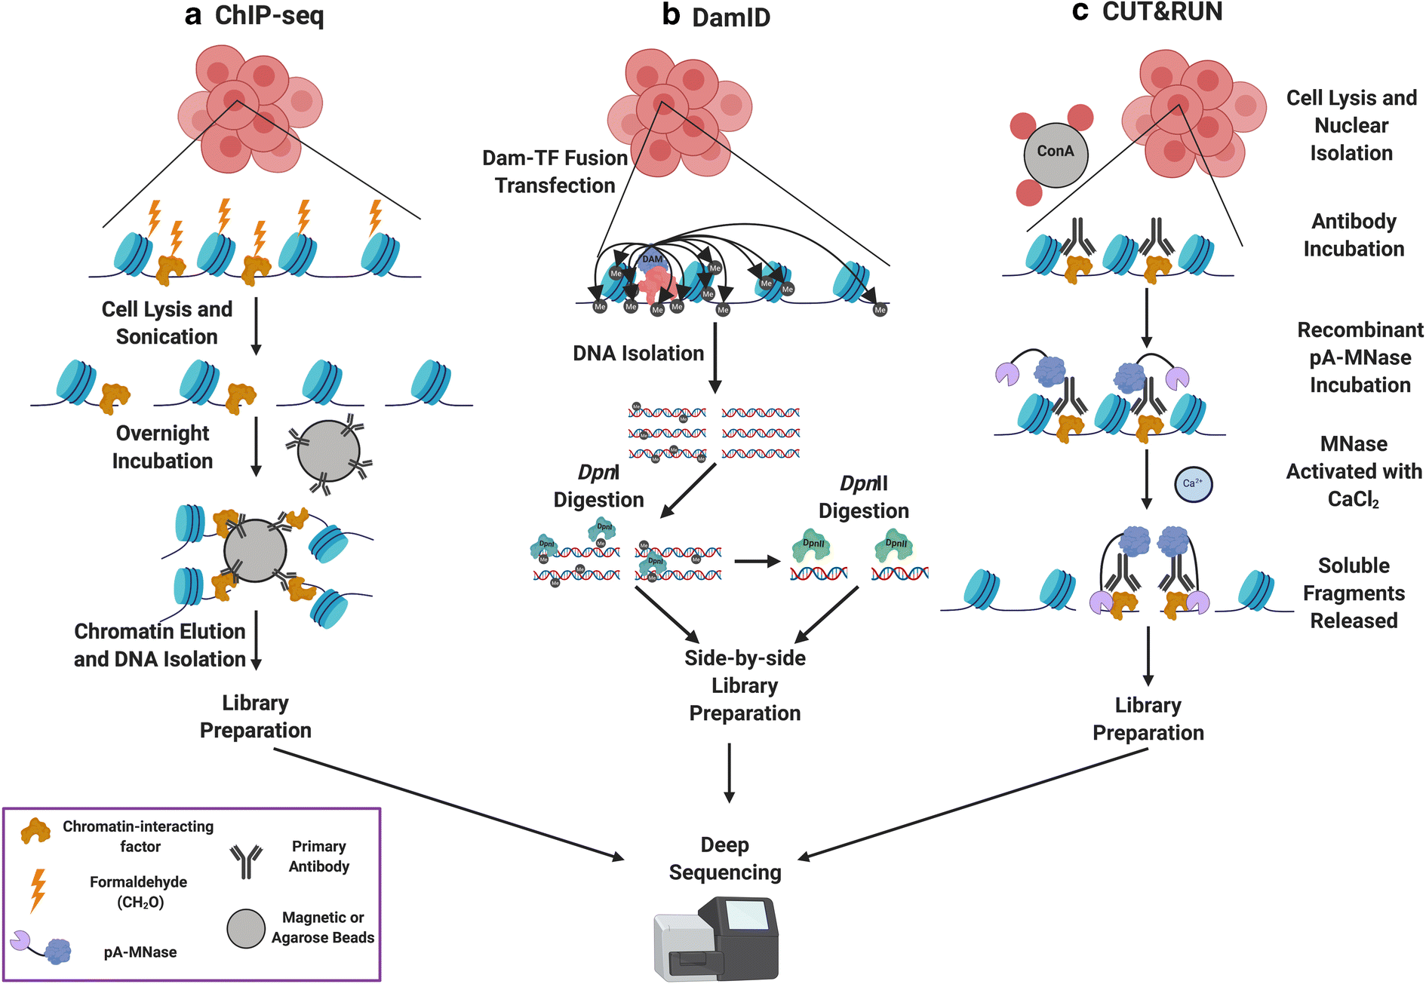
Current ChIP-seq approaches
Indirect approaches
Klein & Hainer, Chromosome Research 2020

Slide 7


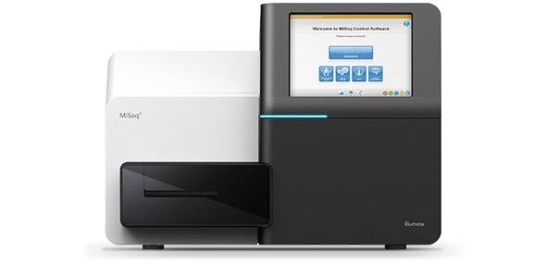
ChIP-seq downstream analysis
Get .bcl files
Create fastq files
Or bcl2fastq
QC: remove/trim low quality reads
E.g. cutadapt
Align fastq to BAM
E.g. bowtie2
Filter duplicates, artifacts, …
E.g. samtools
Generate tracks
E.g. deepTools
Assay-specific downstream analysis
Peak calling
Differential peak analysis
Motif finding
Peak co-occurrence analysis

Slide 8
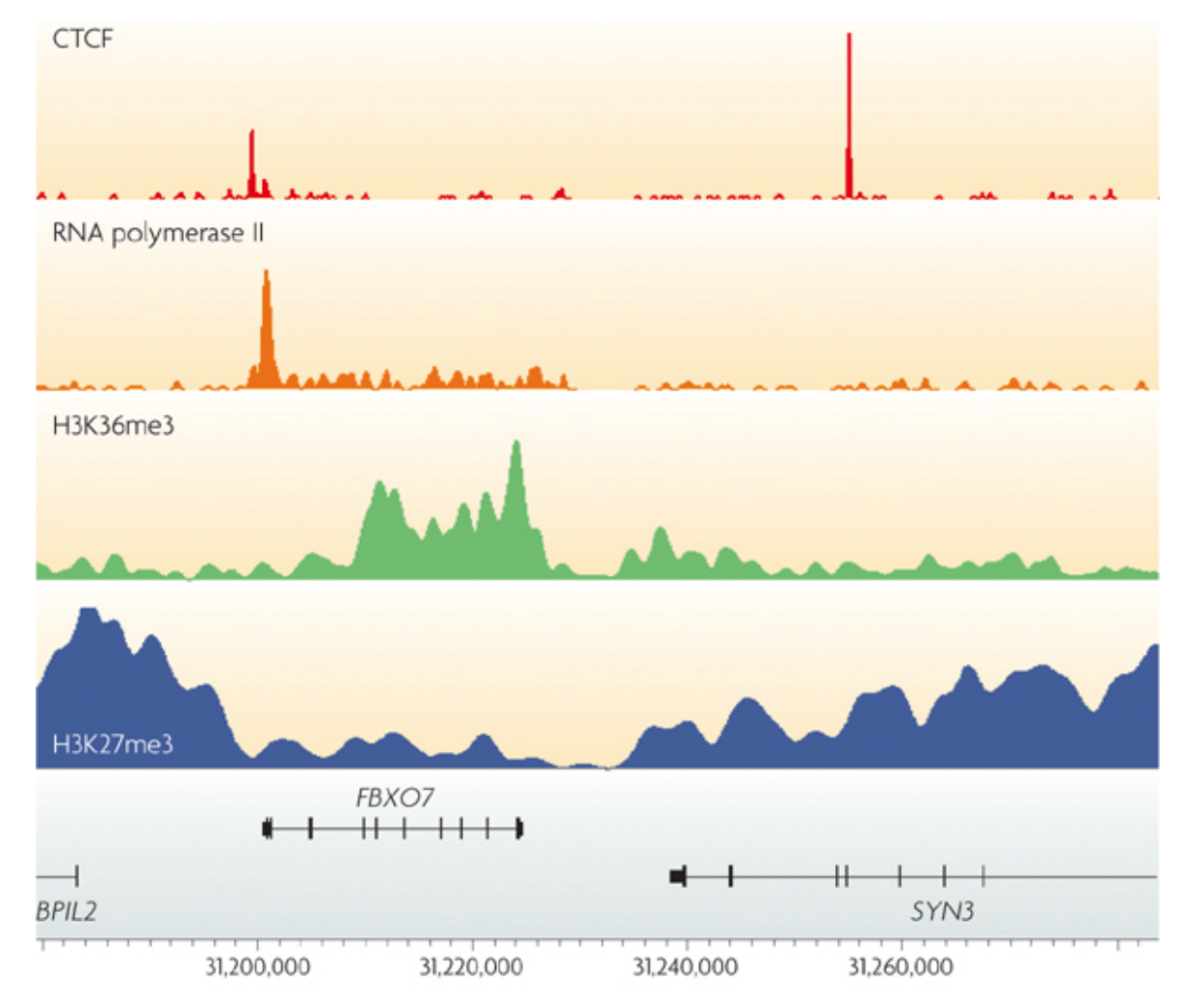
ChIP-seq outputs
Genome-wide coverage tracks
Can be directly viewed in a genome browser
Park et al., Nat. Rev. Genet. 2009

Slide 9
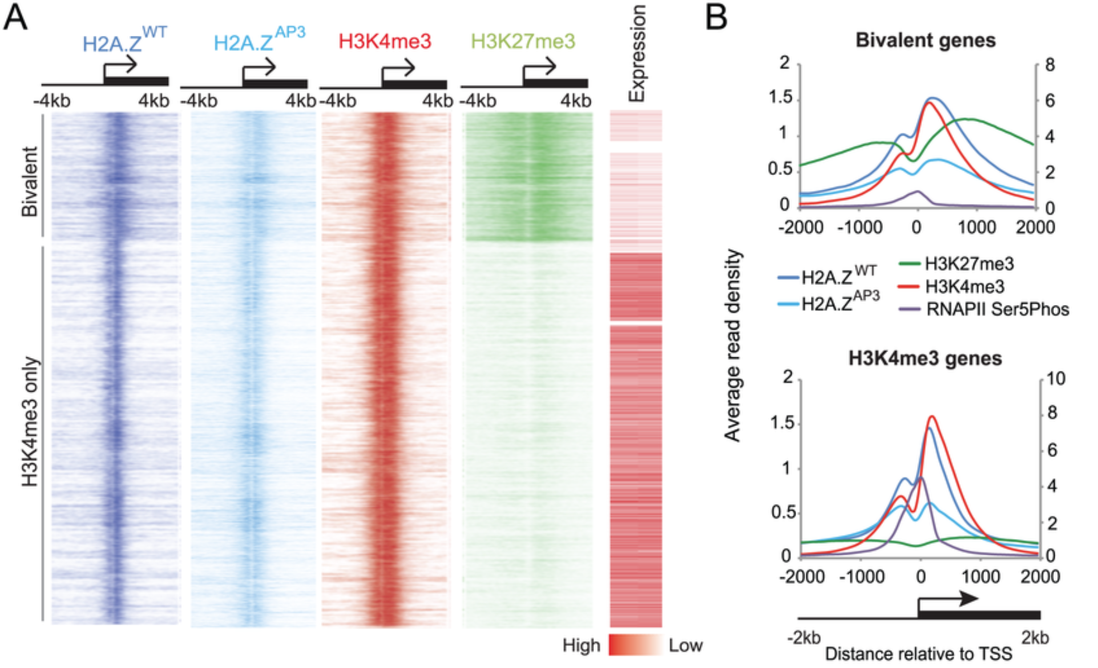
ChIP-seq outputs
Genome-wide coverage tracks
Can be directly viewed in a genome browser
Can also be aligned at genomic features of interest (e.g. TSSs)
Subramanian et al., PLoS Genetics 2013

Slide 10
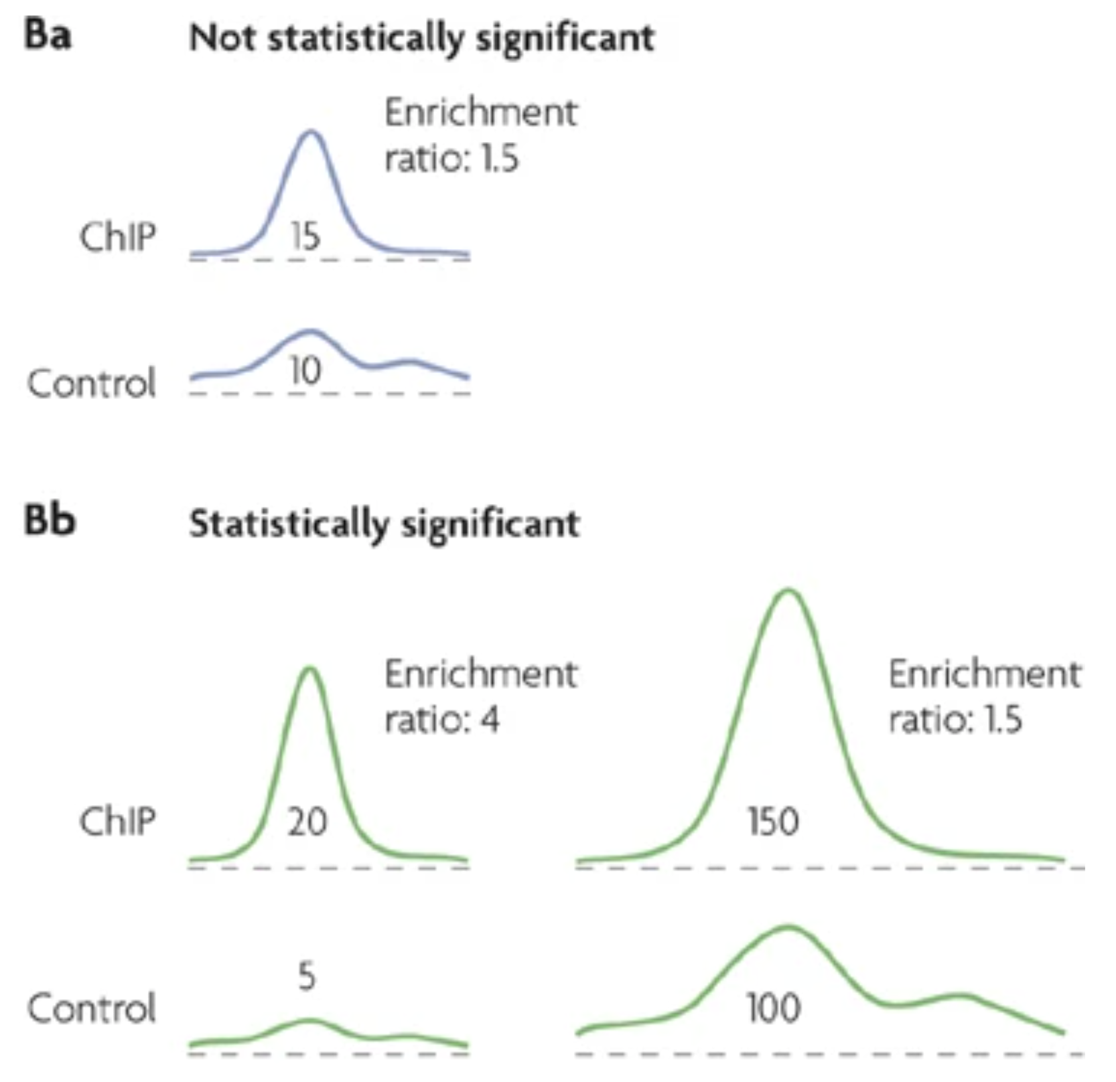
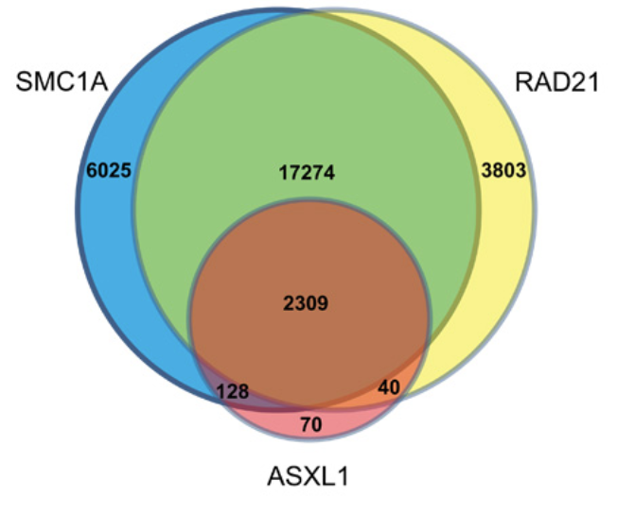
ChIP-seq outputs
Genome-wide coverage tracks
Can be directly viewed in a genome browser
Can also be aligned at genomic features of interest (e.g. TSSs)
Peak sets
Subramanian et al., PLoS Genetics 2013

Slide 11
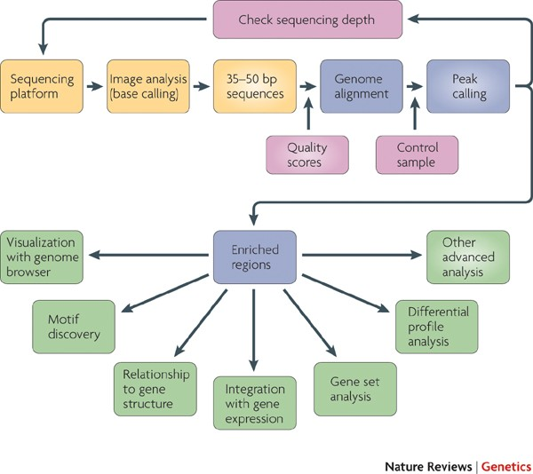
ChIP-seq outputs
Genome-wide coverage tracks
Can be directly viewed in a genome browser
Can also be aligned at genomic features of interest (e.g. TSSs)
Peak sets
And more from downstream analyses, according to the biological question:
DNA binding motifs
Differential binding of a factor
Cooperation between factors
Biological functions in which a factor is involved
Temporal dynamics of factor binding

Slide 12
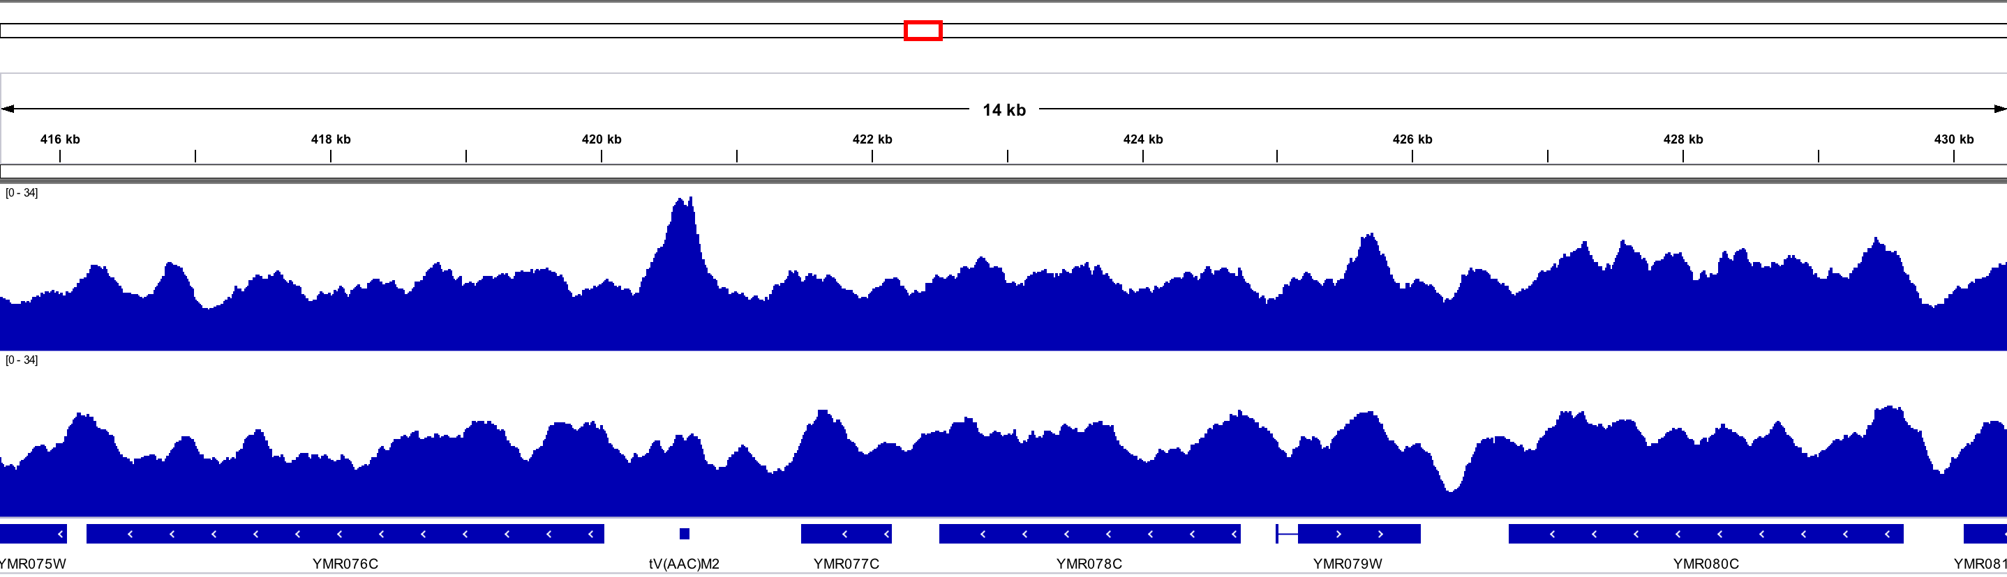
What are “peaks”?
ChIP-seq libraries show uneven genomic coverage: loci with high local coverage compared to neighboring environment are “peaks”.

Slide 13
Inherent ChIP-seq artefacts
Potential sources of artefacts in ChIP-seq experiments are:
DNA shearing: not uniform across genome, which results in more reads in open chromatin regions.
Amplification bias (GC content)
Repetitive regions might appear enriched due to underestimated repeat copies in the reference genome
Sequencing depth may be too low, resulting in noisy peaks
This impedes straightforward identification of peaks in ChIP-seq data

Slide 14
Dealing with ChIP-seq artefacts: using an “input” sample
Input control: DNA is isolated from cells that have been cross-linked and fragmented under the same conditions as the immunoprecipitated DNA

Slide 15
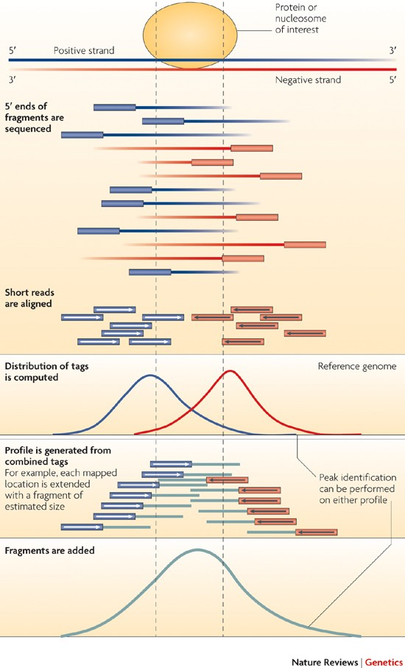
Finding peaks in ChIP-seq (1)
General workflow relies on comparing local read coverage to the input
Park, Nat. Rev. Genetics 2009

Slide 16
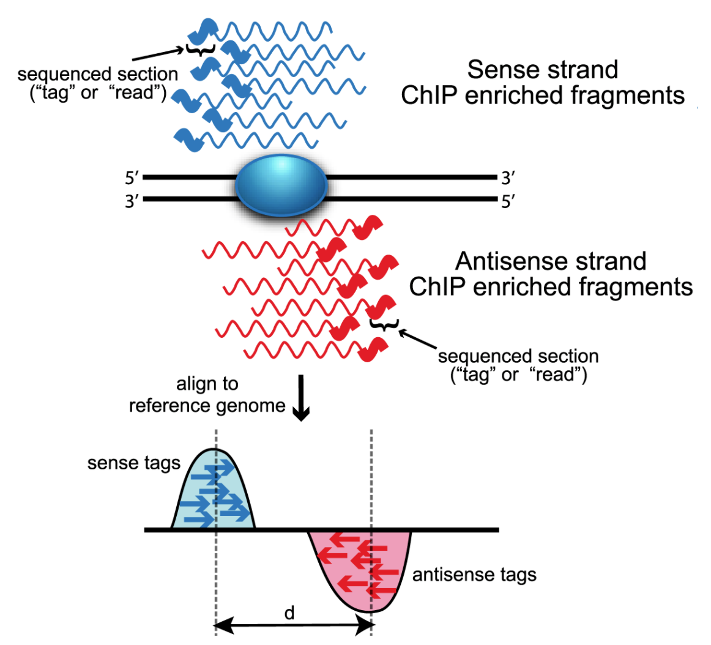
Finding peaks in ChIP-seq (2)
MACS2 finds a model estimating how to shift sense and antisense reads towards a central position
Note: this step is specific to single-end libraries, as paired-end libraries do not have this bias.
Wilbanks and Faccioti, PLoS One 2010

Slide 17
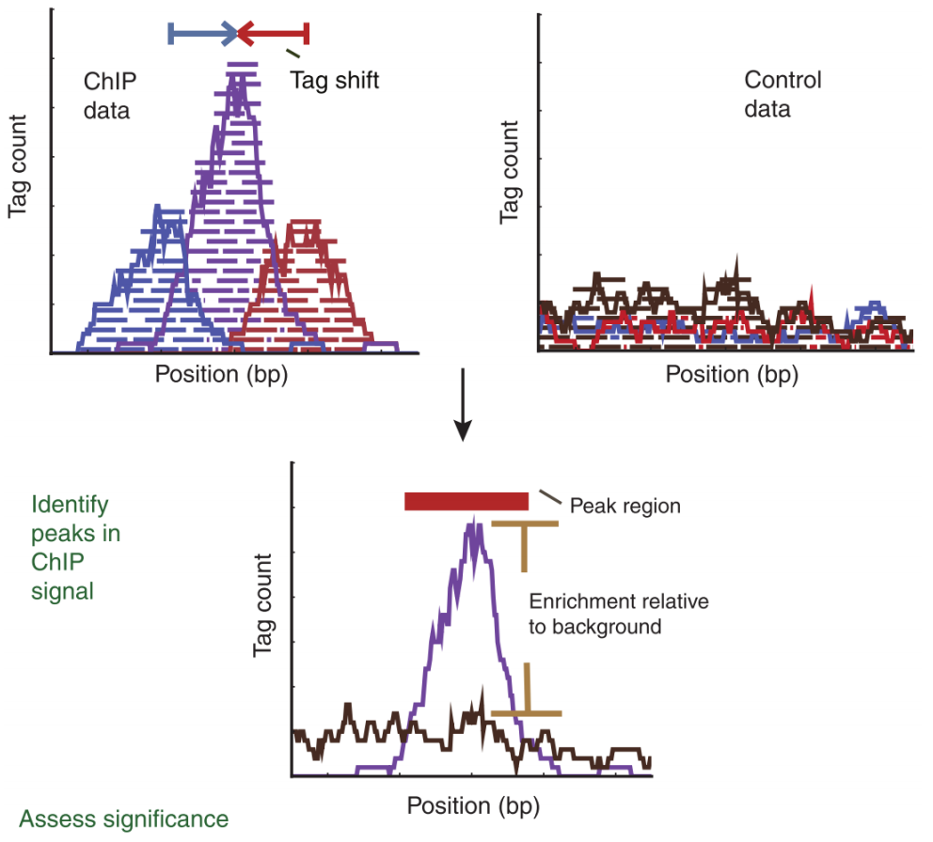
Finding peaks in ChIP-seq (3)
Then MACS2 scans the genome again using a window size which is twice the fragment length.
For each peak, MACS2 calculates a p-value using a dynamic Poisson distribution to capture local biases in read background levels.
If a control sample is available, it is used to calculate the local background.
Zhang et al., Genome Biol. 2008

Slide 18
Finding peaks in ChIP-seq (3)
Then MACS2 scans the genome again using a window size which is twice the fragment length.
For each peak, MACS2 calculates a p-value using a dynamic Poisson distribution to capture local biases in read background levels.
macs2 callpeak --treatment ….bam

Slide 19
Finding peaks in ChIP-seq (3)
Then MACS2 scans the genome again using a window size which is twice the fragment length.
For each peak, MACS2 calculates a p-value using a dynamic Poisson distribution to capture local biases in read background levels.
If a control sample is available, it is used to calculate the local background.
macs2 callpeak --treatment ….bam --control ….bam

Slide 20
Using replicates to peaks
The easiest approach it to take overlapping peak calls across replicates.
Rep. 1
Rep. 2
Combined peaks

Slide 21
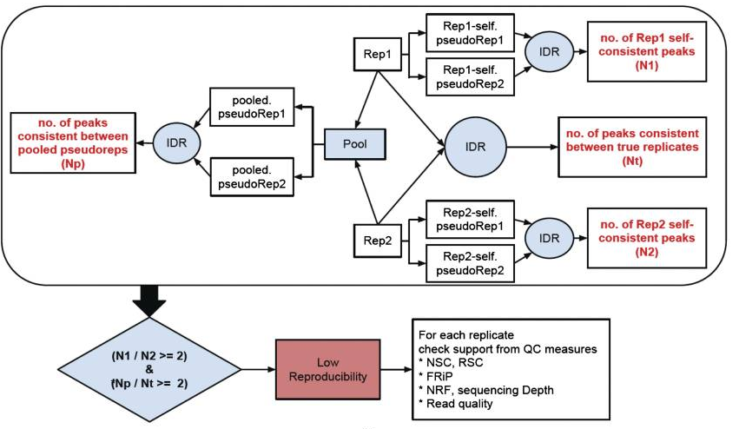
Using replicates to peaks
The easiest approach it to take overlapping peak calls across replicates.
For more advanced users, there are more complex methods that employ statistical testing and evaluate the reproducibility between replicates.
The standard approach to leverage replicates is the IDR (Irreproducibility Discovery Rate) approach.
Qi et al., The Annals of Applied Statistics 2011

Slide 22
Using replicates to peaks
The easiest approach it to take overlapping peak calls across replicates.
For more advanced users, there are more complex methods that employ statistical testing and evaluate the reproducibility between replicates.
The standard approach to leverage replicates is the IDR (Irreproducibility Discovery Rate) approach.
idr --samples rep1.narrowPeak rep2.narrowPeak \
--input-file-type narrowPeak \
--rank p.value \
--output-file idr \
--plot \
--log-output-file idr.log
Qi et al., The Annals of Applied Statistics 2011

