Slide 1
Interpreting Hi-C maps
Epigenomics Data Analysis
Jacques Serizay
Physalia 2026

Slide 2
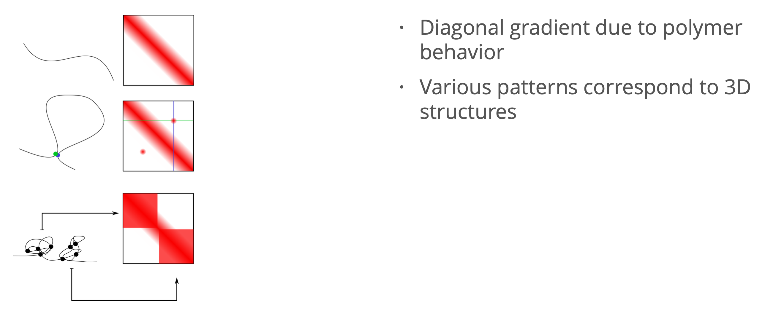
Hi-C experimental workflow

Slide 3
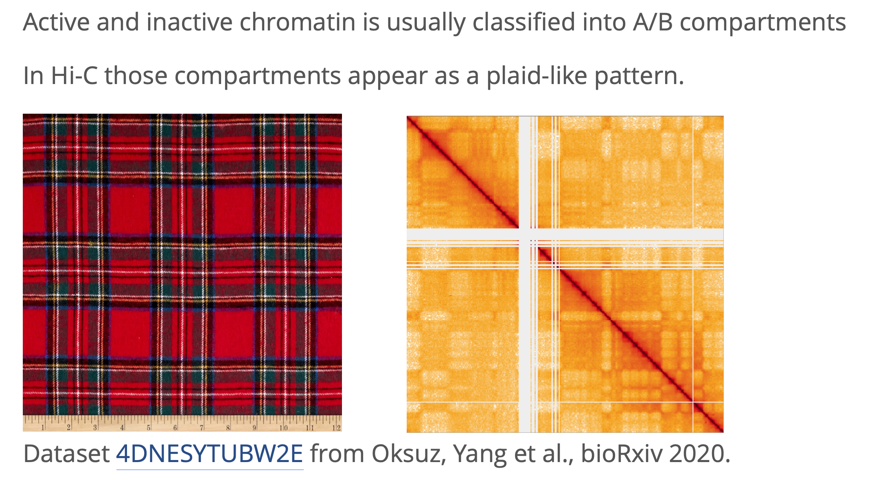
Chromatin compartments

Slide 4
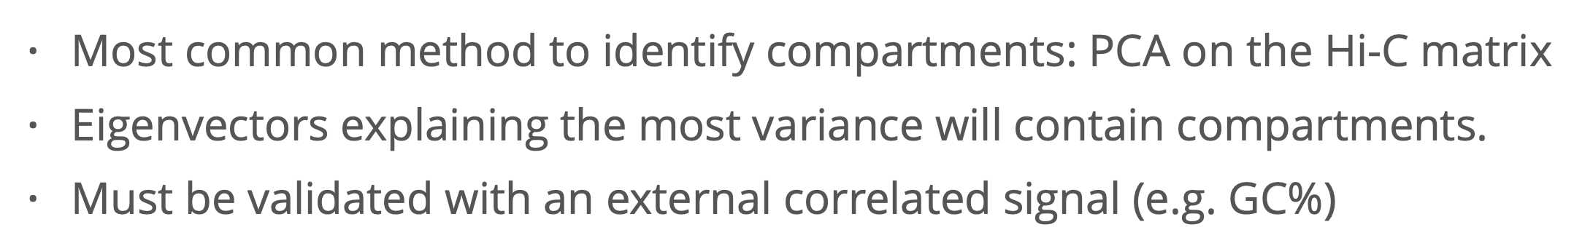
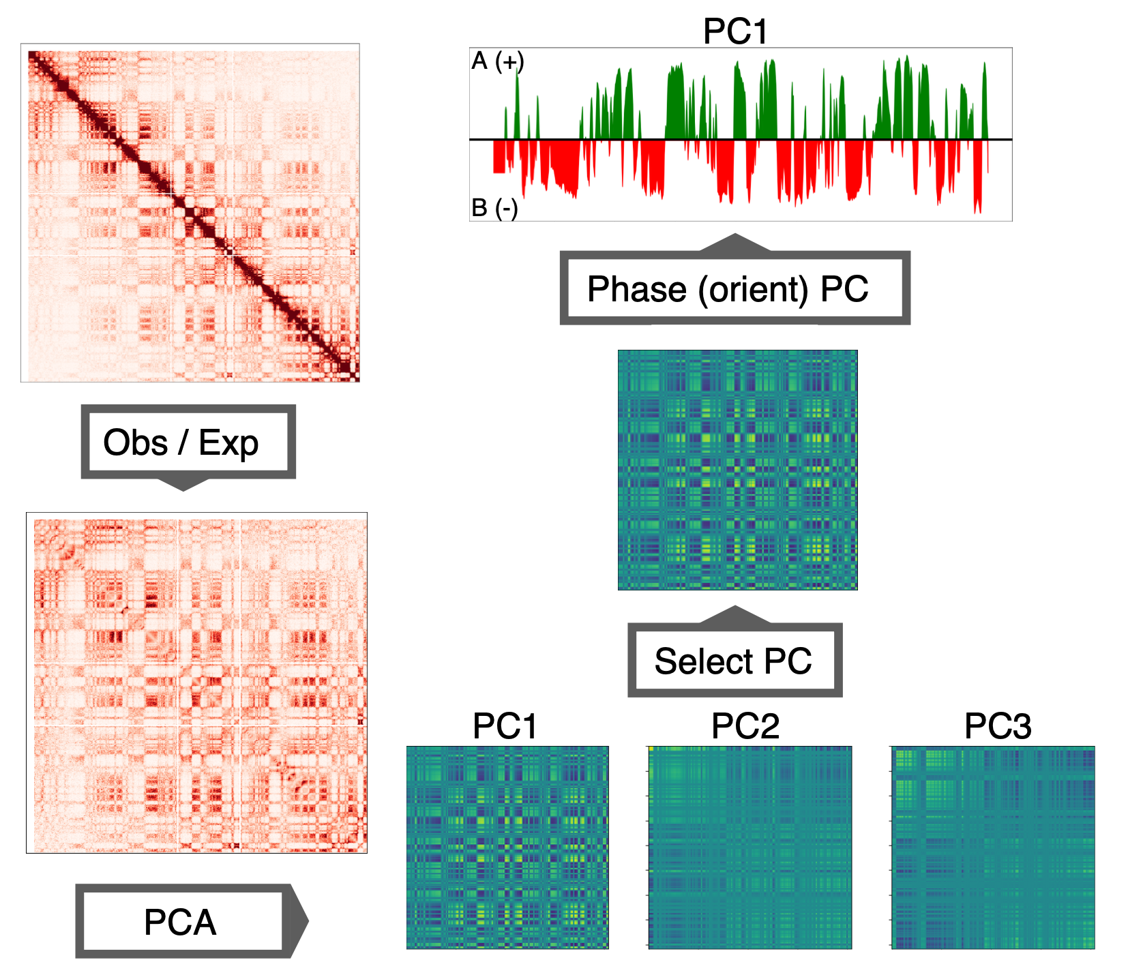
Chromatin compartments

Slide 5
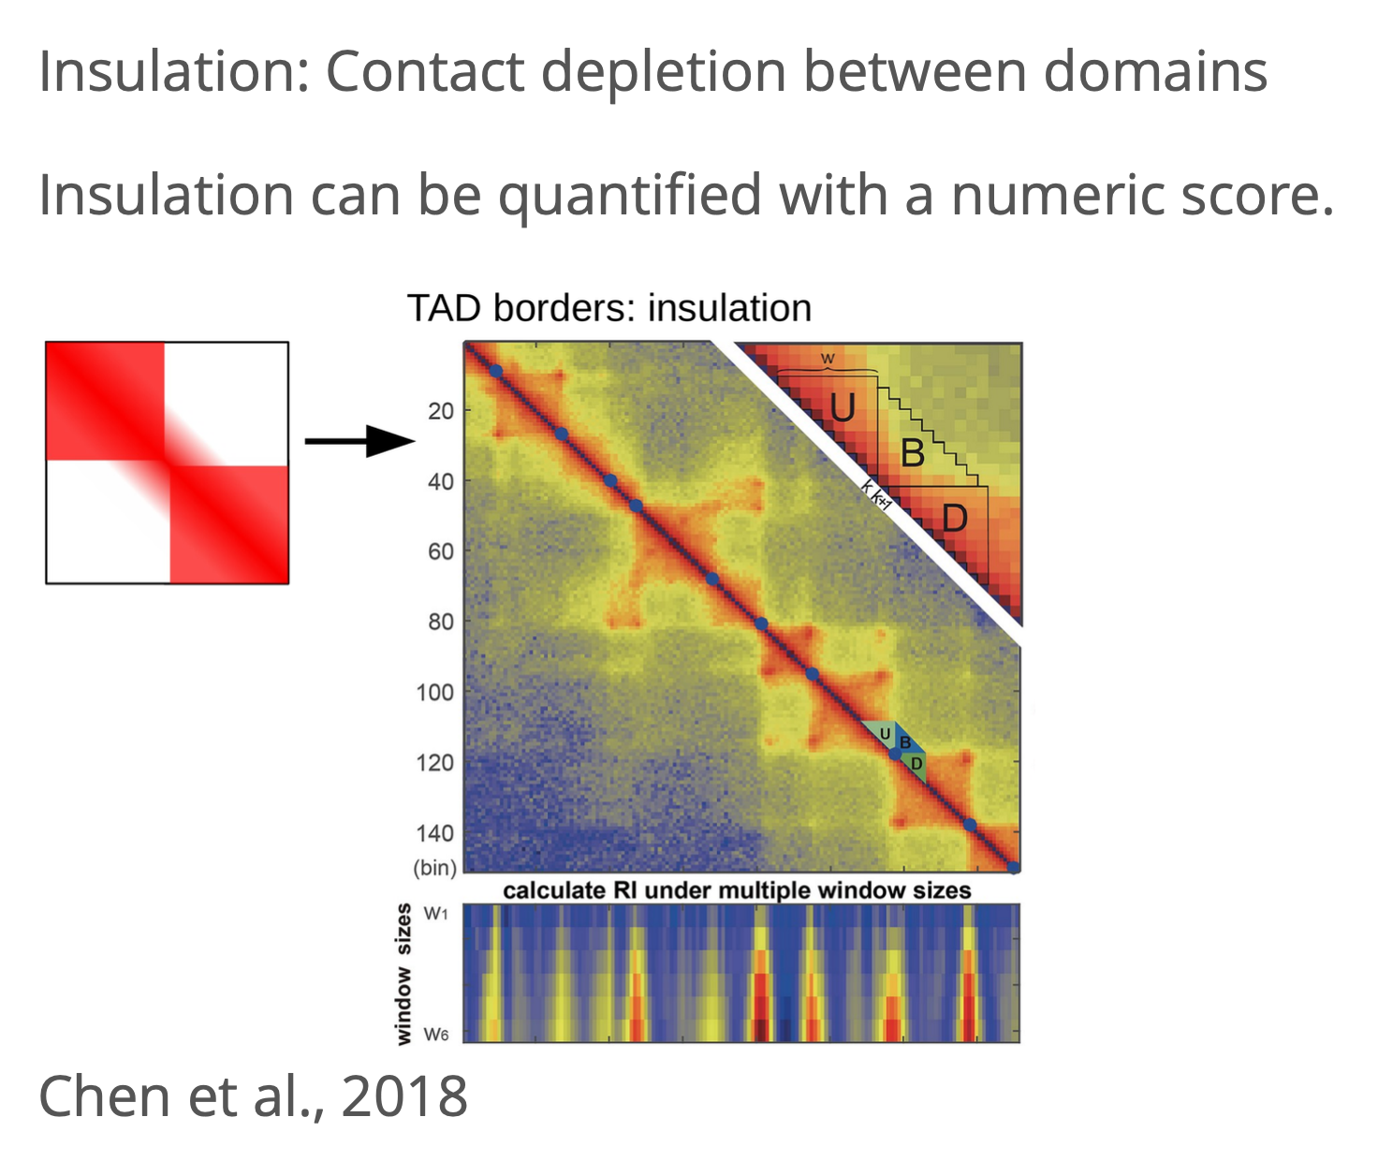
Chromatin domain insulation

Slide 6
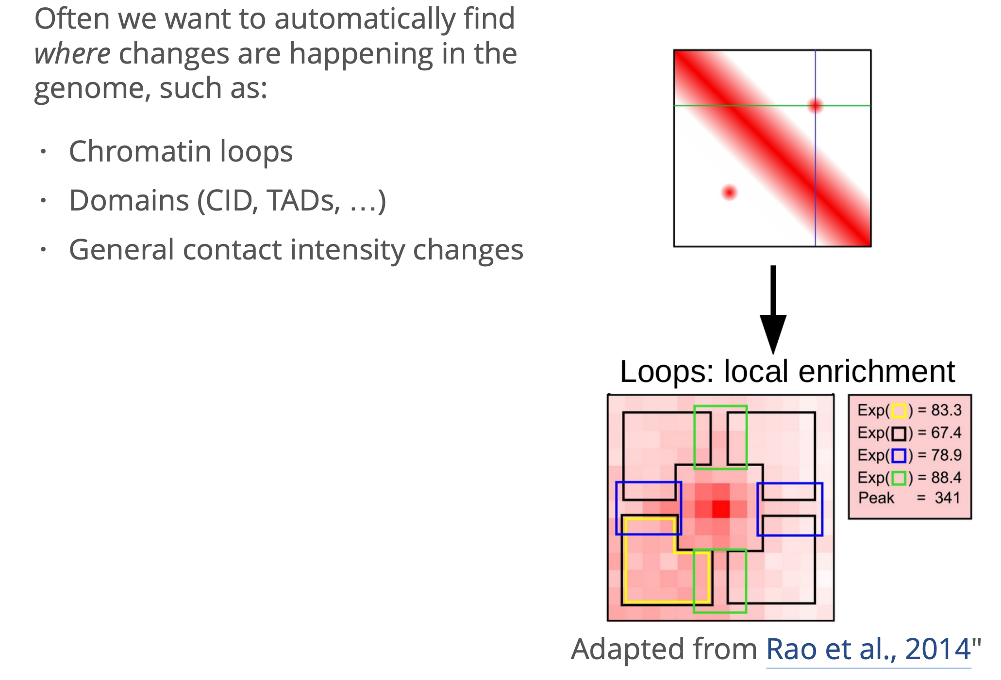
Chromatin features

Slide 7
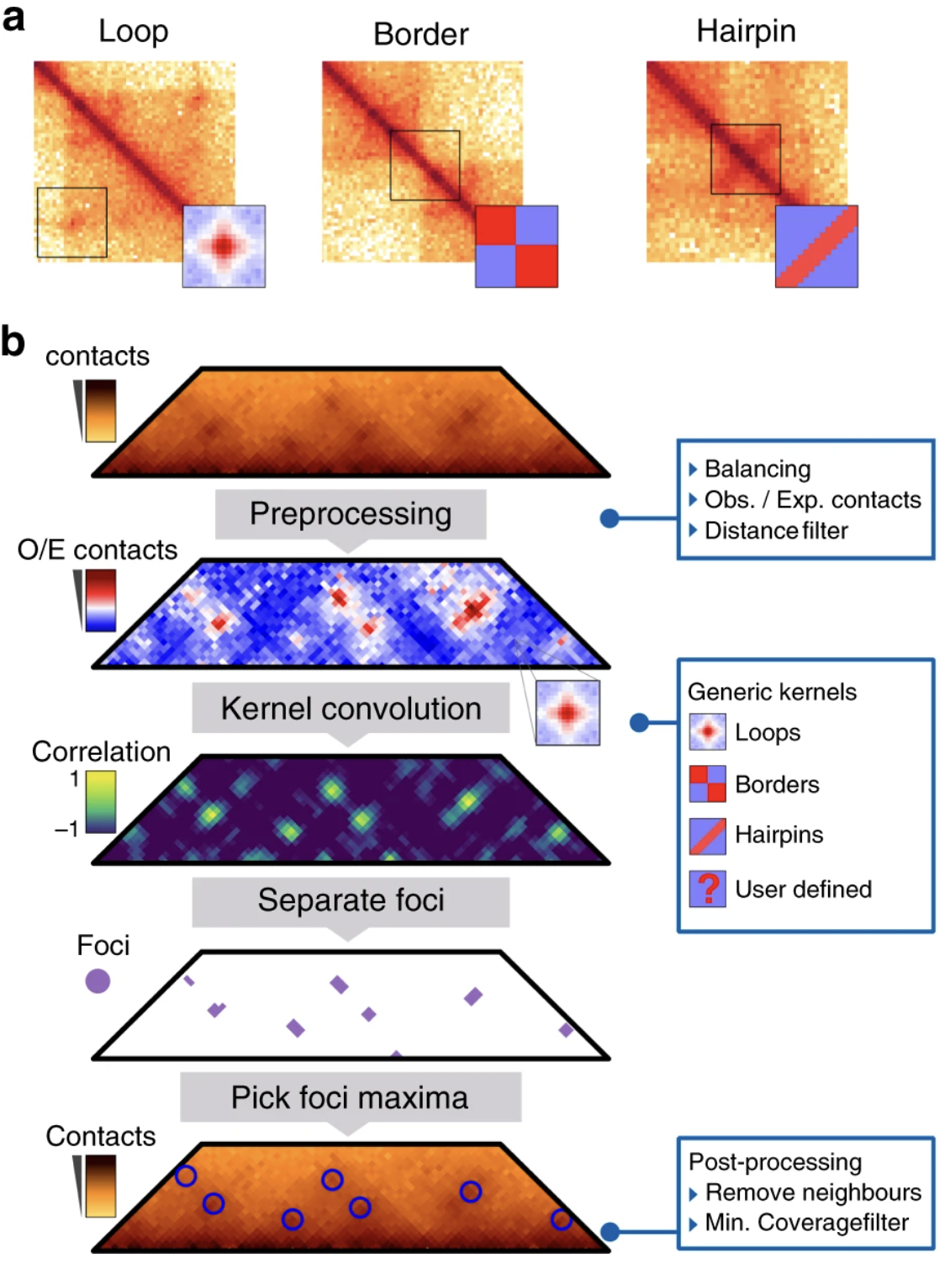
Chromosight
https://github.com/koszullab/chromosight

Slide 8
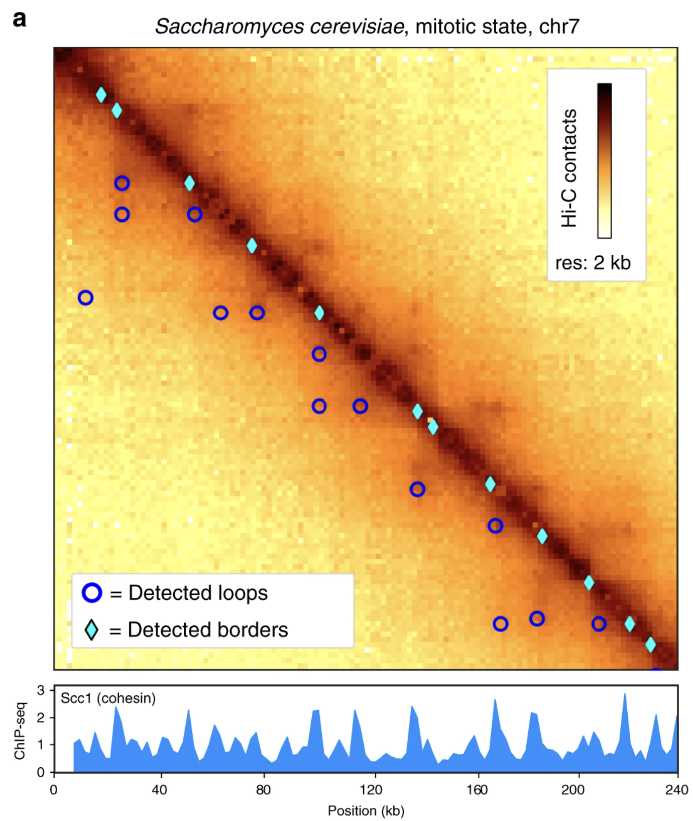
Chromosight
https://github.com/koszullab/chromosight

Slide 9
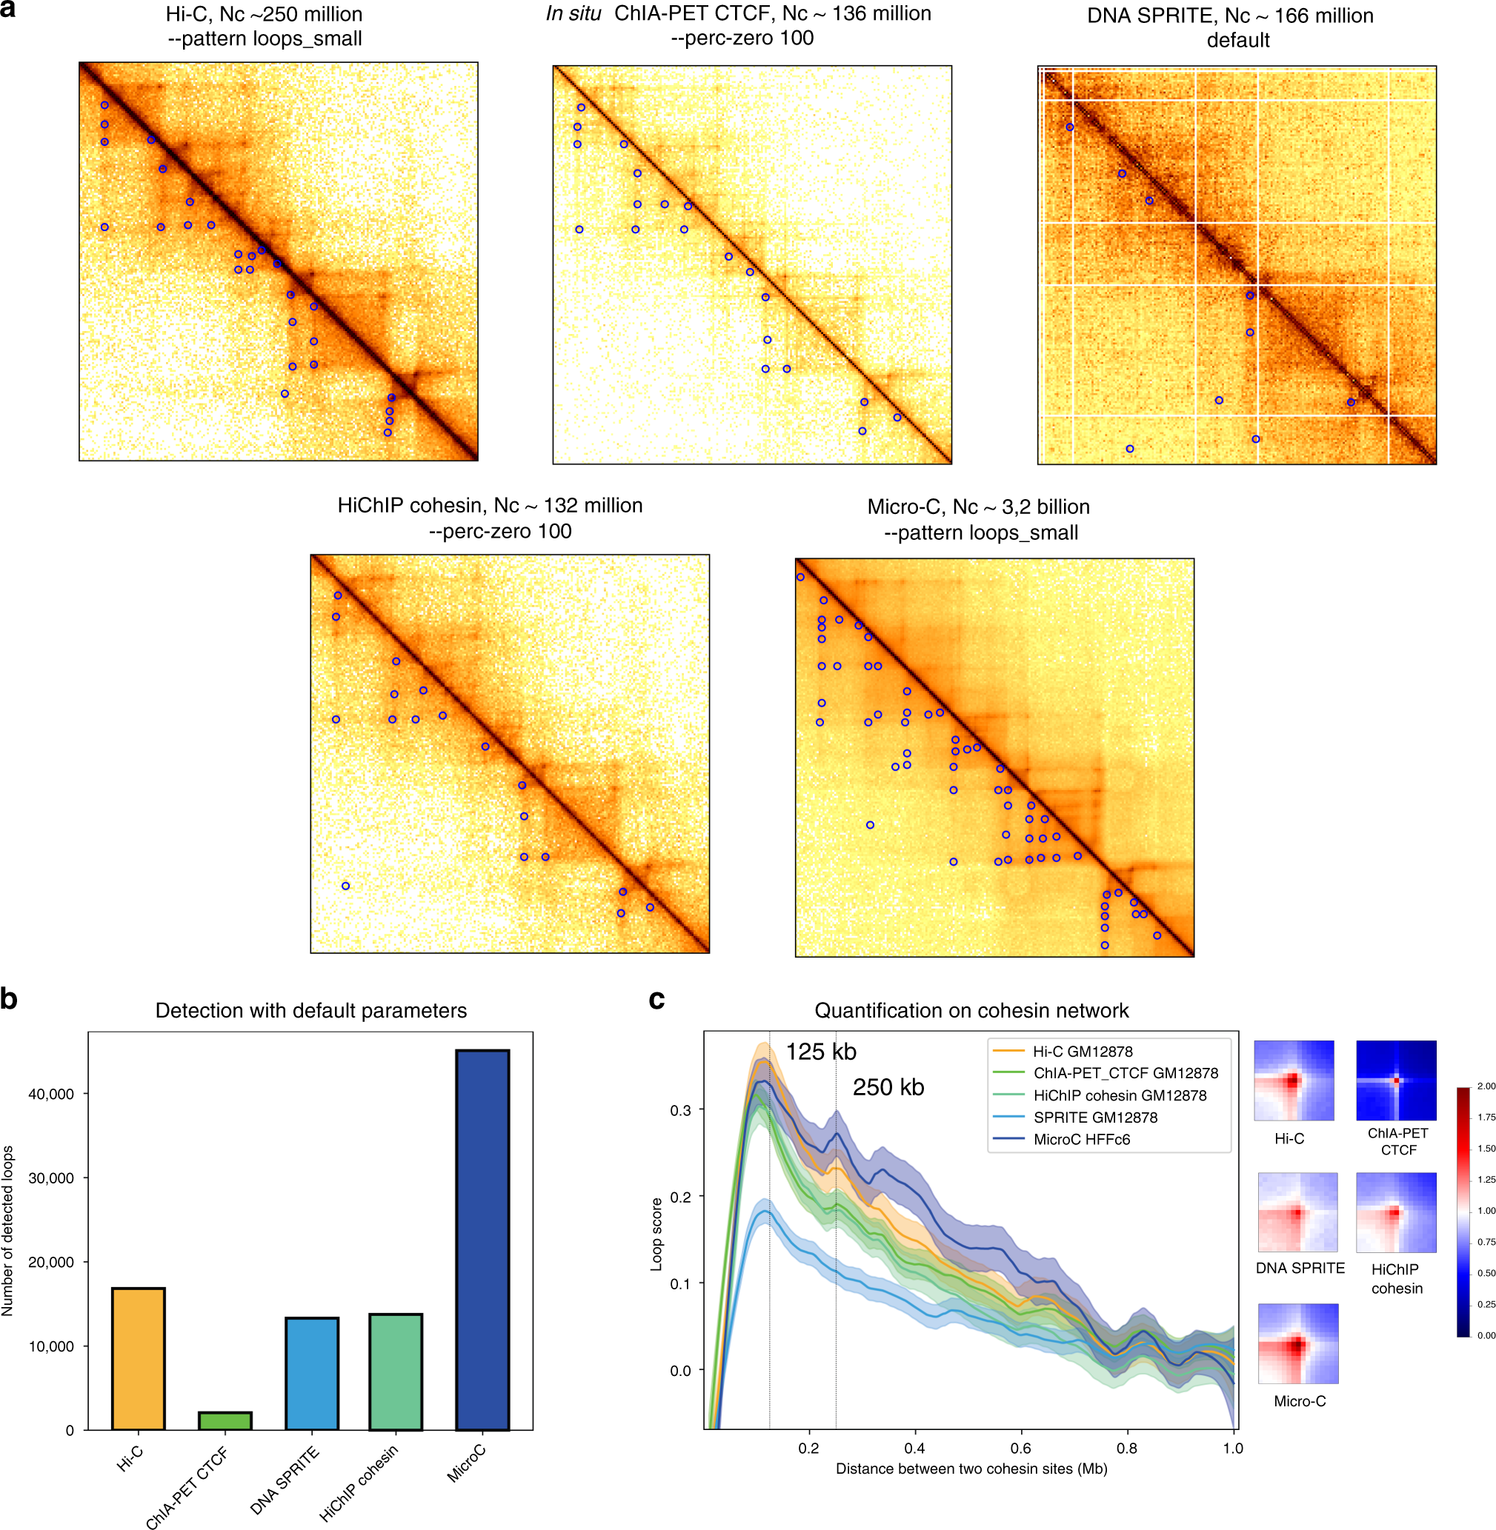
Chromosight
https://github.com/koszullab/chromosight

