Slide 1
Gene ontology, gene set over-representation analyses and public databases Peeking into functional roles of gene sets
Epigenomics Data Analysis
Jacques Serizay
Physalia 2026

Slide 2
Why do we need GO analyses?
After RNA-seq (or ATAC, ChIP, …), we generally end up with a list of genes (or genomic features with the nearest gene).
→ We want to investigate the biological relevance of this set of genes.

Slide 3
GO over-representation analyses: what
An ontology is a formal representation of a body of knowledge within a given domain

Slide 4
GO over-representation analyses: what
An ontology term primarily consists of:
A definition of a concept
A representation of this concept
A formal naming of this concept

Slide 5
GO over-representation analyses: what
An ontology term primarily consists of:
A definition of a concept
A representation of this concept
A formal naming of this concept
=== Example term ===
:id: GO:0000016
:name: lactase activity
:ontology: molecular_function
:def: "Catalysis of the reaction: lactose + H2O=D- glucose + D-galactose." [EC:3.2.1.108]
:synonym: "lactase-phlorizin hydrolase activity" BROAD [EC:3.2.1.108]
:synonym: "lactose galactohydrolase activity" EXACT [EC:3.2.1.108]
:xref: EC:3.2.1.108
:xref: MetaCyc:LACTASE-RXN
:xref: Reactome:20536
:is_a: GO:0004553 ! hydrolase activity, hydrolyzing O-glycosyl compounds

Slide 6
GO over-representation analyses: what
An ontology term primarily consists of:
A definition of a concept
A representation of this concept
A formal naming of this concept
=== Example term ===
:id: GO:0000016
:name: lactase activity
:ontology: molecular_function
:def: "Catalysis of the reaction: lactose + H2O=D- glucose + D-galactose." [EC:3.2.1.108]
:synonym: "lactase-phlorizin hydrolase activity" BROAD [EC:3.2.1.108]
:synonym: "lactose galactohydrolase activity" EXACT [EC:3.2.1.108]
:xref: EC:3.2.1.108
:xref: MetaCyc:LACTASE-RXN
:xref: Reactome:20536
:is_a: GO:0004553 ! hydrolase activity, hydrolyzing O-glycosyl compounds
GO:0000016

Slide 7
GO over-representation analyses: what
An ontology term can be further enriched with additional information:
Elements can be annotated to individual terms
B D
GO:0000022

Slide 8
GO over-representation analyses: what
Ontology terms
GO:0000016
GO:0000017
GO:0000018
GO:0000019
GO:0000020
GO:0000021
GO:0000022
GO:0000023
GO:0000024

Slide 9
GO over-representation analyses: what
Gene Ontology terms
+ GO annotations
GO:0000016
GO:0000017
GO:0000018
A D
E F
A B
C D
G H
I J
GO:0000019
A
B D
B C D
GO:0000020
GO:0000021
A
B D
GO:0000022
GO:0000023
B
D
GO:0000024

Slide 10
GO over-representation analyses: what
Gene Ontology terms
+ GO annotations
+ hierarchy
GO:0000017
A D
E F
A B
C D
G H
I J
GO:0000019
A
B D
B C D
GO:0000020
GO:0000021
A
B D
GO:0000022
GO:0000023
B
D
GO:0000024

Slide 11
GO over-representation analyses: what
Different Ontology terms can contain the same sets of annotations
A D
E F
A B
C D
G H
I J
A
B D
B C D
A
B D
B C D
B
B D
D

Slide 12
GO over-representation analyses: what
In our case, the Gene Ontology (GO) describes the current state of knowledge of the three main biological domains
A D
E F
A B
C D
G H
I J
A
B D
B C D
A
B D
B C D
B
B D
D

Slide 13
GO over-representation analyses: what
In our case, the Gene Ontology (GO) describes the current state of knowledge in biology
Metabolic process
Primary metab. process
Small molecule metab. process
…
Monohydrate metab. process
Carbohydrate metab. process
Hexose biosynthetic process
…
Saccharide biosynthetic process

Slide 14
GO over-representation analyses: what
Gene Ontology (GO) is divided in three domains
Biological Processes (BP)
Cellular Components (CC)
Molecular Functions (MF)
Cellular components
Biological processes
Molecular functions

Slide 15
GO over-representation analyses: what
The Gene Ontology (GO) is a dynamic, frequently updated database
Cellular components
Biological processes
Molecular functions

Slide 16
GO over-representation analyses: what
IMPORTANT:
A GO term (e.g. GO:0000017) is different from its annotations (i.e. the association of some genes to this term)
GO:0000017
GO:0000017
GO term:
Metabolic process

Slide 17
GO over-representation analyses: what
IMPORTANT:
A GO term (e.g. GO:0000017) is different from its annotations (i.e. the association of some genes to this term)
GO:0000017
A B
C D
GO:0000017
GO term:
Metabolic process
GO annotations:
Gene A
Gene B
Gene C
Gene D

Slide 18
GO over-representation analyses: what
IMPORTANT:
GO consortium organizes GO terms and their hierarchy
External providers manage GO term annotations

Slide 19
GO over-representation analyses: what
IMPORTANT:
GO consortium organizes GO terms and their hierarchy
External providers manage GO term annotations
Mouse annotations are provided by MGI (Mouse Genome Informatics)
C. elegans annotations are provided by Wormbase
Yeast annotations are provided by SGD (Saccharomyces Genome Database)

Slide 20
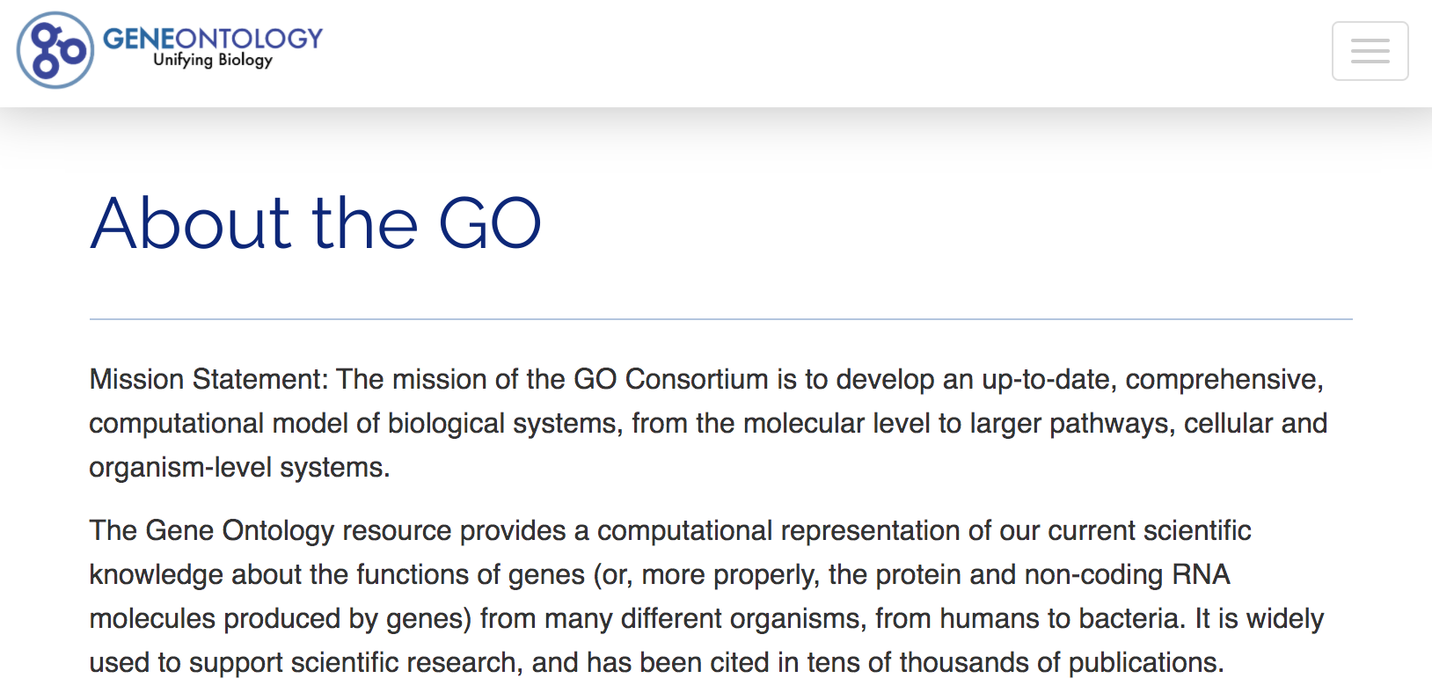
Official GO database
GO Consortium is the provider of official Gene Ontology.

Slide 21
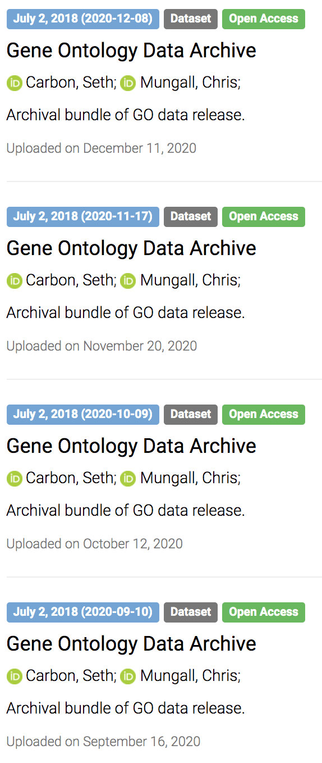
Downloading official GO database
Versioned database
Easy access to entire database
OBO format

Slide 22
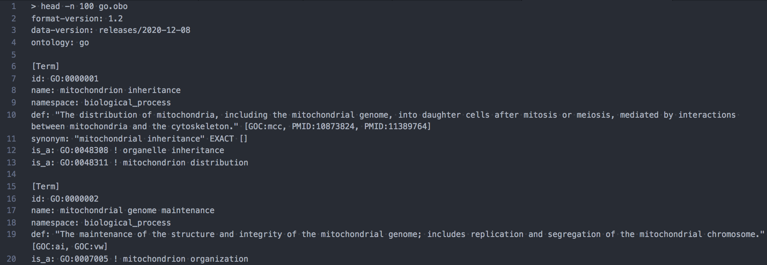
Downloading official GO database
OBO format
wget http://purl.obolibrary.org/obo/go.obo

Slide 23
Downloading GO annotations
GO annotations:
Also versioned
All most recent annotations for individual species available at:
http://current.geneontology.org/annotations/

Slide 24
Downloading GO annotations
Parent goa_dog_rna.gpad.gz goa_chicken_complex.gpad.gz mgi.gaf.gz
.. goa_dog_rna.gpi.gz goa_chicken_complex.gpi.gz mgi.gpad.gz
goa_human.gaf.gz goa_chicken_isoform.gaf.gz mgi.gpi.gz
goa_human.gpad.gz goa_chicken_isoform.gpad.gz pombase.gaf.gz
goa_human.gpi.gz goa_chicken_isoform.gpi.gz pombase.gpad.gz
aspgd.gaf.gz goa_human_complex.gaf.gz goa_chicken_rna.gaf.gz pombase.gpi.gz
aspgd.gpad.gz goa_human_complex.gpad.gz goa_chicken_rna.gpad.gz pseudocap.gaf.gz
aspgd.gpi.gz goa_human_complex.gpi.gz goa_chicken_rna.gpi.gz pseudocap.gpad.gz
cgd.gaf.gz goa_human_isoform.gaf.gz goa_cow.gaf.gz pseudocap.gpi.gz
cgd.gpad.gz goa_human_isoform.gpad.gz goa_cow.gpad.gz reactome.gaf.gz
cgd.gpi.gz goa_human_isoform.gpi.gz goa_cow.gpi.gz reactome.gpad.gz
dictybase.gaf.gz goa_human_rna.gaf.gz goa_cow_complex.gaf.gz reactome.gpi.gz
dictybase.gpad.gz goa_human_rna.gpad.gz goa_cow_complex.gpad.gz rgd.gaf.gz
dictybase.gpi.gz goa_human_rna.gpi.gz goa_cow_complex.gpi.gz rgd.gpad.gz
ecocyc.gaf.gz goa_pig.gaf.gz goa_cow_isoform.gaf.gz rgd.gpi.gz
ecocyc.gpad.gz goa_pig.gpad.gz goa_cow_isoform.gpad.gz sgd.gaf.gz
ecocyc.gpi.gz goa_pig.gpi.gz goa_cow_isoform.gpi.gz sgd.gpad.gz
fb.gaf.gz goa_pig_complex.gaf.gz goa_cow_rna.gaf.gz sgd.gpi.gz
fb.gpad.gz goa_pig_complex.gpad.gz goa_cow_rna.gpad.gz sgn.gaf.gz
fb.gpi.gz goa_pig_complex.gpi.gz goa_cow_rna.gpi.gz sgn.gpad.gz
genedb_lmajor.gaf.gz goa_pig_isoform.gaf.gz goa_dog.gaf.gz sgn.gpi.gz
genedb_lmajor.gpad.gz goa_pig_isoform.gpad.gz goa_dog.gpad.gz tair.gaf.gz
genedb_lmajor.gpi.gz goa_pig_isoform.gpi.gz goa_dog.gpi.gz tair.gpad.gz
genedb_tbrucei.gaf.gz goa_pig_rna.gaf.gz goa_dog_complex.gaf.gz tair.gpi.gz
genedb_tbrucei.gpad.gz goa_pig_rna.gpad.gz goa_dog_complex.gpad.gz wb.gaf.gz
genedb_tbrucei.gpi.gz goa_pig_rna.gpi.gz goa_dog_complex.gpi.gz wb.gpad.gz
goa_chicken.gaf.gz goa_uniprot_all.gaf.gz goa_dog_isoform.gaf.gz wb.gpi.gz
goa_chicken.gpad.gz goa_uniprot_all_noiea.gaf.gz goa_dog_isoform.gpad.gz zfin.gaf.gz
goa_chicken.gpi.gz goa_uniprot_all_noiea.gpad.gz goa_dog_isoform.gpi.gz zfin.gpad.gz
goa_chicken_complex.gaf.gz goa_uniprot_all_noiea.gpi.gz goa_dog_rna.gaf.gz zfin.gpi.gz

Slide 25
Downloading GO annotations
GAF format:
It’s in the name: GO Annotation Format

Slide 26
Downloading GO annotations
GAF format:
!gaf-version: 2.1
!
!Generated by GO Central
!
!Date Generated by GOC: 2020-12-09
!
!Header from source association file:
!=================================
!
!Generated by GO Central
!
!Date Generated by GOC: 2020-12-08
!
!Header from sgd source association file:
!=================================
!Date: 20201207
!From: Saccharomyces Genome Database (SGD)
!URL: https://www.yeastgenome.org/
!Contact Email: sgd-helpdesk@lists.stanford.edu
!Funding: NHGRI at US NIH, grant number U41-HG001315
!
!=================================
!
!Header copied from paint_sgd_valid.gaf
!=================================
!Created on Mon Dec 7 11:33:04 2020.
!generated-by: PANTHER
!date-generated: 2020-12-07
!PANTHER version: v.15.0.
!GO version: 2020-11-17.
!
!=================================
!
!Documentation about this header can be found here: https://github.com/geneontology/go-site/blob/master/docs/gaf_validation.md
!
...
SGD S000004103 HOG1 GO:0003682 PMID:24508389 IDA F Mitogen-activated protein kinase involved in osmoregulation YLR113W|SSK3|mitogen-activated protein kinase HOG1
SGD S000004103 HOG1 GO:0004707 PMID:10805732 IDA F Mitogen-activated protein kinase involved in osmoregulation YLR113W|SSK3|mitogen-activated protein kinase HOG1
SGD S000004103 HOG1 GO:0005516 PMID:27421986 IPI UniProtKB:P06787 F Mitogen-activated protein kinase involved in osmoregulation YLR113W|SSK3|mitogen-activated protein kinase HOG1
SGD S000004103 HOG1 GO:0006468 PMID:10805732 IDA P Mitogen-activated protein kinase involved in osmoregulation YLR113W|SSK3|mitogen-activated protein kinase HOG1
SGD S000004103 HOG1 GO:0006468 PMID:12743037 IDA P Mitogen-activated protein kinase involved in osmoregulation YLR113W|SSK3|mitogen-activated protein kinase HOG1
SGD S000004103 HOG1 GO:0006468 PMID:23178807 IDA P Mitogen-activated protein kinase involved in osmoregulation YLR113W|SSK3|mitogen-activated protein kinase HOG1
SGD S000004103 HOG1 GO:0006972 PMID:7681220 IMP P Mitogen-activated protein kinase involved in osmoregulation YLR113W|SSK3|mitogen-activated protein kinase HOG1
SGD S000004103 HOG1 GO:0007231 PMID:7681220 IMP P Mitogen-activated protein kinase involved in osmoregulation YLR113W|SSK3|mitogen-activated protein kinase HOG1
SGD S000004103 HOG1 GO:0016241 PMID:16874103 IMP P Mitogen-activated protein kinase involved in osmoregulation YLR113W|SSK3|mitogen-activated protein kinase HOG1
SGD S000004103 HOG1 GO:0033262 PMID:23178807 IDA P Mitogen-activated protein kinase involved in osmoregulation YLR113W|SSK3|mitogen-activated protein kinase HOG1
SGD S000004103 HOG1 GO:0045944 PMID:12743037 IDA P Mitogen-activated protein kinase involved in osmoregulation YLR113W|SSK3|mitogen-activated protein kinase HOG1
...

Slide 27
Downloading GO annotations
GAF format
!gaf-version: 2.1
!
!Generated by GO Central
!
!Date Generated by GOC: 2020-12-09
!
!Header from source association file:
!=================================
!
!Generated by GO Central
!
!Date Generated by GOC: 2020-12-08
!
!Header from sgd source association file:
!=================================
!Date: 20201207
!From: Saccharomyces Genome Database (SGD)
!URL: https://www.yeastgenome.org/
!Contact Email: sgd-helpdesk@lists.stanford.edu
!Funding: NHGRI at US NIH, grant number U41-HG001315
!
!=================================
!
!Header copied from paint_sgd_valid.gaf
!=================================
!Created on Mon Dec 7 11:33:04 2020.
!generated-by: PANTHER
!date-generated: 2020-12-07
!PANTHER version: v.15.0.
!GO version: 2020-11-17.
!
!=================================
!
!Documentation about this header can be found here: https://github.com/geneontology/go-site/blob/master/docs/gaf_validation.md
!
...
SGD S000004103 HOG1 GO:0003682 PMID:24508389 IDA F Mitogen-activated protein kinase involved in osmoregulation YLR113W|SSK3|mitogen-activated protein kinase HOG1
SGD S000004103 HOG1 GO:0004707 PMID:10805732 IDA F Mitogen-activated protein kinase involved in osmoregulation YLR113W|SSK3|mitogen-activated protein kinase HOG1
SGD S000004103 HOG1 GO:0005516 PMID:27421986 IPI UniProtKB:P06787 F Mitogen-activated protein kinase involved in osmoregulation YLR113W|SSK3|mitogen-activated protein kinase HOG1
SGD S000004103 HOG1 GO:0006468 PMID:10805732 IDA P Mitogen-activated protein kinase involved in osmoregulation YLR113W|SSK3|mitogen-activated protein kinase HOG1
SGD S000004103 HOG1 GO:0006468 PMID:12743037 IDA P Mitogen-activated protein kinase involved in osmoregulation YLR113W|SSK3|mitogen-activated protein kinase HOG1
SGD S000004103 HOG1 GO:0006468 PMID:23178807 IDA P Mitogen-activated protein kinase involved in osmoregulation YLR113W|SSK3|mitogen-activated protein kinase HOG1
SGD S000004103 HOG1 GO:0006972 PMID:7681220 IMP P Mitogen-activated protein kinase involved in osmoregulation YLR113W|SSK3|mitogen-activated protein kinase HOG1
SGD S000004103 HOG1 GO:0007231 PMID:7681220 IMP P Mitogen-activated protein kinase involved in osmoregulation YLR113W|SSK3|mitogen-activated protein kinase HOG1
SGD S000004103 HOG1 GO:0016241 PMID:16874103 IMP P Mitogen-activated protein kinase involved in osmoregulation YLR113W|SSK3|mitogen-activated protein kinase HOG1
SGD S000004103 HOG1 GO:0033262 PMID:23178807 IDA P Mitogen-activated protein kinase involved in osmoregulation YLR113W|SSK3|mitogen-activated protein kinase HOG1
SGD S000004103 HOG1 GO:0045944 PMID:12743037 IDA P Mitogen-activated protein kinase involved in osmoregulation YLR113W|SSK3|mitogen-activated protein kinase HOG1
...
Annotation provider

Slide 28
Downloading GO annotations
GAF format
!gaf-version: 2.1
!
!Generated by GO Central
!
!Date Generated by GOC: 2020-12-09
!
!Header from source association file:
!=================================
!
!Generated by GO Central
!
!Date Generated by GOC: 2020-12-08
!
!Header from sgd source association file:
!=================================
!Date: 20201207
!From: Saccharomyces Genome Database (SGD)
!URL: https://www.yeastgenome.org/
!Contact Email: sgd-helpdesk@lists.stanford.edu
!Funding: NHGRI at US NIH, grant number U41-HG001315
!
!=================================
!
!Header copied from paint_sgd_valid.gaf
!=================================
!Created on Mon Dec 7 11:33:04 2020.
!generated-by: PANTHER
!date-generated: 2020-12-07
!PANTHER version: v.15.0.
!GO version: 2020-11-17.
!
!=================================
!
!Documentation about this header can be found here: https://github.com/geneontology/go-site/blob/master/docs/gaf_validation.md
!
...
SGD S000004103 HOG1 GO:0003682 PMID:24508389 IDA F Mitogen-activated protein kinase involved in osmoregulation YLR113W|SSK3|mitogen-activated protein kinase HOG1
SGD S000004103 HOG1 GO:0004707 PMID:10805732 IDA F Mitogen-activated protein kinase involved in osmoregulation YLR113W|SSK3|mitogen-activated protein kinase HOG1
SGD S000004103 HOG1 GO:0005516 PMID:27421986 IPI UniProtKB:P06787 F Mitogen-activated protein kinase involved in osmoregulation YLR113W|SSK3|mitogen-activated protein kinase HOG1
SGD S000004103 HOG1 GO:0006468 PMID:10805732 IDA P Mitogen-activated protein kinase involved in osmoregulation YLR113W|SSK3|mitogen-activated protein kinase HOG1
SGD S000004103 HOG1 GO:0006468 PMID:12743037 IDA P Mitogen-activated protein kinase involved in osmoregulation YLR113W|SSK3|mitogen-activated protein kinase HOG1
SGD S000004103 HOG1 GO:0006468 PMID:23178807 IDA P Mitogen-activated protein kinase involved in osmoregulation YLR113W|SSK3|mitogen-activated protein kinase HOG1
SGD S000004103 HOG1 GO:0006972 PMID:7681220 IMP P Mitogen-activated protein kinase involved in osmoregulation YLR113W|SSK3|mitogen-activated protein kinase HOG1
SGD S000004103 HOG1 GO:0007231 PMID:7681220 IMP P Mitogen-activated protein kinase involved in osmoregulation YLR113W|SSK3|mitogen-activated protein kinase HOG1
SGD S000004103 HOG1 GO:0016241 PMID:16874103 IMP P Mitogen-activated protein kinase involved in osmoregulation YLR113W|SSK3|mitogen-activated protein kinase HOG1
SGD S000004103 HOG1 GO:0033262 PMID:23178807 IDA P Mitogen-activated protein kinase involved in osmoregulation YLR113W|SSK3|mitogen-activated protein kinase HOG1
SGD S000004103 HOG1 GO:0045944 PMID:12743037 IDA P Mitogen-activated protein kinase involved in osmoregulation YLR113W|SSK3|mitogen-activated protein kinase HOG1
...
DB object symbol

Slide 29
Downloading GO annotations
GAF format
!gaf-version: 2.1
!
!Generated by GO Central
!
!Date Generated by GOC: 2020-12-09
!
!Header from source association file:
!=================================
!
!Generated by GO Central
!
!Date Generated by GOC: 2020-12-08
!
!Header from sgd source association file:
!=================================
!Date: 20201207
!From: Saccharomyces Genome Database (SGD)
!URL: https://www.yeastgenome.org/
!Contact Email: sgd-helpdesk@lists.stanford.edu
!Funding: NHGRI at US NIH, grant number U41-HG001315
!
!=================================
!
!Header copied from paint_sgd_valid.gaf
!=================================
!Created on Mon Dec 7 11:33:04 2020.
!generated-by: PANTHER
!date-generated: 2020-12-07
!PANTHER version: v.15.0.
!GO version: 2020-11-17.
!
!=================================
!
!Documentation about this header can be found here: https://github.com/geneontology/go-site/blob/master/docs/gaf_validation.md
!
...
SGD S000004103 HOG1 GO:0003682 PMID:24508389 IDA F Mitogen-activated protein kinase involved in osmoregulation YLR113W|SSK3|mitogen-activated protein kinase HOG1
SGD S000004103 HOG1 GO:0004707 PMID:10805732 IDA F Mitogen-activated protein kinase involved in osmoregulation YLR113W|SSK3|mitogen-activated protein kinase HOG1
SGD S000004103 HOG1 GO:0005516 PMID:27421986 IPI UniProtKB:P06787 F Mitogen-activated protein kinase involved in osmoregulation YLR113W|SSK3|mitogen-activated protein kinase HOG1
SGD S000004103 HOG1 GO:0006468 PMID:10805732 IDA P Mitogen-activated protein kinase involved in osmoregulation YLR113W|SSK3|mitogen-activated protein kinase HOG1
SGD S000004103 HOG1 GO:0006468 PMID:12743037 IDA P Mitogen-activated protein kinase involved in osmoregulation YLR113W|SSK3|mitogen-activated protein kinase HOG1
SGD S000004103 HOG1 GO:0006468 PMID:23178807 IDA P Mitogen-activated protein kinase involved in osmoregulation YLR113W|SSK3|mitogen-activated protein kinase HOG1
SGD S000004103 HOG1 GO:0006972 PMID:7681220 IMP P Mitogen-activated protein kinase involved in osmoregulation YLR113W|SSK3|mitogen-activated protein kinase HOG1
SGD S000004103 HOG1 GO:0007231 PMID:7681220 IMP P Mitogen-activated protein kinase involved in osmoregulation YLR113W|SSK3|mitogen-activated protein kinase HOG1
SGD S000004103 HOG1 GO:0016241 PMID:16874103 IMP P Mitogen-activated protein kinase involved in osmoregulation YLR113W|SSK3|mitogen-activated protein kinase HOG1
SGD S000004103 HOG1 GO:0033262 PMID:23178807 IDA P Mitogen-activated protein kinase involved in osmoregulation YLR113W|SSK3|mitogen-activated protein kinase HOG1
SGD S000004103 HOG1 GO:0045944 PMID:12743037 IDA P Mitogen-activated protein kinase involved in osmoregulation YLR113W|SSK3|mitogen-activated protein kinase HOG1
...
GO term

Slide 30
Downloading GO annotations
GAF format
!gaf-version: 2.1
!
!Generated by GO Central
!
!Date Generated by GOC: 2020-12-09
!
!Header from source association file:
!=================================
!
!Generated by GO Central
!
!Date Generated by GOC: 2020-12-08
!
!Header from sgd source association file:
!=================================
!Date: 20201207
!From: Saccharomyces Genome Database (SGD)
!URL: https://www.yeastgenome.org/
!Contact Email: sgd-helpdesk@lists.stanford.edu
!Funding: NHGRI at US NIH, grant number U41-HG001315
!
!=================================
!
!Header copied from paint_sgd_valid.gaf
!=================================
!Created on Mon Dec 7 11:33:04 2020.
!generated-by: PANTHER
!date-generated: 2020-12-07
!PANTHER version: v.15.0.
!GO version: 2020-11-17.
!
!=================================
!
!Documentation about this header can be found here: https://github.com/geneontology/go-site/blob/master/docs/gaf_validation.md
!
...
SGD S000004103 HOG1 GO:0003682 PMID:24508389 IDA F Mitogen-activated protein kinase involved in osmoregulation YLR113W|SSK3|mitogen-activated protein kinase HOG1
SGD S000004103 HOG1 GO:0004707 PMID:10805732 IDA F Mitogen-activated protein kinase involved in osmoregulation YLR113W|SSK3|mitogen-activated protein kinase HOG1
SGD S000004103 HOG1 GO:0005516 PMID:27421986 IPI UniProtKB:P06787 F Mitogen-activated protein kinase involved in osmoregulation YLR113W|SSK3|mitogen-activated protein kinase HOG1
SGD S000004103 HOG1 GO:0006468 PMID:10805732 IDA P Mitogen-activated protein kinase involved in osmoregulation YLR113W|SSK3|mitogen-activated protein kinase HOG1
SGD S000004103 HOG1 GO:0006468 PMID:12743037 IDA P Mitogen-activated protein kinase involved in osmoregulation YLR113W|SSK3|mitogen-activated protein kinase HOG1
SGD S000004103 HOG1 GO:0006468 PMID:23178807 IDA P Mitogen-activated protein kinase involved in osmoregulation YLR113W|SSK3|mitogen-activated protein kinase HOG1
SGD S000004103 HOG1 GO:0006972 PMID:7681220 IMP P Mitogen-activated protein kinase involved in osmoregulation YLR113W|SSK3|mitogen-activated protein kinase HOG1
SGD S000004103 HOG1 GO:0007231 PMID:7681220 IMP P Mitogen-activated protein kinase involved in osmoregulation YLR113W|SSK3|mitogen-activated protein kinase HOG1
SGD S000004103 HOG1 GO:0016241 PMID:16874103 IMP P Mitogen-activated protein kinase involved in osmoregulation YLR113W|SSK3|mitogen-activated protein kinase HOG1
SGD S000004103 HOG1 GO:0033262 PMID:23178807 IDA P Mitogen-activated protein kinase involved in osmoregulation YLR113W|SSK3|mitogen-activated protein kinase HOG1
SGD S000004103 HOG1 GO:0045944 PMID:12743037 IDA P Mitogen-activated protein kinase involved in osmoregulation YLR113W|SSK3|mitogen-activated protein kinase HOG1
...
Ref. for evidence

Slide 31
Downloading GO annotations
GAF format
!gaf-version: 2.1
!
!Generated by GO Central
!
!Date Generated by GOC: 2020-12-09
!
!Header from source association file:
!=================================
!
!Generated by GO Central
!
!Date Generated by GOC: 2020-12-08
!
!Header from sgd source association file:
!=================================
!Date: 20201207
!From: Saccharomyces Genome Database (SGD)
!URL: https://www.yeastgenome.org/
!Contact Email: sgd-helpdesk@lists.stanford.edu
!Funding: NHGRI at US NIH, grant number U41-HG001315
!
!=================================
!
!Header copied from paint_sgd_valid.gaf
!=================================
!Created on Mon Dec 7 11:33:04 2020.
!generated-by: PANTHER
!date-generated: 2020-12-07
!PANTHER version: v.15.0.
!GO version: 2020-11-17.
!
!=================================
!
!Documentation about this header can be found here: https://github.com/geneontology/go-site/blob/master/docs/gaf_validation.md
!
...
SGD S000004103 HOG1 GO:0003682 PMID:24508389 IDA F Mitogen-activated protein kinase involved in osmoregulation YLR113W|SSK3|mitogen-activated protein kinase HOG1
SGD S000004103 HOG1 GO:0004707 PMID:10805732 IDA F Mitogen-activated protein kinase involved in osmoregulation YLR113W|SSK3|mitogen-activated protein kinase HOG1
SGD S000004103 HOG1 GO:0005516 PMID:27421986 IPI UniProtKB:P06787 F Mitogen-activated protein kinase involved in osmoregulation YLR113W|SSK3|mitogen-activated protein kinase HOG1
SGD S000004103 HOG1 GO:0006468 PMID:10805732 IDA P Mitogen-activated protein kinase involved in osmoregulation YLR113W|SSK3|mitogen-activated protein kinase HOG1
SGD S000004103 HOG1 GO:0006468 PMID:12743037 IDA P Mitogen-activated protein kinase involved in osmoregulation YLR113W|SSK3|mitogen-activated protein kinase HOG1
SGD S000004103 HOG1 GO:0006468 PMID:23178807 IDA P Mitogen-activated protein kinase involved in osmoregulation YLR113W|SSK3|mitogen-activated protein kinase HOG1
SGD S000004103 HOG1 GO:0006972 PMID:7681220 IMP P Mitogen-activated protein kinase involved in osmoregulation YLR113W|SSK3|mitogen-activated protein kinase HOG1
SGD S000004103 HOG1 GO:0007231 PMID:7681220 IMP P Mitogen-activated protein kinase involved in osmoregulation YLR113W|SSK3|mitogen-activated protein kinase HOG1
SGD S000004103 HOG1 GO:0016241 PMID:16874103 IMP P Mitogen-activated protein kinase involved in osmoregulation YLR113W|SSK3|mitogen-activated protein kinase HOG1
SGD S000004103 HOG1 GO:0033262 PMID:23178807 IDA P Mitogen-activated protein kinase involved in osmoregulation YLR113W|SSK3|mitogen-activated protein kinase HOG1
SGD S000004103 HOG1 GO:0045944 PMID:12743037 IDA P Mitogen-activated protein kinase involved in osmoregulation YLR113W|SSK3|mitogen-activated protein kinase HOG1
...
Type of evidence

Slide 32
GO over-representation analyses: when
When you have a defined set of tens to hundreds of genes
Genes significantly over-expressed (e.g. fold-change > 2 and adj. p-value < 0.01) in one condition vs a control
Genes whose promoter is bound by a specific combination of transcription factors
Thousands are probably too many genes…

Slide 33
GO over-representation analyses: why
Essentially, to know whether GO terms are over-enriched in a specific list of genes
To get an idea of the functional/structural role of your set of genes
To bring a piece of evidence that your treatment triggers some BP/MF/CC
To know how much of the genes involved in a specific BP/MF/CC are present in your set of interest.

Slide 34
GO over-representation analyses: how
Finding over-represented GO terms in a given set of genes is one of the most common tasks in genomics.

Slide 35
GO over-representation analyses: how
Finding over-represented GO terms in a given set of genes is one of the most common tasks in genomics.
It usually relies on a straightforward Fisher test

Slide 36

GO over-representation analyses: how
Finding over-represented GO terms in a given set of genes is one of the most common tasks in genomics.
It usually relies on a straightforward Fisher test
Guy who has drunk a ton of tea | Milk first | Tea added first
Cup is good | 23 | 52
Cup is bad | 43 | 12
Milk first / Tea first ?
Good / bad ?

Slide 37
GO over-representation analyses: how
Finding over-represented GO terms in a given set of genes is one of the most common tasks in genomics.
It usually relies on a straightforward Fisher test
300 genes annotated with GO:0043534
Universe: ~5,000 genes with at least 1 GO annotation
100 genes of interest

Slide 38
GO over-representation analyses: how
Finding over-represented GO terms in a given set of genes is one of the most common tasks in genomics.
It usually relies on a straightforward Fisher test
Think about it in terms of contingency tables

Slide 39
GO over-representation analyses: how
UNIVERSE = All Yeast genes annotated in the Biological Processes (5067 genes) | Genes over-expressed in an assay (152) | Genes over-expressed in an assay
Genes annotated in GO:0006836 (243) | 89 | 154
Genes annotated in GO:0006836 | 63 | 5067 – 89 – 154 - 63
→ Sum = number of genes in GO:0006836 (243)
↓
Sum = number of genes over-expressed in an assay (152)
Total sum = number of genes in BP (5067)

Slide 40
GO over-representation analyses: how
UNIVERSE = All Yeast genes annotated in the Biological Processes (5067 genes) | Genes over-expressed in an assay (152) | Genes over-expressed in an assay
Genes annotated in GO:0006836 (243) | 89 | 154
Genes annotated in GO:0006836 | 63 | 5067 – 89 – 154 - 63
Now repeat that for the 44,945 GO terms in the GO database……….

Slide 41
GO over-representation analyses: how
UNIVERSE = All Yeast genes annotated in the Biological Processes (5067 genes) | Genes over-expressed in an assay (152) | Genes over-expressed in an assay
Genes annotated in GO:0006836 (243) | 89 | 154
Genes annotated in GO:0006836 | 63 | 5067 – 89 – 154 - 63
AND DON’T FORGET TO CORRECT FOR MULTIPLE TESTING (because testing 44,945 times is multiple testing…)

Slide 42
GO over-representation analyses: how
Fortunately, there are many tools already out there to efficiently perform these calculations
Some web-based, some with programmatic access
They function with a range of “autonomy”. Some need you to download the GO database, the GO annotations, or are doing all the work for you in the background

Slide 43
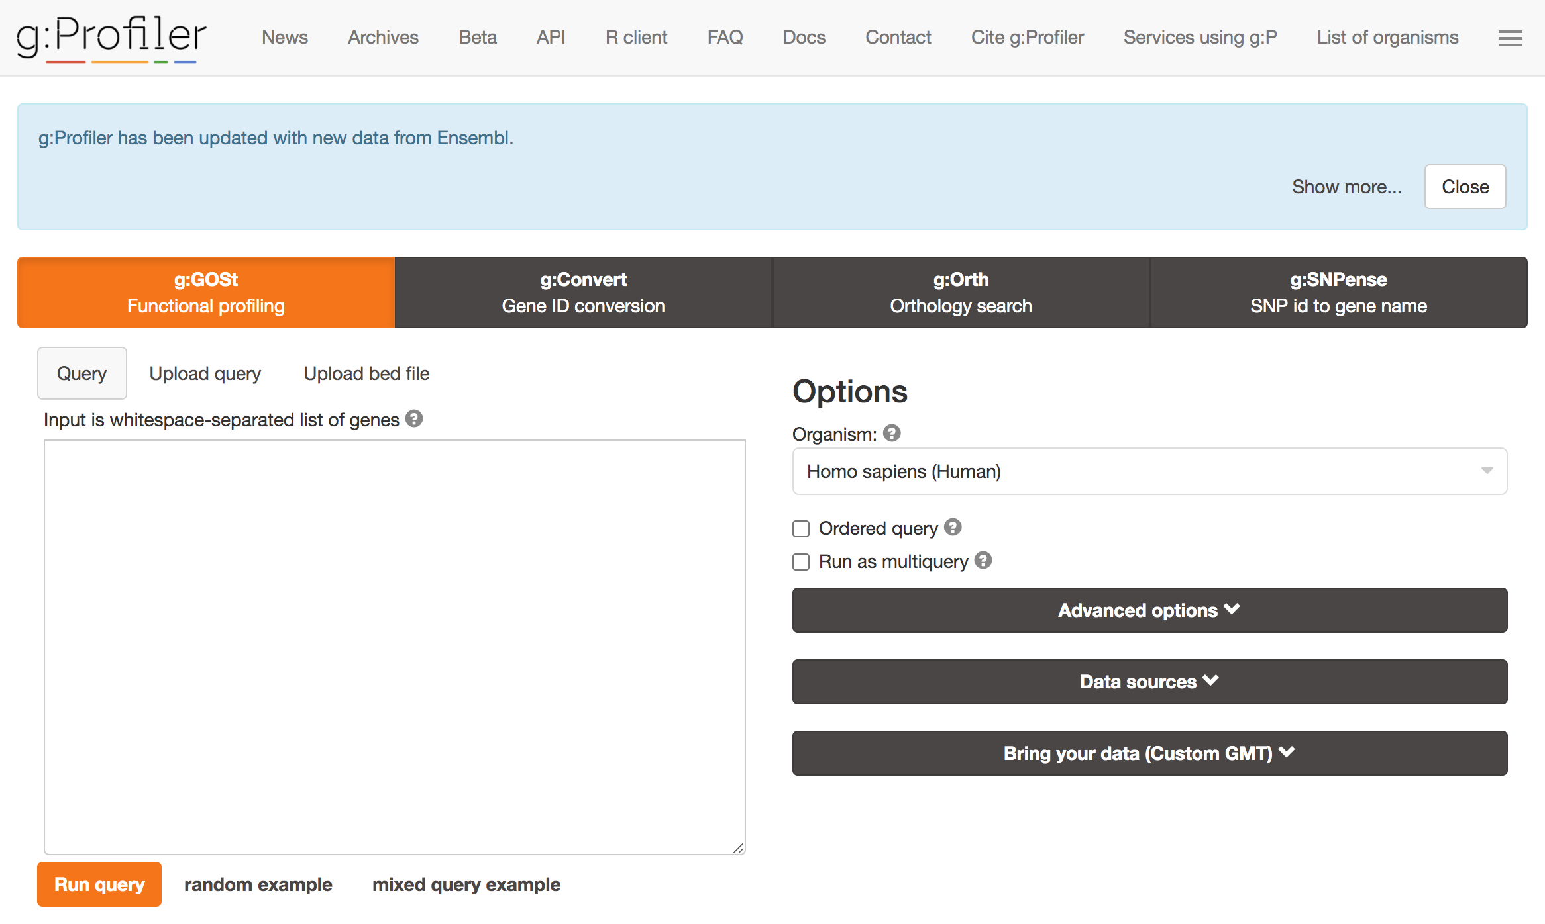
Programs to run GO over-representation analyses: gProfiler

Slide 44
Programs to run GO over-representation analyses: gProfiler
Also available in R!
Simple, but many optional parameters to optimize your search
gprofiler2::gost(
geneList,
organism = 'scerevisiae’
)

Slide 45
What if I don’t have a gene set of interest?
Sometimes, you cannot really decide what is significant or not
You don’t like the idea of taking the top 100 genes differently expressed genes
How to set a threshold for your genes? FC>2? FC>5? ???

Slide 46

Gene Set Enrichment Analysis: cutoff-free functional analysis of ranked lists of genes
GSEA (Gene Set Enrichment Analysis) uses a ranked list of genes as input
First gene
Last gene
Log2(FC)
0
~ 20,000 genes ordered by their fold-change vs. a control

Slide 47
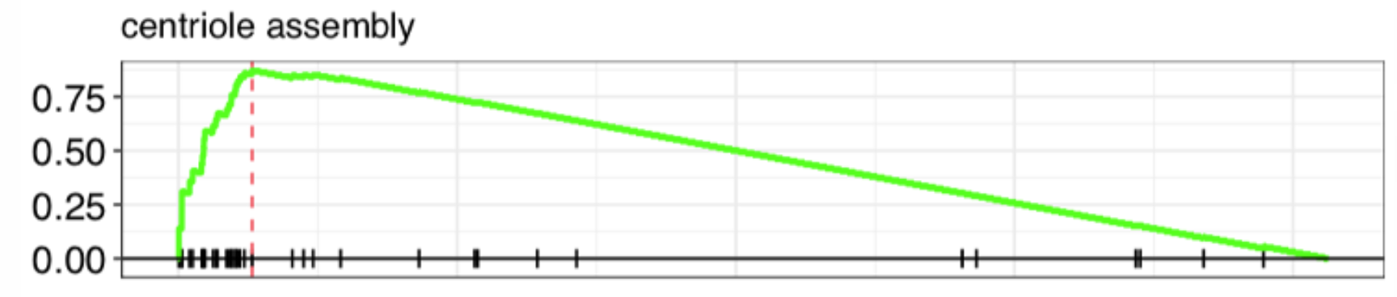
Gene Set Enrichment Analysis: cutoff-free functional analysis of ranked lists of genes
Within this list, it flags the genes belonging to a gene set (e.g. genes annotated in “centriole assembly” GO term)
First gene
Last gene
Log2(FC)
0
~ 20,000 genes ordered by their fold-change vs. a control

Slide 48
Gene Set Enrichment Analysis: cutoff-free functional analysis of ranked lists of genes
Based on the distribution of the flagged genes, it computes a “running score” and an “enrichment score”
Enrichment score
0.87
Running score
Log2(FC)
0
~ 20,000 genes ordered by their fold-change vs. a control

Slide 49
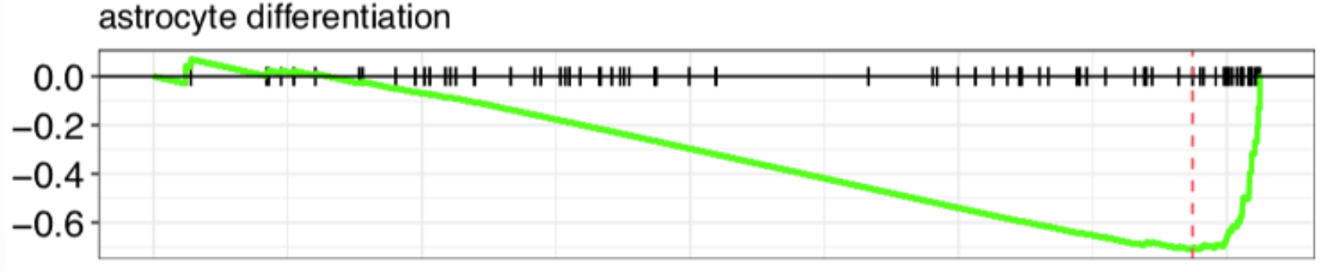
Gene Set Enrichment Analysis: cutoff-free functional analysis of ranked lists of genes
It can also find negative enrichment scores (indicated a depletion of genes of interest in the top of a ranked list)
Running score
-0.7
Enrichment score
Log2(FC)
0
~ 20,000 genes ordered by their fold-change vs. a control

Slide 50
How to perform GSEA?
Original software: in JAVA
I never managed to use it…

Slide 51
How to perform GSEA?
Original software: in JAVA
I never managed to use it…
Since then: many programmatic implementations notably in R
clusterProfiler is my personal favorite
Based on fgsea, the original GSEA implementation in R
Very complete and extensive doc
Nice visualization outputs
Well-integrated with GO ecosystem and other databases (disease ontology, Reactome, …)

Slide 52
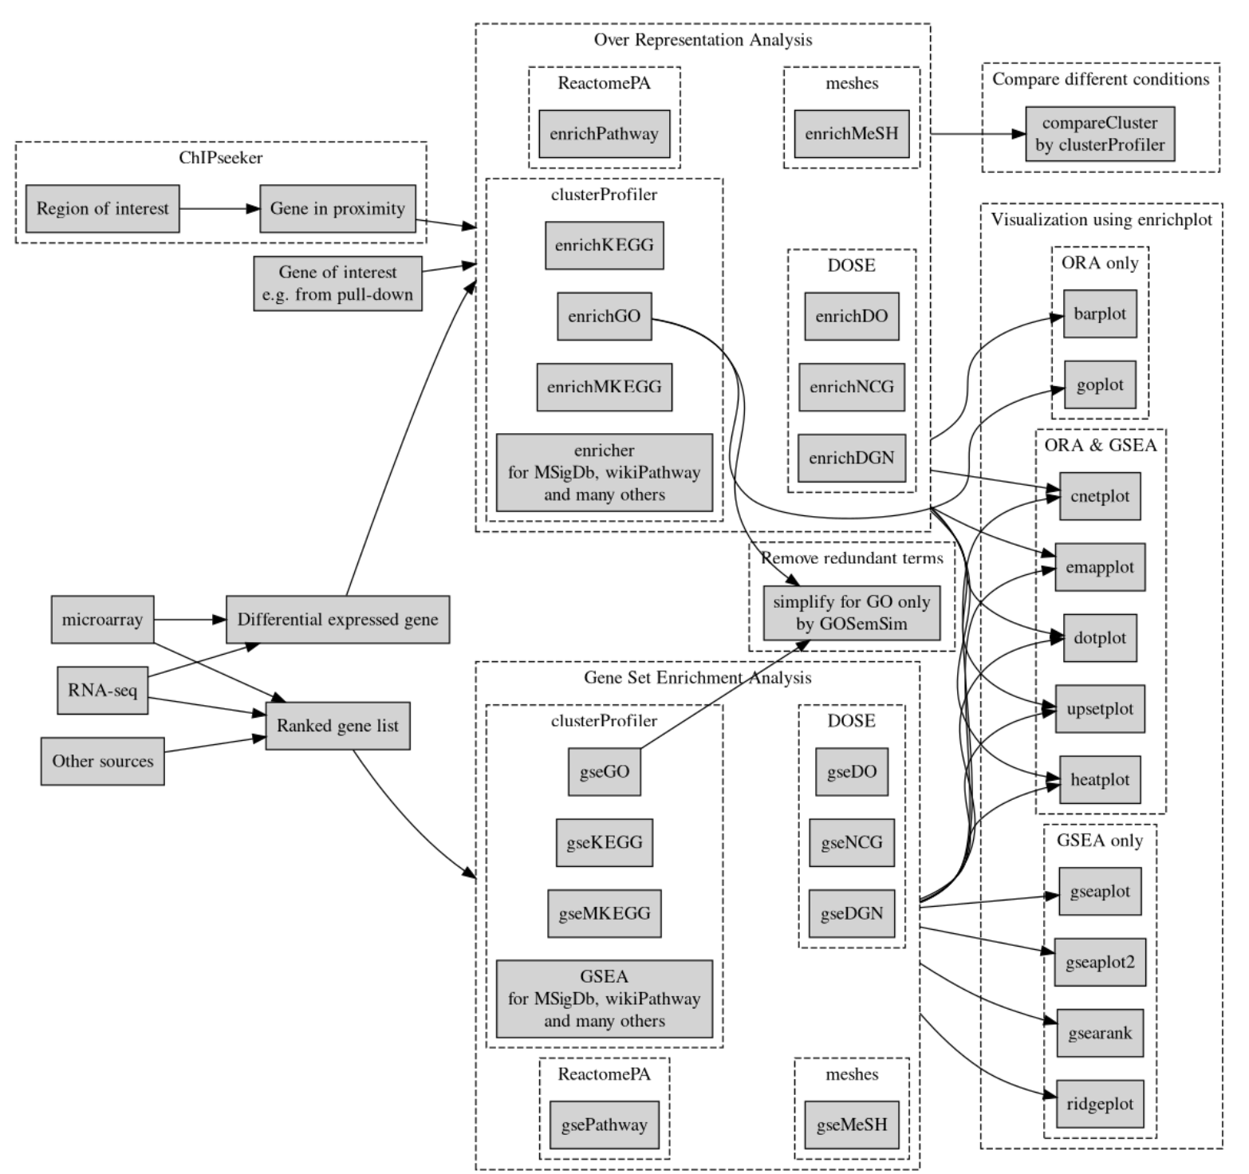
clusterProfiler
clusterProfiler is a rich set of tools to assess and visualize enrichment of a set of genes of interest compared to different databases

Slide 53
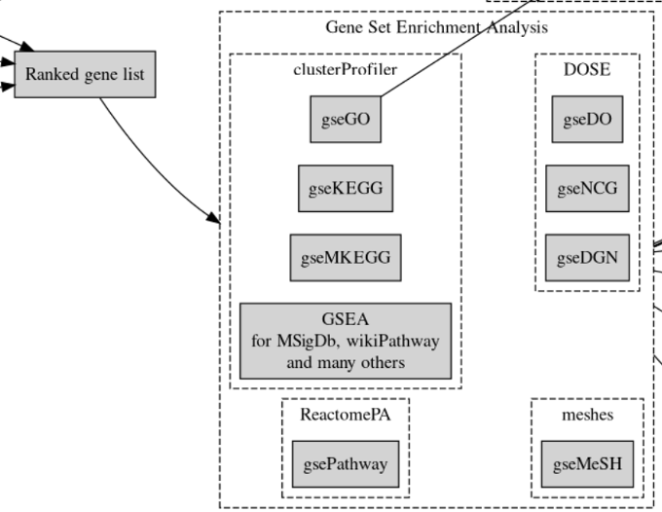
clusterProfiler
clusterProfiler provides multiple gse*() functions, based on the type of gene sets you want to use

Slide 54
clusterProfiler
clusterProfiler provides multiple gse*() functions, based on the type of gene sets you want to use
gseGO() compares your ranked list of genes to the reference up-to-date GO annotations
clusterProfiler::gseGO(
rankedGeneLit,
keyType = "ENSEMBL",
OrgDb = org.Sc.sgd.db::org.Sc.sgd.db
)

Slide 55
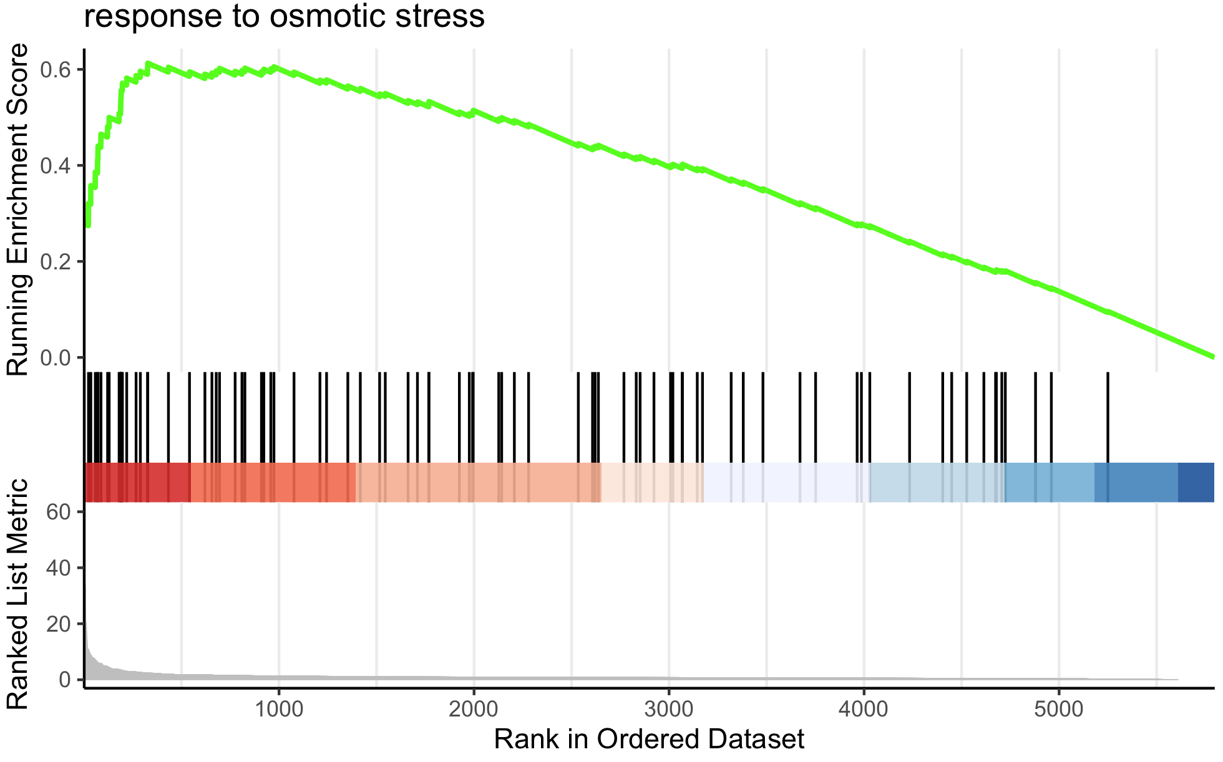
clusterProfiler
clusterProfiler provides plotting functions to check the results for a given GO term
TERM <- “response to osmotic stress”
enrichplot::gseaplot2(
gsea_results,
title = TERM,
geneSetID = which(gsea_results@result$Description == TERM)
)

Slide 56
Resources
Ten Quick Tips for Using the Gene Ontology, Blake PLoS Comp. Biol. 2013
clusterProfiler: universal enrichment tool for functional and comparative study, Guangchuang Yu (http://yulab-smu.top/clusterProfiler-book/)
Tip 1a: Know the Source of the GO Annotations You Use
Tip 1b: Know the Version of the GO Annotations You Use

