Slide 1
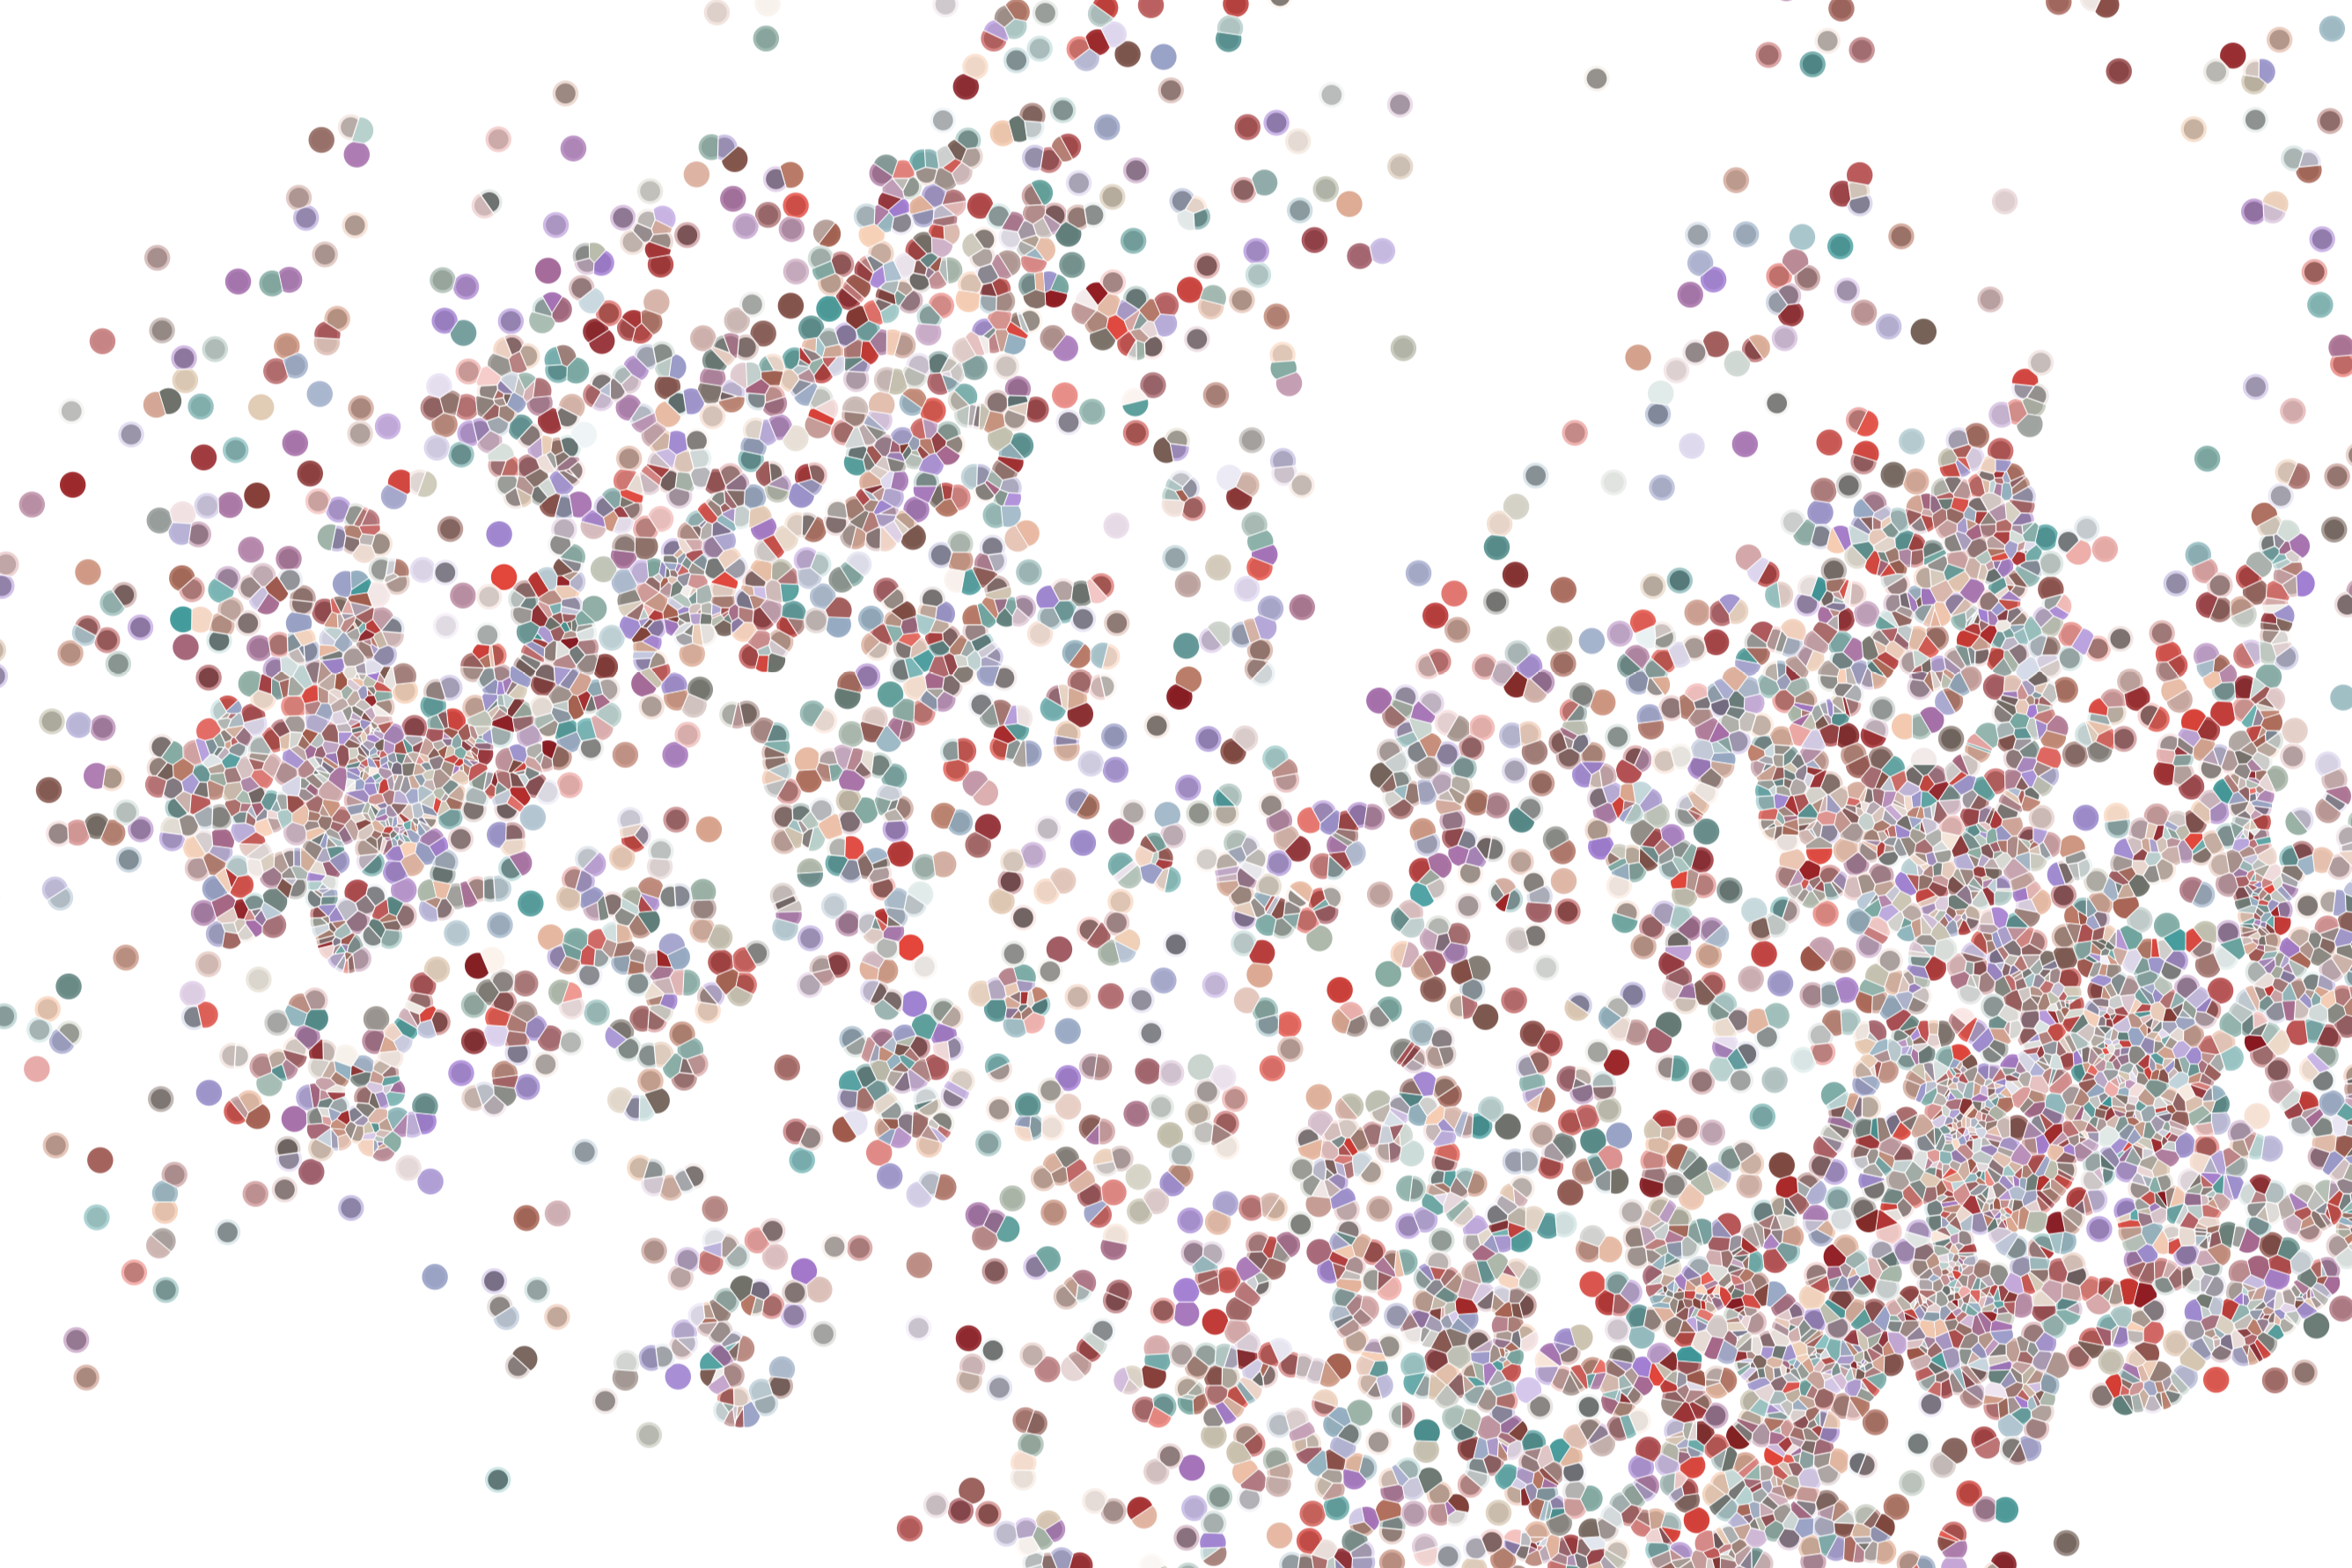
Lecture 1
Analysis of single-cell RNA-Seq data:
Experimental Design
Physalia course 2026
—
Single-cell RNA-seq with R/Bioconductor
Instructors: Orr Ashenberg, Jacques Serizay, Fabrício Almeida-Silva
Notes:
Hello everybody and thank you for attending my presentation. I am going to talk about the project I recently started working on in the Spassky and Koszul labs, both located in Paris. This project focuses on the unusual cooption of the mitotic machinery to drive, not cell division but cell differentiation.

Slide 2
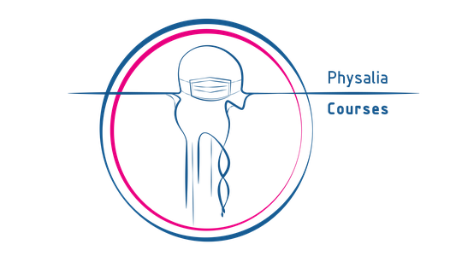
Overall goals
Introduction to the rapidly expanding world of single-cell transcriptomics
Focus less on specific software tools but more on underlying concepts - so down the line, you can make informed choices
Hands on lab exercises analyzing single-cell heterogeneity
Create a fun, learning, collaborative, and interactive environment over the next week
2
Notes:
I would like to expand these observations to in vivo data. I also want to check what happens in terms of transcriptional dynamics in cells where Cyclin O, a key non-canonical cyclin involved in MCC diff., is knocked-out.

Slide 3
A few organizational notes
Workshop link: https://jserizay.com/scRNAseq_Physalia_2025/
Ask questions or use chat! Raise hand in Zoom (Participants). Please use video, and mute microphone when not in use.
Write course notes and questions in a shared Google document. We will send you a link to store your flash talk.
Please be patient with technical issues (network, Zoom, etc...)
3
Notes:
I would like to expand these observations to in vivo data. I also want to check what happens in terms of transcriptional dynamics in cells where Cyclin O, a key non-canonical cyclin involved in MCC diff., is knocked-out.

Slide 4
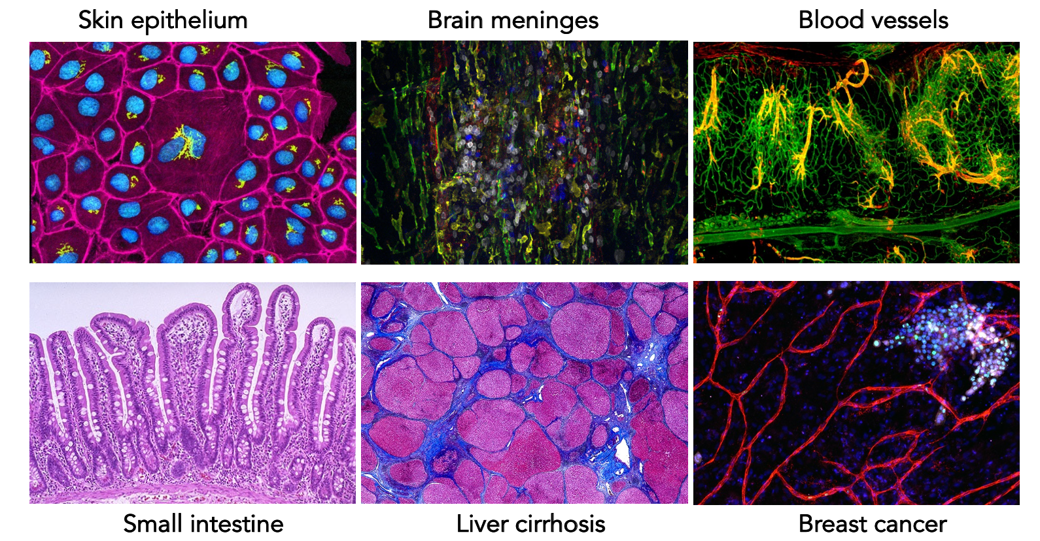
Incredible diversity in cell types, states, and interactions across human tissues
4
Notes:
I would like to expand these observations to in vivo data. I also want to check what happens in terms of transcriptional dynamics in cells where Cyclin O, a key non-canonical cyclin involved in MCC diff., is knocked-out.

Slide 5
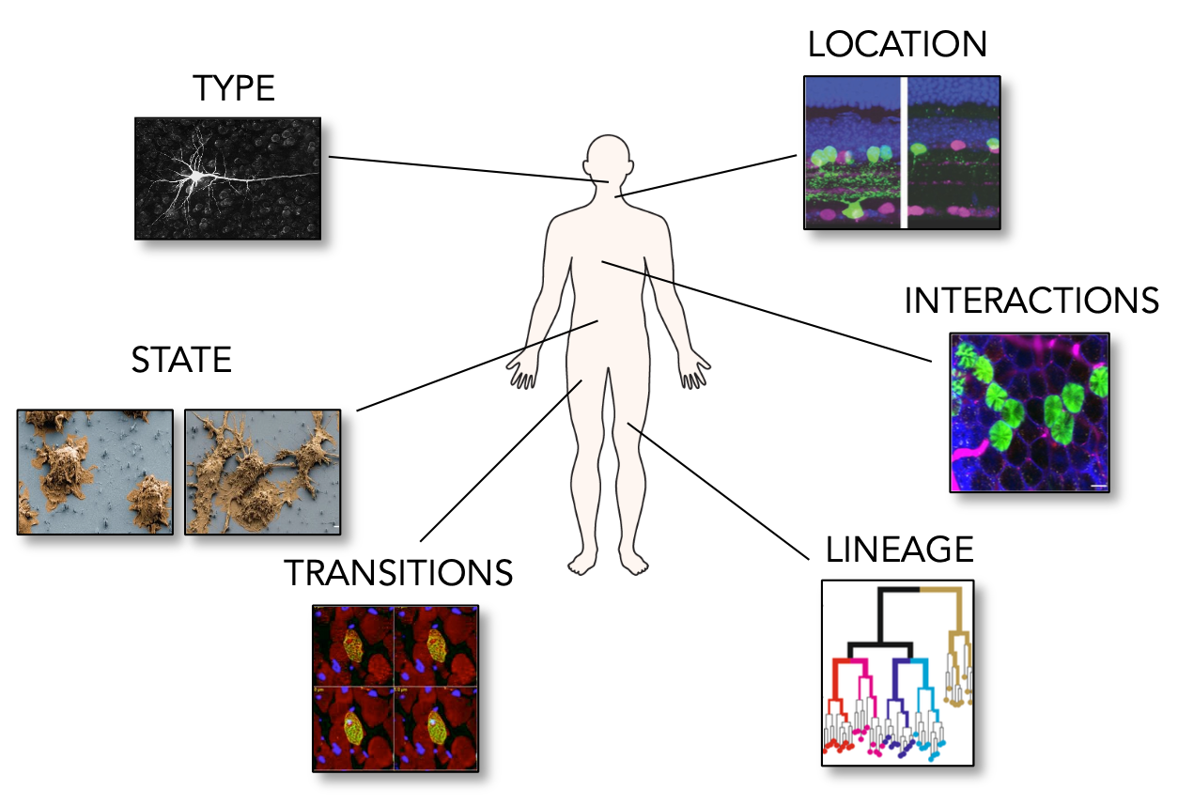
A cell’s identity and fate are shaped by many features
5
Notes:
I would like to expand these observations to in vivo data. I also want to check what happens in terms of transcriptional dynamics in cells where Cyclin O, a key non-canonical cyclin involved in MCC diff., is knocked-out.

Slide 6
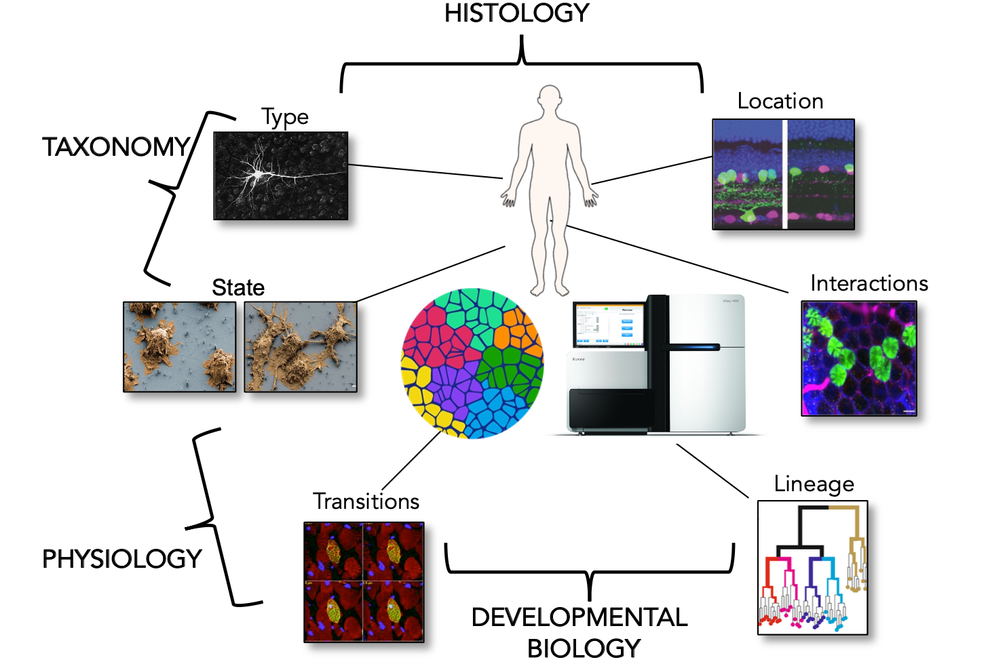
A cell’s identity and fate are shaped by many features
6
Notes:
I would like to expand these observations to in vivo data. I also want to check what happens in terms of transcriptional dynamics in cells where Cyclin O, a key non-canonical cyclin involved in MCC diff., is knocked-out.

Slide 7
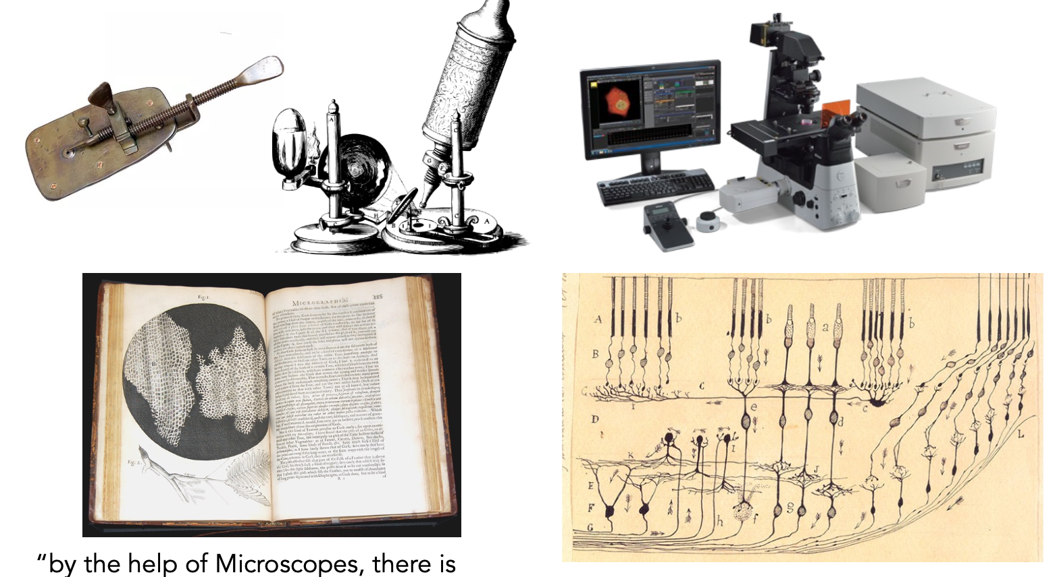
Technological innovations allow observation at increasing resolution
“by the help of Microscopes, there is nothing so small as to escape our inquiry” Robert Hooke
7
Notes:
I would like to expand these observations to in vivo data. I also want to check what happens in terms of transcriptional dynamics in cells where Cyclin O, a key non-canonical cyclin involved in MCC diff., is knocked-out.

Slide 8
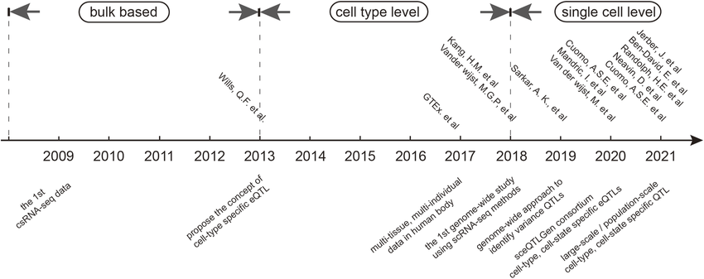
Last decade: emergence of single-cell transcriptomics
Luo et al. Front in Genet 2023
8
Notes:
I would like to expand these observations to in vivo data. I also want to check what happens in terms of transcriptional dynamics in cells where Cyclin O, a key non-canonical cyclin involved in MCC diff., is knocked-out.

Slide 9
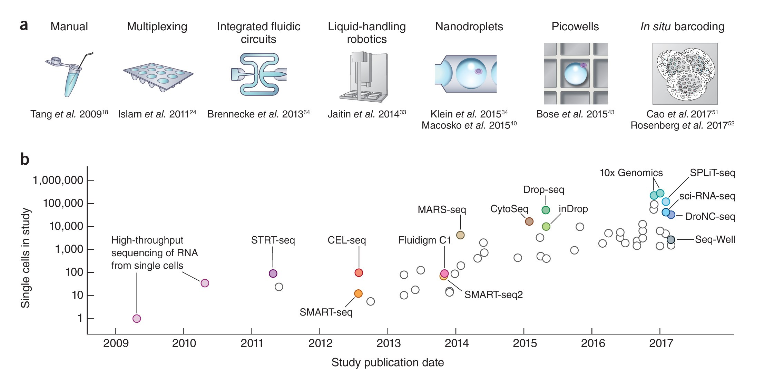
Single-cell RNA sequencing has grown exponentially
Svensson et al. Nat Protocols 2018
9
Notes:
I would like to expand these observations to in vivo data. I also want to check what happens in terms of transcriptional dynamics in cells where Cyclin O, a key non-canonical cyclin involved in MCC diff., is knocked-out.

Slide 10
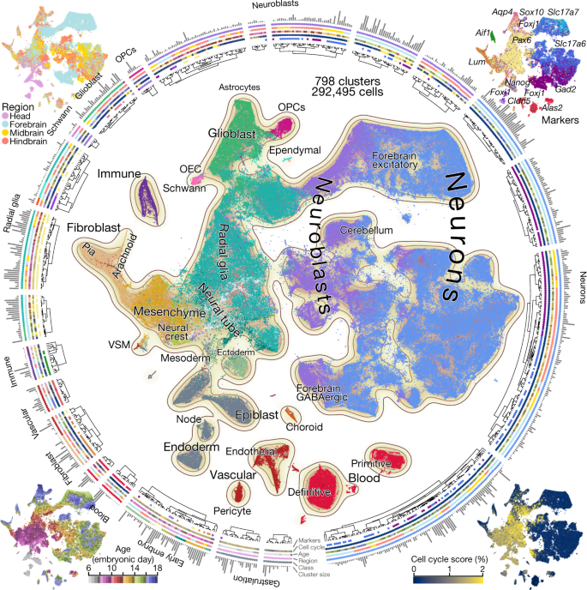
Molecular architecture of the developing mouse brain
Droplet-based single-cell RNA sequencing was used to profile the embryonic mouse brain each day between E7 and E18:
93 samples and 292,495 cells
La Manno et al. Nature 2021
10
Notes:
I would like to expand these observations to in vivo data. I also want to check what happens in terms of transcriptional dynamics in cells where Cyclin O, a key non-canonical cyclin involved in MCC diff., is knocked-out.

Slide 11
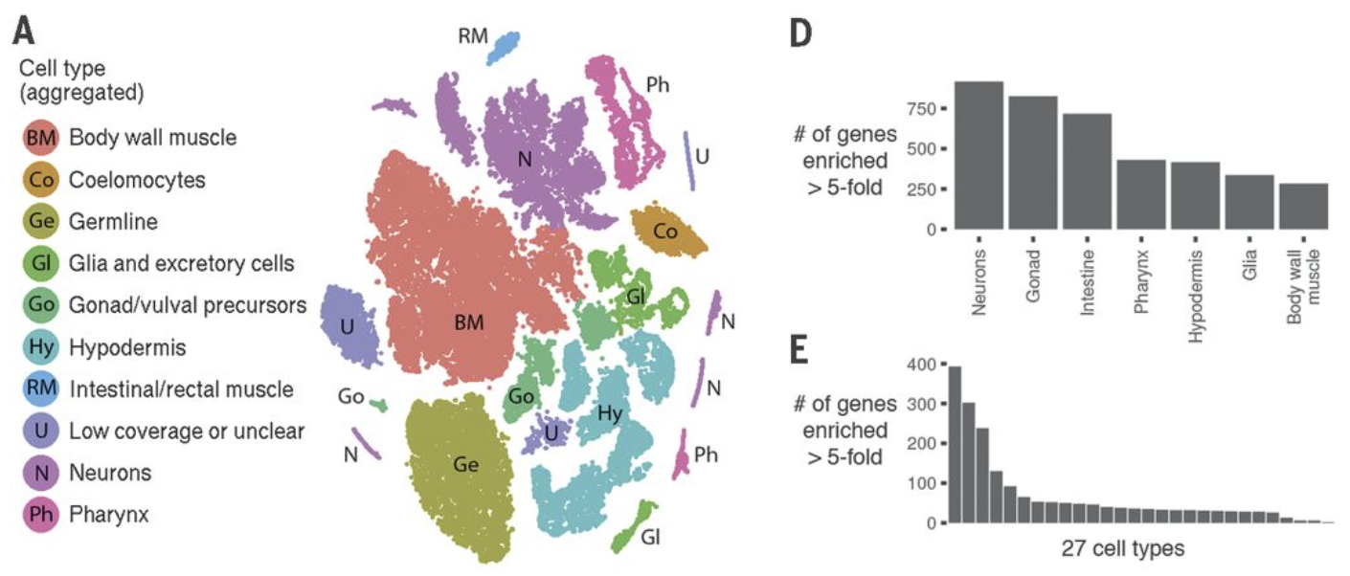
Comprehensive single-cell transcriptional profiling of a multicellular organism
sci-RNA-seq enables profiling of all tissues from a whole organism.
Cao, J., at al. Science 2017
11
Notes:
I would like to expand these observations to in vivo data. I also want to check what happens in terms of transcriptional dynamics in cells where Cyclin O, a key non-canonical cyclin involved in MCC diff., is knocked-out.

Slide 12
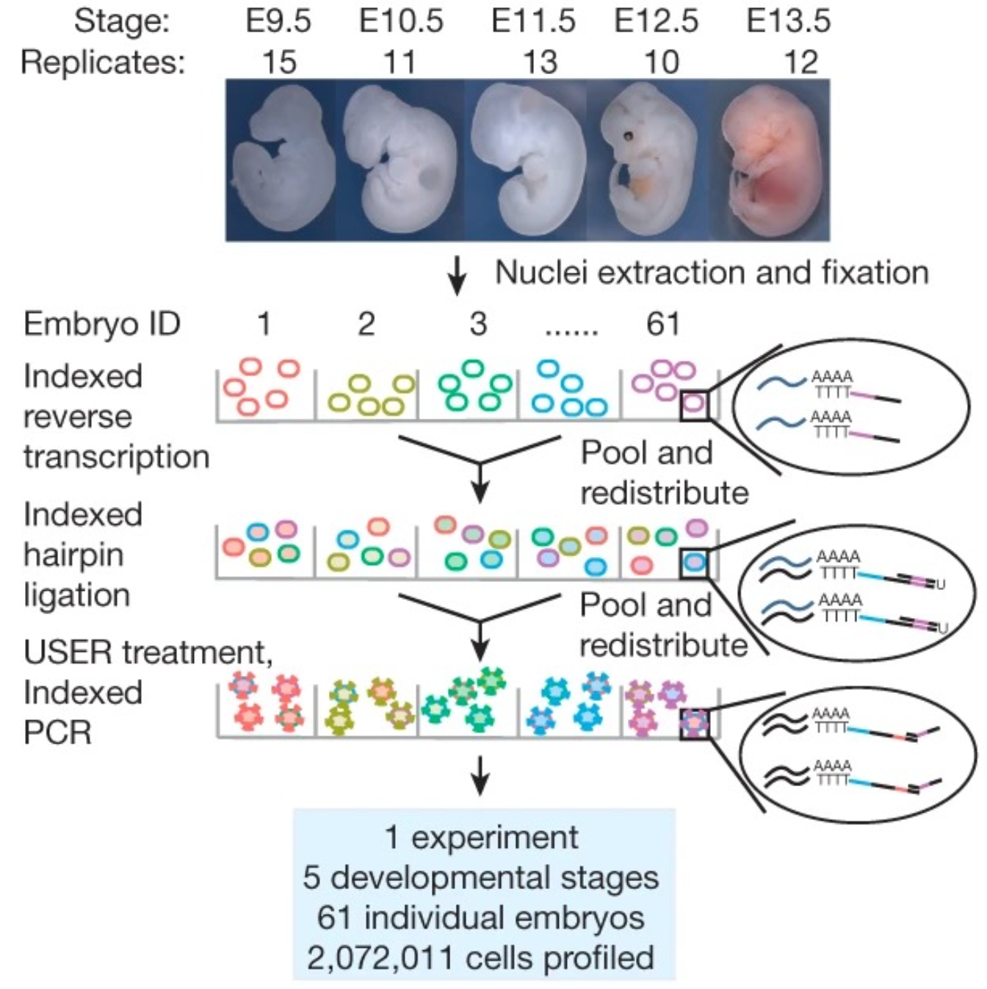
Mouse organogenesis studied by single-cell RNA sequencing
sci-RNA-seq3 enables profiling of 2,072,011 cells from 61 mouse embryos
across 5 developmental stages in a single experiment.
Cao, J., at al. Nature 2019
12
Notes:
I would like to expand these observations to in vivo data. I also want to check what happens in terms of transcriptional dynamics in cells where Cyclin O, a key non-canonical cyclin involved in MCC diff., is knocked-out.

Slide 13
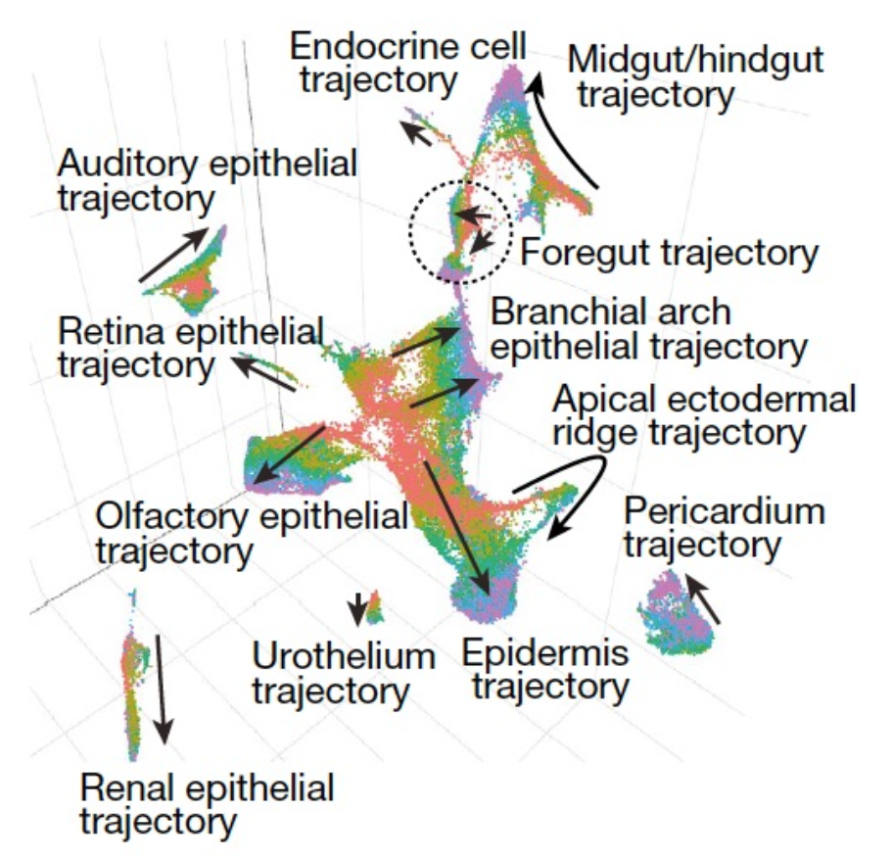
Mouse organogenesis studied by single-cell RNA sequencing
sci-RNA-seq3 enables profiling of 2,072,011 cells from 61 mouse embryos
across 5 developmental stages in a single experiment.
Cao, J., at al. Nature 2019
13
Notes:
I would like to expand these observations to in vivo data. I also want to check what happens in terms of transcriptional dynamics in cells where Cyclin O, a key non-canonical cyclin involved in MCC diff., is knocked-out.

Slide 14
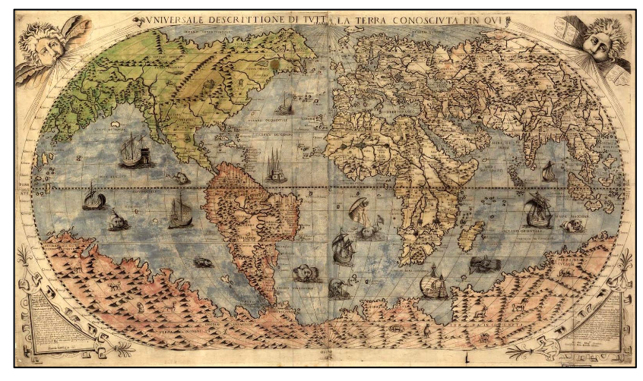
Why so much profiling?
To create a comprehensive reference map of the types and properties of all human cells, the fundamental unit of life, as a basis for understanding, diagnosing, monitoring, and treating health and disease.
"The vestiges of the rupture reveal themselves, if someone brings forward a map of the world and considers carefully the coasts of the three [continents].”
Dutch map maker Abraham Ortelius (1596)
14
Notes:
I would like to expand these observations to in vivo data. I also want to check what happens in terms of transcriptional dynamics in cells where Cyclin O, a key non-canonical cyclin involved in MCC diff., is knocked-out.

Slide 15
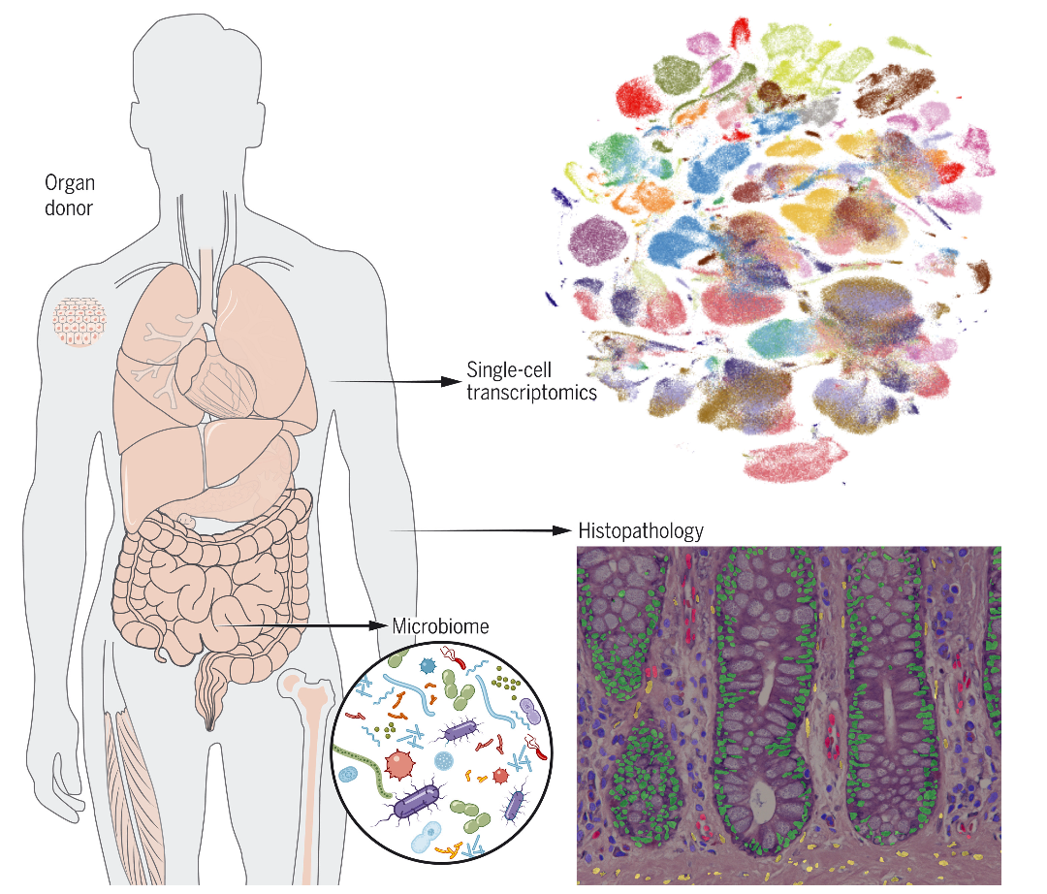
A series of human cell atlases published in May 2022
500,000 cells from 24 different tissues and organs
The Tabula Sapiens Consortium. Science 2022
15
Notes:
I would like to expand these observations to in vivo data. I also want to check what happens in terms of transcriptional dynamics in cells where Cyclin O, a key non-canonical cyclin involved in MCC diff., is knocked-out.

Slide 16
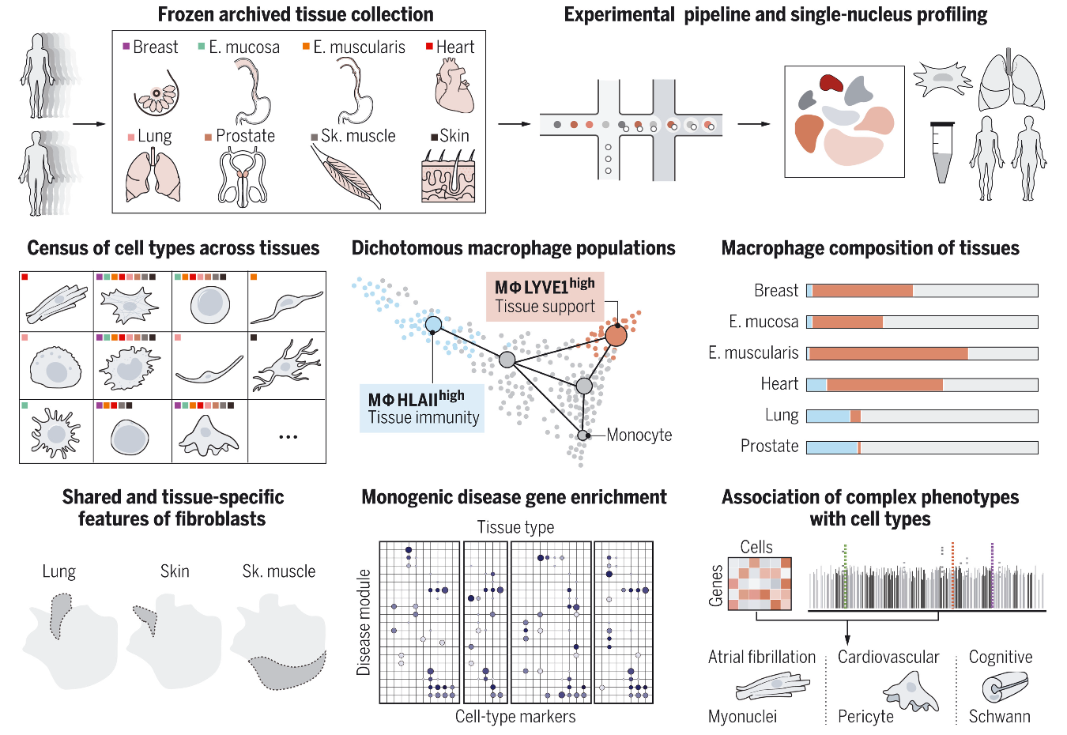
A series of human cell atlases published in May 2022
500,000 cells from 24 different tissues and organs
Association of cell types and states with human disease
Eraslan et al. Science 2022
16
Notes:
I would like to expand these observations to in vivo data. I also want to check what happens in terms of transcriptional dynamics in cells where Cyclin O, a key non-canonical cyclin involved in MCC diff., is knocked-out.

Slide 17
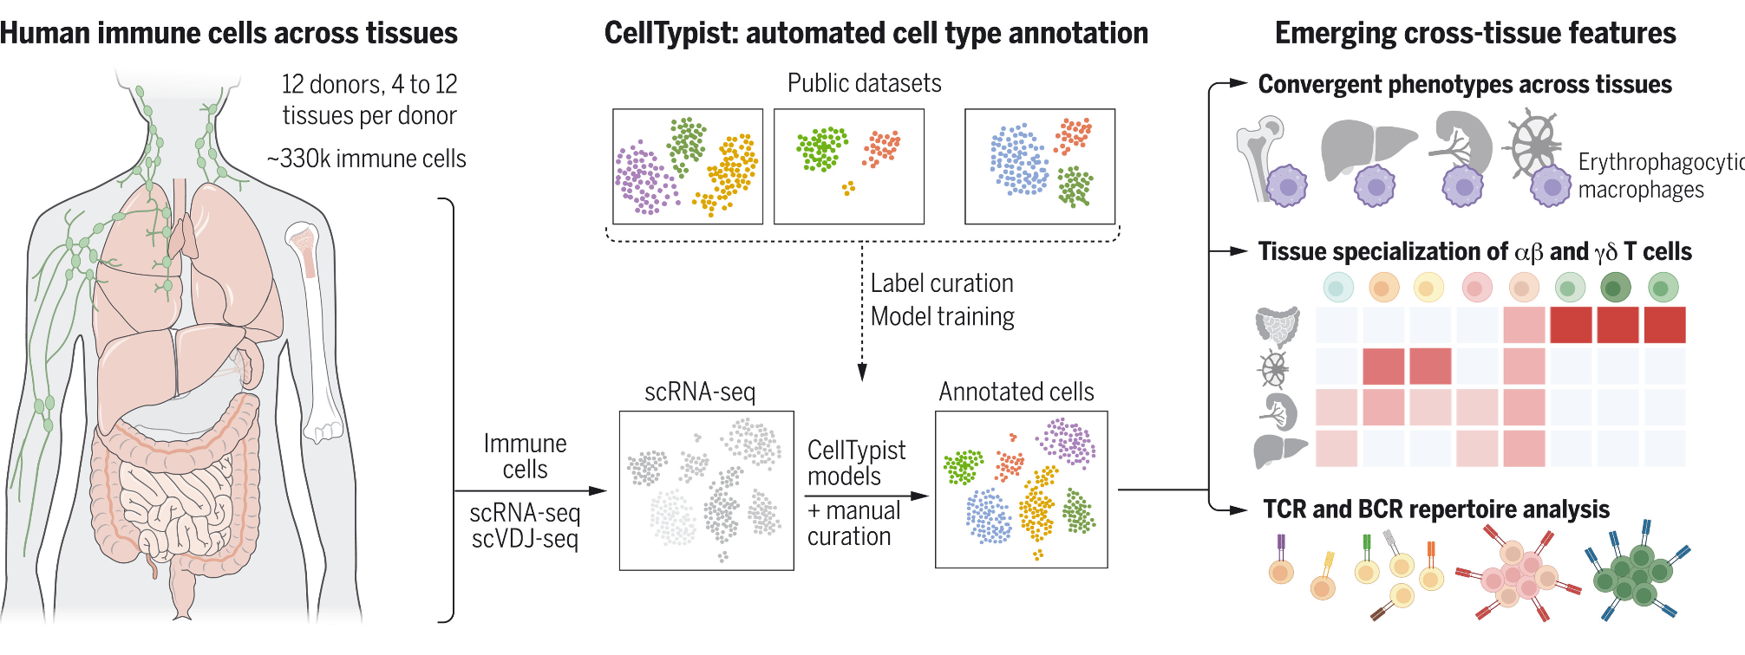
A series of human cell atlases published in May 2022
500,000 cells from 24 different tissues and organs
Association of cell types and states with human disease
300,000 immune cells from 16 different tissues
Domínguez Conde et al. Science 2022
17
Notes:
I would like to expand these observations to in vivo data. I also want to check what happens in terms of transcriptional dynamics in cells where Cyclin O, a key non-canonical cyclin involved in MCC diff., is knocked-out.

Slide 18
A series of human cell atlases published in May 2022
500,000 cells from 24 different tissues and organs
Association of cell types and states with human disease
300,000 immune cells from 16 different tissues
Domínguez Conde et al. Science 2022
18
Notes:
I would like to expand these observations to in vivo data. I also want to check what happens in terms of transcriptional dynamics in cells where Cyclin O, a key non-canonical cyclin involved in MCC diff., is knocked-out.

Slide 19
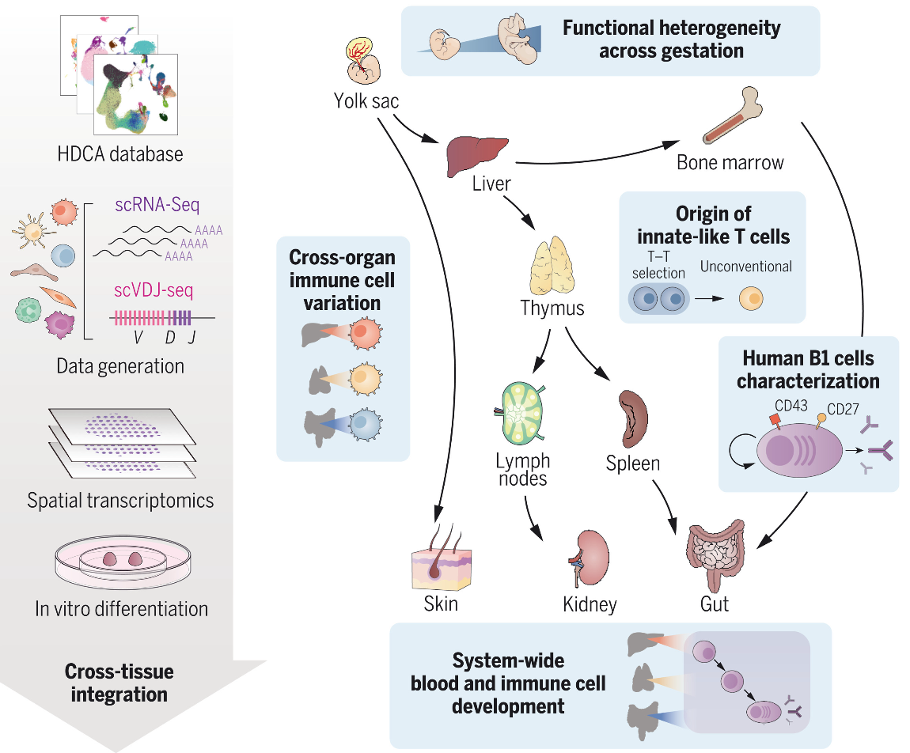
A series of human cell atlases published in May 2022
500,000 cells from 24 different tissues and organs
Association of cell types and states with human disease
300,000 immune cells from 16 different tissues
Developing human immune system
Suo et al. Science 2022
19
Notes:
I would like to expand these observations to in vivo data. I also want to check what happens in terms of transcriptional dynamics in cells where Cyclin O, a key non-canonical cyclin involved in MCC diff., is knocked-out.

Slide 20
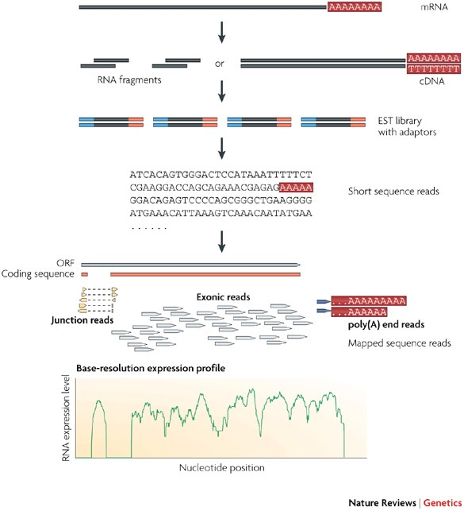
Typical RNA-seq workflow, bulk
Wang et al., Nat. Rev. Genet. 2009
20
Notes:
I would like to expand these observations to in vivo data. I also want to check what happens in terms of transcriptional dynamics in cells where Cyclin O, a key non-canonical cyclin involved in MCC diff., is knocked-out.

Slide 21
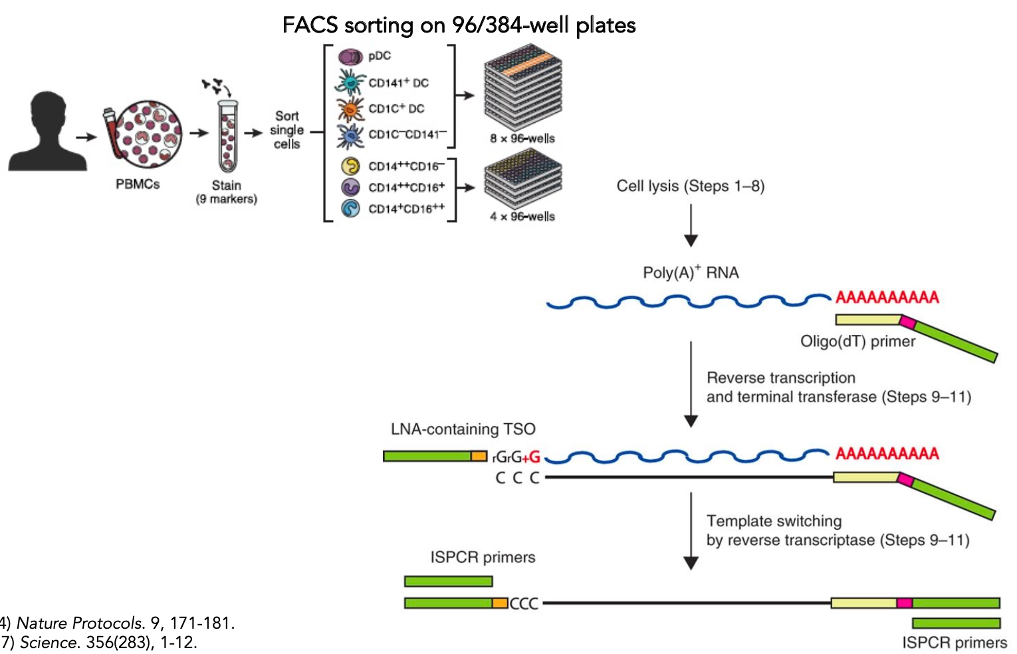
Typical RNA-seq workflow, single-cell
Picelli et al. Nat Protocols 2014; Villani et al. Science 2017
21
Notes:
I would like to expand these observations to in vivo data. I also want to check what happens in terms of transcriptional dynamics in cells where Cyclin O, a key non-canonical cyclin involved in MCC diff., is knocked-out.

Slide 22
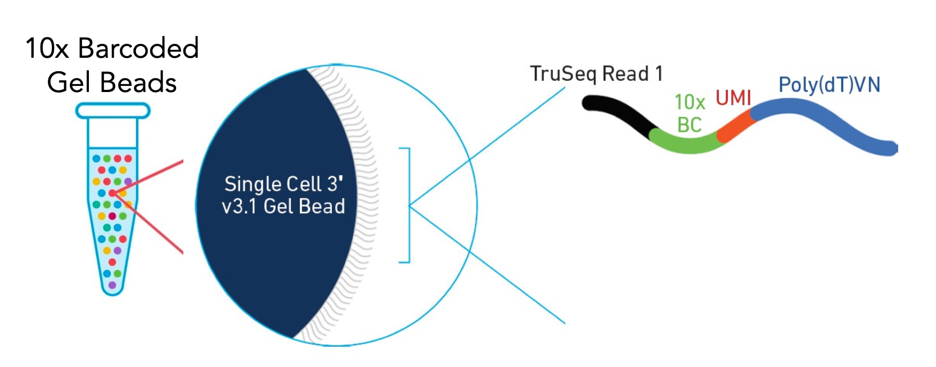
Typical RNA-seq workflow, single-cell (2)
10X genomics
22
Notes:
I would like to expand these observations to in vivo data. I also want to check what happens in terms of transcriptional dynamics in cells where Cyclin O, a key non-canonical cyclin involved in MCC diff., is knocked-out.

Slide 23
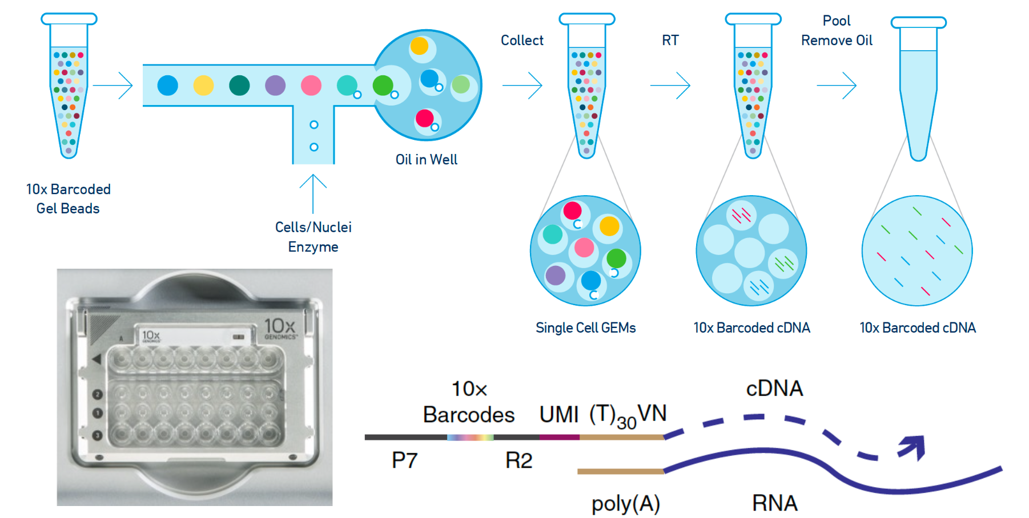
Typical RNA-seq workflow, single-cell (2)
10X genomics
23
Notes:
I would like to expand these observations to in vivo data. I also want to check what happens in terms of transcriptional dynamics in cells where Cyclin O, a key non-canonical cyclin involved in MCC diff., is knocked-out.

Slide 24
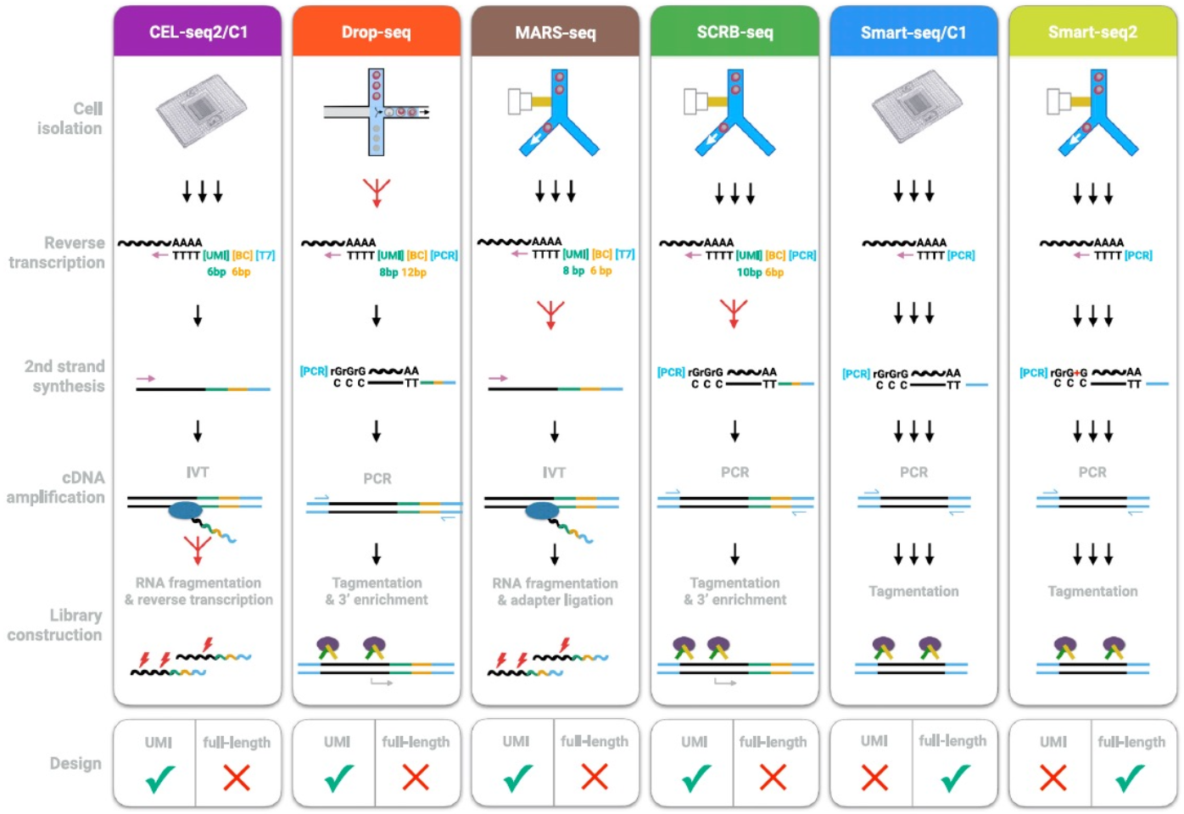
There are many single-cell RNA sequencing methods
Ziegenhain et al. Mol Cell 2017
24
Notes:
I would like to expand these observations to in vivo data. I also want to check what happens in terms of transcriptional dynamics in cells where Cyclin O, a key non-canonical cyclin involved in MCC diff., is knocked-out.

Slide 25
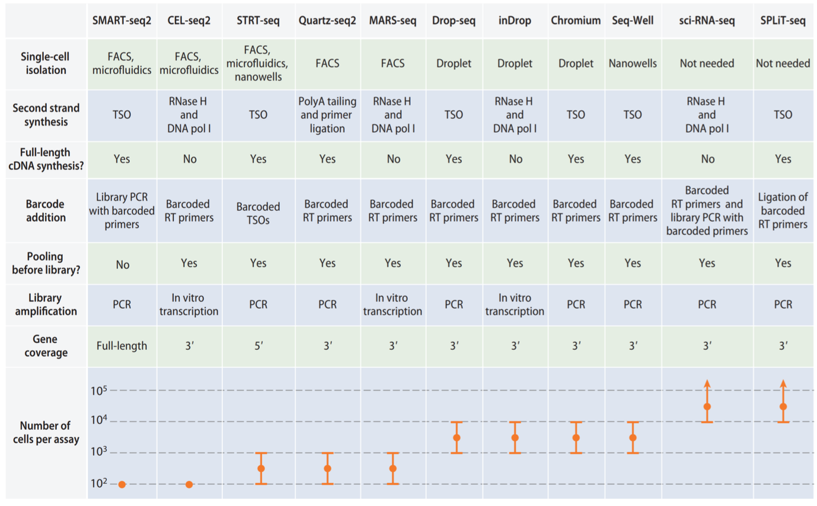
There are many single-cell RNA sequencing methods
Chen et al. Ann Rev of Biomed Data Sci 2018
25
Notes:
I would like to expand these observations to in vivo data. I also want to check what happens in terms of transcriptional dynamics in cells where Cyclin O, a key non-canonical cyclin involved in MCC diff., is knocked-out.

Slide 26
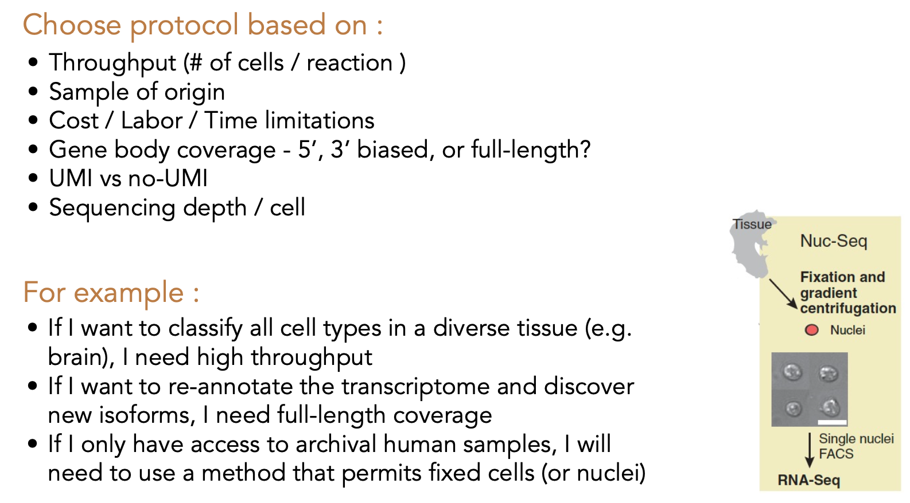
Considerations for single cell RNA-Seq
Habib et al. Science 2016
26
Notes:
I would like to expand these observations to in vivo data. I also want to check what happens in terms of transcriptional dynamics in cells where Cyclin O, a key non-canonical cyclin involved in MCC diff., is knocked-out.

Slide 27
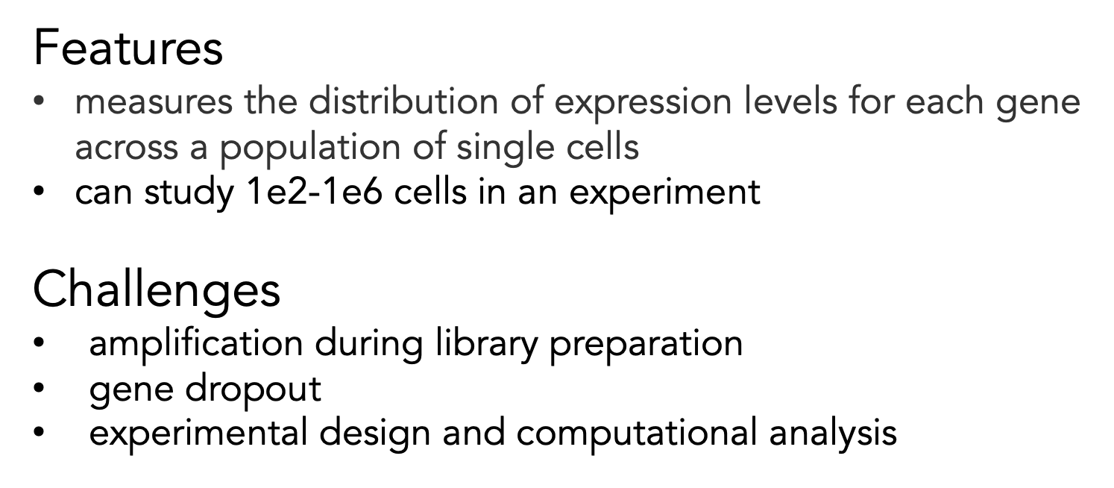
Some unique features and challenges of single cell RNA-Seq
Habib et al. Science 2016
27
Notes:
I would like to expand these observations to in vivo data. I also want to check what happens in terms of transcriptional dynamics in cells where Cyclin O, a key non-canonical cyclin involved in MCC diff., is knocked-out.

Slide 28
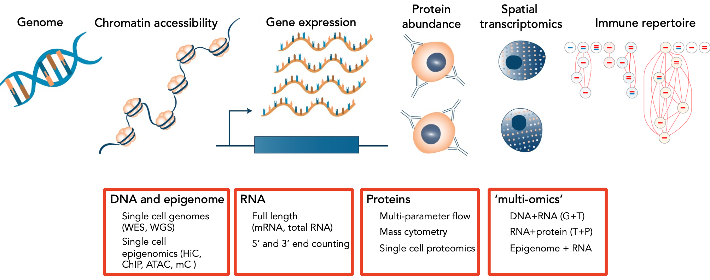
Ongoing developments in single-cell genomics: Many other molecules from single cells may be profiled
Efremova et al. Nat Methods 2020
28
Notes:
I would like to expand these observations to in vivo data. I also want to check what happens in terms of transcriptional dynamics in cells where Cyclin O, a key non-canonical cyclin involved in MCC diff., is knocked-out.

Slide 29
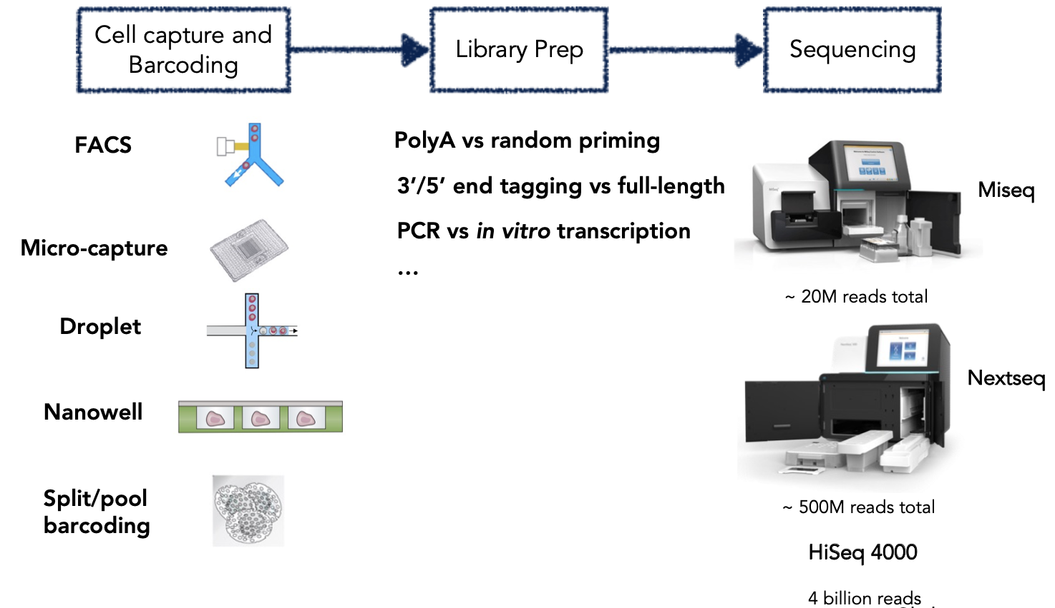
scRNAseq requires combination of wet and dry lab expertise
29
Notes:
I would like to expand these observations to in vivo data. I also want to check what happens in terms of transcriptional dynamics in cells where Cyclin O, a key non-canonical cyclin involved in MCC diff., is knocked-out.

Slide 30
A few singlecell resources
Comprehensive list of single-cell resources
https://github.com/seandavi/awesome-single-cell https://www.scrna-tools.org/
Computational packages for single-cell analysis
https://satijalab.org/seurat/
https://scanpy.readthedocs.io/
https://bioconductor.org/books/release/OSCA/
eLife Commentary on the Human Cell Atlas (HCA) https://elifesciences.org/articles/27041
Nature Commentary on the HCA https://www.nature.com/news/the-human-cell-atlas-from-vision-to-reality-1.22854
Online courses
https://bioconductor.org/books/release/OSCA/
https://lmweber.org/OSTA-book/
https://uppsala.instructure.com/courses/52011
Single cell data repositories
http://jinglebells.bgu.ac.il/
https://tabula-sapiens-portal.ds.czbiohub.org/
https://www.nxn.se/single-cell-studies/gui
https://tabula-muris.ds.czbiohub.org/
https://data.humancellatlas.org/
30
Notes:
I would like to expand these observations to in vivo data. I also want to check what happens in terms of transcriptional dynamics in cells where Cyclin O, a key non-canonical cyclin involved in MCC diff., is knocked-out.

Slide 31
Flash talk instructions
Each one of us will give a 1 minute, 1 slide presentation on a question that they are interested in, which could benefit from single-cell RNA-Seq. It can be an area you are currently investigating, something you are broadly interested in and wish to explore in the near future, or an idea for future projects.
The goal of this is for all of us to get to know each other a little more, and for you to see the diversity of research possibilities in this area.
Please prepare a 1 slide pdf for Tuesday, and place the pdf in the shared Google drive.
Include your name in the filename, and please ask for any clarifications.
31
Notes:
I would like to expand these observations to in vivo data. I also want to check what happens in terms of transcriptional dynamics in cells where Cyclin O, a key non-canonical cyclin involved in MCC diff., is knocked-out.

Slide 32

Any question?

