Slide 1
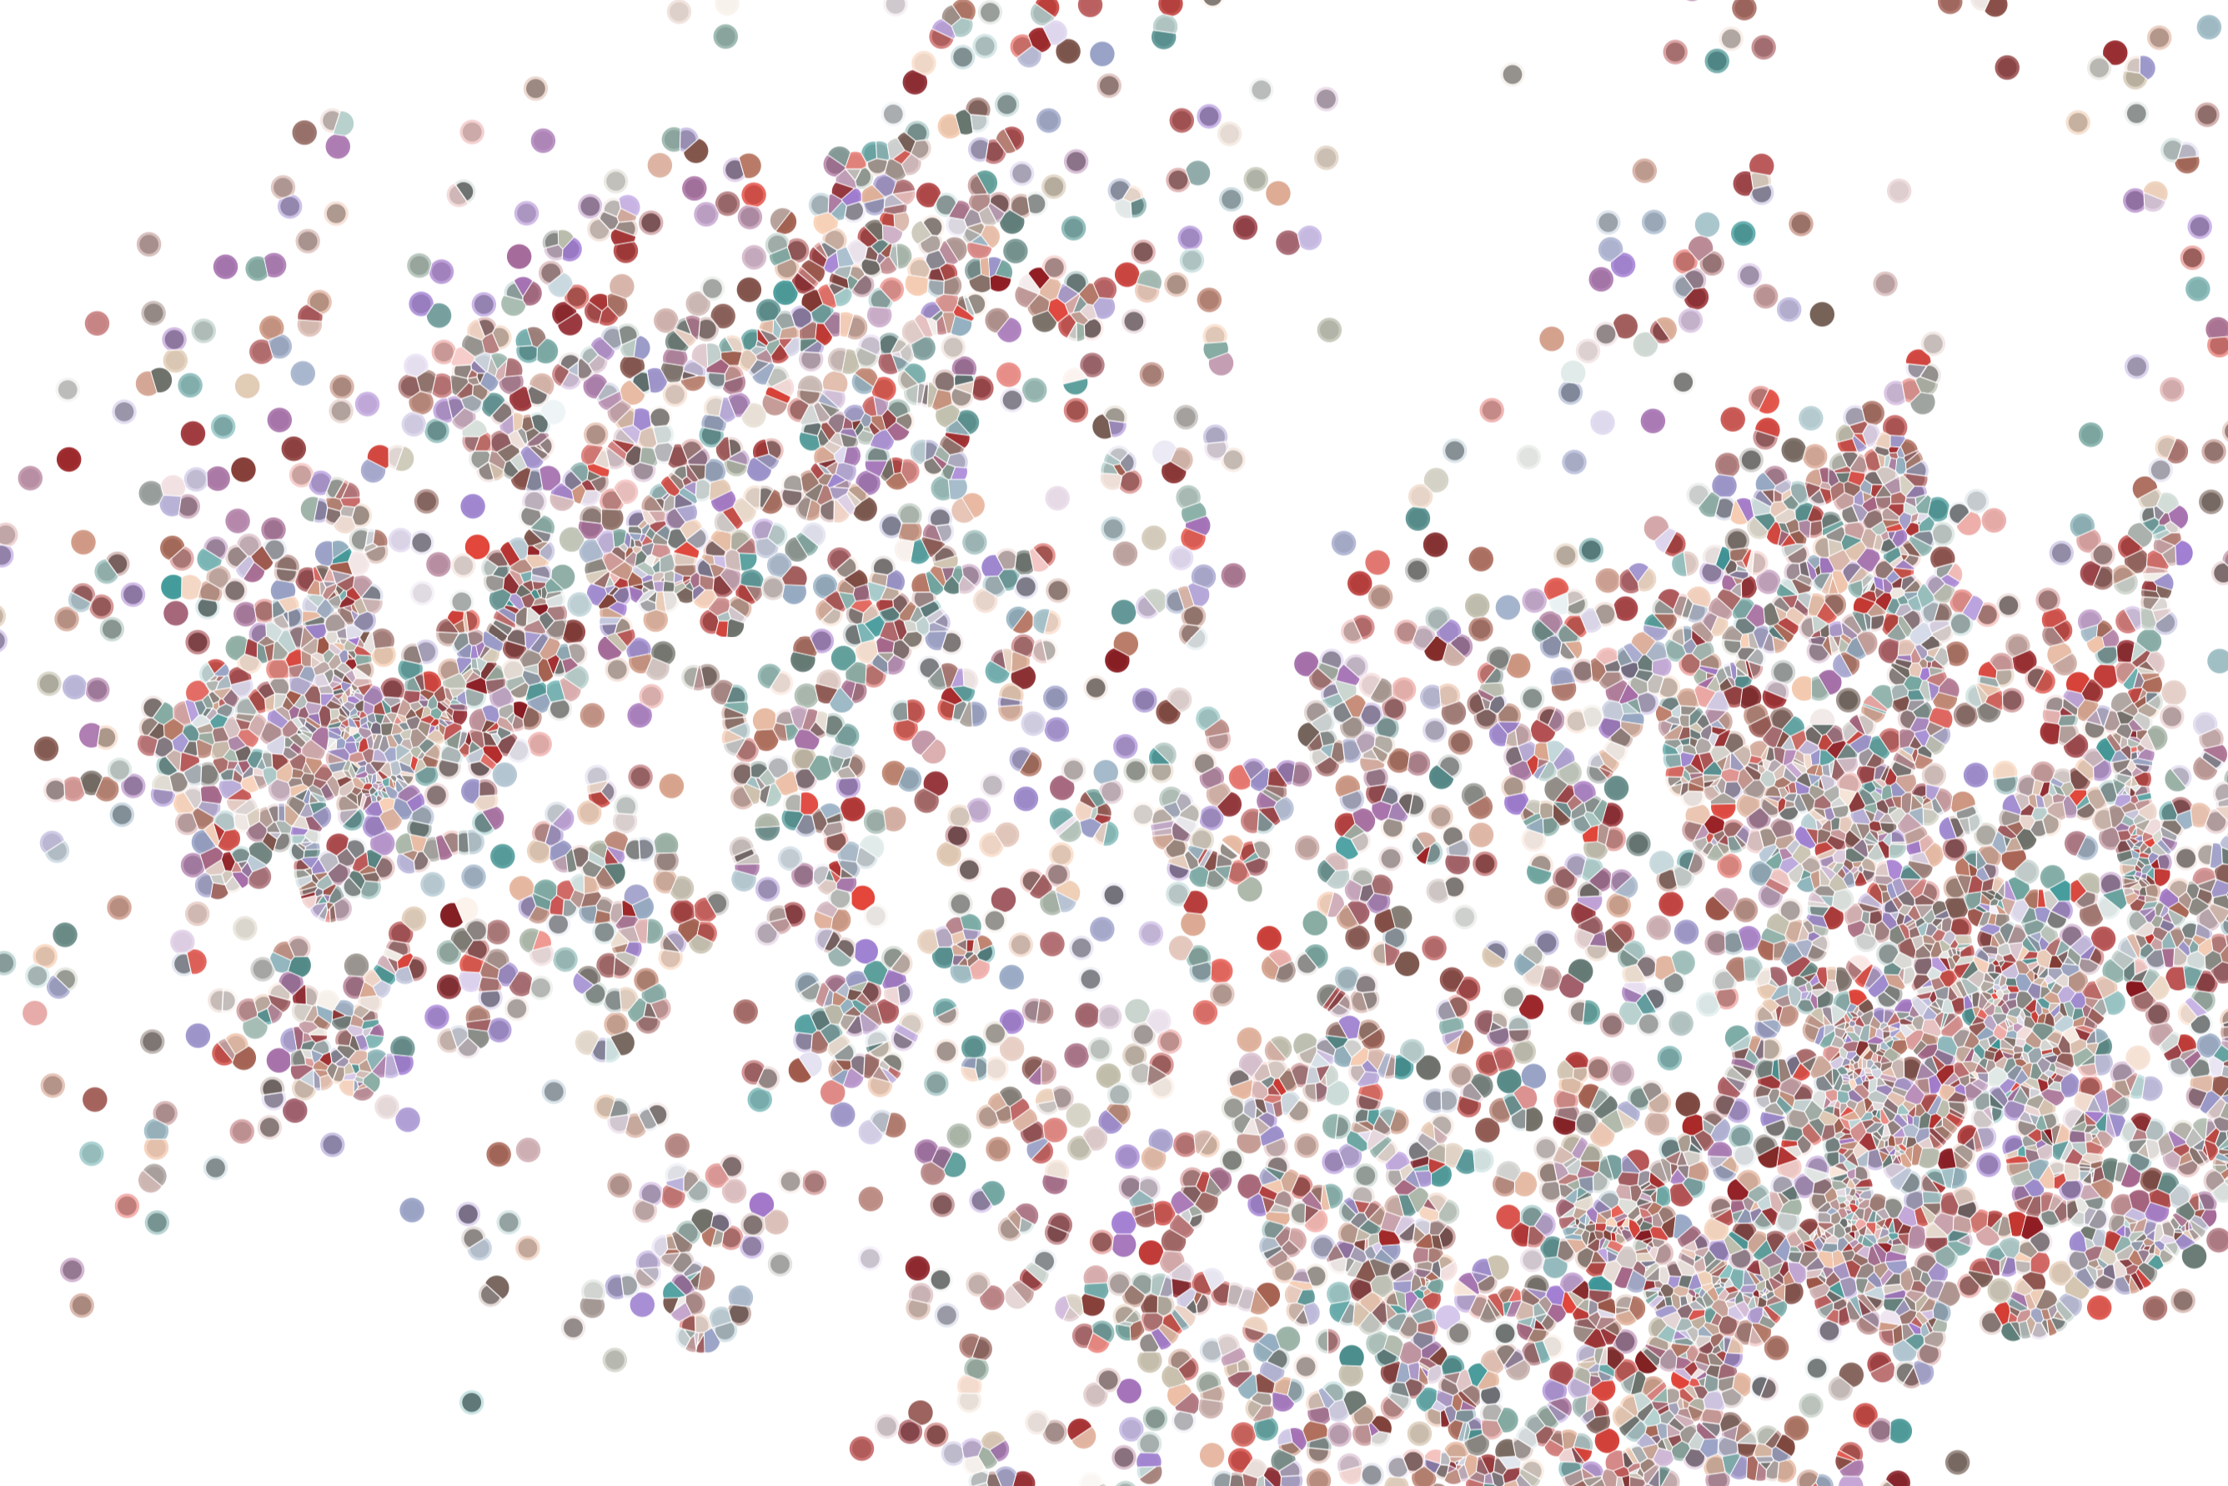
Lecture 2
Intro to Data processing:
From bcl to count matrix
Physalia course 2026
—
Single-cell RNA-seq with R/Bioconductor
Instructors: Orr Ashenberg, Jacques Serizay, Fabrício Almeida-Silva
Notes:
Hello everybody and thank you for attending my presentation. I am going to talk about the project I recently started working on in the Spassky and Koszul labs, both located in Paris. This project focuses on the unusual cooption of the mitotic machinery to drive, not cell division but cell differentiation.

Slide 2


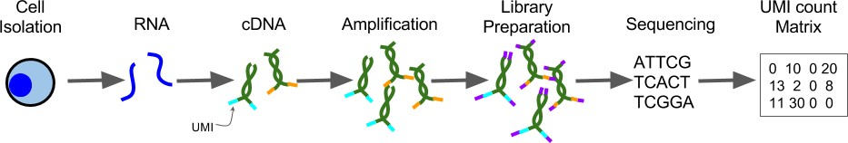
Experimental pipeline
Processing
Regardless of who is going to do the experimental steps, DISCUSS WITH THEM !!!
Experimental design is crucial for the success of a single-cell project !!!
Systematic comparison of single-cell and single-nucleus RNA-sequencing methods, Ding et al., Nat. Biotech. 2020
Notes:
I would like to expand these observations to in vivo data. I also want to check what happens in terms of transcriptional dynamics in cells where Cyclin O, a key non-canonical cyclin involved in MCC diff., is knocked-out.

Slide 3

Flowchart: from .bcl to count matrix
Get bcl file
bcl files – result of sequencing
Create fastq files
fastq files – R1, R2 and I files showing raw reads
QC: assess overall quality
QC: remove low quality reads
Align fastq to BAM
bam file – reads aligned to a reference genome
QC: collapse UMI
View alignment
Count matrix
count matrix – cell by gene, showing expression of gene in cell
3
Notes:
I would like to expand these observations to in vivo data. I also want to check what happens in terms of transcriptional dynamics in cells where Cyclin O, a key non-canonical cyclin involved in MCC diff., is knocked-out.

Slide 4
Flowchart: from .bcl to count matrix
Get bcl file
Create fastq files
QC: assess overall quality
QC: remove low quality reads
Align fastq to BAM
QC: collapse UMI
View alignment
Count matrix
4
Notes:
I would like to expand these observations to in vivo data. I also want to check what happens in terms of transcriptional dynamics in cells where Cyclin O, a key non-canonical cyclin involved in MCC diff., is knocked-out.

Slide 5
.bcl files
.bcl:
Raw data output of a sequencing run
Binary, non-human-readable file
Contains the base calling and quality score per cluster per sequencing lane
Notes:
I would like to expand these observations to in vivo data. I also want to check what happens in terms of transcriptional dynamics in cells where Cyclin O, a key non-canonical cyclin involved in MCC diff., is knocked-out.

Slide 6
Flowchart: from .bcl to count matrix
Get bcl file
That is the role of the sequencing machine!
Create fastq files
QC: assess overall quality
QC: remove low quality reads
Align fastq to BAM
QC: collapse UMI
View alignment
Count matrix
6
Notes:
I would like to expand these observations to in vivo data. I also want to check what happens in terms of transcriptional dynamics in cells where Cyclin O, a key non-canonical cyclin involved in MCC diff., is knocked-out.

Slide 7
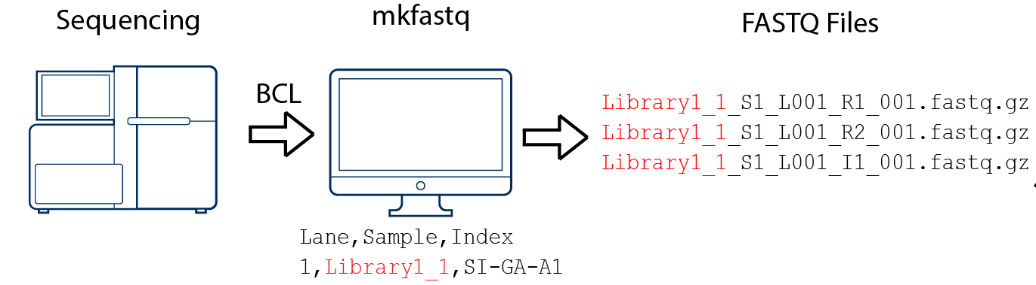
bcl2fastq
Command:
bcl2fastq --run-folder-dir <bcl_files_folder> -p 12 --output-dir <fastq_files_folder>
User guide:
https://support.illumina.com/content/dam/illumina-support/documents/documentation/software_documentation/bcl2fastq/bcl2fastq_letterbooklet_15038058brpmi.pdf
Notes:
I would like to expand these observations to in vivo data. I also want to check what happens in terms of transcriptional dynamics in cells where Cyclin O, a key non-canonical cyclin involved in MCC diff., is knocked-out.

Slide 8
bcl2fastq
Command:
bcl2fastq --run-folder-dir <bcl_files_folder> -p 12 --output-dir <fastq_files_folder>
User guide:
https://support.illumina.com/content/dam/illumina-support/documents/documentation/software_documentation/bcl2fastq/bcl2fastq_letterbooklet_15038058brpmi.pdf
Notes:
I would like to expand these observations to in vivo data. I also want to check what happens in terms of transcriptional dynamics in cells where Cyclin O, a key non-canonical cyclin involved in MCC diff., is knocked-out.

Slide 9
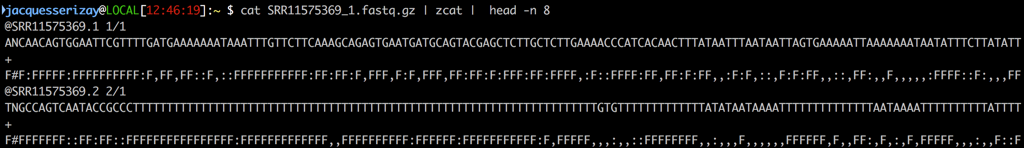
How is a .fastq organized?
Each fastq file contains reads, each read is composed of 4 lines:
A sequence identifier with information about the sequencing run
The sequence (the base calls; A, C, T, G and N).
A separator, which is simply a plus (+) sign.
The base call quality scores, using ASCII characters to represent the numerical quality scores.
Notes:
I would like to expand these observations to in vivo data. I also want to check what happens in terms of transcriptional dynamics in cells where Cyclin O, a key non-canonical cyclin involved in MCC diff., is knocked-out.

Slide 10
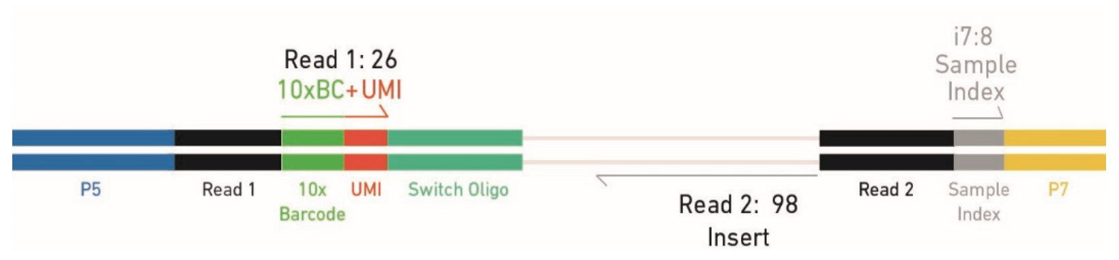
Why do we end up with so many fastq files?
We sequence the paired ends of each DNA fragment molecule, in 3 different sequencing “runs”.
R1.fastq
R2.fastq
I1.fastq
Notes:
I would like to expand these observations to in vivo data. I also want to check what happens in terms of transcriptional dynamics in cells where Cyclin O, a key non-canonical cyclin involved in MCC diff., is knocked-out.

Slide 11
I1 is important for demultiplexing multiple samples simultaneously sequenced
Each fastq generated by bcl2fastq contains a different information:
I1.fastq contains sample index
R1.fastq contains cell barcode + UMI
R2.fatsq contains transcript information
R1.fastq
R2.fastq
I1.fastq
Notes:
I would like to expand these observations to in vivo data. I also want to check what happens in terms of transcriptional dynamics in cells where Cyclin O, a key non-canonical cyclin involved in MCC diff., is knocked-out.

Slide 12
R1 contains information on the cell of origin (as well as a UMI)
Each fastq generated by bcl2fastq contains a different information:
I1.fastq contains sample index
R1.fastq contains cell barcode + UMI
R2.fatsq contains transcript information
R1.fastq
R2.fastq
I1.fastq
Notes:
I would like to expand these observations to in vivo data. I also want to check what happens in terms of transcriptional dynamics in cells where Cyclin O, a key non-canonical cyclin involved in MCC diff., is knocked-out.

Slide 13
R2 contains sequence of the DNA fragment captured by sequencing
Each fastq generated by bcl2fastq contains a different information:
I1.fastq contains sample index
R1.fastq contains cell barcode + UMI
R2.fatsq contains transcript information
R1.fastq
R2.fastq
I1.fastq
Notes:
I would like to expand these observations to in vivo data. I also want to check what happens in terms of transcriptional dynamics in cells where Cyclin O, a key non-canonical cyclin involved in MCC diff., is knocked-out.

Slide 14
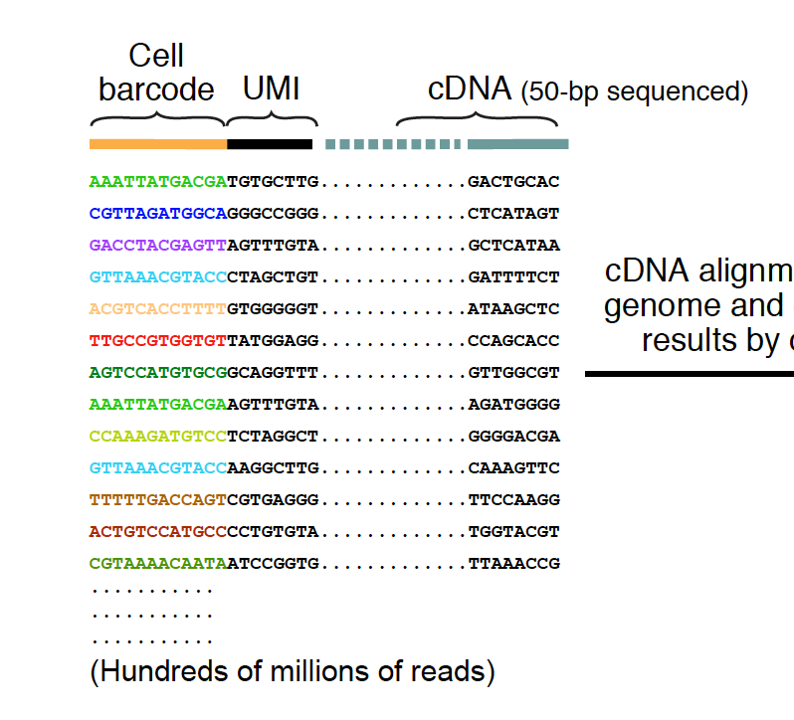
Reconstructing actual molecules loaded in the sequencer
After demultiplexing (thanks to the I1 file), here is what you have:
R1.fastq
R2.fastq
Notes:
I would like to expand these observations to in vivo data. I also want to check what happens in terms of transcriptional dynamics in cells where Cyclin O, a key non-canonical cyclin involved in MCC diff., is knocked-out.

Slide 15
Flowchart: from .bcl to count matrix
Get bcl file
That is the role of the sequencing machine!
Create fastq files
bcl2fastq
Create fastq files
QC: assess overall quality
QC: remove low quality reads
Align fastq to BAM
QC: collapse UMI
View alignment
Count matrix
15
Notes:
I would like to expand these observations to in vivo data. I also want to check what happens in terms of transcriptional dynamics in cells where Cyclin O, a key non-canonical cyclin involved in MCC diff., is knocked-out.

Slide 16
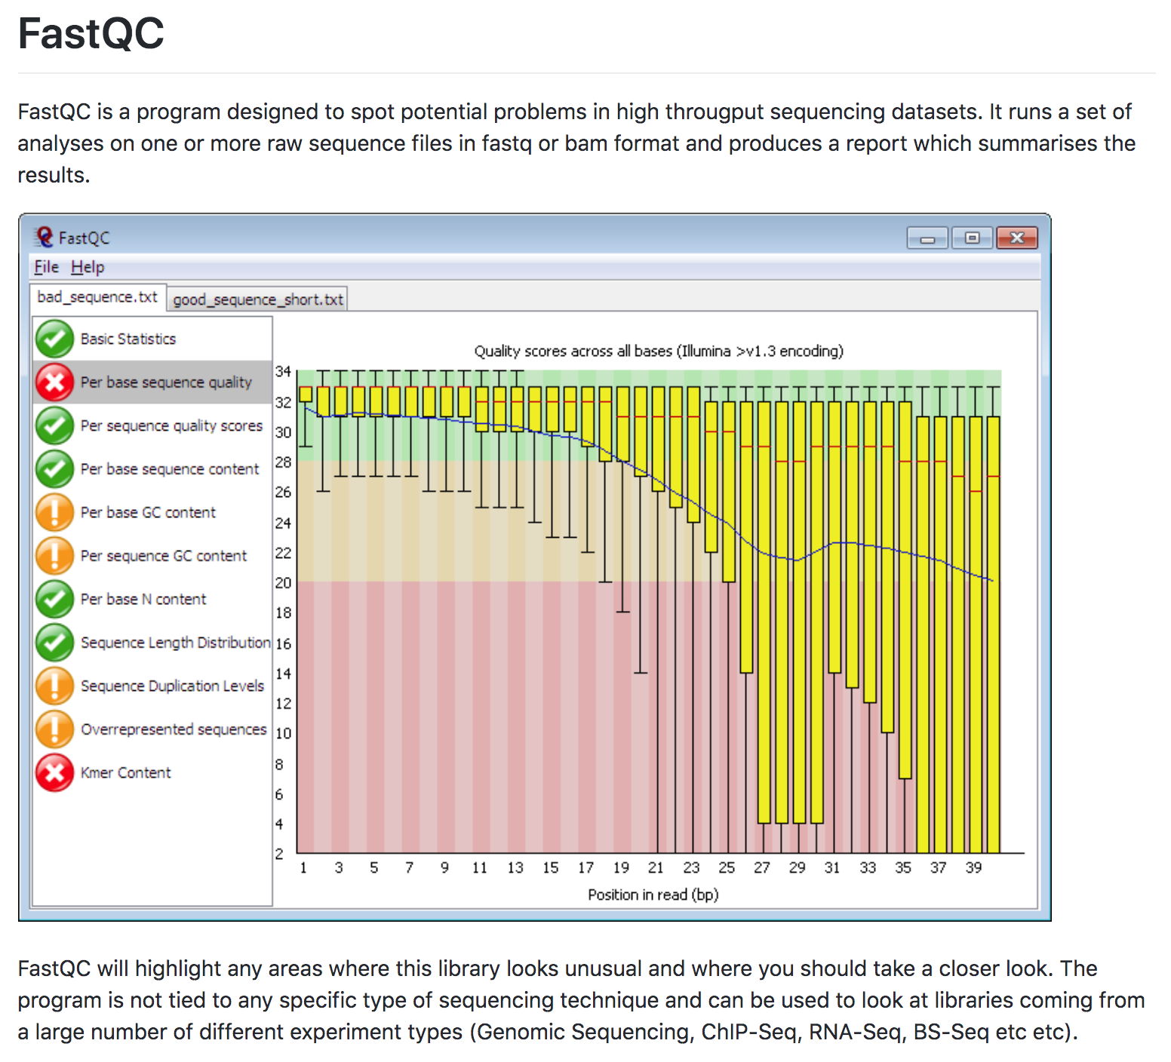
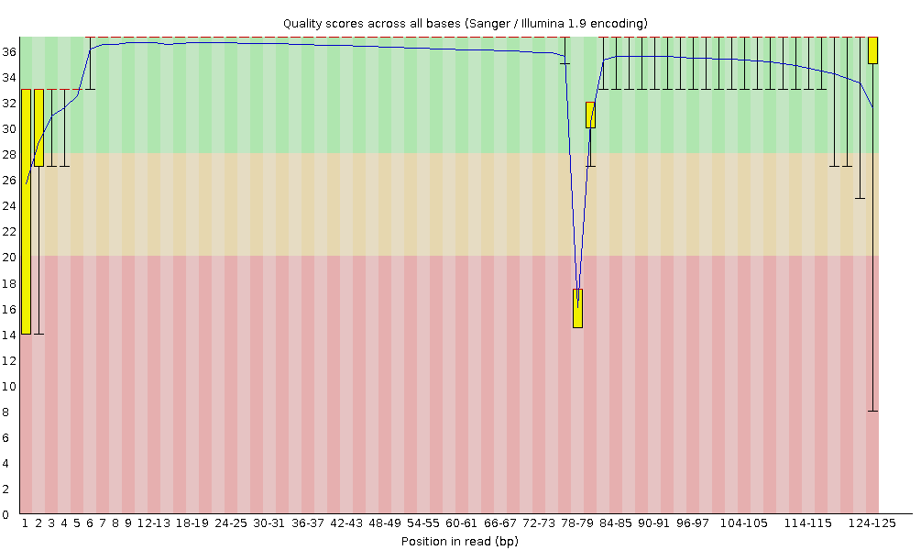
Raw sequencing QC is typically done with Fastqc
Notes:
I would like to expand these observations to in vivo data. I also want to check what happens in terms of transcriptional dynamics in cells where Cyclin O, a key non-canonical cyclin involved in MCC diff., is knocked-out.

Slide 17
Flowchart: from .bcl to count matrix
Get bcl file
That is the role of the sequencing machine!
Create fastq files
bcl2fastq
Create fastq files
QC: assess overall quality
fastqc
Cellranger
QC: remove low quality reads
Align fastq to BAM
QC: collapse UMI
View alignment
Count matrix
17
Notes:
I would like to expand these observations to in vivo data. I also want to check what happens in terms of transcriptional dynamics in cells where Cyclin O, a key non-canonical cyclin involved in MCC diff., is knocked-out.

Slide 18
Filtering low quality reads
It is important to consider (and remove!) :
Reads with overall low quality
Unrecognized cell barcode
Notes:
I would like to expand these observations to in vivo data. I also want to check what happens in terms of transcriptional dynamics in cells where Cyclin O, a key non-canonical cyclin involved in MCC diff., is knocked-out.

Slide 19
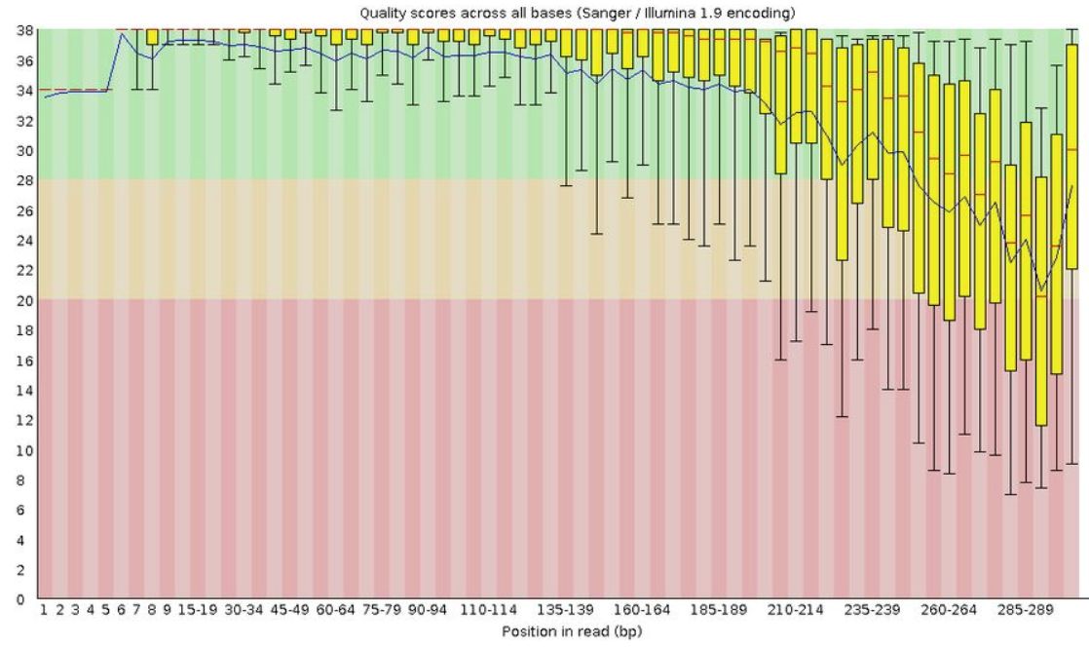
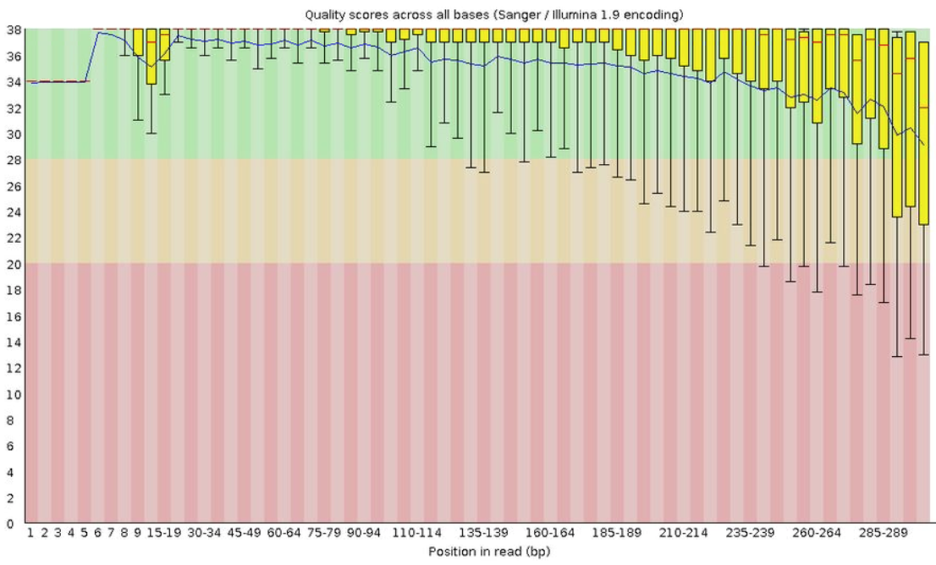
Filtering low quality reads
It is important to consider (and remove!) :
Reads with overall low quality
Unrecognized cell barcode
Notes:
I would like to expand these observations to in vivo data. I also want to check what happens in terms of transcriptional dynamics in cells where Cyclin O, a key non-canonical cyclin involved in MCC diff., is knocked-out.

Slide 20
Filtering low quality reads
It is important to consider (and remove!) :
Reads with overall low quality
Unrecognized cell barcode
What is a barcode whitelist?
List of all known barcode sequences that have been included in the assay kit and are available during library preparation.
For example, there are roughly 737,000 cell barcodes in the whitelist for Cell Ranger's Single Cell 3' applications. Here are the first 10 lines of the corresponding barcode whitelist 737K-august-2016.txt:
AAACCTGAGAAACCAT
AAACCTGAGAAACCGC
AAACCTGAGAAACCTA
AAACCTGAGAAACGAG
AAACCTGAGAAACGCC
AAACCTGAGAAAGTGG
AAACCTGAGAACAACT
AAACCTGAGAACAATC
AAACCTGAGAACTCGG
AAACCTGAGAACTGTA
Notes:
I would like to expand these observations to in vivo data. I also want to check what happens in terms of transcriptional dynamics in cells where Cyclin O, a key non-canonical cyclin involved in MCC diff., is knocked-out.

Slide 21
Relaxing barcode filtering
How to correct barcode sequencing errors?
For every observed barcode in the dataset not on the whitelist, but 1-Hamming-distance away (i.e. 1 mismatch) from a whitelist barcode:
    Compute the posterior probability that the observed barcode originated from the whitelist barcode with a sequencing error at the differing base (based on the base Q score).
    Replace the observed barcode with the whitelist barcode with the highest posterior probability that exceeds 0.975.
Notes:
I would like to expand these observations to in vivo data. I also want to check what happens in terms of transcriptional dynamics in cells where Cyclin O, a key non-canonical cyclin involved in MCC diff., is knocked-out.

Slide 22
Flowchart: from .bcl to count matrix
Get bcl file
That is the role of the sequencing machine!
Create fastq files
bcl2fastq
Create fastq files
QC: assess overall quality
fastqc
Cellranger
QC: remove low quality reads
Automatic in most aligners
Align fastq to BAM
QC: collapse UMI
View alignment
Count matrix
22
Notes:
I would like to expand these observations to in vivo data. I also want to check what happens in terms of transcriptional dynamics in cells where Cyclin O, a key non-canonical cyclin involved in MCC diff., is knocked-out.

Slide 23
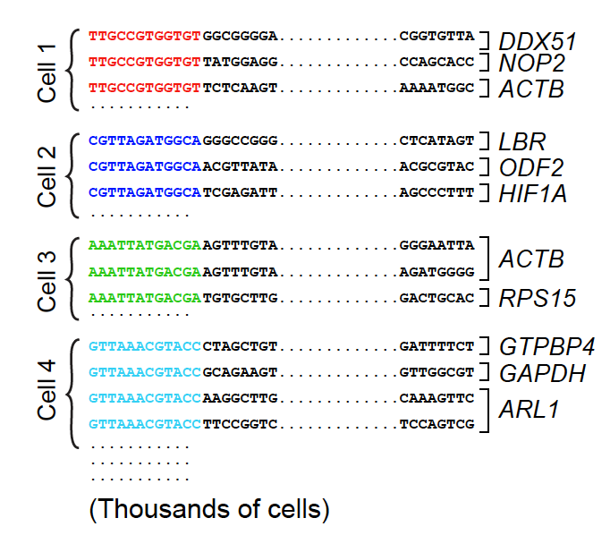
Aligning reads to a transcriptome reference
Group reads by cell-of-origin (using the cell barcodes)
Notes:
I would like to expand these observations to in vivo data. I also want to check what happens in terms of transcriptional dynamics in cells where Cyclin O, a key non-canonical cyclin involved in MCC diff., is knocked-out.

Slide 24
Aligning reads to a transcriptome reference
Group reads by cell-of-origin (using the cell barcodes)
Recover which transcript the cDNA sequence aligns to
Notes:
I would like to expand these observations to in vivo data. I also want to check what happens in terms of transcriptional dynamics in cells where Cyclin O, a key non-canonical cyclin involved in MCC diff., is knocked-out.

Slide 25
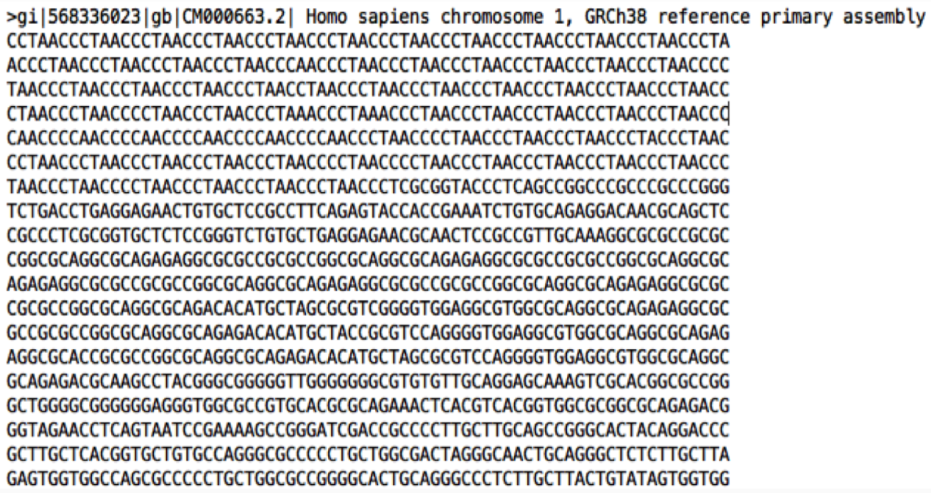
What do I need to align my reads?
Most aligners (included STAR-based cellranger) will map scRNAseq reads on a transcriptome index.
A transcriptome index consists of:
A genome sequence reference
FASTA example
Notes:
I would like to expand these observations to in vivo data. I also want to check what happens in terms of transcriptional dynamics in cells where Cyclin O, a key non-canonical cyclin involved in MCC diff., is knocked-out.

Slide 26
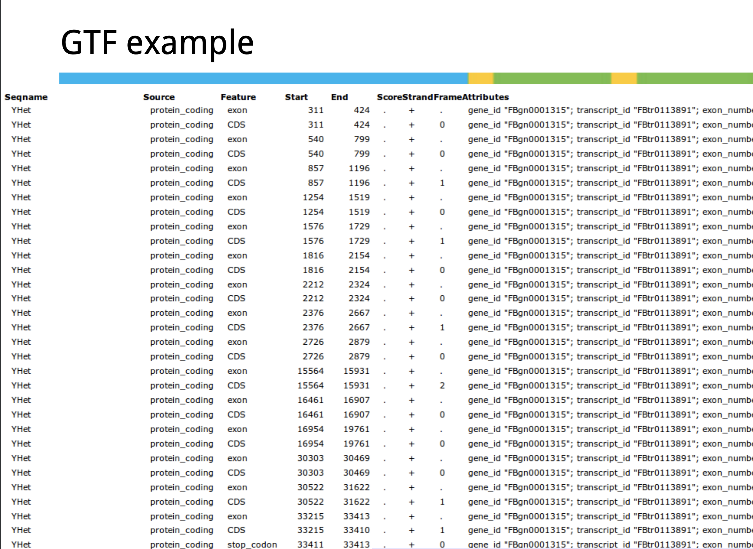
What do I need to align my reads?
Most aligners (included STAR-based cellranger) will map scRNAseq reads on a transcriptome index.
A transcriptome index consists of:
A genome sequence reference
A gene feature annotation reference
Notes:
I would like to expand these observations to in vivo data. I also want to check what happens in terms of transcriptional dynamics in cells where Cyclin O, a key non-canonical cyclin involved in MCC diff., is knocked-out.

Slide 27
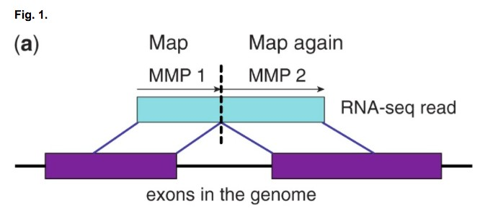
STAR aligner
STAR is a traditional aligner that works by trying to find the longest possible sequence which matches one or more sequences in the reference genome.
Notes:
I would like to expand these observations to in vivo data. I also want to check what happens in terms of transcriptional dynamics in cells where Cyclin O, a key non-canonical cyclin involved in MCC diff., is knocked-out.

Slide 28
STAR aligner
STAR is a traditional aligner that works by trying to find the longest possible sequence which matches one or more sequences in the reference genome.
Advantages: STAR is a splice aware aligner, making it suitable if you are interested in studying alternative splicing.
Disadvantage: STAR requires a lot of RAM.
An alternative requiring less RAM is HISAT2.
Notes:
I would like to expand these observations to in vivo data. I also want to check what happens in terms of transcriptional dynamics in cells where Cyclin O, a key non-canonical cyclin involved in MCC diff., is knocked-out.

Slide 29
Aligning reads to a transcriptome reference
 | Cell1 | Cell2 | Cell3 | Cell4
ACTB | 1 | 0 | 2 | 0
ARL1 | 0 | 0 | 0 | 2
…
Group reads by cell-of-origin (using the cell barcodes)
Recover which transcript the cDNA sequence aligns to
Notes:
I would like to expand these observations to in vivo data. I also want to check what happens in terms of transcriptional dynamics in cells where Cyclin O, a key non-canonical cyclin involved in MCC diff., is knocked-out.

Slide 30
Flowchart: from .bcl to count matrix
Get bcl file
That is the role of the sequencing machine!
Create fastq files
bcl2fastq
Create fastq files
QC: assess overall quality
fastqc
Cellranger
QC: remove low quality reads
Automatic in most aligners
Align fastq to BAM
STAR / Kallisto / Bowtie / ...
QC: collapse UMI
View alignment
Count matrix
30
Notes:
I would like to expand these observations to in vivo data. I also want to check what happens in terms of transcriptional dynamics in cells where Cyclin O, a key non-canonical cyclin involved in MCC diff., is knocked-out.

Slide 31
PCR duplicates
PCR amplifications is an issue for both bulk and scRNAseq.
During the PCR amplification process, some transcripts become over represented in the final library compared to their true abundance.
The problem worsened when a high number of PCR cycles are used to generate the sequencing library, for example in scRNAseq due to the low amount of starting material.
Notes:
I would like to expand these observations to in vivo data. I also want to check what happens in terms of transcriptional dynamics in cells where Cyclin O, a key non-canonical cyclin involved in MCC diff., is knocked-out.

Slide 32
Solution: using UMIs
UMIs enable sequencing reads to be assigned to individual transcript molecules and then the removal of amplification noise and biases from scRNAseq data.
(98-bp sequenced)
2 reads, 1 molecule
AGATGGGG
AGATGGGG
2 reads, 2 molecules
GTTGGCGT
GTTGGCGT
Notes:
I would like to expand these observations to in vivo data. I also want to check what happens in terms of transcriptional dynamics in cells where Cyclin O, a key non-canonical cyclin involved in MCC diff., is knocked-out.

Slide 33
Solution: using UMIs
UMIs enable sequencing reads to be assigned to individual transcript molecules and then the removal of amplification noise and biases from scRNAseq data.
 | Cell1 | Cell2 | Cell3 | Cell4
ACTB | 1 | 0 | 1 | 0
ARL1 | 0 | 0 | 0 | 2
(98-bp sequenced)
Columns: cells
Rows: features
2 reads, 1 molecule
AGATGGGG
AGATGGGG
2 reads, 2 molecules
GTTGGCGT
GTTGGCGT
Notes:
I would like to expand these observations to in vivo data. I also want to check what happens in terms of transcriptional dynamics in cells where Cyclin O, a key non-canonical cyclin involved in MCC diff., is knocked-out.

Slide 34
Solution: using UMIs
“Error-correcting” almost-correct UMIs:
A UMI that is 1-Hamming-distance away from another UMI (with more reads) for the same cell barcode and gene is corrected to the UMI with more reads.
Notes:
I would like to expand these observations to in vivo data. I also want to check what happens in terms of transcriptional dynamics in cells where Cyclin O, a key non-canonical cyclin involved in MCC diff., is knocked-out.

Slide 35
Flowchart: from .bcl to count matrix
Get bcl file
That is the role of the sequencing machine!
Create fastq files
bcl2fastq
Create fastq files
QC: assess overall quality
fastqc
Cellranger
QC: remove low quality reads
Automatic in most aligners
Align fastq to BAM
STAR / Kallisto / Bowtie / ...
QC: collapse UMI
Automatic in most aligners
View alignment
Count matrix
35
Notes:
I would like to expand these observations to in vivo data. I also want to check what happens in terms of transcriptional dynamics in cells where Cyclin O, a key non-canonical cyclin involved in MCC diff., is knocked-out.

Slide 36
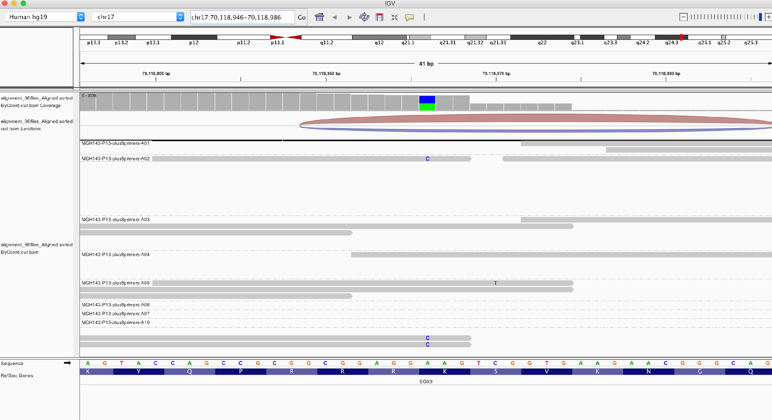
Visualization with IGV
Point mutation, splice junction, …
Notes:
I would like to expand these observations to in vivo data. I also want to check what happens in terms of transcriptional dynamics in cells where Cyclin O, a key non-canonical cyclin involved in MCC diff., is knocked-out.

Slide 37
Flowchart: from .bcl to count matrix
Get bcl file
That is the role of the sequencing machine!
Create fastq files
bcl2fastq
Create fastq files
QC: assess overall quality
fastqc
Cellranger
QC: remove low quality reads
Automatic in most aligners
Align fastq to BAM
STAR / Kallisto / Bowtie / ...
QC: collapse UMI
Automatic in most aligners
View alignment
Automatic in most aligners
Count matrix
37
Notes:
I would like to expand these observations to in vivo data. I also want to check what happens in terms of transcriptional dynamics in cells where Cyclin O, a key non-canonical cyclin involved in MCC diff., is knocked-out.

Slide 38
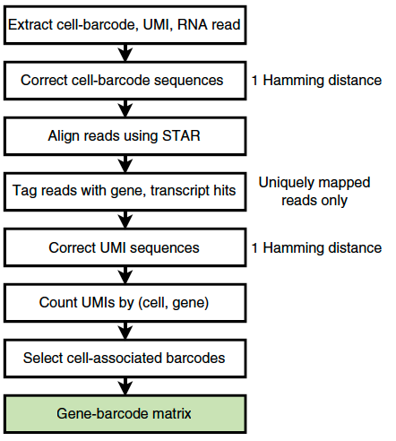
Cellranger count pipeline
Notes:
I would like to expand these observations to in vivo data. I also want to check what happens in terms of transcriptional dynamics in cells where Cyclin O, a key non-canonical cyclin involved in MCC diff., is knocked-out.

Slide 39
Cellranger count pipeline
Which reads are considered for UMI counting by Cell Ranger?
Only reads with a valid UMI and a valid 10x barcode.
No bases with base quality < 10.
Read maps to exactly one gene.
Overlaps an exon by at least 50% in a way consistent with annotated splice junctions and strand annotation.
Multiple reads that map to the same UMI will only count once.
Notes:
I would like to expand these observations to in vivo data. I also want to check what happens in terms of transcriptional dynamics in cells where Cyclin O, a key non-canonical cyclin involved in MCC diff., is knocked-out.

Slide 40
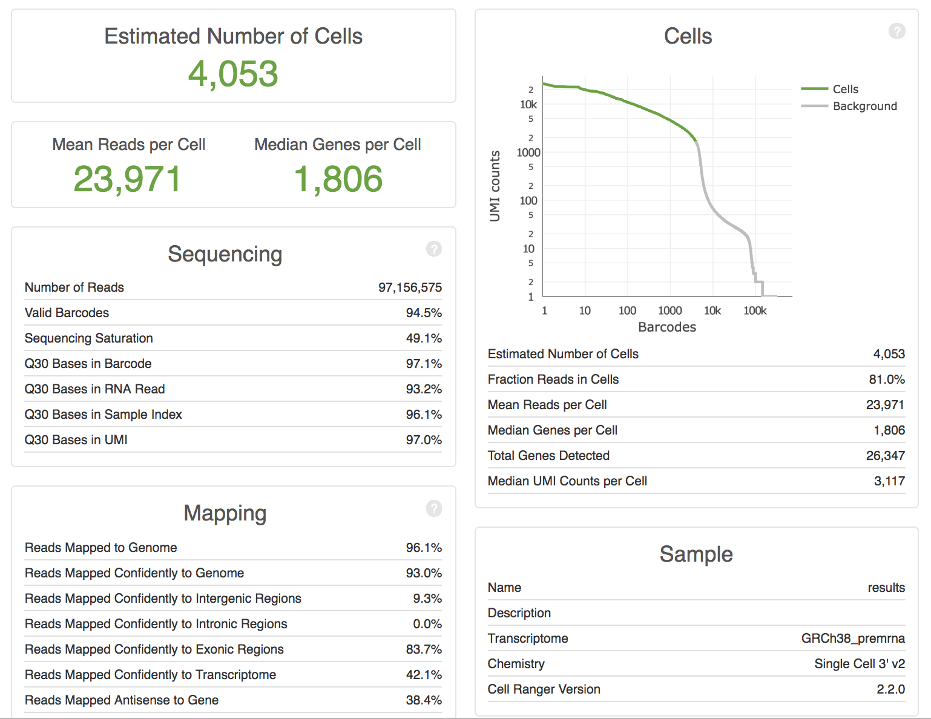
Cellranger count pipeline
Cellranger output
Notes:
I would like to expand these observations to in vivo data. I also want to check what happens in terms of transcriptional dynamics in cells where Cyclin O, a key non-canonical cyclin involved in MCC diff., is knocked-out.

Slide 41
Cellranger count pipeline
Cellranger output
Some cell barcodes have many UMIs, but most do not.
Notes:
I would like to expand these observations to in vivo data. I also want to check what happens in terms of transcriptional dynamics in cells where Cyclin O, a key non-canonical cyclin involved in MCC diff., is knocked-out.

Slide 42
Sequencing depth
How deeply do I need to sequence?
- At high sequencing depth, we can detect:
    The expression of rare splice variants.
    Quantitative modulations in transcript abundance.
- Lower sequencing depth can still be very powerful :
    Catalog of cell types.
    Catalog of transcriptional programs.
Notes:
I would like to expand these observations to in vivo data. I also want to check what happens in terms of transcriptional dynamics in cells where Cyclin O, a key non-canonical cyclin involved in MCC diff., is knocked-out.

Slide 43
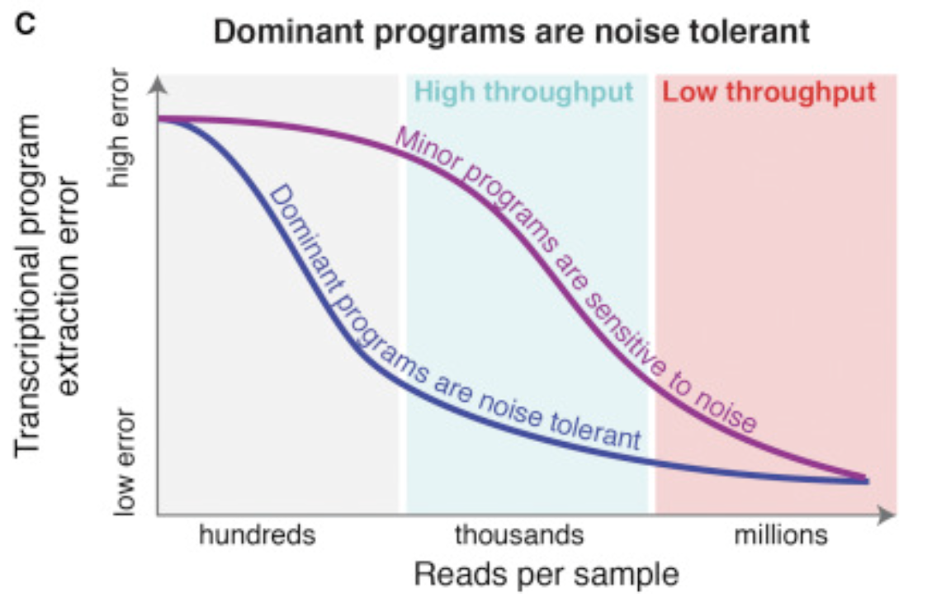
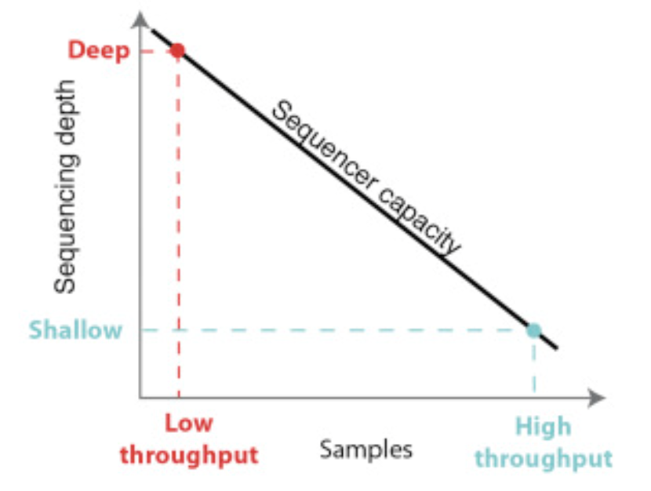
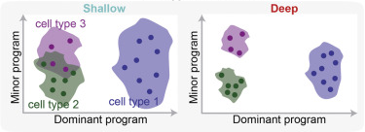
Sequencing depth
How deeply do I need to sequence?
Heimberg et al. Low Dimensionality in Gene Expression Data Enables the Accurate Extraction of Transcriptional Programs from Shallow Sequencing. Cell Systems 2016.
Notes:
I would like to expand these observations to in vivo data. I also want to check what happens in terms of transcriptional dynamics in cells where Cyclin O, a key non-canonical cyclin involved in MCC diff., is knocked-out.

Slide 44
Flowchart: from .bcl to count matrix
Get bcl file
That is the role of the sequencing machine!
Create fastq files
bcl2fastq
Create fastq files
QC: assess overall quality
fastqc
Cellranger
QC: remove low quality reads
Automatic in most aligners
Align fastq to BAM
STAR / Kallisto / Bowtie / ...
QC: collapse UMI
Automatic in most aligners
View alignment
Automatic in most aligners
Count matrix
Cellranger
Count matrix
44
Notes:
I would like to expand these observations to in vivo data. I also want to check what happens in terms of transcriptional dynamics in cells where Cyclin O, a key non-canonical cyclin involved in MCC diff., is knocked-out.

Slide 45
Any question?

