Slide 1
Quality control for scRNA-Seq data
Orr Ashenberg, Jacques Serizay, Fabricio Almeida-Silva
November 2026
Notes:
₁

Slide 2
Outline: Quality control of scRNA-Seq data
Quality control and normalization starting from gene count matrices.
Interacting with Seurat objects.
Next step will be dimensionality reduction, clustering, and visualization
Notes:
Add a biological background
Mention SingleCellExperimemnt

Slide 3
Determining cell type, state, and function
Quality control
Normalization
Feature selection
Dimensional reduction
Cell-cell distances
Unsupervised clustering
Kiselev C. at al. (2019) Nature Reviews Genetics. 20: 273-282.

Slide 4
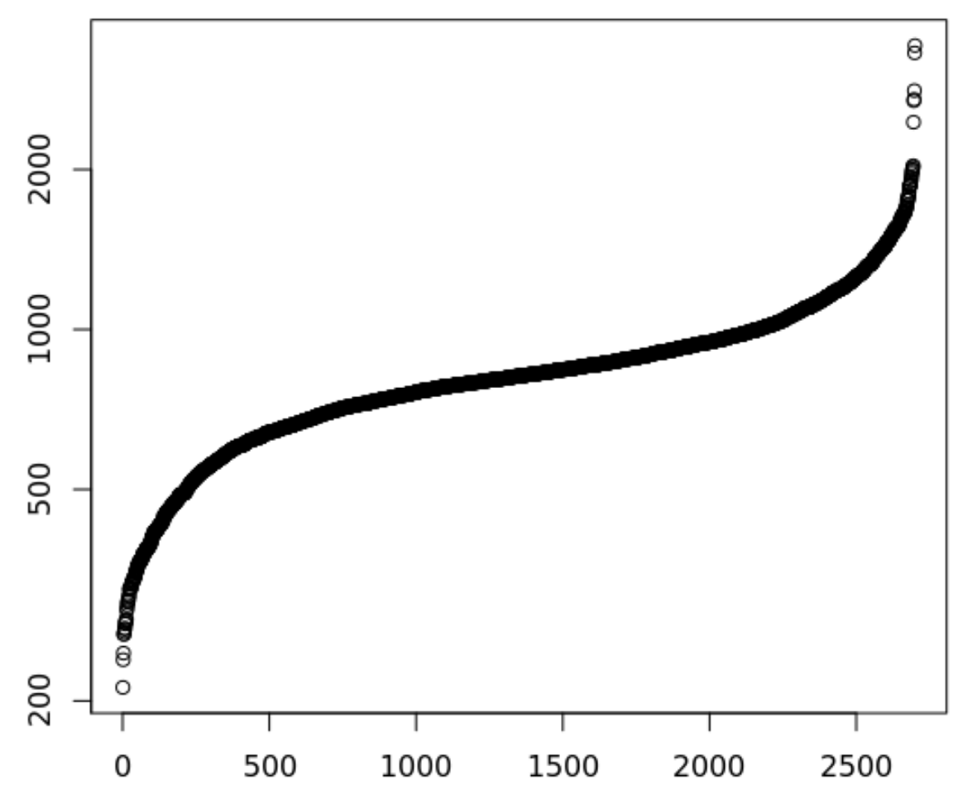
There are many quality control filters for genes and cells
Genes detected per cell (ordered)
Complexity =
Number of genes detected in a cell
Complexity
Complexity
Cell
Notes:
Filtering both ends.
Lower: Failed libraries?
Higher: Doublets?
Outlier cells are not just measured by complexity
•Percent Reads Mapping
•Percent Mitochondrial Reads
•Presence of marker genes
•Intergenic/ exonic rate
•5' or 3' bias
•other metadata …
•Useful Tools
Picard Tools and RNASeQC

Slide 5
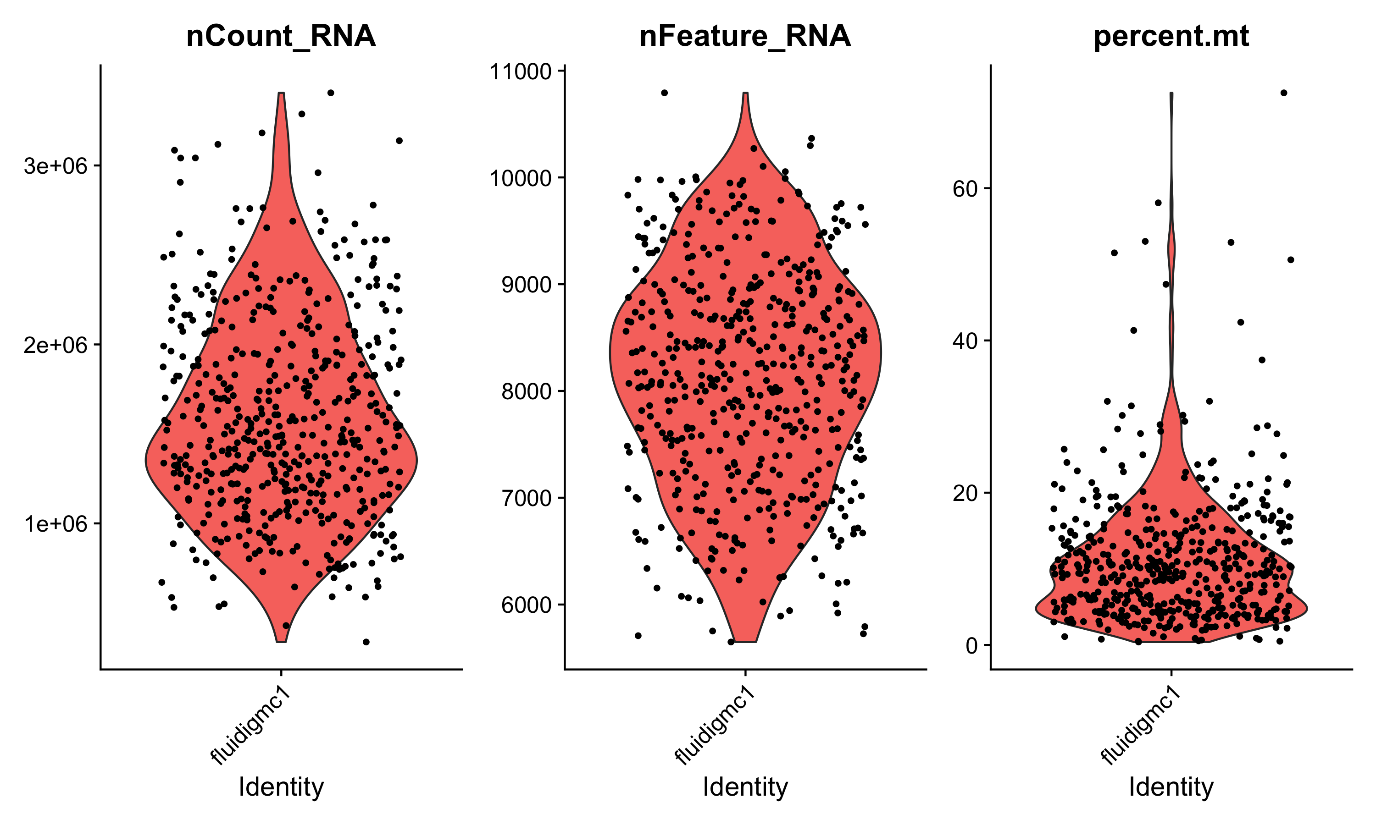
There are many quality control filters for genes and cells
We filter cells based on technical or biological parameters.
# reads or UMIs detected in a cell
# genes detected in a cell
% mito expression in a cell

Slide 6
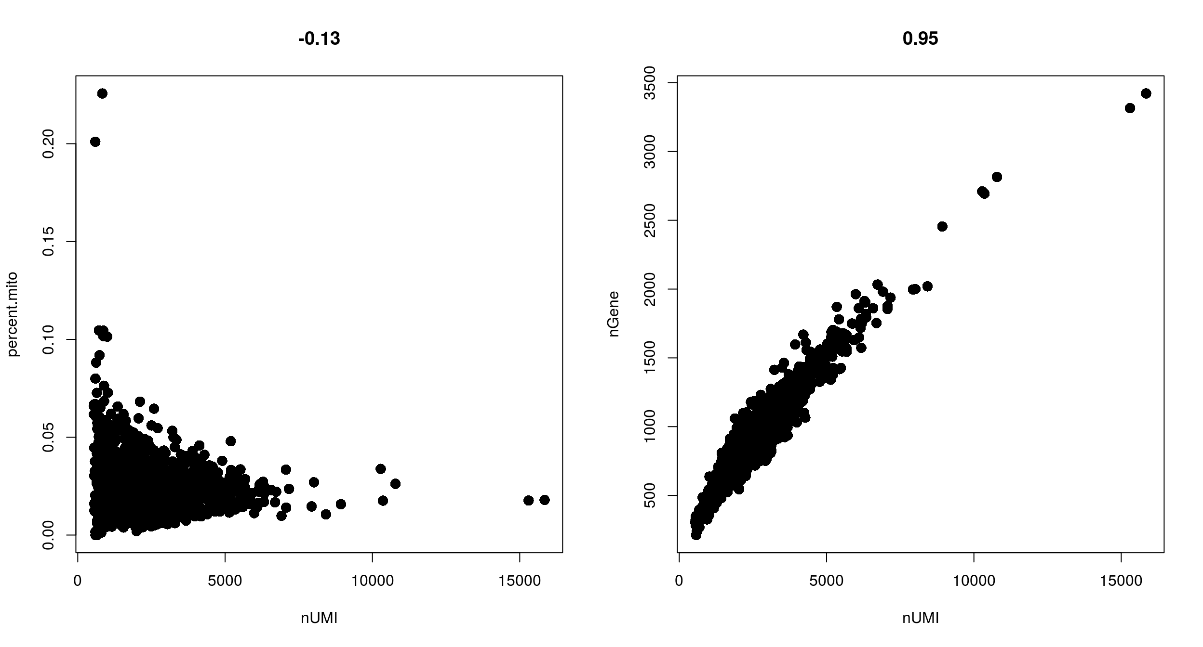
Filtering with combinations of quality control filters
Low nUMI and high % mitochondrial- Cells captured but lost a lot of the mRNA, and the mitochondrial genes were protected and retained
High nUMI & low nGene ratio – low quality library or capture rate
nGene
% mito
High nUMI & high nGene – doublets
nUMI
nUMI
Notes:
Cells got raptured and lost a lot of the mRNA, but the mitochondrial genes are protected (0.1, 10000)
Add black dot on the right

Slide 7
Appropriate quality control filters vary with platform and
cell types
Different platforms set different expectations
  e.g. Smart-Seq2 often yields more genes detected per cell than 10x Chromium.
Different cell types set different expectations
  Immune cells normally have fewer genes detected per cell than non-immune cells
  Malignant cells normally have more genes detected per cell than non-malignant cells
Notes:
Malignant cells are more transcriptional active

Slide 8
Detecting cell doublets with Scrublet
Scrublet (Single-Cell Remover of Doublets)
Wolock, Lopez, Klein. Cell Systems 8.4 (2019): 281-291.
Notes:
Finally, we do another step of processing to distinguish droplets that contain a single cell from those droplets that contain two or more cells. The latter are not useful, especially as one of our main goals is to identify cell-type specific eQTLs and these doublets do not represent a real cell type.

Slide 9
Detecting cell doublets with Scrublet
Wolock, Lopez, Klein. Cell Systems 8.4 (2019): 281-291.

Slide 10
Detecting empty drops containing ambient RNA – manual
Look for transcripts expressed in unexpected cell types and remove those genes from all subsequent analysis
e.g. hemoglobin gene expressed in a T cell

Slide 11
Detecting empty drops containing ambient RNA – automatic
EmptyDrops (distinguish cells from empty droplets)
Cells ranked by total
unique molecular identifiers (UMI)
10000
1000
100
10
Cell encapsulated in droplet
Total UMI detected per cell
Mixture
Ambient RNA encapsulated in droplet
Lun, A.T.L. et al. Genome Biol (2019). 20, 63.

Slide 12
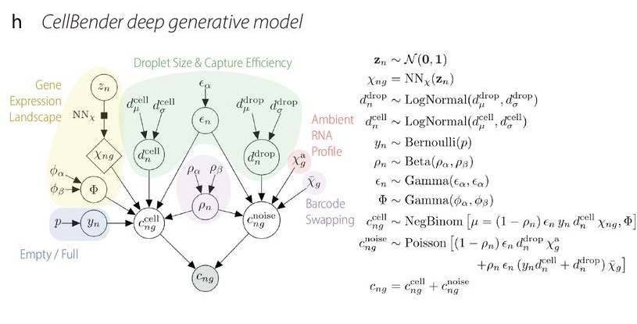
Further quality control to correct for ambient RNA
Cells ranked by total
unique molecular identifiers (UMI)
CellBender is a deep generative model of background-contaminated counts
correct ambient RNA and barcode swapping
detect empty droplets
10000
1000
100
10
Cell encapsulated in droplet
Total UMI in cell
Mixture
Ambient RNA encapsulated in droplet
Fleming S. J. et al. Nature Methods (2023).

Slide 13
Removing ambient RNA using CellBender in COVID-19 tissue
CellBender applied to COVID-19 lung tissue
CellBender qualitative observations
cell subsets become more distinct
cell type marker genes become more specific
can lower UMI and gene cutoffs, allowing for significantly more recovery of lymphocytes
Delorey T. et al. Nature (2021).
Notes:
SFTPA1 in AT2 cells

Slide 14
Quality control tips
We often revisit quality control decisions multiple times when analyzing data.
Start with permissive thresholds when filtering, and investigate the effects of these thresholds before applying more stringent thresholds.
If the distributions of QC metrics differ between samples, thresholds should be determined separately for each sample to account for sample quality differences.
Visualize QC metrics per cell subset in order to flag technical biases.
Luecken M. D. et al. Molecular Systems Biology (2019) 15:e8746.

Slide 15
Determining cell type, state, and function
Quality control
Normalization
Feature selection
Dimensional reduction
Cell-cell distances
Unsupervised clustering
Kiselev C. at al. (2019) Nature Reviews Genetics. 20: 273-282.

Slide 16
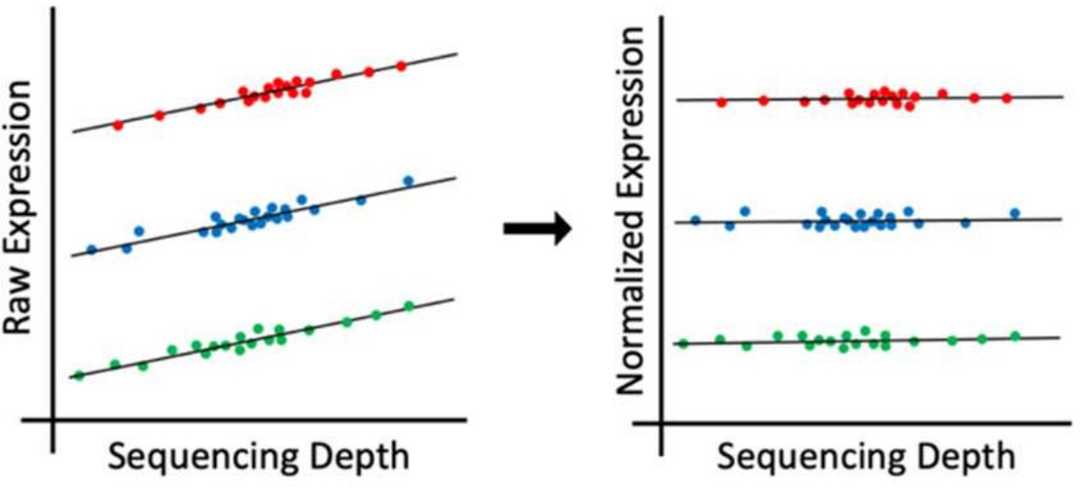
Single-cell RNA-Seq analysis: normalization
Why normalize gene expression within a cell?
cell type 1
cell type 2
cell type 3
Differences in sequencing depth can lead to false differences in gene expression.

Slide 17
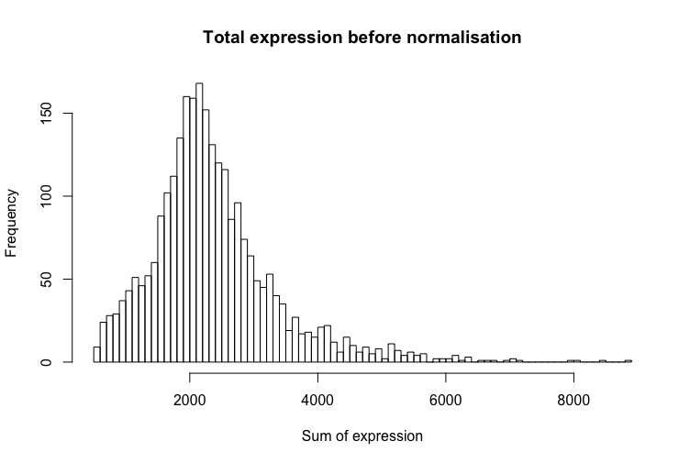
Single-cell RNA-Seq analysis: normalization
Why normalize gene expression within a cell?
  cells are sequenced to different depths (technical)
  cells of different type have different amounts of mRNA (biological)
  there are typically extreme values in distribution of gene expression
  more highly expressed genes are more variable

Slide 18
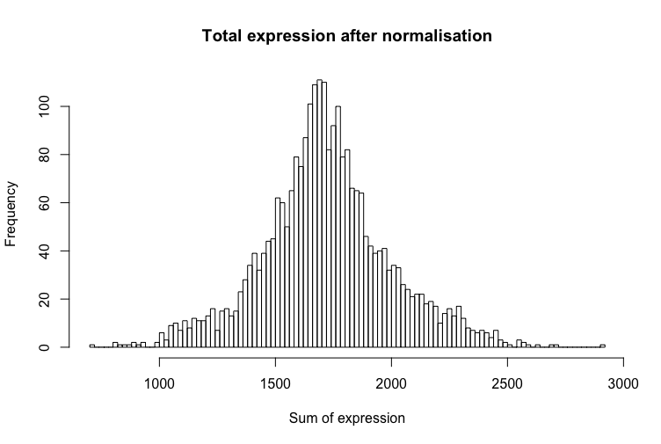
Single-cell RNA-Seq analysis: normalization
How to normalize
  Gene expression measurements for each cell are normalized by the total gene expression or median gene expression
  Gene expression values then scaled to sum to 10,000 (typically), and then log(1+x)-transformed.

Slide 19
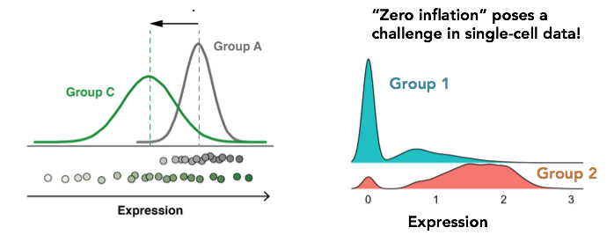
Is standard normalization appropriate?
Reassessing the idea that droplet scRNA-Seq is zero-inflated.
Single
cell
Bulk
“Droplet scRNA-seq is not zero-inflated.” Svensson, Nature Biotechnology (2020)
”Feature selection and dimension reduction for single-cell RNA-Seq based on a multinomial model.” Townes et al. Genome Biology (2019)
“Normalization and variance stabilization of single-cell RNA-seq data using regularized negative binomial regression.” Hafemeister et al. Genome Biology (2019)
“Statistics or biology: the zero-inflation controversy about scRNA-seq data.” Jiang et al. Genome Biology (2022)

Slide 20

Identify highly variable genes
Cells are in ~20,000 dimensional space (one dimension for each gene)
many genes are lowly detected or noisy measurements
variable genes contain the biological signal we are interested in

Slide 21
Identify highly variable genes
CV (counts)
Mean counts
Find genes (features) that are outliers in a plot of mean of gene expression vs variance of gene expression

Slide 22

Calculating gene signatures
Relying on capturing a specific gene is not robust, but relying on a set of genes (signature) is much more stable!

Slide 23
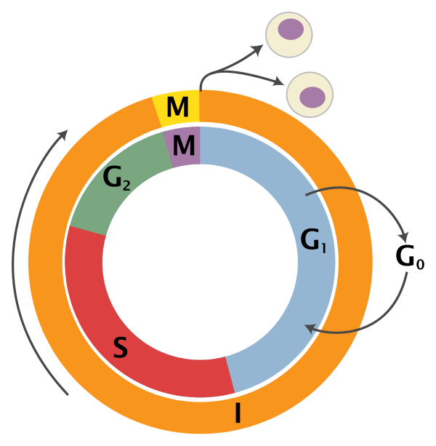
Gene signature example: cell cycle markers
variability of individual genes
cell cycle genes

Slide 24


Seurat and scanpy: single cell analysis toolkits
https://satijalab.org/seurat/
https://scanpy.readthedocs.io/en/stable/

Slide 25
Interacting with Seurat objects
Seurat object is used for to store 10x data and perform analysis
  Count matrices for different assays are stored (gene expression, protein expression, chromatin accessibility, etc…)
  Counts are stored as: counts (raw), data (normalized), scaled data (centered and scaled) in sparse matrices when possible
  Metadata describes individual cells and genes
  Functions for analysis (quality control, normalization, feature selection, dimensional reduction, cell-cell distances, unsupervised clustering)
https://github.com/satijalab/seurat/wiki
https://satijalab.org/seurat/essential_commands.html

Slide 26
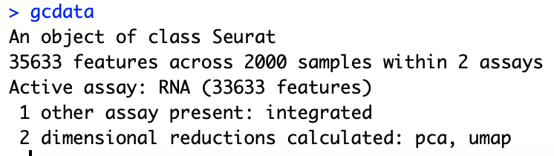
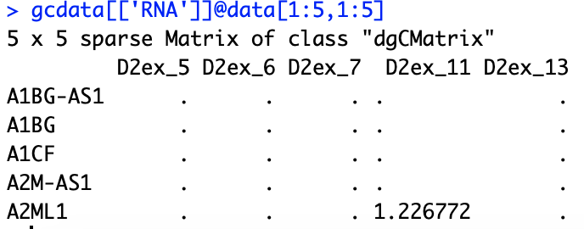
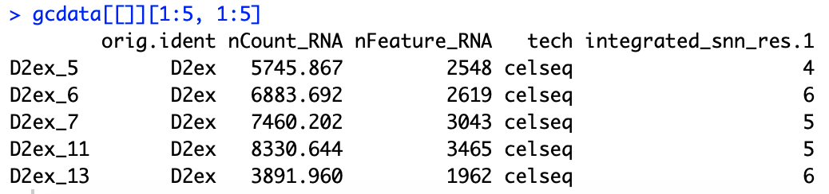
Interacting with Seurat objects
Seurat object
Accessing count slot from RNA assay
Accessing cell metadata
Running analysis function

Slide 27
Loading data into a Seurat object
gcdata <- CreateSeuratObject(counts = celseq.data)
counts matrix

Slide 28
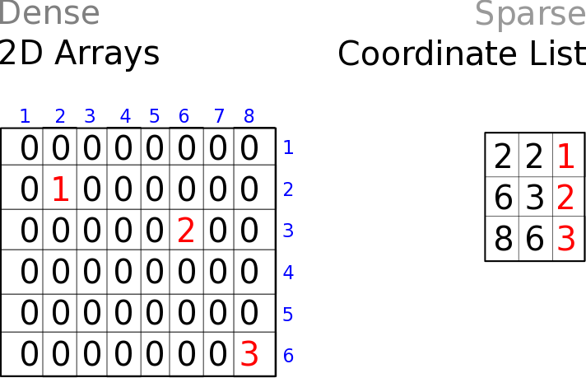
Storing counts data in dense vs sparse format
cells
genes
Dense matrices
Sparse matrices

