Slide 1
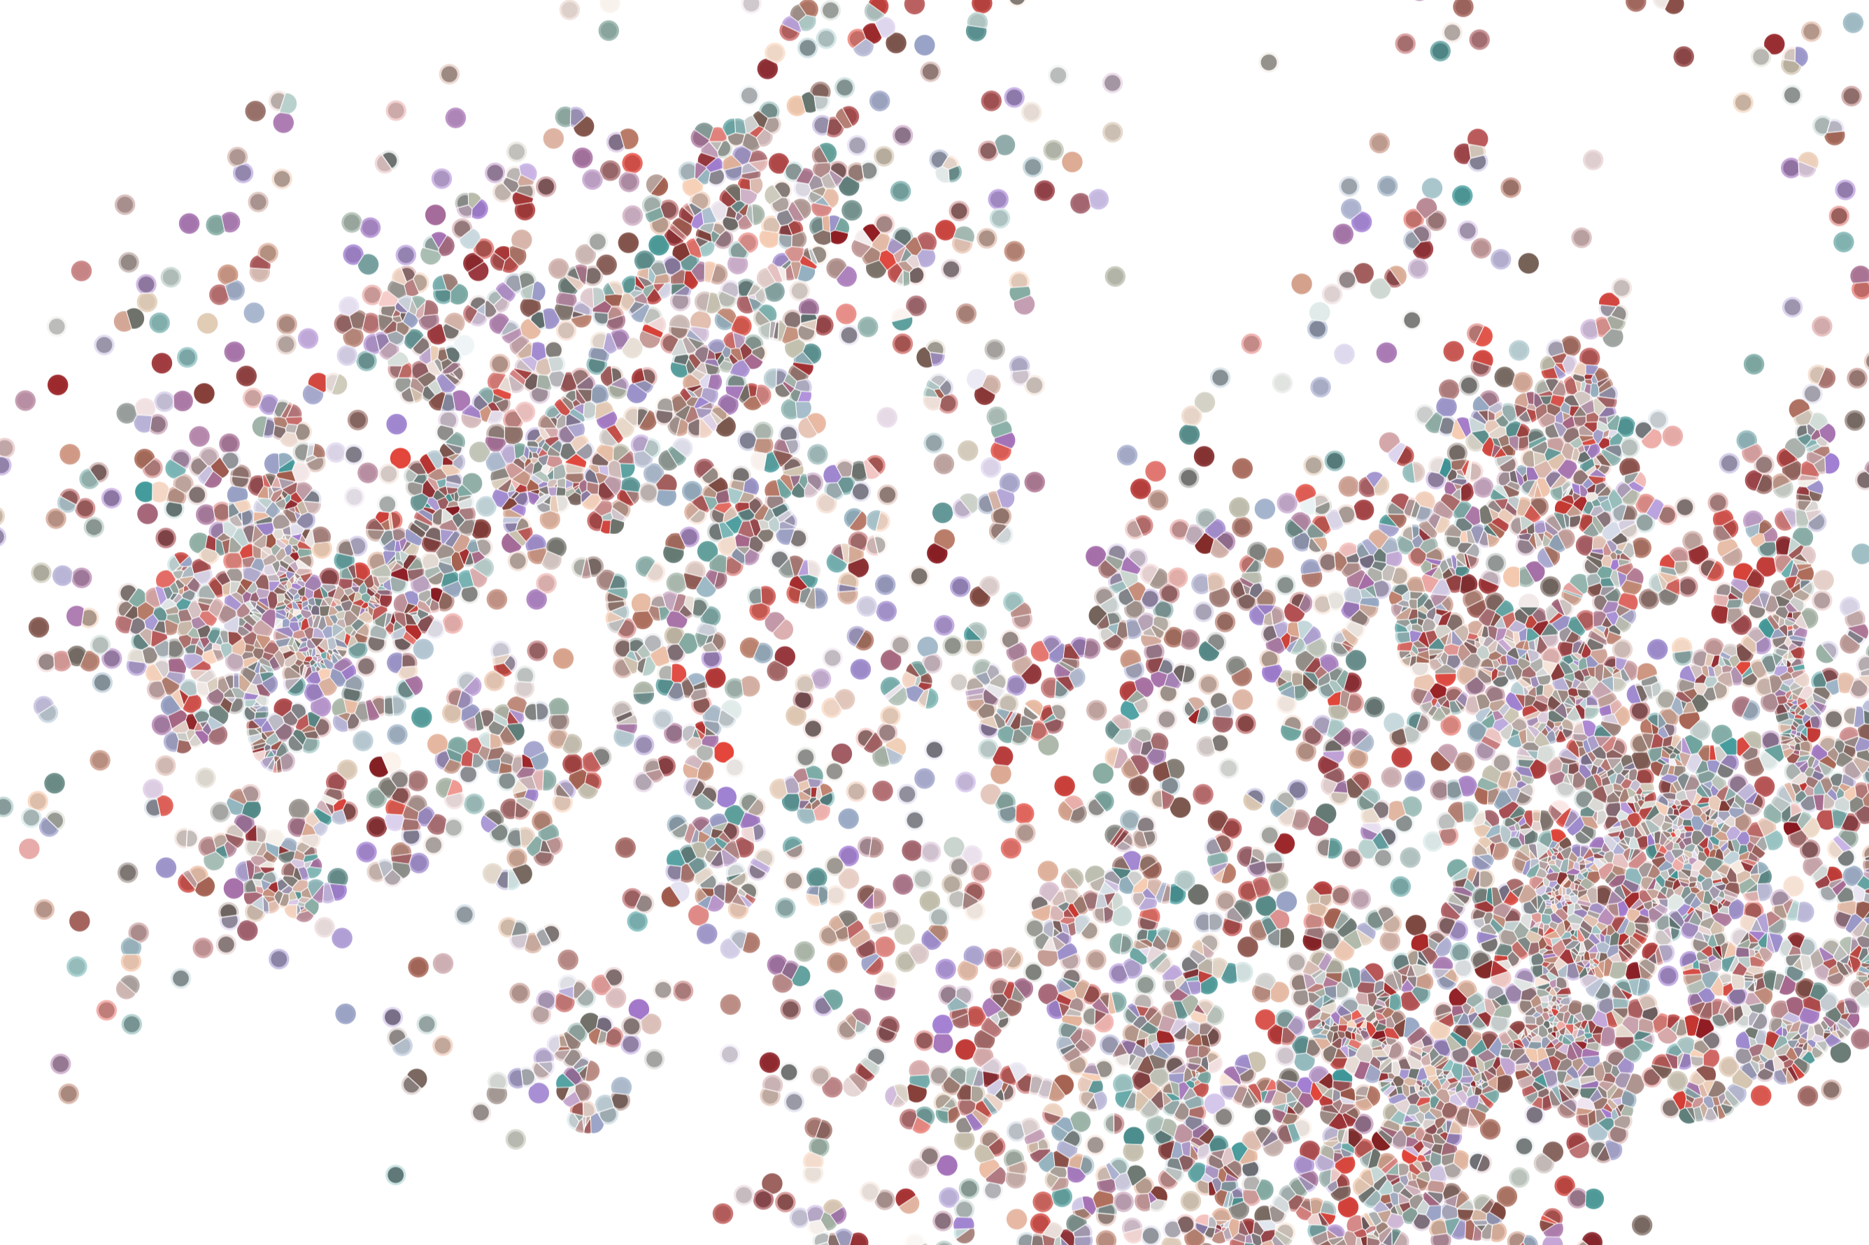
Lecture 4
Identifying cell populations
Physalia course 2026
—
Single-cell RNA-seq with R/Bioconductor
Instructors: Orr Ashenberg, Jacques Serizay, Fabrício Almeida-Silva
Notes:
Hello everybody and thank you for attending my presentation. I am going to talk about the project I recently started working on in the Spassky and Koszul labs, both located in Paris. This project focuses on the unusual cooption of the mitotic machinery to drive, not cell division but cell differentiation.

Slide 2

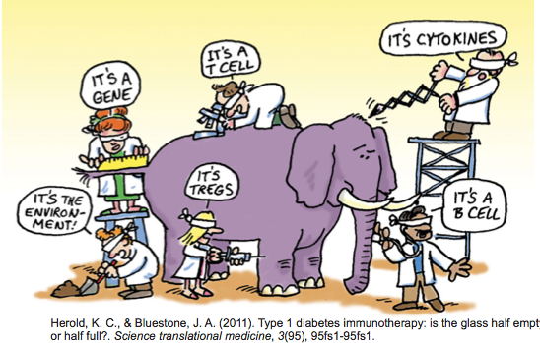
How Do We Define Cellular Identity?
A cell participates in multiple processes/contexts.
2
Notes:
I would like to expand these observations to in vivo data. I also want to check what happens in terms of transcriptional dynamics in cells where Cyclin O, a key non-canonical cyclin involved in MCC diff., is knocked-out.

Slide 3

Analysis workflow
Pre-Processing
Clustering
Biology
Expression Matrix
(GENES x CELLS)
1. Identify
Variable Genes
5. Differentially Expressed Genes
Quality Control / Filter Cells
2. Dimensionality Reduction
6. Assigning
Cell Type
Normalization
3. Clustering
7. Functional Annotation
4. Explore (known)
marker genes
Notes:
I would like to expand these observations to in vivo data. I also want to check what happens in terms of transcriptional dynamics in cells where Cyclin O, a key non-canonical cyclin involved in MCC diff., is knocked-out.

Slide 4
Analysis workflow
Pre-Processing
Clustering
Biology
Expression Matrix
(GENES x CELLS)
1. Identify
Variable Genes
5. Differentially Expressed Genes
Quality Control / Filter Cells
2. Dimensionality Reduction
6. Assigning
Cell Type
Normalization
3. Clustering
7. Functional Annotation
4. Explore (known)
marker genes
Notes:
I would like to expand these observations to in vivo data. I also want to check what happens in terms of transcriptional dynamics in cells where Cyclin O, a key non-canonical cyclin involved in MCC diff., is knocked-out.

Slide 5
Making sense of variation
For something to be informative, it needs to exhibit variation
5
Notes:
I would like to expand these observations to in vivo data. I also want to check what happens in terms of transcriptional dynamics in cells where Cyclin O, a key non-canonical cyclin involved in MCC diff., is knocked-out.

Slide 6

Making sense of variation
For something to be informative, it needs to exhibit variation
QUESTION: Can I group these emoticons by their facial hair style?
6
Notes:
I would like to expand these observations to in vivo data. I also want to check what happens in terms of transcriptional dynamics in cells where Cyclin O, a key non-canonical cyclin involved in MCC diff., is knocked-out.

Slide 7
Making sense of variation
For something to be informative, it needs to exhibit variation
QUESTION: Can I group these emoticons by their facial hair style?
7
Notes:
I would like to expand these observations to in vivo data. I also want to check what happens in terms of transcriptional dynamics in cells where Cyclin O, a key non-canonical cyclin involved in MCC diff., is knocked-out.

Slide 8

Making sense of variation
Not everything that exhibits variation is informative. It depends on the question!
QUESTION: Which ones of these emoticons are smiling?
8
Notes:
I would like to expand these observations to in vivo data. I also want to check what happens in terms of transcriptional dynamics in cells where Cyclin O, a key non-canonical cyclin involved in MCC diff., is knocked-out.

Slide 9
Making sense of variation
Cells are in ~20,000 dimensional space (one dimension per gene)
Many genes are lowly detected or noisy measurements
Variable genes contain the biological signal we are interested in
The most used approach is to find genes that have high variance
9
Notes:
I would like to expand these observations to in vivo data. I also want to check what happens in terms of transcriptional dynamics in cells where Cyclin O, a key non-canonical cyclin involved in MCC diff., is knocked-out.

Slide 10
Sources of variations in gene expression
In (single-cell) RNA-seq, the variance in gene expression depends on the level of expression of this gene: A gene highly expressed will have a high variation of expression across cells.
Poisson distribution is generally viewed as a good way to model counts, such as those in a scRNAseq count matrix.
According to Poisson distribution, the variance of counts is equal to the mean of the counts.
10
Notes:
I would like to expand these observations to in vivo data. I also want to check what happens in terms of transcriptional dynamics in cells where Cyclin O, a key non-canonical cyclin involved in MCC diff., is knocked-out.

Slide 11
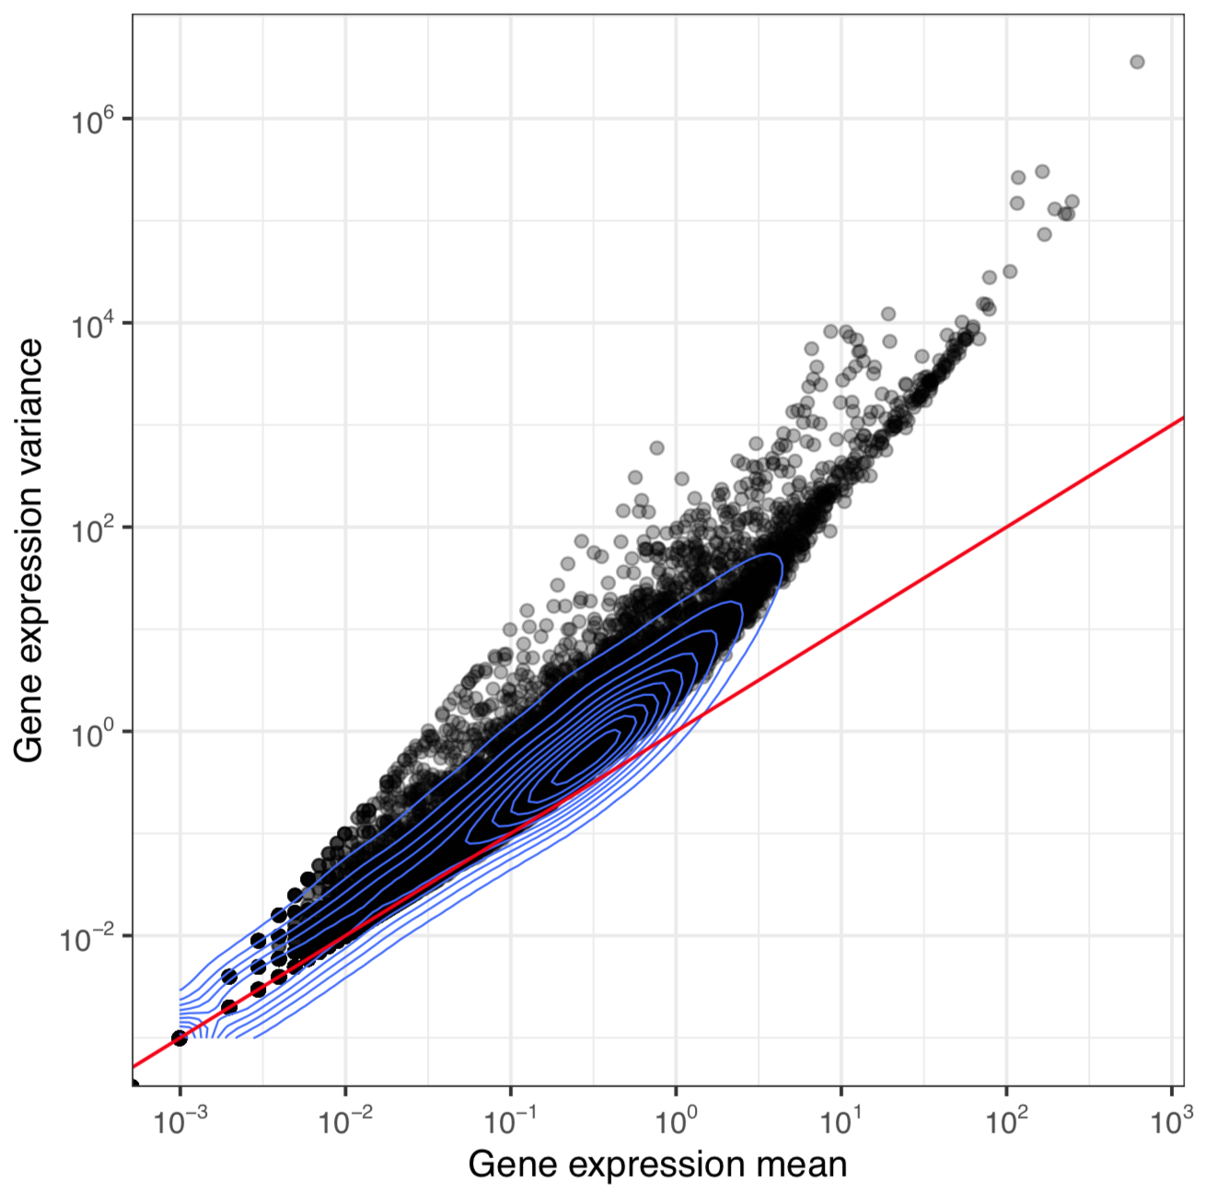
Sources of variations in gene expression
This is the identity curve
variance = mean
11
Notes:
I would like to expand these observations to in vivo data. I also want to check what happens in terms of transcriptional dynamics in cells where Cyclin O, a key non-canonical cyclin involved in MCC diff., is knocked-out.

Slide 12
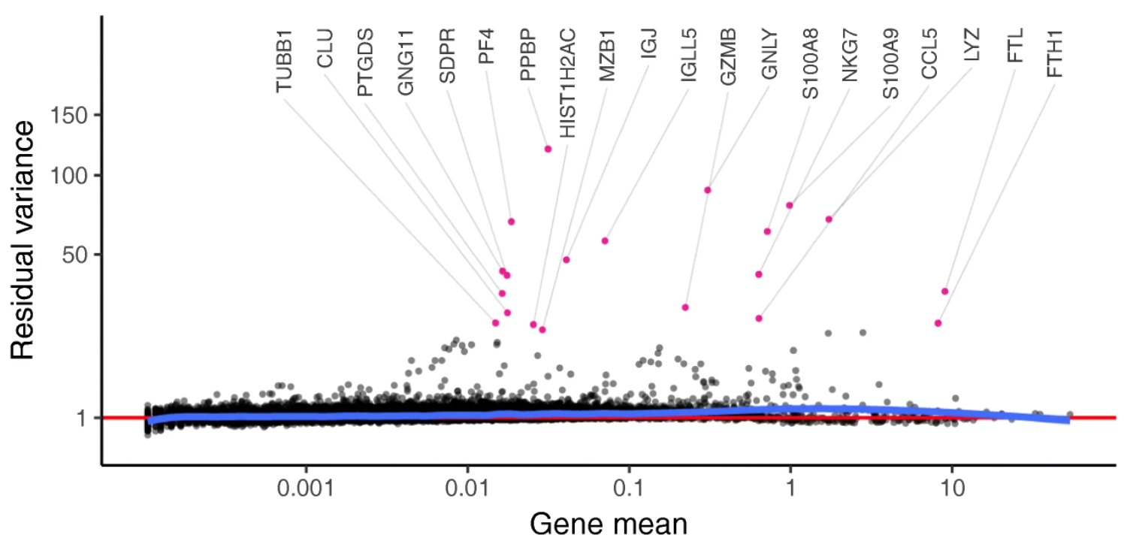
Variance residuals
The computed variance residuals can be used to identify highly variable genes.
Hafemeister & Sajita, Genome Biology 2019
12
Notes:
I would like to expand these observations to in vivo data. I also want to check what happens in terms of transcriptional dynamics in cells where Cyclin O, a key non-canonical cyclin involved in MCC diff., is knocked-out.

Slide 13
Making sense of variation
The computed variance residuals can be used to identify highly variable genes.
Either taking the first n genes (ranked by decreasing residual variance)
e.g. 200-2000 genes
13
Notes:
I would like to expand these observations to in vivo data. I also want to check what happens in terms of transcriptional dynamics in cells where Cyclin O, a key non-canonical cyclin involved in MCC diff., is knocked-out.

Slide 14
Making sense of variation
The computed variance residuals can be used to identify highly variable genes.
Either taking the first n genes (ranked by decreasing residual variance)
e.g. 200-2000 genes
Or by taking the first % genes (ranked by decreasing residual variance)
e.g. 2-10% genes
14
Notes:
I would like to expand these observations to in vivo data. I also want to check what happens in terms of transcriptional dynamics in cells where Cyclin O, a key non-canonical cyclin involved in MCC diff., is knocked-out.

Slide 15
Making sense of variation
The computed variance residuals can be used to identify highly variable genes.
Either taking the first n genes (ranked by decreasing residual variance)
e.g. 200-2000 genes
Or by taking the first % genes (ranked by decreasing residual variance)
e.g. 2-10% genes
→ Or by taking all genes with a residual variance > threshold
e.g. genes with residual variance > 0.02
15
Notes:
I would like to expand these observations to in vivo data. I also want to check what happens in terms of transcriptional dynamics in cells where Cyclin O, a key non-canonical cyclin involved in MCC diff., is knocked-out.

Slide 16
Analysis workflow
Pre-Processing
Clustering
Biology
Expression Matrix
(GENES x CELLS)
1. Identify
Variable Genes
5. Differentially Expressed Genes
Quality Control / Filter Cells
2. Dimensionality Reduction
6. Assigning
Cell Type
Normalization
3. Clustering
7. Functional Annotation
4. Explore (known)
marker genes
Notes:
I would like to expand these observations to in vivo data. I also want to check what happens in terms of transcriptional dynamics in cells where Cyclin O, a key non-canonical cyclin involved in MCC diff., is knocked-out.

Slide 17
Dimensional reduction in scRNAseq studies
High-dimensional data can be difficult to interpret.
One approach to simplification is to assume that the data of interest lies within lower-dimensional space. If the data of interest is of low enough dimension, the data can be visualised in the low-dimensional space.
A scRNA seq starts with many measurements (features, genes).
We want to reduce it to fewer informative dimensions.
We have starting doing this by using only highly variable genes.
We can further reduce dimension with linear or non-linear approaches.
17
Notes:
I would like to expand these observations to in vivo data. I also want to check what happens in terms of transcriptional dynamics in cells where Cyclin O, a key non-canonical cyclin involved in MCC diff., is knocked-out.

Slide 18
Dimensional reduction in scRNAseq studies
High-dimensional data can be difficult to interpret.
One approach to simplification is to assume that the data of interest lies within lower-dimensional space. If the data of interest is of low enough dimension, the data can be visualised in the low-dimensional space.
Common Techniques
Principal Component Analysis (PCA)
Independent Component Analysis (ICA)
Multidimensional Scaling (MDS)
Non-negative Matrix Factorization (NMF)
Probabilistic Modeling (e.g. Latent Dirichlet Allocation - LDA)
18
Notes:
I would like to expand these observations to in vivo data. I also want to check what happens in terms of transcriptional dynamics in cells where Cyclin O, a key non-canonical cyclin involved in MCC diff., is knocked-out.

Slide 19
Principal Component Analysis
PCA is a dimensionality reduction method that transforms a set of features into a set of linearly uncorrelated variables called principal components
1,000s cells
1,000s cells
10,000 genes
(few) Principal components
https://stats.stackexchange.com/questions/2691/making-sense-of-principal-component-analysis-eigenvectors-eigenvalues
19
Notes:
I would like to expand these observations to in vivo data. I also want to check what happens in terms of transcriptional dynamics in cells where Cyclin O, a key non-canonical cyclin involved in MCC diff., is knocked-out.

Slide 20
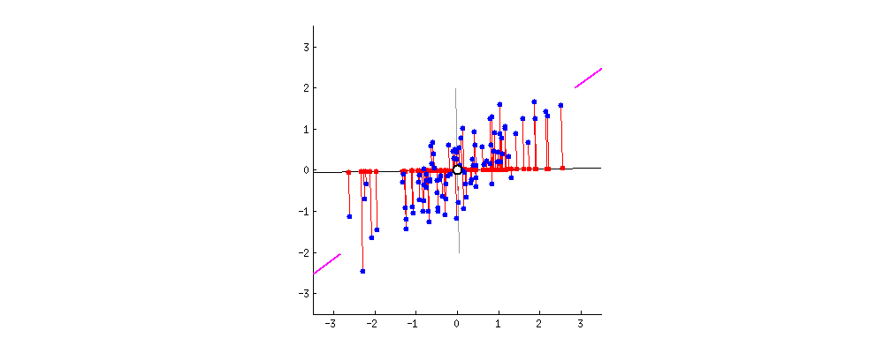
Principal Component Analysis
PCA is a dimensionality reduction method that transforms a set of features into a set of linearly uncorrelated variables called principal components
The first principal component contains the most variance, and each component after contains as much variance while still being orthogonal to other components
https://stats.stackexchange.com/questions/2691/making-sense-of-principal-component-analysis-eigenvectors-eigenvalues
20
Notes:
I would like to expand these observations to in vivo data. I also want to check what happens in terms of transcriptional dynamics in cells where Cyclin O, a key non-canonical cyclin involved in MCC diff., is knocked-out.

Slide 21
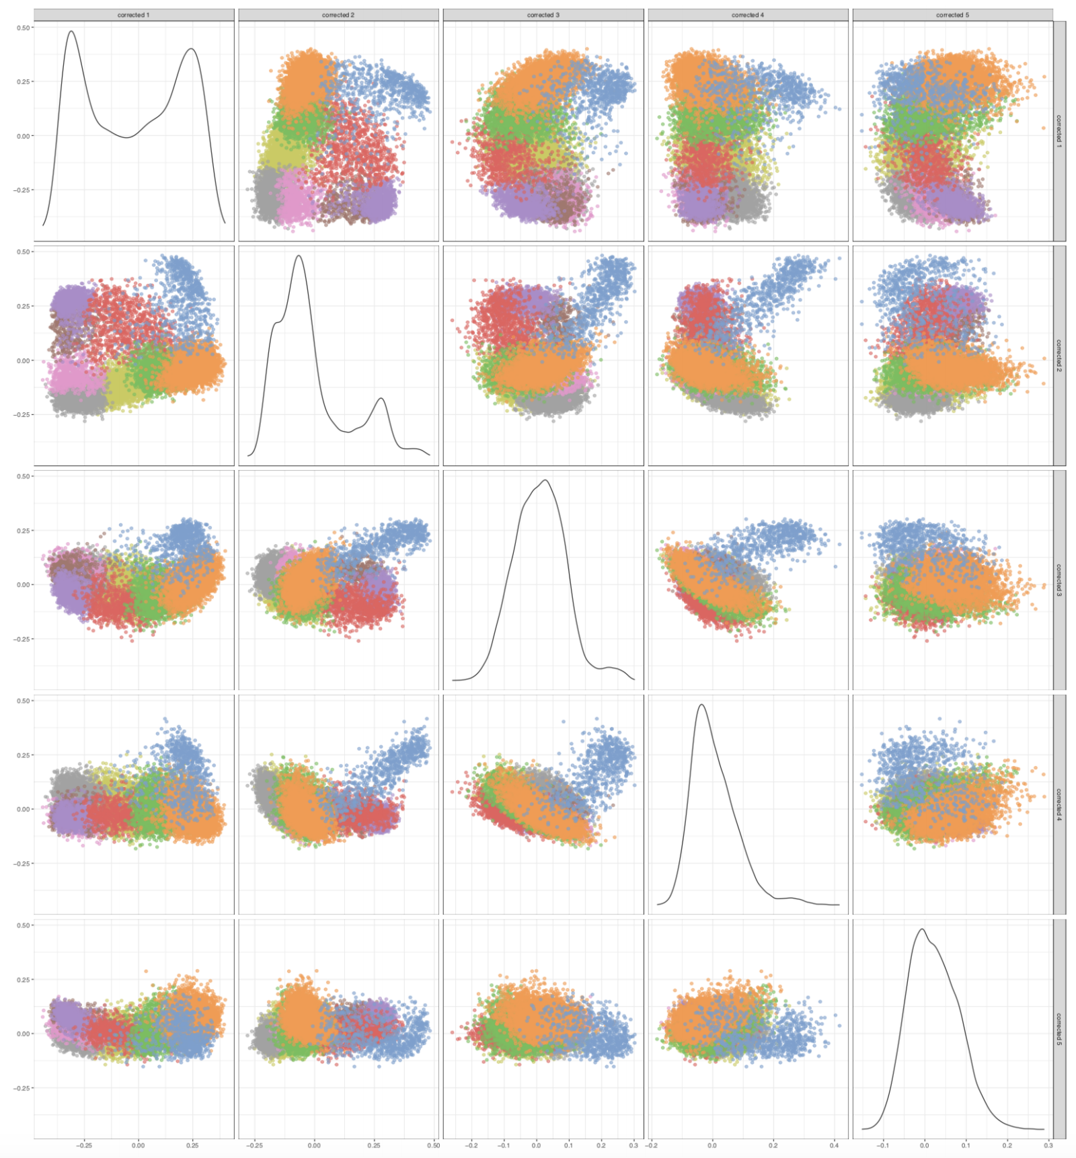
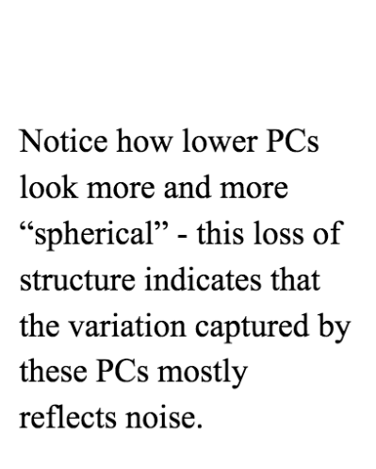
Principal Component Analysis: assessing lower dimensions
21
Notes:
I would like to expand these observations to in vivo data. I also want to check what happens in terms of transcriptional dynamics in cells where Cyclin O, a key non-canonical cyclin involved in MCC diff., is knocked-out.

Slide 22
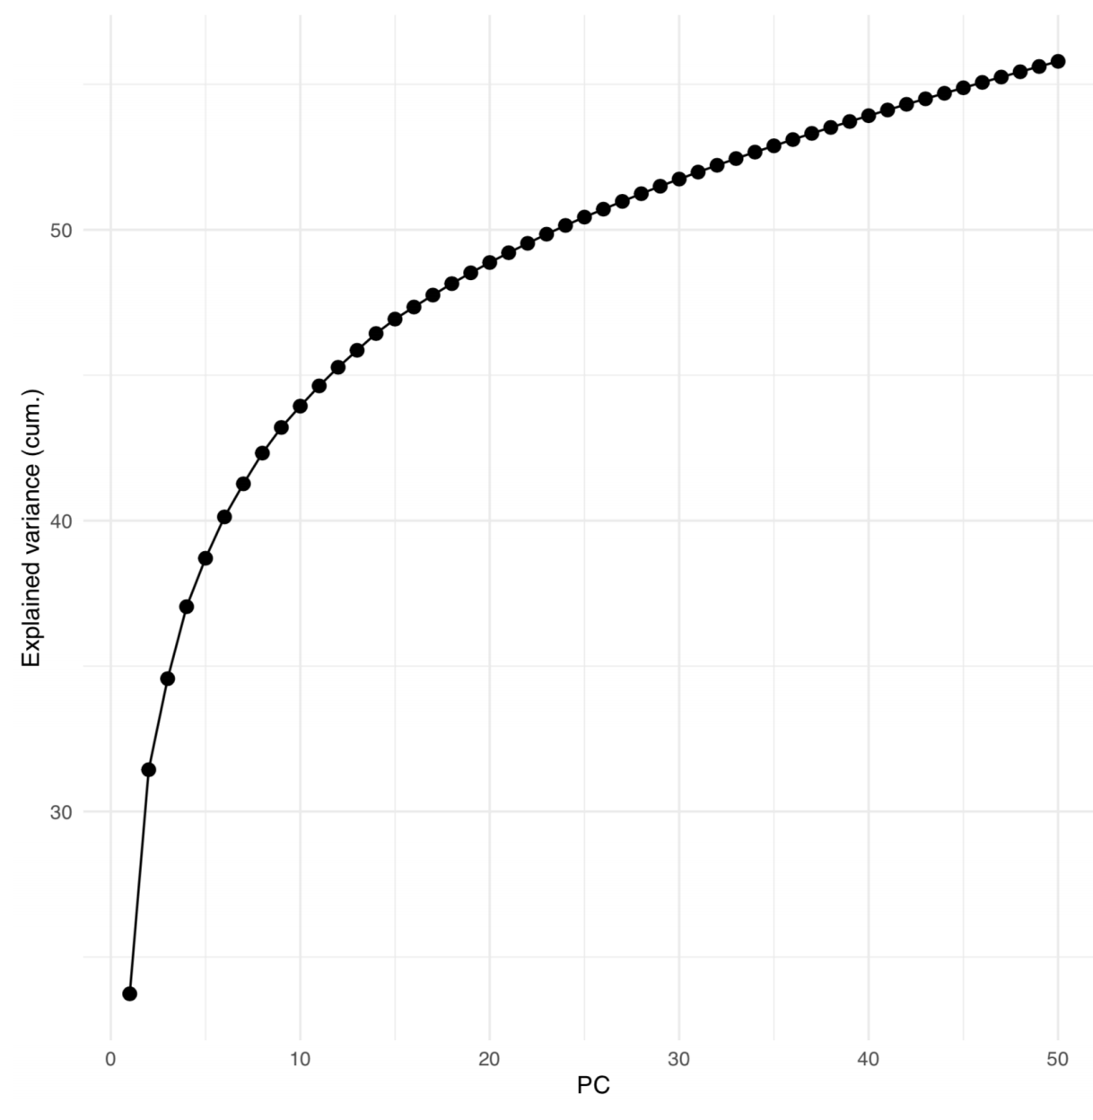
Principal Component Analysis: assessing lower dimensions
22
Notes:
I would like to expand these observations to in vivo data. I also want to check what happens in terms of transcriptional dynamics in cells where Cyclin O, a key non-canonical cyclin involved in MCC diff., is knocked-out.

Slide 23
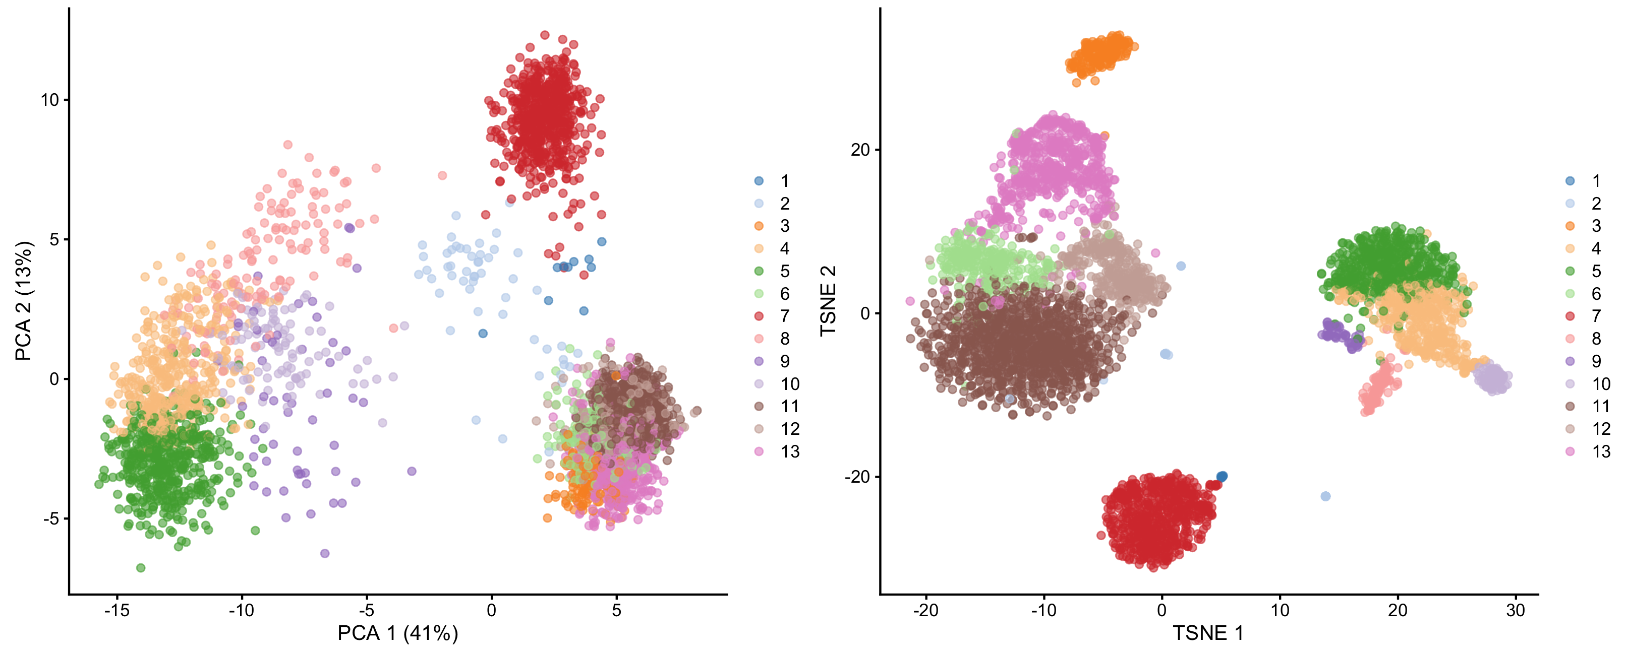
Going further: non-linear dimensional reductions
In a t-SNE projection, similar objects (cells) are modeled by nearby two-(three)dimensional points and dissimilar objects are modeled by distant points with high probability.
1,000s cells
1,000s cells
10,000 genes
(few) Principal components
23
Notes:
I would like to expand these observations to in vivo data. I also want to check what happens in terms of transcriptional dynamics in cells where Cyclin O, a key non-canonical cyclin involved in MCC diff., is knocked-out.

Slide 24
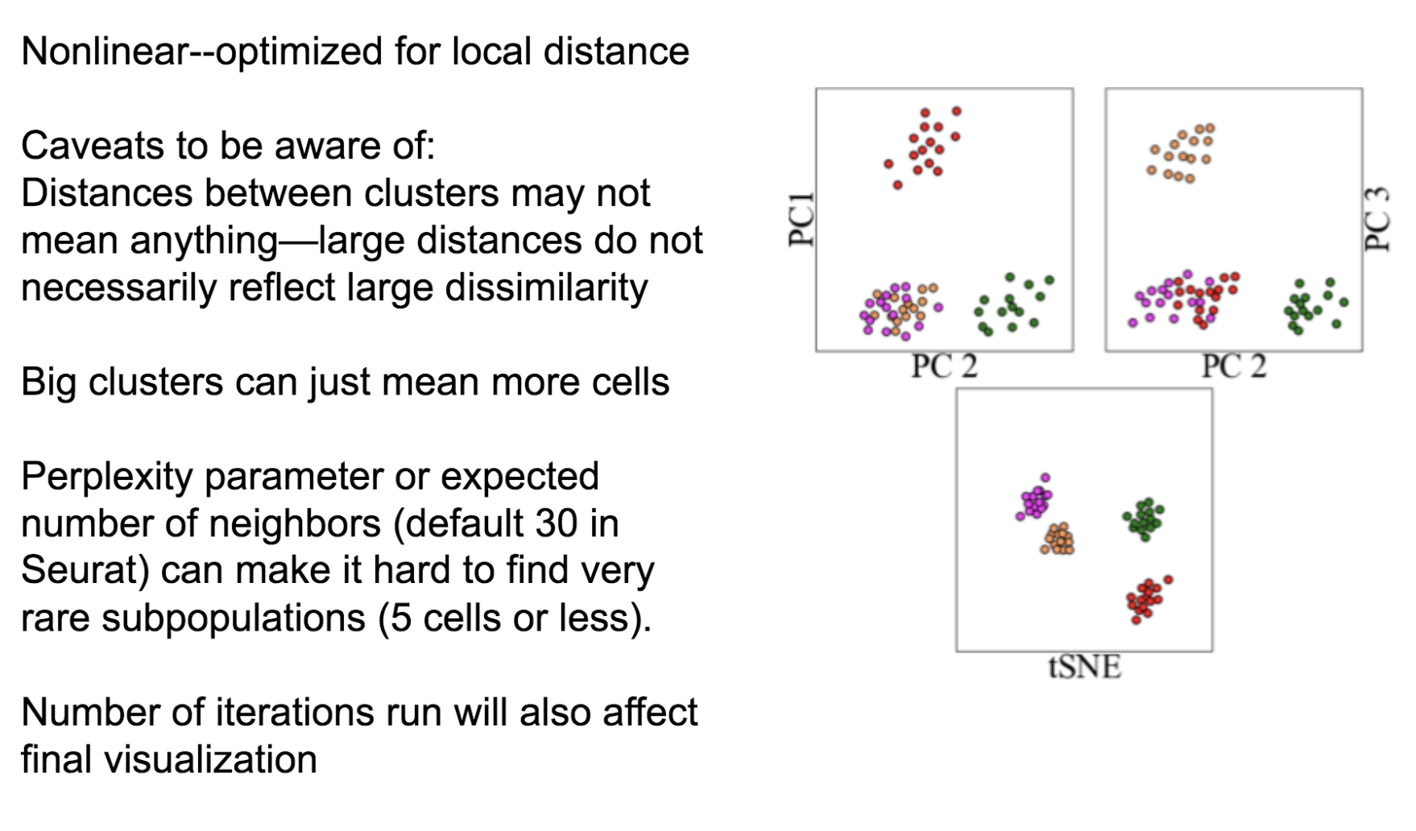
Caution with tSNE visualization
A great tSNE resource! https://distill.pub/2016/misread-tsne/
24
Notes:
I would like to expand these observations to in vivo data. I also want to check what happens in terms of transcriptional dynamics in cells where Cyclin O, a key non-canonical cyclin involved in MCC diff., is knocked-out.

Slide 25
Caution with tSNE visualization
A great tSNE resource! https://distill.pub/2016/misread-tsne/
25
Notes:
I would like to expand these observations to in vivo data. I also want to check what happens in terms of transcriptional dynamics in cells where Cyclin O, a key non-canonical cyclin involved in MCC diff., is knocked-out.

Slide 26
Other non-linear dimensional reduction approaches
Force-directed graph embedding
UMAP
Diffusion Maps
Non-negative Matrix Factorization
Probabilistic (topic models/Latent Dirichlet Allocation (LDA))
BE AWARE!!
Some are linear, some other are not.
While PCA is a general “one-size-fits-all” approach, others will yield more specific outputs, targeting a particular question.
26
Notes:
I would like to expand these observations to in vivo data. I also want to check what happens in terms of transcriptional dynamics in cells where Cyclin O, a key non-canonical cyclin involved in MCC diff., is knocked-out.

Slide 27
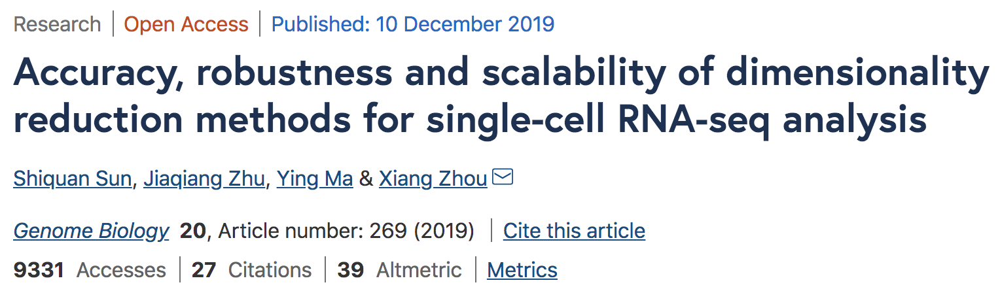
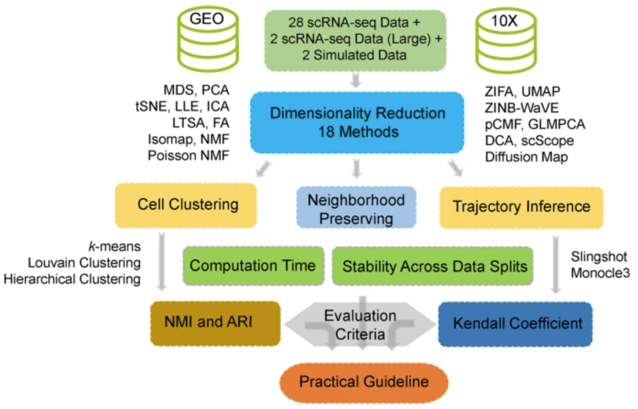
Other non-linear dimensional reduction approaches
27
Notes:
I would like to expand these observations to in vivo data. I also want to check what happens in terms of transcriptional dynamics in cells where Cyclin O, a key non-canonical cyclin involved in MCC diff., is knocked-out.

Slide 28
Analysis workflow
Pre-Processing
Clustering
Biology
Expression Matrix
(GENES x CELLS)
1. Identify
Variable Genes
5. Differentially Expressed Genes
Filter Cells /
Quality Control
2. Dimensionality Reduction
6. Assigning
Cell Type
Normalization
3. Clustering
7. Functional Annotation
4. Explore (known)
marker genes
Notes:
I would like to expand these observations to in vivo data. I also want to check what happens in terms of transcriptional dynamics in cells where Cyclin O, a key non-canonical cyclin involved in MCC diff., is knocked-out.

Slide 29
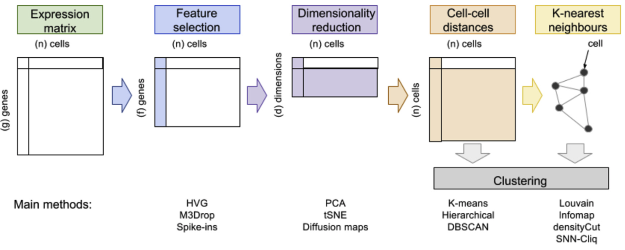
Different methodologies for clustering
Andrews et al., 2018
29
Notes:
I would like to expand these observations to in vivo data. I also want to check what happens in terms of transcriptional dynamics in cells where Cyclin O, a key non-canonical cyclin involved in MCC diff., is knocked-out.

Slide 30
”Traditional” clustering
Andrews et al., 2018
30
Notes:
I would like to expand these observations to in vivo data. I also want to check what happens in terms of transcriptional dynamics in cells where Cyclin O, a key non-canonical cyclin involved in MCC diff., is knocked-out.

Slide 31
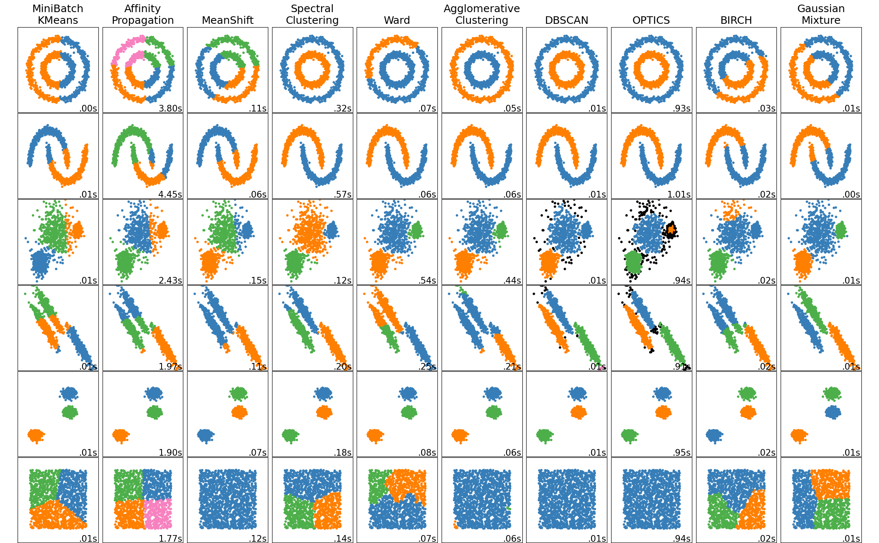
”Traditional” clustering
https://scikit-learn.org/stable/modules/clustering.html#overview-of-clustering-methods
31
Notes:
I would like to expand these observations to in vivo data. I also want to check what happens in terms of transcriptional dynamics in cells where Cyclin O, a key non-canonical cyclin involved in MCC diff., is knocked-out.

Slide 32
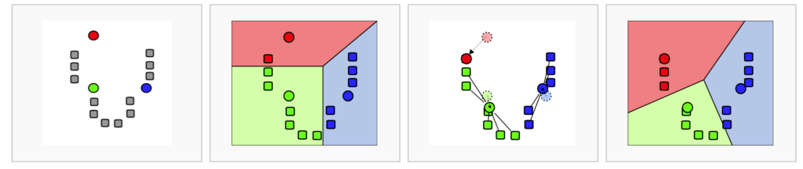
”Traditional” clustering
K-means algorithm is both fast and generally reliable, as a first approach.
32
Notes:
I would like to expand these observations to in vivo data. I also want to check what happens in terms of transcriptional dynamics in cells where Cyclin O, a key non-canonical cyclin involved in MCC diff., is knocked-out.

Slide 33
Graph-based clustering
Andrews et al., 2018
33
Notes:
I would like to expand these observations to in vivo data. I also want to check what happens in terms of transcriptional dynamics in cells where Cyclin O, a key non-canonical cyclin involved in MCC diff., is knocked-out.

Slide 34
Why do we need graph-based clustering?
Curse of dimensionality:
“All data become sparse in high-dimensional space and therefore similarities measured by Euclidean distances etc are generally low between all objects.”
There is no point performing a hierarchical clustering of 10,000 cells if 90% of the pairwise distances are null !!
Andrews et al., 2018
34
Notes:
I would like to expand these observations to in vivo data. I also want to check what happens in terms of transcriptional dynamics in cells where Cyclin O, a key non-canonical cyclin involved in MCC diff., is knocked-out.

Slide 35
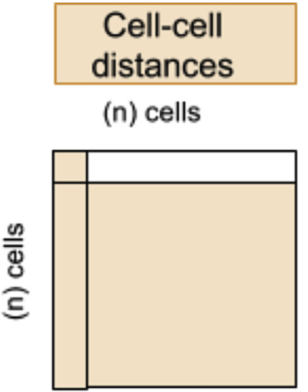

Building a k-Nearest Neighbors graph (with k = 4)
35
Notes:
I would like to expand these observations to in vivo data. I also want to check what happens in terms of transcriptional dynamics in cells where Cyclin O, a key non-canonical cyclin involved in MCC diff., is knocked-out.

Slide 36
Building a k-Nearest Neighbors graph (with k = 4)
1
36
Notes:
I would like to expand these observations to in vivo data. I also want to check what happens in terms of transcriptional dynamics in cells where Cyclin O, a key non-canonical cyclin involved in MCC diff., is knocked-out.

Slide 37
Building a k-Nearest Neighbors graph (with k = 4)
1
2
37
Notes:
I would like to expand these observations to in vivo data. I also want to check what happens in terms of transcriptional dynamics in cells where Cyclin O, a key non-canonical cyclin involved in MCC diff., is knocked-out.

Slide 38
Building a k-Nearest Neighbors graph (with k = 4)
1
3
2
38
Notes:
I would like to expand these observations to in vivo data. I also want to check what happens in terms of transcriptional dynamics in cells where Cyclin O, a key non-canonical cyclin involved in MCC diff., is knocked-out.

Slide 39
Building a k-Nearest Neighbors graph (with k = 4)
4
1
3
2
39
Notes:
I would like to expand these observations to in vivo data. I also want to check what happens in terms of transcriptional dynamics in cells where Cyclin O, a key non-canonical cyclin involved in MCC diff., is knocked-out.

Slide 40
Building a k-Nearest Neighbors graph (with k = 4)
4
1
3
2
4
1
3
2
40
Notes:
I would like to expand these observations to in vivo data. I also want to check what happens in terms of transcriptional dynamics in cells where Cyclin O, a key non-canonical cyclin involved in MCC diff., is knocked-out.

Slide 41
Building a k-Nearest Neighbors graph (with k = 4)
41
Notes:
I would like to expand these observations to in vivo data. I also want to check what happens in terms of transcriptional dynamics in cells where Cyclin O, a key non-canonical cyclin involved in MCC diff., is knocked-out.

Slide 42
Extending KNN to SNN graphs (Shared Nearest Neighbors) (still with k = 4)
42
Notes:
I would like to expand these observations to in vivo data. I also want to check what happens in terms of transcriptional dynamics in cells where Cyclin O, a key non-canonical cyclin involved in MCC diff., is knocked-out.

Slide 43
Extending KNN to SNN graphs (Shared Nearest Neighbors) (still with k = 4)
Two cells are connected by an edge if any of their nearest neighbors are shared.
43
Notes:
I would like to expand these observations to in vivo data. I also want to check what happens in terms of transcriptional dynamics in cells where Cyclin O, a key non-canonical cyclin involved in MCC diff., is knocked-out.

Slide 44
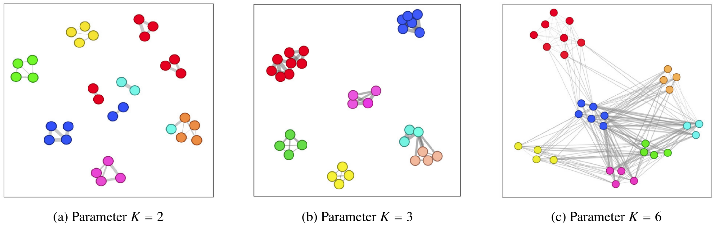
Extending KNN to SNN graphs (Shared Nearest Neighbors) (still with k = 4)
K is important when building KNN or SNN graphs !
44
Notes:
I would like to expand these observations to in vivo data. I also want to check what happens in terms of transcriptional dynamics in cells where Cyclin O, a key non-canonical cyclin involved in MCC diff., is knocked-out.

Slide 45
Graph-based clustering
Graph-based clustering is nothing more than community detection (an “old” field from ’00s).
45
Notes:
I would like to expand these observations to in vivo data. I also want to check what happens in terms of transcriptional dynamics in cells where Cyclin O, a key non-canonical cyclin involved in MCC diff., is knocked-out.

Slide 46
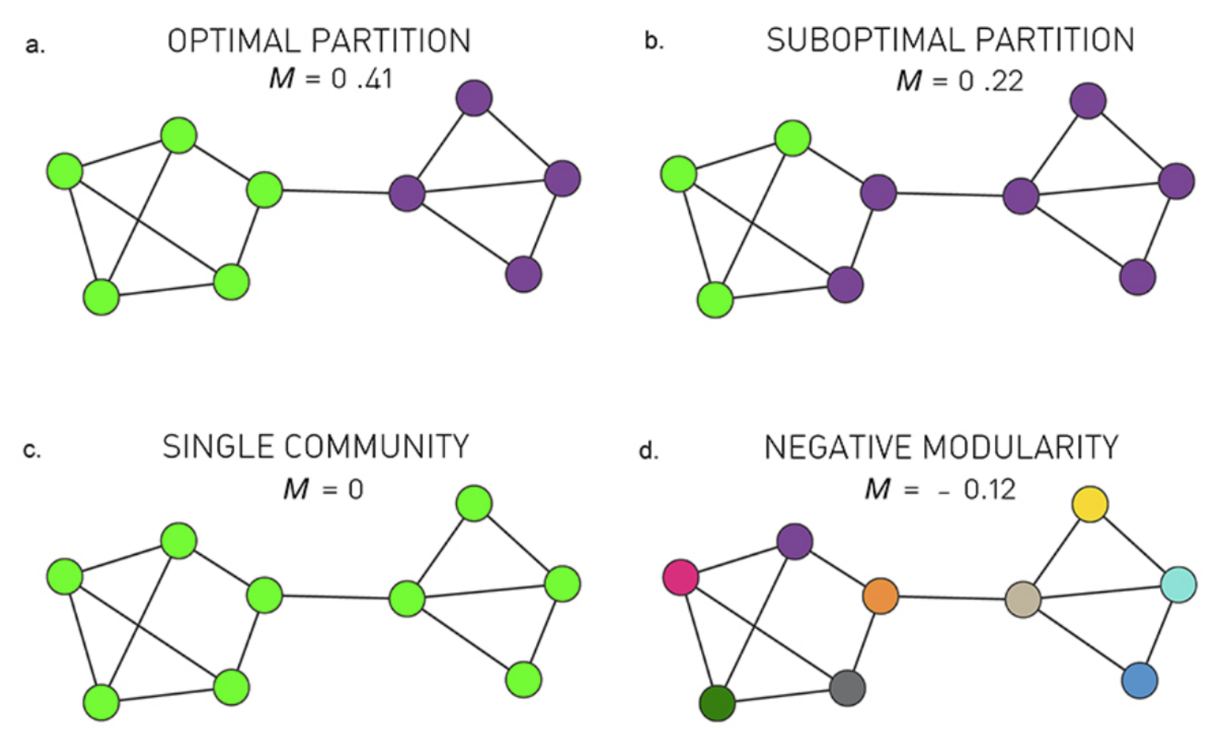
Graph-based clustering
Graph-based clustering is nothing more than community detection (an “old” field from ’00s).
Many different algorithms for community detection:
Louvain (heuristic)
Infomap
Walktrap
…
Most of them are based on modularity maximization
46
Notes:
I would like to expand these observations to in vivo data. I also want to check what happens in terms of transcriptional dynamics in cells where Cyclin O, a key non-canonical cyclin involved in MCC diff., is knocked-out.

Slide 47

Graph-based clustering
Graph-based clustering is nothing more than community detection (an “old” field from ’00s).
The Atlas for the Aspiring Network Scientist,
Michele Coscia 2021
47
Notes:
I would like to expand these observations to in vivo data. I also want to check what happens in terms of transcriptional dynamics in cells where Cyclin O, a key non-canonical cyclin involved in MCC diff., is knocked-out.

Slide 48
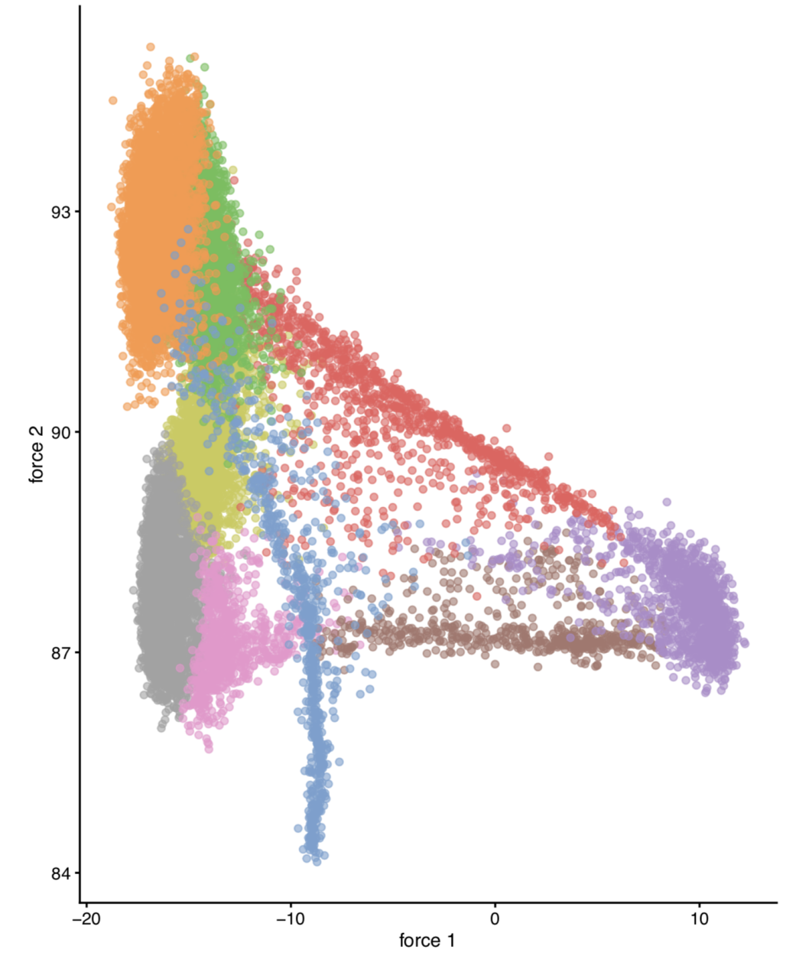
Graph-based clustering
CAREFUL!
A graph can be visualized (i.e. embedded) in 2D, but the graph-based clustering step (i.e. community finding) is not done on its 2D embedding!!
“Do not let the tail (of visualization) wag the dog (of quantitative analysis)”
-- A. Lun
48
Notes:
I would like to expand these observations to in vivo data. I also want to check what happens in terms of transcriptional dynamics in cells where Cyclin O, a key non-canonical cyclin involved in MCC diff., is knocked-out.

Slide 49
Analysis workflow
Pre-Processing
Clustering
Biology
Expression Matrix
(GENES x CELLS)
1. Identify
Variable Genes
5. Differentially Expressed Genes
Filter Cells /
Quality Control
2. Dimensionality Reduction
6. Assigning
Cell Type
Normalization
3. Clustering
7. Functional Annotation
4. Explore (known)
marker genes
Notes:
I would like to expand these observations to in vivo data. I also want to check what happens in terms of transcriptional dynamics in cells where Cyclin O, a key non-canonical cyclin involved in MCC diff., is knocked-out.

Slide 50
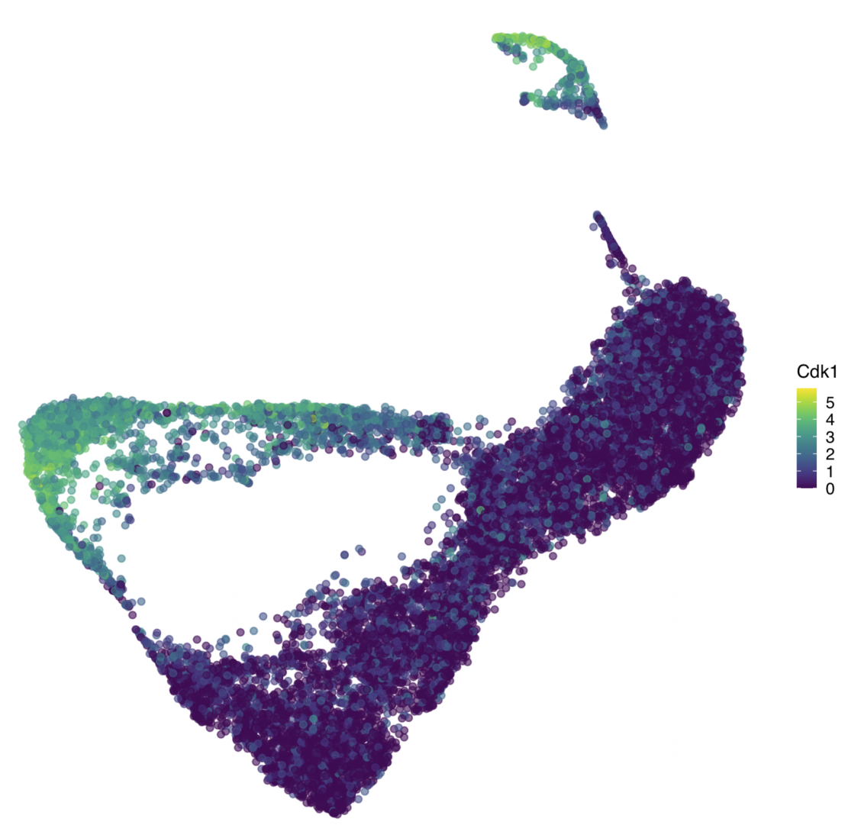
Visualizing expression of a gene of interest
On the dataset embedding:
50
Notes:
I would like to expand these observations to in vivo data. I also want to check what happens in terms of transcriptional dynamics in cells where Cyclin O, a key non-canonical cyclin involved in MCC diff., is knocked-out.

Slide 51
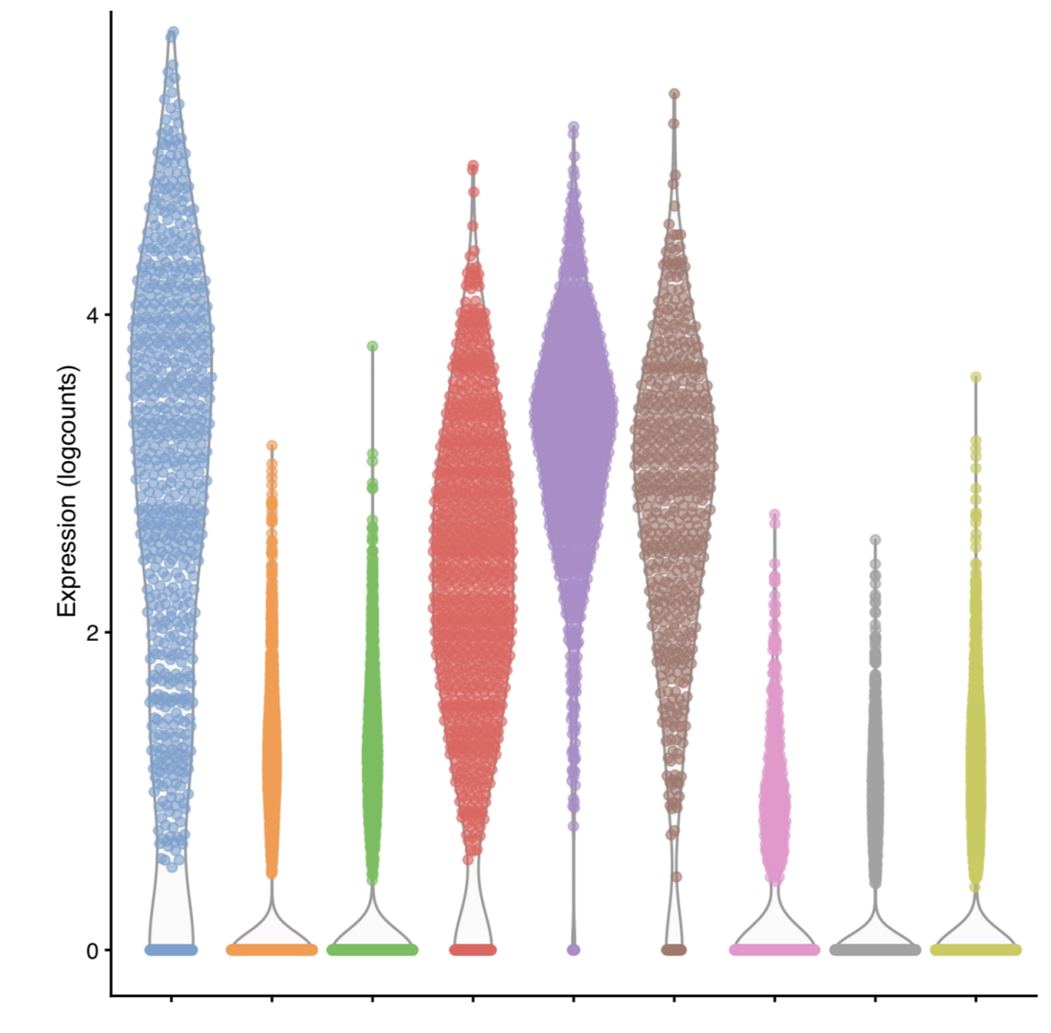
Visualizing expression of a gene of interest
On the dataset embedding:
By clusters:
51
Notes:
I would like to expand these observations to in vivo data. I also want to check what happens in terms of transcriptional dynamics in cells where Cyclin O, a key non-canonical cyclin involved in MCC diff., is knocked-out.

Slide 52
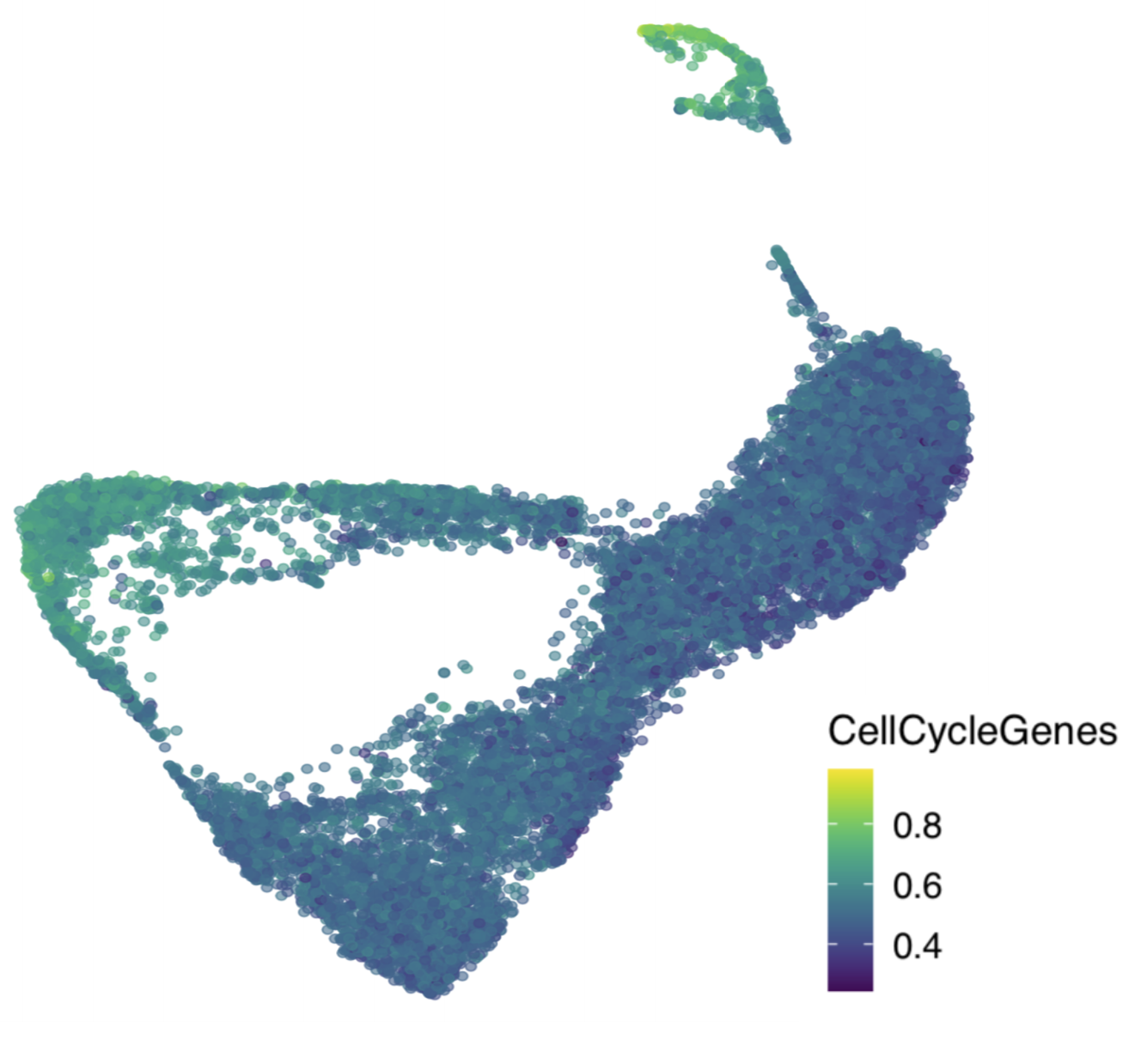
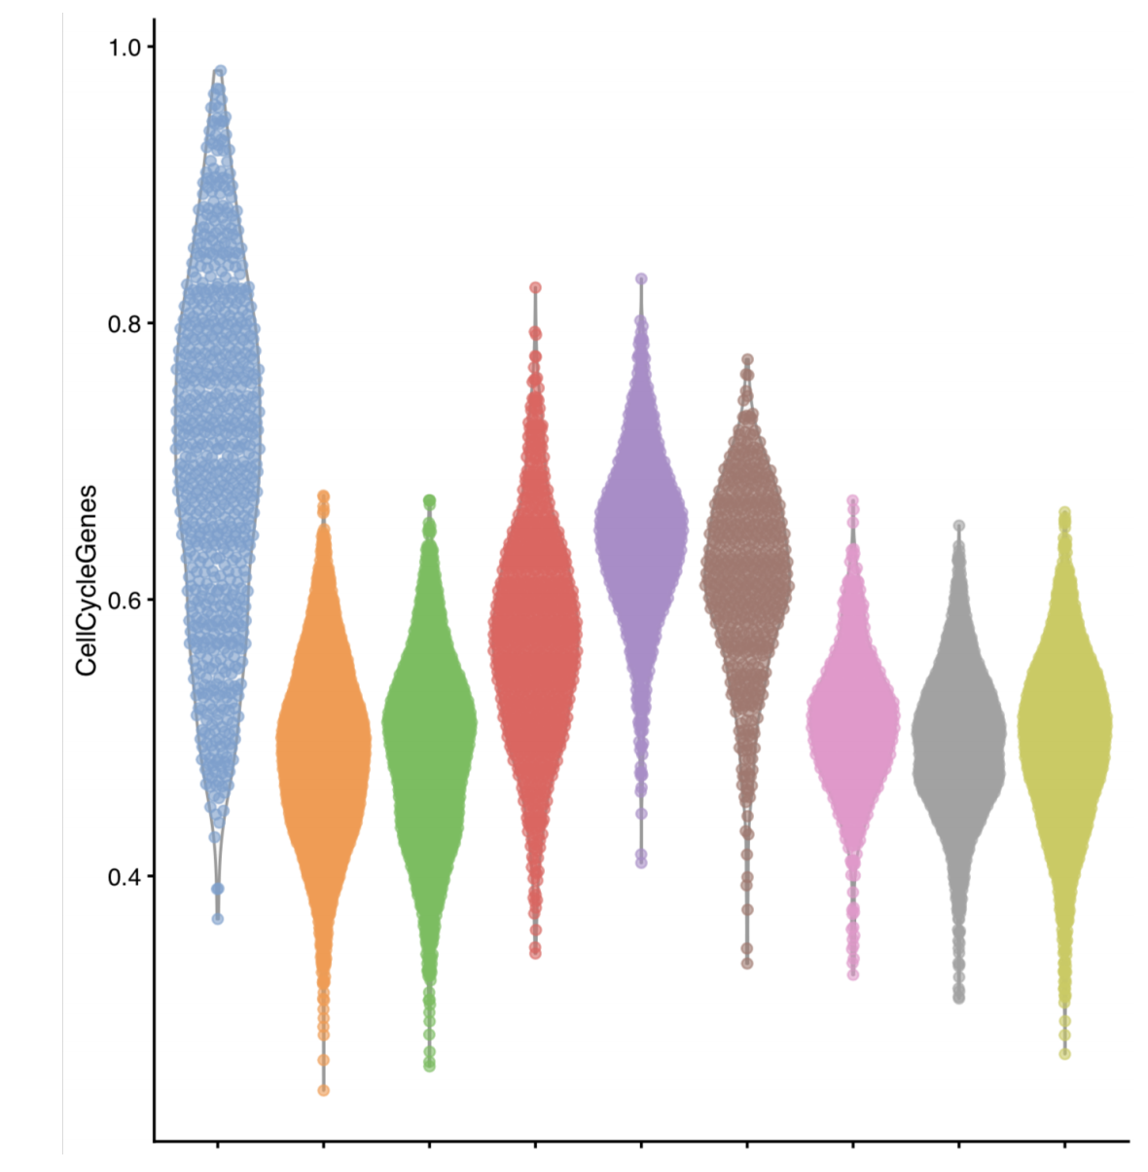
Visualizing expression of a module of interest
On the dataset embedding:
By clusters:
52
Notes:
I would like to expand these observations to in vivo data. I also want to check what happens in terms of transcriptional dynamics in cells where Cyclin O, a key non-canonical cyclin involved in MCC diff., is knocked-out.

Slide 53
Analysis workflow
Pre-Processing
Clustering
Biology
Expression Matrix
(GENES x CELLS)
1. Identify
Variable Genes
5. Differentially Expressed Genes
Filter Cells /
Quality Control
2. Dimensionality Reduction
6. Assigning
Cell Type
Normalization
3. Clustering
7. Functional Annotation
4. Explore (known)
marker genes
Notes:
I would like to expand these observations to in vivo data. I also want to check what happens in terms of transcriptional dynamics in cells where Cyclin O, a key non-canonical cyclin involved in MCC diff., is knocked-out.

Slide 54
Differential Expression Testing
In scRNA-seq we often do not have a defined set of experimental conditions.
Instead, we can perform pairwise comparisons of gene expression, between pairs of cell clusters, using some of the following tests:
"wilcox" : Wilcoxon rank sum test (default)
t" : Student’s t-test
"poisson" : Likelihood ratio test assuming an underlying poisson distribution. Use only for UMI-based datasets
"negbinom" : Likelihood ratio test assuming an underlying negative binomial distribution. Use only for UMI-based datasets
Others…
54
Notes:
I would like to expand these observations to in vivo data. I also want to check what happens in terms of transcriptional dynamics in cells where Cyclin O, a key non-canonical cyclin involved in MCC diff., is knocked-out.

Slide 55
Differential Expression Testing
In scRNA-seq we often do not have a defined set of experimental conditions.
Instead, we can perform pairwise comparisons of gene expression, between pairs of cell clusters, using some of the following tests:
See Seurat::FindMarkers() and scran::findMarkers() for more info…
markers <- scran::findMarkers(
sce,
groups = sce$cluster,
test.type = ”t”
)
55
Notes:
I would like to expand these observations to in vivo data. I also want to check what happens in terms of transcriptional dynamics in cells where Cyclin O, a key non-canonical cyclin involved in MCC diff., is knocked-out.

Slide 56

Differential Expression Testing
Think about your experimental design!!!
BACKGROUND
N genes
N reads
BATCH
RUN
1,000s cells
56
Notes:
I would like to expand these observations to in vivo data. I also want to check what happens in terms of transcriptional dynamics in cells where Cyclin O, a key non-canonical cyclin involved in MCC diff., is knocked-out.

Slide 57
Differential Expression Testing
Think about your experimental design!!!
BACKGROUND
N genes
N reads
BATCH
RUN
1,000s cells
Not all the cells are the same: there are confounding variables.
57
Notes:
I would like to expand these observations to in vivo data. I also want to check what happens in terms of transcriptional dynamics in cells where Cyclin O, a key non-canonical cyclin involved in MCC diff., is knocked-out.

Slide 58
Differential Expression Testing
Think about your experimental design!!!
BACKGROUND
N genes
N reads
BATCH
RUN
1,000s cells
BLOCKING MATRIX
Not all the cells are the same: there are confounding variables.
markers <- scran::findMarkers(
sce,
groups = sce$cluster,
test.type = ”t”,
block = <BLOCKING MATRIX>
)
58
Notes:
I would like to expand these observations to in vivo data. I also want to check what happens in terms of transcriptional dynamics in cells where Cyclin O, a key non-canonical cyclin involved in MCC diff., is knocked-out.

Slide 59
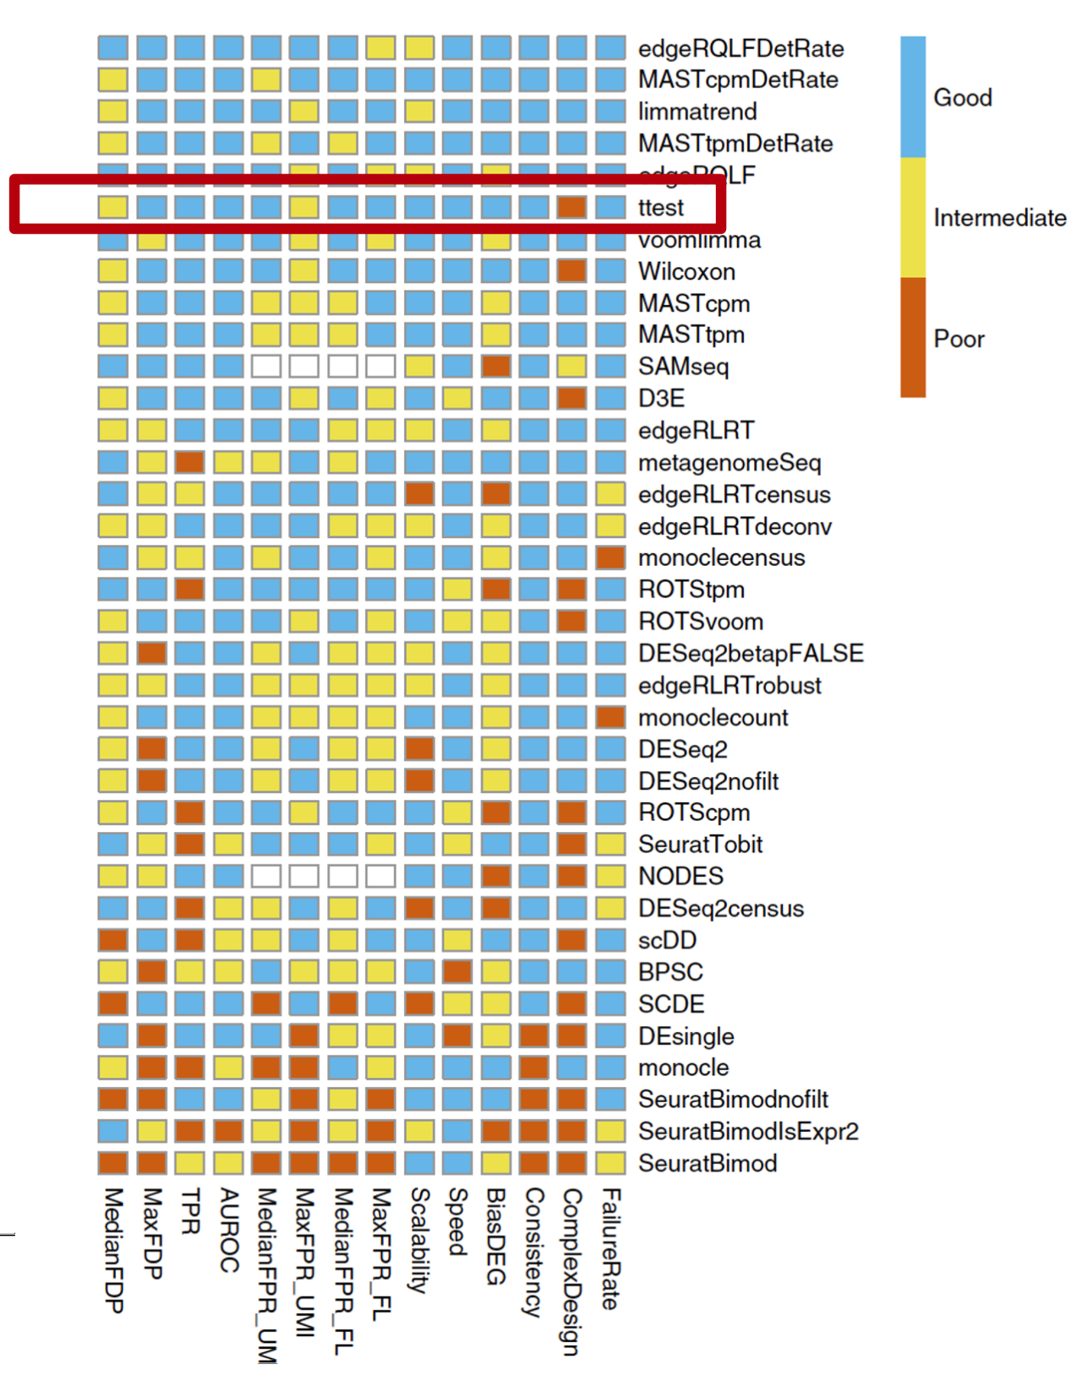
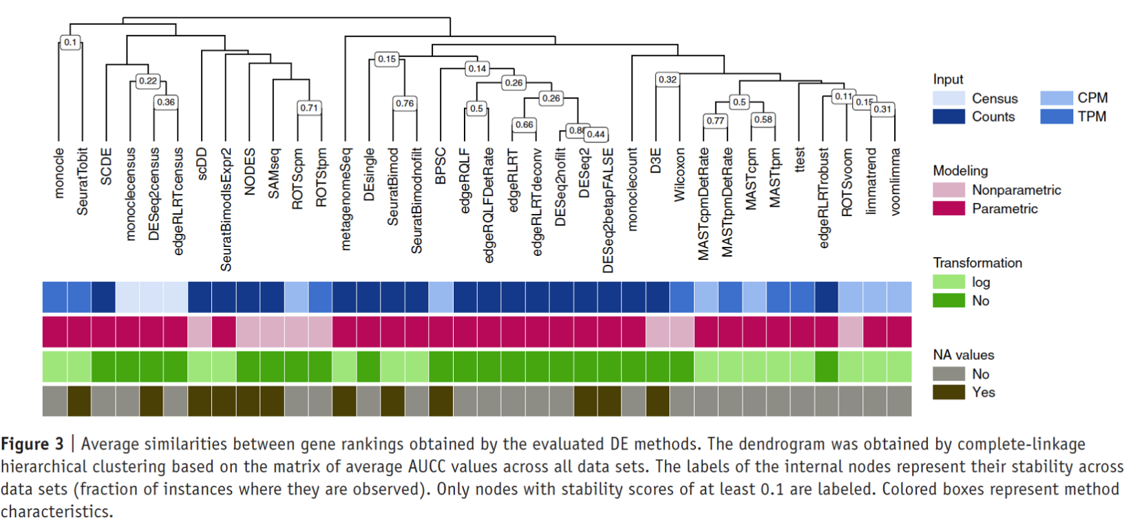
Differential Expression Testing: many different assays…
Again, different tests are available and depending on your study case, might be more/less appropriate.
I would recommend going with t-test as default.
Soneson and Robinson, 2018
59
Notes:
I would like to expand these observations to in vivo data. I also want to check what happens in terms of transcriptional dynamics in cells where Cyclin O, a key non-canonical cyclin involved in MCC diff., is knocked-out.

Slide 60
Analysis workflow
Pre-Processing
Clustering
Biology
Expression Matrix
(GENES x CELLS)
1. Identify
Variable Genes
5. Differentially Expressed Genes
Filter Cells /
Quality Control
2. Dimensionality Reduction
6. Assigning
Cell Type
Normalization
3. Clustering
7. Functional Annotation
4. Explore (known)
marker genes
Notes:
I would like to expand these observations to in vivo data. I also want to check what happens in terms of transcriptional dynamics in cells where Cyclin O, a key non-canonical cyclin involved in MCC diff., is knocked-out.

Slide 61
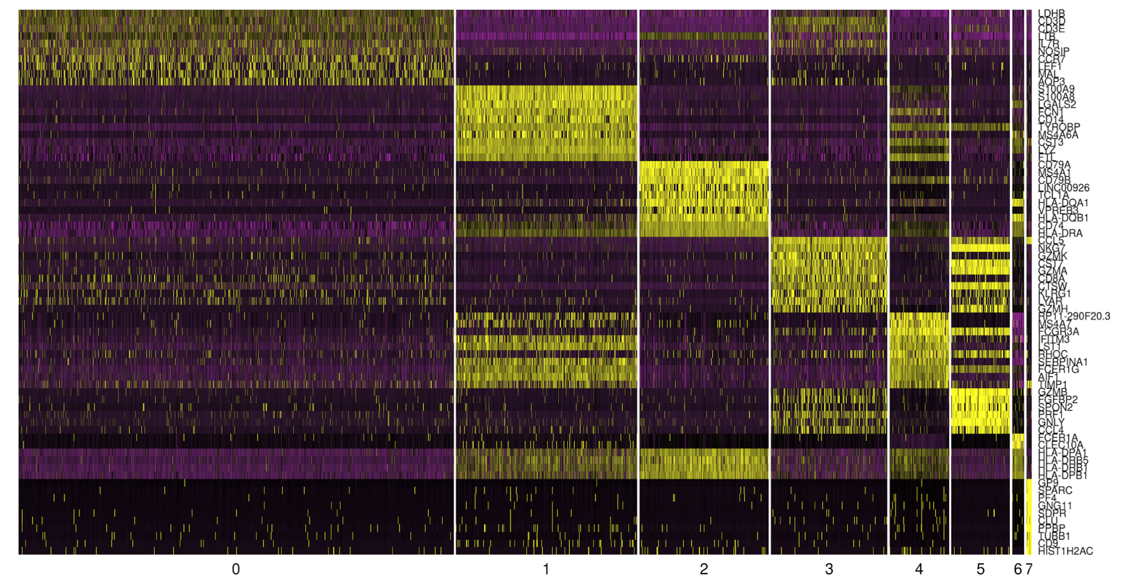
Cell type annotation using identified markers per cluster
Genes
Cell clusters
61
Notes:
I would like to expand these observations to in vivo data. I also want to check what happens in terms of transcriptional dynamics in cells where Cyclin O, a key non-canonical cyclin involved in MCC diff., is knocked-out.

Slide 62
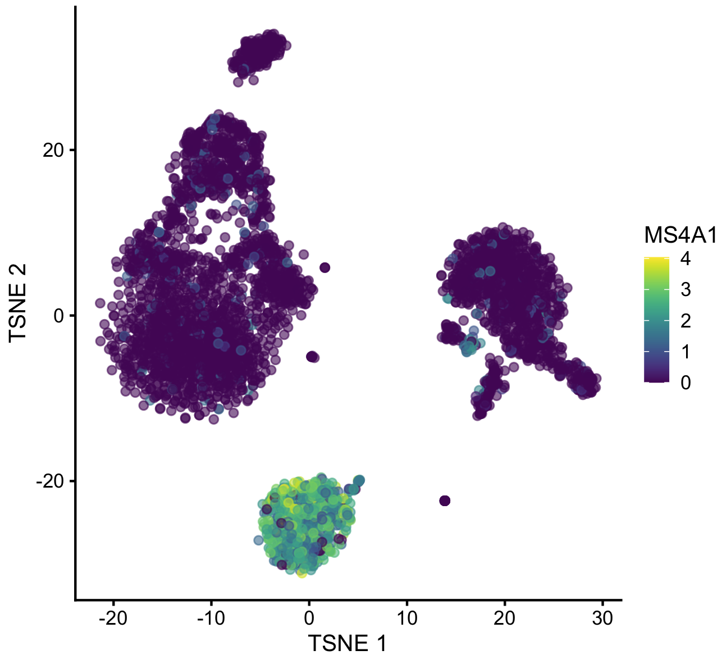
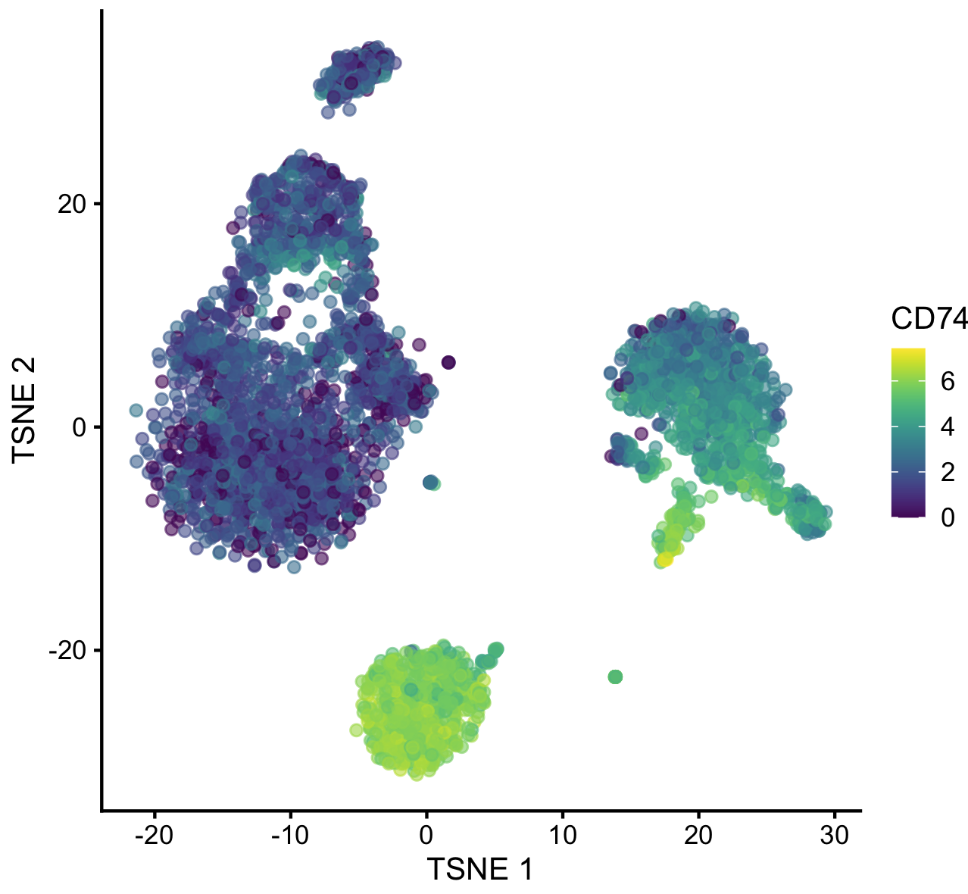
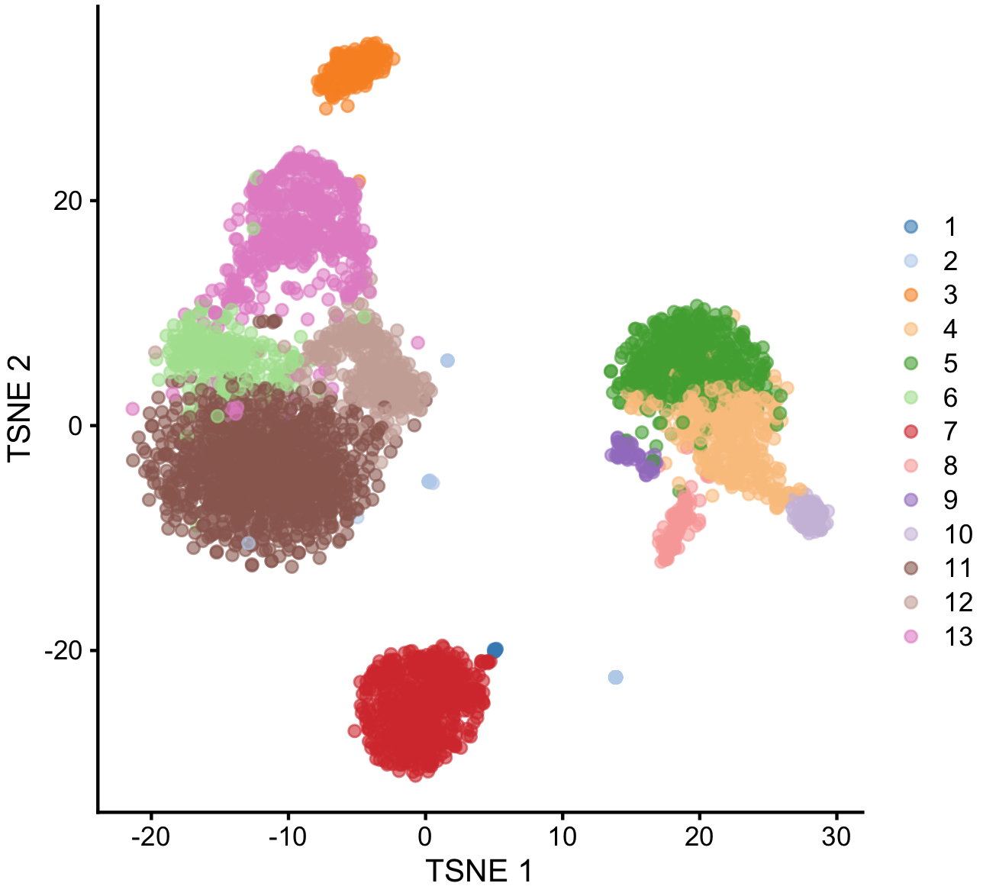
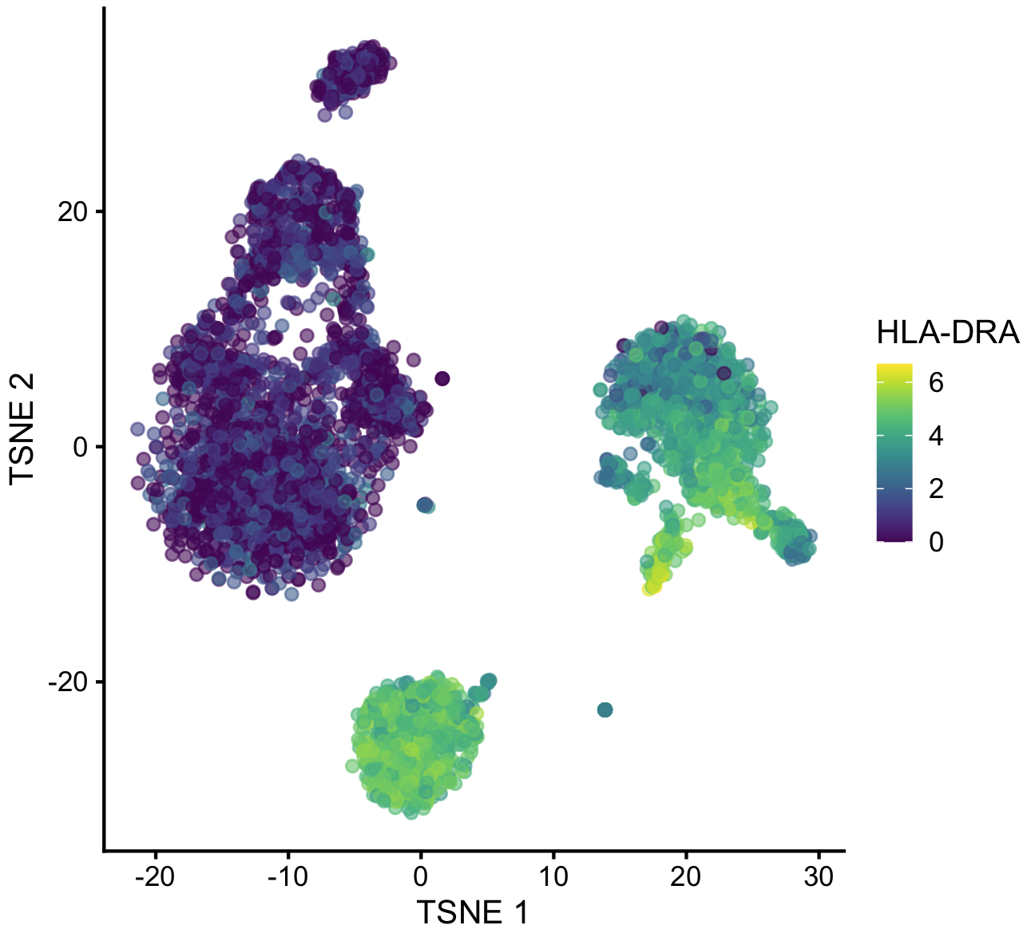

Manual cell type annotation using identified markers per cluster
Top markers of cluster #7 in PBMCs:
CD74
HLA-DRA
MS4A1
CD79A
HLA-DRB1
HLA-DPA1
CD79B
LTB
HLA-DQB1
TCL1A
CD52
HLA-DPB1
CD37
62
Notes:
I would like to expand these observations to in vivo data. I also want to check what happens in terms of transcriptional dynamics in cells where Cyclin O, a key non-canonical cyclin involved in MCC diff., is knocked-out.

Slide 63
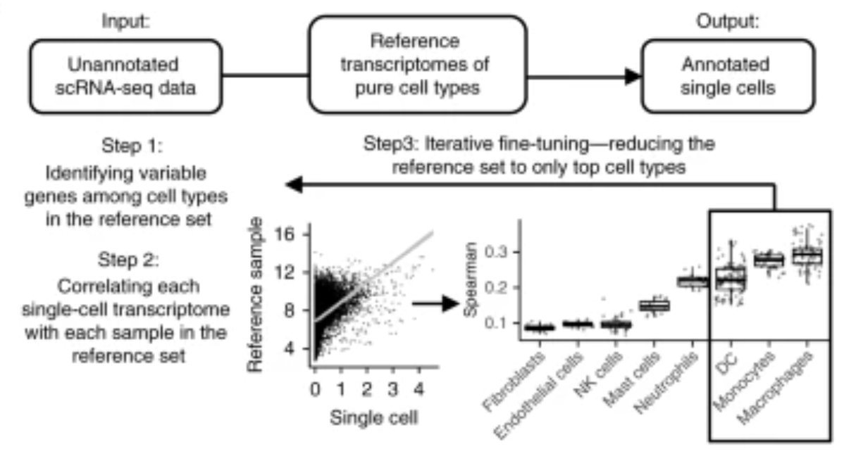
Automated cell type annotation using public marker databases
SingleR can rely on references of pure cell types to annotate individual cells within a scRNAseq dataset.
Aran et al., Nat. Immuno. 2019
63
Notes:
I would like to expand these observations to in vivo data. I also want to check what happens in terms of transcriptional dynamics in cells where Cyclin O, a key non-canonical cyclin involved in MCC diff., is knocked-out.

Slide 64
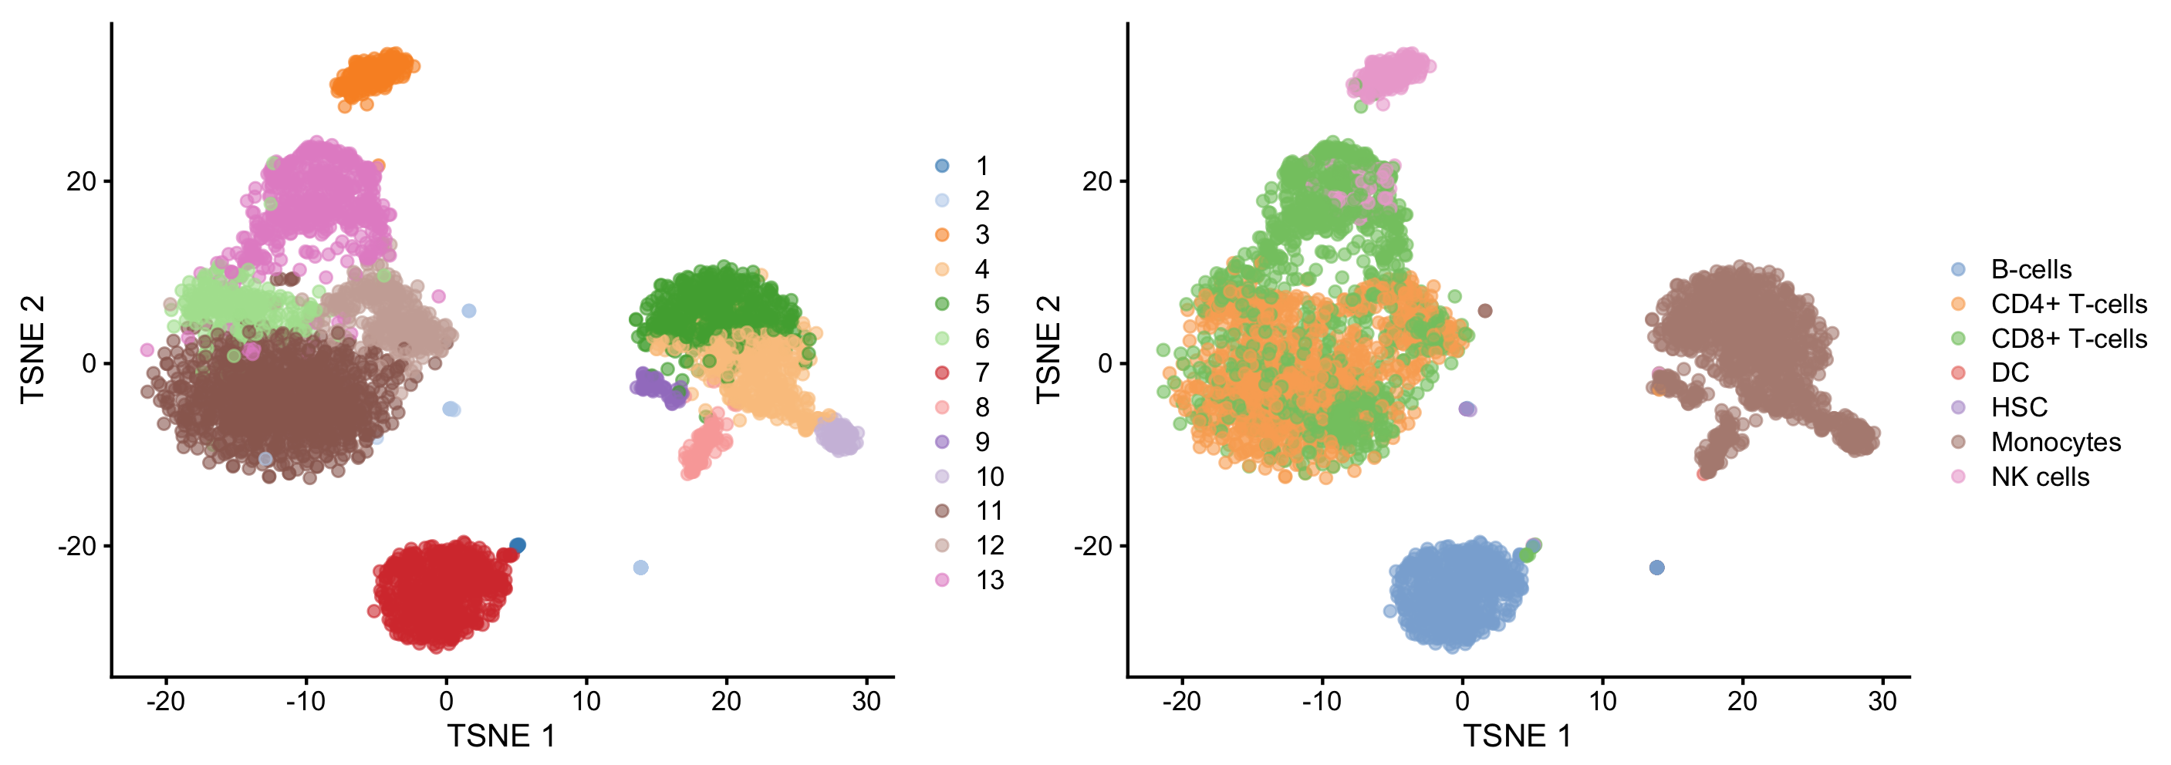
Automated cell type annotation using public marker databases
SingleR can rely on references of pure cell types to annotate individual cells within a scRNAseq dataset.
However, it is limited in sensitivity, as it can only identify cells based on the references used.
64
Notes:
I would like to expand these observations to in vivo data. I also want to check what happens in terms of transcriptional dynamics in cells where Cyclin O, a key non-canonical cyclin involved in MCC diff., is knocked-out.

Slide 65
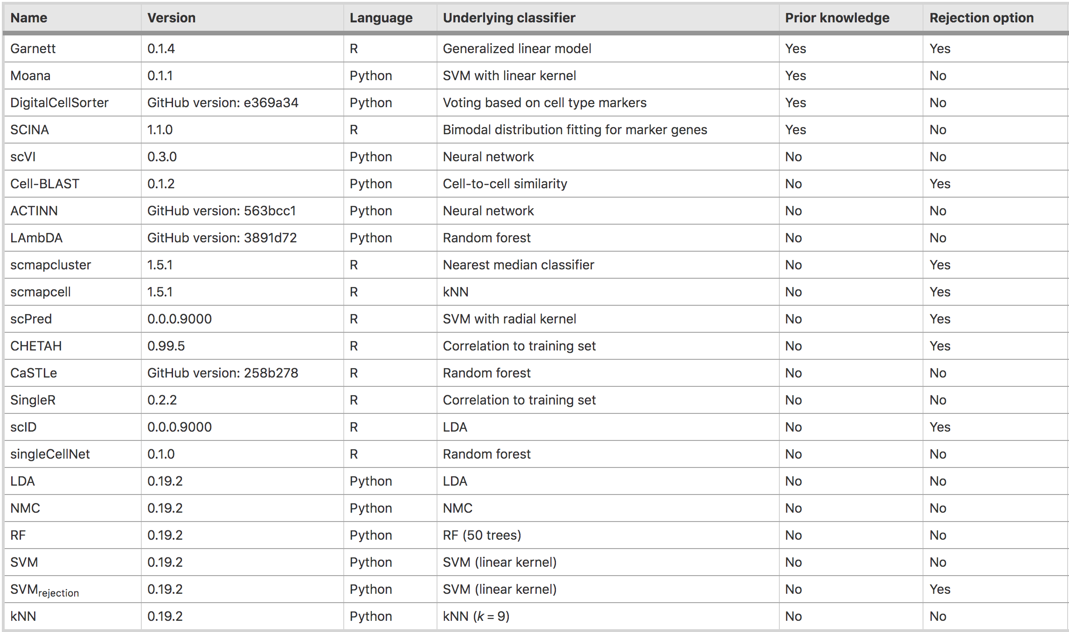
Automated cell type annotation using public marker databases
Huge (and growing!) collection of tools for automated cell annotation…
Abdelaal et al., Genome Biol. 2019
65
Notes:
I would like to expand these observations to in vivo data. I also want to check what happens in terms of transcriptional dynamics in cells where Cyclin O, a key non-canonical cyclin involved in MCC diff., is knocked-out.

Slide 66
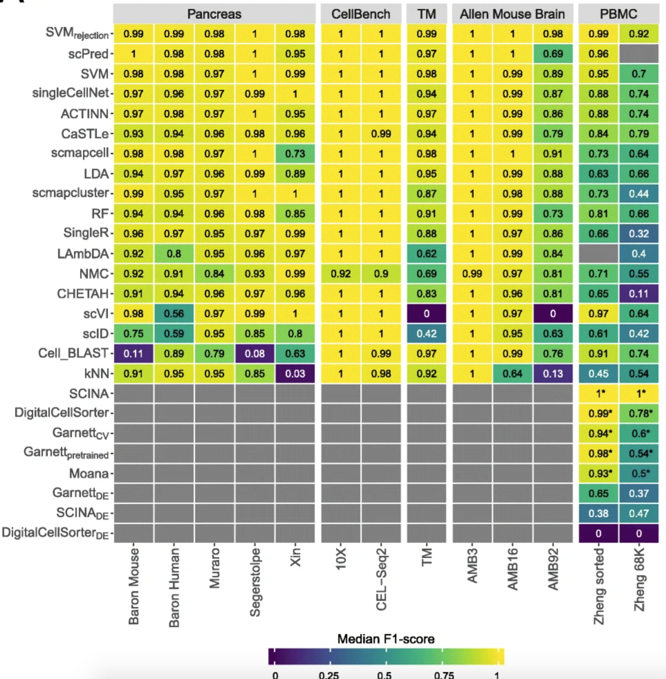
Automated cell type annotation using public marker databases
Huge (and growing!) collection of tools for automated cell annotation…
Abdelaal et al., Genome Biol. 2019
66
Notes:
I would like to expand these observations to in vivo data. I also want to check what happens in terms of transcriptional dynamics in cells where Cyclin O, a key non-canonical cyclin involved in MCC diff., is knocked-out.

