Slide 1
Analysis of Single Cell RNA-Seq Data:
Data integration and batch effect correction
Orr Ashenberg, Jacques Serizay, Fabricio Almeida-Silva
November 2026
Notes:
₁

Slide 2
Outline: Batch effects and data integration
Types of data integration.
Where batch effects come from.
Computational approaches to correct for batch effects and integrate data.
Making biological comparisons after data integration.

Slide 3
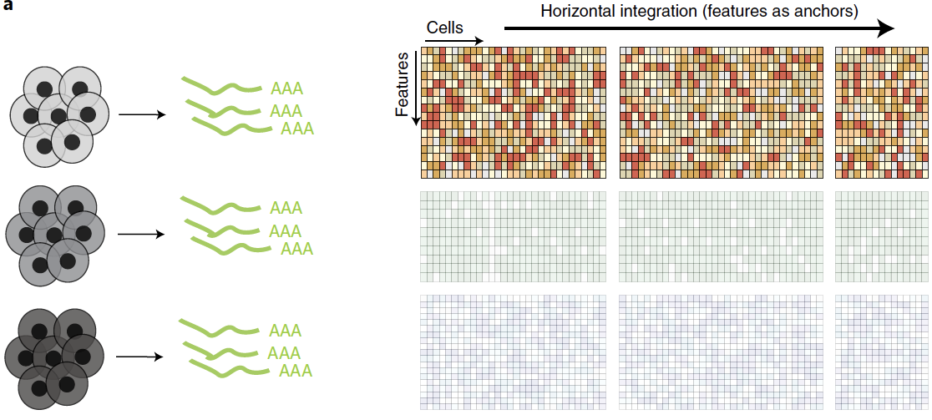
Data integration
Shared features across different batches of cells
Argelaguet R. et al. (2022) Nature Methods.
Notes:
In addition to RNA, we can profile many other cellular molecules. DNA- genome, epigenome- chromatin accessibility, methylation. Protein- mass cytometry. One particularly important advance is being able to make multiple different measurements on a single cell. Establish causality between RNA + protein or epigenome + RNA.

Slide 4
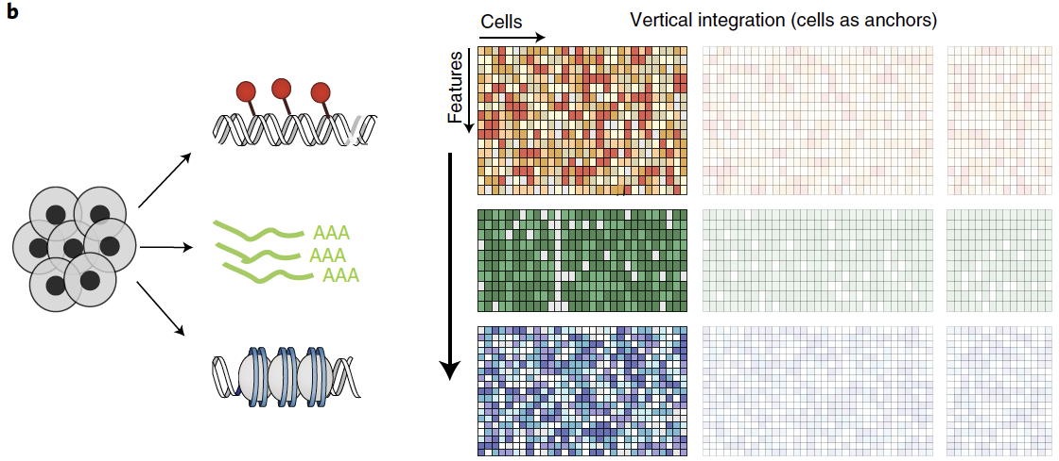
Data integration
Different features measured from same cells
Argelaguet R. et al. (2022) Nature Methods.
Notes:
In addition to RNA, we can profile many other cellular molecules. DNA- genome, epigenome- chromatin accessibility, methylation. Protein- mass cytometry. One particularly important advance is being able to make multiple different measurements on a single cell. Establish causality between RNA + protein or epigenome + RNA.

Slide 5
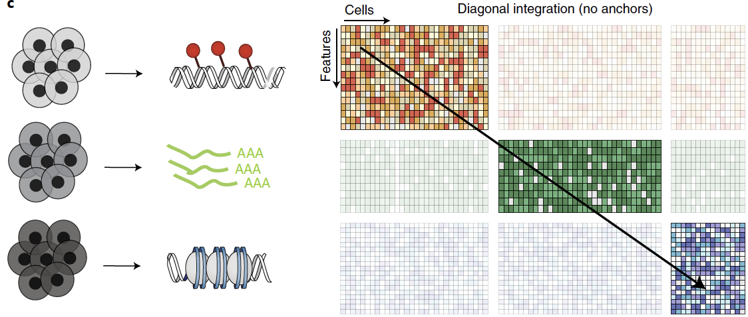
Data integration
Different cell batches and features in each experiment
Efremova M. et al. (2020) Nature Methods. 17:11-20.
Notes:
In addition to RNA, we can profile many other cellular molecules. DNA- genome, epigenome- chromatin accessibility, methylation. Protein- mass cytometry. One particularly important advance is being able to make multiple different measurements on a single cell. Establish causality between RNA + protein or epigenome + RNA.

Slide 6
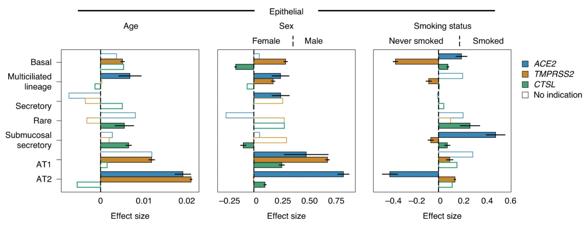
Why perform data integration and batch effect correction?
We often require large cohorts of individuals (n > 10) to make biological comparisons (case vs control, mutant vs wildtype etc…).
As an example, how do smoking status and age contribute to SARS-CoV-2 entry-related genes in lung cells?
Challenges
Technical batch effects confound biological variation of interest (e.g. site and time of collection, experimental protocol used…)
Different sources of biological variation confound biological variation of interest (e.g. cell cycle, treatment status…)
1,320,896 cells from 228 individuals
Muus C. et al. (2021) Nature Medicine.

Slide 7
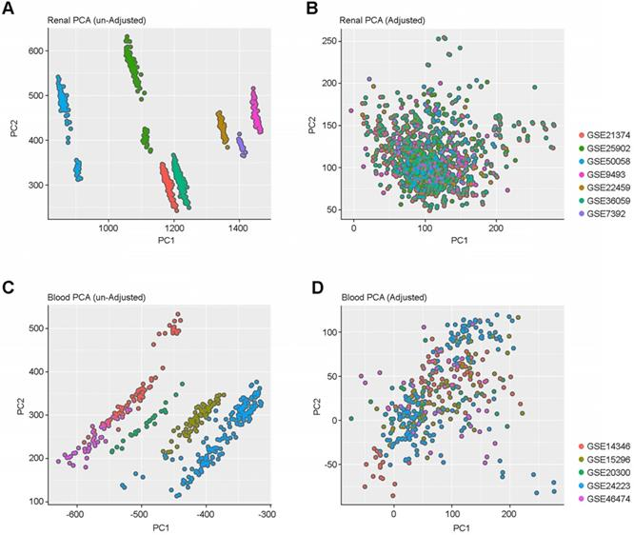
Distinguishing biological effects from technical, batch effects is a difficult problem
Correcting for batch effects allows us to combine datasets and boost biological signal, while reducing technical confounders
Shaw et al., Theranostics 2020

Slide 8
Distinguishing biological effects from technical, batch effects is a difficult problem
Correcting for batch effects allows us to combine datasets and boost biological signal, while reducing technical confounders
Shaw et al., Theranostics 2020

Slide 9
Cells are colored by cell type.
Symbols represent different batches.
Distinguishing biological effects from technical, batch effects is a difficult problem
Correcting for batch effects allows us to combine datasets and boost biological signal, while reducing technical confounders

Slide 10
The most powerful way to control batch effects is with careful experimental design
Sound experimental design : Replication, Randomization and Blocking
- R. A. Fisher, 1935
https://scrnaseq-course.cog.sanger.ac.uk/website/ideal-scrnaseq-pipeline-as-of-oct-2017.html

Slide 11
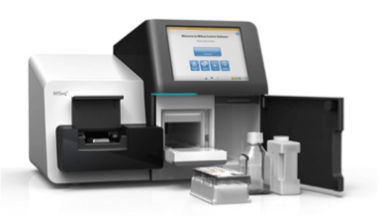
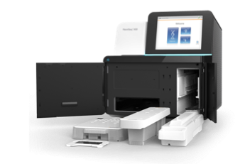
Batch effects: technical sources
Differences in how samples are sequenced
  sequencing depth and saturation
  sequencing instrument
Miseq
~ 20M reads total
Nextseq
~ 500M reads total
HiSeq 4000
4 billion reads

Slide 12
A few basic approaches to batch correction
Down sampling of sequencing reads
Normalization
Using variable genes common to multiple samples
Removing genes correlated with batch
Regression of residuals with technical covariates
  batch id
  number of UMI per cell
  number of genes per cell
  % mitochondrial reads
ComBat (developed for microarray experiments)
Notes:
Github site
Bookdown course site with labs

Slide 13
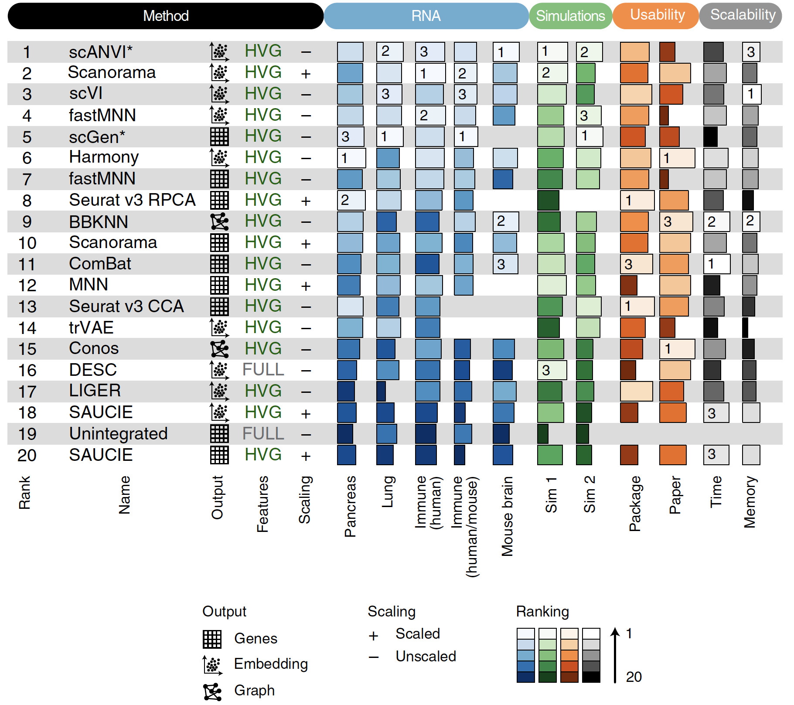
Benchmarking of data integration methods
Luecken M. D. et al. (2022) Nature Methods.
Notes:
In addition to RNA, we can profile many other cellular molecules. DNA- genome, epigenome- chromatin accessibility, methylation. Protein- mass cytometry. One particularly important advance is being able to make multiple different measurements on a single cell. Establish causality between RNA + protein or epigenome + RNA.

Slide 14
Common assumptions during batch correction
At least one cell population is found shared in both datasets.
The batch effect and the biological differences do not overlap with one another (ie orthogonal).
The magnitude and variation of the biological effect you care about is greater than that of the batch effect.

Slide 15
Canonical Correlation Analysis (CCA)
CCA finds the linear combinations of variables across two datasets that are maximally correlated with one another.
  The first pair of canonical variables maximizes the correlation across datasets.
  The second pair of canonical variables maximizes the correlation subject to the constraint of not being correlated with the first pair, and so on.
Goals of CCA
  Similar to Principal Components Analysis (PCA)
  Dimensional reduction: explain covariation between datasets with a small number of linear combinations of variables
https://www.mathworks.com
https://github.com/mhaghighat/ccaFuse

Slide 16
Canonical Correlation Analysis (CCA)
“Effectively, we treat the data sets as multiple
measurements of a gene–gene covariance structure, and search for patterns that are common to the data sets.”
Butler, A, et al. Nature Biotechnology 36.5 (2018): 411.
Notes:
“Effectively, we treat the data sets as multiple measurements of a gene–gene covariance structure, and search for patterns that are common to the data sets.”
Wikipedia: “dynamic time warping (DTW) is one of the algorithms for measuring similarity between two temporal sequences”

Slide 17
Canonical Correlation Analysis (CCA)
Assessing the performance of batch correction
“For every cell, we calculate how many of its k nearest-neighbors belong to the same data set and average this over all cells. If the data sets are well-aligned, we would expect that each cells’ nearest neighbors would be evenly shared across all data sets.”
Butler, A, et al. Nature Biotechnology 36.5 (2018): 411.

Slide 18
Mutual Nearest Neighbors
“If a pair of cells from each batch is contained in each other’s set of nearest neighbors, those cells are considered to be mutual nearest neighbors. We interpret these pairs as containing cells that belong to the same cell type or state despite being generated in different batches. Thus, any systematic differences in expression level between cells in MNN pairs should represent the batch effect.”
Haghverdi, L, et al. Nature biotechnology 36.5 (2018): 421.
Notes:
Where could this go wrong? Are there cases where cells from batches could be labeled as mutually nearest neighbors but that would be a bad correction to make? One such example could be cells in different states: for example cytotoxic T cells and naïve T cells. MNN correction might lose information about cell states.

Slide 19
Mutual Nearest Neighbors
4 pancreas datasets
Haghverdi, L, et al. Nature Biotechnology (2018).

Slide 20
Combining CCA and Mutual Nearest Neighbors (Seurat v3)
Stuart et al. Cell (2019).
Notes:
To overcome this, we first jointly reduce the dimensionality of both datasets using diagonalized canonical correlation analysis (CCA), then apply L2-normalization to the canonical correlation vectors (Figure 1A,B). We next search for MNNs in this shared low-dimensional representation.
each anchor pair was assigned a score based on the shared overlap of mutual neighborhoods for the two cells in a pair (Figure 1 D; Methods). High-scoring correspondences therefore reflect cases where many similar cells in one dataset are predicted to correspond to the same group of similar cells in a second
dataset, reflecting increased robustness in the association between the anchor cells.
Therefore, for each cell in the query dataset, we aim to apply a transformation (correction vector) that represents a weighted average across multiple batch vectors. These weights are determined by two components: a cell similarity score, computed individually for each cell in the dataset, and the anchor score, computed once for each anchor. The cell similarity score is defined by the distance between each query cell and its k nearest anchors in principal component space (Methods), prioritizing
anchors representing a similar biological state.

Slide 21
Combining CCA and Mutual Nearest Neighbors (Seurat v3)
Human and mouse pancreas datasets
Stuart et al. Cell (2019).

Slide 22
Classifying nuclei from a single cell ATAC-seq experiment using single cell RNA-seq data as a reference
Integrating data modalities
14,249 cells from scRNA-seq and 2,548 cells from scATAC-seq
Stuart et al. Cell (2019).

Slide 23
Batch correction and data modality integration
Nonnegative Matrix Factorization (NMF)
“Our goal is to find a small number of metagenes, each defined as a positive linear combination of the N genes. We can then approximate the gene expression pattern of samples as positive linear combinations of these metagenes. Mathematically, this corresponds to factoring matrix A into two matrices with positive entries, A ∼ WH.”
Brunet J. et al. (2004) PNAS..

Slide 24
Batch correction and data modality integration using LIGER
LIGER implements non-negative matrix factorization
Welch, et al. Cell (2019).
Notes:
Identifying shared and dataset-specific factors through integrative non-negative matrix factorization (iNMF).

Slide 25
Batch correction and data modality integration using LIGER
LIGER implements non-negative matrix factorization
Welch, et al. Cell (2019).

Slide 26
Using LIGER to integrate single-cell transcriptomic and
in situ spatial transcriptomic data
71,000 cells from scRNA-seq
2,500 cells from STARmap
What are advantages of integrated analysis of these 2 datasets?
Welch, et al. Cell (2019).
Notes:
“Integrated analysis of spatial transcriptomic and scRNA-seq data using LIGER could offer two potential advantages compared to separate analyses of the two data modalities: (1) assigning spatial locations to cell clusters observed in data from dissociated cells; and (2) increasing the resolution for detecting cell clusters from the in situ data. ”

Slide 27
Using LIGER to integrate single-cell transcriptomic and
single-cell DNA methylation data
56,000 cells from scRNA-seq
3,000 cells from DNA methylation
“We reasoned that, because gene body methylation is generally anticorrelated with gene expression, reversing the direction of the methylation signal would allow joint analysis.”
Welch, et al. Cell (2019).

Slide 28
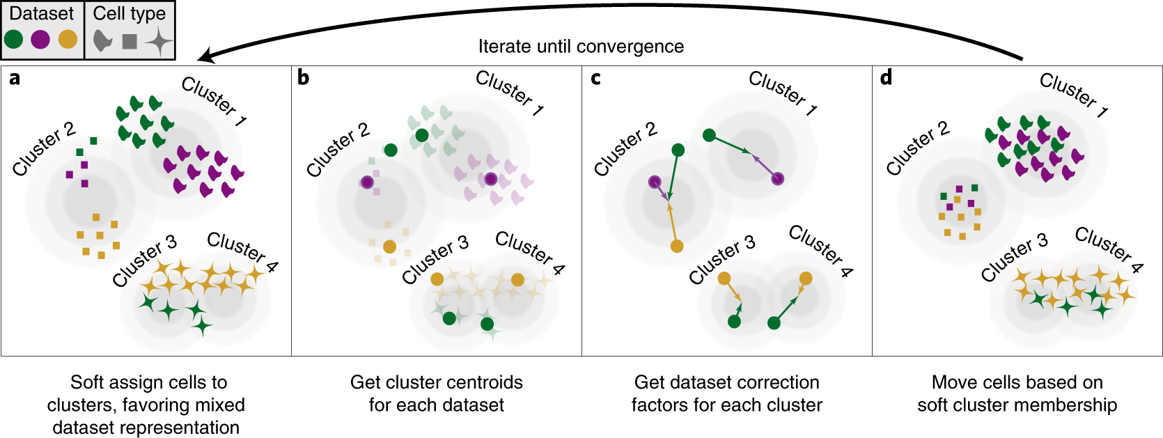
Batch correction and data modality integration using Harmony
Korsunksy I. et al. Nature Methods (2019).

Slide 29
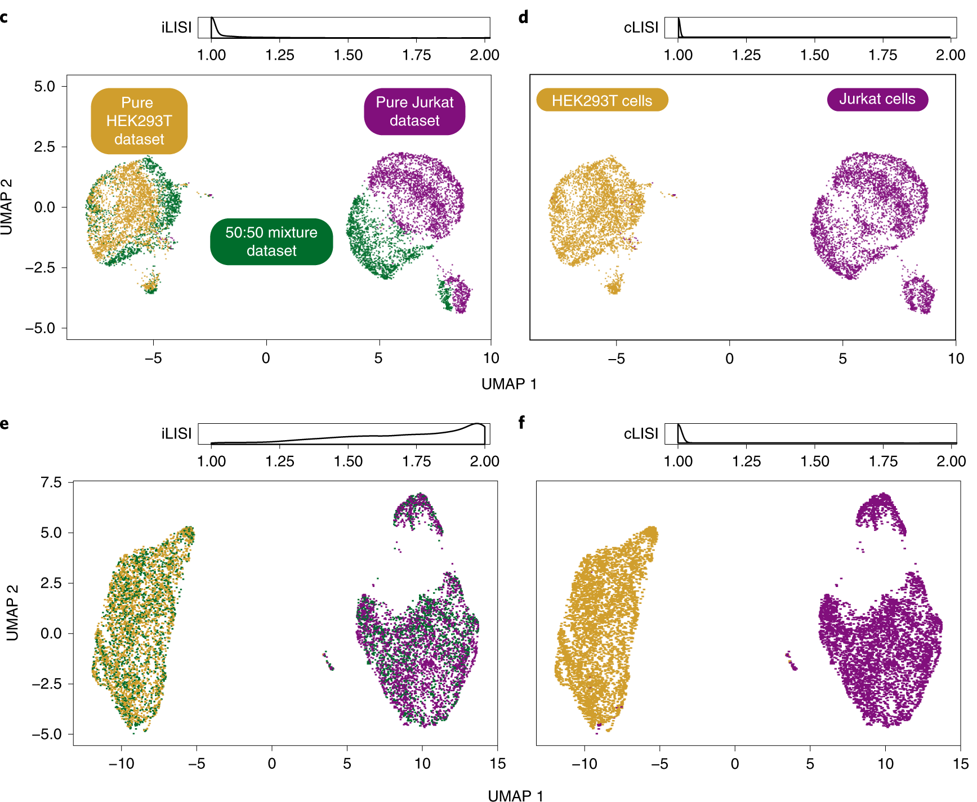
Harmony integrates different datasets while
maintaining cell type differences
Before integration
After integration
Korsunksy I. et al. Nature Methods (2019).

Slide 30
Batch correction and biological differences
Batch correction in single-cell transcriptomics is designed to remove technical variations that arise due to differences in the experimental procedures such as sample preparation, sequencing, and data analysis. The goal of batch correction is to reduce technical noise in the data and allow biological differences between cells to be better distinguished.
However, batch correction can potentially remove some biological differences in the data, particularly if the biological differences are correlated with the batch effect.
For example, if cells from different batches are isolated from different tissues or at different stages of development, then the batch correction algorithm may inadvertently adjust the expression levels of genes that are differentially expressed between these groups.

Slide 31
Methods to assess performance of batch correction
Entropy of batch mixing
kBET - k-nearest neighbor batch effect test
Silhouette coefficient
  cells of the same cell type are close together and far from other cells of a different type
Adjusted rand index
  do batch labels and cluster labels agree with one another?
Biological significance
Luecken M. D. et al. (2022) Nature Methods.
Notes:
kBET – is local batch label distribution sufficiently similar to the global batch label

Slide 32
Recent helpful articles on data integration methods
Argelaguet, Ricard, et al. "Computational principles and challenges in single-cell data integration." Nature biotechnology (2021).
  Review
Luecken, Malte D., et al. "Benchmarking atlas-level data integration in single-cell genomics." Nature methods (2022).
  Methods comparison
Tran, Hoa Thi Nhu, et al. "A benchmark of batch-effect correction methods for single-cell RNA sequencing data." Genome biology (2020).
  Methods comparison

Slide 33
Comparison between discussed approaches
Aspect | CCA | MNN | NMF | LIGER | Harmony | scVI
Type | Linear | Distance-based | Linear | Linear+NMF | Linear | Non-linear (neural)
Computational Cost | Low-Medium | Low | Medium | Medium | Low-Medium | High (GPU recommended)
Scalability | Small | Medium | Medium | Good | Excellent | Excellent
# Batches | 2 main | 2+ | 2+ | 2+ | 3+ (optimal) | 2+
Batch Assumptions | Linear | Uniform | Additive | Shared factors | Density-based | Complex/non-linear
Interpretability | Low | Anchors clear | High (factors) | High (factors) | Medium | Low (black box)
Preserves Structure | Modest | Excellent | Moderate | Good | Excellent | Good
Handles Dropout | No | No | Partially | Partially | No | Yes

Slide 34
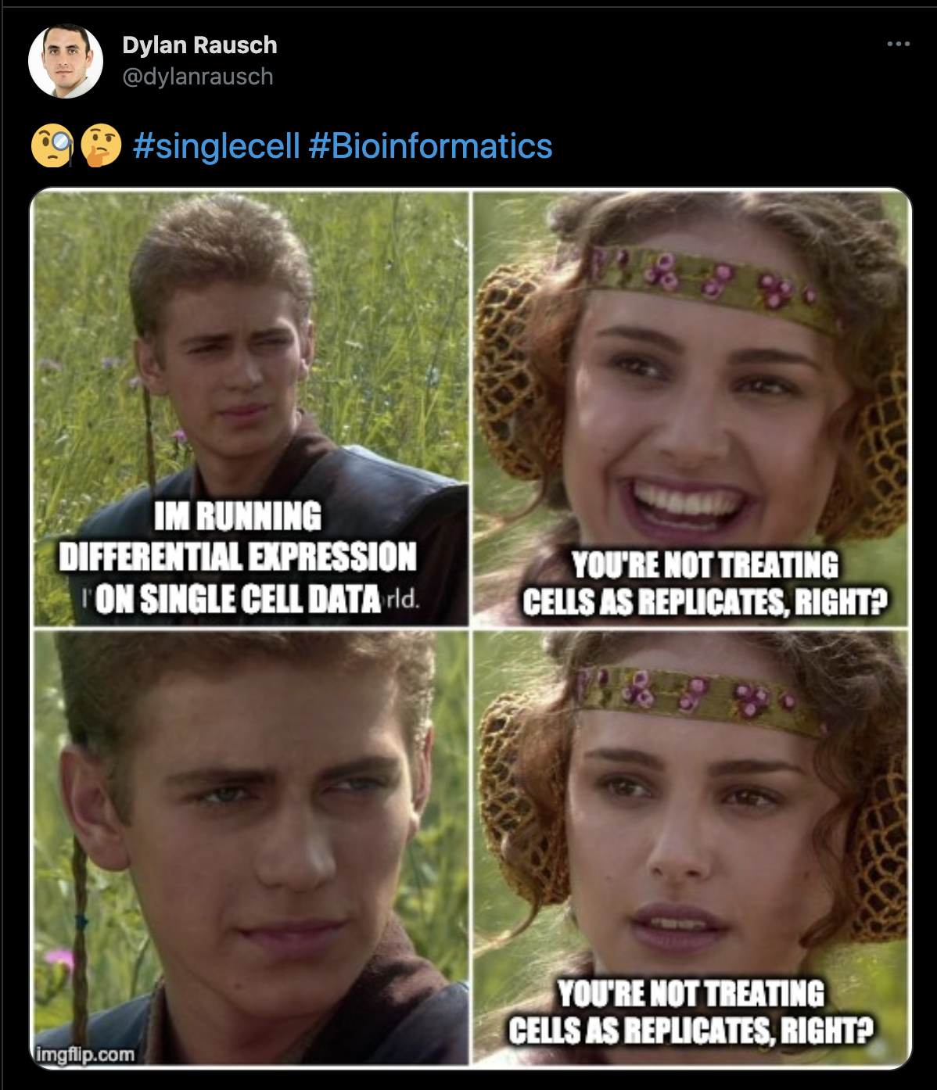
Once data is integrated, how do we
compare across biological conditions?
When detecting gene differentially expressed across different biological conditions (e.g. case vs control, treated vs untreated, etc…), what is the replicate? A single cell? A sample?
Strongly consider using pseudobulk models or mixed effect models when comparing samples across conditions.
Remember: go back to normalized (non batch-corrected) gene expression values for DE analyses! Add covariates for your batches in the DE statistical model.

