Slide 1
Analysis of single-cell ATAC-seq data
Orr Ashenberg, Jacques Serizay, Fabricio Almeida-Silva
November 2026
Notes:
₁

Slide 2
Multimodal measurements
Protein
abundance
Spatial
transcriptomics
Genome
Chromatin accessibility
Gene expression
Immune repertoire
Combining single-cell transcriptomic measurements with other data modalities can reveal gene function and gene regulation.
Efremova M. et al. (2020) Nature Methods. 17:11-20.
Notes:
In addition to RNA, we can profile many other cellular molecules. DNA- genome, epigenome- chromatin accessibility, methylation. Protein- mass cytometry. One particularly important advance is being able to make multiple different measurements on a single cell. Establish causality between RNA + protein or epigenome + RNA.

Slide 3
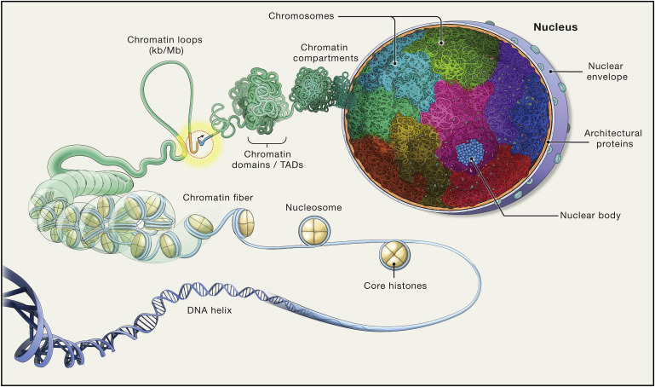
3D organization of DNA
Misteli T. et al. (2020) Cell. 183:28-45.

Slide 4
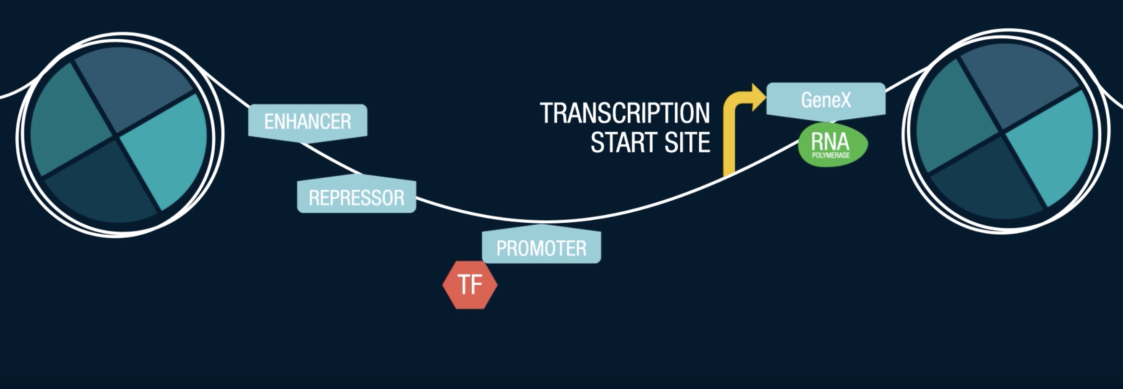
ATAC-Seq detects accessible chromatin regions
In the cell nucleus, the chromosomes contain tightly packed chromatin material. Part of the chromatin is open and accessible to many regulatory factors who control the expression and suppression of a variety of genes.
“How Single-Cell ATAC-Seq Works”, Bio-Rad Laboratories
Notes:
In the cell nucleus, the chromosomes contain tightly packed chromatin material. Part of the chromatin is open and accessible to many regulatory factors who control the expression and suppression of a variety of genes.
The DNA is wrapped around chromatin. To know what has the potential to be expressed we can measure the open chromatone.

Slide 5
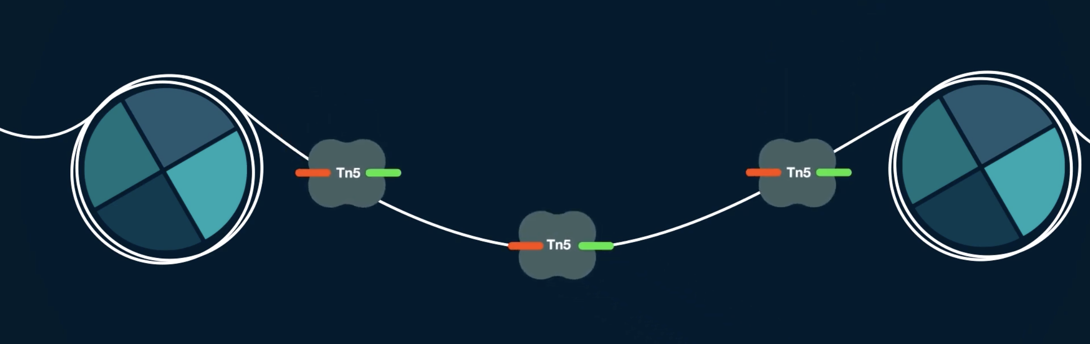
ATAC-Seq detects accessible chromatin regions
ATACseq (as well as scATACseq) measures how open this piece of DNA is. This openness is a proxy of how easily a transcription factor can bind these parts of the genome. ATACseq measures by using an enzyme called Tn5 transposase which binds open chromatin and inserts DNA sequencing adapters.
The Tn5 transposase ideally cuts DNA just once between the neighboring nucleosomes.
“How Single-Cell ATAC-Seq Works”, Bio-Rad Laboratories

Slide 6
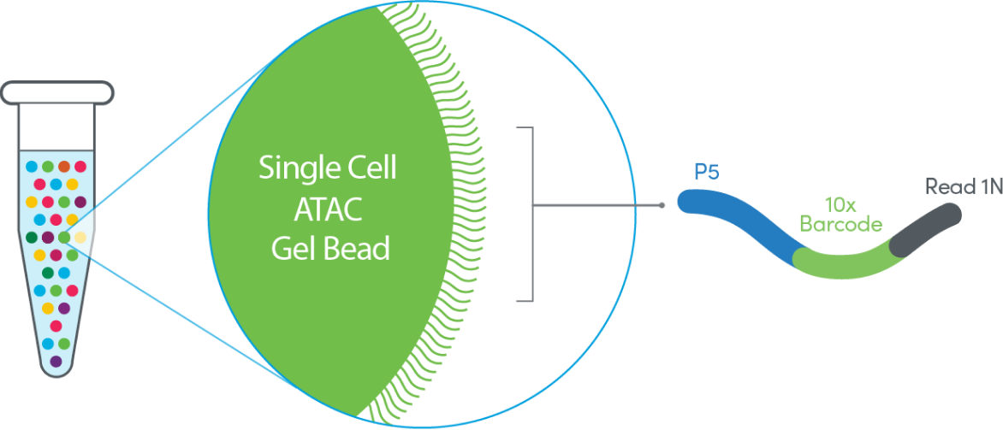
Chromium Single Cell ATAC-Seq (10x)

Slide 7
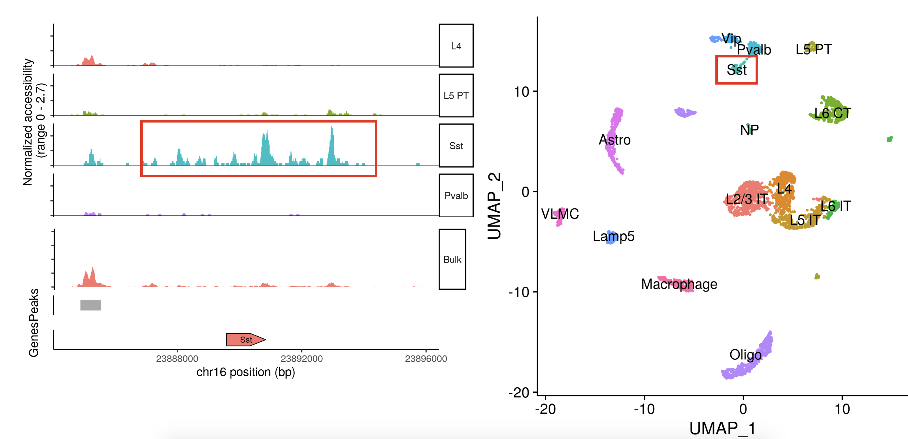
Single cell resolution reveals cell-type specific regulatory elements
Figure adopted from “Analyzing single-cell ATAC-seq datasets” lecture by Tim Stuart

Slide 8
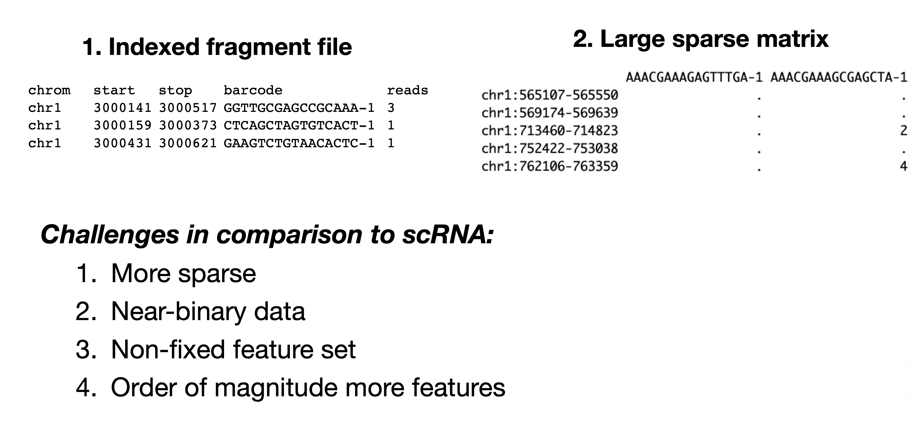
Pre-processing generates a fragment file
and a peak/cell matrix
A full list of all unique fragments across all single cells, as opposed to only reads that map to peaks.
Each value in the matrix represents the number of Tn5 cut sites for each single barcode (i.e. cell) that map within each peak
Figure adopted from “Analyzing single-cell ATAC-seq datasets” lecture by Tim Stuart
Notes:
fragments is used only for gene activity?

Slide 9
scATAC-Seq data is highly sparse
Figure adopted from “Analyzing single-cell ATAC-seq datasets” lecture by Tim Stuart
Notes:
fragments is used only for gene activity?

Slide 10
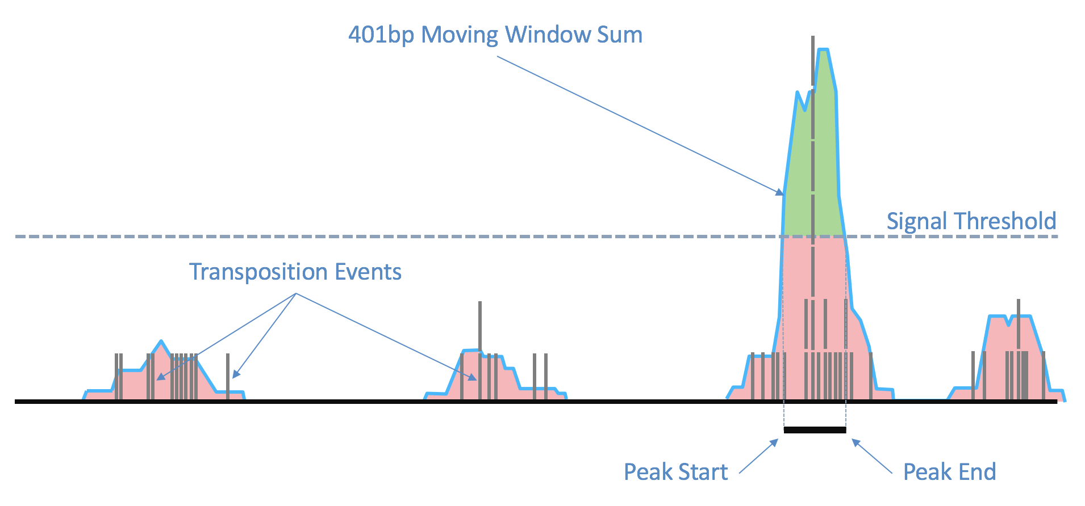
Peak calling: from chromatin accessible fragments to peaks
https://support.10xgenomics.com/single-cell-atac/software/pipelines/latest/algorithms/overview#peaks

Slide 11
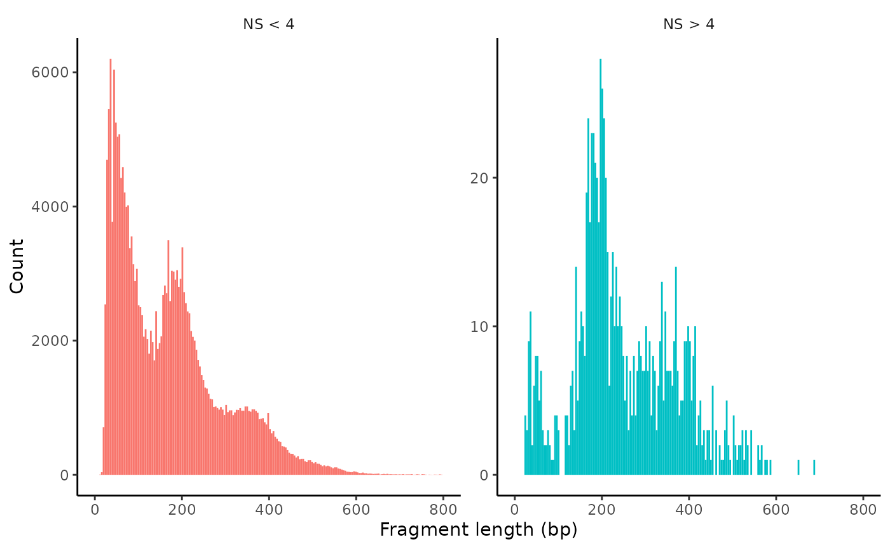
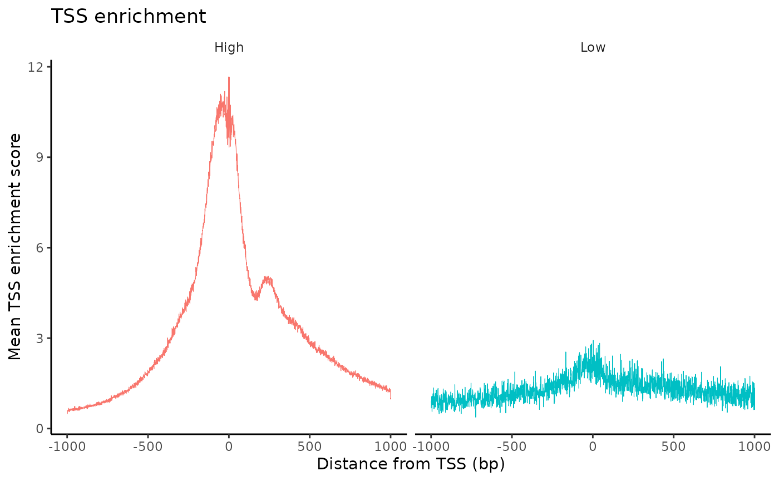
Quality control metrics for scATAC-seq data
Nucleosome banding pattern
Transcriptional start site (TSS) enrichment
Total number of fragments in peaks
Fraction of fragments in peaks

Slide 12
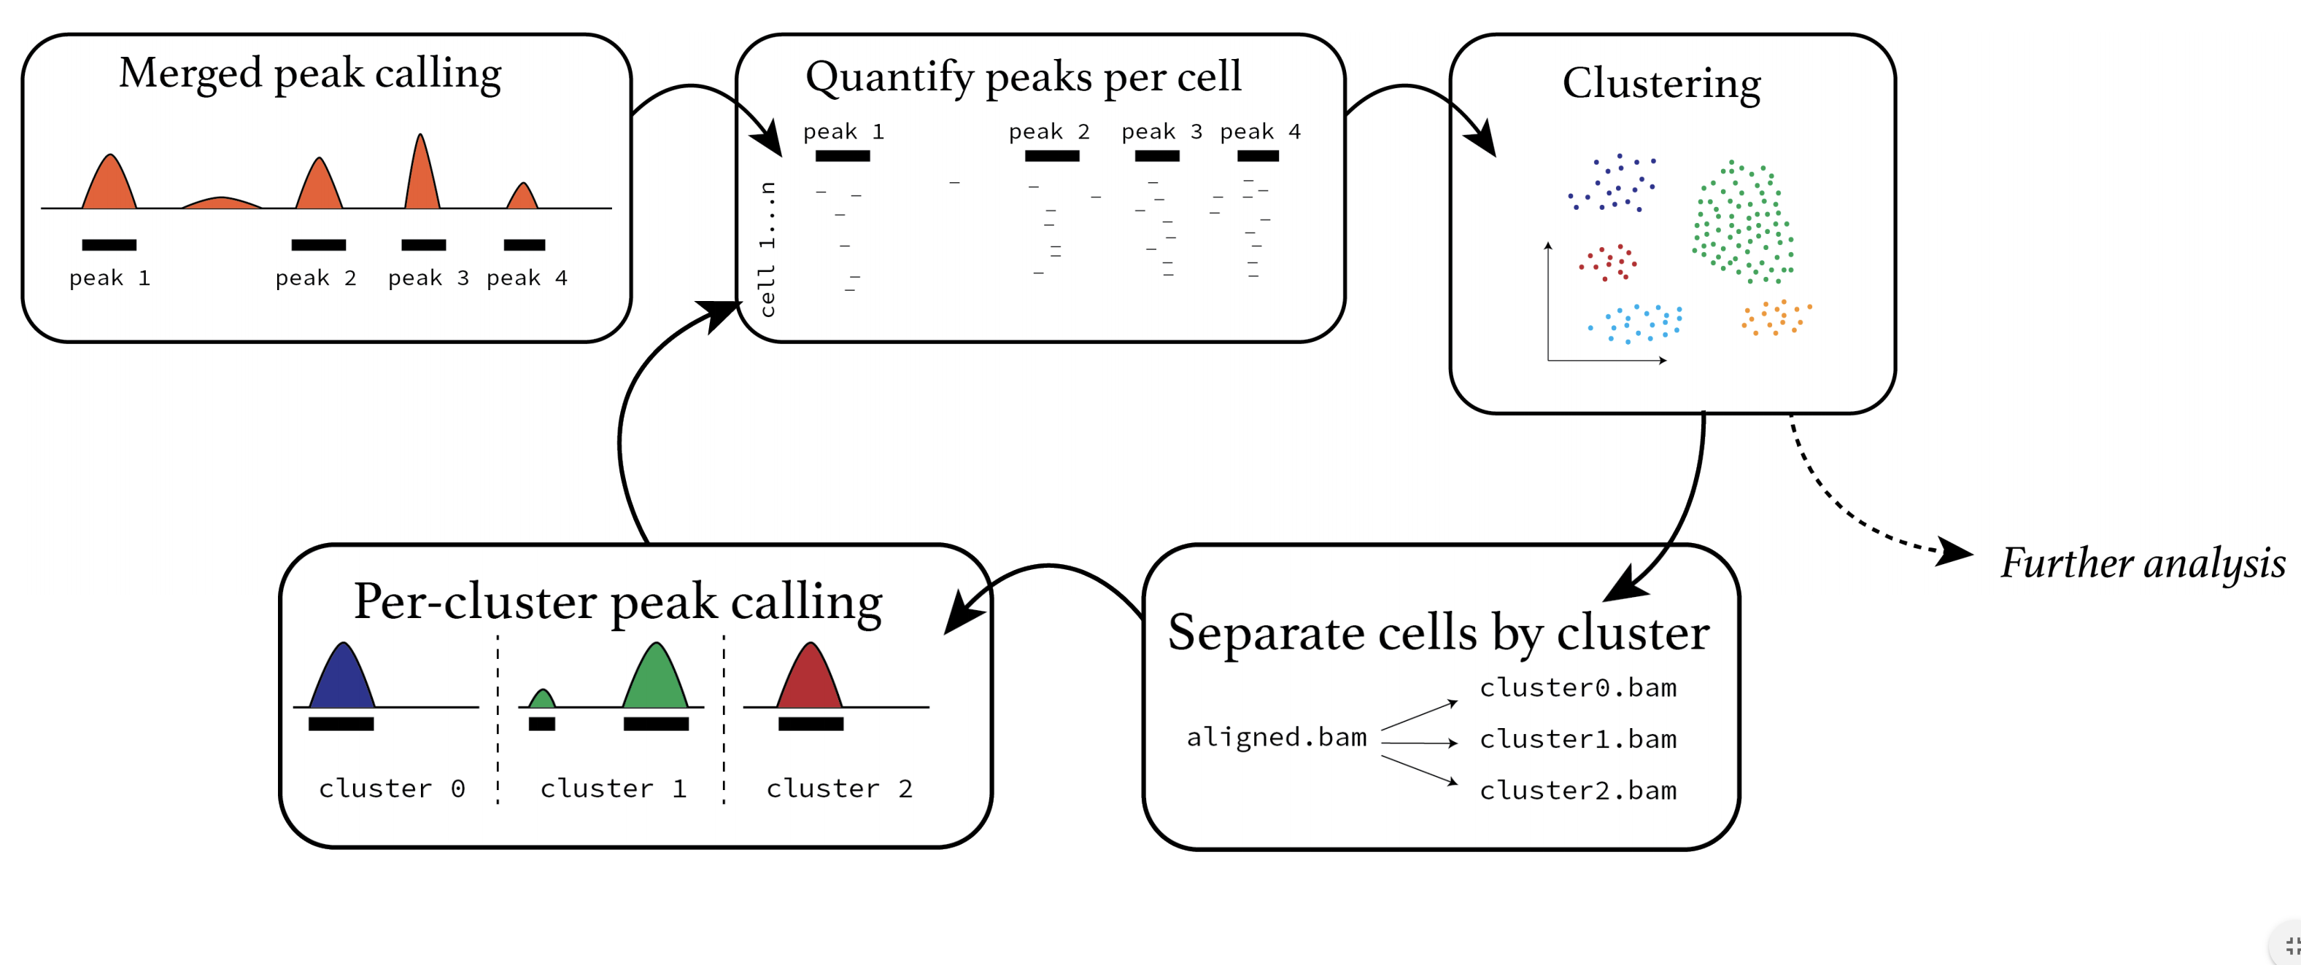
Overview of scATAC-Seq analysis
Figure adopted from “Analyzing single-cell ATAC-seq datasets” lecture by Tim Stuart
Notes:
how do the first peaks defined?

Slide 13
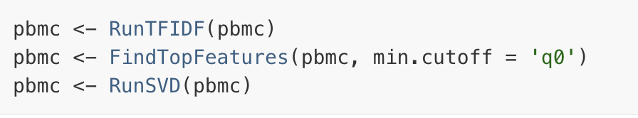
scATAC-Seq often uses latent semantic indexing (LSI) for dimensionality reduction
Originally developed for topic modeling / natural language processing (Deerwester et al. 1990) and first applied to scATAC-Seq in 2015 (Cusanovich et al. Science)
term frequency-inverse document frequency (TF-IDF) normalization followed by singular value decomposition (SVD)
Cell = document and peak = term
Term frequency: normalize across cells to correct for differences in sequencing depth
Inverse document frequency: give higher values to more rare peaks
Figure adopted from “Analyzing single-cell ATAC-seq datasets” lecture by Tim Stuart

Slide 14
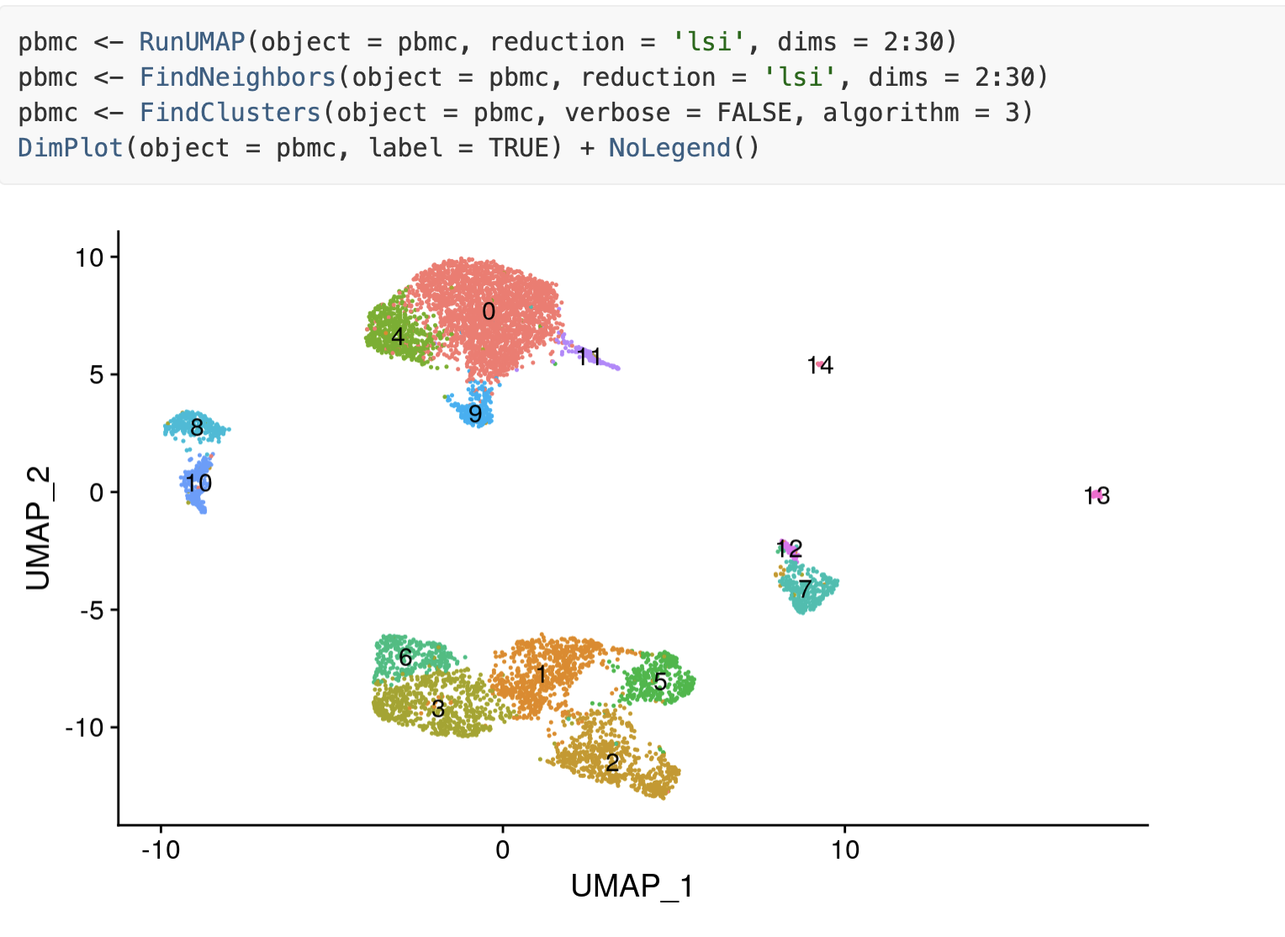
Visualize clusters in scATAC-Seq
Figure adopted from signac tutorial, https://satijalab.org/signac/articles/pbmc_vignette.html

Slide 15
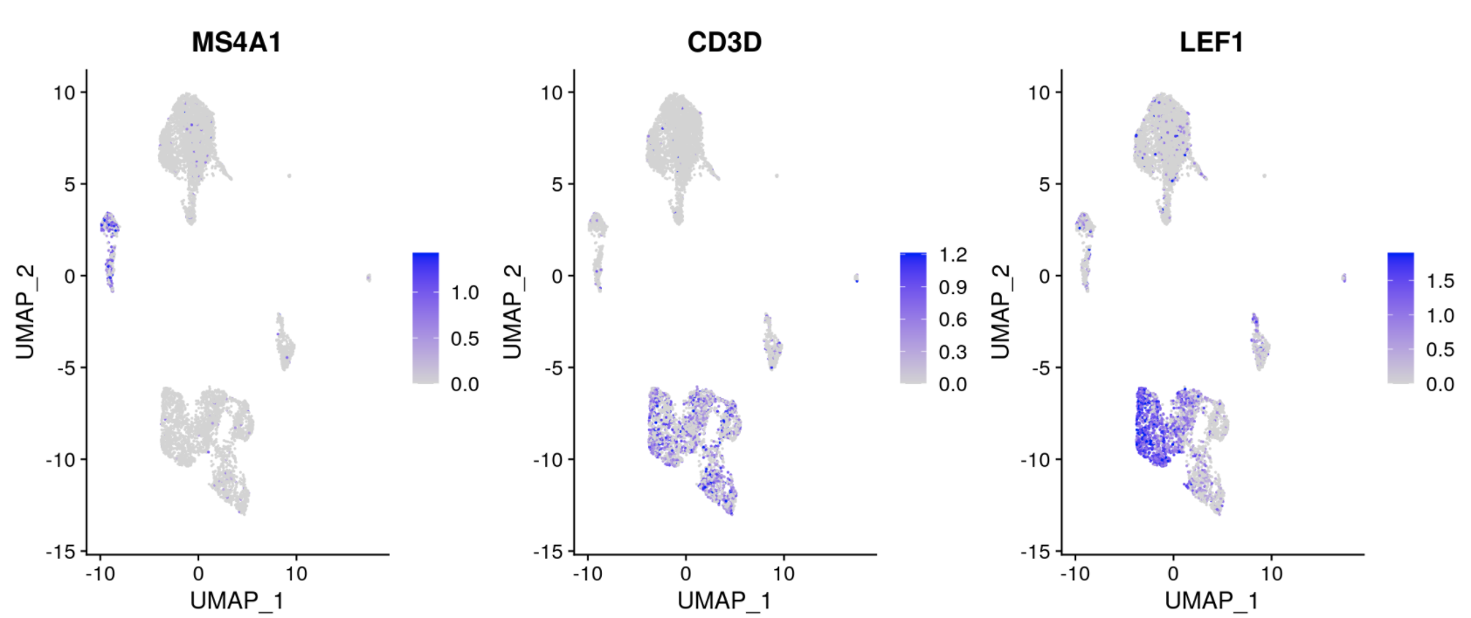
Fragment file helps infer gene “activity” and annotate clusters
Quantify the activity of each gene in the genome by assessing the chromatin accessibility associated with each gene: count the number of fragments for each cell that map to the promoter + gene body
Figure adopted from signac tutorial, https://satijalab.org/signac/articles/pbmc_vignette.html

Slide 16
Integrating with scRNA-seq data using
CCA + MNN (Seurat v4)
Critical assumption: there is generally a positive correlation between chromatin accessibility and gene expression!!!!
Figure adopted from signac tutorial, https://satijalab.org/signac/articles/pbmc_vignette.html

Slide 17
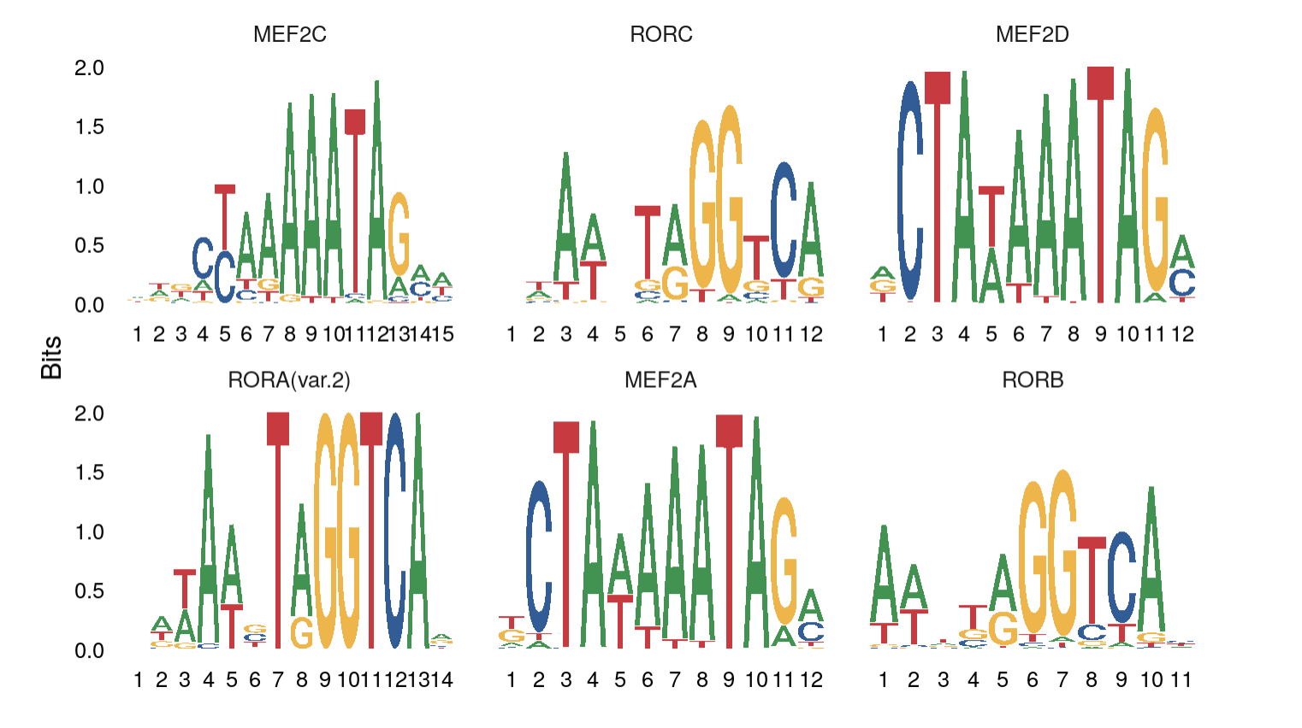
Finding overrepresented motifs
To identify potentially important cell-type-specific regulatory sequences, signac searches for DNA motifs that are overrepresented in a set of peaks that are differentially accessible between cell types.
Figure adopted from signac tutorial, https://satijalab.org/signac/articles/pbmc_vignette.html

Slide 18
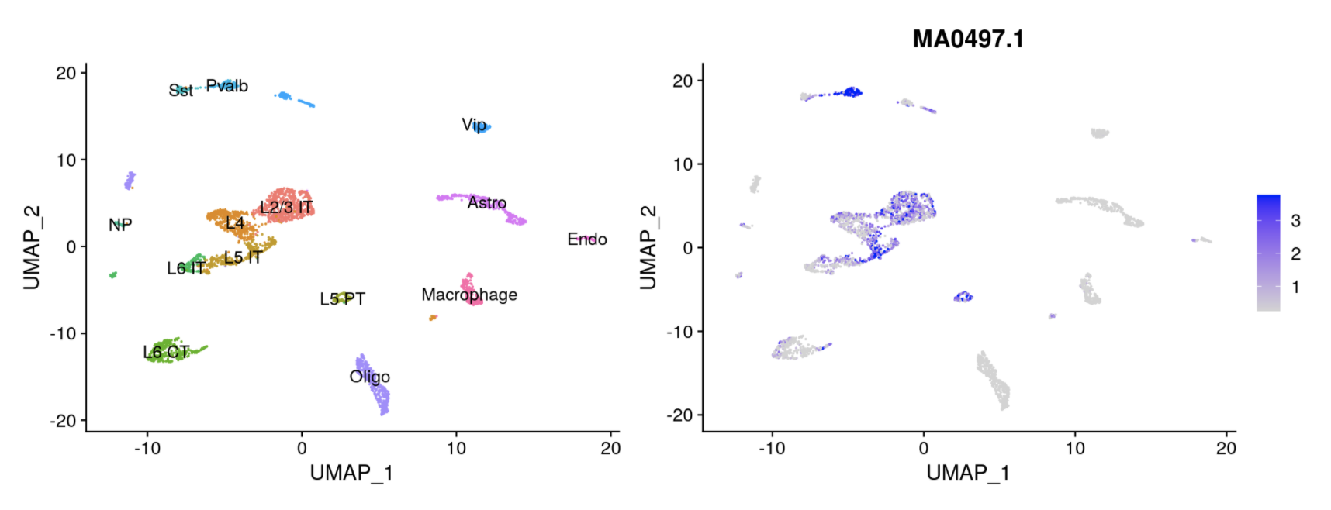
Computing motif activities
ChromVAR identifies motifs associated with variability in chromatin accessibility between cells.
Figure adopted from signac tutorial, https://satijalab.org/signac/articles/pbmc_vignette.html
Notes:
what is the difference

Slide 19
Software for scATAC-Seq analysis
Signac | https://satijalab.org/signac/index.html
SnapATAC | https://github.com/r3fang/SnapATAC
ArchR | https://www.archrproject.com/
cisTopic | https://github.com/aertslab/cisTopic
chromVAR | https://github.com/GreenleafLab/chromVAR
CICERO | https://cole-trapnell-lab.github.io/cicero-release/
episcanpy | https://episcanpy.readthedocs.io/en/latest/

Slide 20
Software for scATAC-Seq analysis

Slide 21
Some approaches to multiome data (scRNA-seq and scATAC-seq)
ArchR: https://greenleaflab.github.io/ArchR_2020/Ex-Analyze-Multiome.html
Signac (same people who built Seurat): https://satijalab.org/signac/articles/pbmc_multiomic.html
FigR: https://buenrostrolab.github.io/FigR

Slide 22
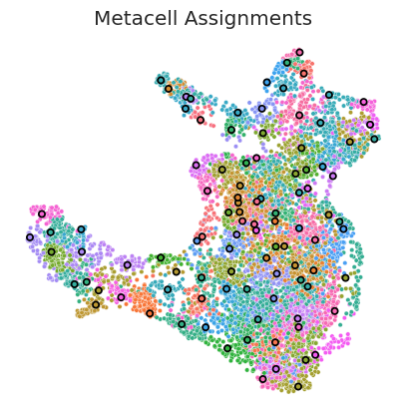
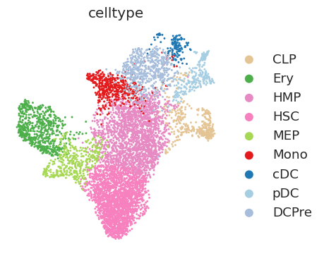
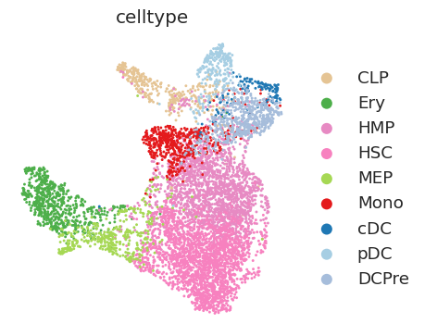
Methods to overcome sparsity in ATAC-seq data
Computing meta-cells is on methodology used to overcome sparsity in scATAC-seq data
Computing meta-cells (e.g. SEACells algorithm) can improve computation of peak-gene associations
scRNA-seq
scATAC-seq
Persad S., et al. Nature Biotechnology (2023).

Slide 23
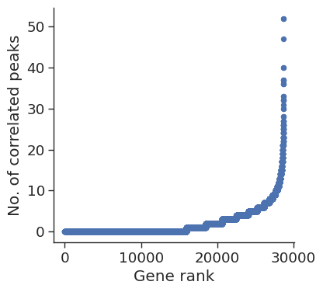
Methods to overcome sparsity in ATAC-seq data
Generate summarized ATAC and RNA metacells
Used the paired multiome metacells to compute the correlation of gene expression and accessibility of peaks within the vicinity of the gene
Pick out highly regulated genes that are correlated with multiple peaks
Calculate gene scores as the weighted sum of the accessibility of correlated peaks
To calculate gene accessibility metrics identify the subset of peaks that are open in each metacell
Open peaks are used to compute a gene accessibility metric which represents the fraction of correlated open peaks

Slide 24
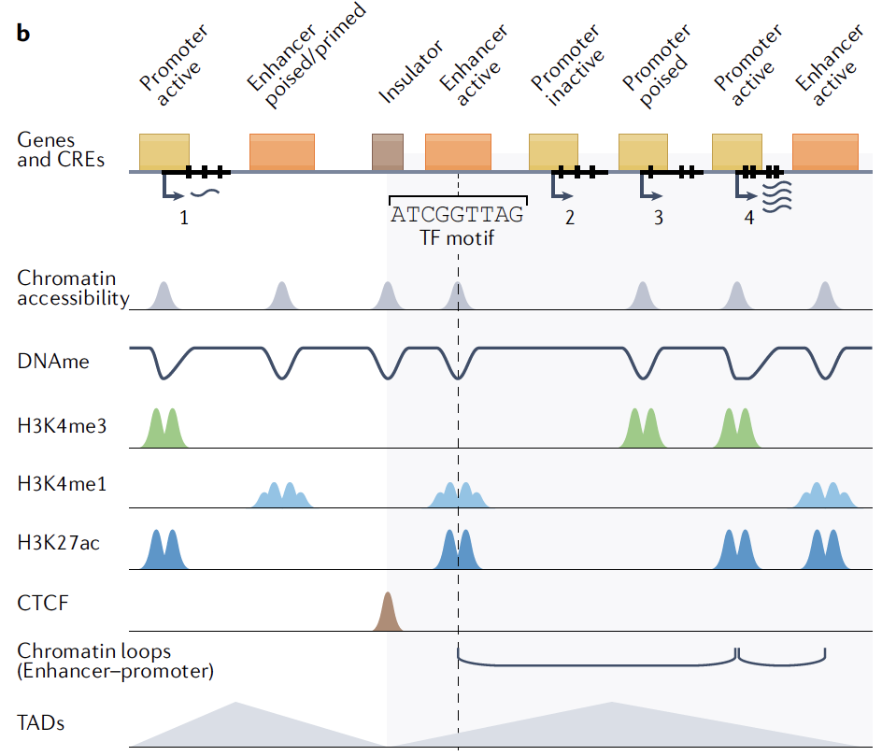
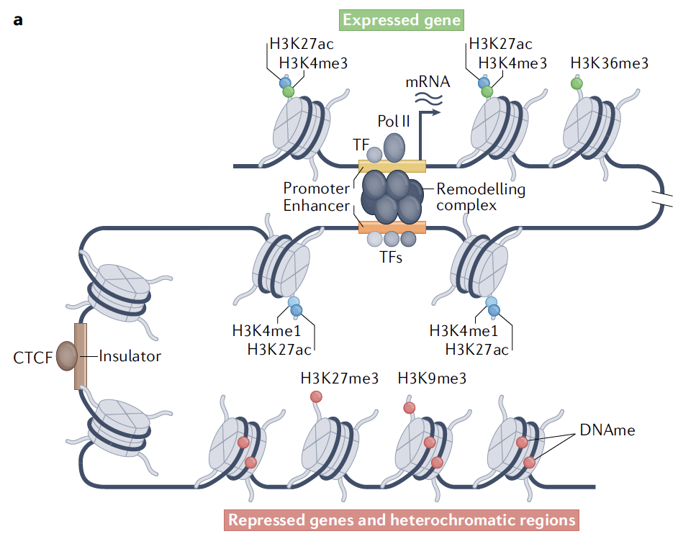
Studying gene regulation using single-cell epigenomics
Preissl S. et al. (2022) Nature Reviews Genetics.

Slide 25
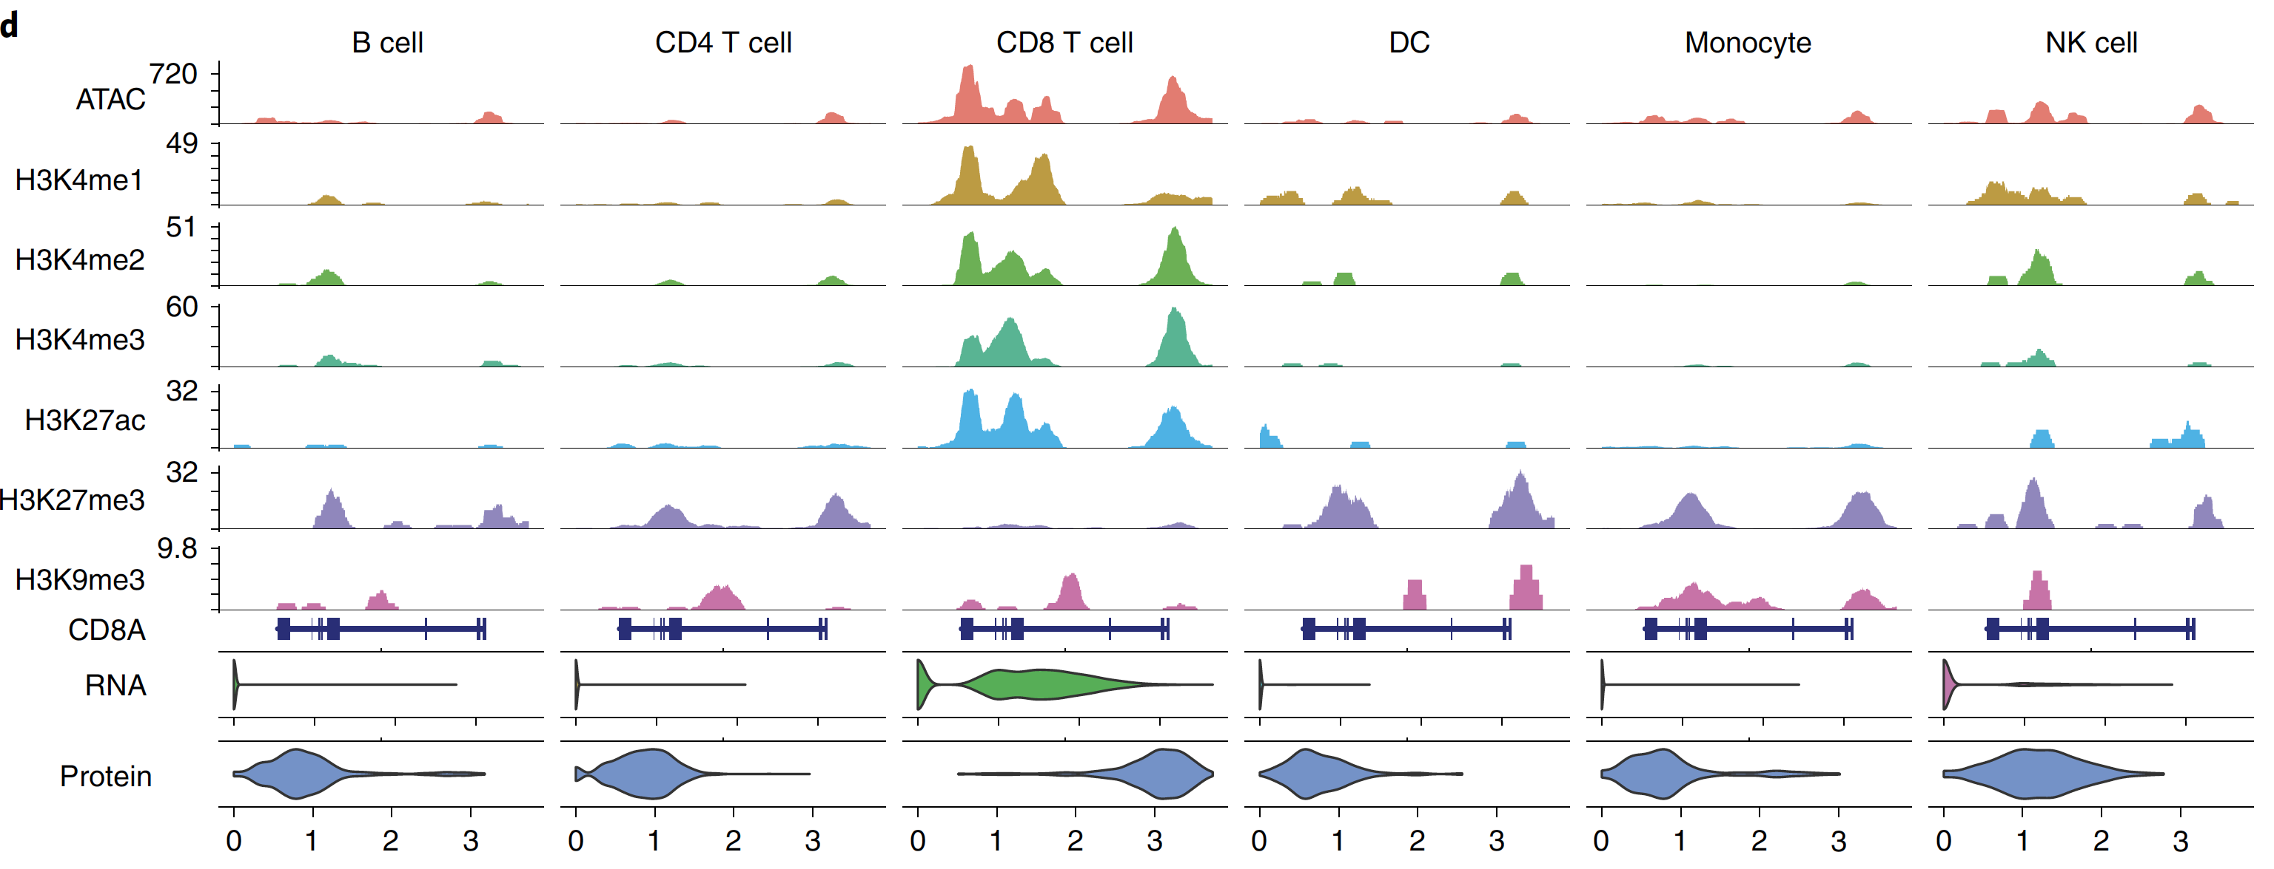
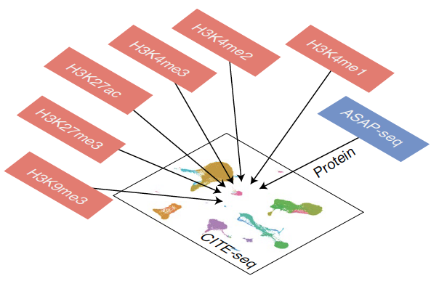
Studying gene regulation using single-cell epigenomics
Zhang B. et al. (2022) Nature Biotechnology. 40:1220-1230.

