Slide 1

Where is my data?
BABI 4005
Amy Goldlist

Slide 2
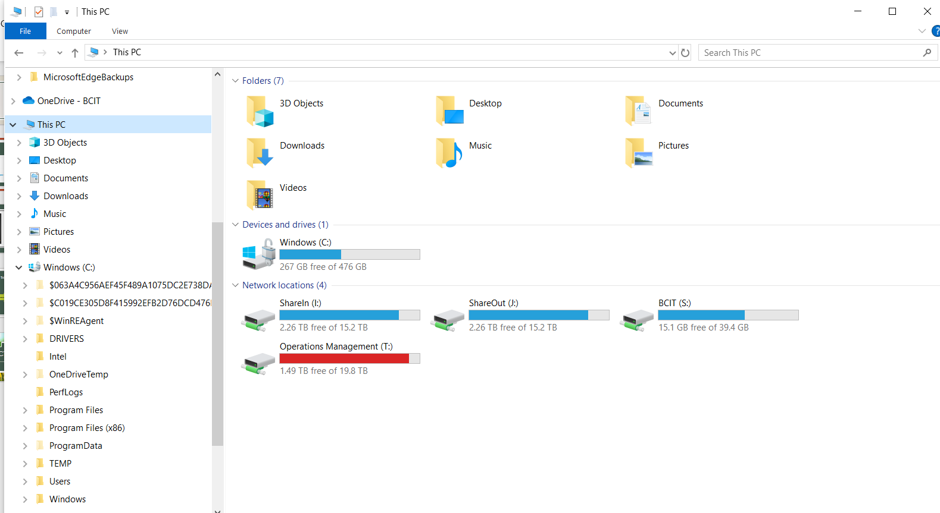
Folders

Slide 3
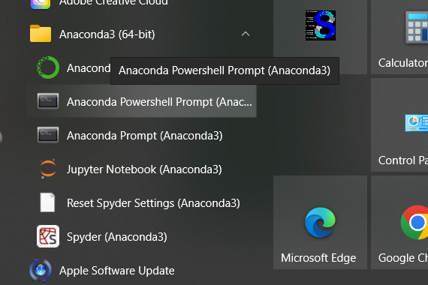
Terminals

Slide 4
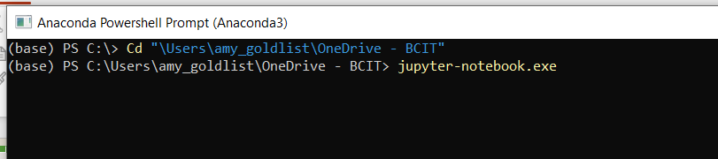
Where am I?

Slide 5

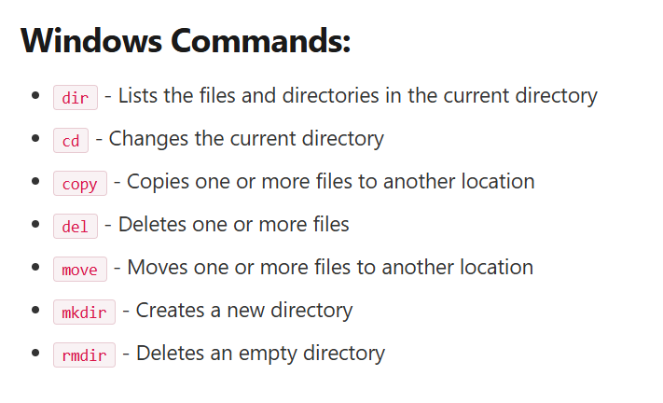
ls or dir?
https://softhints.com/windows-linux-commands/

Slide 6
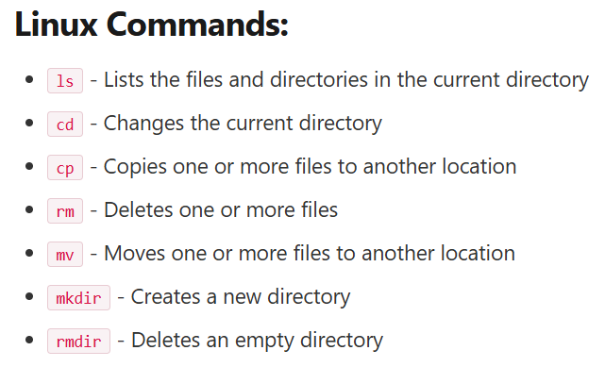
ls or dir?
https://softhints.com/windows-linux-commands/

Slide 7
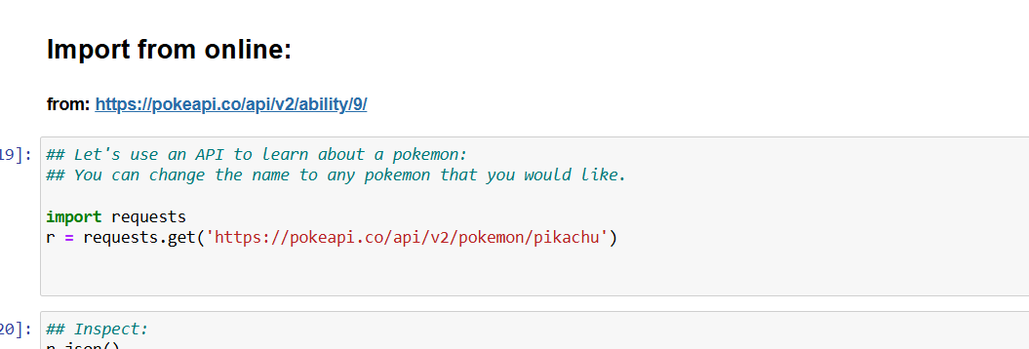
The Cloud?

Slide 8
Github
https://github.com/amygoldlist/BusinessAnalytics

