Slide 1


Slide 2
Rolemon (EAST results)
@santasalojoosua
Joosua Santasalo – Sr. Principal Security Researcher - CTU

Slide 3



Role change
Rolemon service
Notification service
Monitors changes to Azure AD Roles
Sends notifications based on rolechanges
Role change
This solution enables subscribing, alerting and logging of directoryRoleChanges based on delta API and role assignments. -The core part of the function reads the Graph Delta API for changes and Outputs role change history to storage account (uses Function Managed Identity to write to storage account)
Mistakenly given AAD Roles
Mistakenly given AAD Roles and Azure RBAC permissions
Notes:
find . -type f | sed -e 's/.*\.//' | sort | uniq -c | sort -n | grep -Ei '(js)$’
find . -mindepth 1 -maxdepth 1 -type d | wc -l

Slide 4
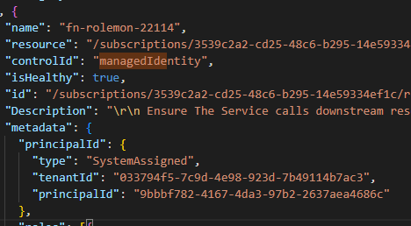





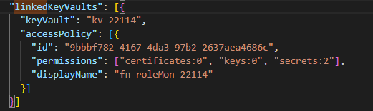

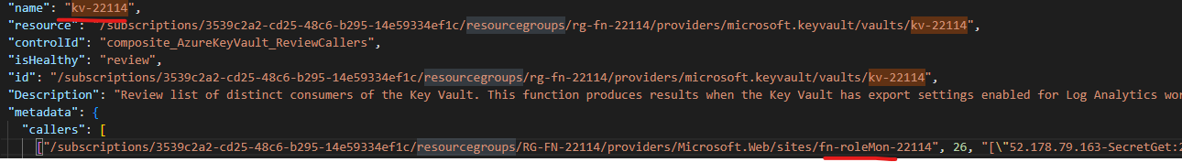

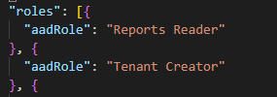
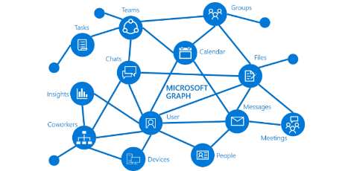


Azure RBAC assignments
events produced in Azure Activity Log
Azure Key Vault access
Logs produced by Key Vault access
Multiple Azure Services supporting managed identity's
Azure AD roles granted to managed Identity
Azure AD AppRoleAssignments
MS Graph permissions etc.
4
Picture source:Microsoft Graph overview -

