Slide 1

Subverting the Windows Kernel
when VBS / HVCI / kCET are enabled
Table hijacking to gain arbitrary kernel code execution
Brucon Security Conference
Juan Sacco <jsacco@exploitpack.com> - https://exploitpack.com
BRUCON SECURITY CONFERENCE 2026
1

Slide 2

Who am I ?
$ whoami: Exploit Writer, Reverse Engineer, OSCP, OSCE, Advanced Corelan, IDA Pro Advanced training
Principal developer and co-founder of https://exploitpack.com
BRUCON SECURITY CONFERENCE 2026
4

Slide 3
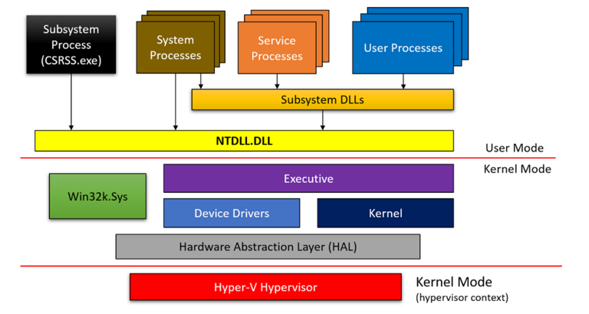
What is the Windows Kernel?
The Windows kernel is the privileged execution environment of the operating system.
It executes in kernel mode and provides the mechanisms required for scheduling, interrupt and exception dispatch, synchronization, memory management, object management, process. On current Windows systems, the core kernel and executive services are implemented primarily in ntoskrnl.exe.
Windows uses a hardware-enforced separation between user mode and kernel mode.
BRUCON SECURITY CONFERENCE 2026
3

Slide 4
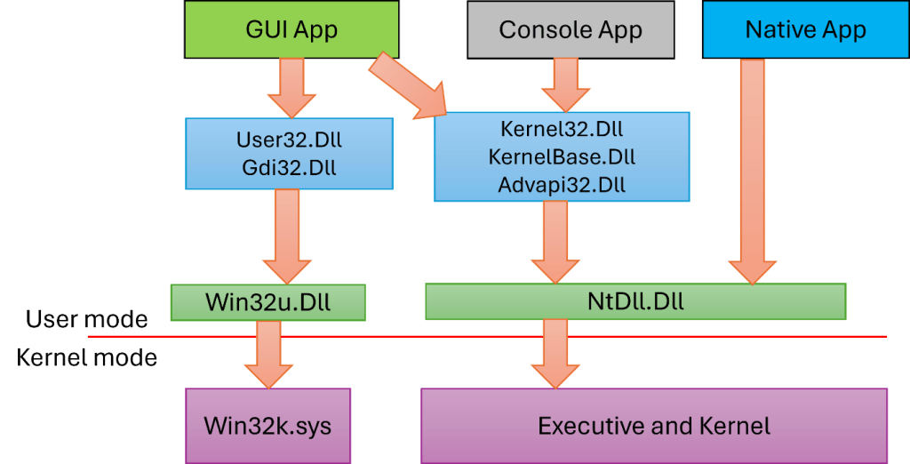
Windows System Architecture
Windows is organized around a user-mode and kernel-mode separation.
User mode contains applications, services, subsystem processes, and the Win32 API layer.
Kernel mode contains the executive, the low-level kernel, the hardware abstraction layer, and kernel-mode drivers. The executive provides high-level operating system services, including the memory manager, object manager, I/O manager, process manager, security reference monitor and registry.
BRUCON SECURITY CONFERENCE 2026
3

Slide 5
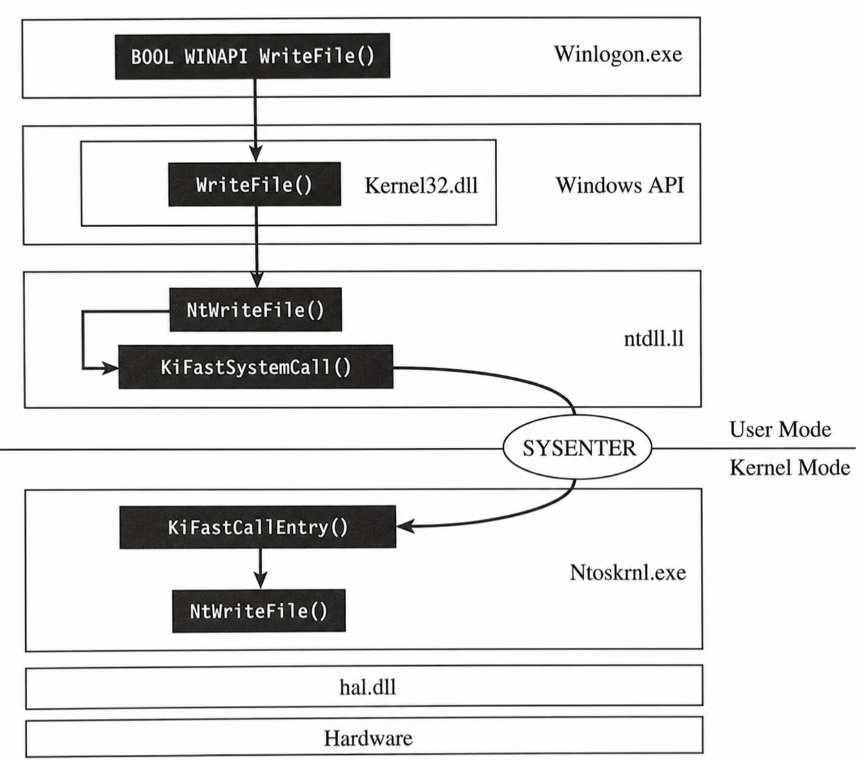
And a Syscall flow looks like this:
On x64, the user-mode call site follows the standard Windows x64 calling convention before the privilege transition.
The first four integer or pointer arguments are placed in RCX, RDX, R8, and R9, additional arguments are passed on the user stack.
The native API stub then loads the system service number into EAX.
Because the syscall instruction overwrites RCX with the user return address and R11 with the saved user RFLAGS, the stub copies the original first argument from RCX into R10...
A typical x64 stub therefore has the form mov r10, rcx, mov eax, ServiceId, syscall, ret.
BRUCON SECURITY CONFERENCE 2026
3

Slide 6
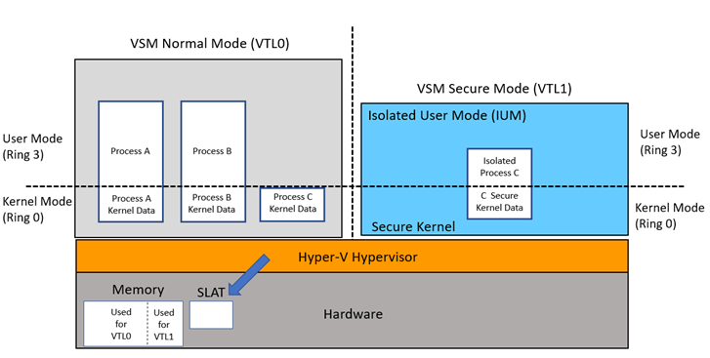
VBS (Virtualization Based-Security) VTL0/VTL1
Virtualization-Based Security, or VBS, is the Windows security architecture that uses the hypervisor to create an isolated execution environment for security-critical operating...
In the VBS model, the ordinary Windows kernel continues to run in VTL0, while a more privileged isolated environment runs in VTL1.
Microsoft describes this isolated environment as the root of trust of the operating system in the event that the normal kernel is compromised.
The secure kernel and isolated user-mode trustlets execute in this higher trust level, and access to VTL1 memory is mediated by the hypervisor rather than by the VTL0 kernel…
SLAT: Second Level Address Translation
BRUCON SECURITY CONFERENCE 2026
3

Slide 7
Why VBS/HVCI changes the exploitation scene
The hypervisor enforces kernel code integrity and W^X at the second-level translation layer.
The kernel cannot simply map attacker-controlled bytes as executable kernel code.
kCET shadow stacks is meant to stop classic return-address ROP. JOP/COP are only constrained if enforcement such as IBT is active for the relevant kernel code. JOP uses indirect jmps. COP uses indirect calls. neither depends on corrupting a ret address the way classic ROP does.
And PatchGuard?
Patchguard is meant to detect and prevent persistent modifications in Kernel components.
The main issue with HVCI
HVCI blocks new executable bytes. It does not make every kernel data structure immutable, nor does it remove or prevent vulnerable signed drivers.
BRUCON SECURITY CONFERENCE 2026
3

Slide 8
PART 1
From Physical Memory to Kernel Control
BRUCON SECURITY CONFERENCE 2026
4

Slide 9
The setup and initial kick-off
A signed-driver first party or third party module with physical memory primitive can be subverted to provide kernel access.
Setup
Primitive
Expected result
A MS Windows target with VBS, HVCI and kCET enabled.
Read/write physical memory from user mode to Kernel via a vulnerable driver and a VA->PA translator.
Trampoline functionality via table hijacking
BYOVD
Physmem IOCTL
VA->PA
Table
Kernel call
>
>
>
>
BRUCON SECURITY CONFERENCE 2026
2

Slide 10
Primitive exploitation
IOCTL
physical R/W
VA->PA
KVA R/W
call primitive
>
>
>
>
Vulnerable signed drivers turn vendor kernel code into an attacker-controlled primitive. Even with VBS/HVCI enabled, a driver vulnerability that exposes kernel or physical memory access can mutate trusted kernel state and reuse existing executable code.
First-party drivers are not outside the attack surface. They are high-value kernel gateways: trusted, already deployed, hard to block.
BRUCON SECURITY CONFERENCE 2026
6

Slide 11
PART 2
MSR Hijacking
BRUCON SECURITY CONFERENCE 2026
7

Slide 12
The syscall-entry MSRs
RDMSR will be used as an infoleak. WRMSR can redirect a x64 SYSCALL.
STAR selects syscall segments, LSTAR holds the x64 entry and FMASK controls cleared RFLAGS bits.
A signed-driver exposing RDMSR/WRMSR IOCTLs.
RDMSR leaks the exact LSTAR and leads to kernel base (kASLR defeat). WRMSR creates transient, CPU-local redirection.
IA32_LSTAR = 0xC0000082
original = RDMSR(LSTAR)
WRMSR(LSTAR, target)
SYSCALL → RIP = LSTAR
WRMSR(LSTAR, original)
user SYSCALL
IA32_LSTAR
first gadget
syscall handler
kernel callback
>
>
>
>
BRUCON SECURITY CONFERENCE 2026
8

Slide 13
The L_STAR Register
Leak the live entry(RDMSR) -> redirect one CPU -> trigger SYSCALL to execute the callback and restore state.
1. Discover with RDMSR
2. Resolve the chain
3. Pin and arm LSTAR
Read IA32_LSTAR through the selected driver backend and calculate the live ntoskrnl base.
Find pop-rcx, mov-cr4 and SYSRET gadgets plus KPCR user/kernel stack offsets.
Raise priority, pin the thread and WRMSR LSTAR to the first gadget; the race window begins.
4. Trigger, execute and restore
SYSCALL disables SMEP, enters the custom handler, restores the exact leaked LSTAR before the callback, then restores CR4 and returns with SYSRET.
RDMSR(LSTAR) → save exact KiSystemCall entry
WRMSR(LSTAR, pop_rcx) → SYSCALL → CR4 chain
restore LSTAR → callback → restore CR4 → SYSRET
BRUCON SECURITY CONFERENCE 2026
9

Slide 14
PART 3
ROP Chain via Suspended Threads
BRUCON SECURITY CONFERENCE 2026
11

Slide 15
Abusing Suspended Threads to execute a ROP chain
A ROP chain to obtain code execution
This demo creates a suspended dummy thread, leaks its KTHREAD, and uses the available physical-memory primitive to locate and modify a return slot on that thread’s kernel stack.
The original kernel return address is replaced with a small ROP chain that runs when the thread is resumed.
The chain performs a direct privileged write to replace the current process _EPROCESS.Token with a SYSTEM token value, then restores the original return address and repairs RSP so kernel execution can continue normally.
Without kCET, the CPU follows the corrupted kernel stack and the ROP chain executes; with kCET enabled, the architectural return stack no longer matches the protected shadow stack, so the same ROP chain is blocked.
BRUCON SECURITY CONFERENCE 2026
12

Slide 16
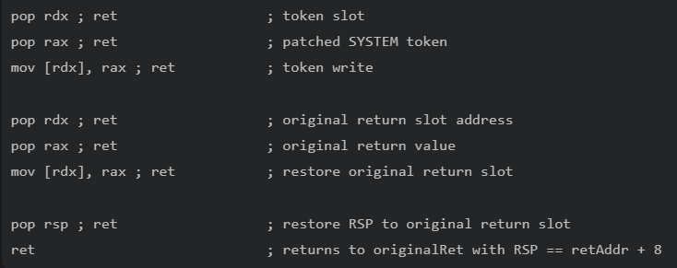
Abusing Suspended Threads to get our ROP executed
A ROP chain to get code execution via a suspended thread
1. Load current process token slot into RDX
2. Load patched SYSTEM token fast-ref into RAX
3. Write RAX into [RDX]
4. Restore the original return address at retAddr
5. Pivot RSP back to retAddr
6. Return normally into original kernel control flow
BRUCON SECURITY CONFERENCE 2026
13

Slide 17
PART 4
Native SSDT Hijack
BRUCON SECURITY CONFERENCE 2026
14

Slide 18
The native syscall dispatch table
The SSDT is at the core of the ntoskrnl syscall path.
Entries are compressed 32-bit signed offsets, not function pointers.
A writable table entry becomes a temporary call-routing primitive.
The target must be reachable by the SSDT entry encoding range.
raw = KiServiceTable[index]
offset = raw >> 4
handler = KiServiceTable + offset
argbytes = raw & 0xF
call handler
ntdll stub
syscall
KiSystemCall64
KiServiceTable
nt!target
>
>
>
>
BRUCON SECURITY CONFERENCE 2026
15

Slide 19
SSDT hijack implementation
Use a syscall slot to write the encoded target then trigger it and clean up
Resolve KeServiceDescriptorTable by patterning KiSystemCall64 symbols.
Use NtSetQuotaInformationFile as the controllable native syscall slot. (Can be changed of course)
Verify direct physical write to KiServiceTable, with PDE permission where needed.
Call DbgPrint/memcpy/Ps* helpers through the selected syscall path.
Restore the original entry and validate guard entries.
write_ssdt_entry32(slot, target)
InvokeSyscallBlob(...)
write_ssdt_entry32(slot, original)
verify(previous, current, next)
Proof of concept payloads
DbgPrint(): visible kernel execution signal
Token swap: privilege outcome without new executable kernel memory
BRUCON SECURITY CONFERENCE 2026
16

Slide 20
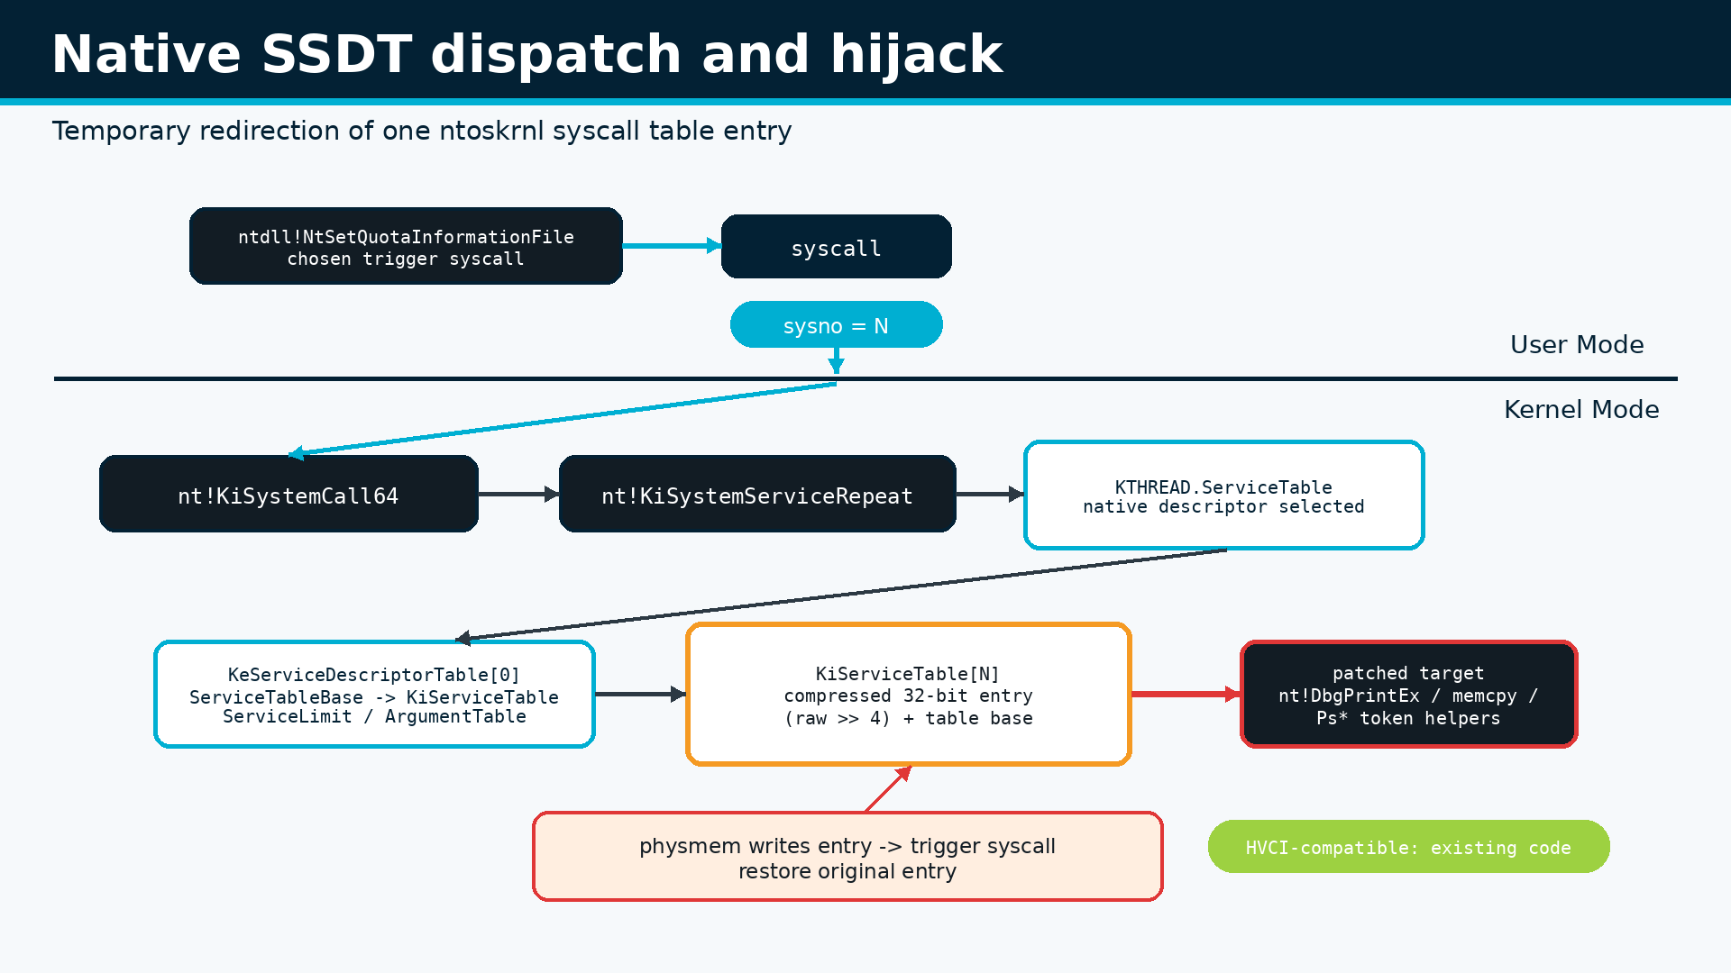
SSDT hijack implementation
BRUCON SECURITY CONFERENCE 2026
17

Slide 21
Why this works with HVCI on
Gadgets instead
There is no ROP/COP/JOP
Data mutation
The redirect lands on existing signed kernel image bytes already executable under code integrity policy.
The syscall dispatcher performs a normal call into the selected routine; this avoids the classic return-chain shape kCET blocks.
The attacker-controlled operation is a data write to dispatch metadata plus controlled user-mode arguments.
HVCI is doing its job: arbitrary unsigned kernel shellcode is restricted and blocked.
HVCI blocks unsigned kernel code, but it does not stop a vulnerable driver from rewriting trusted kernel data and steering execution into existing kernel routines.
The restore phase matters operationally and defensively: detection has a narrow time window.
BRUCON SECURITY CONFERENCE 2026
18

Slide 22
PART 5
Shadow SSDT Hijack
BRUCON SECURITY CONFERENCE 2026
19

Slide 23
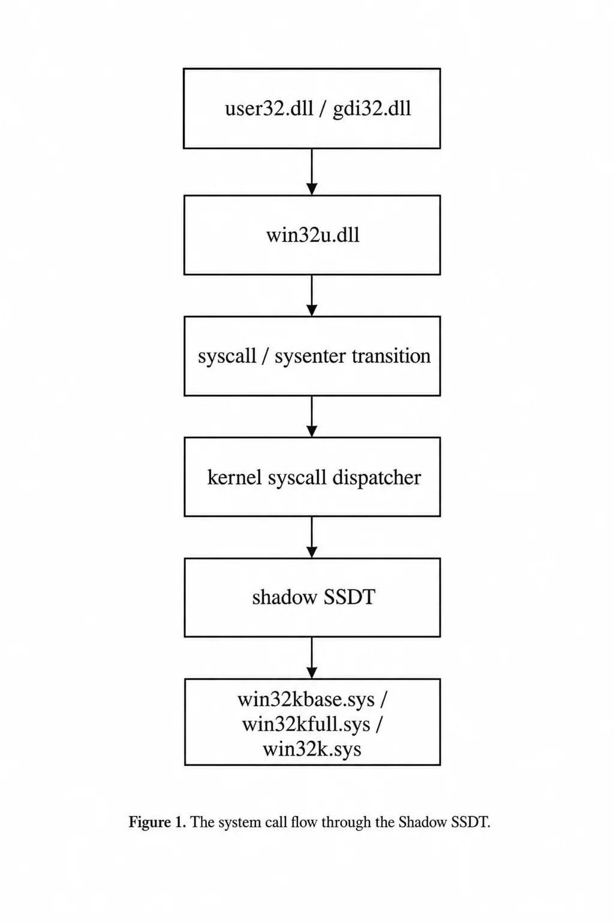
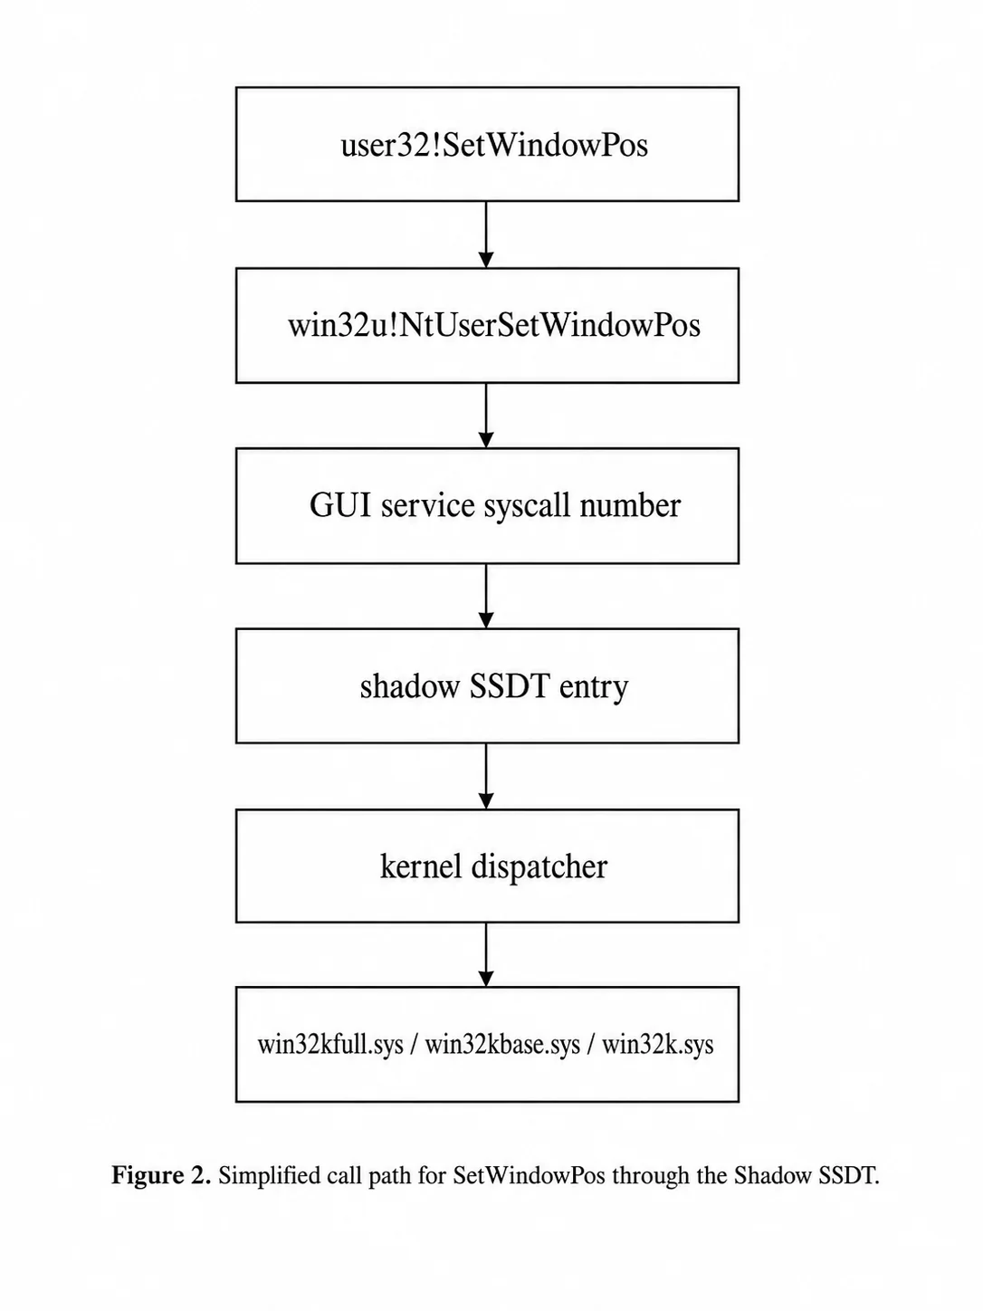
The GUI (Win32k Shadow) syscall table
win32u-originated calls route through the Shadow SSDT into win32k.
win32u stub
bit 12 set
KTHREAD table
Shadow SSDT
win32k
>
>
>
>
Shadow syscalls cover NtUser*, NtGdi* and related GUI subsystem services.
The thread must run in an interactive desktop/window-station context.
The table and many useful thunks live in win32k/session space, so translation context is different.
The implementation uses a candidate win32u syscall and keeps only a working slot for the run.
BRUCON SECURITY CONFERENCE 2026
20

Slide 24
Shadow route used by the demo
Redirect a low-traffic GUI syscall through a live win32kbase dispatch thunk.
1. Select trigger
2. Find thunk
3. Patch it
Resolve win32u!NtUserGetForegroundWindow or another candidate and extract its syscall index.
Locate a win32kbase dispatch thunk with a writable RIP-relative function slot.
Patch thunk slot to target routine and shadow entry to the selected thunk entry.
4. Trigger and restore
Call the win32u stub from a GUI thread, copy return value, restore shadow entry and dispatch slot.
ShadowPatchForCall(context, target)
ShadowInvokeVdmTrampoline(args)
ShadowRestorePatch(context)
BRUCON SECURITY CONFERENCE 2026
21

Slide 25
Crossing the argument gap
GUI syscalls were not designed as arbitrary kernel function call adapters.
Direct register arguments cover simple calls.
Wider signatures use a kernel argument block allocated through ExAllocatePool2.
The trampoline keeps attacker-controlled bytes in user mode, kernel execution remains in existing routines.
Cleanup handles both dispatch metadata and temporary kernel pool allocations.
kMaxKernelCallArgs = 11
arg_block = ExAllocatePool2(...)
memcpy(arg_block, user_args, ...)
call target(arg_block...)
Proof of concept payloads
DbgPrint proves controlled kernel call. Token manipulation proves impact while staying compatible with HVCI's executable-memory rules.
BRUCON SECURITY CONFERENCE 2026
22

Slide 26
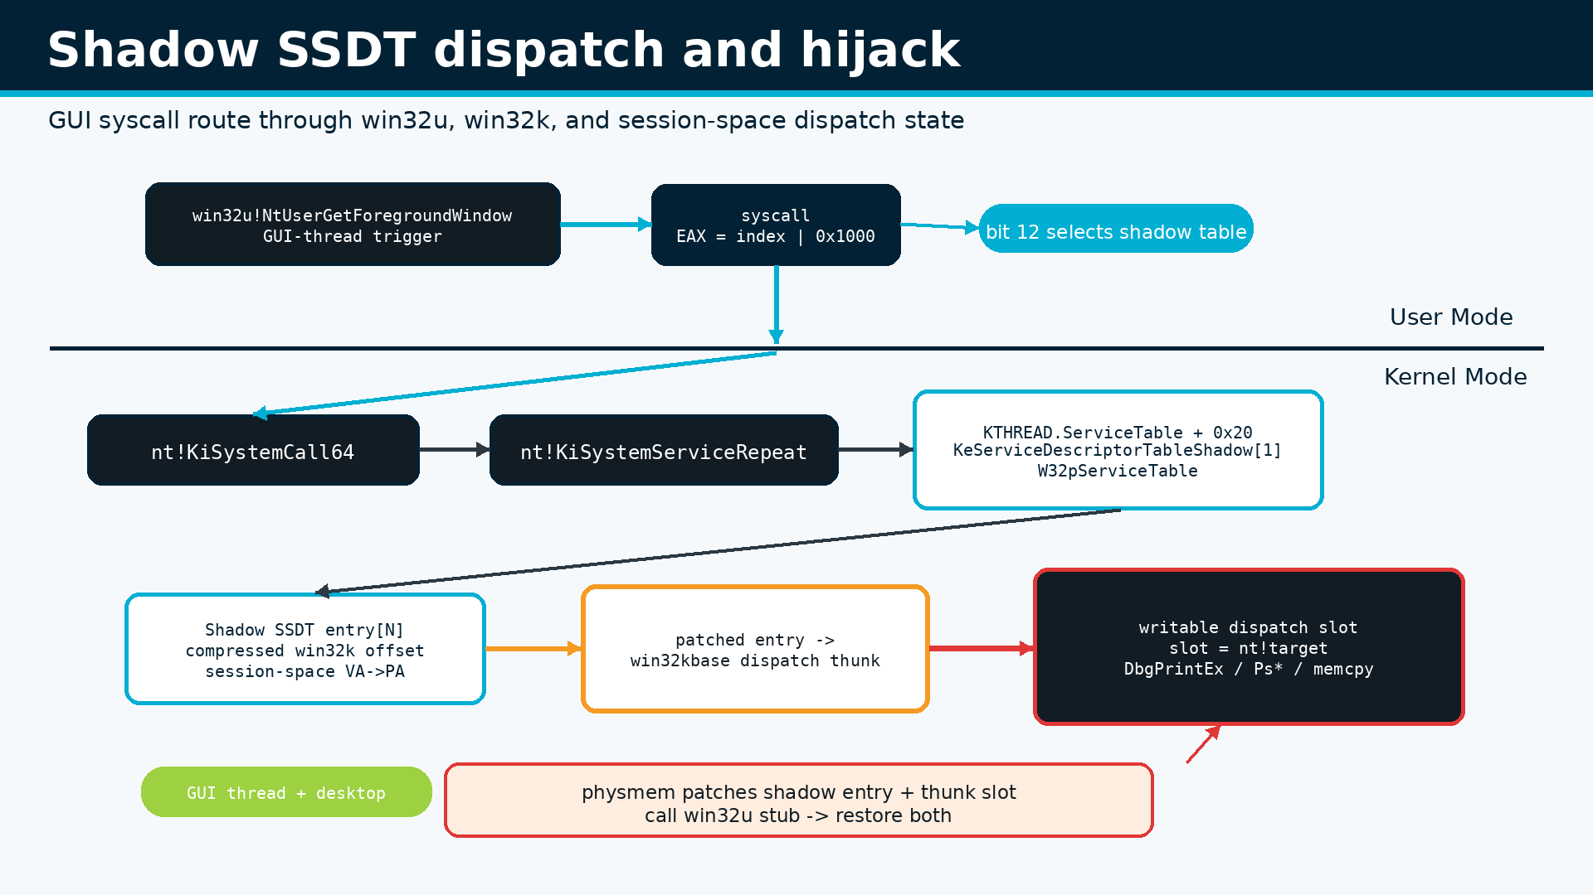
Shadow SSDT hijack implementation
BRUCON SECURITY CONFERENCE 2026
23

Slide 27
PART 6
IDT Table Hijack
BRUCON SECURITY CONFERENCE 2026
26

Slide 28
Page cloning and remapping
Keep the table VA stable while temporarily replacing the physical page underneath it.
IDTR and GDTR expose virtual bases. Then walk the selected DTB to recover the table page and its leaf PTE.
The full 4-KiB page is copied into verified FWA backing, preserving every unrelated descriptor.
The clone contains data, not code, execution still lands in existing signed kernel images.
table_va = IDTR/GDTR.base
original_pa = VA→PA(table_va)
clone_pa = copy(original_pa)
clone[target] = new descriptor
PTE(table_va).PFN = clone_pa
same table VA
leaf PTE
clone PFN
modified gate
existing code
>
>
>
>
BRUCON SECURITY CONFERENCE 2026
24

Slide 29
Transient clone/remap workflow
Clone first and swap only the mapping, trigger and then restore and clean.
1. Resolve and clone
2. Patch only the clone
3. Arm the mapping
Pin the CPU, read SIDT/SGDT, translate the table VA, locate its 4-KiB leaf PTE and copy the page.
IDT: #BP receives the INT2E handler. GDT: an unused 16-byte window receives the DPL3 call gate.
Preserve the original PTE flags, replace only its PFN, invalidate the TLB and verify the CPU-visible table.
4. Trigger, restore and verify
Execute INT3 or the WOW64 far call, restore the exact original PTE, flush again, verify readback and clear the FWA clone.
clone page → patch descriptor → swap PFN → flush TLB → trigger
restore original PTE → flush + verify → clear clone | reject large pages
BRUCON SECURITY CONFERENCE 2026
25

Slide 30
The interrupt descriptor table
An interrupt vector selects a CPU-local gate and kernel handler.
Each 16-byte gate defines a handler, selector, gate type, DPL, present bit and optional IST.
The active IDT is CPU-local, so the trigger thread is pinned.
DOG clones the table page and redirects only its leaf PTE while the trigger executes.
IDTR = { limit, base }
gate = IDT[vector]
handler = offset_high:mid:low
selector = gate.selector
CPU transfers control
INT3
IDT[#BP]
INT2E handler
KiServiceTable
nt!target
>
>
>
>
BRUCON SECURITY CONFERENCE 2026
27

Slide 31
Hijacking the IDT Table
Clone the active IDT, route #BP into the existing INT2E path, trigger it, then restore.
1. Locate the active table
2. Clone and redirect #BP
3. Prepare an ABI carrier
Pin the CPU, read IDTR with SIDT, translate the IDT page and locate its leaf PTE.
Copy the IDT into FWA backing and replace the #BP handler with the existing INT2E handler.
Borrow one native SSDT slot and encode the selected ntoskrnl target while preserving metadata.
4. Trigger and restore
Execute INT3, capture RAX, then restore the service entry, original IDT mapping and clone state.
SIDT → clone IDT; #BP handler = INT2E handler
INT3 → INT2E → service carrier → target
restore(service entry, IDT PTE, clone)
BRUCON SECURITY CONFERENCE 2026
28

Slide 32
PART 7
GDT Call-Gate Hijack
BRUCON SECURITY CONFERENCE 2026
29

Slide 33
The global descriptor table
Selectors still define system descriptors, TSS state and privilege transitions in long mode.
Long mode flattens most segmentation, but the GDT still defines selectors, TSS/LDT state and call gates.
An IA-32e call gate is 16 bytes and occupies two consecutive GDT slots.
A present DPL3 gate accepts a CPL3 far call when its target descriptor and mappings pass CPU checks.
GDTR = { limit, base }
selector = index | TI | RPL
descriptor = GDT[index]
call gate = selector + offset + DPL
far call → CPU validation
WOW64 helper
far call
DPL3 call gate
WOW64 service
ABI target
>
>
>
>
BRUCON SECURITY CONFERENCE 2026
30

Slide 34
GDT Table Hijack
Clone the processor's GDT then add a DPL3 call gate and invoke it from a WOW64 helper.
1. Control the GDT
2. Build the cloned table
3. Bind the WOW64 context
Pin the CPU, read GDTR with SGDT, decode descriptors and find an unused 16-byte window.
Copy the live GDT into FWA backing and insert a present IA-32e call gate with DPL3.
Resolve wow64!Wow64SystemServiceEx and materialize the required helper DTB mappings.
4. Trigger, prove and restore
The 32-bit helper performs the far call; the carrier invokes DbgPrint, captures the result and restores the mapping.
SGDT → clone GDT → add DPL3 call gate
WOW64 far call → Wow64SystemServiceEx → DbgPrint
Token shell: direct physical swap + restore
BRUCON SECURITY CONFERENCE 2026
31

Slide 35
PART 9
Defense
BRUCON SECURITY CONFERENCE 2026
34

Slide 36
What you should be watching
Reduce the attack surface
Physical memory APIs calls
Dispatch integrity
Block known-abusable signed drivers yourself, don’t trust MS.
Flag unusual IOCTLs that expose raw physical reads/writes.
Flag RDMSR/WRMSR IOCTLs, transient SSDT/Shadow changes and CPU-local IDT/GDT remaps.
Is VBS/HVCI/kCET enough to protect you?
… not really VTL0-based detections are not enough.
VBS/HVCI is necessary but not sufficient against data-only attacks
BRUCON SECURITY CONFERENCE 2026
35

Slide 37
Takeaways
MSR hijacking works with VBS off and VBS forces a move away LSTAR.
Suspended-thread ROP survives that transition, but kCET shadow stacks break the forged return chain.
SSDT, Shadow SSDT, IDT and GDT then provide data-only paths into existing kernel code.
Short-lived redirection plus restoration reduces instability and narrows detection.
Mitigation needs driver allow-listing, memory-integrity telemetry and dispatch-state validation together, most of this is not possible to implement.
There is no silver-bullet to stop this type of advanced attack scenarios.
BRUCON SECURITY CONFERENCE 2026
36

Slide 38
¡Thank you!
Subverting the Windows Kernel when VBS / HVCI / kCET is enabled
Questions?
Let’s connect! <jsacco@exploitpack.com>
BRUCON SECURITY CONFERENCE 2026
37

