Slide 1

E6121 Reliable Software
Final Project
InfeRS
Static memory leak detection for Android
Alon Grinshpoon
ag3848@columbia.edu
Jacob Sachs
jss2273@columbia.edu

Slide 2






About Problem Solution Approach Novelty Implementation Results Conclusions
ag3848@columbia.edu
Alon-grinshpoon
alongrinshpoon
jss2273@columbia.edu
jsachs
jacobsachs
Alon Grinshpoon
Jacob Sachs
MS candidate in CS
BSc in CS & EE from TAU
Former SW Engineer at Mellanox
Android Fanboy
MS candidate in CS
BS in CS & Physics from Chicago
Software Developer at Amida
Android n00b

Slide 3

About Problem Solution Approach Novelty Implementation Results Conclusions
Android apps can run into a problem of dropped references when switching between activities (screens).
If an app retains any references to an inactive activity, it cannot be garbage collected.
The lost objects can lead to slowdowns and crashes.

Slide 4
About Problem Solution Approach Novelty Implementation Results Conclusions
Pre-detect the 4 programming anti-patterns indicative of "lost objects" within Android that commonly cause activity memory leaks:
Static Activities
Static Views
Inner Classes
Anonymous Classes

Slide 5
About Problem Solution Approach Novelty Implementation Results Conclusions
Static Activities
public class StaticActivityLeak extends Activity { // Static Activity Variable static Activity activity; @Override public void onCreate(Bundle icicle) {
… // Leak memory leakMemory(); } private void leakMemory(){ activity = this; } }
A static variable remains loaded in memory for the entire runtime of the app.
If a static class object holds a reference to the activity instance and is not cleared before the activity shutdowns, the activity will not be garbage collected. This results in the activity being leaked.
{Code Pattern}
Declaring a static variable inside the class definition of an activity followed by setting that variable with the running instance of the activity.

Slide 6
About Problem Solution Approach Novelty Implementation Results Conclusions
Static Views
public class StaticViewLeak extends Activity
{ // Static View Variable static View view; @Override public void onCreate(Bundle icicle) {
… // Leak memory leakMemory(); } private void leakMemory(){ view = this.findViewById(R.id.button); }
@Override public void onDestroy(Bundle icicle) {
… // view = null;
… } }
A View maintains a reference to its Context, which, in this case, is the activity.
Some views remain unchanged and take a long time to instantiate. Thus, in recurring activities it would be useful to keep them loaded in memory for a quick restore. Making a static view reference seems as a logical design choice.
Yet storing a static reference to the View means a persistent reference chain to the activity.
{Code Pattern}
Declaring a static view inside the class definition of an activity follow by setting that view with a instantiated reference of some view.

Slide 7
About Problem Solution Approach Novelty Implementation Results Conclusions
Inner Classes
public class InnerClassLeak extends Activity
{ // Inner Class Definition class InnerClass {} // Static Reference static InnerClass innerClass;
@Override public void onCreate(Bundle icicle) {
… // Leak memory leakMemory(); } private void leakMemory(){ innerClass = new InnerClass(); } }
A class defined inside the definition of the activity class. Mostly used for readability and encapsulation.
Inner Class instances have access to the variables of their outer class by maintaining a reference to the outer class instance. Here, the activity is the leaked outer class.
{Code Pattern}
Holding an static reference to an instance of an Inner Class will cause a memory leak.

Slide 8
About Problem Solution Approach Novelty Implementation Results Conclusions
Anonymous Classes
public class AnonymousClassLeak extends Activity { @Override public void onCreate(Bundle icicle) {
… // Leak memory leakMemory(); } private void leakMemory(){ new AsyncTask<Void, Void, Void>() { @Override protected Void doInBackground(Void... params)
{ while(true); } }.execute(); } }
Anonymous Classes hold a reference to the class inside which they were declared.
If an activity has an anonymous class inside it which performs background work, a reference to that activity will persist and not be garbage collected until the work ends.
Examples: AsyncTasks, Handlers, Threads, and TimerTasks that call doBackgroundWork() or run() functions.
{Code Pattern}
Inside an activity, anonymously declare and instantiate a class that performs background work pass the destruction of the activity.

Slide 9



About Problem Solution Approach Novelty Implementation Results Conclusions
+
=

Slide 10
About Problem Solution Approach Novelty Implementation Results Conclusions
1
Fork Facebook's Infer static analyzer library for Android.
Create generalized abstractions for the anti-patterns.
Extend the "checkers" component in Infer and add test cases to the codebase.
Create memory-leaking Android test applications.
Test leaks detection with our static analyzer, and compare with bugs found by LeakCanary, a leading dynamic analysis tool.
2
3
4
5

Slide 11
About Problem Solution Approach Novelty Implementation Results Conclusions
While memory leaks can be found with dynamic analysis, static analysis is extremely important in development lifecycle.
This type of memory leak is not adequately covered by existing static analysis tools.
Currently, tracking down these types of issues ahead of time involves heap dumps in Android studio. Static analysis is automatic and mean less additional work by the developer.

Slide 12

About Problem Solution Approach Novelty Implementation Results Conclusions
InfeRS
→
→
Android
Code
Bugs
↕
Build System

Slide 13

About Problem Solution Approach Novelty Implementation Results Conclusions
An Activity is a single screen in Android.
Includes a group of callback methods that allow the activity to understand its changing state:
A memory leak will occur if onDestroy() finishes and some reference to the Activity still exists.
onCreate()
onStart()
onResume()
onStop()
onPause()
onRestart()
onDestroy()

Slide 14
About Problem Solution Approach Novelty Implementation Results Conclusions
Diverging from the defined Activity Lifecycle and persisting a reference in memory is an extremely dangerous yet preventable practice.
onRestart()
Activity Launched
onCreate()
onStart()
onResume()
User returns to the activity
User navigate to the activity
Activity Running
Another Activity comes to the foreground
onPause()
The Activity is no longer visible
onStop()
The activity is finishing or being destroyed
onDestroy()
App process killed
Activity Shutdown
User navigate to the activity
Apps with higher priority need memory

Slide 15
Live Demo
We developed a leaky Android app that implements all 4 anti-patterns.
Destroy an Activity by switching the phone orientation. A memory leak will follow.
APK file included with submission.
E6121 Reliable Software
Final Project
InfeRS
Static memory leak detection for Android
Alon Grinshpoon
ag3848@columbia.edu
Jacob Sachs
jss2273@columbia.edu

Slide 16
About Problem Solution Approach Novelty Implementation Results Conclusions
Checkers
The Infer analyzer performs sophisticated interprocedural static analysis.
When this is not needed, one may refer to the Infer:Checkers framework.
Checkers can analyze and check for a given property in each method of a given project intra-procedurally instead of inter-procedurally.
http://fbinfer.com/docs/checkers.html

Slide 17
About Problem Solution Approach Novelty Implementation Results Conclusions
Written in OCaml.
Checks if the anti-patterns exist in the code and references still exist to the Activity. This will result in a memory leak.
Already integrated in the Infer framework.
Run:
infer -a checkers -- ./gradlew build && ./gradlew clean
Our Checkers

Slide 18
About Problem Solution Approach Novelty Implementation Results Conclusions
Considered as Context leaks specific to Android.
In Android, Activity is a subtype of the Context class.
Infer reports a Context leak when it determines that a chain of references between a static field and a Context may exist at the end of a public method of a non-Application Context subtype.
Implementing
Static Activities
Inner Classes
Detection

Slide 19
About Problem Solution Approach Novelty Implementation Results Conclusions
Wrote our own checker over Infer:
1
Detects the Activity Class
Detects static views that were defined
Makes sure the that all static views were nullified in the onDestroy() function.
Reports an error otherwise.
Implementing
2
Static Views
3
Detection
4

Slide 20
About Problem Solution Approach Novelty Implementation Results Conclusions
Wrote our own checker over Infer:
1
Detects the Activity Class
Detects anonymous classes that were defined
Checks if they preform any background work that may continue after the activity is destroyed.
Reports an error.
Implementing
2
Anonymous Classes
3
Detection
4

Slide 21

About Problem Solution Approach Novelty Implementation Results Conclusions
VS

Slide 22

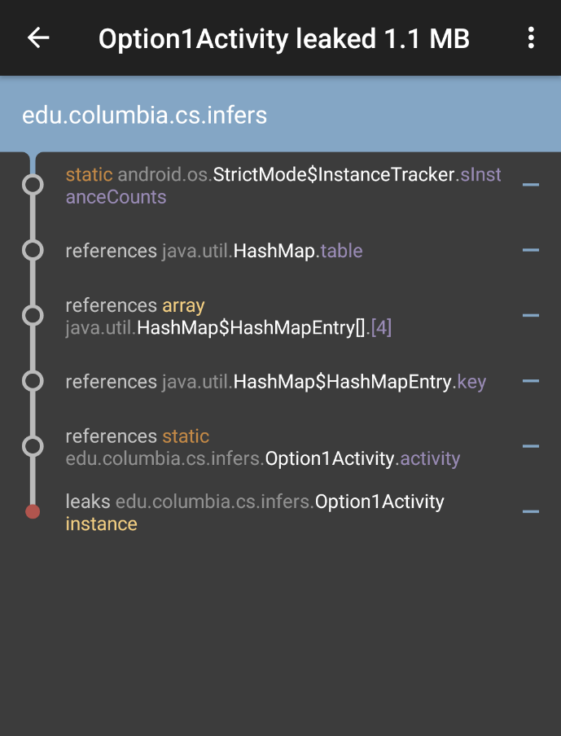
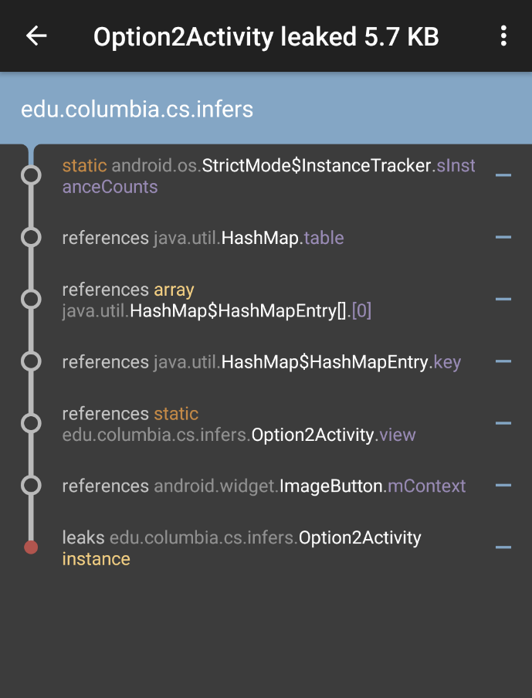
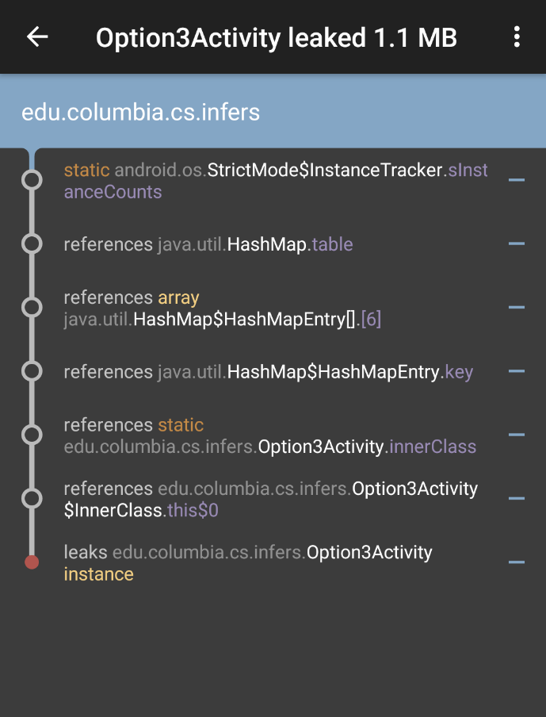
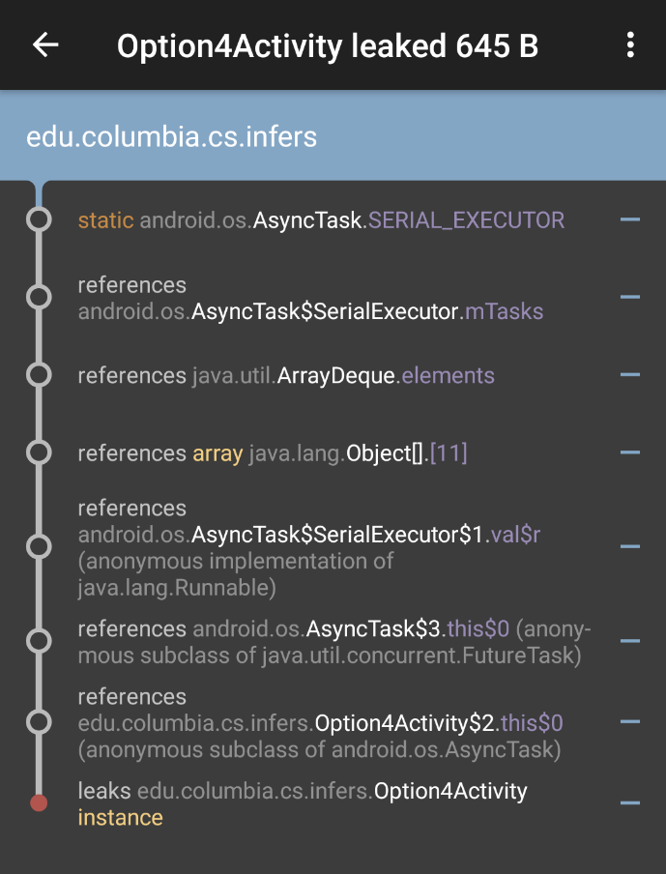
About Problem Solution Approach Novelty Implementation Results Conclusions
Static Activities
Static Views
Inner Classes
Anonymous Classes

Slide 23
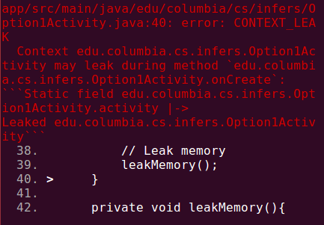
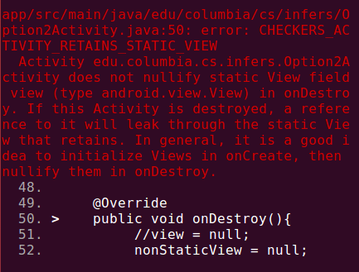
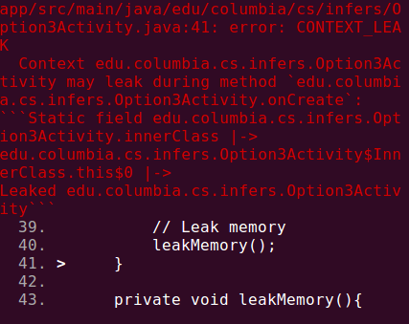
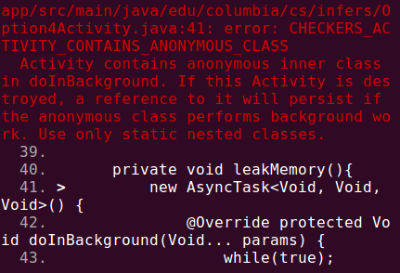
About Problem Solution Approach Novelty Implementation Results Conclusions
Static Activities
Static Views
Inner Classes
Anonymous Classes

Slide 24


About Problem Solution Approach Novelty Implementation Results Conclusions
We ran our project on an open-source Android app.
Habitica is a free habit building and productivity app with more that 2 million users.
InfeRS has found around 30 potential memory leaking bugs.
https://github.com/HabitRPG/habitica

Slide 25

About Problem Solution Approach Novelty Implementation Results Conclusions
The most promising alternative tool to Infer, which we initially considered evaluating, is Google's Error Prone.
Error Prone exists as a plugin which can be added to most Java build stacks.
Error Prone does not catch any of our memory leaks. This tools really only serves as a linter, catching common Java programming mistakes and typos.
VS
https://github.com/google/error-prone

Slide 26
About Problem Solution Approach Novelty Implementation Results Conclusions
We created a way for Android developers to check for and prevent memory leaks by extending Facebook Infer.
We managed to identify and implement the memory leak scenarios in our own Android app.
We successfully developed Infer-based checkers that detect scenarios not covered by Infer.
We succeeded in testing our checkers with our reference app and compare its results to LeakCanany.
Our results were on par with those of the dynamic analyzer, covering all memory leaks in the app.
We ran our checkers on Habitica and detected numerous bugs.
We compared our performance with ErrorProne by Google at concluded that our solution is able to better detect memory leaks in Andorid.
We have posted a pull request to Facebook for our project to be integrate into Infer.
We hope that our project will help Android developers to avoid slowdowns and crashes in their applications by statically detecting possible memory leaks throughout the development cycle.

Slide 27
Thank you.

Slide 28
References
E6121 Reliable Software Course Website, Final Project: http://www.cs.columbia.edu/~junfeng/17sp-e6121/hw/hw3.html
Android Developers, The Activity Lifecycle: https://developer.android.com/guide/components/activities/activity-lifecycle.html
JavaPoint, Android Activity Lifecycle: http://www.javatpoint.com/android-life-cycle-of-activity
Nimbledroid Blog, Ways Your Android App Can Leak Memory: http://blog.nimbledroid.com/2016/05/23/memory-leaks.html
Codexpedia, Memory Leaks in Android, http://www.codexpedia.com/android/memory-leak-examples-and-solutions-in-android/
Medium, Memory Leaks in Android, https://medium.com/freenet-engineering/memory-leaks-in-android-identify-treat-and-avoid-d0b1233acc8
Infer by Facebook, http://fbinfer.com/
Infer Bug Types, http://fbinfer.com/docs/infer-bug-types.html
Infer Simple Intraprocedural Checkers, http://fbinfer.com/docs/adding-checkers.html
LeakCanary, Source Code, https://github.com/square/leakcanary
LeakCanary, FAQ, https://github.com/square/leakcanary/wiki/FAQ
Using LeakCanary, https://www.youtube.com/watch?v=2VKBjlHtKMY
Open-Source Android Apps, https://github.com/pcqpcq/open-source-android-apps
F-Droid, catalogue of FOSS (Free and Open Source Software) Android apps, https://f-droid.org/repository/browse/
Wikipedia, List of free and open-source Android apps, https://en.wikipedia.org/wiki/List_of_free_and_open-source_Android_applications

Slide 29
Static Activities
Static Views
Inner Classes
Anonymous Classes

Slide 30
E6121 Reliable Software
Static Activities
Final Project
Activity Running
InfeRS
Static memory leak detection for Android
Alon Grinshpoon
ag3848@columbia.edu
Jacob Sachs
jss2273@columbia.edu

Slide 31
E6121 Reliable Software
Static Views
Final Project
Activity Running
InfeRS
Static memory leak detection for Android
Alon Grinshpoon
ag3848@columbia.edu
Jacob Sachs
jss2273@columbia.edu

Slide 32
E6121 Reliable Software
Inner Classes
Final Project
Activity Running
InfeRS
Static memory leak detection for Android
Alon Grinshpoon
ag3848@columbia.edu
Jacob Sachs
jss2273@columbia.edu

Slide 33
E6121 Reliable Software
Anonymous Classes
Final Project
Activity Running
InfeRS
Static memory leak detection for Android
Alon Grinshpoon
ag3848@columbia.edu
Jacob Sachs
jss2273@columbia.edu

