Slide 1
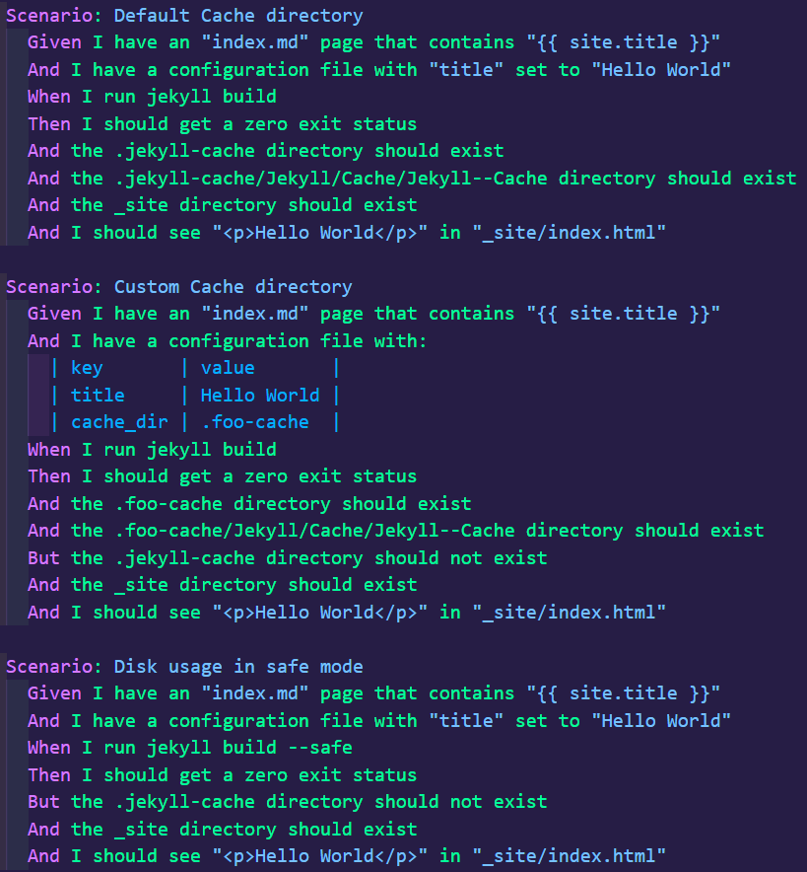
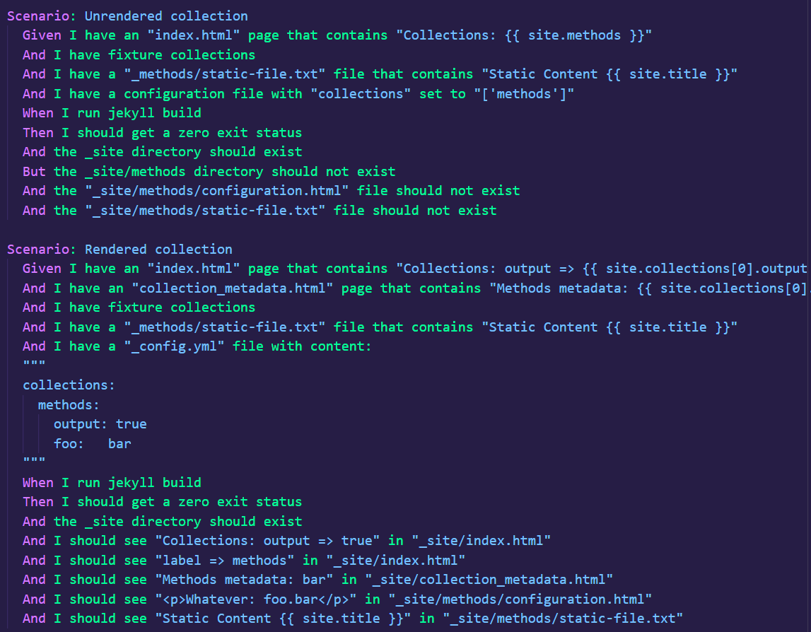
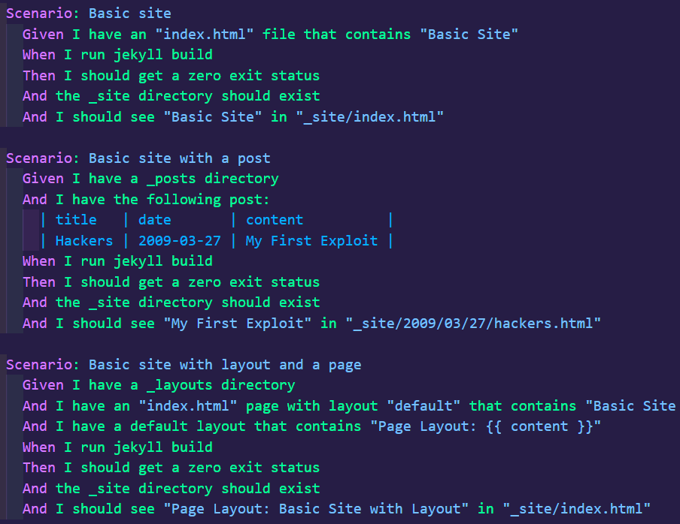
cache.feature
collection.feature
create_sites.feature

Slide 2
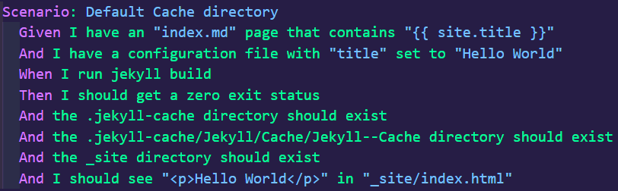
Stringify test cases (step names)
“1: I have an “index.md” page that contains “{{ site.title }}”\n
2: I have a configuration file with “title” set to “Hello World”\n
3: I run Jekyll build\n
4: I should get a zero exit status\n
5: the .Jekyll-cache directory should exist\n
6: the .Jekyll-cache/Jekyll/Cache/Jekyll—Cache directory should exist\n
7: the _site directory should exist\n
8: I should see “<p>Hello World</p>” in “_site/index.html”\n
”

Slide 3
Calculate Normalized Compression Distance
“1: I have an “index.md” page that contains “{{ site.title }}”\n
2: I have a configuration file with “title” set to “Hello World”\n
3: I run Jekyll build\n
4: I should get a zero exit status\n
5: the .Jekyll-cache directory should exist\n
6: the .Jekyll-cache/Jekyll/Cache/Jekyll—Cache directory should exist\n
7: the _site directory should exist\n
8: I should see “<p>Hello World</p>” in “_site/index.html”\n
”
Calculate TF-IDF matrix
Calculate cosine
similarity
Calculate euclidean
similarity
Calculate manhattan
distance

Slide 4
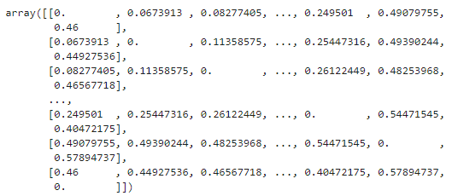
Similarity
matrix
Shape = (num of test cases, num of test cases)

Slide 5
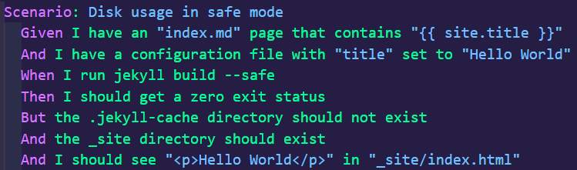

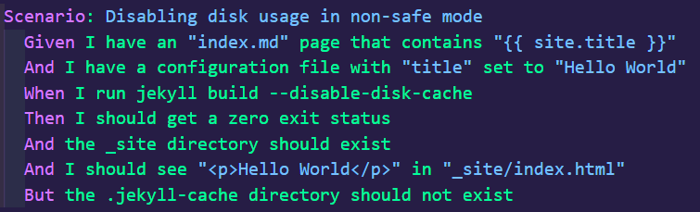
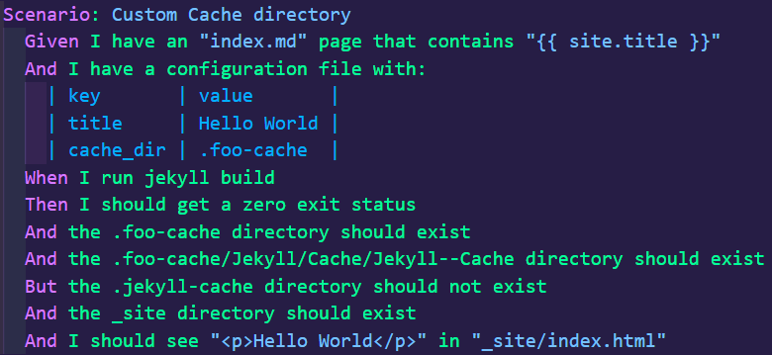
Successful similarity calculation

Slide 6
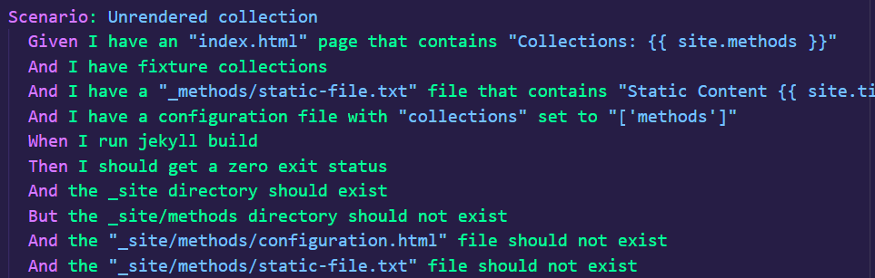
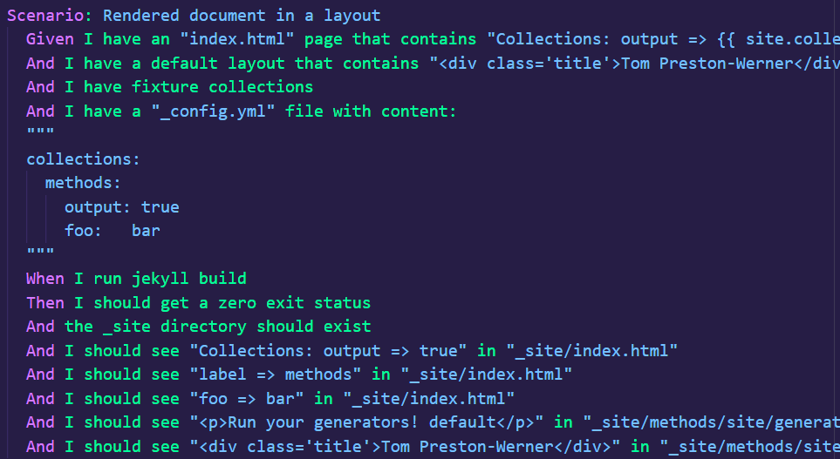
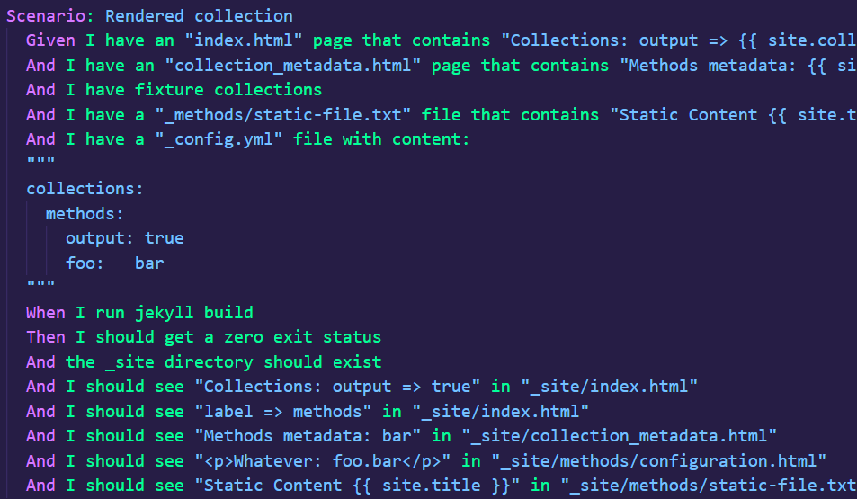
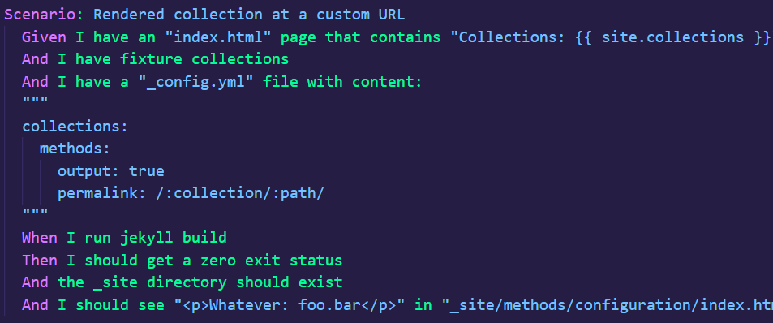
Most of the time, the similarity calculation is unable to distinguish noisy test cases

Slide 7
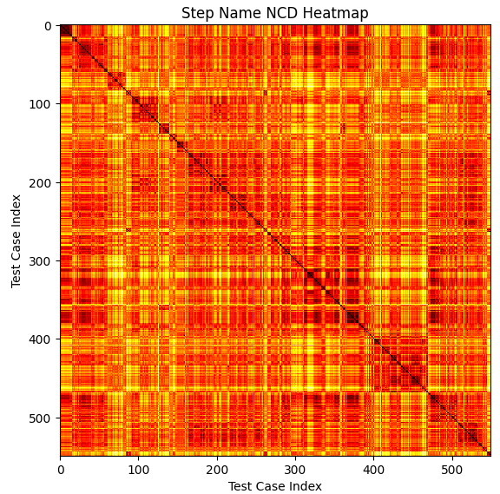
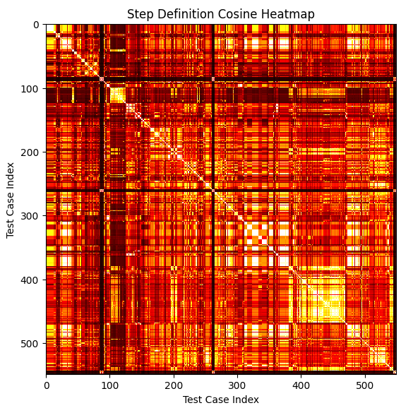
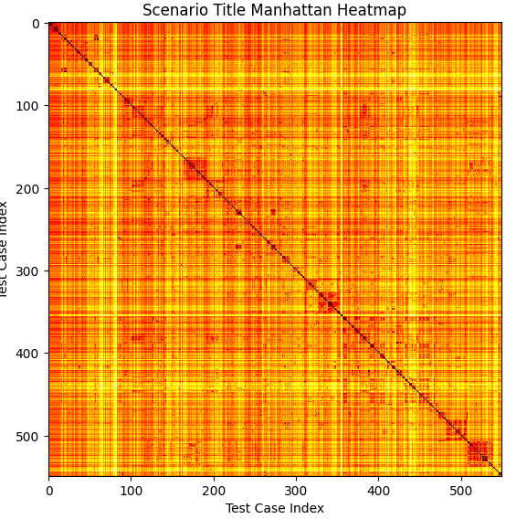
Datasets are too noisy, similarity calculations find similarity amongst too many test cases
Subtle differences in test cases are not captured by similarity metrics

Slide 8
Issues
Similarity calculation struggles to capture nuance and semantics of similar test cases that are grouped in different files
The way test cases are grouped together isn’t always consistent which causes issues with clustering
First two scenario titles are similar to each
other but different compared to last two
Cache.feature

