Slide 1
PSEt 5: Dask and you shall receive
Joanna Saikali
Abstract: See the value first-hand of translating your Pandas feature engineering script to leverage Dask Dataframe & Dask Delayed functionalities, based off of the work in PSET 2 but using a large Yelp Reviews dataset.

Slide 2
Why should I listen?
You have feature engineering code in Pandas.
You can make it faster and more efficient with a minimal learning curve.

Slide 3
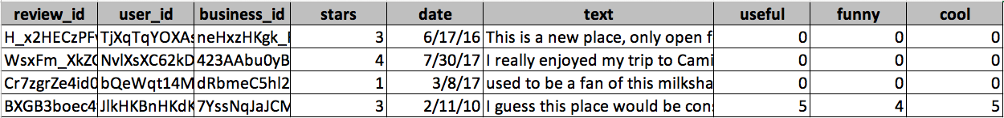
THE data
1,000,000 Rows
Subset of Yelp Reviews dataset found on Kaggle:
https://www.kaggle.com/luisfredgs/yelp-reviews-csv#yelp_review.csv

Slide 4
Problem set design
Objective: Demonstrate the value-add of Dask by translating Pandas code.
Part I:
Clone Pset 2: word embeddings & neighbors using demographic survey data
Yelp Review dataset instead of Demographic Survey
Repurpose code to use Dask Dataframes & compare time spent
Run WordEmbedding using Dask Delayed & compare time spent
Visualize the Dask computation graph

Slide 5
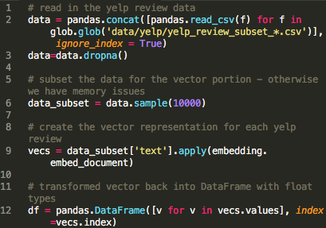
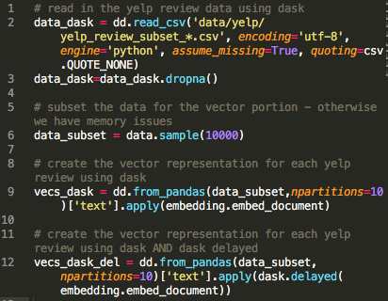
Pandas
Dask

Slide 6
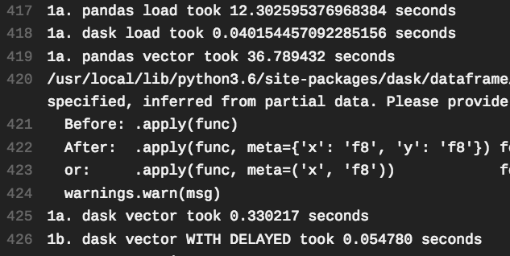
Results
main_answers.py output

Slide 7
Problem set design
Objective: Demonstrate the value-add of Dask by translating Pandas code.
Part II:
Aggregate Metrics
Compare traditional Pandas method to using Dask Dataframes
Reindex to optimize for the aggregations being performed

Slide 8

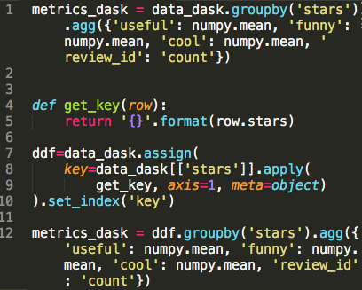
Pandas
Dask

Slide 9
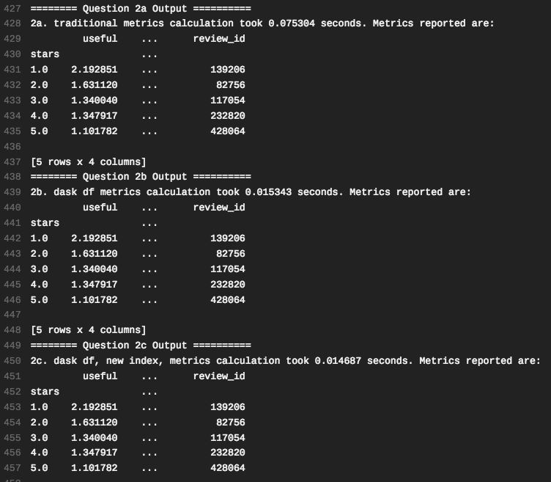
Results
main_answers.py output

Slide 10
Problem set design
Objective: Demonstrate the value-add of Dask by translating Pandas code.
Part III:
Find Distance
Using Dask Dataframe and Dask Delayed, for each Yelp Review text, find the “most similar” review and extract its star value
Calculate the MSE of star value vs. ”similar review” star value, using Dask Delayed

Slide 11
Lessons learned
Dask is really fast and efficient!
Syntax is very similar to Pandas with some exceptions
Struggled with custom functions in a .groupby().agg()
Struggled with filtering dataframe by index
There may be things that Dask is worse at – or that I just did not discover successfully
Random resampling

