Slide 1
PSEt 5: Dask and you shall receive
Joanna Saikali
Abstract: See the value first-hand of translating your Pandas data manipulations to leverage Dask Dataframe & Dask Delayed functionalities, based off of the work in PSET 2 using a large Yelp Reviews dataset.

Slide 2
Why should I listen?
You have feature engineering / data manipulation code in Pandas.
You can make it faster and more efficient with a minimal learning curve.

Slide 3
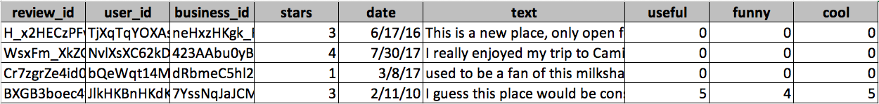
THE data
1,000,000 Rows
Subset of Yelp Reviews dataset found on Kaggle:
https://www.kaggle.com/luisfredgs/yelp-reviews-csv#yelp_review.csv

Slide 4
Problem set design
Objective: Demonstrate the value-add of Dask by translating Pandas code.
Three Parts
Part 1: Pset2 in Dask
Part 2: Aggregating Metrics using Delayed and Dask Dataframes
Part 3: Word/Distance Vectors

Slide 5
Part 1
Clone Pset 2: word embeddings & neighbors using demographic survey data
Yelp Review dataset instead of Demographic Survey
Repurpose code to use Dask Dataframes & compare time spent
Run WordEmbedding using Dask Delayed & compare time spent
Visualize the Dask computation graph

Slide 6
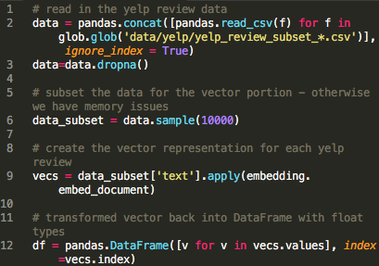
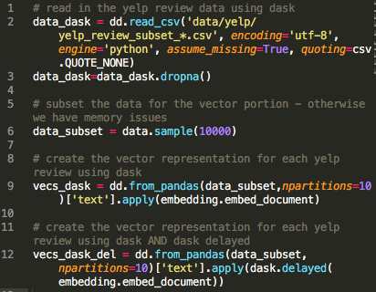
Pandas
Dask

Slide 7
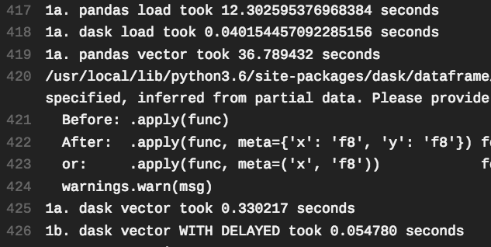
Results
main_answers.py output

Slide 8
PARt 2
Aggregate Metrics
Compare traditional Pandas method to using Dask Dataframes
Reindex to optimize for the aggregations being performed

Slide 9

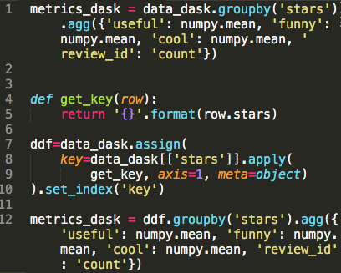
Pandas
Dask

Slide 10
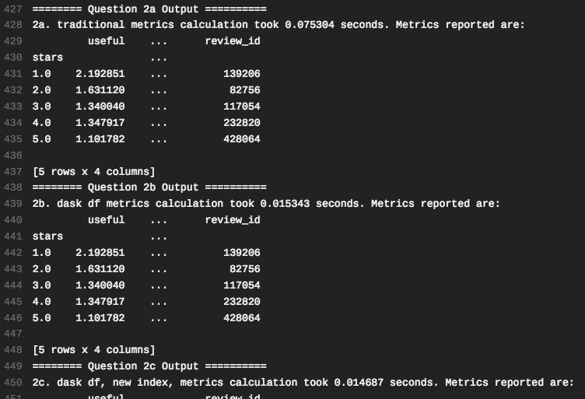
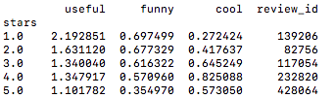
Results
main_answers.py output

Slide 11
Part 3
Find Distance
Using Dask Dataframe and Dask Delayed, for each Yelp Review text, find the “most similar” review – function find_distance
Calculate MSE for the reference text vs. “similar” text

Slide 12

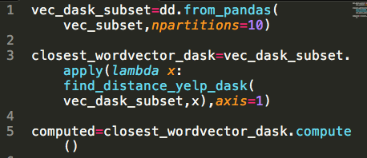
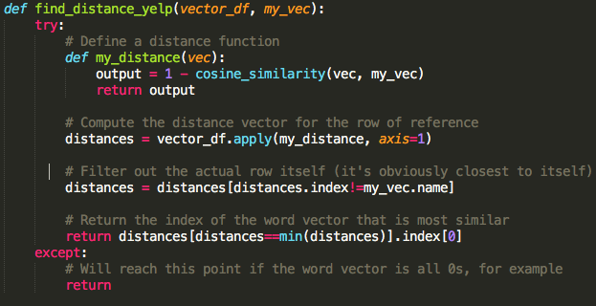
Pandas
Dask
Function provided to student

Slide 13
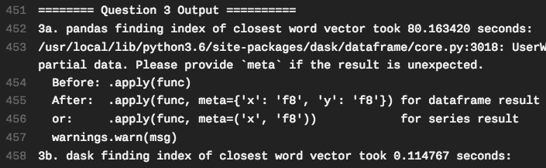
Results
main_answers.py output

Slide 14
Lessons learned
Dask is really fast and efficient!
Syntax is very similar to Pandas with some exceptions
In many instances, all I needed to do was read as a dask dataframe and/or wrap functions with dask.delayed to see improvements in efficiency
Some syntax struggles:
Custom functions in a .groupby().agg()
Filtering dataframe by index
Sometimes dask.delayed produced something like this, and would not compute:
Delayed(‘trial-7512ffcc-3b10-445f-928a-f01c01bae29c')
There may be things that Dask is worse at – or that I just did not discover successfully
Random sampling – requires shuffling

Slide 15
Thank you
Joanna Saikali

