Slide 1
DRM – DIRECT RENDERING MANAGER
BY,
PRASAD
CHANDANA

Slide 2
Contents :
Introduction
Why DRM ?
Software Architecture
GPU
DRM Display Pipeline
DRM Components
DRM features

Slide 3
Introduction :
What is DRM ?
Subsystem of Linux Kernel, responsible for interfacing with GPU of video cards
Exposes API that user programs can use to perform operations such as configuring the mode setting of the display and framebuffer management
User-space programs can use the DRM API to command the GPU to do hardware-accelerated 3D rendering and video decoding

Slide 4
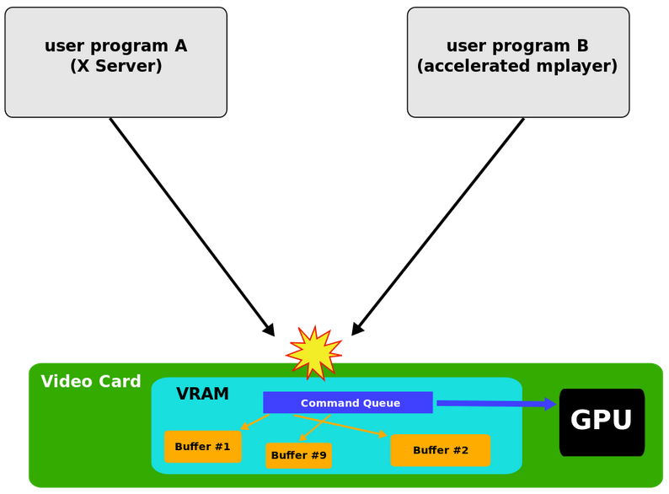
Why DRM?
When two or more programs tried to control the same video card at the same time, they ends with disastrous event.

Slide 5
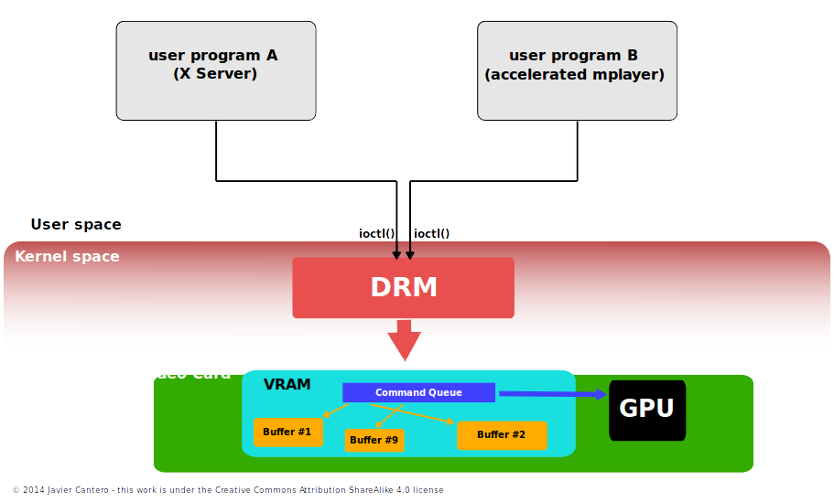
Continued....
DRM provides synchronized access to graphics hardware when multiple programs try
to access the video card
DRM acts as an arbitartor,
thus avoiding conflicts during access

Slide 6
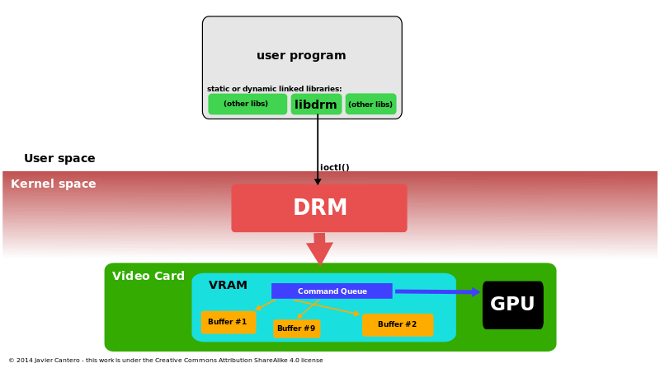
Software architecture
DRM exposes GPU through the filesystem name space using device files under /dev hierarchy.
Each GPU detected by DRM referred as DRM device, and device file /dev/dri/cardX created to interface with it.
User space programs that want to talk to the GPU must open the file and use ioctl calls to communicate with DRM
libdrm facilitates interface of user space programs with DRM subsystem.

Slide 7
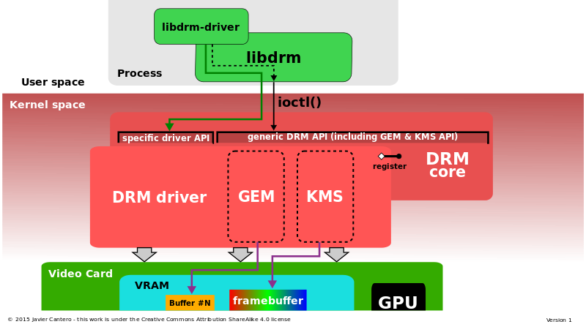
Continued....
DRM consists of two parts
  DRM Core
  DRM Driver
DRM core provides basic framework where different DRM drivers can register, and also provides user space a minimum set API of ioctls with common independent functionality
DRM driver implements hardware-dependent part of the API specific to the type of GPU.

Slide 8
Graphical Processing Unit (GPU)
A graphics processing unit (GPU), is a specialized electronic circuit designed to rapidly manipulate and alter memory to accelerate the creation of images in a frame buffer intended for output to a display.
In a personal computer, a GPU can be present on a video card, or it can be embedded on the motherboard or—in certain CPUs—on the CPU die.
The GPU’s advanced capabilities were originally used primarily for 3D game rendering.

Slide 9
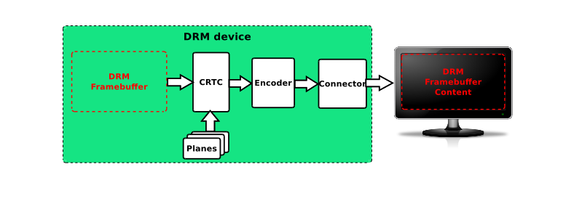
DRM display pipeline
;
memory
SoC
Off - chip

Slide 10
DRM Components
Framebuffer
CRTC
Encoder
Connector

Slide 11
Frame buffer
Frame buffer is a standard object storing information about the content to be displayed.
struct drm_farmebuffer {
  […]
  unsigned int pitches[4];
  unsigned int offsets[4];
  unsigned int width;
  unsigned int height;
  […]
};

Slide 12
CRTC
How display content is updated hasn't changed much since the creation of CRT monitors (though technology has evolved)
Requires at least 3 signals:
Pixel Clock: drive the pixel stream (1 pixel updated per clock
cycle)
VSYNC: Vertical Synchronization signal, asserted at the
beginning of each frame
HSYNC: Horizontal Synchronization signal, asserted at the
beginning of each pixel line

Slide 13
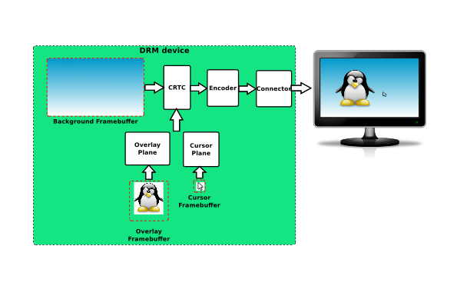
Planes

Slide 14
Continued....
A plane is an image layer
The final image displayed by the CRTC is the composition of one or several planes
Different plane types:
  DRM_PLANE_TYPE_PRIMARY (mandatory, 1 per CRTC)
  DRM_PLANE_TYPE_CURSOR (optional, 1 per CRTC)
  DRM_PLANE_TYPE_OVERLAY (optional, 0 to N per CRTC)

Slide 15
Encoder
Directly related to the Connector concept
Responsible for converting a frame into the appropriate format to be transmitted through the connector
Example: HDMI connector is transmitting Transition-minimized differential signaling(TMDS) encoded data, and thus needs a TMDS encoder

Slide 16
Connector
Represent a display connector (HDMI, DP, VGA, DVI, …)
Transmit the signals to the display
Detect display connection/removal
Expose display supported modes

Slide 17
Features included in DRM
Three types of formats used by the DRM/KMS subsystem:
  RGB: Each pixel is encoded with an RGB tuple (a specific value for each component)
  YUV: Same thing but with Y, U and V components
  C8: Uses a conversion table to map a value to an RGB tuple
Dynamic allocation of framebuffers is allowed.
Can share a single framebuffer between different applications.

