Slide 1
Android's Audio HAL
- Mallamma V N

Slide 2
Contents
Audio stack
Audio terminology
Audio recording path
Obtain audio playback path
supply audio data
Bad callback
Contributors audio latency
Code flow

Slide 3
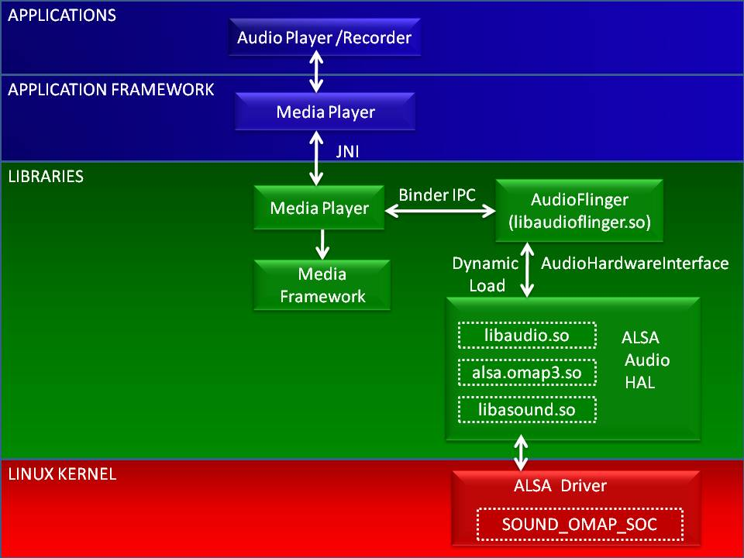
Audio stack

Slide 4
Audio terminology
Downmixing
Duck
sonification
Xrun
latency
Surround sound
Upmixing
Virtualizer

Slide 5

Audio recording path
Audio ADC
Device hardware
Use VOICE_RECOGNITION preset
Effects
Effects can
add latency
Use PCM_16 format
Audio framework
App audio sink
Application

Slide 6

Obtaining audio path
App audio source
Application
Use sample rate to create
audio stream on path
Resampler
Obtain the sample
rate
Audio manager
API
Effects
Mixer
Audio framework
DAC
Device hardware

Slide 7
Contd...
Supply audio data
App audio source
Application
Supply cunk of audio data
Callback on heigh
Priority thread
Get optimal size using
Audio Manager API
Audio frames
Audio framework
Feed me
DAC
Device hardware

Slide 8
Bad Callback
Void badCallback(SLAndroidSimpleBufferQueueItf bq,void *context){
  __android_log_print(ANDROID_LOG_VERBOSE,TAG,”logging”);
  int16_t *newAudioBuffer = new int16_t[LOADS_OF_ITEMS];
  while(!isOtherThreadReady){
  audiofile.open();
    audiofile.read(newAudioBuffer,size);
    sleep(50);
  }
}

Slide 9
Contributors audio latency
Linux CFS (Completely Fair Scheduler)
high-priority threads with SCHED_FIFO scheduling
priority inversion
long-running interrupt handlers

Slide 10
Code flow
Application framework
frameworks/base/media/java/android/media/
MediaRouter.java
JNI
frameworks/base/media/jni
android_media_MediaPlayer.cpp
Media server
Frameworks/services/audioflinger
AudioFlinger.cpp
Native framework
frameworks/av/media/libmedia
AudioRecord.cpp AudioTrack.cpp
HAL
Device/vender/product/audio
Audio hal implimentation
binder
Binder IPC proxies
frameworks/av/media/libmedia
IAudioRecord.cpp IAudioTrack.cpp
Linux kernel
ALSA/OSS/Custom driver

